Slide 1

Scalable Statistical Relational Learning for NLP
William Wang
CMU → UCSB
William Cohen
CMU
joint work with:
Kathryn Rivard Mazaitis

Slide 2
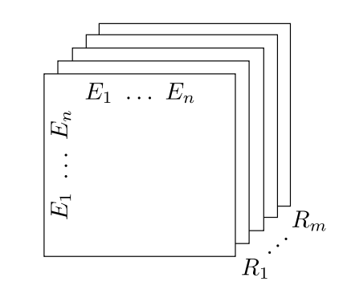
Modeling Latent Relations
RESCAL (Nickel, Tresp, Kriegel 2011 ICML)
  Tensor factorization model for relations & entities:

Slide 3

TransE
Relationships as translations in the embedding space (Bordes et al., 2013 NIPS)
  If (h, l, t) holds, then the embedding of the tail should be close to the head plus some vector that depends on the relationship l.

Slide 4
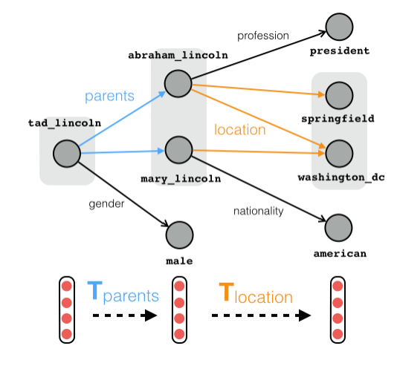
Modeling Latent Path Factors
Compositional training of path queries (Guu, Miller, Liang 2015 EMNLP).
“Where are
Tad Lincoln’s
parents
located?”

Slide 5
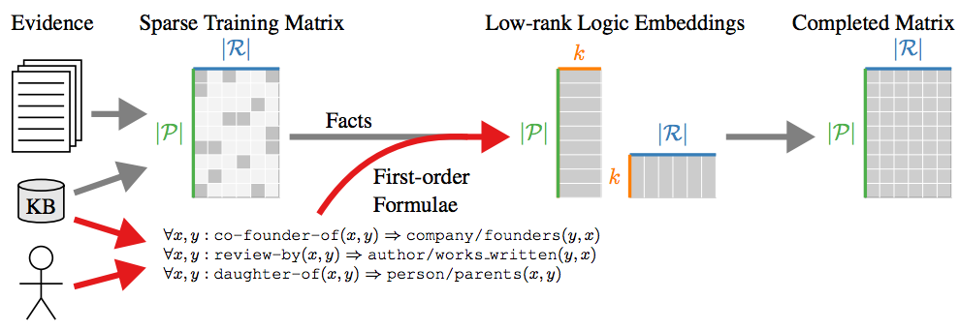
Using Logic Formula as Constraints
Injecting Logical Background Knowledge into Embeddings for Relation Extraction (Rocktaschel et al., 2015).

Slide 6
Modeling Latent Logic Formulas
Learning First-Order Logic Embeddings (IJCAI 2016).
Given a knowledge graph and a program, learn low-dimensional latent vector embeddings for formulas.
Motivations:
  Traditionally logic formulas are discrete (T or F);
  Probabilistic logics typically learn a 1D parameter;
  Richer, more expressive representation for logics.

Slide 7
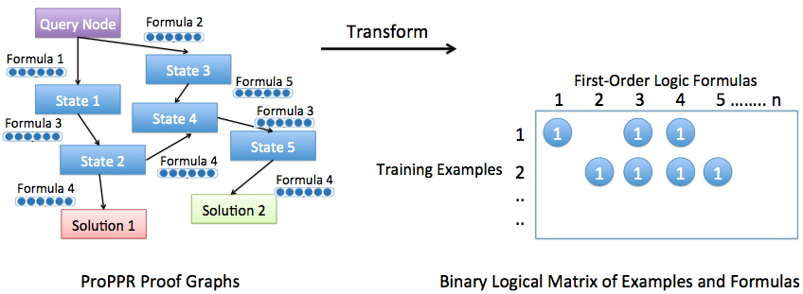
Matrix Factorization of Formulas
An alternative parameter learning method.

Slide 8
Experimental Setup
Same training and testing procedures.
Evaluation: Hits@10, i.e., the proportion of correct answers ranked in top-10 positions.
Datasets: (1) freebase15K -- 592K triples
(2) wordnet40K – 151K triples

Slide 9
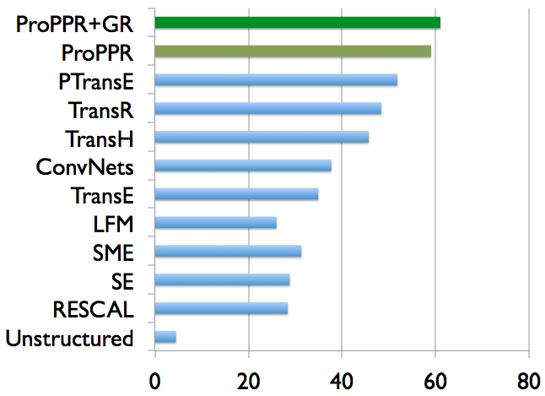
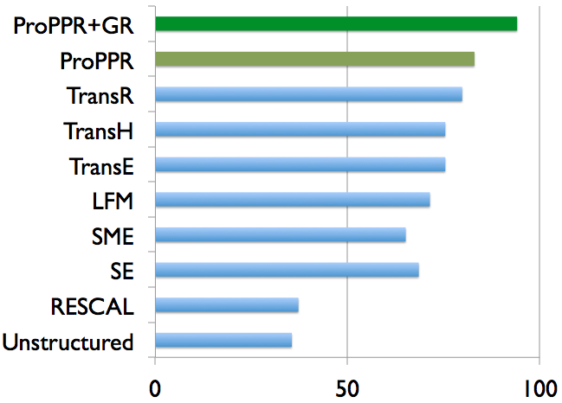
Large-Scale Knowledge Graph Completion
Runtime: ~2 hours.
Latent Factor
Models
Deep
Learning
Hits@10 on WordNet benchmark dataset
Hits@10 on FB15K benchmark dataset

Slide 10
Joint Information Extraction & Reasoning: a NLP Application
ACL 2015

Slide 11
Joint Extraction and Reasoning
Information Extraction (IE) from Text:
  Most extractors consider only context;
  No inference of multiple relations.
Knowledge Graph Reasoning:
  Most systems only consider triples;
  Important contexts are ignored.
Motivation: build a joint system for better IE and reasoning.

Slide 12
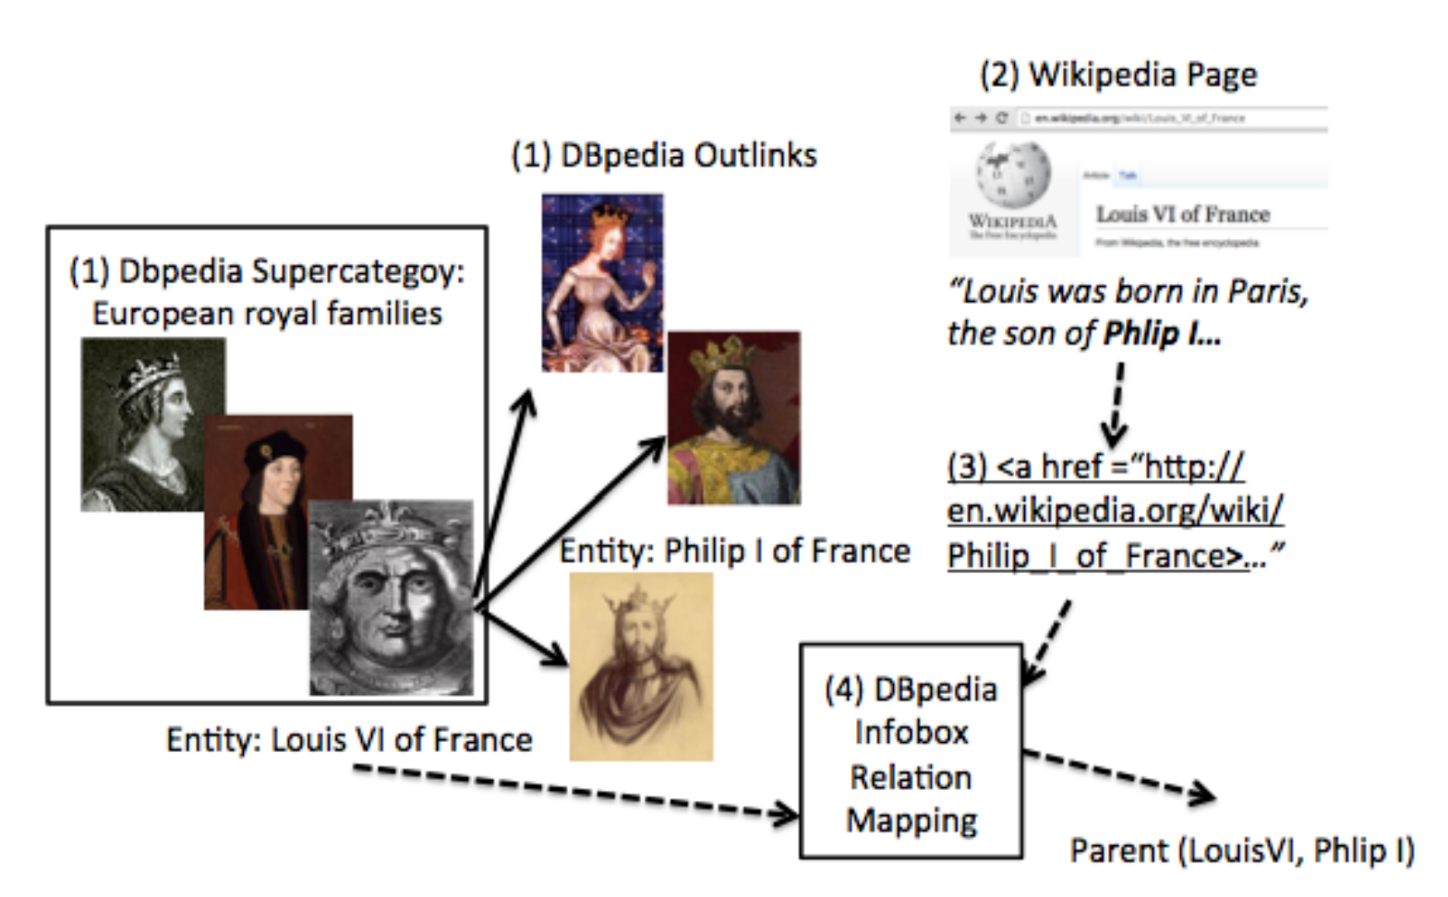
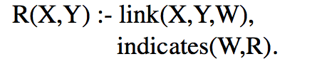
Data: groups of related Wikipedia pages
knowledge base: infobox facts
IE task: classify links from page X to page Y
  features: nearby words
  label to predict: possible relationships between X and Y (distant supervision)
Train/test split: temporal
To simulate filling in an incomplete KB: randomly delete X% of the facts in train

Slide 13
Joint IE+SL theory
Information Extraction
  R(X,Y) :- link(X,Y,W),indicates(W,R).
  R(X,Y) :- link(X,Y,W1),link(X,Y,W2),
        indicates(W1,W2,R).
Structure Learning:
  Entailment: P(X,Y) :- R(X,Y).
  Inversion: P(X,Y) :- R(Y,X).
  Chain: P(X,Y) :- R1(X,Z),R2(Z,Y).

Slide 14
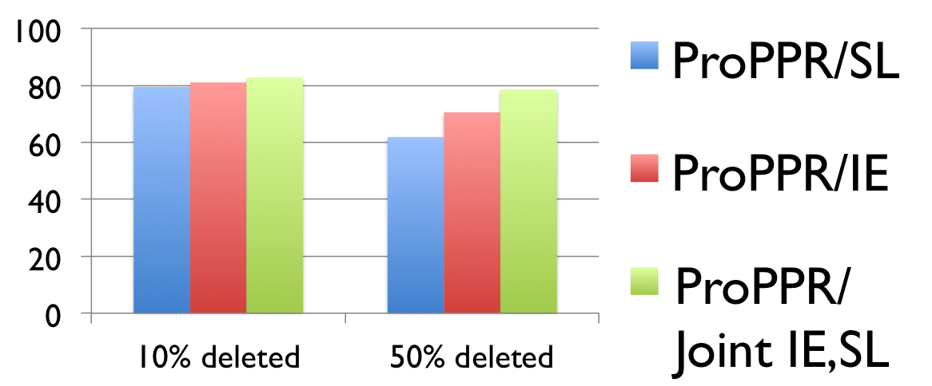
Experiments
Task: Noisy KB Completion
Three Wikipedia Datasets: royal, geo, american
  67K, 12K, and 43K links
  MAP Results for predicted facts on Royal, similar results on two other InfoBox datasets
Notes:
royal: 2258 pages, 15 relations,
american: 679 pages, 12k links, 30 relations
geo: 500 pages, 43k mentions/links, 10 relations

Slide 15
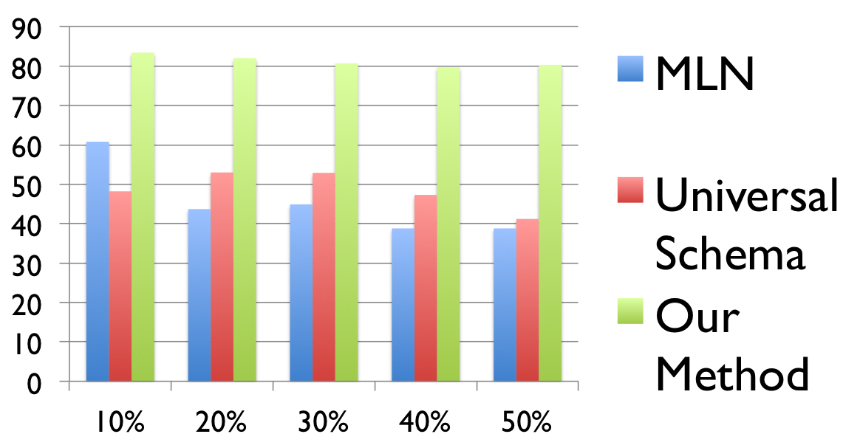
Joint IE and relation learning
Baselines: MLNs (Richardson and Domingos, 2006), Universal Schema (Riedel et al., 2013), IE- and structure-learning-only models

Slide 16
Latent context invention
Making the classifier deeper: introduce latent classes (analogous to invented predicates) which can be combined with the context words in the features used by the classifier
  R(X,Y) :- latent(L),link(X,Y,W),indicates(W,L,R).
  R(X,Y) :- latent(L1),latent(L2),link(X,Y,W),
        indicates(W,L1,L2,R).

Slide 17
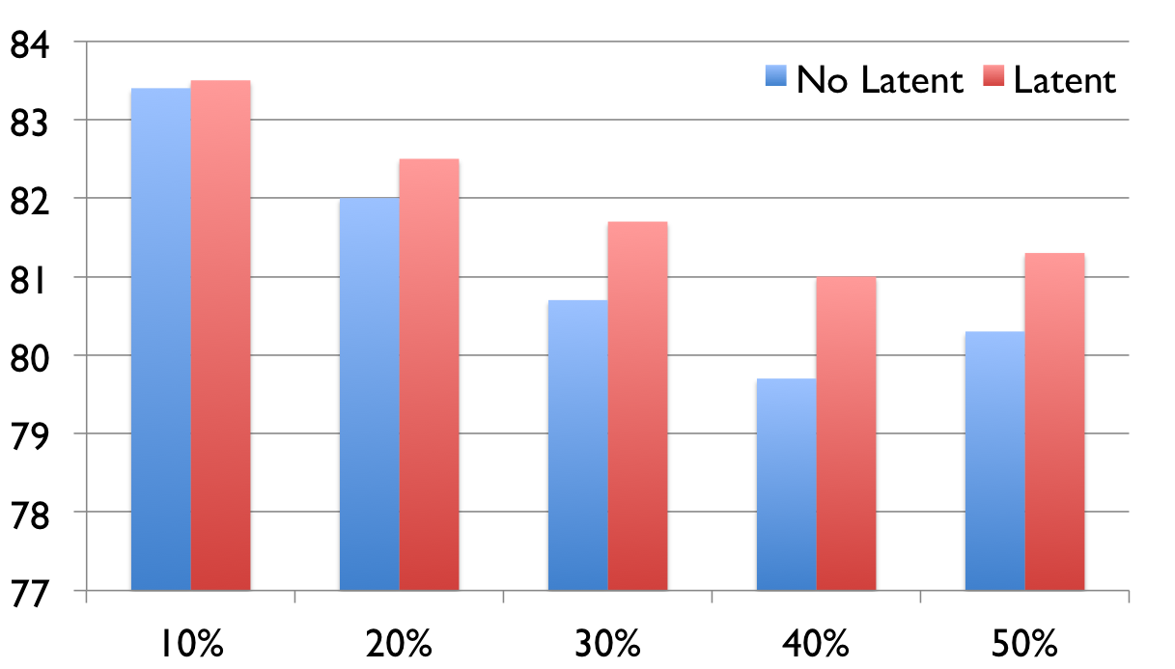
Effect of latent context invention

Slide 18
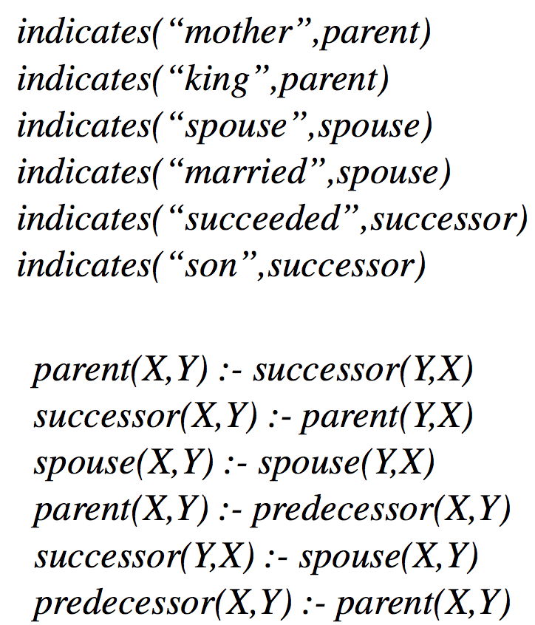
Joint IE and relation learning
Universal schema: learns a joint embedding of IE features and relations
ProPPR: learns
  weights on features indicates(word,relation) for link-classification task
  Horn rules relating the relations
Highest-weight of each type

Slide 19
Outline
Motivation/Background
  Logic
  Probability
  Combining logic and probabilities:
    Inference and semantics: MLNs
    Probabilistic DBs and the independent-tuple mechanism
Recent research
  ProPPR – a scalable probabilistic logic
  Structure learning
  Applications: knowledge-base completion
  Joint learning
Cutting-edge research
  ….

Slide 20
Statistical Relational Learning vs Deep Learning
Problem:
  Systems like ProPPR, MLNS, etc are not useful as a component in end-to-end neural (or hybrid) models
  ProPPR can’t incorporate and tune pre-trained models for text, vision, ….
Possible solution: Differentiable logical systems
  Neural Module Networks [NAACL 2016]
  Neural Theorem Prover [WAKBC 2016]
  TensorLog (our current work, arxiv)

Slide 21

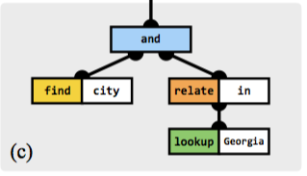
Neural Module Networks
Key ideas:
  question + syntactic analysis used to build deep network
  network is based on modules which have parameters, derived from question
  instances of modules share weights
  each has a functional role….
[Andreas, Rohrbach, Darrell, Klein]
“city”, “in”, …
are module
parameters

Slide 22
Neural Module Networks
[Andreas, Rohrbach, Darrell, Klein]
Examples of modules:
find[city]: concatenate vector for “city” with each row of W, and classify the pairs with a 2-layer network: if v^{i} ~ “city” then returns
Parameter input v^{i} and module output: (maybe singleton) sets of entities, encoded as vectors
a,d,B,C: module weights,
shared across all find’s
answer
W: “world” to which questions are applied
accessible to all modules

Slide 23
Neural Module Networks
[Andreas, Rohrbach, Darrell, Klein]
Examples of modules:
find[city]: concatenate vector for “city” with each row of W, and classify the pairs with a 2-layer network: if v^{i} ~ “city” then returns*
relate[in](h): similar to “find” but also concatenates a representation of the “region of attention” h
lookup[Georgia]: retrieve the one-hot encoding of “Georgia” from W
also and(…), describe[i], exists(h)
answer
W: “world” to which questions are applied
accessible to all modules
* also saves output as h, “region of attention”

Slide 24
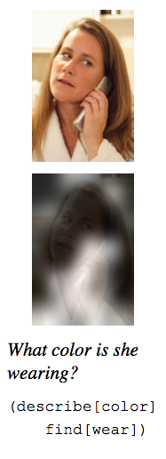
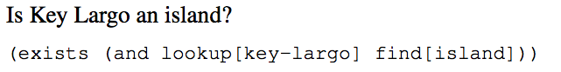
Dynamic Neural Module Networks
[Andreas, Rohrbach, Darrell, Klein]
Dynamic Module Networks: also learn how to map from questions to network structures.
Excellent performance on visual q/a and ordinary q/a.
learned process to build networks

Slide 25
Statistical Relational Learning vs Deep Learning
Possible solution: Differentiable logical systems
  Neural Module Networks [NAACL 2016]
  Neural Theorem Prover [WAKBC 2016]
  TensorLog (our current work)
A neural module implements a function, not a logical theory or subtheory…so it’s easier to map to a network, e.g.,
Can you convert logic to a neural net?

Slide 26
Neural Theorem Prover
[Rocktaschel and Riedel, WAKBC 2016]
Classes of goals: e.g., G=#1(#2,X)
  E.g. instance of G: grandpa(abe,X)
  grandpa and abe would be one-hot vectors
  Answer is a “substitution structure” S, which provides a vector to associate with X

Slide 27
Neural Theorem Prover
[Rocktaschel and Riedel, WAKBC 2016]
Basic ideas:
  Output of theorem proving is a substitution: i.e., a mapping from variables in query to DB constants
  For queries with a fixed format, the structure of the substitution is fixed: grandpa(__, Y) → Map[Y→ __ ]
  NTP constructs a substitution-producing network given a class of queries
    network is built from reusable modules
    unification of constants is soft matching in vector space

Slide 28
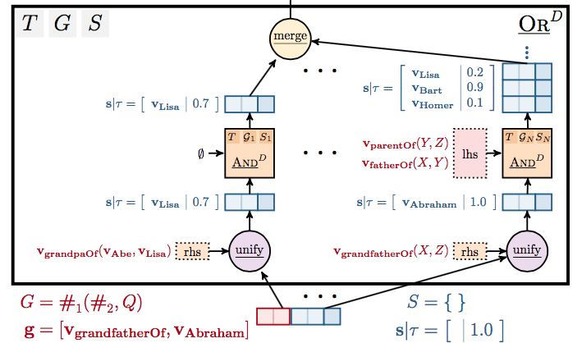
Neural Theorem Prover
[Rocktaschel and Riedel, WAKBC 2016]
Proofs: start with an OR/AND network with a branch for each rule….
grandpaOf(abe,lisa) :-
grandfatherOf(X,Z):-fatherOf(X,Y),parentOf(Y,Z)

Slide 29
Neural Theorem Prover
[Rocktaschel and Riedel, WAKBC 2016]
Unification is based on dot-product similarity of the representations and outputs a substitution
grandpaOf(abe,lisa) :-
grandfatherOf(X,Z):-fatherOf(X,Y),parentOf(Y,Z)

Slide 30
Neural Theorem Prover
[Rocktaschel and Riedel, WAKBC 2016]
… and is followed by an AND network for the literals in the body of the rule...splicing in a copy of the NTP for depth D-1
grandpaOf(abe,lisa) :-
grandfatherOf(X,Z):-fatherOf(X,Y),parentOf(Y,Z)

Slide 31
Neural Theorem Prover
[Rocktaschel and Riedel, WAKBC 2016]
… and is followed by an AND network for the literals in the body of the rule...splicing in a copy of the NTP for depth D-1
grandpaOf(abe,lisa) :-
grandfatherOf(X,Z):-fatherOf(X,Y),parentOf(Y,Z)

Slide 32

Neural Theorem Prover
[Rocktaschel and Riedel, WAKBC 2016]
… and finally there’s a merge step (which takes a max)
grandpaOf(abe,lisa) :-
grandfatherOf(X,Z):-fatherOf(X,Y),parentOf(Y,Z)

Slide 33
Neural Theorem Prover
[Rocktaschel and Riedel, WAKBC 2016]
Review:
  NTP builds a network that computes a function from goals g in some class G to substitutions that are associated with proofs of g:
    f(goal g) = substitution structure
  network is built from reusable modules / shared params
  unification of constants is soft matching in vector space
  ☺ you can handle even second-order rules
  ☹ the network can be large – rules can get re-used
  status: demonstrated only on small-scale problems

Slide 34
Statistical Relational Learning vs Deep Learning
Possible solution: Differentiable logical systems
  Neural Module Networks [NAACL 2016]
  Neural Theorem Prover [WAKBC 2016]
  TensorLog (our current work)
  More restricted but more efficient - a deductive DB, not a language
  Like NTP:
    define functions for classes of goals
  Unlike NTP:
    query goals have one free variable – functions return a set
    don’t enumerate all proofs and encapulate this in a network: instead use dynamic programming to collect results of theorem-proving

Slide 35
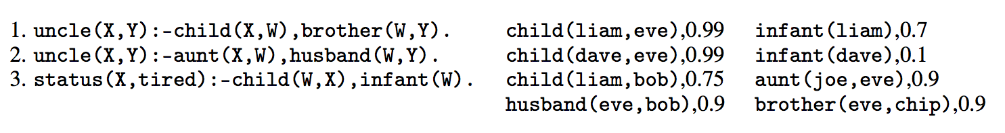
A probabilistic deductive DB
Actually all constants are only in the database

Slide 36
A PrDDB
Old trick: If you want to weight a rule you can introduce a rule-specific fact….
r3. status(X,tired) :- child(W,X), infant(W), weighted(r3).
r3. status(X,tired) :- child(W,X), infant(W) {r3}.
weighted(r3),0.88
So learning rule weights (like ProPPR) is a special case of learning weights for selected DB facts.

Slide 37
TensorLog: Semantics 1/3
The set of proofs of a clause is encoded as a factor graph
Logical variable ➔ random variable; literal➔factor
status(X,tired):- parent(X,W),infant(W)
status(X,T):-
const_tired(T),child(X,W),
infant(W),any(T,W).
uncle(X,Y):-child(X,W),brother(W,Y)
X
W
brother
Y
child
X
const_tired
any
T
X
W
Y
child
aunt
husband
W
infant
uncle(X,Y):-aunt(X,W),husband(W,Y)
Key thing we can do now: weighted proof-counting

Slide 38
TensorLog: Semantics 1/3
Query: uncle(liam, Y) ?
General case for p(c,Y):
initialize the evidence variable X to a one-hot vector for c
wait for BP to converge
read off the message y that would be sent from the output variable Y.
  un-normalized prob
y[d] is the weighted number of proofs supporting p(c,d) using this clause
uncle(X,Y):-child(X,W),brother(W,Y)
X
W
brother
Y
child
[liam=1]
[eve=0.99,bob=0.75]
[chip=0.99*0.9]
Key thing we can do now: weighted proof-counting

Slide 39
TensorLog: Semantics 1/3
But currently Tensor log only handles polytrees
For chain joins BP performs a random walk (without damping)
But we can handle more complex clauses as well
status(X,T):-
const_tired(T),child(X,W),
infant(W),any(T,W).
uncle(X,Y):-child(X,W),brother(W,Y)
X
W
brother
Y
child
X
const_tired
any
T
X
W
Y
child
aunt
husband
W
infant
uncle(X,Y):-aunt(X,W),husband(W,Y)
Key thing we can do now: weighted proof-counting

Slide 40
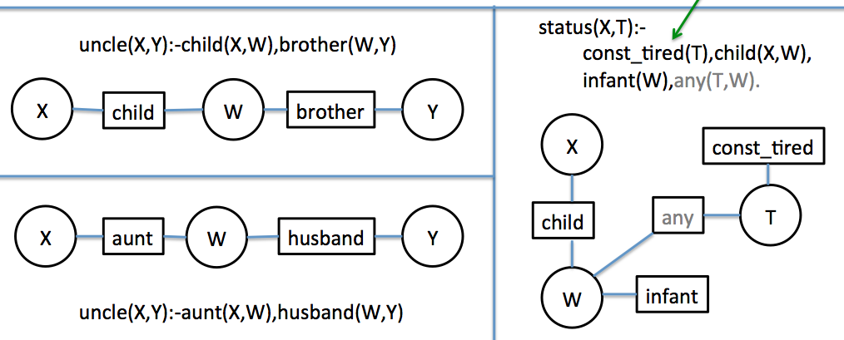
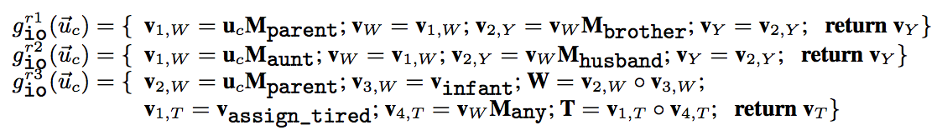
TensorLog: Semantics 2/3
Given a query type (inputs, and outputs) replace BP on factor graph with a function to compute the series of messages that will be passed, given an input…
can run backprop on these

Slide 41
TensorLog: Semantics 3/3
We can combine these functions compositionally:
multiple clauses defining the same predicate: add the outputs!
r1
g_{io}^{r1}(u) = { … return v_{Y;} }
g_{io}^{r2}(u) = { … return v_{Y;} }
r2
r2
g_{io}^{uncle}(u) = g_{io}^{r1}(u) + g_{io}^{r2}(u)

Slide 42
TensorLog: Semantics 3/3
We can combine these functions compositionally:
multiple clauses defining the same predicate: add the outputs
nested predicate calls: call the appropriate subroutine!
g_{io}^{r2}(u) = { …; v_{i} = v_{j} M_{aunt} ; …}
r2
aunt(X,Y) :- child(X,W),sister(W,Y)
aunt(X,Y) :- …
g_{io}^{r2}(u) = { …; v_{i} = g_{io}^{aunt} (v_{j} ); …}
g_{io}^{aunt}(u) = ….

Slide 43
TensorLog: Semantics vs Prior Work
TensorLog:
One random variable for each logical variable used in a proof.
Random variables are multinomials over the domain of constants.
Each literal in a proof [e.g., aunt(X,W)] is a factor.
Factor graph is linear in size of theory + depth of recursion
Message size = O(#constants)
Markov Logic Networks
One random variable for each possible ground atomic literal [e.g. aunt(sue,bob)]
Random variables are binary (literal is true or false)
Each ground instance of a clause is a factor.
Factor graph is linear in the number of possible ground literals = O(#constants ^{arity} )
Messages are binary

Slide 44
TensorLog: Semantics vs Prior Work
TensorLog:
Use BP to count proofs
Language is constrained to messages are “small” and BP converges quickly.
Score for a fact is a potential (to be learned from data), and overlapping facts in explanations are ignored.
ProbLog2, ….
Use logical theorem proving to find all “explanations” (minimal sets of supporting facts)
  This set can be exponentially large
Tuple-independence: each DB fact is independent probability ➔ scoring a set of overlapping explanations is NP-hard.

Slide 45
TensorLog: Semantics vs Prior Work
TensorLog:
Use BP to count proofs
Language is constrained to messages are “small” and BP converges quickly.
Score for a fact is a potential (to be learned from data), and overlapping facts in explanations are ignored.
ProPPR, ….
Use logical theorem proving to find all “explanations”)
  Set is of limited size because of PageRank-Nibble approximation
Weights are assigned to rules, not facts
Can differentiate with respect to “control” over theorem proving, but not the full DB

Slide 46
TensorLog status
Current implementation is quite limited
  single-threaded, ….
  no structure learning yet
Runtime is faster than ProbLog2 and MLNs
  comparable to ProPPR on medium-size problems
  should scale better with many examples but worse with very large KBs
Accuracy similar to ProPPR
  on small set of problems we’ve compared on

Slide 47
Conclusion
We reviewed background in statistical relational learning, focusing on Markov Logic Networks;
We described the ProPPR language, a scalable probabilistic first-order logic for reasoning;
We introduced TensorLog, a recently proposed deductive database.

Slide 48
Key References For Part 3
Rocktaschel and Riedel, Learning Knowledge Base Inference with Neural Theorem Provers, Proc of WAKBC 2016
Rocktäschel, …, Riedel, Injecting logical background knowledge into embeddings for relation extraction, ACL 2015
Andreas, …, Klein, Learning to Compose Neural Networks for Question Answering, NAACL 2016
Cohen, TensorLog: A Differentiable Deductive Database, arxiv xxxx.xxxx
Sourek, …, Kuzelka, Lifted Relational Neural Networks, arxiv.org 1508.05128

