Slide 1
William W. Cohen
Machine Learning Dept and Language Technology Dept

Slide 2
Outline
Web-scale information extraction:
  discovering factual by automatically reading language on the Web
NELL: A Never-Ending Language Learner
  Goals, current scope, and examples
Key ideas:
  Redundancy of information on the Web
  Constraining the task by scaling up
Current and future directions:
  Additional types of learning and input sources

Slide 3
Information Extraction
Goal:
  Extract facts about the world automatically by reading text
  IE systems are usually based on learning how to recognize facts in text
    .. and then (sometimes) aggregating the results
    Latest-generation IE systems need not require large amounts of training
    … and IE does not necessarily require subtle analysis of any particular piece of text

Slide 4
Never Ending Language Learning (NELL)
NELL is a large-scale IE system
  Simultaneously learning 500-600 concepts and relations (person, celebrity, emotion, aquiredBy, locatedIn, capitalCityOf, ..)
  Uses 500M web page corpus + live queries
  Running (almost) continuously for over a year
  Currently has learned 3.2M low-confidence “beliefs” and over 500K high-confidence beliefs
    about 85% of high-confidence beliefs are correct

Slide 5
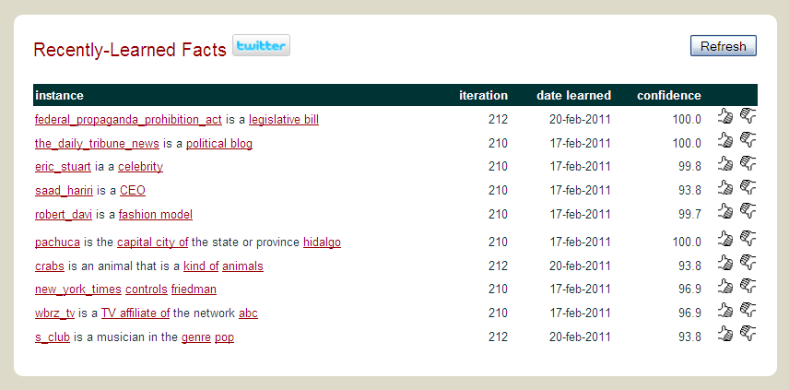
Examples of what NELL knows

Slide 6
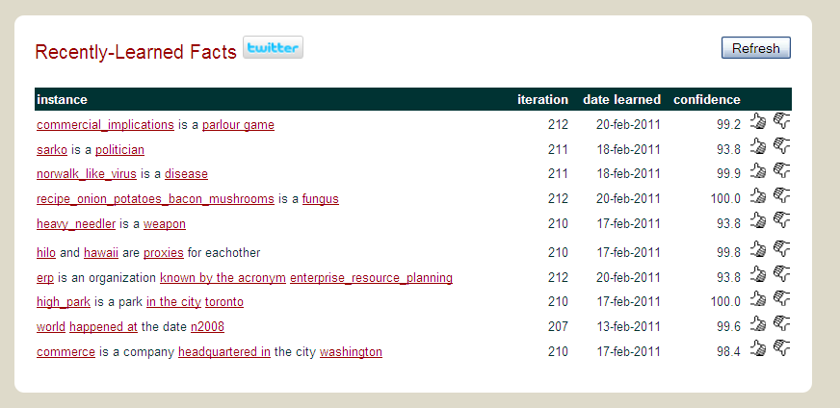
Examples of what NELL knows

Slide 7
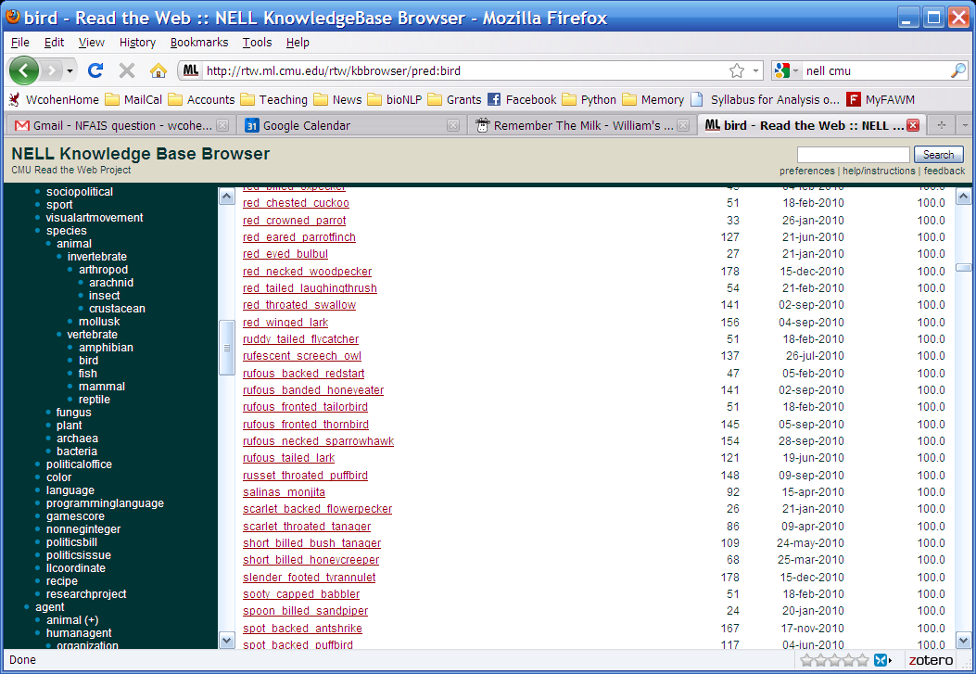
Examples of what NELL knows

Slide 8
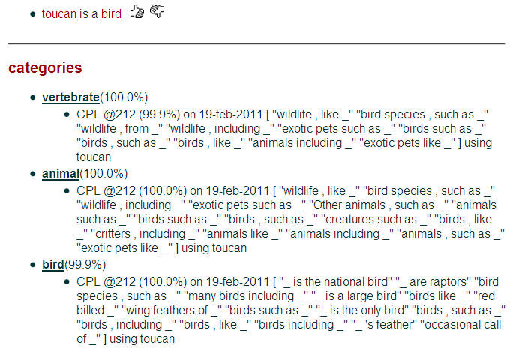

Slide 9
learned extraction patterns: playsSport(arg1,arg2)
arg1_was_playing_arg2 arg2_megastar_arg1 arg2_icons_arg1 arg2_player_named_arg1 arg2_prodigy_arg1 arg1_is_the_tiger_woods_of_arg2 arg2_career_of_arg1 arg2_greats_as_arg1 arg1_plays_arg2 arg2_player_is_arg1 arg2_legends_arg1 arg1_announced_his_retirement_from_arg2 arg2_operations_chief_arg1 arg2_player_like_arg1 arg2_and_golfing_personalities_including_arg1 arg2_players_like_arg1 arg2_greats_like_arg1 arg2_players_are_steffi_graf_and_arg1 arg2_great_arg1 arg2_champ_arg1 arg2_greats_such_as_arg1 arg2_professionals_such_as_arg1 arg2_course_designed_by_arg1 arg2_hit_by_arg1 arg2_course_architects_including_arg1 arg2_greats_arg1 arg2_icon_arg1 arg2_stars_like_arg1 arg2_pros_like_arg1 arg1_retires_from_arg2 arg2_phenom_arg1 arg2_lesson_from_arg1 arg2_architects_robert_trent_jones_and_arg1 arg2_sensation_arg1 arg2_architects_like_arg1 arg2_pros_arg1 arg2_stars_venus_and_arg1 arg2_legends_arnold_palmer_and_arg1 arg2_hall_of_famer_arg1 arg2_racket_in_arg1 arg2_superstar_arg1 arg2_legend_arg1 arg2_legends_such_as_arg1 arg2_players_is_arg1 arg2_pro_arg1 arg2_player_was_arg1 arg2_god_arg1 arg2_idol_arg1 arg1_was_born_to_play_arg2 arg2_star_arg1 arg2_hero_arg1 arg2_course_architect_arg1 arg2_players_are_arg1 arg1_retired_from_professional_arg2 arg2_legends_as_arg1 arg2_autographed_by_arg1 arg2_related_quotations_spoken_by_arg1 arg2_courses_were_designed_by_arg1 arg2_player_since_arg1 arg2_match_between_arg1 arg2_course_was_designed_by_arg1 arg1_has_retired_from_arg2 arg2_player_arg1 arg1_can_hit_a_arg2 arg2_legends_including_arg1 arg2_player_than_arg1 arg2_legends_like_arg1 arg2_courses_designed_by_legends_arg1 arg2_player_of_all_time_is_arg1 arg2_fan_knows_arg1 arg1_learned_to_play_arg2 arg1_is_the_best_player_in_arg2 arg2_signed_by_arg1 arg2_champion_arg1

Slide 10
Outline
Web-scale information extraction:
  discovering factual by automatically reading language on the Web
NELL: A Never-Ending Language Learner
  Goals, current scope, and examples
Key ideas:
  Redundancy of information on the Web
  Constraining the task by scaling up
Current and future directions:
  Using language to understand and combine information in structured databases

Slide 11
Semi-Supervised Bootstrapped Learning
it’s underconstrained!!
Extract cities:
Paris
Pittsburgh
Seattle
Cupertino
San Francisco
Austin
denial
anxiety
selfishness
Berlin
mayor of arg1
live in arg1
arg1 is home of
traits such as arg1

Slide 12
One Key to Accurate Semi-Supervised Learning
teamPlaysSport(t,s)
playsForTeam(a,t)
person
sport
playsSport(a,s)
team
coach(NP)
athlete
coach
coachesTeam(c,t)
NP
NP1
NP2
Krzyzewski coaches the Blue Devils.
Krzyzewski coaches the Blue Devils.
hard (underconstrained)
semi-supervised learning problem
much easier (more constrained)
semi-supervised learning problem
Easier to learn 100’s of interrelated tasks than to learn one isolated task

Slide 13
SEAL: Set Expander for Any Language
Another key: use lists and tables as well as text
Seeds
Extractions
Single-page Patterns
…
…
ford, toyota, nissan
…
honda
…
…
*Richard C. Wang and William W. Cohen: Language-Independent Set Expansion of Named Entities using the Web. In Proceedings of IEEE International Conference on Data Mining (ICDM 2007), Omaha, NE, USA. 2007.

Slide 14

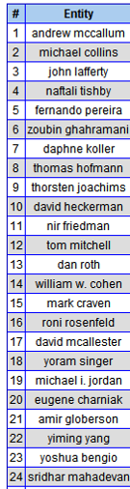
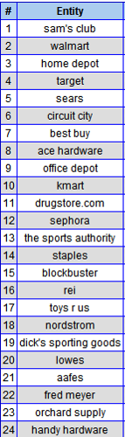
Extrapolating user-provided seeds
Set expansion (SEAL):
  Given seeds (kdd, icml, icdm), formulate query to search engine and collect semi-structured web pages
  Detect lists on these pages
  Merge the results, ranking items “frequently” occurring on “good” lists highest
  Details: Wang & Cohen ICDM 2007, 2008; EMNLP 2008, 2009
Notes:
These are ranked lists – so somehow ijcai is more like the kdd conference than stoc is, and mango is a better tropical fruit than a tamgerine.

Slide 15
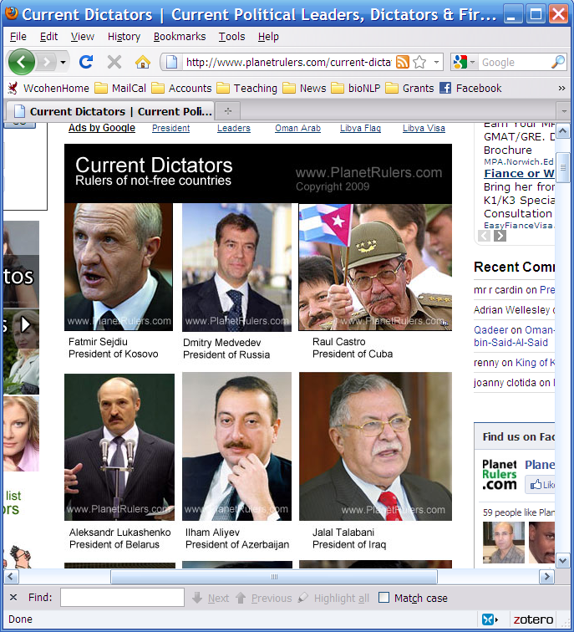
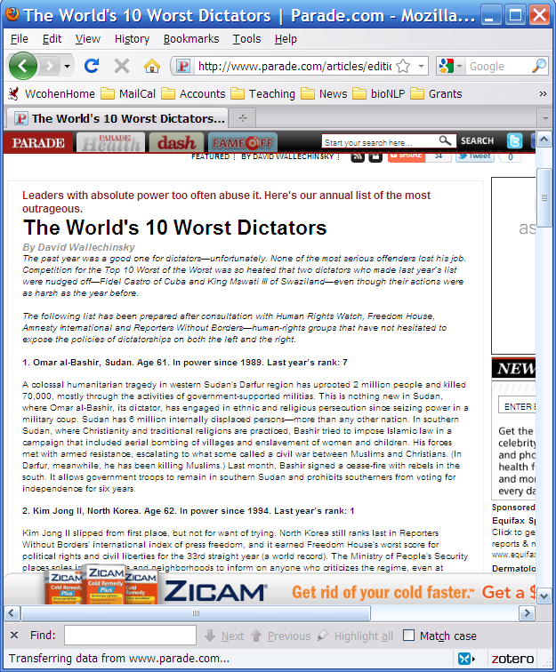
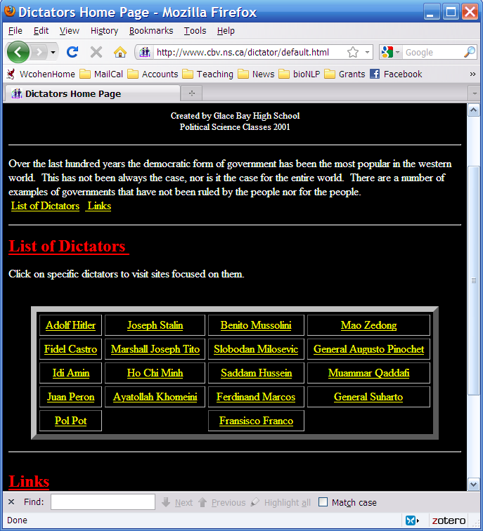
Sample semi-structure pages for the concept “dictators

Slide 16
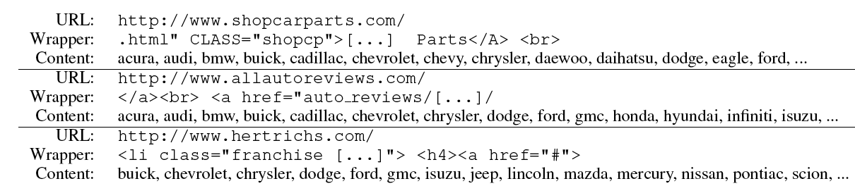
For each class being learned,
On each iteration
Retrain CBL from current KB, allow it to add to KB
Retrain SEAL from current KB, allow it to add to KB
Typical learned SEAL extractors:

Slide 17
evidence integration, self reflection
CBL
text extraction patterns
SEAL
HTML extraction patterns
Morph
Morphologybased extractor
RL
learned inference rules
Ontology and populated KB
the Web

Slide 18

evidence integration, self reflection
CBL
text extraction patterns
SEAL
HTML extraction patterns
Morph
Morphology based extractor
RL
learned inference rules
Wikipedia category-based extractor
Ontology and populated KB
Geonames, DBPedia, FreeBase, Biomedical data…
the Web

Slide 19
Looking forward
Huge value in mining/organizing/making accessible publically available information
Information is more than just facts
  It’s also how people write about the facts, how facts are presented (in tables, …), how facts structure our discourse and communities, …
  IE is the science of all these things

