Slide 1
Holistic Web Page Classification
William W. Cohen
Center for Automated Learning and Discovery (CALD)
Carnegie-Mellon University

Slide 2
Outline
Web page classification: assign a label from a fixed set (e.g “pressRelease, other”) to a page.
This talk: page classification as information extraction.
  why would anyone want to do that?
Overview of information extraction
  Site-local, format-driven information extraction as recognizing structure
How recognizing structure can aid in page classification

Slide 3
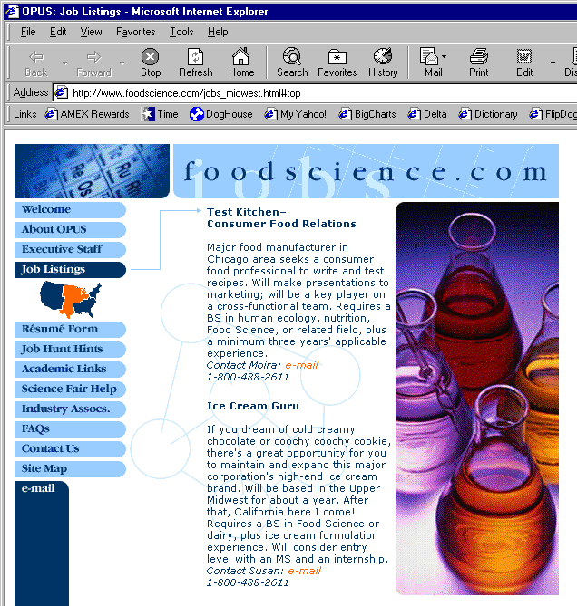
foodscience.com-Job2
JobTitle: Ice Cream Guru
Employer: foodscience.com
JobCategory: Travel/Hospitality
JobFunction: Food Services
JobLocation: FL-Deerfield Beach
ContactInfo: 1-800-488-2611
DateExtracted: January 8, 2001
Source: www.foodscience.com/jobs_midwest.html
OtherCompanyJobs: foodscience.com-Job1
Notes:
Idea of system – spider a site, extract data, organize into DB records

Slide 4
Two flavors of information extraction systems
Information extraction task 1: extract all data from 10 different sites.
  Technique: write 10 different systems each driven by formatting information from a single site (site-dependent extraction)
Information extraction task 2: extract most data from 50,000 different sites.
  Technique: write one site-independent system

Slide 5
Extracting from one web site
  Use site-specific formatting information: e.g., “the JobTitle is a bold-faced paragraph in column 2”
  For large well-structured sites, like parsing a formal language
Extracting from many web sites:
  Need general solutions to entity extraction, grouping into records, etc.
  Primarily use content information
  Must deal with a wide range of ways that users present data.
  Analogous to parsing natural language
Problems are complementary:
  Site-dependent learning can collect training data for/boost accuracy of a site-independent learner

Slide 6
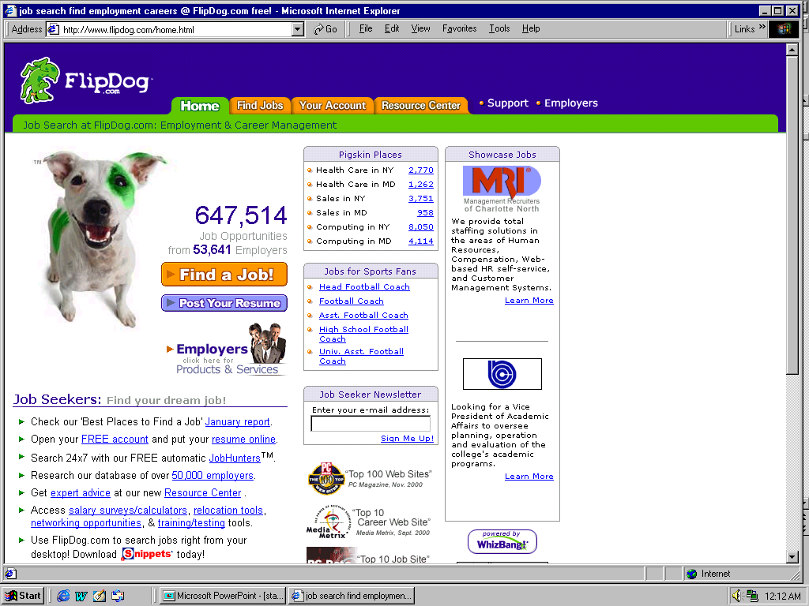
Notes:
Allows db-style search. Shows front page of job db -

Slide 7
An architecture for site-local learning
Engineer a number of “builders”:
  Infer a “structure” (e.g. a list, table column, etc) from few positive examples of that structure.
  A “structure” extracts all its members
    f(page) = { x: x is a “structure element” on page }
A master learning algorithm co-ordinates use of the “builders”
Add/remove “builders” to optimize performance on a domain.
  See (Cohen,Hurst,Jensen WWW-2002)

Slide 8
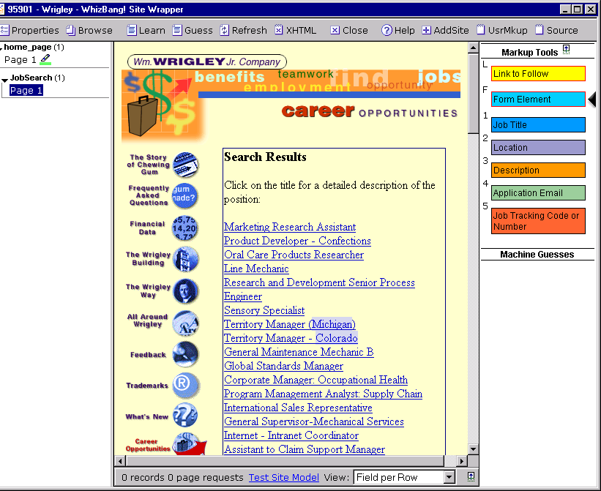

Slide 9
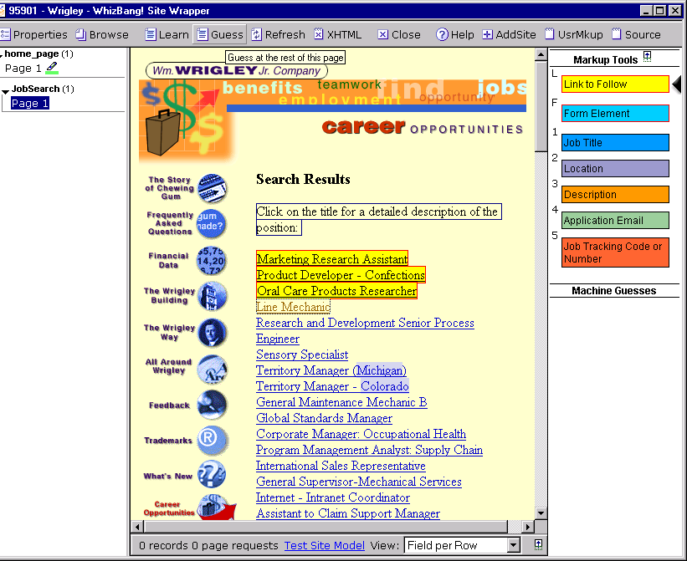
Builder

Slide 10
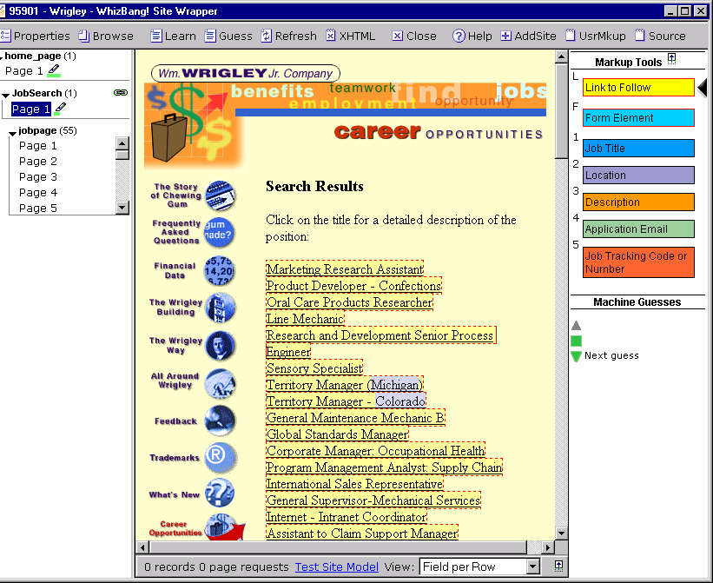

Slide 11
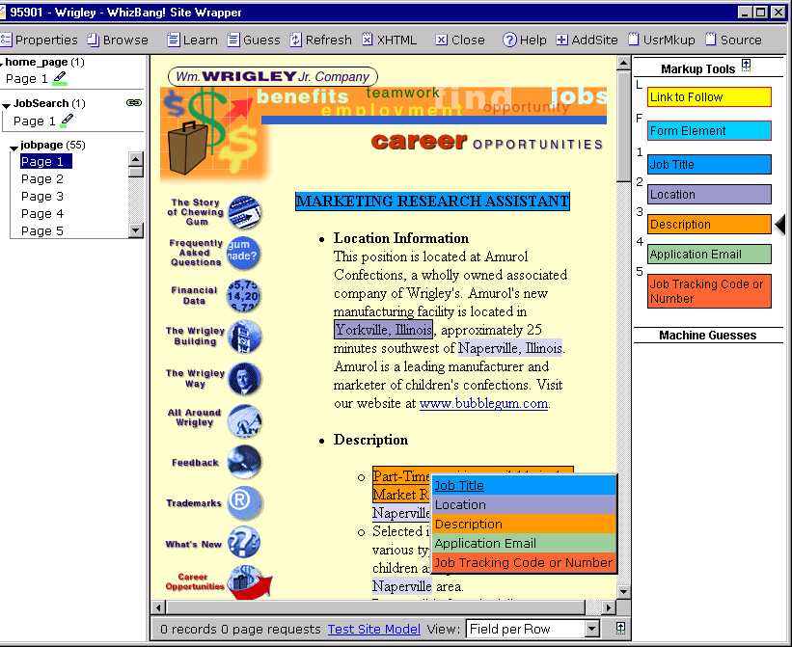

Slide 12
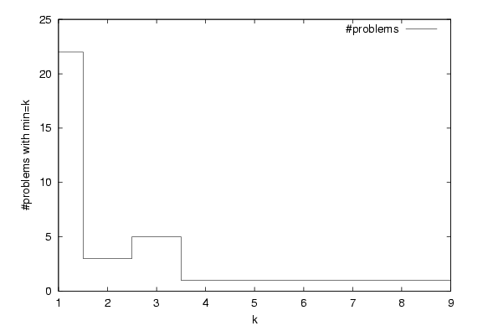
Experimental results: most “structures” need only 2-3 examples for recognition
Examples needed for 100% accuracy

Slide 13
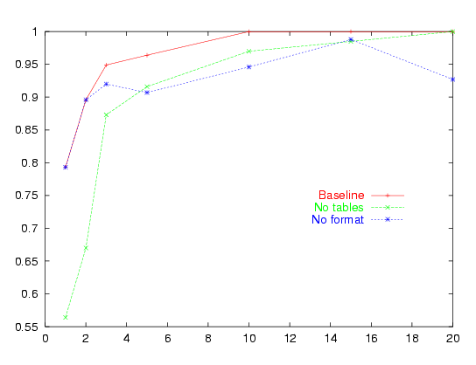
Experimental results:
2-3 examples leads to high average accuracy
F1
#examples

Slide 14


Why learning from few examples is important
At training time, only four examples are available—but
one would like to generalize to future pages as well…

Slide 15
Outline
Overview of information extraction
  Site-local, format-driven information extraction as recognizing structure
How recognizing structure can aid in page classification
  Page classification: assign a label from a fixed set (e.g “pressRelease, other”) to a page.

Slide 16
Previous work:
  Exploit hyperlinks (Slattery&Mitchell 2000; Cohn&Hofmann, 2001; Joachims 2001): Documents pointed to by the same “hub” should have the same class.
This work:
  Use structure of hub pages (as well as structure of site graph) to find better “hubs”
The task: classifying “executive bio pages”.

Slide 17
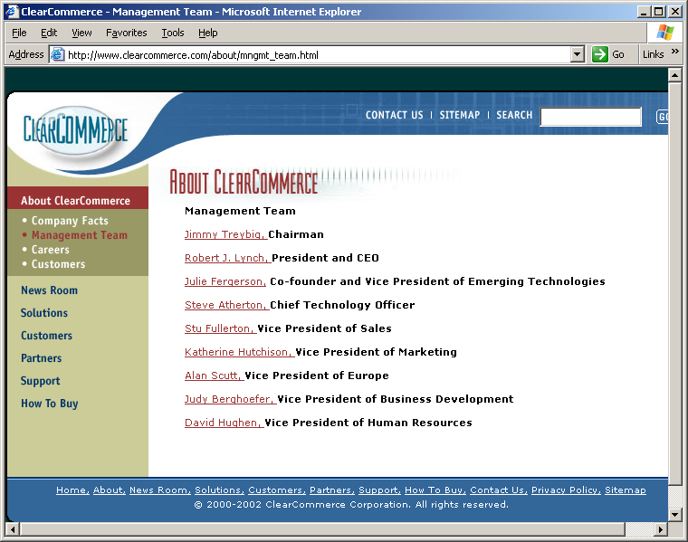

Slide 18
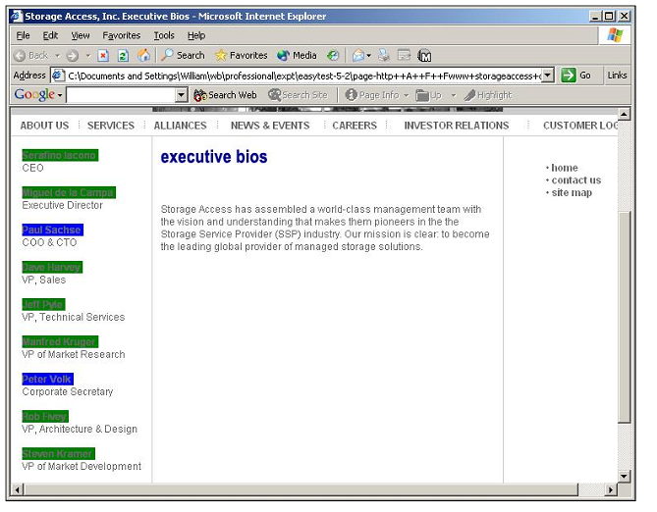


Slide 19
Background: “co-training” (Mitchell and Blum, ‘98)
Suppose examples are of the form (x1, x2,y) where x1,x2 are independent (given y), and where each xi is suffcient for classification, and unlabeled examples are cheap.
  (E.g., x1 = bag of words, x2 = bag of links).
Co-training algorithm:
1. Use x1’s (on labeled data D) to train f1(x1) = y.
2. Use f1 to label additional unlabeled examples U.
3. Use x2’s (on labeled part of U and D) to train f2(x2) = y.
4. Repeat . . .

Slide 20
1-step co-training for web pages
f1 is a bag-of-words page classifier, and S is web site containing unlabeled pages.
1. Feature construction. Represent a page x in S as a bag of pages that link to x (“bag of hubs”).
2. Learning. Learn f2 from the bag-of-hubs examples, labeled with f1.
3. Labeling. Use f2(x) to label pages from S.

Slide 21
Improving the “bag of hubs” representation
Assumptions:
  Index pages (of the kind shown) are common.
  “Builders” can recognize index structures from a few positive examples (true positive examples can be extrapolated to the entire index list, with some builder).
  A global bag-of-words page classifier will be moderately accurate, but it’s useful to “smooth” the predictions of the classifier so that it’s consistent with some index page(s).

Slide 22
Improved 1-step co-training for web pages
Anchor labeling. Label an anchor a in S positive iff it points to a positive page x (according to f1).
Feature construction.
- Let D be the set of all (x’, a) : a is a positive anchor in x’. Generate many small training sets D_{i} from D, (by sliding small windows over D).
- Let P be the set of all “structures” found by any builder from any subset D_{i}.
- Say that p links to x if p extracts an anchor that points to x. Represent a page x as the bag of structures in P that link to x.
Learning and labeling: as before.

Slide 23

List1
builder
extractor

Slide 24
builder
extractor
List2

Slide 25
builder
extractor
List3

Slide 26
BOH representation:
{ List1, List3,…}, PR
{ List1, List2, List3,…}, PR
{ List2, List 3,…}, Other
{ List2, List3,…}, PR
…
Learner

Slide 27
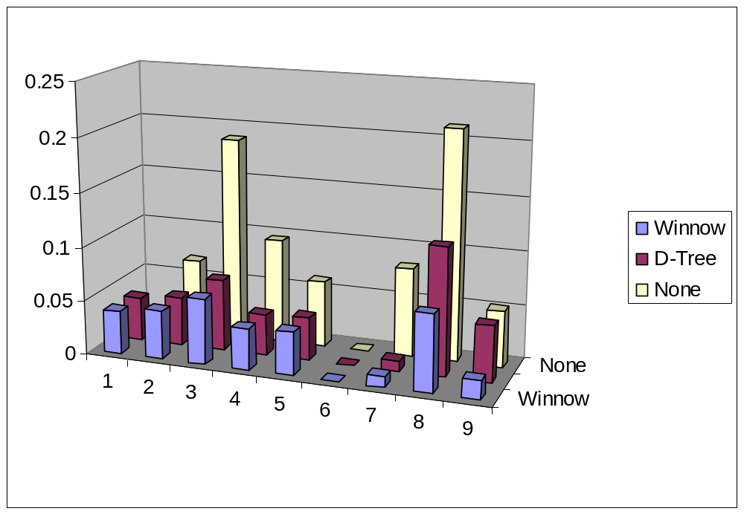
Experimental results
Co-training hurts
No improvement

Slide 28
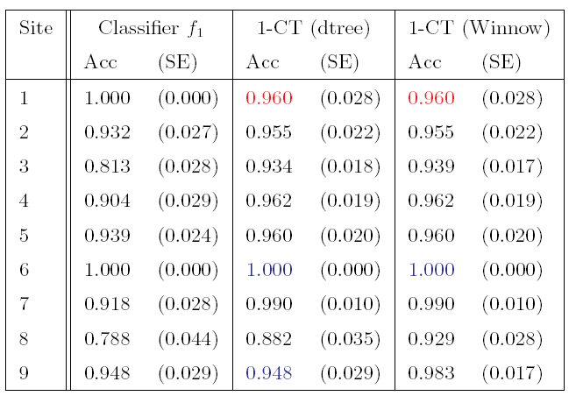
Experimental results

Slide 29
Concluding remarks
- “Builders” (from a site-local extraction system) let one discover and use structure of web sites and index pages to smooth page classification results.
- Discovering good “hub structures” makes it possible to use 1-step co-training on small (50-200 example) unlabeled datasets.
– Average error rate was reduced from 8.4% to 3.6%.
– Difference is statistically significant with a 2-tailed paired sign test or t test.
– EM with probabilistic learners also works—see (Blei et al, UAI 2002)
- Details to appear in (Cohen, NIPS2002)

