Slide 1
Learning to Reason with Extracted Information
William W. Cohen
Carnegie Mellon University
joint work with:
William Wang, Kathryn Rivard Mazaitis,
Stephen Muggleton, Tom Mitchell, Ni Lao,
Richard Wang, Frank Lin, Ni Lao, Estevam Hruschka, Jr., Burr Settles, Partha Talukdar, Derry Wijaya, Edith Law, Justin Betteridge, Jayant Krishnamurthy, Bryan Kisiel, Andrew Carlson, Weam Abu Zaki , Bhavana Dalvi, Malcolm Greaves,
Lise Getoor, Jay Pujara, Hui Miao, …

Slide 2
Outline
Background: information extraction and NELL
Key ideas in NELL
  Coupled learning
  Multi-view, multi-strategy learning
Inference in NELL
  Inference as another learning strategy
    Learning in graphs
    Path Ranking Algorithm
    ProPPR
  Structure learning in ProPPR
Conclusions & summary

Slide 3
Never Ending Language Learning (NELL)
NELL is a broad-coverage IE system
  Simultaneously learning hundreds of concepts and relations (person, celebrity, emotion, aquiredBy, locatedIn, capitalCityOf, ..)
  Starting point: containment/disjointness relations between concepts, types for relations, and O(10) examples per concept/relation, and large web corpus
  Running continuously for over four years
  Has learned tens of millions of “beliefs”

Slide 4
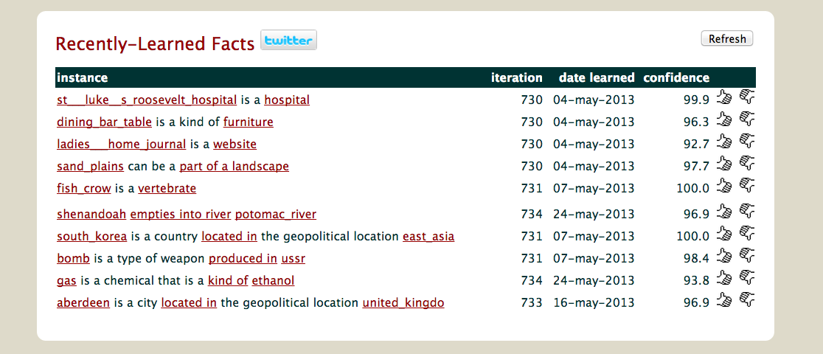
NELL Screenshots

Slide 5
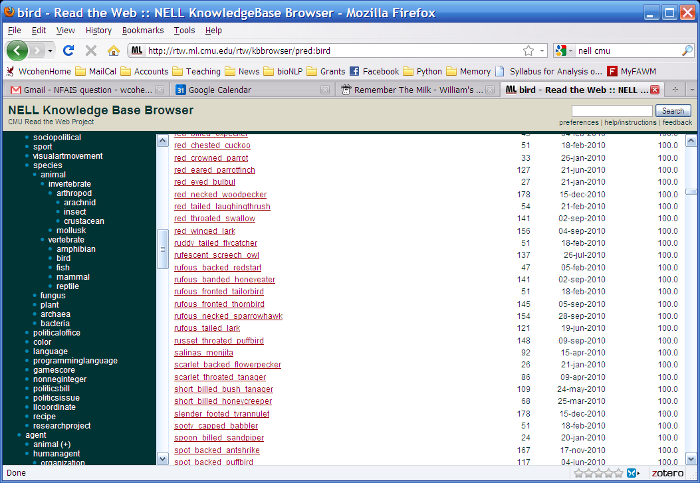
More examples of what NELL knows

Slide 6
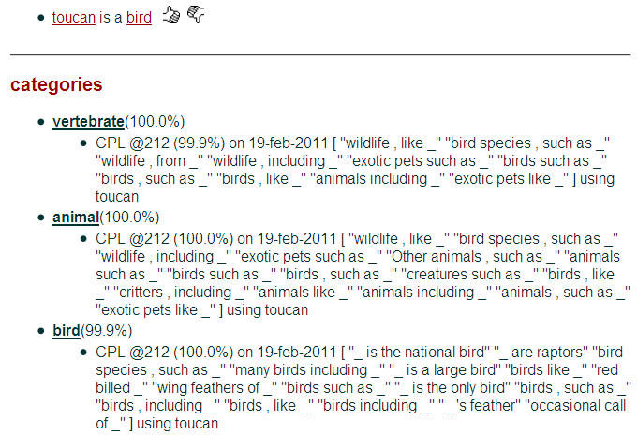

Slide 7
One Key: Coupled Semi-Supervised Learning
teamPlaysSport(t,s)
playsForTeam(a,t)
person
sport
playsSport(a,s)
team
coach(NP)
athlete
coach
coachesTeam(c,t)
NP
NP1
NP2
Krzyzewski coaches the Blue Devils.
Krzyzewski coaches the Blue Devils.
hard (underconstrained)
semi-supervised learning problem
much easier (more constrained)
semi-supervised learning problem
Easier to learn many interrelated tasks than one isolated task
Also easier to learn using many different types of information

Slide 8
Another key idea: use multiple “views” of the data
evidence integration
CBL
text extraction patterns
SEAL
HTML extraction patterns
Morph
Morphologybased extractor
PRA
learned inference rules
Ontology and populated KB
the Web

Slide 9
Outline
Background: information extraction and NELL
Key ideas in NELL
  Coupled learning
  Multi-view, multi-strategy learning
Inference in NELL
  Inference as another learning strategy
    Learning in graphs
    Path Ranking Algorithm
    ProPPR
  Structure learning in ProPPR
Conclusions & summary

Slide 10
Motivations
Short-term, practical:
  Extend the knowledge base with additional probabilistically-inferred facts
  Understand noise, errors and regularities: e.g., is “competes with” transitive?
Long-term, fundamental:
  From an AI perspective, inference is what you do with a knowledge base
  People do reason, so intelligent systems must reason:
    when you’re working with a user, you can’t wait for them to say something that they’ve inferred to be true

Slide 11
Summary of this section
Background: where we’re coming from
ProPPR: the first-order extension of our past work
Parameter learning in ProPPR
  small-scale
  medium-large scale
Structure learning for ProPPR
  small-scale
  medium-scale …

Slide 12
Background

Slide 13


Learning about graph similarity: past work
Personalized PageRank aka Random Walk with Restart: basically PageRank where surfer always “teleports” to a start node x.
  Query: Given type t* and node x, find y:T(y)=t* and y~x
  Answer: ranked list of y’s similar-to x
Einat Minkov’s thesis (2008): Learning parameterized variants of personalized PageRank for PIM and language tasks.
Ni Lao’s thesis (2012): New, better learning methods
  richer parameterization: one parameter per “path”
  faster inference

Slide 14
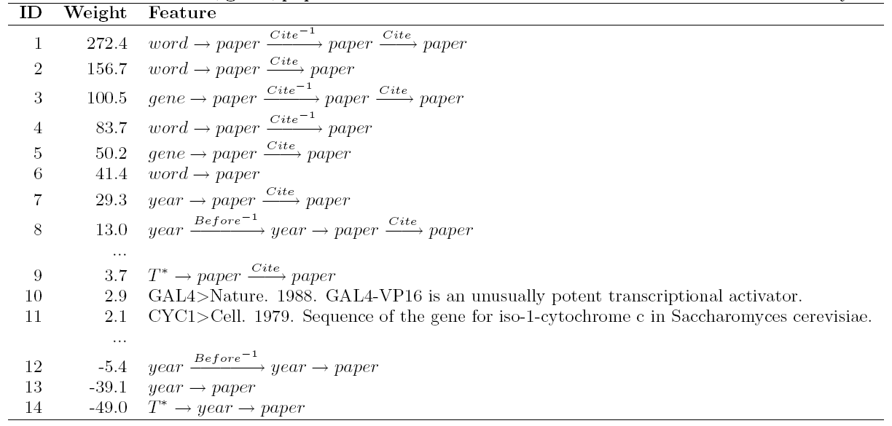
Lao: A learned random walk strategy is a weighted set of random-walk “experts”, each of which is a walk constrained by a path (i.e., sequence of relations)
Recommending papers to cite in a paper being prepared
1) papers co-cited with on-topic papers
6) approx. standard IR retrieval
7,8) papers cited during the past two years
12-13) papers published during the past two years

Slide 15
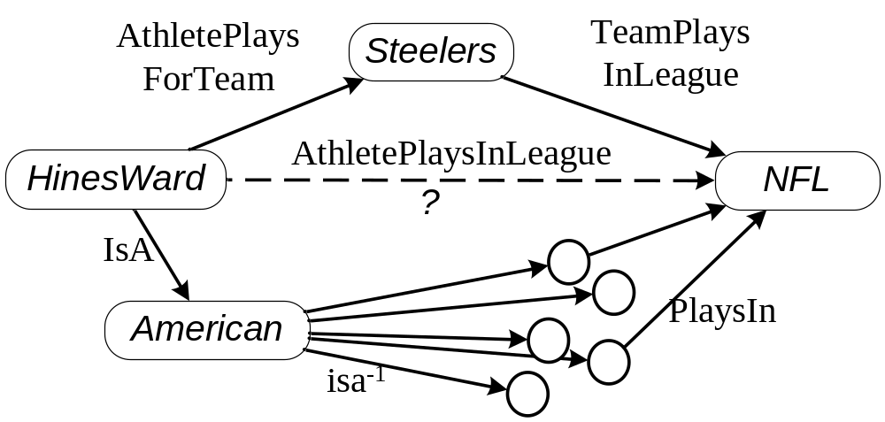
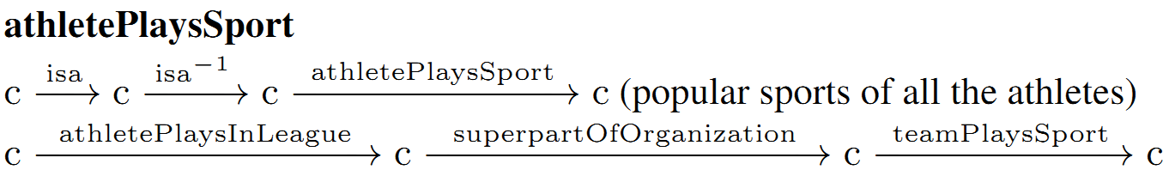
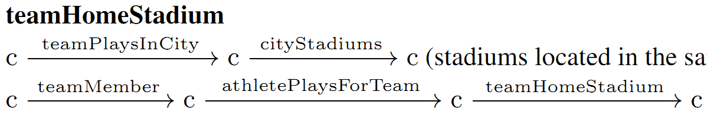
These paths are a closely related to logical inference rules
(Lao, Cohen, Mitchell 2011)
(Lao et al, 2012)
Random walk interpretation is crucial
i.e. 10-15 extra points in MRR
Synonyms of the query team
Notes:
show PRA paths

Slide 16
These paths are a closely related to logical inference rules
(Lao, Cohen, Mitchell 2011)
(Lao et al, 2012)
athletePlaysSport(X,Y) ←
isa(X,Concept),
isa(Z,Concept),
athletePlaysSport(Z,Y).
athletePlaysSport(X,Y) ←
athletePlaysInLeague(X,League),
superPartOfOrg(League,Team),
teamPlaysSport(Team,Y).
path is a continuous feature of a <Source,Destination> pair
strength of feature is random-walk probability
final prediction is weighted combination of these
Synonyms of the query team
Notes:
show PRA paths

Slide 17
evidence integration
CBL
text extraction patterns
SEAL
HTML extraction patterns
Morph
Morphologybased extractor
PRA
learned inference rules
Ontology and populated KB
the Web
PRA is now part of NELL

Slide 18
On beyond path-ranking….

Slide 19
A limitation of PRA
Paths are learned separately for each relation type, and one learned rule can’t call another
So, PRA can learn this….
athletePlaySportViaRule(Athlete,Sport) ⬅
onTeamViaKB(Athlete,Team), teamPlaysSportViaKB(Team,Sport)
teamPlaysSportViaRule(Team,Sport) ⬅
memberOfViaKB(Team,Conference),
hasMemberViaKB(Conference,Team2),
playsViaKB(Team2,Sport).
teamPlaysSportViaRule(Team,Sport) ⬅
onTeamViaKB(Athlete,Team), athletePlaysSportViaKB(Athlete,Sport)

Slide 20
A limitation
Paths are learned separately for each relation type, and one learned rule can’t call another
But PRA can not learn this…..
athletePlaySport(Athlete,Sport) ⬅
onTeam(Athlete,Team), teamPlaysSport(Team,Sport)
athletePlaySport(Athlete,Sport) ⬅ athletePlaySportViaKB(Athlete,Sport)
teamPlaysSport(Team,Sport) ⬅
memberOf(Team,Conference),
hasMember(Conference,Team2),
plays(Team2,Sport).
teamPlaysSport(Team,Sport) ⬅
onTeam(Athlete,Team), athletePlaysSport(Athlete,Sport)
teamPlaysSport(Team,Sport) ⬅ teamPlaysSportViaKB(Team,Sport)

Slide 21
So PRA is only single-step inference: known facts →inferred facts but not known facts → inferred facts → more inferred facts → …
Proposed solution: extend PRA to include large subset of Prolog, a first-order logic
athletePlaySport(Athlete,Sport) ⬅
onTeam(Athlete,Team), teamPlaysSport(Team,Sport)
athletePlaySport(Athlete,Sport) ⬅ athletePlaySportViaKB(Athlete,Sport)
teamPlaysSport(Team,Sport) ⬅
memberOf(Team,Conference),
hasMember(Conference,Team2),
plays(Team2,Sport).
teamPlaysSport(Team,Sport) ⬅
onTeam(Athlete,Team), athletePlaysSport(Athlete,Sport)
teamPlaysSport(Team,Sport) ⬅ teamPlaysSportViaKB(Team,Sport)

Slide 22


Programming with Personalized PageRank (ProPPR)
William Wang
Kathryn Rivard Mazaitis

Slide 23
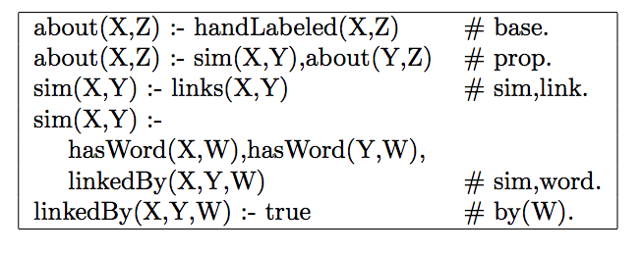
Sample ProPPR program….
Horn rules
features of rules
(generated on-the-fly)

Slide 24
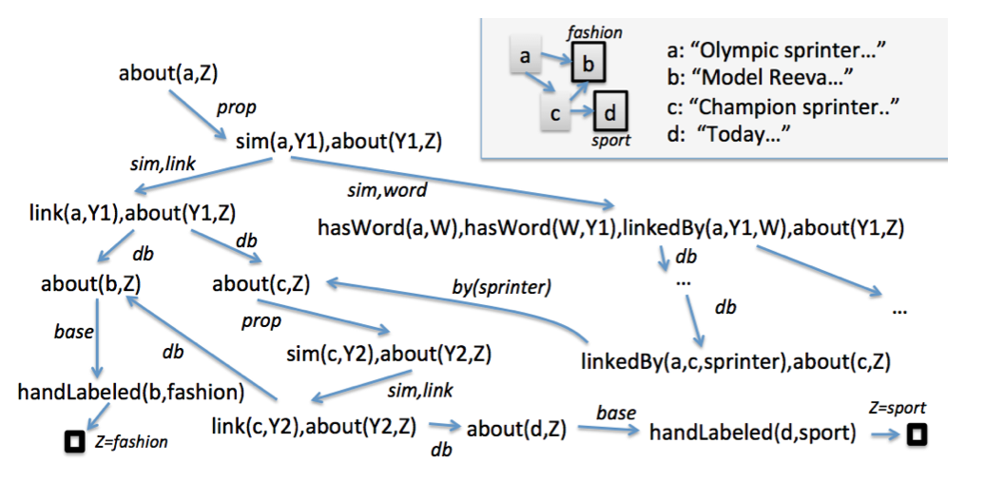
.. and search space…
Insight: This is a graph!

Slide 25
Score for a query soln (e.g., “Z=sport” for “about(a,Z)”) depends on probability of reaching a ☐ node*
  learn transition probabilities based on features of the rules
  implicit “reset” transitions with (p≥α) back to query node
Looking for answers supported by many short proofs
“Grounding” (proof tree) size is O(1/αε) … ie independent of DB size ➔ fast approx incremental inference (Reid,Lang,Chung, 08)
*as in Stochastic Logic Programs
[Cussens, 2001]
Learning: supervised variant of personalized PageRank (Backstrom & Leskovic, 2011)

Slide 26
Programming with Personalized PageRank (ProPPR)
Advantages:
  Can attach arbitrary features to a clause
  Minimal syntactic restrictions: can allow recursion, multiple predicates, function symbols (!), ….
  Grounding cost -- conversion to the zero-th order learning problem -- does not depend on the number of known facts in the approximate proof case.

Slide 27
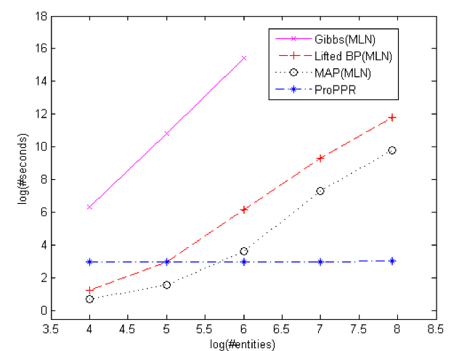
Inference Time: Citation Matching vs Alchemy
“Grounding”cost is independent of DB size

Slide 28
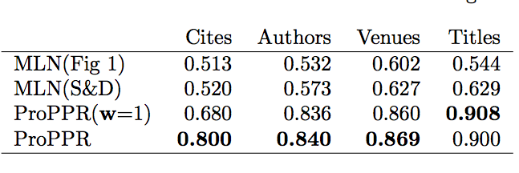
Accuracy: Citation Matching
Our rules
UW rules
AUC scores: 0.0=low, 1.0=hi
w=1 is before learning

Slide 29
It gets better…..
Learning uses many example queries
  e.g: sameCitation(c120,X) with X=c123+, X=c124-, …
Each query is grounded to a separate small graph (for its proof)
Goal is to tune weights on these edge features to optimize RWR on the query-graphs.
Can do SGD and run RWR separately on each query-graph in parallel
  Graphs do share edge features, so there’s some synchronization needed

Slide 30
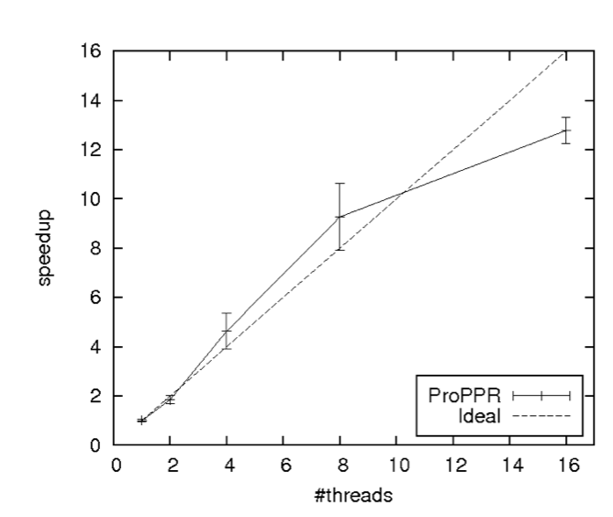
Learning can be parallelized by splitting on the separate “groundings” of each query

Slide 31
So we can scale: entity-matching problems
Cora bibliography linking: about
  11k facts
  2k train/test queries
TAC KBP entity linking: about
  460,000k facts
  1.2k train/test queries
Timing:
  load: 2.5min
  train/test: < 1 hour
    wall clock time
    8 threads, 20Gb
  plausible performance with 8-rule theory

Slide 32
Using ProPPR to learn inference rules over NELL’s KB
See also William Wang’s poster here at NLU-2014

Slide 33
Experiment:
Take top K paths for each predicate learned by PRA
Convert to a mutually recursive ProPPR program
Train weights on entire program
athletePlaySport(Athlete,Sport) ⬅
onTeam(Athlete,Team), teamPlaysSport(Team,Sport)
athletePlaySport(Athlete,Sport) ⬅ athletePlaySportViaKB(Athlete,Sport)
teamPlaysSport(Team,Sport) ⬅
memberOf(Team,Conference),
hasMember(Conference,Team2),
plays(Team2,Sport).
teamPlaysSport(Team,Sport) ⬅
onTeam(Athlete,Team), athletePlaysSport(Athlete,Sport)
teamPlaysSport(Team,Sport) ⬅ teamPlaysSportViaKB(Team,Sport)

Slide 34
Some details
DB = Subsets of NELL’s KB
Theory = top K PRA rules for each predicate
Test = new facts from later iterations

Slide 35
Some details
DB = Subsets of NELL’s KB
  From “ordinary” RWR from seeds: google, beatles, baseball
  Vary size by thresholding distance from seeds: M=1k, …, 100k, 1,000k entities then project
  Get different “well-connected” subsets
  Smaller KB sizes are better-connected ➔ easier
Theory = top K PRA rules for each predicate
Test = new facts from later iterations

Slide 36
Some details
DB = Subsets of NELL’s KB
Theory = top K PRA rules for each predicate
  For PRA rule p(X,Y) :- q(Y,Z),r(Z,Y)
    PRA recursive: q, r can invoke other rules AND p(X,Y) can also be proved via KB lookup via a “base case rule”
    PRA non-recursive: q, r must be KB lookup
    KB only: only the “base case” rules
Test = new facts from later iterations

Slide 37
Some details
DB = Subsets of NELL’s KB
Theory = top K PRA rules for each predicate
Test = new facts from later iterations
  Negative examples from ontology constraints

Slide 38
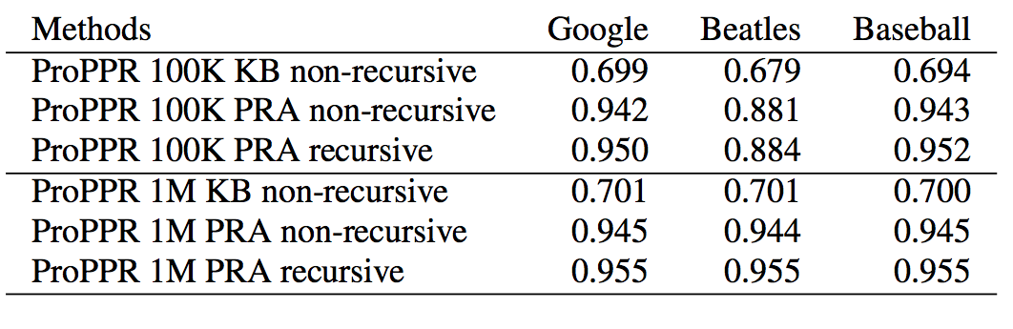
Results: AUC on test data varying KB size
* KBs overlap a lot at 1M entities

Slide 39
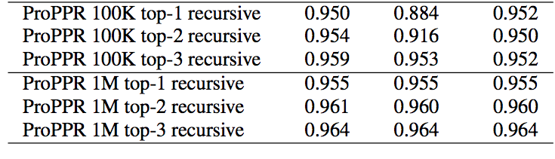
Results: AUC on test data varying theory size
 | 100k (rec) | 1M (rec)
top 1 | ~ 430-540 | ~ 550
top 2 | ~ 620-770 | ~ 800
top 3 | ~800-1000 | ~1000

Slide 40
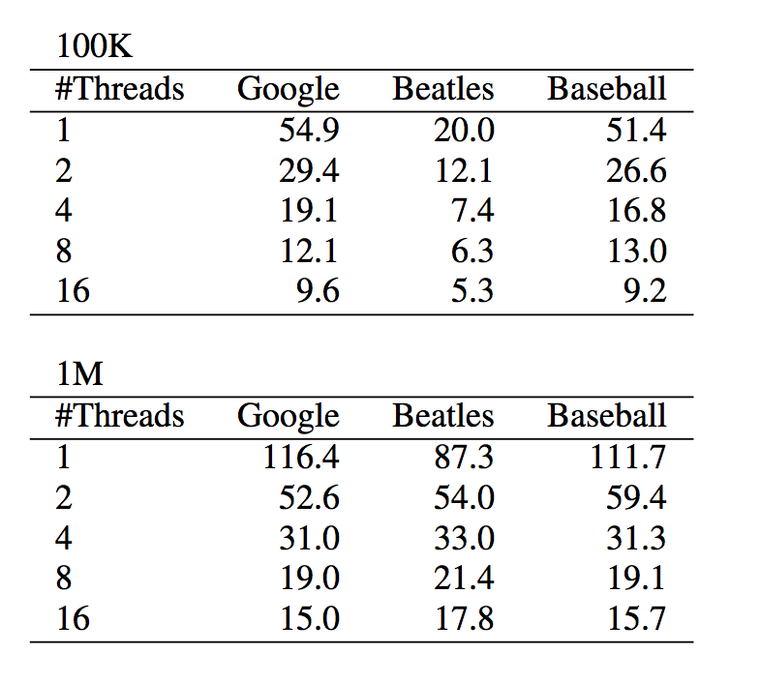
Results: training time in sec

Slide 41
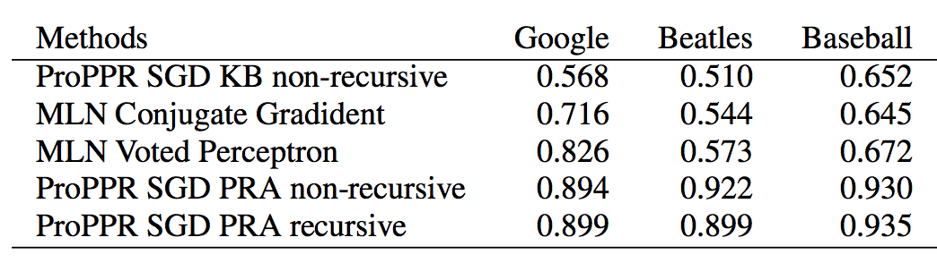
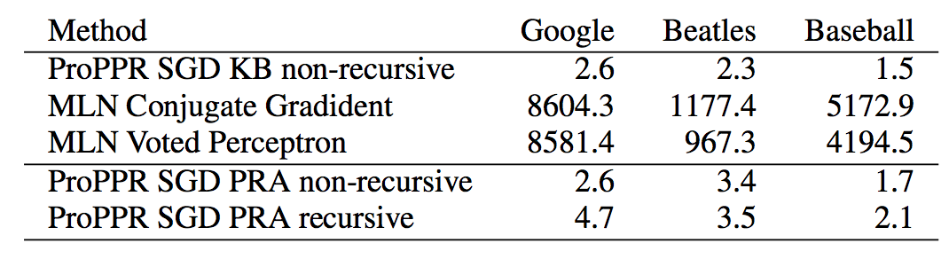
vs Alchemy/MLNs on 1k KB subset

Slide 42
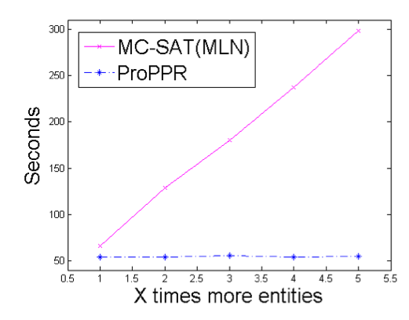
Results: training time in sec
inference time as a function of KB size: varying KB from 10k to 50k entities

Slide 43
Outline
Background: information extraction and NELL
Key ideas in NELL
  Coupled learning
  Multi-view, multi-strategy learning
Inference in NELL
  Inference as another learning strategy
    Learning in graphs
    Path Ranking Algorithm
    ProPPR
  Structure learning in ProPPR
Conclusions & summary

Slide 44
Structure learning for ProPPR
So far: we’re doing parameter learning on rules learned by PRA and “forced” into a recursive program ☹
Goal: learn structure of rules directly
  Learn rules for many relations at once
  Every relation can call others recursively
Challenges in prior work:
  Inference is expensive!
    often approximated, using ~= pseudo-likelihood
  Search space for structures is large and discrete
until now….

Slide 45
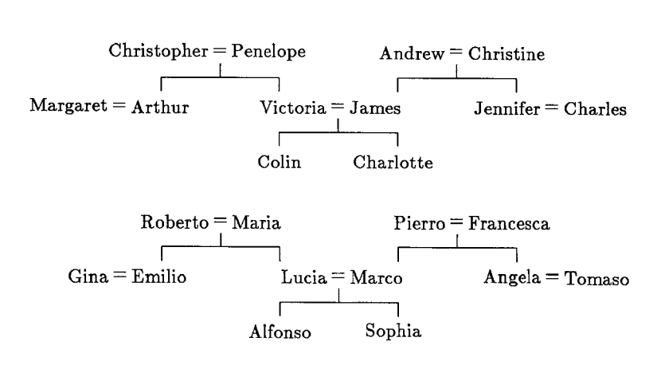
Structure Learning: Example
two families and 12 relations: brother, sister, aunt, uncle, …

Slide 46
Structure Learning: Example
two families and 12 relations: brother, sister, aunt, uncle, …
corresponds to 112 “beliefs”: wife(christopher,penelope), daughter(penelope,victoria), brother(arthur,victoria), …
and 104 “queries”: uncle(charlotte,Y) with positive and negative “answers”: [Y=arthur]+, [Y=james]-, …
experiment:
repeat n times
hold out four test queries
for each relation R:
  learn rules predicting R from the other relations
test

Slide 47
Structure Learning: Example
two families and 12 relations: brother, sister, aunt, uncle, …
Result:
7/8 tests correct (Hinton 1986)
78/80 tests correct (Quinlan 1990, FOIL)
but…..
experiment:
repeat n times
hold out four test queries
for each relation R:
  learn rules predicting R from the other relations
test

Slide 48
Structure Learning: Example
two families and 12 relations: brother, sister, aunt, uncle, …
New experiment (1):
One family is train, one is test
For each relation R:
  learn rules defining R in terms of all other relations Q1,…,Qn
Result: 100% accuracy! (with FOIL, c 1990)
Alchemy with structure learning is also perfect on 11/12 relations
The Qi’s are background facts / extensional predicates / KB
R for train family are the training queries / intensional preds
R for test family are the test queries

Slide 49
Structure Learning: Example
two families and 12 relations: brother, sister, aunt, uncle, …
New experiment (2):
One family is train, one is test
For relation pairs R1,R2
  learn (mutually recursive) rules defining R1 and R2 in terms of all other relations Q1,…,Qn
Result: 0% accuracy! (with FOIL, c 1990)
Why?
R1/R2 are pairs: wife/husband, brother/sister, aunt/uncle, niece/nephew, daughter/son

Slide 50
Structure Learning: Example
two families and 12 relations: brother, sister, aunt, uncle, …
New experiment (2):
One family is train, one is test
For relation pairs R1,R2
  learn (mutually recursive) rules defining R1 and R2 in terms of all other relations Q1,…,Qn
Result: 0% accuracy! (with FOIL, c 1990)
Why?
In learning R1, FOIL approximates meaning of R2 using the examples not the partially learned program
Typical FOIL result:
uncle(A,B) ⬅ husband(A,C),aunt(C,B)
aunt(A,B) ⬅ wife(A,C),uncle(C,B)
Alchemy uses pseudo-likelihood, gets 27% MAP on test queries

Slide 51
Structure Learning: Example
two families and 12 relations: brother, sister, aunt, uncle, …
New experiment (3):
One family is train, one is test
Use 95% of the beliefs as KB
Use 100% of the training-family beliefs as training
Use 100% of the test-family beliefs as test
Like NELL: learning to complete a KB that has 5% missing data
Result: FOIL MAP is < 65%; Alchemy MAP is < 7.5%
Baseline MAP using incomplete KB: 96.4%

Slide 52
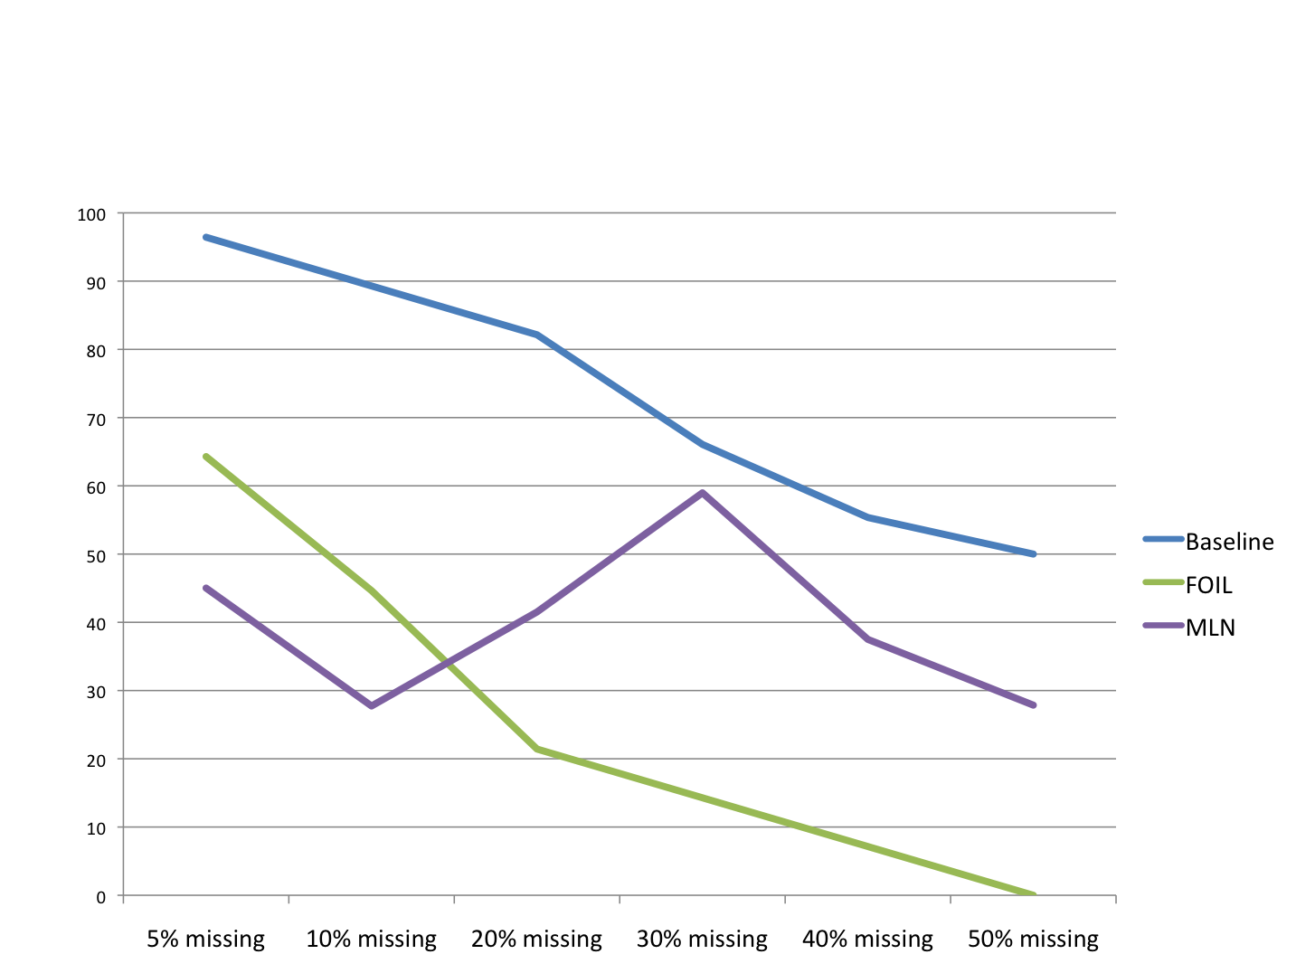
KB Completion

Slide 53
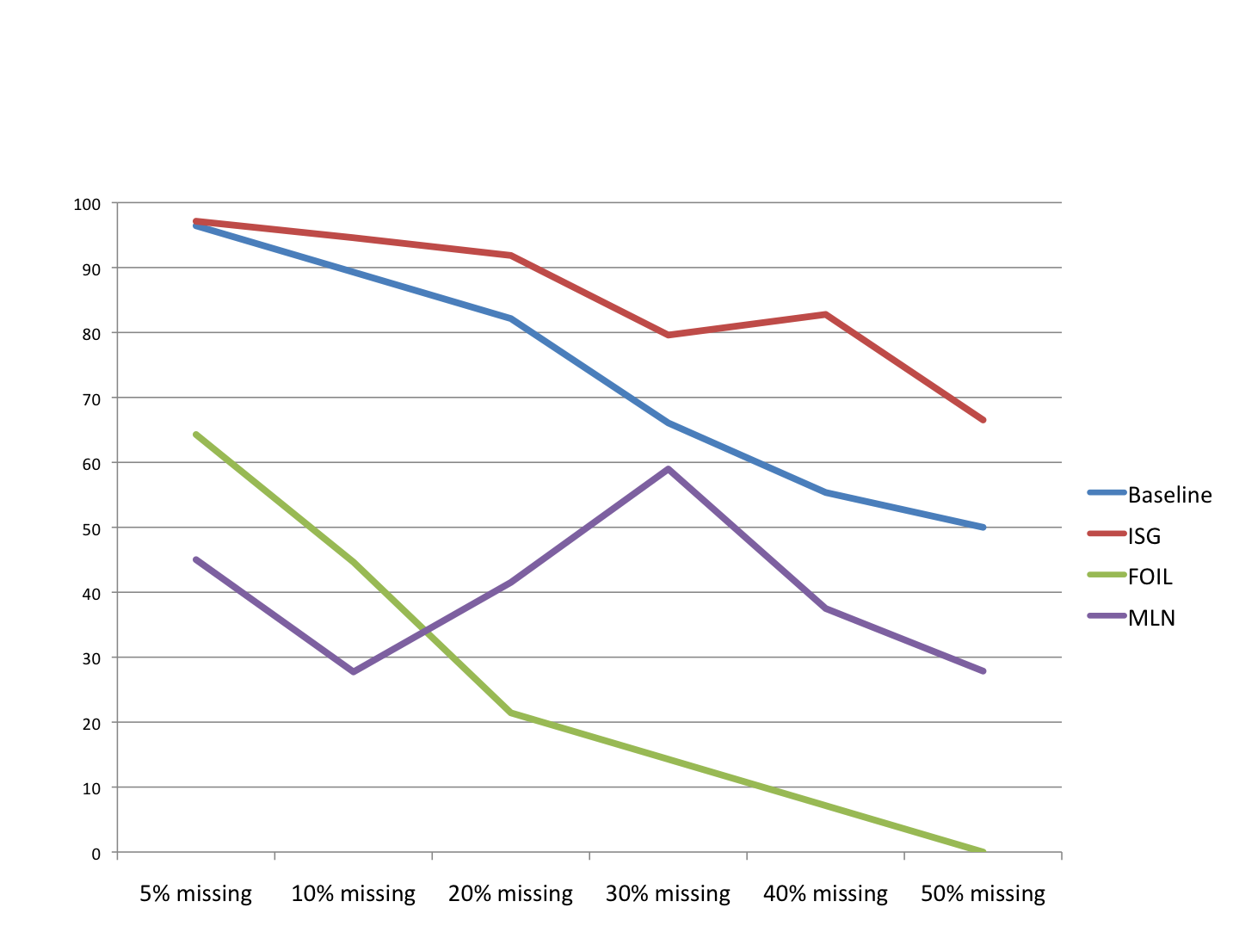
KB Completion
New algorithm

Slide 54
Structure learning for ProPPR
Goal: learn structure of rules
  Learn rules for many relations at once
  Every relation can call others recursively
Challenges in prior work:
  Inference is expensive!
    often approximated, using ~= pseudo-likelihood
  Search space for structures is large and discrete
until now….
➔ reduce structure learning to parameter learning via the “Metagol trick” [Muggleton et al]

Slide 55
The “Metagol” Approach
Start with an “abductive second order theory” that defines the space of structures.
Introduce minimal set of assumptions needed to prove that the positive examples are covered.
  Each assumption is about the existence of a rule in the learned theory.
Metagol uses iterative deepening to search for minimal assumptions (and hence theory) and learns a “hard” theory.
Here’s how we translate this to ProPPR…

Slide 56
The “Metagol” Approach
second-order | ProPPR
P(X,Y) :- R(X,Y) | interp(P,X,Y) :- interp0(R,X,Y), abduce_if(P,R).
P(X,Y) :- R(Y,X) | interp(P,X,Y) :- interp0(R,Y,X), abduce_ifInv(P,R).
P(X,Y) :- R1(X,Z),R2(Z,Y) | interp(P,X,Y) :- interp0(R1,Y,Z), interp0(R2,Z,Y), abduce_chain(P,R1,R2)
 | abduce_if(P,R) :- true # f_if(P,R) abduce_ifInv(P,R) :- true # f_ifInv(P,R) abduce_chain(P,R1,R2) :- true # f_chain(P,R1,R2) interp0(P,X,Y) :- kbContains(P,X,Y)

Slide 57
The “Metagol” Approach
second-order | ProPPR
P(X,Y) :- R(X,Y) | interp(P,X,Y) :- interp0(R,X,Y), abduce_if(P,R).
P(X,Y) :- R(Y,X) | interp(P,X,Y) :- interp0(R,Y,X), abduce_ifInv(P,R).
P(X,Y) :- R1(X,Z),R2(Z,Y) | interp(P,X,Y) :- interp0(R1,Y,Z), interp0(R2,Z,Y), abduce_chain(P,R1,R2)
 | abduce_if(P,R) :- true # f_if(P,R) abduce_ifInv(P,R) :- true # f_ifInv(P,R) abduce_chain(P,R1,R2) :- true # f_chain(P,R1,R2) interp0(P,X,Y) :- kbContains(P,X,Y)
interp(uncle,joe,Y)
interp0(R,Y,joe), abduce_ifInv(uncle,R)
kbContains(R,Y,joe), abduce_ifInv(uncle,R)
interp(uncle,joe,sam)
kbContains(nephew,sam,joe), abduce_ifInv(uncle,nephew)
true

Slide 58
The “Metagol” Approach
second-order | ProPPR
P(X,Y) :- R(Y,X) | interp(P,X,Y) :- interp0(R,Y,X), abduce_ifInv(P,R).
 | abduce_ifInv(P,R) :- true # f_ifInv(P,R)
interp(uncle,joe,Y)
interp0(R,Y,joe), abduce_ifInv(uncle,R)
kbContains(R,Y,joe), abduce_ifInv(uncle,R)
uncle(joe,sam)
kbContains(nephew,sam,joe), abduce_ifInv(uncle,nephew)
f_ifInv(uncle,nephew)
true

Slide 59
The “Metagol” Approach
second-order | ProPPR
P(X,Y) :- R(X,Y) | interp(P,X,Y) :- interp0(R,X,Y), abduce_if(P,R).
P(X,Y) :- R(Y,X) | interp(P,X,Y) :- interp0(R,Y,X), abduce_ifInv(P,R).
P(X,Y) :- R1(X,Z),R2(Z,Y) | interp(P,X,Y) :- interp0(R1,Y,Z), interp0(R2,Z,Y), abduce_chain(P,R1,R2)
 | abduce_if(P,R) :- true # f_if(P,R) abduce_ifInv(P,R) :- true # f_ifInv(P,R) abduce_chain(P,R1,R2) :- true # f_chain(P,R1,R2) interp0(P,X,Y) :- kbContains(P,X,Y)
Proof will follow a 2-step PRA-style path and then introduce a feature naming it.
Longer paths, etc: a few more second-order rules.

Slide 60
Iterated Structural Gradient: Idea
Main idea:
  Features (and parameters) in the second-order theory ~= first-order rules
  But, the second-order theory is much slower:
    Second-order: do a random walk (interpret a clause), and then accept (or more likely reject) it
    First-order: just use the clauses you need
  So: interleave gradient steps in the second-order theory with addition of the corresponding first-order rules for parameters with useful gradients
    But translate these rules into the second-order syntax….

Slide 61
Iterated Structural Gradient: Algorithm
For t=1,…
  Compute gradient of loss for the second-order theory
  See which features reduce loss: f_if(p,q), f_ifInv(q,p), f_chain(p,q,r), ….
  Add the corresponding rules to the “second-order” theory: p(X,Y) :- q(X,Y), p(X,Y):-q(Y,X), p(X,Y):-q(Y,Z),r(Z,Y), ..

Slide 62
The “Metagol” Approach: Example
second-order | ProPPR
P(X,Y) :- R(X,Y) | interp(P,X,Y) :- interp0(R,X,Y), abduce_if(P,R).
P(X,Y) :- R(Y,X) | interp(P,X,Y) :- interp0(R,Y,X), abduce_ifInv(P,R).
P(X,Y) :- R1(X,Z),R2(Z,Y) | interp(P,X,Y) :- interp0(R1,Y,Z), interp0(R2,Z,Y), abduce_chain(P,R1,R2)
 | abduce_if(P,R) :- true # f_if(P,R) abduce_ifInv(P,R) :- true # f_ifInv(P,R) abduce_chain(P,R1,R2) :- true # f_chain(P,R1,R2) interp0(P,X,Y) :- kbContains(P,X,Y) interp0(uncle,X,Y) :- interp0(nephew,Y,X)
f_inv(uncle,nephew)

Slide 63
Iterated Structural Gradient
For t=1,…
  Compute gradient of loss of the second-order theory
  See which features reduce loss: f_if(p,q), f_ifInv(q,p), f_chain(p,q,r), ….
  Add the corresponding rules to the “second-order” theory
  Repeat…until no more rules are added
Discard second-order rules and re-learn parameter weights.

Slide 64
Iterated Structural Gradient: Example
Iteration 1:
interp0(aunt,X,Y) :- kb(sister,X,Z), kb(father,Z,Y).
interp0(uncle,X,Y) :- kb(brother,X,Z), kb(mother,Z,Y).
interp0(aunt,X,Y) :- kb(nephew,Y,X).
interp0(aunt,X,Y) :- kb(niece,Y,X).
interp0(uncle,X,Y) :- kb(nephew,Y,X).
interp0(uncle,X,Y) :- kb(niece,Y,X).
Iteration 2:
interp0(aunt,X,Y) :- kb(wife,X,Z), interp0(uncle,Z,Y).
interp0(uncle,X,Y) :- kb(husband,X,Z), interp0(aunt,Z,Y).
interp0(aunt,X,Y) :- kb(wife,X,Z), interp0(aunt,Z,Y).
interp0(uncle,X,Y) :- kb(husband,X,Z), interp0(uncle,Z,Y).
interp0(aunt,X,Y) :- interp0(uncle,X,Y).
interp0(uncle,X,Y) :- interp0(aunt,X,Y).
interp0(aunt,X,Y) :- interp0(aunt,X,Y).
interp0(uncle,X,Y) :- interp0(uncle,X,Y).
Overgeneral – but recall we’re counting proofs and ranking
Seem useful since we’re still overgeneralized & confused about aunts vs. uncles
Mostly harmless

Slide 65
Results on Family Relations
 | FOIL | Grad | MLN | SG | ISG
father+mother | 0.0 | 23.32 | 42.53 | 70.05 | 100.0
husband+wife | 0.0 | 4.73 | 3.20 | 39.63 | 79.4
daughter+son | 0.0 | 11.49 | 22.74 | 70.05 | 100.0
sister+brother | 0.0 | 3.29 | 10.37 | 62.18 | 78.85
uncle+aunt | 0.0 | 10.41 | 53.35 | 79.41 | 100.0
niece+nephew | 0.0 | 6.49 | 28.54 | 72.25 | 80.09
average | 0.0 | 9.96 | 26.79 | 65.60 | 89.70

Slide 66
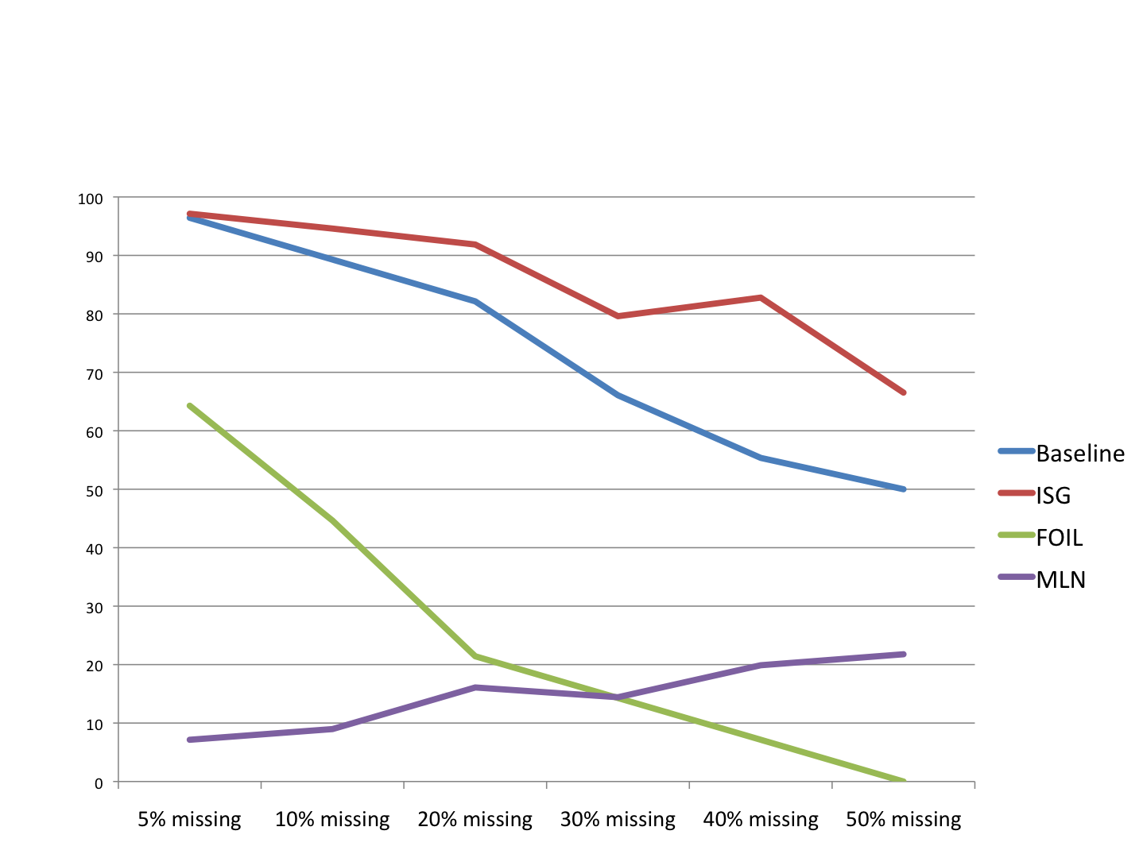
KB Completion

Slide 67
Summary of this section
Background: where we’re coming from
ProPPR: the first-order extension of our past work
Parameter learning in ProPPR
  small-scale
  medium-large scale
Structure learning for ProPPR
  small-scale
  medium-scale …

Slide 68
Completing the NELL KB
DB = Subsets of NELL’s KB
  Subsets selected as before
Theory – learned via ISG
  Randomly-selected N beliefs used for training
  Disjoint set of N beliefs used for test
    No negative information used!
  Rest used as background/KB
We’re testing activity of completing a (noisy) KB: not (yet) the correctness of the beliefs

Slide 69
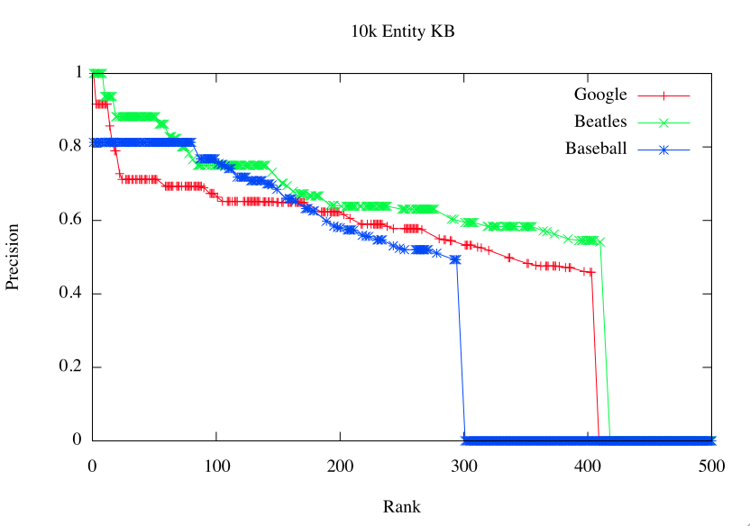

Slide 70
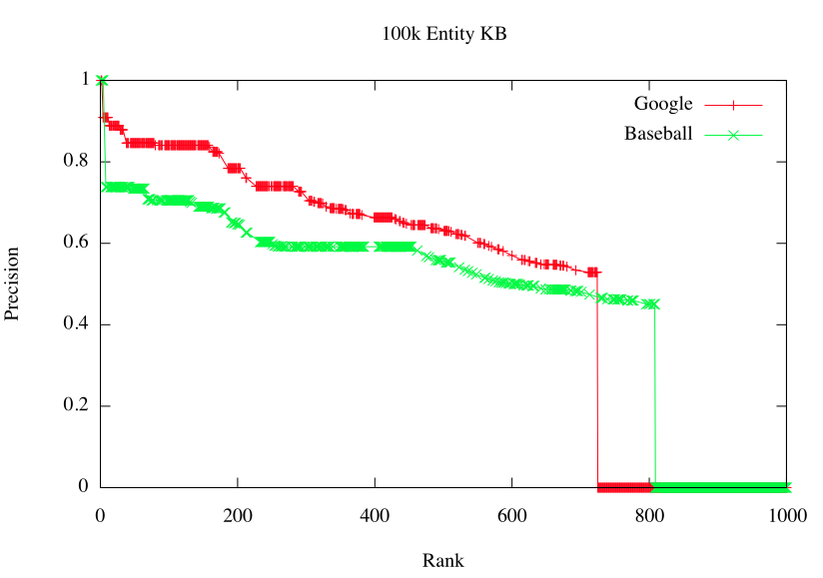

Slide 71
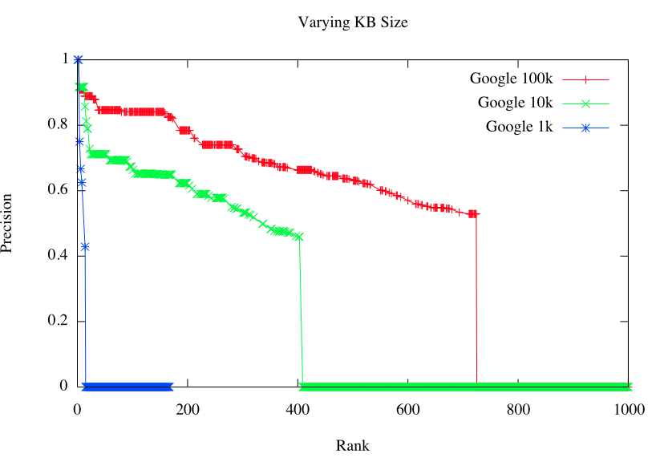

Slide 72
Outline
Background: information extraction and NELL
Key ideas in NELL
  Coupled learning
  Multi-view, multi-strategy learning
Inference in NELL
  Inference as another learning strategy
    Learning in graphs
    Path Ranking Algorithm
    ProPPR
  Structure learning in ProPPR
Conclusions & summary

Slide 73
Summary
What can you do with a large real-world KB?
  Probabilistic inference: derive new facts from it, using plausible inference rules
  Structure learning: learn plausible inference rules from data
Probabilistic inference is very challenging
  … especially when you’re interested in scaling
  Existing systems are restricted to inference over small KBs, highly restricted logics, or both
  Big problem: the grounding problem (translation to a non-first order representation)
  Structural learning is challenging²

Slide 74
Summary
ProPPR is an efficient first-order probabilistic logic
  Queries are “locally grounded”—i.e., converted to a small O(1/αε) subset of the full KB.
  Inference is a random-walk process on a graph (with edges labeled with feature-vectors, derived from the KB/queries)
  Consequence: inference is fast, even for large KBs and parameter-learning can be parallelized.
Parameter learning improves from hours to seconds and scales from KBs with thousands of entities to millions of entities.

Slide 75
Summary
ProPPR is an efficient first-order probabilistic logic
  Queries are “locally grounded”—i.e., converted to a small O(1/αε) subset of the full KB.
  Inference is a random-walk process on a graph (with edges labeled with feature-vectors, derived from the KB/queries)
  Consequence: inference is fast, even for large KBs and parameter-learning can be parallelized.
Parameter learning improves from hours to seconds and scales from KBs with thousands of entities to millions of entities.
We can now attack structure learning with full inference in the “inner loop”
  Using the “Metagol trick” to reduce structure learning to parameter learning

Slide 76
Future Work on ProPPR
Other joint-learning applications
More memory-efficient structures, integrating external classifiers, etc
Constrained learning
  currently learning can push reset weights too low
Learning better-integrated with proofs
  currently learning uses power-iteration computation for PPR, not approximation scheme used in theorem-proving

Slide 77

Thank You!

Slide 78
Backup Slides

Slide 79
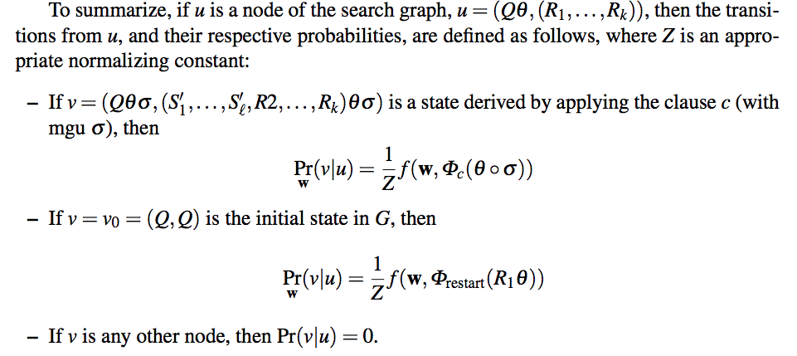
Backup Slides - Proof Space

Slide 80
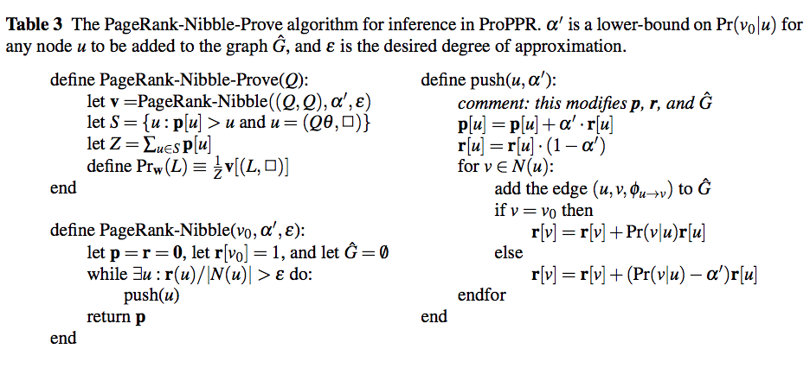
Backup Slides - Approximate Proofs

Slide 81
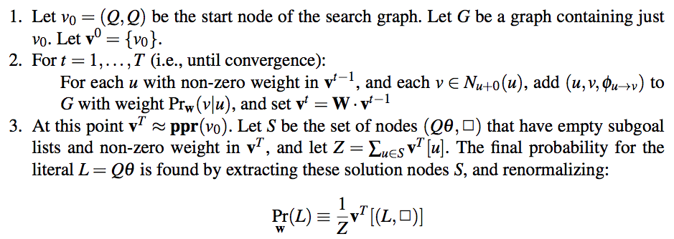
Backup Slides - Exact Proofs

Slide 82

Backup Slides - Loss

