Slide 1
Learning to Extract a Broad-Coverage Knowledge Base from the Web
William W. Cohen
Carnegie Mellon University
Machine Learning Dept and Language Technology Dept

Slide 2
Learning to Extract a Broad-Coverage Knowledge Base from the Web
William W. Cohen
joint work with:
Tom Mitchell, Richard Wang, Frank Lin, Ni Lao, Estevam Hruschka, Jr., Burr Settles, Derry Wijaya, Edith Law, Justin Betteridge, Jayant Krishnamurthy,
Bryan Kisiel, Andrew Carlson, Weam Abu Zaki

Slide 3
Outline
Web-scale information extraction:
  discovering factual by automatically reading language on the Web
NELL: A Never-Ending Language Learner
  Goals, current scope, and examples
Key ideas:
  Redundancy of information on the Web
  Constraining the task by scaling up
  Learning by propagating labels through graphs
Current and future directions:
  Additional types of learning and input sources

Slide 4
Information Extraction
Goal:
  Extract facts about the world automatically by reading text
  IE systems are usually based on learning how to recognize facts in text
    .. and then (sometimes) aggregating the results
    Latest-generation IE systems need not require large amounts of training
    … and IE does not necessarily require subtle analysis of any particular piece of text

Slide 5
Never Ending Language Learning (NELL)
NELL is a large-scale IE system
  Simultaneously learning 500-600 concepts and relations (person, celebrity, emotion, aquiredBy, locatedIn, capitalCityOf, ..)
  Starting point: containment/disjointness relations between concepts, types for relations, and O(10) examples per concept/relation
  Uses 500M web page corpus + live queries
  Running (almost) continuously for over a year
  Has learned more than 3.2M low-confidence “beliefs” and more than 500K high-confidence beliefs
    about 85% of high-confidence beliefs are correct

Slide 6
More details on corpus size
500 M English web pages
  25 TB uncompressed
  2.5 B sentences POS/NP-chunked
Noun phrase/context graph
  2.2 B noun phrases,
  3.2 B contexts,
  100 GB uncompressed;
  hundreds of billions of edges
After thresholding:
  9.8 M noun phrases, 8.6 M contexts

Slide 7
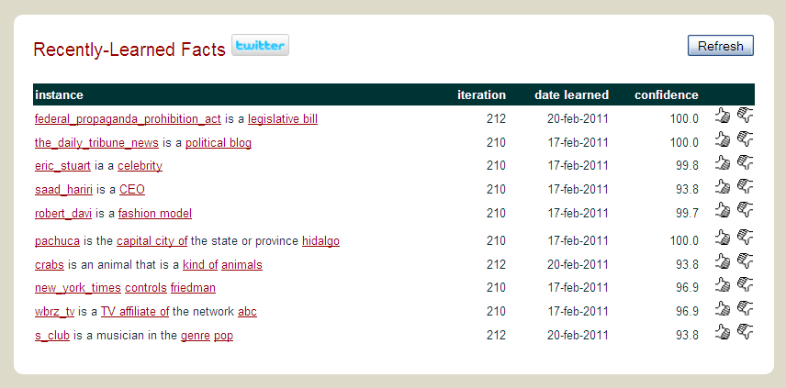
Examples of what NELL knows

Slide 8
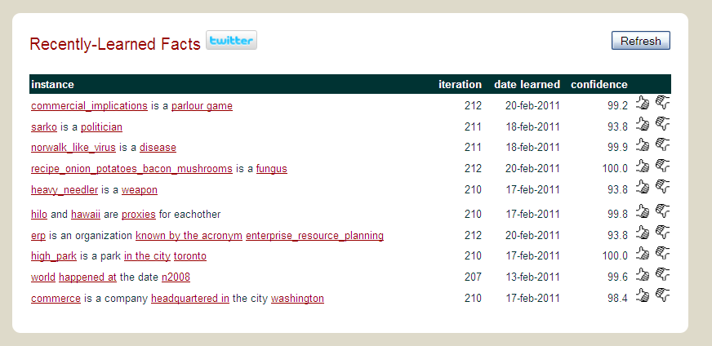
Examples of what NELL knows

Slide 9
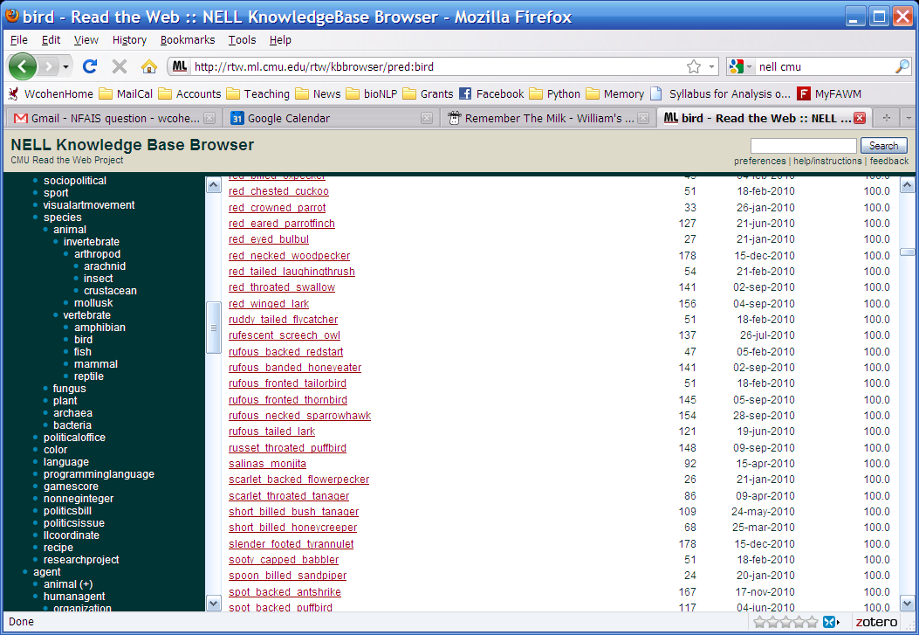
Examples of what NELL knows

Slide 10
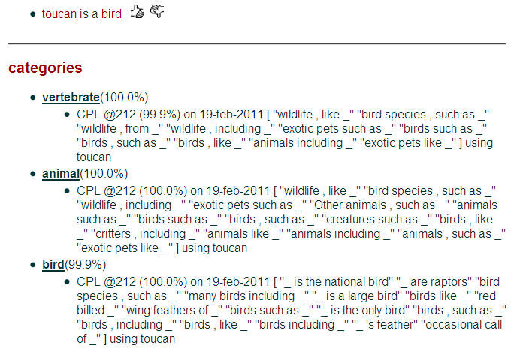

Slide 11
learned extraction patterns: playsSport(arg1,arg2)
arg1_was_playing_arg2 arg2_megastar_arg1 arg2_icons_arg1 arg2_player_named_arg1 arg2_prodigy_arg1 arg1_is_the_tiger_woods_of_arg2 arg2_career_of_arg1 arg2_greats_as_arg1 arg1_plays_arg2 arg2_player_is_arg1 arg2_legends_arg1 arg1_announced_his_retirement_from_arg2 arg2_operations_chief_arg1 arg2_player_like_arg1 arg2_and_golfing_personalities_including_arg1 arg2_players_like_arg1 arg2_greats_like_arg1 arg2_players_are_steffi_graf_and_arg1 arg2_great_arg1 arg2_champ_arg1 arg2_greats_such_as_arg1 …

Slide 12
Outline
Web-scale information extraction:
  discovering factual by automatically reading language on the Web
NELL: A Never-Ending Language Learner
  Goals, current scope, and examples
Key ideas:
  Redundancy of information on the Web
  Constraining the task by scaling up
  Learning by propagating labels through graphs
Current and future directions:
  Additional types of learning and input sources

Slide 13
Semi-Supervised Bootstrapped Learning
it’s underconstrained!!
Extract cities:
Paris
Pittsburgh
Seattle
Cupertino
San Francisco
Austin
denial
anxiety
selfishness
Berlin
mayor of arg1
live in arg1
arg1 is home of
traits such as arg1
Given: four seed examples of the class “city”

Slide 14
One Key to Accurate Semi-Supervised Learning
teamPlaysSport(t,s)
playsForTeam(a,t)
person
sport
playsSport(a,s)
team
coach(NP)
athlete
coach
coachesTeam(c,t)
NP
NP1
NP2
Krzyzewski coaches the Blue Devils.
Krzyzewski coaches the Blue Devils.
hard (underconstrained)
semi-supervised learning problem
much easier (more constrained)
semi-supervised learning problem
Easier to learn many interrelated tasks than one isolated task
Also easier to learn using many different types of information

Slide 15
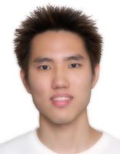
SEAL: Set Expander for Any Language
Another key: use lists and tables as well as text
Seeds
Extractions
Single-page Patterns
…
…
ford, toyota, nissan
…
honda
…
…
*Richard C. Wang and William W. Cohen: Language-Independent Set Expansion of Named Entities using the Web. In Proceedings of IEEE International Conference on Data Mining (ICDM 2007), Omaha, NE, USA. 2007.

Slide 16

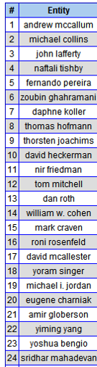
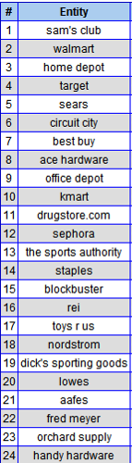
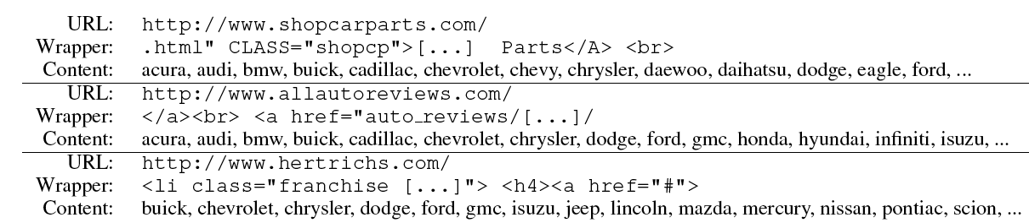
Extrapolating user-provided seeds
Set expansion (SEAL):
  Given seeds (kdd, icml, icdm), formulate query to search engine and collect semi-structured web pages
  Detect lists on these pages
  Merge the results, ranking items “frequently” occurring on “good” lists highest
  Details: Wang & Cohen ICDM 2007, 2008; EMNLP 2008, 2009
Notes:
These are ranked lists – so somehow ijcai is more like the kdd conference than stoc is, and mango is a better tropical fruit than a tamgerine.

Slide 17
evidence integration, self reflection
CBL
text extraction patterns
SEAL
HTML extraction patterns
Morph
Morphologybased extractor
RL
learned inference rules
Ontology and populated KB
the Web

Slide 18
Outline
Web-scale information extraction:
  discovering factual by automatically reading language on the Web
NELL: A Never-Ending Language Learner
  Goals, current scope, and examples
Key ideas:
  Redundancy of information on the Web
  Constraining the task by scaling up
  Learning by propagating labels through graphs
Current and future directions:
  Additional types of learning and input sources

Slide 19
Semi-Supervised Bootstrapped Learning
Extract cities:
Paris
Pittsburgh
Seattle
Cupertino
San Francisco
Austin
denial
anxiety
selfishness
Berlin
mayor of arg1
live in arg1
arg1 is home of
traits such as arg1

Slide 20
Semi-Supervised Bootstrapped Learning vs Label Propagation
mayor of arg1
arg1 is home of
San Francisco
Austin
Paris
Pittsburgh
anxiety
live in arg1
traits such as arg1
denial
selfishness
Seattle

Slide 21
Semi-Supervised Bootstrapped Learning as Label Propagation
mayor of arg1
arg1 is home of
Information from other categories tells you “how far” (when to stop propagating)
San Francisco
Austin
Paris
Pittsburgh
anxiety
traits such as arg1
live in arg1
traits such as arg1
arrogance
denial
selfishness
denial
selfishness
Seattle
Nodes “near” seeds
Nodes “far from” seeds

Slide 22
Semi-Supervised Learning as Label Propagation on a (Bipartite) Graph
mayor of arg1
Propagation methods: “personalized PageRank” (aka damped PageRank, random-walk-with-reset)
arg1 is home of
San Francisco
Austin
Paris
Pittsburgh
Propagate labels to nearby nodes
X is “near” Y if there is a high probability of reaching X from Y with a random walk where each step is either (a) move to a random neighbor or (b) jump back to start node Y, if you’re at an NP node
  rewards multiple paths
  penalizes long paths
  penalizes high-fanout paths
anxiety
live in arg1
traits such as arg1
denial
selfishness
Seattle
I like arg1
beer

Slide 23
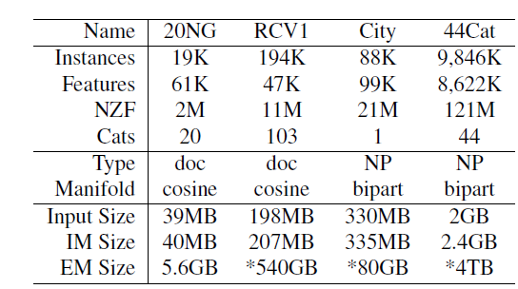
Semi-Supervised Bootstrapped Learning as Label Propagation
Co-EM (semi-supervised method used in NELL) is equivalent to label propagation using harmonic functions
  Seeds have score 1; score of other nodes X is weighted average of neighbors’ scores
  Edge weight between NP node X and NP node Y is inner product of context features, weighted by inverse frequency
Similar to, but different than Personalized PageRank/RWR
Compute edge weights
  On-the-fly from features
  Huge reduction in cost
Both very easy to parallelize

Slide 24
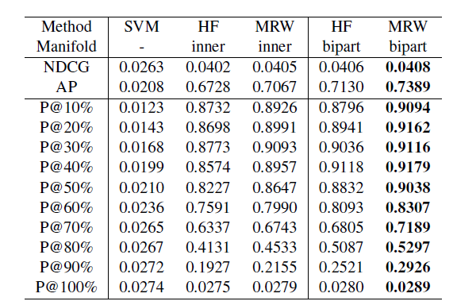
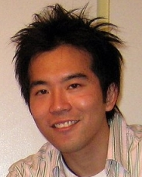
Comparison on “City” data
Start with city lexicon
Hand-label entries based on typical contexts
  Is this really a city? Boston, Split, Drug, ..
Evaluate using this as gold standard
Supervised
With 21
examples
coEM (current)
PageRank
based
With 21 seeds
[Frank Lin & Cohen, current work]

Slide 25
Another example of propagation:
Extrapolating seeds in SEAL
Set expansion (SEAL):
  Given seeds (kdd, icml, icdm), formulate query to search engine and collect semi-structured web pages
  Detect lists on these pages
  Merge the results, ranking items “frequently” occurring on “good” lists highest
  Details: Wang & Cohen ICDM 2007, 2008; EMNLP 2008, 2009
Notes:
These are ranked lists – so somehow ijcai is more like the kdd conference than stoc is, and mango is a better tropical fruit than a tamgerine.

Slide 26
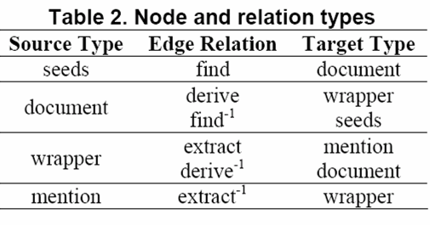
List-merging using propagation on a graph
“ford”, “nissan”, “toyota”
Wrapper #2
find
extract
northpointcars.com
curryauto.com
derive
“chevrolet”
22.5%
“volvo chicago”
8.4%
“honda”
26.1%
Wrapper #1
Wrapper #3
Wrapper #4
“acura”
34.6%
“bmw pittsburgh”
8.4%
A graph consists of a fixed set of…
  Node Types: {seeds, document, wrapper, mention}
  Labeled Directed Edges: {find, derive, extract}
    Each edge asserts that a binary relation r holds
    Each edge has an inverse relation r⁻¹ (graph is cyclic)
  Intuition: good extractions are extracted by many good wrappers, and good wrappers extract many good extractions
  Good ranking scheme: find mentions “near” the seeds
Notes:
I will go through the steps of building a graph that contains all elements of interest: seeds, document, wrapper, and mentions.
First, the seeds find some documents from the Web. <@>
Then the documents derive some wrappers; <@> they are also found by the seeds.
The wrappers then extract some entity mentions; <@> they are also derived by the documents.
<@> Lastly, the mentions are extracted by the wrappers.
In brief, a graph consists of a fixed set of node types: seeds, document, wrapper, mention, and a fixed set of labeled directed edges: find, derive, extract.
Each edge asserts that a binary relation holds, and also asserts that the inverse of that binary relation holds, with the edge directed in the opposite direction.
This also ensure that the graph is cyclic.
This framework for building graphs was previously published in Einat and William’s SIGIR 2006 paper.
The percentage on the mention nodes are the probabilities assigned due to graph walk.
As expected, noisy entity mentions volvo chicago and bmw pittsburgh are assigned the least weight.
One of many reasons is that they have fewer incoming edges.
I will explain to you how these probability weights are computed in the next slide.

Slide 27
Outline
Web-scale information extraction:
  discovering factual by automatically reading language on the Web
NELL: A Never-Ending Language Learner
  Goals, current scope, and examples
Key ideas:
  Redundancy of information on the Web
  Constraining the task by scaling up
  Learning by propagating labels through graphs
Current and future directions:
  Additional types of learning and input sources

Slide 28
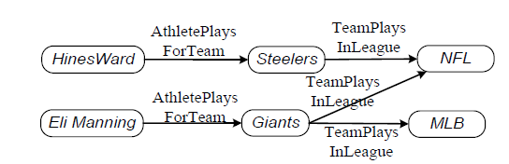
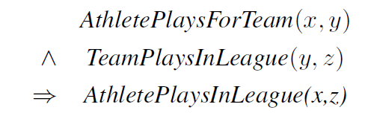
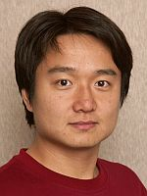
Learning to reason from the KB
Learned KB is noisy, so chains of logical inference may be unreliable.
How can you decide which inferences are safe?
Approach:
  Combine graph proximity with learning
  Learn which sequences of edge labels usually lead to good inferences
[Ni Lao, Cohen, Mitchell – current work]

Slide 29
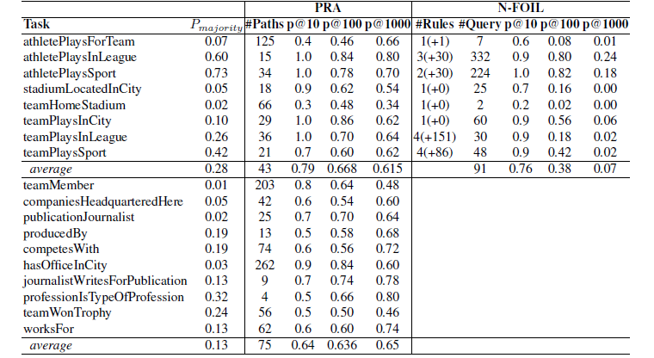
Results

Slide 30
Semi-Supervised Bootstrapped Learning vs Label Propagation
mayor of arg1
arg1 is home of
San Francisco
Austin
Paris
Pittsburgh
anxiety
live in arg1
traits such as arg1
denial
selfishness
Seattle

Slide 31
Semi-Supervised Bootstrapped Learning vs Label Propagation
mayor of arg1
Paris’s new show
mayor of Paris
mayor of Pittsburgh
Paris
Pittsburgh
live in Paris
mayor of San Francisco
live in Pittsburgh
live in arg1
San Franciso
Basic idea: propogate labels from context-NP pairs and classify NP’s in context, not NP’s out-of-context.
Challenge: Much larger (and sparser) data

Slide 32
Looking forward
Huge value in mining/organizing/making accessible publically available information
Information is more than just facts
  It’s also how people write about the facts, how facts are presented (in tables, …), how facts structure our discourse and communities, …
  IE is the science of all these things
NELL is based one premise that doing it right means scaling
  From small to large datasets
  From fewer extraction problems to many interrelated problems
  From one view to many different views of the same data

Slide 33
Thanks to:
Tom Mitchell and other collaborators
  Frank Lin, Ni Lao, (alumni) Richard Wang
DARPA, NSF, Google, the Brazilian agency CNPq (project funding)
Yahoo! and Microsoft Research (fellowships)

