Slide 1
Symbolic/Neural Reasoning With Declarative Knowledge
William W Cohen
Machine Learning Department
Carnegie Mellon University / Google
joint with
Fan Yang, Zhilin Yang, Kathryn Rivard Mazaitis

Slide 2
What is intelligence?
Sensing
vision, sound, language, …
Learning
from experience
from instruction/programming
Reasoning
Acting

Slide 3
What is intelligence?
Sensing
vision, sound, language, …
Learning
from experience
from instruction/programming
Reasoning
Acting
e.g., declarative knowledge as facts and rules
very mature solutions

Slide 4
What is intelligence?
Sensing
vision, sound, language, …
Learning
from experience
from instruction/programming
Reasoning
Acting

Slide 5
What is intelligence?
Sensing
vision, sound, language, …
Learning
from experience
from instruction/programming
Reasoning
Acting
Neural methods
declarative knowledge as facts and rules ???
soft implicit knowledge as parameters and architecture
(hard) explicit knowledge

Slide 6
How do we bridge the divide?
Sensing
vision, sound, language, …
Learning
from experience
from instruction/programming
Reasoning
Acting
Neural methods
Symbolic
methods
Knowledge
Graphs,
KBs, DBs,
inference rules, business rules, …
soft implicit knowledge as parameters and architecture
(hard) explicit knowledge

Slide 7
How do we bridge the divide?
This talk: a neural probabilistic database system
Rules and “soft” facts
Inference is differentiable and scalable
Data and inference rules are compiled into a neural backend (e.g., Tensorflow, Theano)
You can learn weights for DB facts
You can call out to neural models in the rules, or vice versa
You can learn the inference rules themselves

Slide 8
Outline: Learning and Reasoning with TensorLog
Background:
knowledge graphs and deductive DBs
standard approach: first-order reasoning by “grounding” to propositions
TensorLog: reasoning and parameter-learning
semantics
sample problem
more experiments
Learning TensorLog rules
Conclusions

Slide 9
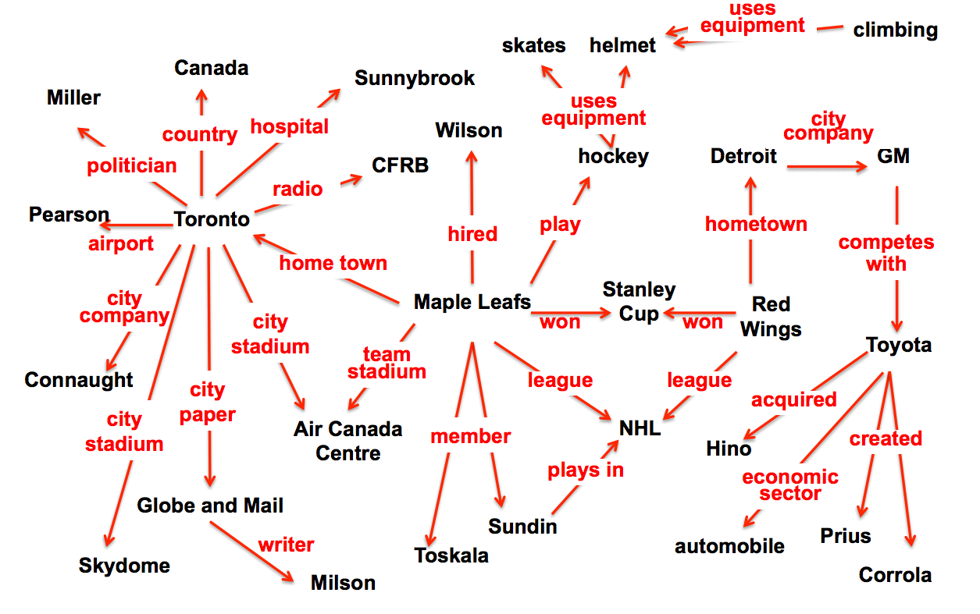
Background: Knowledge Graphs
A triple-based formalism (subject, object, verb) or relation(arg1, arg2) is a widely used scheme for expressing simple declarative knowledge
created(toyota,prius)

Slide 10
Background: Knowledge Graphs
Reasoning with a KG means performing inference: combining facts to form new ones.
Formalism TensorLog is built on:
a probabilistic deductive database
created(toyota,prius)

Slide 11
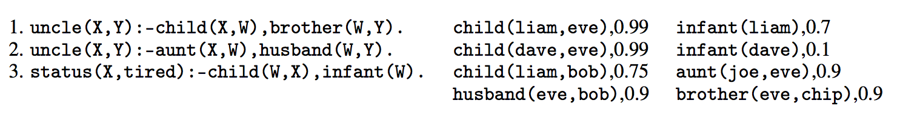
Background: PrDDB
DB facts: predicate(entity2,entity2)
DB is a knowledge graph = only unary and binary predicates

Slide 12
Background: PrDDB
rule syntax: variables in UpperCase
A :- B2,…,Bk means (B1 and … and Bk) ➔ A
assign_tired(tired), 1.0
Actually all constants/entities are only in the database.
Also, all numeric parameters are only in the database.

Slide 13
Background: PrDDB
Old trick: If you want to weight a rule you can introduce a rule-specific fact….
0.98
r3. status(X,tired) :- child(W,X), infant(W), weighted(r3).
weighted(r3),0.98
So learning rule weights is a special case of learning weights for selected DB facts.

Slide 14
Key question: how do you reason?
Lots of clever tricks for reasoning symbolically

Slide 15
Key question: how do you reason?
KBANN idea (1991): convert every DB fact, and every possible inferable fact, to a neuron.
Architecture and initial weights implement inference rules

Slide 16
Key question: how do you reason?
uncle(liam,dave)
uncle(liam,eve)
uncle(liam,chip)
possible inferences
σ(….)
σ(….)
σ(….)
child(liam,eve)
brother(eve,chip)
DB facts
child(liam,bob)
“Grounding” the rules

Slide 17
Explicit grounding is not scalable
Example: inferring family relations like “uncle”
N people
N² possible “uncle” inferences
N = 2 billion ➔ N² = 4 quintillion
N = 1 million ➔ N² = 1 trillion
A KB with 1M entities is small

Slide 18
Key question: how do you reason?
KBANN idea (1991): convert every DB fact, and every possible inferable fact, to a neuron.
Similar “grounding strategies” are used by nearly every soft logic: Markov Logic Networks, Probabilistic Soft Logic, …
A neuron for every possible inferable fact is “too many” --- i.e., bigger than the DB.

Slide 19
Key question: how do you reason?
TensorLog uses a knowledge-graph specific trick to get scalability:
“reasoning” means answering a query like: find all Y for which p(a,Y) is true for some given predicate p, query entity a (and rules and DB)
inferences for a logical theory can be encoded as a bunch of functions: for every p, f_{p}(a) returns a vector encoding answers y (and confidences)
actually we have functions for p(a,Y) and p(Y,a)….

Slide 20
Key question: how do you reason?
Example: inferring family relations like “uncle”
N people
N² possible “uncle” facts
N = 1 million ➔ N² = 1 trillion
f₁(x) = Y f₂(x) = Y
x is the nephew
x is the uncle
one-hot vectors
vectors encoding
weighted set of DB instances

Slide 21
Key question: how do you reason?
TensorLog uses a knowledge-graph specific trick…functions from sets of entities to sets of entities
Key idea: You can describe the reasoning process as a factor graph
Example: Let’s start with some example one-rule theories

Slide 22
TensorLog: Semantics 1/3
The set of proofs of a rule is encoded as a factor graph
Logical variable ➔ random variable; literal➔factor
Domain of random variable = DB entities; factors = DB relation
as sparse matrix
uncle(X,Y):-child(X,W),brother(W,Y)
X
W
brother
Y
child

Slide 23
TensorLog: Semantics 1/3
The set of proofs of a rule is encoded as a factor graph
Logical variable ➔ random variable; literal➔factor
status(X,tired):- parent(X,W),infant(W)
status(X,T):-
assign_tired(T),child(X,W),
infant(W)
uncle(X,Y):-child(X,W),brother(W,Y)
X
W
brother
Y
assign_tired
child
X
assign_r3
T
X
W
Y
child
R3
weight
aunt
husband
W
infant
uncle(X,Y):-aunt(X,W),husband(W,Y)
Key thing we can do now: weighted proof-counting

Slide 24
TensorLog: Semantics 1/3
Query: uncle(liam, Y) ?
General case for p(c,Y):
initialize the evidence variable X to a one-hot vector for c
wait for BP to converge
read off the message y that would be sent from the output variable Y.
un-normalized prob
y[d] is the weighted number of proofs supporting p(c,d) using this clause
uncle(X,Y):-child(X,W),brother(W,Y)
X
W
brother
Y
child
…
[liam=1]
[eve=0.99,bob=0.75]
[chip=0.99*0.9]
output msg for brother is sparse mat multiply: v_{W} M_{brother}
Key thing we can do now: weighted proof-counting

Slide 25
TensorLog: Semantics 1/3
For chain joins BP performs a random walk (like PRA [Lao & Cohen])
But we can handle more complex clauses as well
we assume factor graph is a polytree
status(X,T):-
const_tired(T),child(X,W),
infant(W)
uncle(X,Y):-child(X,W),brother(W,Y)
X
W
brother
Y
child
X
const_tired
T
X
W
Y
child
aunt
husband
W
infant
uncle(X,Y):-aunt(X,W),husband(W,Y)
Key thing we can do now: weighted proof-counting

Slide 26
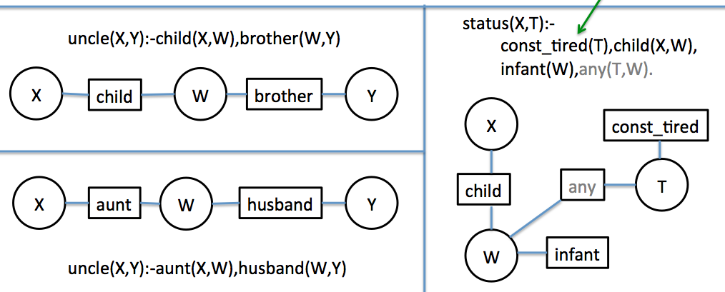
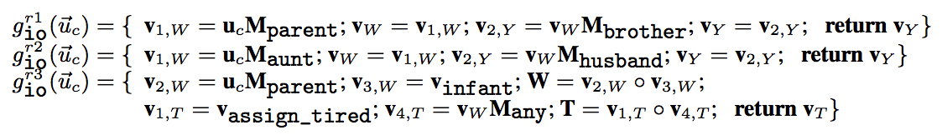
TensorLog: Semantics 2/3
Given a query type (inputs, and outputs) simulate BP on factor graph and record the series of messages that will be passed, given an input. This series of messages defines a function.
can run backprop on these

Slide 27
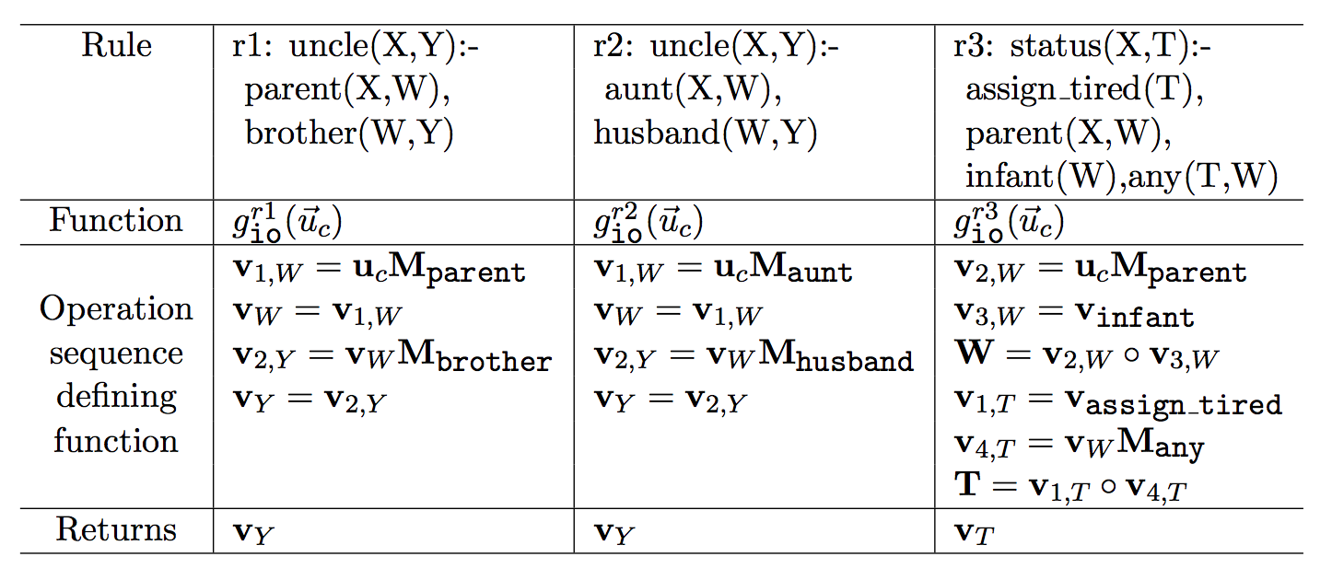

Slide 28
Key question: how do you reason?
TensorLog uses a knowledge-graph specific trick…functions from sets of entities to sets of entities
Key idea: You can describe the reasoning process as a factor graph
Example: Let’s start with some example one-rule theories
And then go on

Slide 29
TensorLog: Semantics 3/3
We can combine these functions compositionally:
multiple clauses defining the same predicate: add the outputs!
r1
g_{io}^{r1}(u) = { … return v_{Y;} }
g_{io}^{r2}(u) = { … return v_{Y;} }
r2
g_{io}^{uncle}(u) = g_{io}^{r1}(u) + g_{io}^{r2}(u)

Slide 30
TensorLog: Semantics 3/3
We can combine these functions compositionally:
defined predicate: replace the factor with a function call
r1
... = g_{aunt} (v_{W}); ….
g_{io}^{r2}(u) = { … = v_{w} M_{aunt} ; …. }
r2

Slide 31
TensorLog: Semantics 3/3
We can combine these functions compositionally:
defined predicate: replace the factor with a function call
recursive theory: unroll recursion to fixed max depth
r1
... = g_{aunt} (v_{W}); ….
g_{io}^{r2}(u) = { … = v_{w} M_{aunt} ; …. }
r2

Slide 32
TensorLog: Learning
Inference is via a numeric function: y = g_{io}^{uncle}(u_{a})
y encodes {b:uncle(a,b)} is true and y[b]=confidence in uncle(a,b)
Define loss(g_{io}^{uncle}(u_{a}), y*) = crossEntropy(softmax(g(x)),y*)
To adjust weights of a DB relation: dloss/dM_{brother}

Slide 33
Outline: Learning and Reasoning with TensorLog
Background:
knowledge graphs and deductive DBs
standard approach: first-order reasoning by “grounding” to propositions
TensorLog: reasoning and parameter-learning
semantics
sample problem
more experiments
Learning TensorLog rules
Conclusions

Slide 34
Example: factual Q/A from KG WikiMovies Dataset
who are the actors in Maria's Lovers? ['John Savage', 'Robert Mitchum', …]
who acted in the movie Wise Guys? ['Harvey Keitel', 'Danny DeVito', 'Joe Piscopo', …]
what is a film written by Luke Ricci? ['How to Be a Serial Killer']
what films did DeForest Kelley act in? ['Night of the Lepus']
when was the film Rise of the Zombies released? ['2012']
what movies are about eather graham? ['The Hangover', 'Swingers', 'Drugstore Cowboy', .. ]
who is the director that directed Tobacco Road? ['John Ford']
the film Faster, Pussycat! Kill! Kill! starred which actors? ['Lori Williams', 'Haji', …]
…
starred_actors Wise Guys Harvey Keitel
starred_actors Wise Guys Danny DeVito
starred_actors Wise Guys Joe Piscopo
starred_actors Wise Guys Ray Sharkey
directed_by Wise Guys Brian De Palma
has_genre Wise Guys Comedy
release_year Wise Guys 1986
…

Slide 35
Example: factual Q/A from a KB WikiMovies dataset
who acted in the movie Wise Guys? ['Harvey Keitel', 'Danny DeVito', 'Joe Piscopo', …]
what is a film written by Luke Ricci? ['How to Be a Serial Killer']
…
Data: from Miller, Fisch, Dodge, Karami, Bordes, Weston “Key-Value Memory Networks for Directly Reading Documents”
Questions: 96k train, 20k dev, 10k test Knowledge graph: 421k triples about 16k movies, 10 relations
Subgraph/question embedding:
93.5%
Key-value memory network:
93.9% “reading” the KG
76.2% by reading text of articles
starred_actors Wise Guys Harvey Keitel
starred_actors Wise Guys Danny DeVito
starred_actors Wise Guys Joe Piscopo
starred_actors Wise Guys Ray Sharkey
directed_by Wise Guys Brian De Palma
has_genre Wise Guys Comedy
release_year Wise Guys 1986
...
an initial retrieval process picks the set of
memories to start with that are relevant to
a question: KG triples or text passages

Slide 36
Solution: 2k rules and a classifier…
k = # relations in DB = 9
who acted in the movie Wise Guys? ['Harvey Keitel', 'Danny DeVito', 'Joe Piscopo', …]
what is a film written by Luke Ricci? ['How to Be a Serial Killer']
…
starred_actors Wise Guys Harvey Keitel
starred_actors Wise Guys Danny DeVito
starred_actors Wise Guys Joe Piscopo
starred_actors Wise Guys Ray Sharkey
directed_by Wise Guys Brian De Palma
has_genre Wise Guys Comedy
release_year Wise Guys 1986
…
written_by How to .. Killer Luke Ricci
has_genre How to .. Killer Comedy
...
answer(Question, Entity) :- mentions_entity(Question,Movie) & starred_actors(Movie,Entity) & question_type(Question, y1)
answer(Question, Movie) :-
mentions_entity(Question,Entity) & written_by(Movie,Entity) & question_type(Question, y9)
“forward” and “backward” rules
for each KB relation

Slide 37
Or: 2k rules with 2k soft predicates
k = # relations in DB = 9
who acted in the movie Wise Guys? ['Harvey Keitel', 'Danny DeVito', 'Joe Piscopo', …]
what is a film written by Luke Ricci? ['How to Be a Serial Killer']
…
starred_actors Wise Guys Harvey Keitel
starred_actors Wise Guys Danny DeVito
starred_actors Wise Guys Joe Piscopo
starred_actors Wise Guys Ray Sharkey
directed_by Wise Guys Brian De Palma
has_genre Wise Guys Comedy
release_year Wise Guys 1986
…
written_by How to .. Killer Luke Ricci
has_genre How to .. Killer Comedy
...
answer(Question, Entity) :- mentions_entity(Question,Movie) & starred_actors(Movie,Entity) & feature(Question,F),weight1f(F)
# w1f: relation 1 going “forward”
answer(Question, Movie) :-
mentions_entity(Question,Entity) & written_by(Movie,Entity) & feature(Question,F),weight9b(F)
# w9b: relation 9 going “backward”

Slide 38
Or: 2k rules with 2k soft predicates
k = # relations in DB = 9
who acted in the movie Wise Guys? ['Harvey Keitel', 'Danny DeVito', 'Joe Piscopo', …]
what is a film written by Luke Ricci? ['How to Be a Serial Killer']
…
answer(Question, Entity) :- mentions_entity(Question,Movie) & starred_actors(Movie,Entity) & feature(Question,F),weight1f(F)
weight for rule’s inferences =
weighted count of all proofs of it =
linear combination of assigned weights for this question type to all active features

Slide 39
Example: Factual Q/A with a KB
KB contains:
KB facts from Miller et al about movies (420k)
mentions_entity(question_id, entity_id) = extract longest exact-match entity names
has_feature(question_id,word_id) = set of words in the question (after stoplisting)
Adds about 853k triples (total about 1.3M)

Slide 40
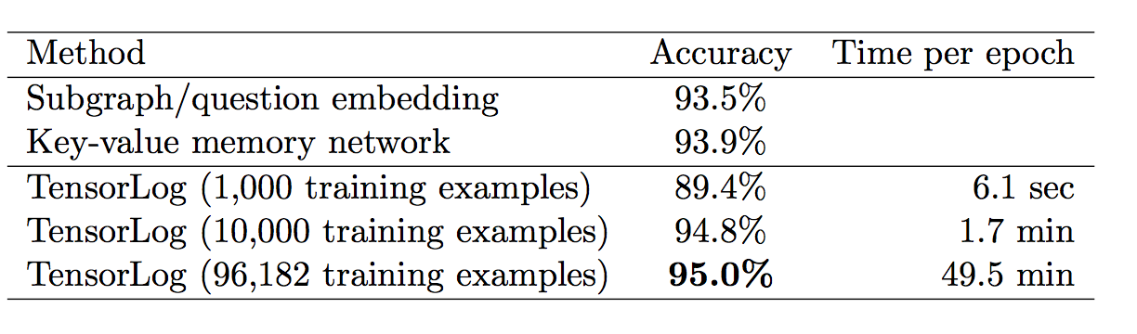
Example: Factual Q/A with a KB
Bigger differences:
memory network “works” with unstructured text instead of KB as input (with enough examples)
TensorLog allows you to update the KB declaratively

Slide 41
Example: Factual Q/A with a KB: in detail

Slide 42
import tensorflow as tf from tensorlog import simple KG_FILE = ‘tlog-format/train-1000.cfacts’ # tab separated values, verb subject object if __name__ == "__main__": # construct the rules for the tensorlog program b = simple.Builder() answer,mentions_entity,has_feature = b.predicates("answer mentions_entity has_feature") Question,Movie,Entity,F = b.variables("Question Movie Entity F") for rel in (‘directed_by’, ….): P = b.predicate(rel) Wb = b.predicate('wBack_%s' % rel) Wf = b.predicate('wFore_%s' % rel) b += (answer(Question,Movie) <= mentions_entity(Question,Entity) & P(Movie,Entity) & has_feature(Question,F) & Wb(F) ) b += (answer(Question,Entity) <= mentions_entity(Question,Movie) & P(Movie,Entity) & has_feature(Question,F) & Wf(F)
)
# create a tensorlog → tensorflow compiler tlog = simple.Compiler(db=KG_FILE, prog=b.rules) # could also specify a file containing the rules
Notes:
syntactic sugar to mark learnable parameters

Slide 43
mode = 'answer/io' #specifies the function we want to construct in Tensorflow
loss = tlog.loss(mode) # cross-entropy of softmax over outputs under the “count-the-reasons” semantics
optimizer = tf.train.AdagradOptimizer(1.0)
train_step = optimizer.minimize(loss)
train_data = tlog.load_big_dataset('tlog-format/train-1000.exam') # simple text format for KB
session = tf.Session()
session.run(tf.global_variables_initializer())
for i in range(10):
for batchmode,(x,y) in tlog.minibatches(train_data,batch_size=200):
assert str(batchmode)==str(mode)
train_batch_fd = {
tlog.input_placeholder_name(mode):x, tlog.target_output_placeholder_name(mode):y}
session.run(train_step, feed_dict=train_batch_fd)
# test the learned model
predicted_y = tlog.inference(mode)
actual_y = tlog.target_output_placeholder(mode)
correct_predictions = tf.equal(tf.argmax(actual_y,1), tf.argmax(predicted_y,1))
accuracy = tf.reduce_mean(tf.cast(correct_predictions, tf.float32))
test_data = tlog.load_small_dataset('tlog-format/test-1000.exam') # returns dict of (x,y) matrix pairs
x,y = test_data[mode]
test_batch_fd = {tlog.input_placeholder_name(mode):x, actual_y.name:y}
print 'test error',100*(1.0 - session.run(accuracy, feed_dict=test_batch_fd)),'%’

Slide 44
Inference times are very fast for a soft logic

Slide 45
TensorLog: Semantics vs Prior Work
TensorLog:
One random variable for each logical variable used in a proof.
Random variables are multinomials over the domain of constants.
Each literal in a proof [e.g., aunt(X,W)] is a factor.
Factor graph is linear in size of theory + depth of recursion
Message size = O(#DB constants)
Inference by differentiable function
KBANN, MLNs, most prior work
One random variable for each possible ground atomic literal [e.g. aunt(sue,bob)]
Random variables are binary (literal is true or false)
Varies: for MLN, a ground instance of a clause is a factor.
Factor graph is linear in the number of possible ground literals = O(#constants ^{arity} )
Messages are binary

Slide 46
TensorLog: Semantics vs Prior Work
TensorLog:
Use BP to count proofs
Language is constrained to messages are “small” and BP converges quickly.
Score for a fact is a potential (to be learned from data), and overlapping facts in explanations are ignored.
ProbLog2, ….probabilistic DBs
Use logical theorem proving to find all “explanations” (minimal sets of supporting facts)
This set can be exponentially large
Tuple-independence: each DB fact is independent probability ➔ scoring a set of overlapping explanations is NP-hard.

Slide 47
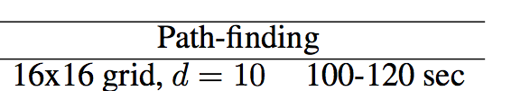
More Experiments
Inference speed vs ProbLog2 (de Raedt et al)
ProbLog2 uses the tuple-independence model
x
 |  |  | y
Each edge is a DB fact
Many proofs of path(x,y)
Proofs reuse the same DB tuples
Keeping track of all the proofs and tuple-reuse is expensive….
path(X,Y) :- edge(X,Y)
path(X,Y) :- edge(X,Z),path(Z,Y)

Slide 48
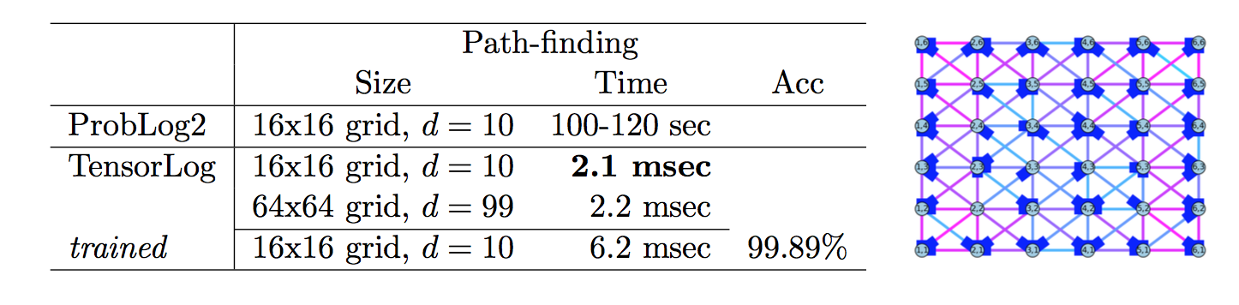
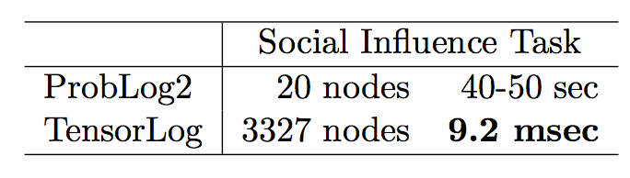
More Experiments

Slide 49
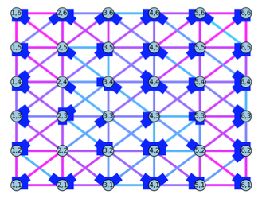
More Experiments
The semantics are different – but TensorLog can be trained to do what you want….

Slide 50
TensorLog: implementation
Compilation to Tensorflow and Theano
sparse matrices for KB relations
dense vectors for “messages” (sets of entities)
GPU-based
Python+scipy “local” implementation
sparse matrices for KB relations
sparse vectors for “messages” (sets of entities)
CPU based

Slide 51
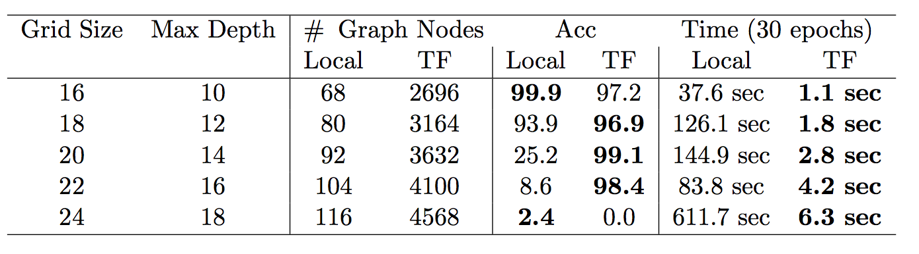
More Experiments on the Grid
scipy CPU and fixed gradient,
no tuning
tensorflow, GPU, Adagrad, no tuning

Slide 52
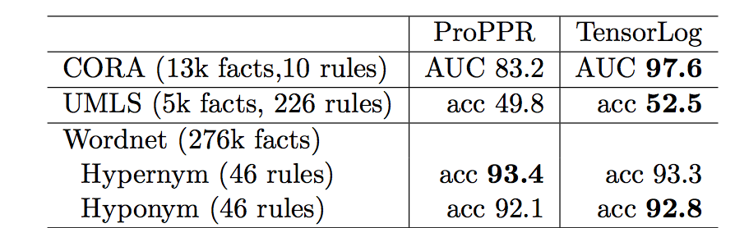
More Experiments: Relational Learning Theories Mostly from ISG (Wang & Cohen, 2014)

Slide 53
Outline: Learning and Reasoning with TensorLog
Background:
knowledge graphs and deductive DBs
standard approach: first-order reasoning by “grounding” to propositions
TensorLog: reasoning and parameter-learning
semantics
sample problem (Wikimovies)
more experiments: very scalable (vs other soft logics) and effective (as a relational learner/knowledge base completion tool) … given the right theory and data
Learning TensorLog rules
Conclusions

Slide 54
Learning rules for TensorLog
Current work with Fan Yang (2nd year PhD at CMU) and Zhilin Yang (3rd year PhD)
Basic idea:
TensorLog programs are compiled to a sequence of differentiable operators
Each operator is applied to a memory location ~= logical variable
Learn sequence with a neural controller

Slide 55
Learning rules for TensorLog
Given only examples:
uncle(liam,Y): Y should be {“bob”}
aunt(liam,Y):Y should be {“mary, “sue”}
…
Learn the inference functions
Current work with Fan Yang (2nd year PhD at CMU) and Zhilin Yang (3rd year PhD)
Basic idea:
TensorLog programs are compiled to a sequence of differentiable operators
Each operator is applied to a memory location ~= logical variable
Learn sequence with a neural controller

Slide 56
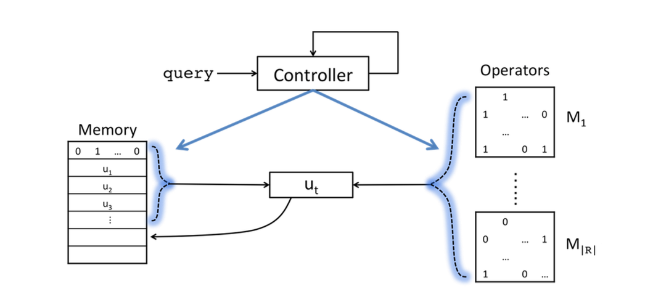
Learning rules for TensorLog
Final output is attention over memory cells after T steps
LSTM controller: reads p,a at each time step in computing Y : p(a,Y)
Current status:
chain rules only,
hard KB
New memory cell allocated at each time step: contents are formed by attention over ops and previous memory cells

Slide 57
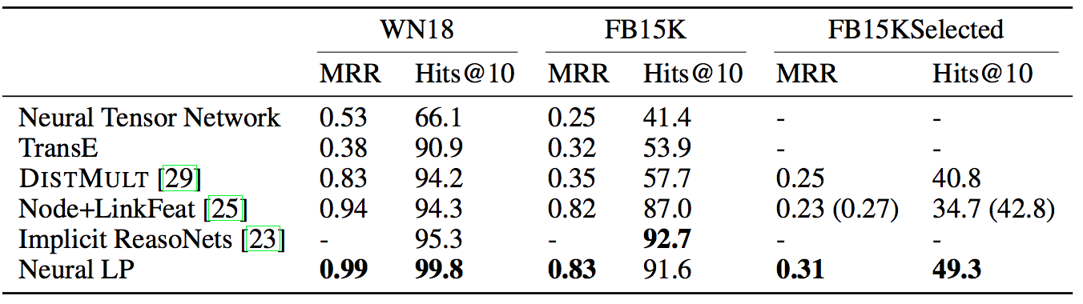
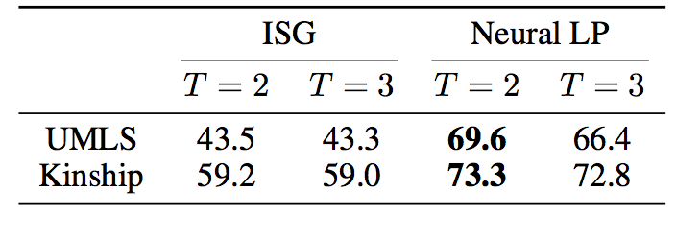
Results for Neural Inductive Logic Programming

Slide 58
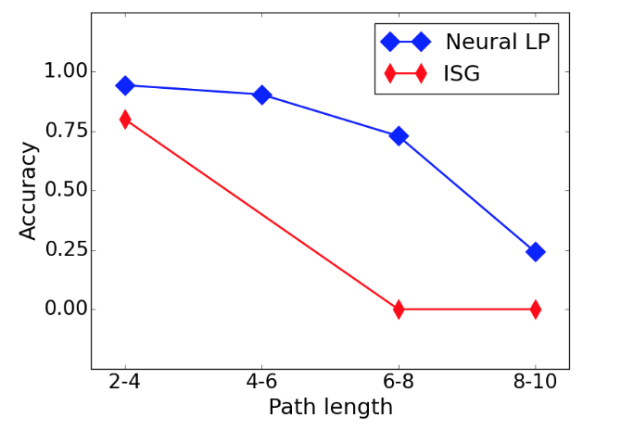
Results for Neural Inductive Logic Programming
Synthetic task: learning specific long paths in grid, like “NE-NE-S-S”

Slide 59
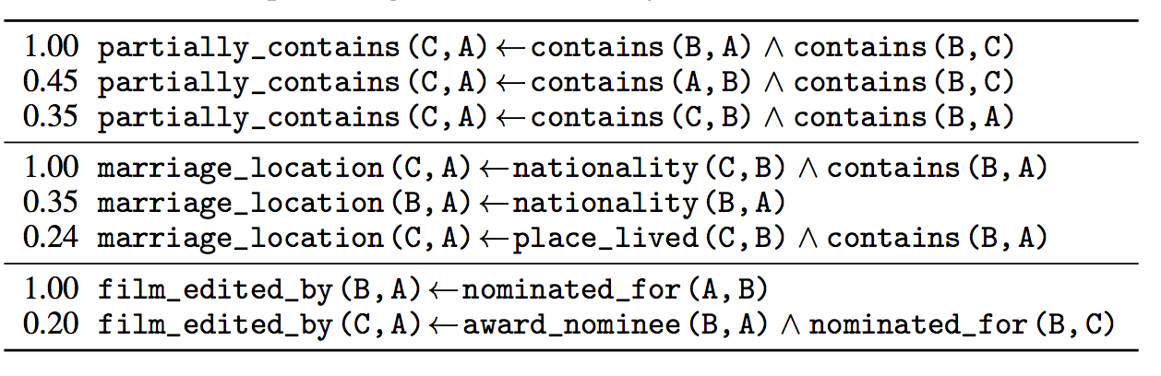
Results for Neural Inductive Logic Programming
You can reconstruct logical rules by monitoring and recording the attention on sample inputs

Slide 60
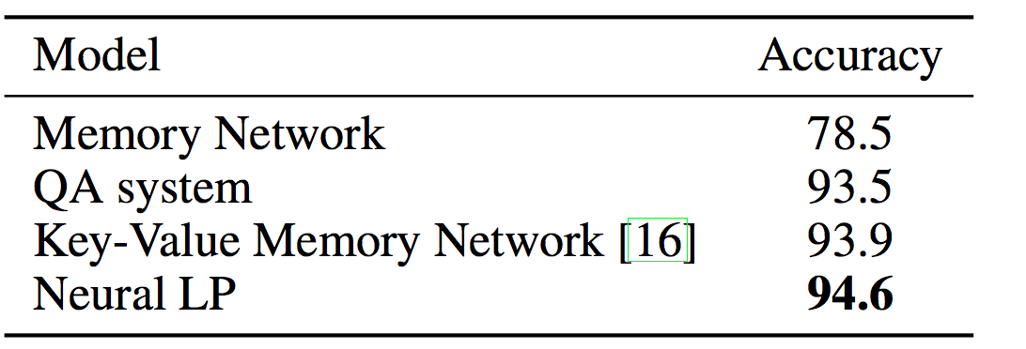
Results for Neural Inductive Logic Programming: WikiMovies
TensorLog with handcoded rules 95.0
LSTM controller: reads p,a at each time step in computing Y : p(a,Y)
LSTM controller: reads w,a at each time step in computing Y : p(w,Y), w is sum of word embeddings for words in question (100-word vocab)

Slide 61
Conclusions
As more tasks move to a neural architecture we need to understand how to integrate “old” methods (like DB) into the neural world
And how do it “the right way”
Declarative knowledge (facts and rules) is practically necessary
This may require substantial rethinking of prior methods
Grounding to boolean vs. compiling inference to functions

Slide 62
Conclusions
TensorLog revisits logic in a neural setting
Scalable (subject to KB fitting in memory)
Supports learning weights for KB facts and rules
Fully differentiable and easy to integrate with existing neural infrastructure
Restricted to: binary relations, polytree clauses
Still looking at
Beyond k-hot embeddings for entities and relations
Further applications/domains/tasks
Closer integration of neural ILP and full TensorLog
Better integration with PyTorch and Theano
Integration with neural readers (e.g., Gated Attention) for better knowledge-driven NLP

Slide 63
Thanks to
Funders: NSF, …. DARPA DEFT/SAFT, Google (William’s last 6 months and next 4 weeks)
Fan Yang, Katie Mazaitis, Zhilin Yang, William Yang Wang (now at UC/Santa Barbara)
TTI and organizers!

Slide 64
Questions?

