Slide 1
Learning to Classify Text
William W. Cohen
Center for Automated Learning and Discovery Carnegie Mellon University

Slide 2
Outline
Some examples of text classification problems
  topical classification vs genre classification vs sentiment detection vs authorship attribution vs ...
Representational issues:
  what representations of a document work best for learning?
Learning how to classify documents
  probabilistic methods: generative, conditional
  sequential learning methods for text
  margin-based approaches
Conclusions/Summary

Slide 3
Text Classification: definition
The classifier:
  Input: a document x
  Output: a predicted class y from some fixed set of labels y₁,...,y_{K}
The learner:
  Input: a set of m hand-labeled documents (x₁,y₁),....,(x_{m},y_{m})
  Output: a learned classifier f:x → y

Slide 4
Text Classification: Examples
Classify news stories as World, US, Business, SciTech, Sports, Entertainment, Health, Other
Add MeSH terms to Medline abstracts
  e.g. “Conscious Sedation” [E03.250]
Classify business names by industry.
Classify student essays as A,B,C,D, or F.
Classify email as Spam, Other.
Classify email to tech staff as Mac, Windows, ..., Other.
Classify pdf files as ResearchPaper, Other
Classify documents as WrittenByReagan, GhostWritten
Classify movie reviews as Favorable,Unfavorable,Neutral.
Classify technical papers as Interesting, Uninteresting.
Classify jokes as Funny, NotFunny.
Classify web sites of companies by Standard Industrial Classification (SIC) code.

Slide 5
Text Classification: Examples
Best-studied benchmark: Reuters-21578 newswire stories
  9603 train, 3299 test documents, 80-100 words each, 93 classes
ARGENTINE 1986/87 GRAIN/OILSEED REGISTRATIONS
BUENOS AIRES, Feb 26
Argentine grain board figures show crop registrations of grains, oilseeds and their products to February 11, in thousands of tonnes, showing those for future shipments month, 1986/87 total and 1985/86 total to February 12, 1986, in brackets:
Bread wheat prev 1,655.8, Feb 872.0, March 164.6, total 2,692.4 (4,161.0).
Maize Mar 48.0, total 48.0 (nil).
Sorghum nil (nil)
Oilseed export registrations were:
Sunflowerseed total 15.0 (7.9)
Soybean May 20.0, total 20.0 (nil)
The board also detailed export registrations for subproducts, as follows....
Categories: grain, wheat (of 93 binary choices)

Slide 6
Representing text for classification
f(
ARGENTINE 1986/87 GRAIN/OILSEED REGISTRATIONS
BUENOS AIRES, Feb 26
Argentine grain board figures show crop registrations of grains, oilseeds and their products to February 11, in thousands of tonnes, showing those for future shipments month, 1986/87 total and 1985/86 total to February 12, 1986, in brackets:
Bread wheat prev 1,655.8, Feb 872.0, March 164.6, total 2,692.4 (4,161.0).
Maize Mar 48.0, total 48.0 (nil).
Sorghum nil (nil)
Oilseed export registrations were:
Sunflowerseed total 15.0 (7.9)
Soybean May 20.0, total 20.0 (nil)
The board also detailed export registrations for subproducts, as follows....
)=y
simplest useful
?
What is the best representation for the document x being classified?

Slide 7
Bag of words representation
ARGENTINE 1986/87 GRAIN/OILSEED REGISTRATIONS
BUENOS AIRES, Feb 26
Argentine grain board figures show crop registrations of grains, oilseeds and their products to February 11, in thousands of tonnes, showing those for future shipments month, 1986/87 total and 1985/86 total to February 12, 1986, in brackets:
Bread wheat prev 1,655.8, Feb 872.0, March 164.6, total 2,692.4 (4,161.0).
Maize Mar 48.0, total 48.0 (nil).
Sorghum nil (nil)
Oilseed export registrations were:
Sunflowerseed total 15.0 (7.9)
Soybean May 20.0, total 20.0 (nil)
The board also detailed export registrations for subproducts, as follows....
Categories: grain, wheat

Slide 8
Bag of words representation
xxxxxxxxxxxxxxxxxxx GRAIN/OILSEED xxxxxxxxxxxxx
xxxxxxxxxxxxxxxxxxxxxxx
xxxxxxxxx grain xxxxxxxxxxxxxxxxxxxxxxxxxxxxxxxx grains, oilseeds xxxxxxxxxx xxxxxxxxxxxxxxxxxxxxxxxxxxx tonnes, xxxxxxxxxxxxxxxxx shipments xxxxxxxxxxxx total xxxxxxxxx total xxxxxxxx xxxxxxxxxxxxxxxxxxxx:
Xxxxx wheat xxxxxxxxxxxxxxxxxxxxxxxxxxxxxxxx, total xxxxxxxxxxxxxxxx
Maize xxxxxxxxxxxxxxxxx
Sorghum xxxxxxxxxx
Oilseed xxxxxxxxxxxxxxxxxxxxx
Sunflowerseed xxxxxxxxxxxxxx
Soybean xxxxxxxxxxxxxxxxxxxxxx
xxxxxxxxxxxxxxxxxxxxxxxxxxxxxxxxxxxxxxxxxxxxxxxxxxx....
Categories: grain, wheat

Slide 9
Bag of words representation
word
freq
xxxxxxxxxxxxxxxxxxx GRAIN/OILSEED xxxxxxxxxxxxx
xxxxxxxxxxxxxxxxxxxxxxx
xxxxxxxxx grain xxxxxxxxxxxxxxxxxxxxxxxxxxxxxxxx grains, oilseeds xxxxxxxxxx xxxxxxxxxxxxxxxxxxxxxxxxxxx tonnes, xxxxxxxxxxxxxxxxx shipments xxxxxxxxxxxx total xxxxxxxxx total xxxxxxxx xxxxxxxxxxxxxxxxxxxx:
Xxxxx wheat xxxxxxxxxxxxxxxxxxxxxxxxxxxxxxxx, total xxxxxxxxxxxxxxxx
Maize xxxxxxxxxxxxxxxxx
Sorghum xxxxxxxxxx
Oilseed xxxxxxxxxxxxxxxxxxxxx
Sunflowerseed xxxxxxxxxxxxxx
Soybean xxxxxxxxxxxxxxxxxxxxxx
xxxxxxxxxxxxxxxxxxxxxxxxxxxxxxxxxxxxxxxxxxxxxxxxxxx....
grain(s) | 3
oilseed(s) | 2
total | 3
wheat | 1
maize | 1
soybean | 1
tonnes | 1
... | ...
Categories: grain, wheat

Slide 10
Text Classification with Naive Bayes
Represent document x as set of (w_{i},f_{i}) pairs:
  x = {(grain,3),(wheat,1),...,(the,6)}
For each y, build a probabilistic model Pr(X|Y=y) of “documents” in class y
  Pr(X={(grain,3),...}|Y=wheat) = ....
  Pr(X={(grain,3),...}|Y=nonWheat) = ....
To classify, find the y which was most likely to generate x—i.e., which gives x the best score according to Pr(x|y)
  f(x) = argmax_{y}Pr(x|y)*Pr(y)

Slide 11
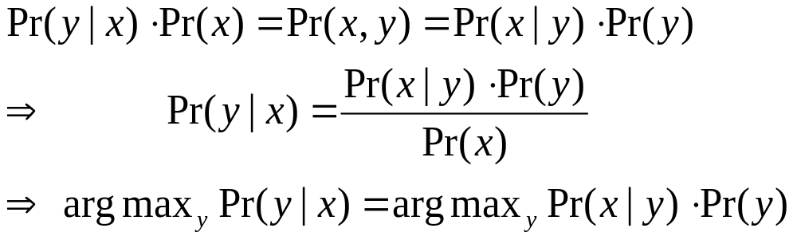
Bayes Rule

Slide 12
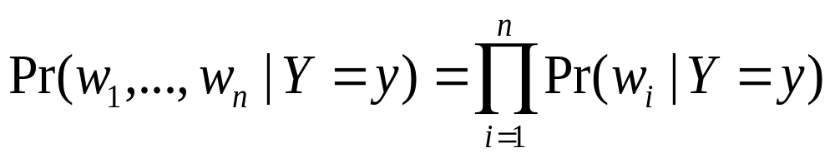
Text Classification with Naive Bayes
How to estimate Pr(X|Y) ?
Simplest useful process to generate a bag of words:
  pick word 1 according to Pr(W|Y)
  repeat for word 2, 3, ....
  each word is generated independently of the others (which is clearly not true) but means
How to estimate Pr(W|Y)?

Slide 13
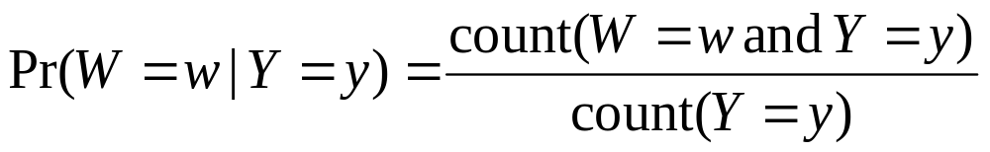
Text Classification with Naive Bayes
How to estimate Pr(X|Y) ?
Estimate Pr(w|y) by looking at the data...
This gives score of zero if x contains a brand-new word w_{new}

Slide 14
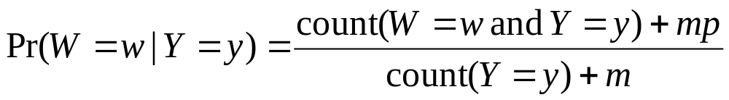
Text Classification with Naive Bayes
How to estimate Pr(X|Y) ?
... and also imagine m examples with Pr(w|y)=p
Terms:
This Pr(W|Y) is a multinomial distribution
This use of m and p is a Dirichlet prior for the multinomial

Slide 15
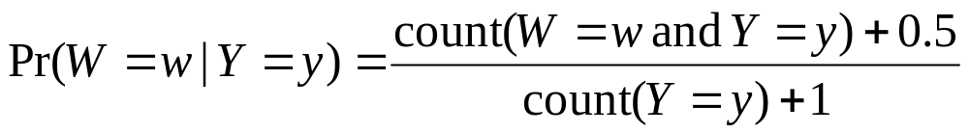
Text Classification with Naive Bayes
How to estimate Pr(X|Y) ?
for instance: m=1, p=0.5

Slide 16
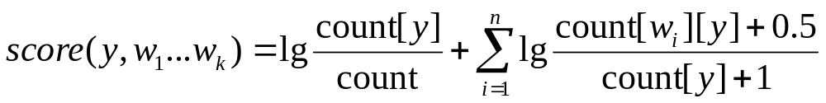
Text Classification with Naive Bayes
Putting this together:
  for each document x_{i} with label y_{i}
    for each word w_{ij} in x_{i}
      count[w_{ij}][y_{i}]++
      count[y_{i}]++
      count++
  to classify a new x=w₁...w_{n}, pick y with top score:
key point: we only need counts for words that actually appear in x

Slide 17
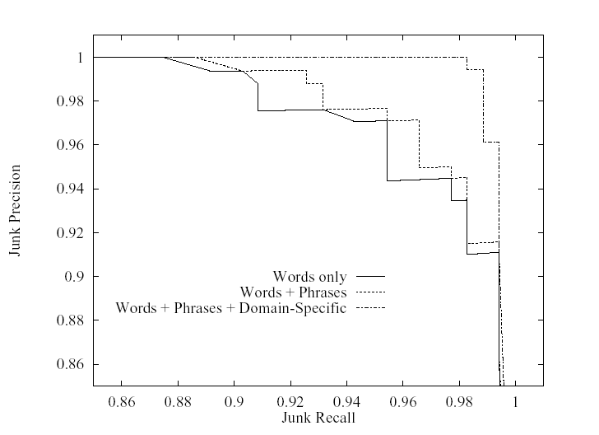
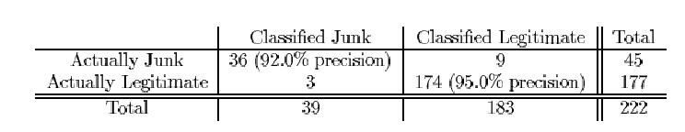
Naïve Bayes for SPAM filtering (Sahami et al, 1998)
Used bag of words, + special phrases (“FREE!”) and + special features (“from *.edu”, …)
Terms: precision, recall
Notes:
SPAM classification, which you might think of as “predicting delete actions”, is pretty well studied, starting from this paper. A little feature engineering led to good results with Naïve Bayes.

Slide 18
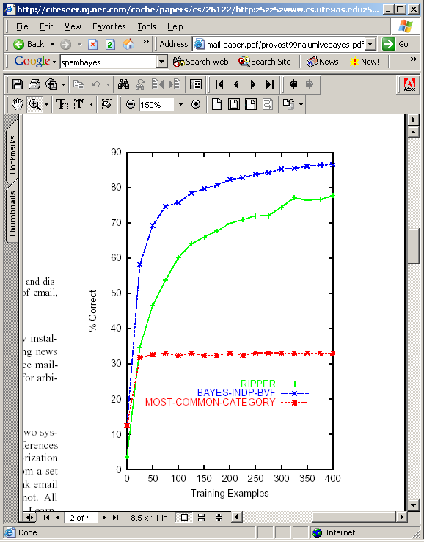
Naïve Bayes vs Rules (Provost 1999)
More experiments: rules (concise boolean queries based on keywords) vs Naïve Bayes for content-based foldering showed Naive Bayes is better and faster.
Notes:
A followup paper by Provost reinforced the idea that content-based Naïve Bayes was good for email classification.

Slide 19
Naive Bayes Summary
Pros:
  Very fast and easy-to-implement
  Well-understood formally & experimentally
    see “Naive (Bayes) at Forty”, Lewis, ECML98
Cons:
  Seldom gives the very best performance
  “Probabilities” Pr(y|x) are not accurate
    e.g., Pr(y|x) decreases with length of x
    Probabilities tend to be close to zero or one

Slide 20
Beyond Naive Bayes
Non-Multinomial Models
Latent Dirichlet Allocation

Slide 21
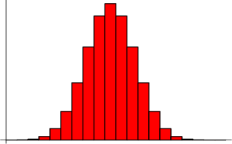
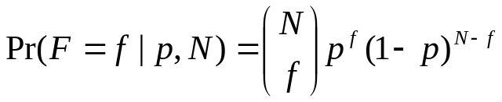
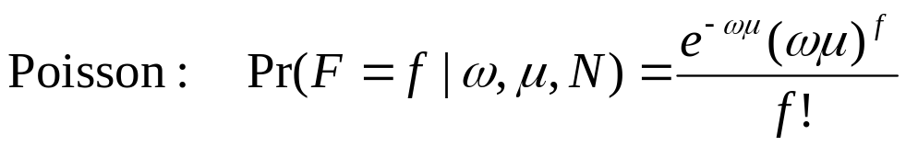
Multinomial, Poisson, Negative Binomial
binomial
Within a class y, usual NB learns one parameter for each word w: p_{w}=Pr(W=w).
...entailing a particular distribution on word frequencies F.
Learning two or more parameters allows more flexibility.

Slide 22
Multinomial, Poisson, Negative Binomial
Binomial distribution does not fit frequent words or phrases very well. For some tasks frequent words are very important...e.g., classifying text by writing style.
  “Who wrote Ronald Reagan’s radio addresses?”, Airoldi & Fienberg, 2003
Problem is worse if you consider high-level features extracted from text
  DocuScope tagger for “semantic markers”

Slide 23
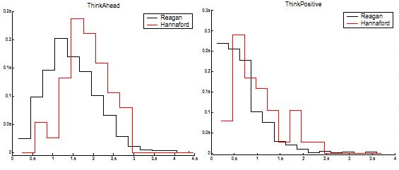
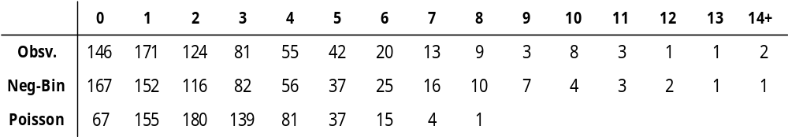
Modeling Frequent Words
“OUR” : Expected versus Observed Word Counts.

Slide 24
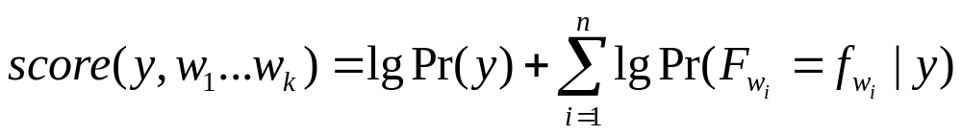
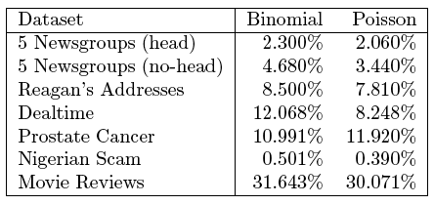
Extending Naive Bayes
Putting this together:
  for each w,y combination, build a histogram of frequencies for w, and fit Poisson to that as estimator for Pr(F_{w}=f|Y=y).
  to classify a new x=w₁...w_{n}, pick y with top score:

Slide 25
More Complex Generative Models
[Blei, Ng & Jordan, JMLR, 2003]
Within a class y, Naive Bayes constructs each x:
  pick N words w₁,...,w_{N} according to Pr(W|Y=y)
A more complex model for a class y:
  pick K topics z₁,...,z_{k} and β_{w,z}=Pr(W=w|Z=z) (according to some Dirichlet prior α)
  for each document x:
    pick a distribution of topics for X, in form of K parameters θ_{z,x}=Pr(Z=z|X=x)
    pick N words w₁,...,w_{N} as follows:
      pick z_{i} according to Pr(Z|X=x)
      pick w_{i} according to Pr(W|Z=z_{i})

Slide 26
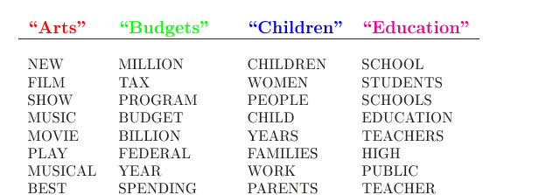
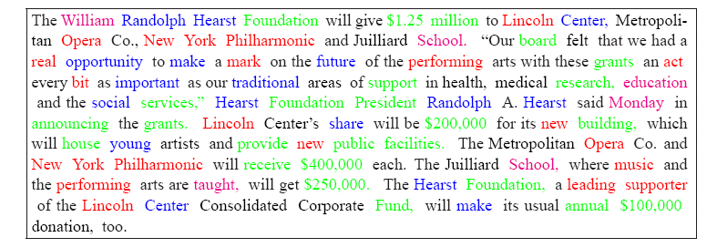
LDA Model: Example

Slide 27
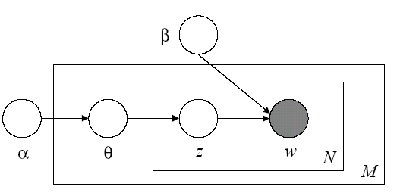
More Complex Generative Models
  pick K topics z₁,...,z_{k} and β_{w,z}=Pr(W=w|Z=z) (according to some Dirichlet prior α)
  for each document x₁,...,x_{M}:
    pick a distribution of topics for x, in form of K parameters θ_{z,x}=Pr(Z=z|X=x)
    pick N words w₁,...,w_{N} as follows:
      pick z_{i} according to Pr(Z|X=x)
      pick w_{i} according to Pr(W|Z=z_{i})
Learning:
If we knew z_{i} for each w_{i} we could learn θ’s and β’s.
The z_{i}‘s are latent variables (unseen).
Learning algorithm:
  pick β’s randomly.
  make “soft guess” at zi‘s for each x
  estimate θ’s and β’s from “soft counts”.
  repeat last two steps until convergence
y

Slide 28
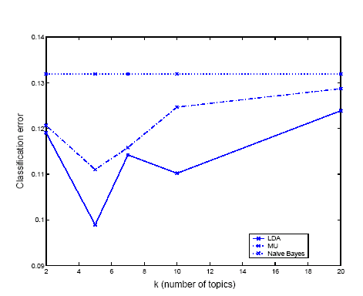
LDA Model: Experiment

Slide 29
Beyond Generative Models
Loglinear Conditional Models

Slide 30
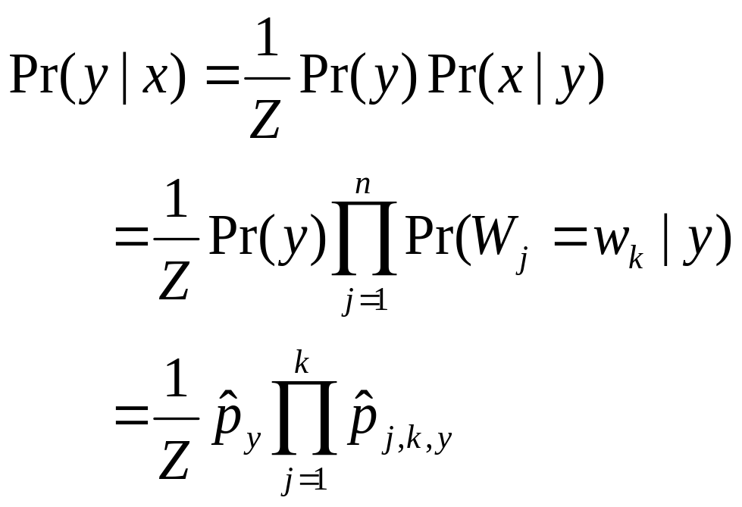
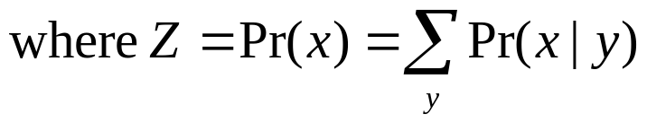
Getting Less Naive
for j,k’s associated with x
for j,k’s associated with x
Estimate these based on
naive independence assumption

Slide 31
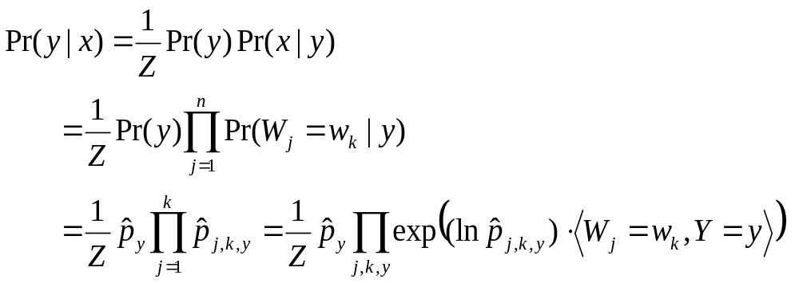
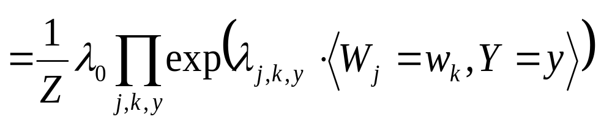
Getting Less Naive
“indicator function”
f(x,y)=1 if condition is
true, f(x,y)=0 else

Slide 32
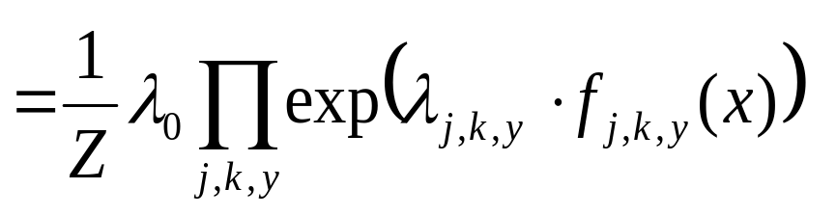
Getting Less Naive
indicator function
simplified
notation

Slide 33
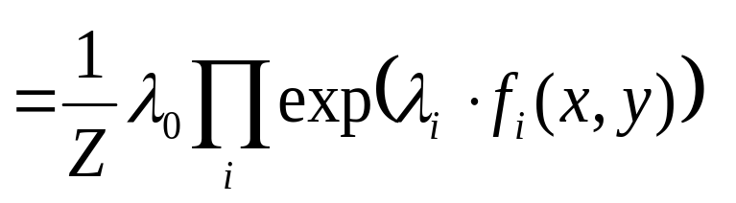
Getting Less Naive
indicator function
simplified
notation

Slide 34
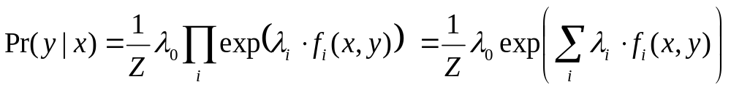
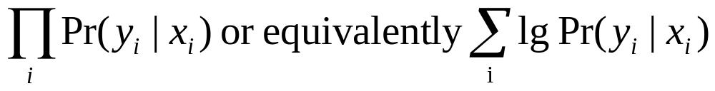
Getting Less Naive
each f_{i}(x,y) indicates a property of x (word k at j with y)
we want to pick each λ in a less naive way
we have data in the form of (x,y) pairs
one approach: pick λ’s to maximize

Slide 35
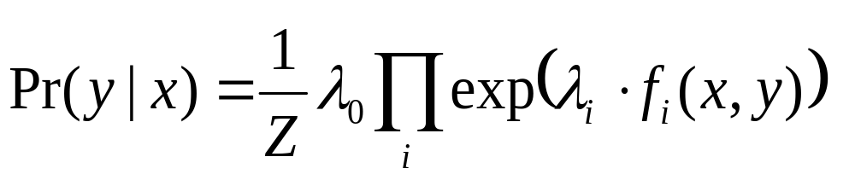
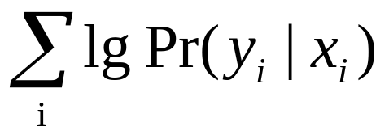
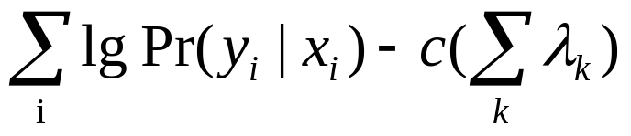
Getting Less Naive
Putting this together:
  define some likely properties f_{i}(x) of an x,y pair
  assume
  learning: optimize λ’s to maximize
    gradient descent works ok
      recent work (Malouf, CoNLL 2001) shows that certain heuristic approximations to Newton’s method converge surprisingly fast
    need to be careful about sparsity
      most features are zero
    avoid “overfitting”: maximize

Slide 36
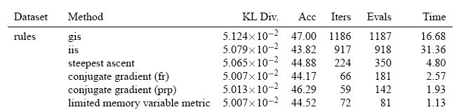
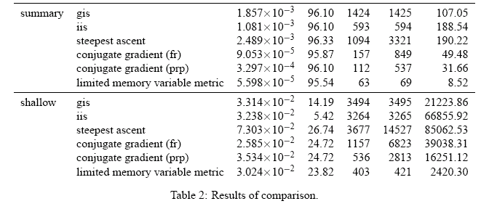
Getting less Naive

Slide 37
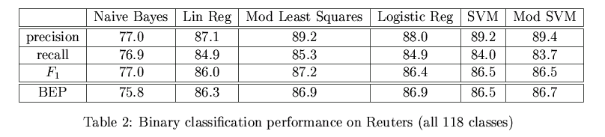
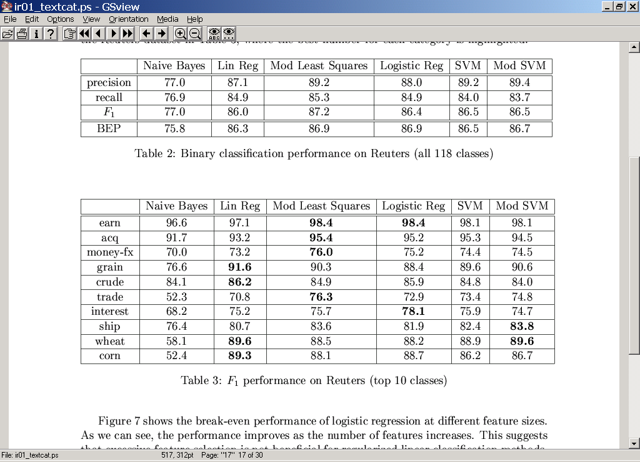
Getting Less Naive
From Zhang & Oles, 2001 – F1 values

Slide 38
HMMs and CRFs

Slide 39
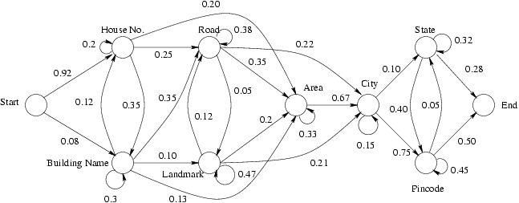
Hidden Markov Models
The representations discussed so far ignore the fact that text is sequential.
One sequential model of text is a Hidden Markov Model.
word W | Pr(W|S)
st. | 0.21
ave. | 0.15
north | 0.04
... | ...
word W | Pr(W|S)
new | 0.12
bombay | 0.04
delhi | 0.12
... | ...
Each state S contains a multinomial distribution

Slide 40
Hidden Markov Models
A simple process to generate a sequence of words:
  begin with i=0 in state S₀=START
  pick S_{i+1} according to Pr(S’|S_{i}), and w_{i} according to Pr(W|S_{i+1})
  repeat unless S_{n}=END

Slide 41
Hidden Markov Models
Learning is simple if you know (w₁,...,w_{n}) and (s₁,...,s_{n})
  Estimate Pr(W|S) and Pr(S’|S) with counts
This is quite reasonable for some tasks!
  Here: training data could be pre-segmented addresses
5000 Forbes Avenue, Pittsburgh PA

Slide 42
Hidden Markov Models
Classification is not simple.
  Want to find s₁,...,s_{n} to maximize Pr(s₁,...,s_{n} | w₁,...,w_{n})
  Cannot afford to try all |S|^{N} combinations.
  However there is a trick—the Viterbi algorithm
time t | Prob(S_{t}=s| w₁,...,w_{n})
 | START | Building | Number | Road | ... | END
t=0 | 1.00 | 0.00 | 0.00 | 0.00 | ... | 0.00
t=1 | 0.00 | 0.02 | 0.98 | 0.00 | ... | 0.00
t=2 | 0.00 | 0.01 | 0.00 | 0.96 | ... | 0.00
... | ... | ... | ... | ... | ... | ...
5000
Forbes
Ave

Slide 43
Hidden Markov Models
Viterbi algorithm:
  each line of table depends only on the word at that line, and the line immediately above it
  ➔ can compute Pr(S_{t}=s| w₁,...,w_{n}) quickly
  a similar trick works for argmax[s₁,...,s_{n}] Pr(s₁,...,s_{n} | w₁,...,w_{n})
time t | Prob(S_{t}=s| w₁,...,w_{n})
 | START | Building | Number | Road | ... | END
t=0 | 1.00 | 0.00 | 0.00 | 0.00 | ... | 0.00
t=1 | 0.00 | 0.02 | 0.98 | 0.00 | ... | 0.00
t=2 | 0.00 | 0.01 | 0.00 | 0.96 | ... | 0.00
... | ... | ... | ... | ... | ... | ...
5000
Forbes
Ave

Slide 44
Hidden Markov Models
Extracting Names from Text
October 14, 2002, 4:00 a.m. PT
For years, Microsoft Corporation CEO Bill Gates railed against the economic philosophy of open-source software with Orwellian fervor, denouncing its communal licensing as a "cancer" that stifled technological innovation.
Today, Microsoft claims to "love" the open-source concept, by which software code is made public to encourage improvement and development by outside programmers. Gates himself says Microsoft will gladly disclose its crown jewels--the coveted code behind the Windows operating system--to select customers.
"We can be open source. We love the concept of shared source," said Bill Veghte, a Microsoft VP. "That's a super-important shift for us in terms of code access.“
Richard Stallman, founder of the Free Software Foundation, countered saying…
Microsoft Corporation
CEO
Bill Gates
Microsoft
Gates
Microsoft
Bill Veghte
Microsoft
VP
Richard Stallman
founder
Free Software Foundation

Slide 45
Hidden Markov Models
Extracting Names from Text
Nymble (BBN’s ‘Identifinder’)
October 14, 2002, 4:00 a.m. PT
For years, Microsoft Corporation CEO Bill Gates railed against the economic philosophy of open-source software with Orwellian fervor, denouncing its communal licensing as a "cancer" that stifled technological innovation.
Today, Microsoft claims to "love" the open-source concept, by which software code is made public to encourage improvement and development by outside programmers. Gates himself says Microsoft will gladly disclose its crown jewels--the coveted code behind the Windows operating system--to select customers.
"We can be open source. We love the concept of shared source," said Bill Veghte, a Microsoft VP. "That's a super-important shift for us in terms of code access.“
Richard Stallman, founder of the Free Software Foundation, countered saying…
Person
end-of-sentence
start-of-sentence
Org
(Five other name classes)
Other
[Bikel et al, MLJ 1998]

Slide 46
Getting Less Naive with HMMs
Naive Bayes model:
  generate class y
  generate words w₁,..,w_{n} from Pr(W|Y=y)
HMM model:
  generate states y₁,...,y_{n}
  generate words w₁,..,w_{n} from Pr(W|Y=y_{i})
Conditional version of Naive Bayes
  set parameters to maximize
Conditional version of HMMs
  conditional random fields (CRFs)

Slide 47
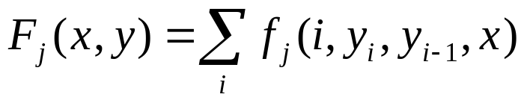
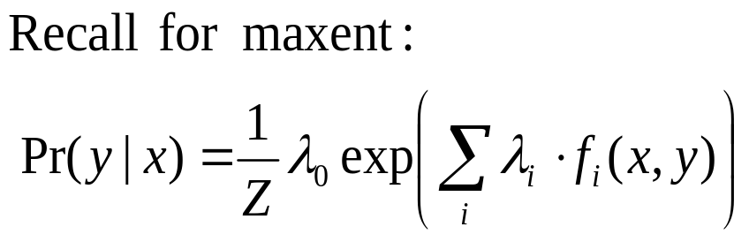
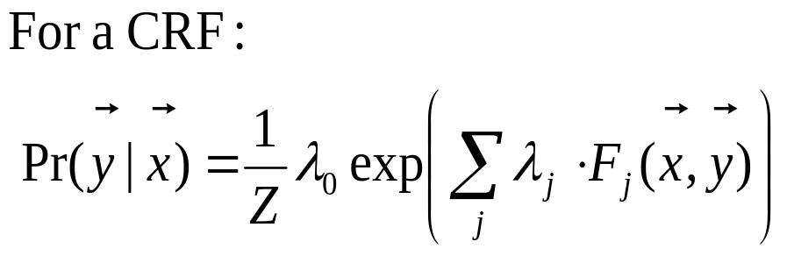
Getting Less Naive with HMMs
Conditional random fields:
  training data is set of pairs (y₁...y_{n}, x₁...x_{n})
  you define a set of features f_{j}(i, y_{i}, y_{i-1}, x₁...x_{n})
    for HMM-like behavior, use indicators for <Y_{i}=y_{i} and Y_{i-1}=y_{i-1}> and <X_{i}=x_{i}>
  I’ll define
Learning requires HMM-computations to compute gradient for optimization, and Viterbi-like computations to classify.

Slide 48
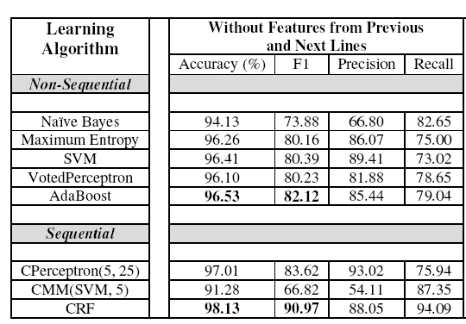
Experiments with CRFs
Learning to Extract Signatures from Email
[Carvalho & Cohen, 2004]

Slide 49
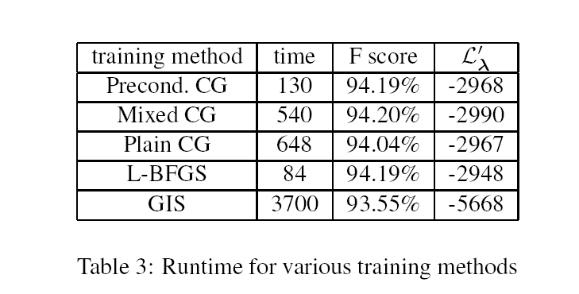
CRFs for Shallow Parsing
[Sha & Pereira, 2003]
in minutes, 375k examples

Slide 50
Beyond Probabilities

Slide 51
The Curse of Dimensionality
Typical text categorization problem:
  TREC-AP headlines (Cohen&Singer,2000): 319,000+ documents, 67,000+ words, 3,647,000+ word 4-grams used as features.
How can you learn with so many features?
  For speed, exploit sparse features.
  Use simple classifiers (linear or loglinear)
  Rely on wide margins.

Slide 52
Margin-based Learning
+
+
+
+
+
+
+
+
+
+
+
+
+
+
+
+
+
+
+
-
-
-
-
-
-
-
-
-
-
-
-
-
-
-
-
-
-
-
-
-
-
-
-
-
The number of features matters not if the margin is sufficiently wide and examples are sufficiently close to the origin (!!)
-
-
-

Slide 53
The Voted Perceptron
Assume y=±1
Start with v₁ = (0,...,0)
For example (x_{i},y_{i}):
  y’ = sign(v_{k} . x_{i})
  if y’ is correct, c_{k+1}++;
  if y’ is not correct:
    v_{k+1} = v_{k} + y_{i}x_{k}
    k = k+1
    c_{k+1} = 1
Classify by voting all v_{k}’s predictions, weighted by c_{k}
An amazing fact: if
for all i, ||x_{i}||<R,
there is some u so that ||u||=1 and for all i, y_{i}*(u.x)>δ then the perceptron makes few mistakes: less than (R/ δ)²
For text with binary features: ||x_{i}||<R means not to many words.
And yi*(u.x)>δ means the margin is at least δ

Slide 54
The Voted Perceptron
Assume y=±1
Start with v₁ = (0,...,0)
For example (x_{i},y_{i}):
  y’ = sign(v_{k} . x_{i})
  if y’ is correct, c_{k+1}++;
  if y’ is not correct:
    v_{k+1} = v_{k} + y_{i}x_{k}
    k = k+1
    c_{k+1} = 1
Classify by voting all v_{k}’s predictions, weighted by c_{k}
An amazing fact: if
for all i, ||x_{i}||<R,
there is some u so that ||u||=1 and for all i, y_{i}*(u.x_{i})>δ then the perceptron makes few mistakes: less than (R/ δ)²
“Mistake” implies v_{k+1} = v_{k} + y_{i}x_{i}
➔ u.v_{k+1} = u(v_{k} + y_{i}x_{k})
u.v_{k+1} = u.v_{k} + uy_{i}x_{k}
➔ u.v_{k+1} > u.v_{k} + δ
So u.v, and hence v, grows by at least δ: v_{k+1}.u>k δ

Slide 55
The Voted Perceptron
Assume y=±1
Start with v₁ = (0,...,0)
For example (x_{i},y_{i}):
  y’ = sign(v_{k} . x_{i})
  if y’ is correct, c_{k+1}++;
  if y’ is not correct:
    v_{k+1} = v_{k} + y_{i}x_{k}
    k = k+1
    c_{k+1} = 1
Classify by voting all v_{k}’s predictions, weighted by c_{k}
An amazing fact: if
for all i, ||x_{i}||<R,
there is some u so that ||u||=1 and for all i, y_{i}*(u.x_{i})>δ then the perceptron makes few mistakes: less than (R/ δ)²
“Mistake” implies y_{i}(v_{k}.x_{i}) < 0
➔ ||v_{k+1}||² = ||v_{k} + y_{i}x_{i}||²
||v_{k+1}||² = ||v_{k}|| + 2y_{i}(v_{k}.x_{i} )+ ||x_{i}||²
||v_{k+1}||² < ||v_{k}|| + 2y_{i}(v_{k}.x_{i} )+ R²
➔ ||v_{k+1}||² < ||v_{k}|| + R²
So v cannot grow too much with each mistake: ||v_{k+1}||² < k R²

Slide 56
The Voted Perceptron
Assume y=±1
Start with v₁ = (0,...,0)
For example (x_{i},y_{i}):
  y’ = sign(v_{k} . x_{i})
  if y’ is correct, c_{k+1}++;
  if y’ is not correct:
    v_{k+1} = v_{k} + y_{i}x_{k}
    k = k+1
    c_{k+1} = 1
Classify by voting all v_{k}’s predictions, weighted by c_{k}
An amazing fact: if
for all i, ||x_{i}||<R,
there is some u so that ||u||=1 and for all i, y_{i}*(u.x_{i})>δ then the perceptron makes few mistakes: less than (R/ δ)²
Two opposing forces:
||v_{k}|| is squeezed between k δ and k⁻²R
this means that k⁻²R < k δ, which bounds k.

Slide 57
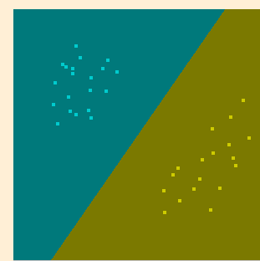
Lessons of the Voted Perceptron
VP shows that you can make few mistakes in incrementally learning as you pass over the data, if the examples x are small (bounded by R), some u exists that is small (unit norm) and has large margin.
Why not look for this u directly?
Support vector machines:
find u to minimize ||u||, subject to some fixed margin δ, or
find u to maximize δ, relative to a fixed bound on ||u||.

Slide 58
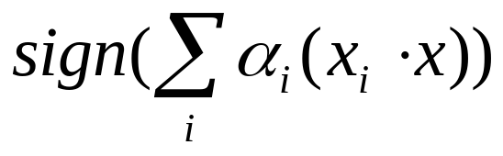
More on Support Vectors for Text
Facts about support vector machines:
  the “support vectors” are the x_{i}’s that touch the margin.
  the classifier sign(u.x) can be written
  where the x_{i}’s are the support vectors.
  the inner products x_{i}.x can be replaced with variant “kernel functions”
  support vector machines often give very good results on topical text classification.

Slide 59
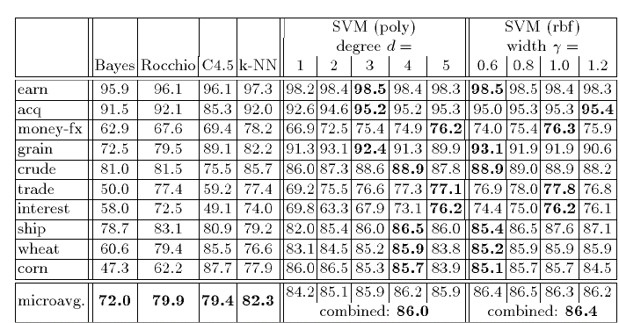
Support Vector Machine Results

Slide 60
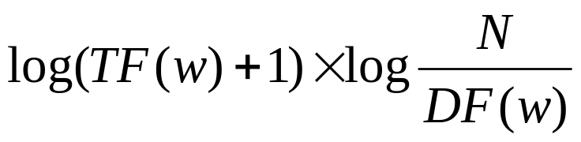
TF-IDF Representation
The results above use a particular weighting scheme for documents:
  for word w that appears in DF(w) docs out of N in a collection, and appears TF(w) times in the doc being represented use weight:
  also normalize all vector lengths (||x||) to 1

Slide 61
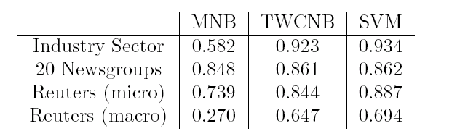
TF-IDF Representation
TF-IDF representation is an old trick from the information retrieval community, and often improves performance of other algorithms:
  Yang, CMU: extensive experiments with K-NN variants and linear least squares using TF-IDF representations
  Rocchio’s algorithm: classify using distance to centroid of documents from each class
  Rennie et al: Naive Bayes with TFIDF on “complement” of class
accuracy
breakeven

Slide 62
Advanced Topics

Slide 63
Conclusions
There are huge number of applications for text categorization.
Bag-of-words representations generally work better than you’d expect
  Naive Bayes and voted perceptron are fastest to learn and easiest to implement
  Linear classifiers that like wide margins tend to do best.
  Probabilistic classifications are sometimes important.
Non-topical text categorization (e.g., sentiment detection) is much less well studied than topic text categorization.

Slide 64
Some Resources for Text Categorization
Surveys and talks:
  Machine Learning in Automated Text Categorization, Fabrizio Sebastiani, ACM Computing Surveys, 34(1):1-47, 2002 , http://faure.isti.cnr.it/~fabrizio/Publications/ACMCS02.pdf
  (Naive) Bayesian Text Classification for Spam Filtering http://www.daviddlewis.com/publications/slides/lewis-2004-0507-spam-talk-for-casa-marketing-draft5.ppt (and other related talks)
Software:
  Minorthird: toolkit for extraction and classification of text: http://minorthird.sourceforge.net
  Rainbow: fast Naive Bayes implementation of text-preprocessing in C: http://www.cs.cmu.edu/~mccallum/bow/rainbow/
  SVM Light: free support vector machine well-suited to text: http://svmlight.joachims.org/
Test Data:
  Datasets: http://www.cs.cmu.edu/~tom/, and http://www.daviddlewis.com/resources/testcollections

Slide 65
Papers Discussed
Naive Bayes for Text:
  A Bayesian approach to filtering junk e-mail. M. Sahami, S. Dumais, D. Heckerman, and E. Horvitz (1998). AAAI'98 Workshop on Learning for Text Categorization, July 27, 1998, Madison, Wisconsin.
  Machine Learning, Tom Mitchell, McGraw Hill, 1997.
  Naive-Bayes vs. Rule-Learning in Classification of Email. Provost, J (1999). The University of Texas at Austin, Artificial Intelligence Lab. Technical Report AI-TR-99-284
  Naive (Bayes) at Forty: The Independence Assumption in Information Retrieval, David Lewis, Proceedings of the 10th European Conference on Machine Learning, 1998
Extensions to Naive Bayes:
  Who Wrote Ronald Reagan's Radio Addresses ? E. Airoldi and S. Fienberg (2003), CMU statistics dept TR, http://www.stat.cmu.edu/tr/tr789/tr789.html
  Latent Dirichlet allocation. D. Blei, A. Ng, and M. Jordan. Journal of Machine Learning Research, 3:993-1022, January 2003
  Tackling the Poor Assumptions of Naive Bayes Text Classifiers
  Jason D. M. Rennie, Lawrence Shih, Jaime Teevan and David R. Karger.
  Proceedings of the Twentieth International Conference on Machine Learning. 2003
MaxEnt and SVMs:
  A comparison of algorithms for maximum entropy parameter estimation. Robert Malouf, 2002. In Proceedings of the Sixth Conference on Natural Language Learning (CoNLL-2002). Pages 49-55.
  Text categorization based on regularized linear classification methods. Tong Zhang and Frank J. Oles. Information Retrieval, 4:5-31, 2001.
  Learning to Classify Text using Support Vector Machines, T. Joachims, Kluwer, 2002.
HMMs and CRFs:
  Automatic segmentation of text into structured records, Borkar et al, SIGMOD 2001
  Learning to Extract Signature and Reply Lines from Email, Carvalo & Cohen, in Conference on Email and Anti-Spam 2004
  Shallow Parsing with Conditional Random Fields. F. Sha and F. Pereira. HLT-NAACL, 2003

