Slide 1
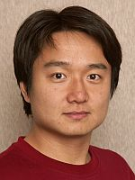
Learning Proximity Relations Defined by Linear Combinations of Constrained Random Walks
William W. Cohen
Machine Learning Department and Language Technologies Institute
School of Computer Science
Carnegie Mellon University
joint work with:
Ni Lao
Language Technologies Institute

Slide 2
Dwar Ev ceremoniously soldered the final connection with gold. The eyes of a dozen television cameras watched him and the subether bore throughout the universe a dozen pictures of what he was doing.
He straightened and nodded to Dwar Reyn, then moved to a position beside the switch that would complete the contact when he threw it. The switch that would connect, all at once, all of the monster computing machines of all the populated planets in the universe - ninety-six billion planets - into the supercircuit that would connect them all into one supercalculator, one cybernetics machine that would combine all the knowledge of all the galaxies.
Dwar Reyn spoke briefly to the watching and listening trillions. Then after a moment’s silence he said, “Now, Dwar Ev.”
Dwar Ev threw the switch. There was a mighty hum, the surge of power from ninety-six billion planets. Lights flashed and quieted along the miles-long panel.
Dwar Ev stepped back and drew a deep breath. “The honour of asking the first questions is yours, Dwar Reyn.”
“Thank you,” said Dwar Reyn. “It shall be a question which no single cybernetics machine has been able to answer.”
He turned to face the machine. “Is there a God ?”
The mighty voice answered without hesitation, without the clicking of a single relay.
“Yes, now there is a god.”
Sudden fear flashed on the face of Dwar Ev. He leaped to grab the switch.
A bolt of lightning from the cloudless sky struck him down and fused the switch shut.
‘Answer’ by Fredric Brown.
©1954, Angels and Spaceships

Slide 3
Outline
Motivation
Technical stuff 1
Technical stuff 2
…
Conclusions/summary

Slide 4
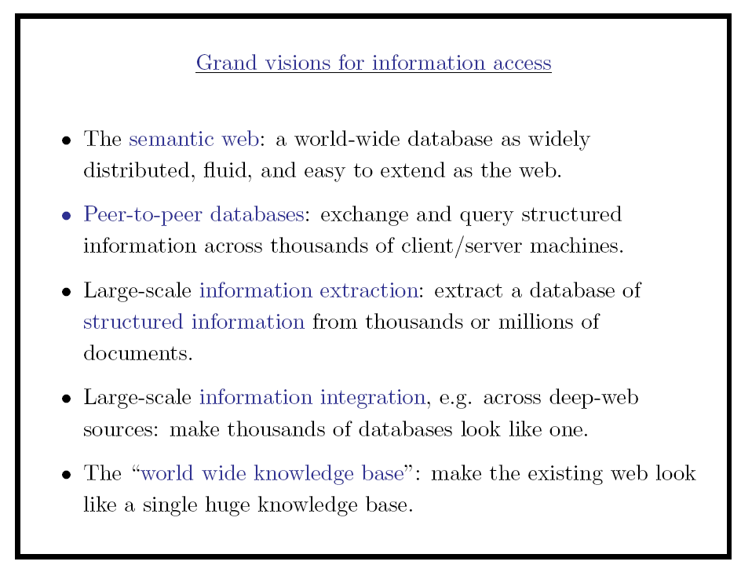
Invited talk – ICML 1999

Slide 5
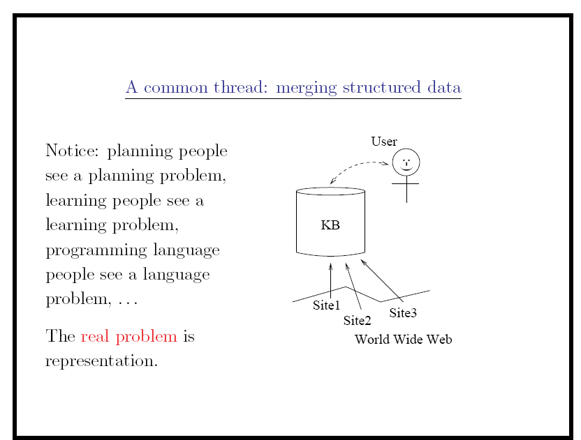
Invited talk – ICML 1999

Slide 6
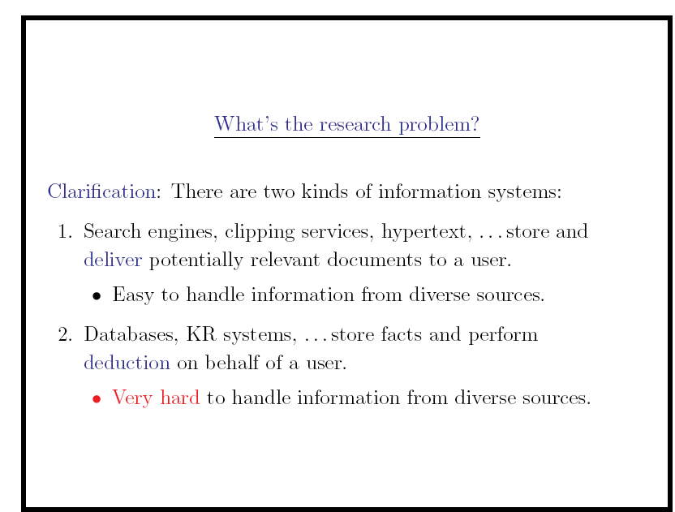
Invited talk – ICML 1999

Slide 7
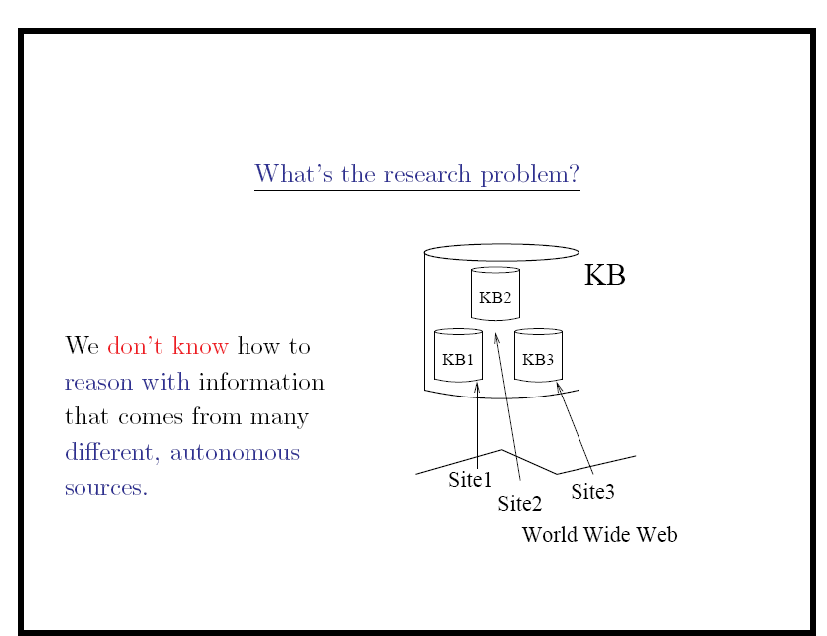
Invited talk – ICML 1999

Slide 8
Why is combining knowledge from many places hard?
When is combining information from many places hard?

Slide 9
Two ways to manage information
“ceremonial soldering”
X:advisor(wc,X)&affil(X,lti) ?
{X=em; X=nl}
Query
Answer
Xxx xxxx xxxx xxx xxx xxx xx xxxx xxxx xxx
Query
Answer
retrieval
inference
Xxx xxxx xxxx xxx xxx xxx xx xxxx xxxx xxx
Xxx xxxx xxxx xxx xxx xxx xx xxxx xxxx xxx
advisor(wc,nl)
advisor(yh,tm)
Xxx xxxx xxxx xxx xxx xxx xx xxxx xxxx xxx
Xxx xxxx xxxx xxx xxx xxx xx xxxx xxxx xxx
affil(wc,mld)
AND
Xxx xxxx xxxx xxx xxx xxx xx xxxx xxxx xxx
affil(vc,nl)
Xxx xxxx xxxx xxx xxx xxx xx xxxx xxxx xxx
Xxx xxxx xxxx xxx xxx xxx xx xxxx xxxx xxx
Xxx xxxx xxxx xxx xxx xxx xx xxxx xxxx xxx
name(wc,William Cohen)
name(nl,Ni Lao)

Slide 10
Why is combining knowledge from many places hard?
When is combining information from many places hard?
  When inference is involved
Why is combining information from many places hard?
  Need to understand the object identifiers in different KBs.
  Need to understand the predicates in different KBs.

Slide 11
WHIRL project (1997-2000)
WHIRL initiated when at AT&T Bell Labs
Lucent/Bell Labs
AT&T Research
AT&T Labs - Research
AT&T Research
AT&T Labs
AT&T Research – Shannon Laboratory
AT&T Shannon Labs
???

Slide 12


When do two names refer to the same entity?
Bell Labs
Bell Telephone Labs
AT&T Bell Labs
A&T Labs
AT&T Labs—Research
AT&T Labs Research, Shannon Laboratory
Shannon Labs
Bell Labs Innovations
Lucent Technologies/Bell Labs Innovations
[1925]
History of Innovation: From 1925 to today, AT&T has attracted some of the world's greatest scientists, engineers and developers…. [www.research.att.com]
Bell Labs Facts: Bell Laboratories, the research and development arm of Lucent Technologies, has been operating continuously since 1925… [bell-labs.com]

Slide 13
Why is combining knowledge from many places hard?
When is combining information from many places hard?
  When inference is involved
Why is combining information from many places hard?
  Need to understand the object identifiers in different KBs for joins to work
  Need to understand the predicates in different KBs for the user to pose a query
    Example: FlyMine integrated database

Slide 14
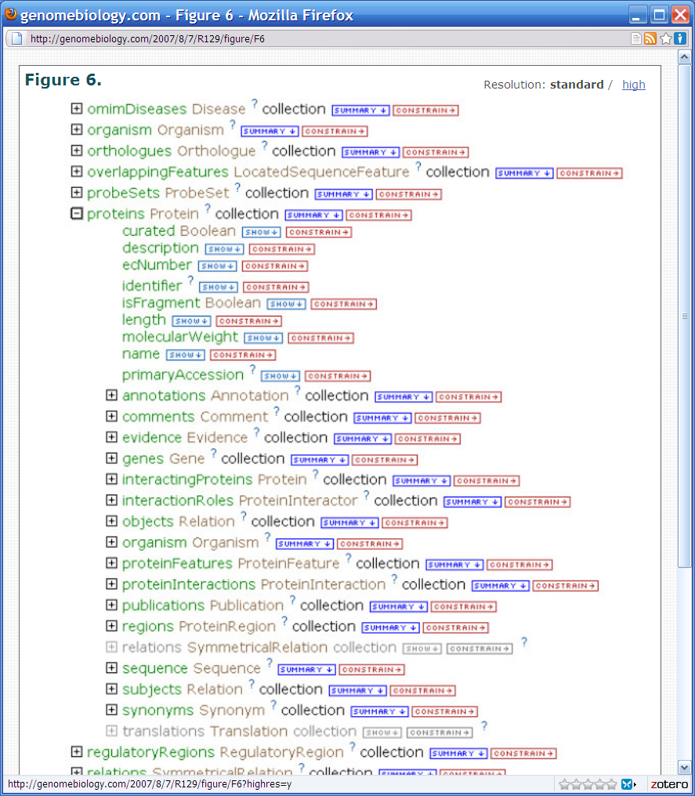
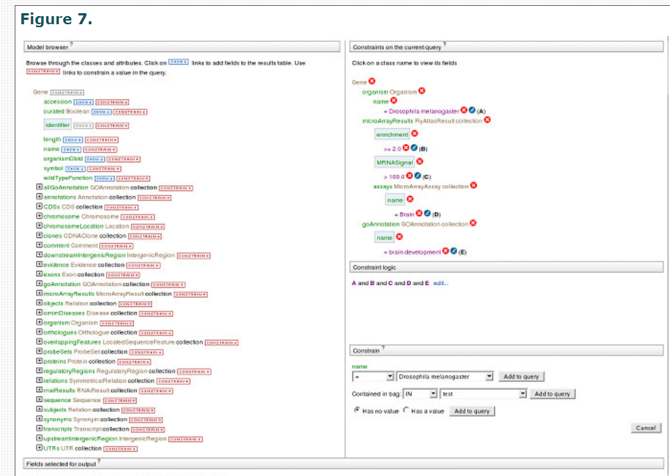

Slide 15
Why is combining knowledge from many places hard?
When is combining information from many places hard?
  When inference is involved
Why is combining information from many places hard?
  Need to understand the object identifiers in different KBs for joins to work
  Need to understand the predicates in different KBs for the user to pose a query
Is there any other way?

Slide 16
Outline
Motivation: graphs as databases
Technical stuff 1
Technical stuff 2
…
Conclusions/summary

Slide 17
BANKS: Browsing And Keywords Search
[Aditya, …, Chakrabarti, …, Sudarshan – IIT Munbai; 2002]
Database is modeled as a graph
  Nodes = tuples
  Edges = references between tuples
    foreign key, inclusion dependencies, ..
    Edges are directed.
User need not know organization of database to formulate queries.
BANKS: Keyword search…
MultiQuery Optimization
paper
writes
Charuta
S. Sudarshan
Prasan Roy
author

Slide 18
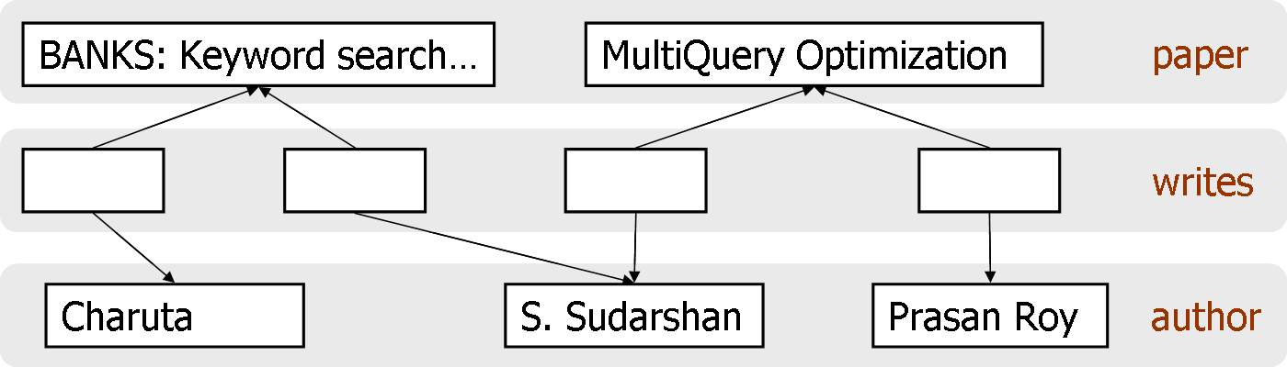
BANKS: Answer to Query
Query: “sudarshan roy” Answer: subtree from graph
paper
MultiQuery Optimization
writes
writes
author
author
S. Sudarshan
Prasan Roy

Slide 19
Why is combining knowledge from many places hard?
Why is combining information from many places hard?
  Need to understand the object identifiers in different KBs for joins to work
  WHIRL solution: base answers on similarity of entity names, not equality of entity names
  Need to understand the predicates in different KBs for the user to pose a query
  BANKS solution: (as I see it): look at “nearness” in graphs to answer join queries.

Slide 20
y: paper(y) & y~“sudarshan”
AND
w: paper(y) & w~“roy”
Query: “sudarshan roy” Answer: subtree from graph

Slide 21
Similarity of Nodes in Graphs
[Personalized PageRank 1999; Random Walk with 200? … ]
  Given type t* and node x, find y:T(y)=t* and y~x.
Similarity defined by “damped” version of PageRank
Similarity between nodes x and y:
  “Random surfer model”: from a node z,
    with probability α, stop and “output” z
    pick an edge label r using Pr(r | z) ... e.g. uniform
    pick a y uniformly from { y’ : z → y with label r }
    repeat from node y ....
  Similarity x~y = Pr( “output” y | start at x)
Intuitively, x~y is summation of weight of all paths from x to y, where weight of path decreases exponentially with length.

Slide 22
Similarity of Nodes in Graphs
Random surfer on graphs:
  natural extension to PageRank
  closely related to Lafferty’s heat diffusion kernel
    but generalized to directed graphs
  somewhat amenable to learning parameters of the walk (gradient search, w/ various optimization metrics):
    Toutanova, Manning & NG, ICML2004
    Nie et al, WWW2005
    Xi et al, SIGIR 2005
  can be sped up and adapted to longer walks by sampling approaches to matrix multiplication (e.g. Lewis & E. Cohen, SODA 1998), similar to particle filtering
  our current implementation (GHIRL): Lucene + Sleepycat/TokyoCabinet

Slide 23
Outline
Motivation
Technical stuff 1
  What’s the right way of improving “nearness” measures using learning?
Technical stuff 2
…
Conclusions/summary

Slide 24
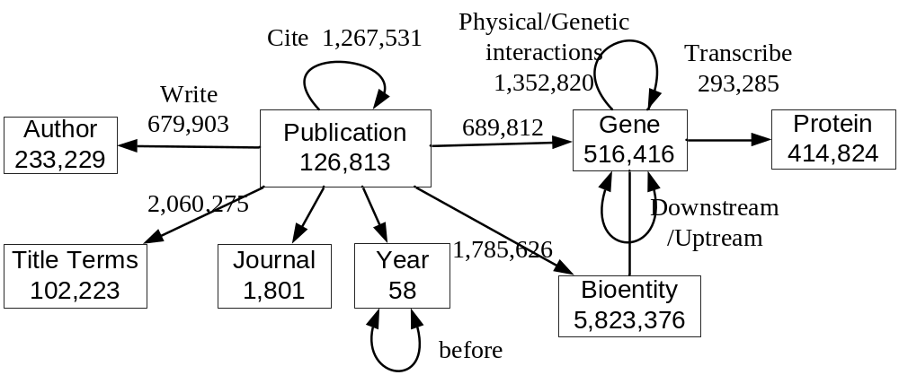

Learning Proximity Measures for
BioLiterature Retrieval Tasks
Data used in this study
  Yeast: 0.2M nodes, 5.5M links
  Fly: 0.8M nodes, 3.5M links
  E.g. the fly graph
Tasks
  Gene recommendation: author, year→gene
  Reference recommendation: title words,year→paper
  Expert-finding: title words, genes→author

Slide 25
Learning Proximity Measures for
BioLiterature Retrieval Tasks
Tasks:
  Gene recommendation: author, year→gene
  Reference recommendation: title words,year→paper
  Expert-finding: title words, genes→author
Baseline method:
  Typed RWR proximity methods
  … with learning layered on top
  … learning method: parameterize Prob(walk edge|edge label=x) and tune the parameters for each x (somehow…)

Slide 26
A Limitation of RWR Learning Methods
One-parameter-per-edge label is limited because the context in which an edge label appears is ignored
  E.g. (observed from real data – task, find papers to read)
Path | Comments
 | Don't read about genes which I have already read
 | Read about my favorite authors
Path | Comments
 | Read about the genes that I am working on
 | Don't need to read paper from my own lab

Slide 27
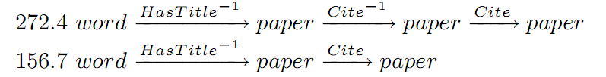

Path Constrained Random Walk
–A New Proximity Measure
Our work (Lao & Cohen, ECML 2010)
  learn a weighted combination of simple “path experts”, each of which corresponds to a particular labeled path through the graph
Citation recommendation--an example
  In the TREC-CHEM Prior Art Search Task, researchers found that it is more effective to ﬁrst ﬁnd patents about the topic, then aggregate their citations
  Our proposed model can discover this kind of retrieval schemes and assign proper weights to combine them. E.g.
Weight Path

Slide 28

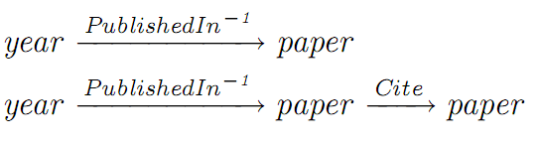
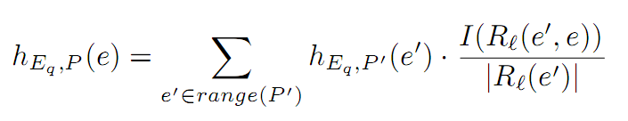
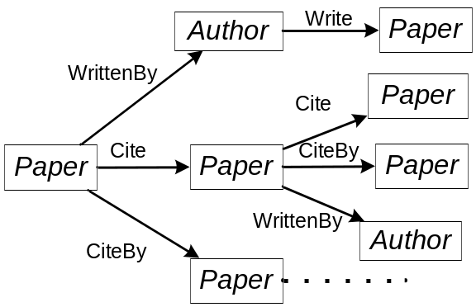
Definitions
An Entity-Relation graph G=(T,E,R), is
  a set of entities types T={T}
  a set of entities E={e}, Each entity is typed with e.T T
  a set of relations R={R}
A Relation path P=(R₁, …,R_{n}) is a sequence of relations
  E.g.
Path Constrained Random Walk
  Given a query q=(E_{q},T_{q})
  Recursively define a distribution for each path
Notes:
The instantiation of type T is I_{E}(T)={e| e.T =T}
Each relation is a pair of entity types R.T₁, R.T₂
R(e1,e2)=1/0 to denote e1,e2 having relation R or not
R(e,•)={e’| R(e,e')=1} to denote the set of entities that have relation R with e

Slide 29
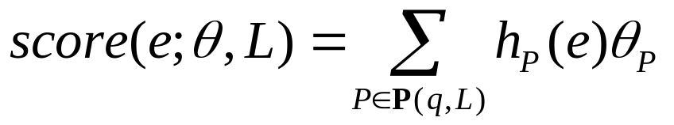
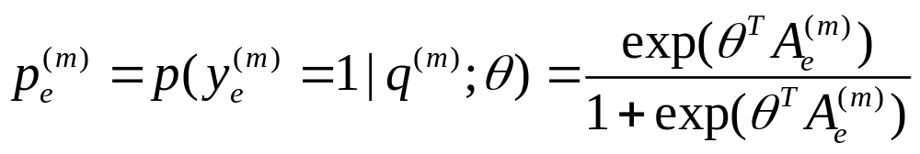
Supervised PCRW Retrieval Model
A Retrieval Model ranks target entities by linearly combining the distributions of different paths
This mode can be optimized by maximizing the probability of the observed relevance
  Given a set of training data D={(q^{(m)}, A^{(m)}, y^{(m)})}, y_{e}^{(m)}=1/0

Slide 30
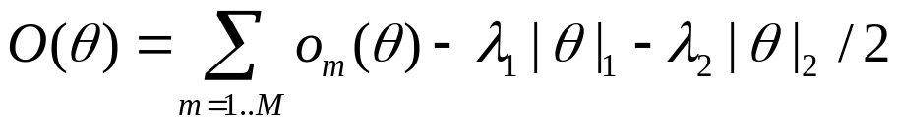
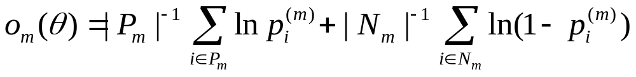
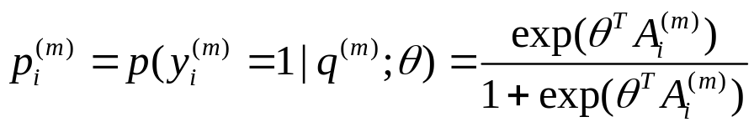
Parameter Estimation (Details)
Given a set of training data
  D={(q^{(m)}, A^{(m)}, y^{(m)})} m=1…M, y^{(m)}(e)=1/0
We can define a regularized objective function
Use average log-likelihood as the objective o_{m}(θ)
  P(m) the index set or relevant entities,
  N(m) the index set of irrelevant entities
  (how to choose them will be discussed later)
Notes:
easy to optimize
does not penalize too harshly to outlier samples

Slide 31
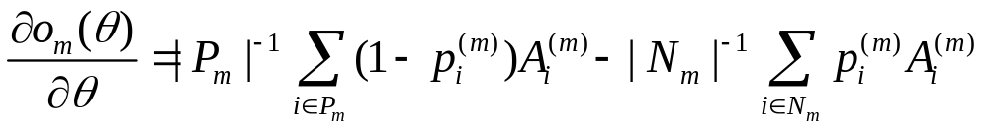
Parameter Estimation (Details)
Selecting the negative entity set N_{m}
  Few positive entities vs. thousands (or millions) of negative entities?
  First sort all the negative entities with an initial model (uniform weight 1.0)
  Then take negative entities at the k(k+1)/2-th position, for k=1,2,….
The gradient
Use orthant-wise L-BFGS (Andrew & Gao, 2007) to estimate θ
  Efficient
  Can deal with L1 regularization

Slide 32
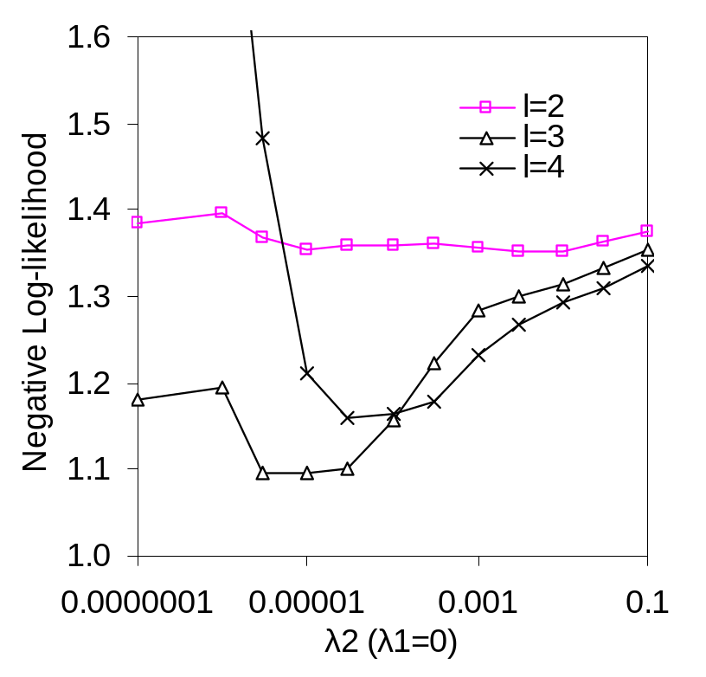
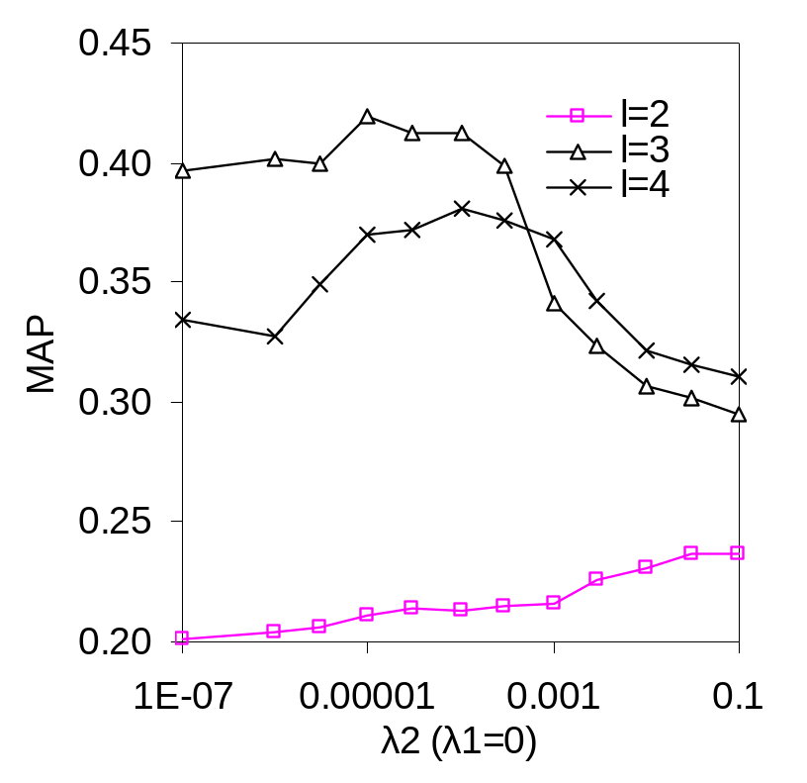
L2 Regularization
Improves retrieval quality
  On the citation recommendation task

Slide 33
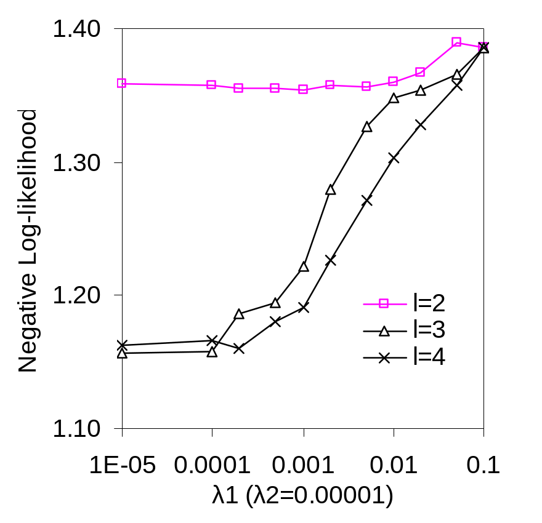
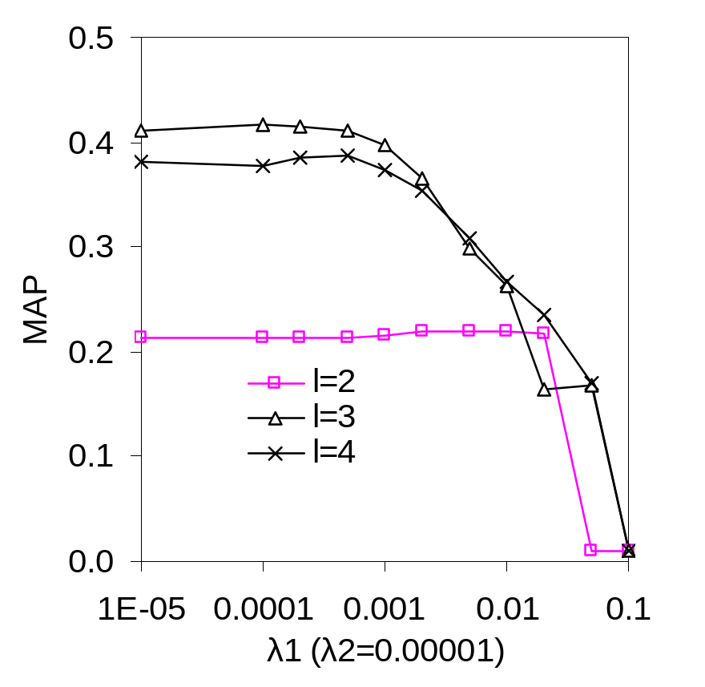
L1 Regularization
Does not improve retrieval quality…

Slide 34
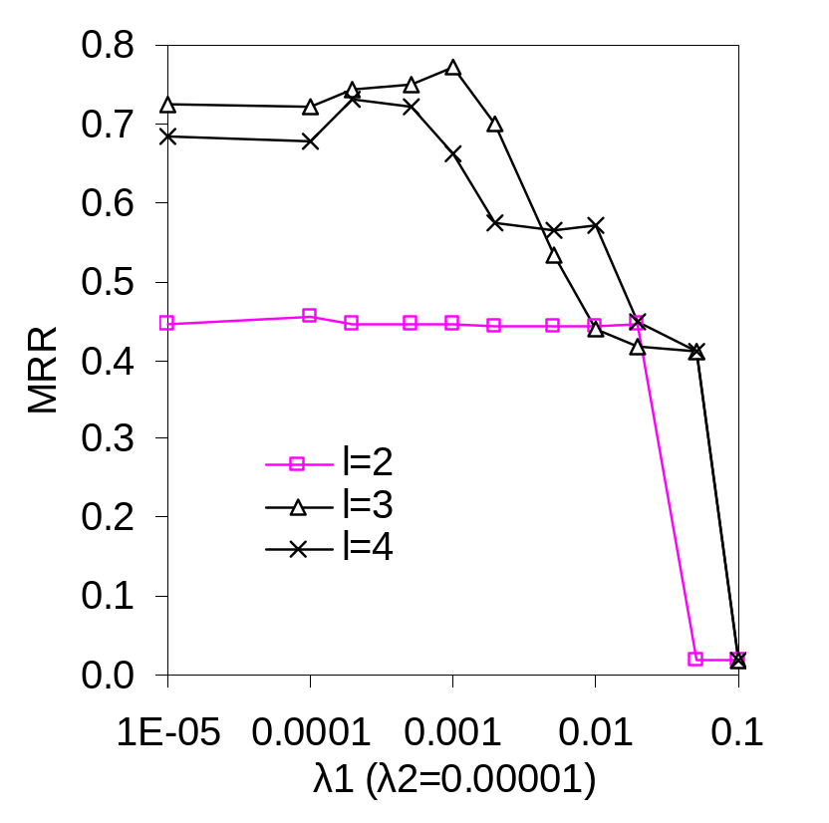
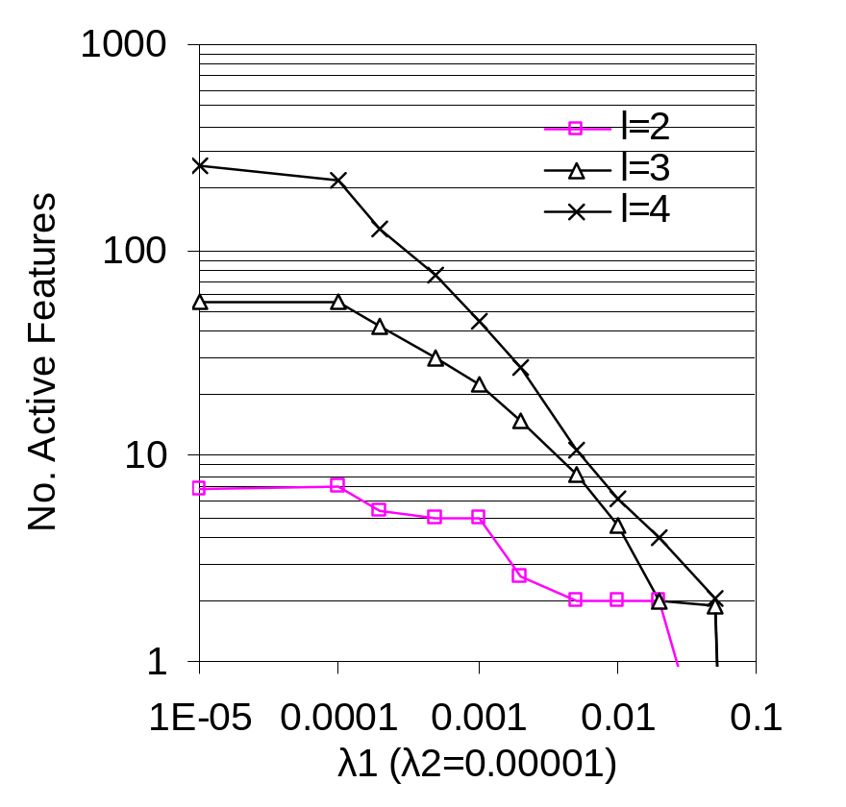
L1 Regularization
… but can help reduce number of features

Slide 35
Outline
Motivation
Technical stuff 1
  What’s the right way of improving “nearness” measures using learning?
  PCRW (Path-Constrained Random Walks): Regularized optimization of a linear combination of path-constrained walkers
Technical stuff 2
  Some extensions

Slide 36
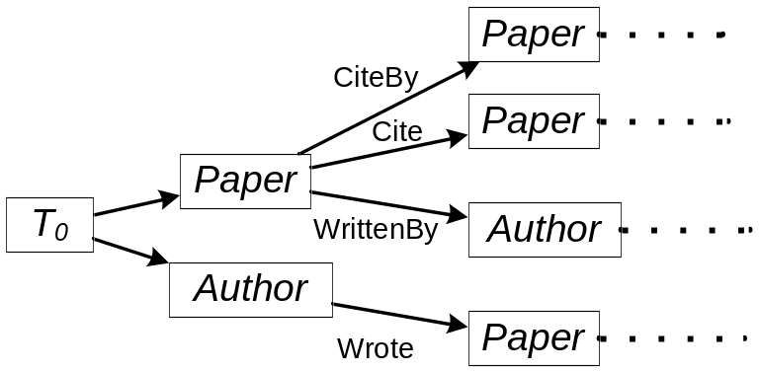
Ext.1: Query Independent Paths
PageRank
  assign an importance score (query independent) to each web page
  later combined with relevance score (query dependent)
Generalize to multiple entity and relation type setting
  We include to each query a special entity e₀ of special type T₀
  T₀ has relation to all other entity types
  e₀ has links to each entity
  Therefore, we have a set of query independent relation paths
  (distributions of which can be calculate offline)
Example
well cited papers
all papers
productive authors
all authors

Slide 37
Ext.2: Popular Entities
There are entity specific characteristics which cannot be captured by a general model
  E.g. Some document with lower rank to a query may be interesting to the users because of features not captured in the data (log mining)
  E.g. Different users may have completely different information needs and goals under the same query (personalized)
  The identity of entity matters

Slide 38
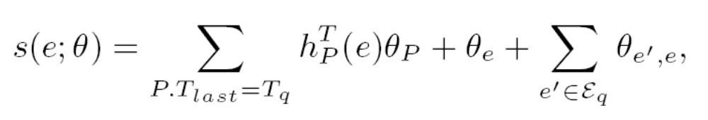

Ext.2: Popular Entities
For a task with query type T₀, and target type T_{q},
  Introduce a bias θ_{e} for each entity e in I_{E}(T_{q})
  Introduce a bias θ_{e’,e} for each entity pair (e’,e) where e in I_{E}(T_{q}) and e’ in I_{E}(T₀)
Then
  Or in matrix form
Efficiency consideration
  Only add to the model top J parameters (measured by |O(θ)/θ_{e}|)
  at each LBFGS iteration

Slide 39
Experiment Setup
Data sources for bio-informatics
  PubMed on-line archive of over 18 million biological abstracts
  PubMed Central (PMC) full-text copies of over 1 million of these papers
  Saccharomyces Genome Database (SGD) a database for yeast
  Flymine a database for fruit flies
Tasks
  Gene recommendation: author, year→gene
  Venue recommendation: genes, title words→journal
  Reference recommendation: title words,year→paper
  Expert-finding: title words, genes→author
Data split
  2000 training, 2000 tuning, 2000 test
Time variant graph
  each edge is tagged with a time stamp (year)
  only consider edges that are earlier than the query, during random walk

Slide 40
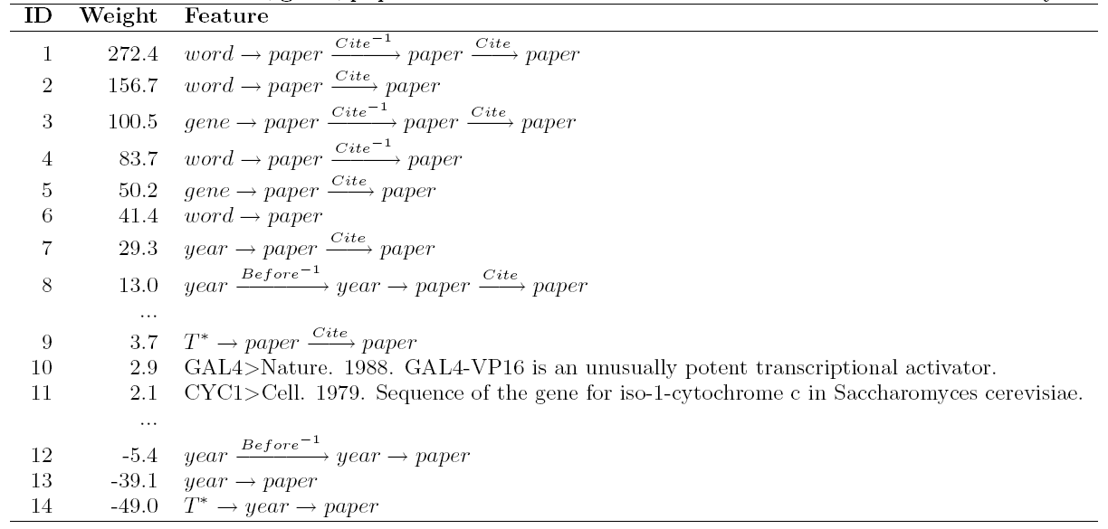
Example Features
A PRA+qip+pop model trained for the reference recommendation task on the yeast data
1) papers co-cited with the on-topic papers
6) resembles a commonly used ad-hoc retrieval system
7,8) papers cited during the past two years
10,11) (important) early papers about specific query terms (genes)
9) well cited papers
12,13) general papers published during the past two years
14) old papers

Slide 41
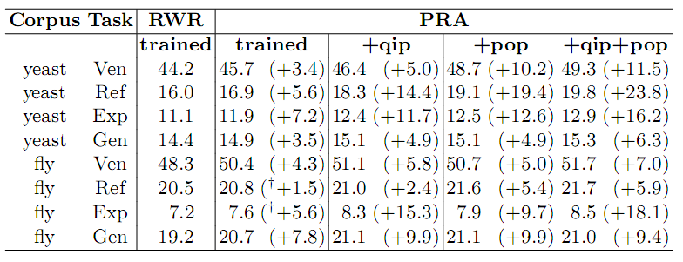
Results
Compare the MAP of PRA to
  RWR model
  query independent paths (qip)
  popular entity biases (pop)
Except these† , all improvements are statistically signiﬁcant at p<0.05 using paired t-test

Slide 42
Outline
Motivation
Technical stuff 1
  What’s the right way of improving “nearness” measures using learning?
  PRA (Path Ranking Algorithm): Regularized optimization of a linear combination of path-constrained walkers
Technical stuff 2
  Some extensions: Query-independent paths and Popular-entity paths
Even more technical stuff
  Making all this faster

Slide 43
The Need for Efficient PCRW
Random walk based model can be expensive to execute
  Especially for dense graphs, or long random walk paths
Popular speedup strategies are
  Sampling (finger printing) strategies
    Fogaras 2004
  Truncation (pruning) strategies
    Chakrabarti 2007
  Build two-level representations of graphs offline
    Raghavan et al., 2003, He et al., 2007, Dalvi et al., 2008
    Tong et al. 06---low-rank matrix approximation of the graph
    Chakrabarti 2007 ---precompute Personalized Pagerank Vectors (PPVs) for a small fraction of nodes
In this study, we will compare different sampling and truncation strategies applied to PCRW

Slide 44
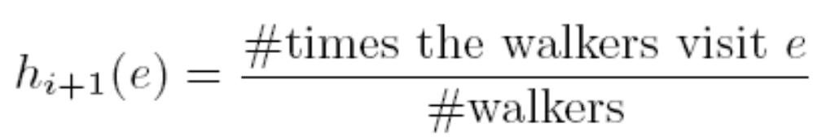
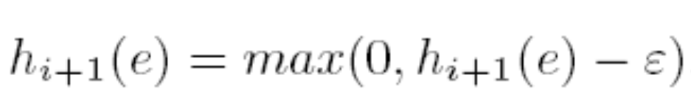
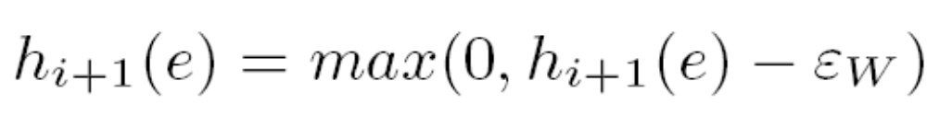
Four Strategies for Efficient Random Walks
Fingerprinting (sampling)
  Simulate a large number of random walkers
Fixed truncation
  Truncate the i-th distribution by throwing away numbers below a fixed value
Beam Truncation
  Keep only the top W most probable entities in a distribution
Weighted Particle Filtering
  A combination of exact inference and sampling
Notes:
Maintaining distribution sparsity during random walking

Slide 45
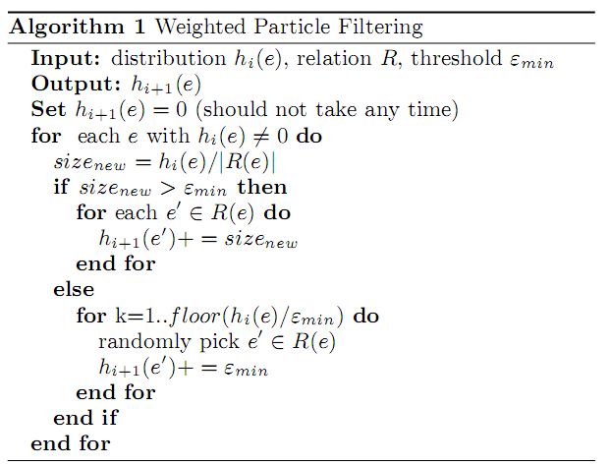
Weighted Particle Filtering
Start from exact inference
switch to sampling when the branching is high

Slide 46
Experiment Setup
Data sources
  Yeast and fly data bases
Automatically labeled tasks generated from publications
  Gene recommendation: author, year→gene
  Reference recommendation: title words,year→paper
  Expert-finding: title words, genes→author
Data split
  2000 training, 2000 tuning, 2000 test
Time variant graph (for training)
  each edge is tagged with a time stamp (year)
  When doing random walk, only consider edges that are earlier than the query
Approximate at training and test time
Vary degree of truncation/sampling/filtering

Slide 47
Possible results
Awesome
Performance
(e.g., MAP)
Possible (approx is useful regularization)
Exact
Different values of beam size, ε, …
Good
Crappy
Not so good
1x
10x
100x
1000x
Speedup

Slide 48
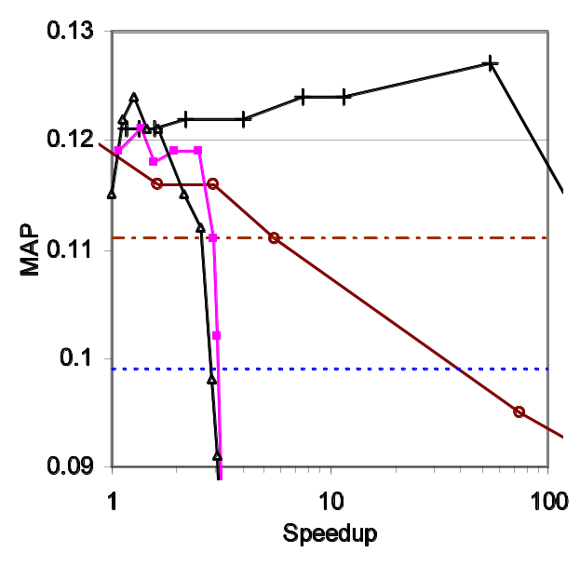
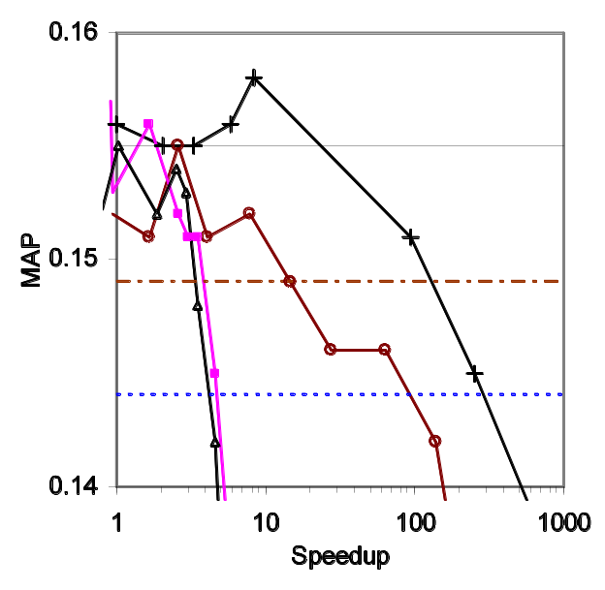
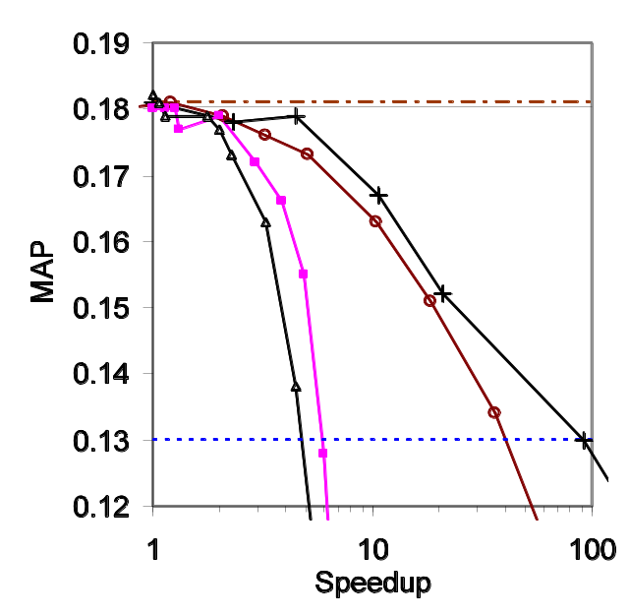
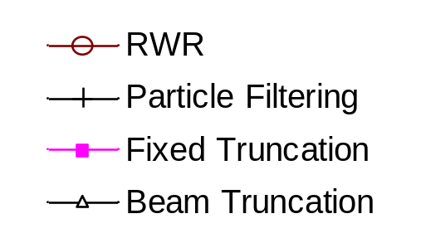
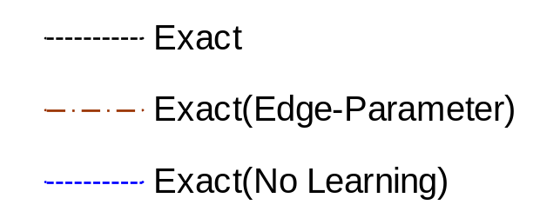
Results on The Yeast Data
Citation
Recommendation
Expert Finding
Gene Recommendation
T₀ = 0.17s, L= 3
T₀ = 1.6s, L = 4
T₀ = 2.7s, L= 3
Fingerprint
PCRW

Slide 49
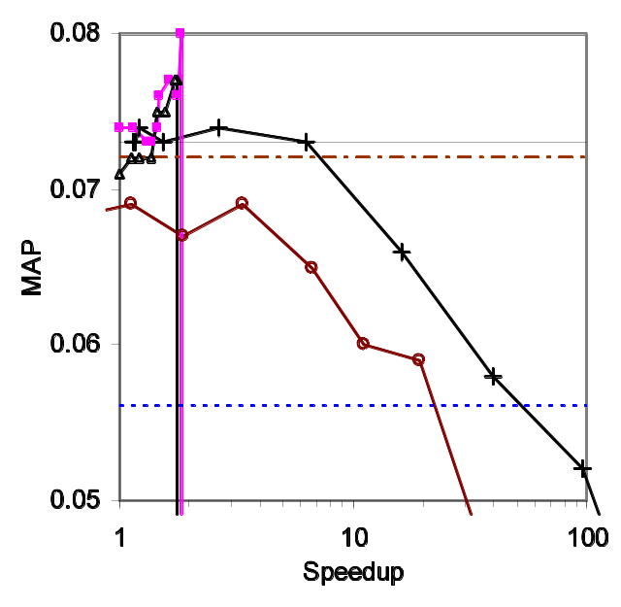
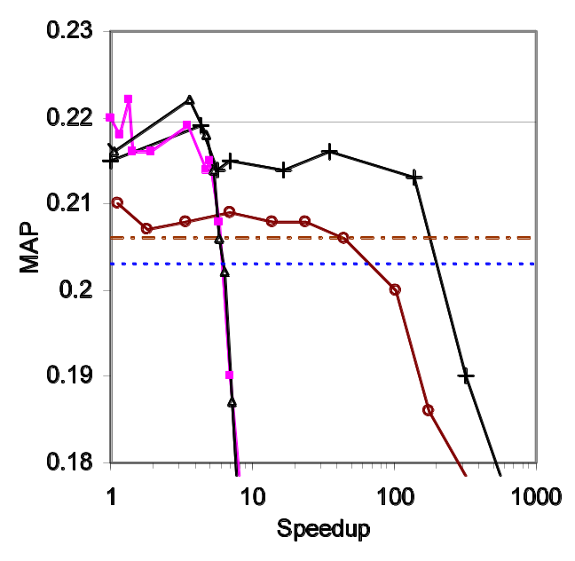
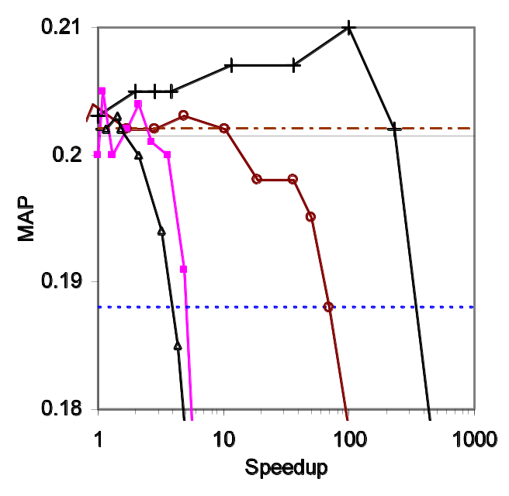
Results on the Fly Data
Citation
Recommendation
Expert Finding
Gene Recommendation
T₀ = 0.15s, L= 3
T₀ = 1.8s, L= 4
T₀ = 0.9s, L= 3
Fingerprint
PCRW

Slide 50
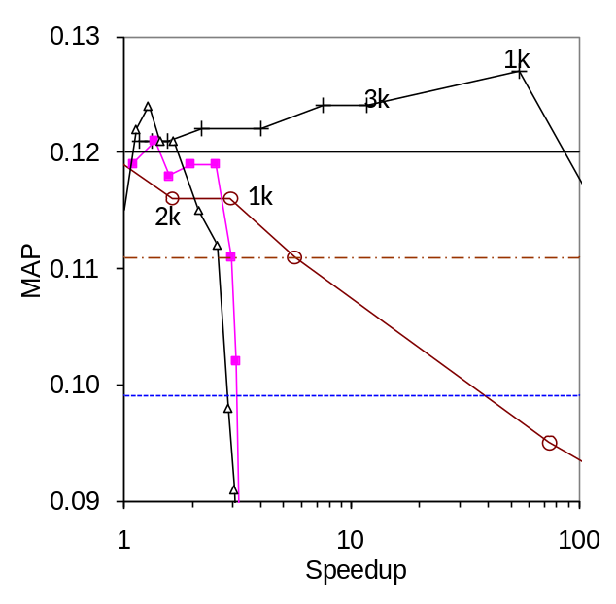
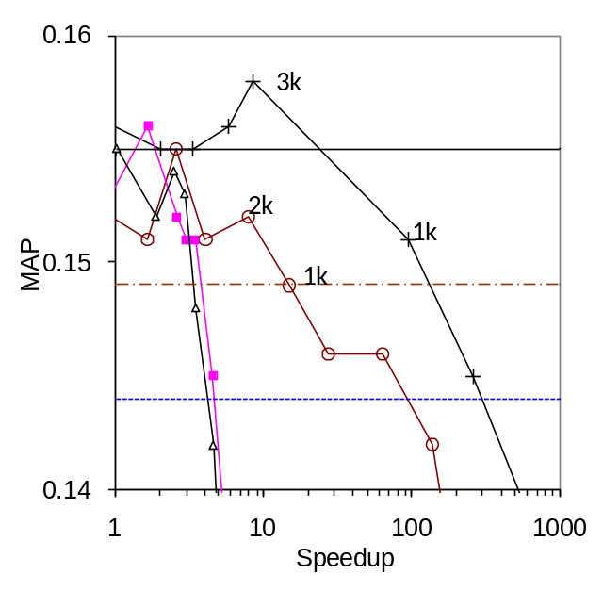
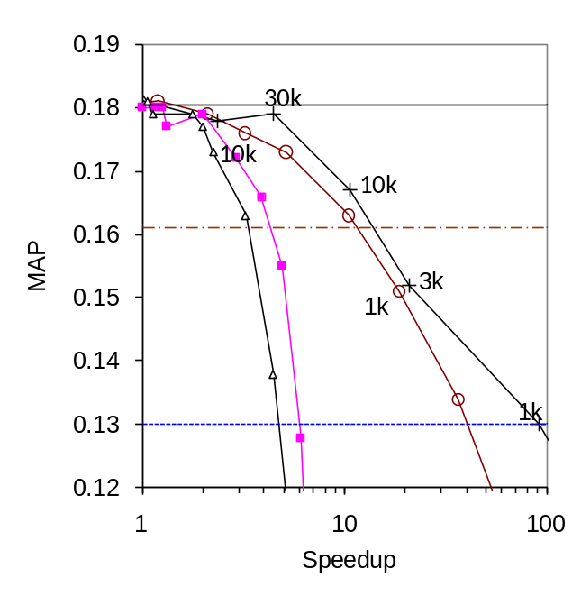
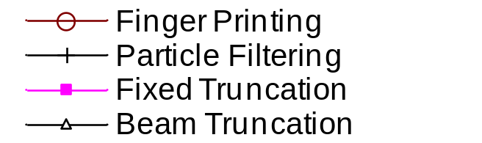
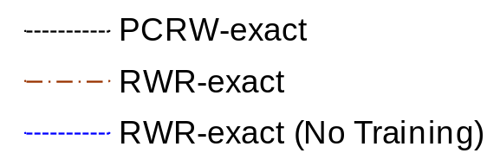
Results on the Yeast Data
Expert Finding
Gene Recommendation
Reference Recommendation
T₀ = 0.17s, L= 3
T₀ = 1.6s, L = 4
T₀ = 2.7s, L= 3

Slide 51
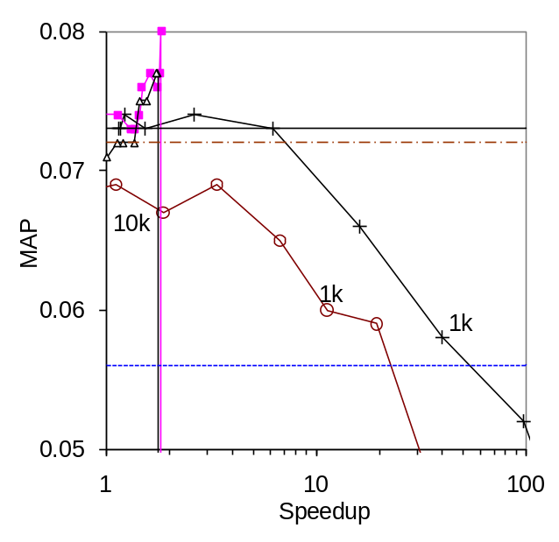
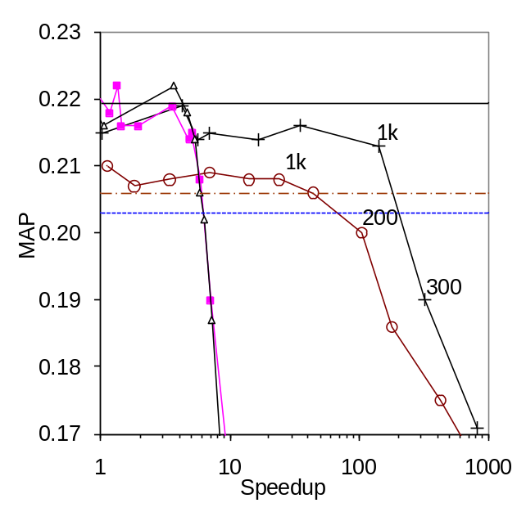
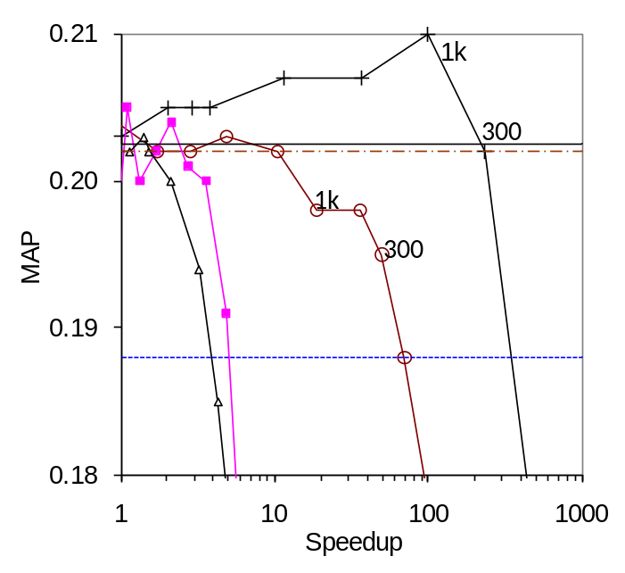
Results on the Fly Data
Expert Finding
Gene Recommendation
Reference Recommendation
T₀ = 0.15s, L= 3
T₀ = 1.8s, L= 4
T₀ = 0.9s, L= 3

Slide 52
Observations
Sampling strategies are more efficient than truncation strategies
  At each step, the truncation strategies need to generate exact distribution before truncation
Particle ﬁltering produces better MAP than ﬁngerprinting
  By reducing the variances of estimations
Retrieval quality is improved in some cases
  By producing better weights for the model

Slide 53
Outline
Motivation
Technical stuff 1
  What’s the right way of improving “nearness” measures using learning?
  PRA (Path Ranking Algorithm): Regularized optimization of a linear combination of path-constrained walkers
Technical stuff 2
  Some extensions: Query-independent paths and Popular-entity paths
Even more technical stuff
  Making all this faster
Conclusions

Slide 54
Dwar Ev ceremoniously soldered the final connection with gold. The eyes of a dozen television cameras watched him and the subether bore throughout the universe a dozen pictures of what he was doing.
He straightened and nodded to Dwar Reyn, then moved to a position beside the switch that would complete the contact when he threw it. The switch that would connect, all at once, all of the monster computing machines of all the populated planets in the universe - ninety-six billion planets - into the supercircuit that would connect them all into one supercalculator, one cybernetics machine that would combine all the knowledge of all the galaxies.
Dwar Reyn spoke briefly to the watching and listening trillions. Then after a moment’s silence he said, “Now, Dwar Ev.”
Dwar Ev threw the switch. There was a mighty hum, the surge of power from ninety-six billion planets. Lights flashed and quieted along the miles-long panel.
Dwar Ev stepped back and drew a deep breath. “The honour of asking the first questions is yours, Dwar Reyn.”
“Thank you,” said Dwar Reyn. “It shall be a question which no single cybernetics machine has been able to answer.”
He turned to face the machine. “Is there a God ?”
The mighty voice answered without hesitation, without the clicking of a single relay.
“Yes, now there is a god.”
Sudden fear flashed on the face of Dwar Ev. He leaped to grab the switch.
A bolt of lightning from the cloudless sky struck him down and fused the switch shut.
‘Answer’ by Fredric Brown.
©1954, Angels and Spaceships

Slide 55
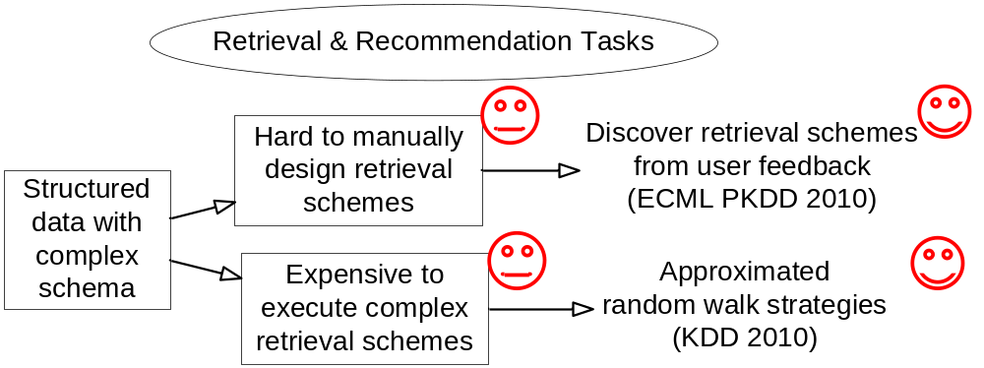
Conclusions/Summary
96-billion planet super-circuit

Slide 56
The End
Brought to you by
  NSF grant IIS-0811562
  NIH grant R01GM081293

