Slide 1
PeerRead
Jixuan Leng

Slide 2
Goal
Build a model that accepts a raw manuscript and outputs:
  A detailed written review
  Recommendation

Slide 3
Initial Data Exploration
PeerRead: Limitations for Today’s Setting
  Covers ICLR 2017, NeurIPS 2013–2017
  Not representative of modern ML conferences
    scale of submissions
    topic distribution
    writing style (LLM-assisted)
  PDF parsing pipeline is outdated

Slide 4


Initial Data Exploration - Cont.
Re-collected data via OpenReview API
  ICLR 2018–2025
  Use earliest available revisions for papers and reviews
    to avoid decision leakage
  Some revision histories are inaccessible
  Store multiple formats:
    JSON metadata + raw PDFs
    cleaned Markdown
  PDF processing pipeline:
    parse with VLMs
    remove author info and headers
    strip references and appendices
ReviewHub/Papers · Datasets at Hugging Face

Slide 5
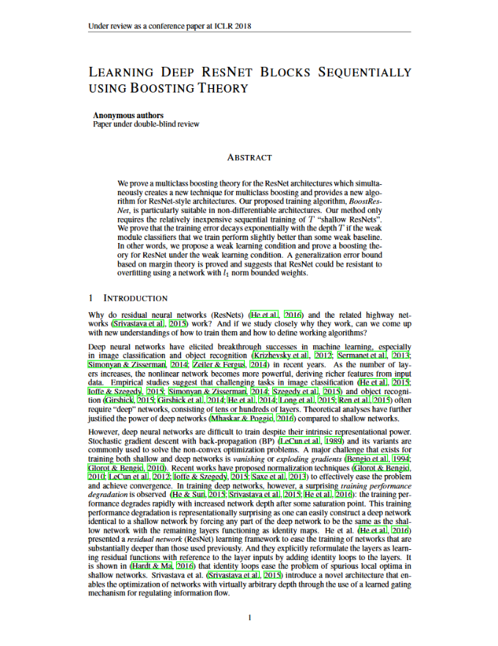
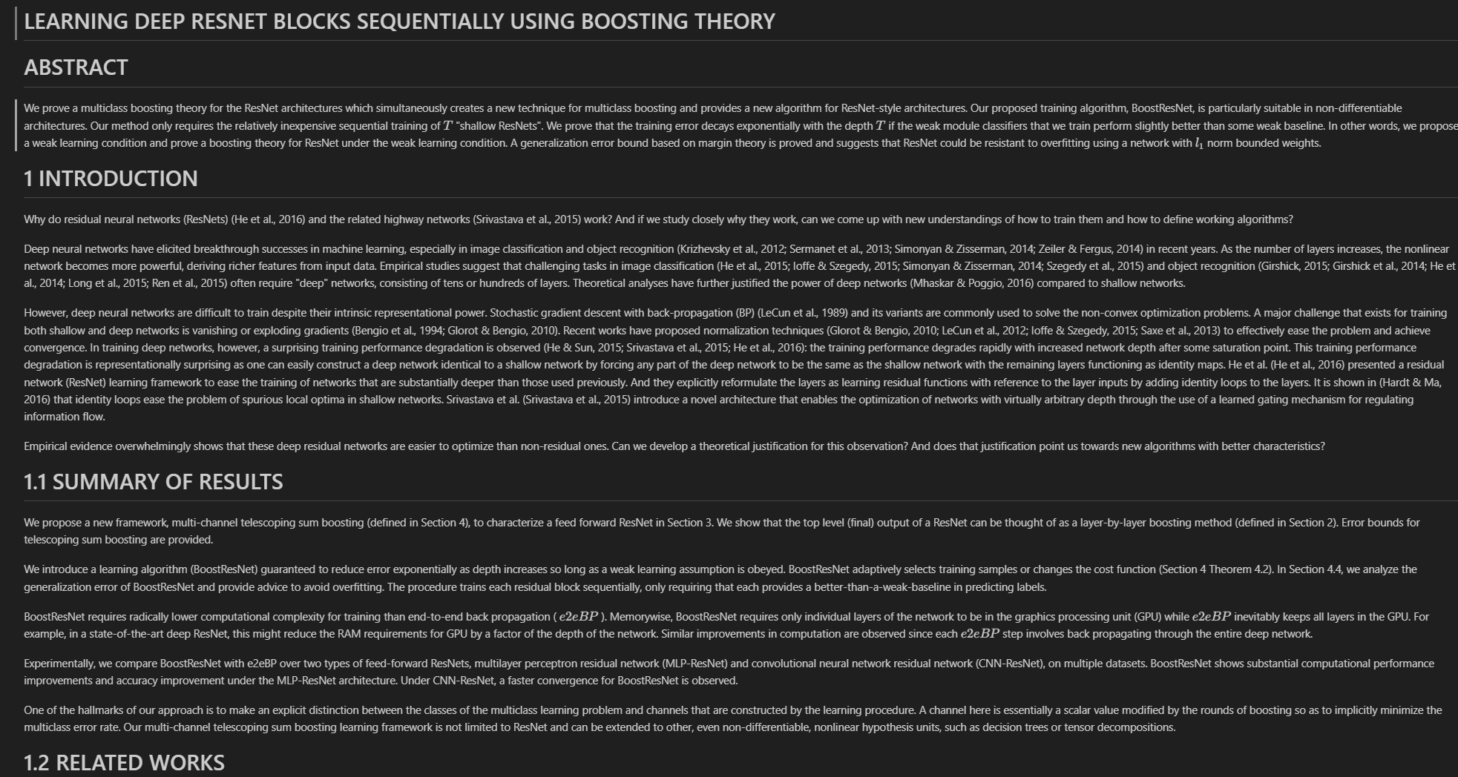
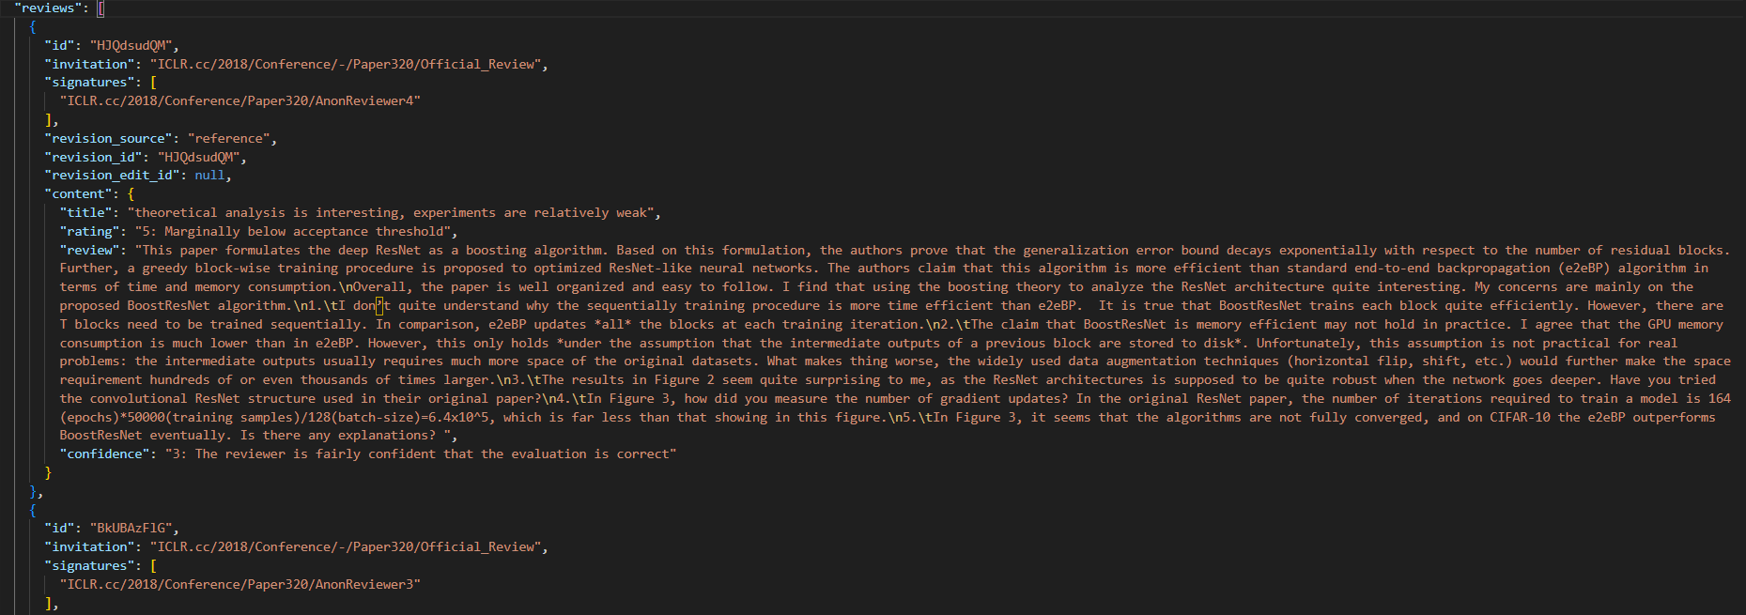

Slide 6
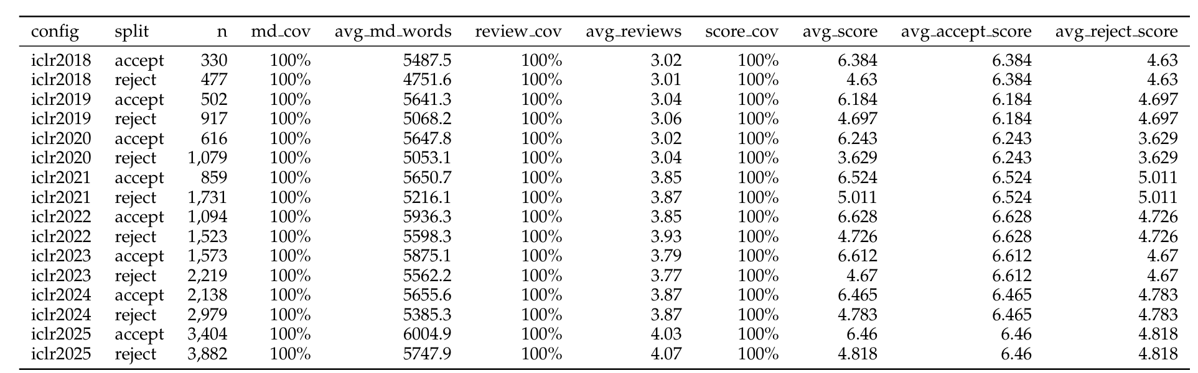
Initial Data Stats

Slide 7
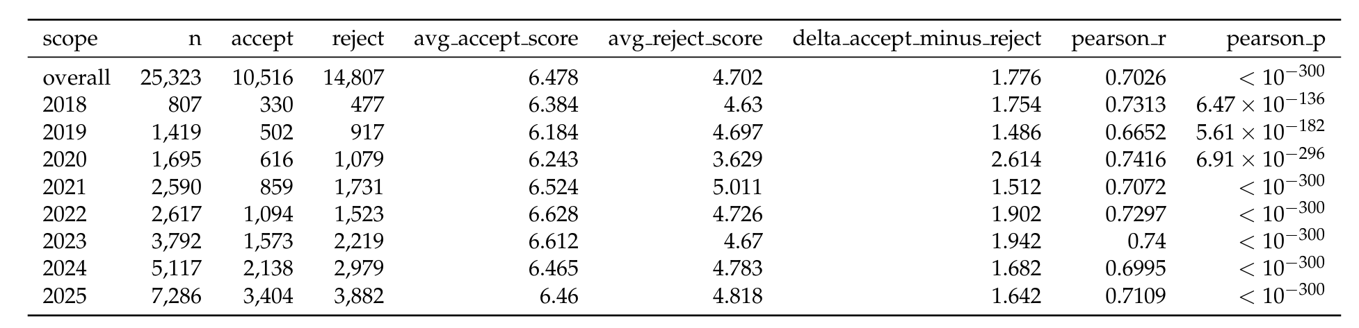
Initial Results

Slide 8
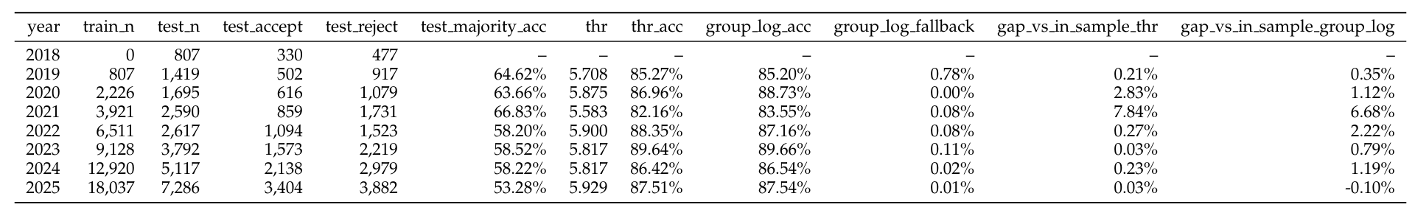
Initial Results

Slide 9
Pipeline Proposal
Two-stage training framework
  SFT
    Prompt + paper manuscript (markdown)
    Output: review + gold score
    Synthetic reviews as labels
  RL
    MSE as reward

Slide 10
Baseline
Classification
Prompted version

