Slide 1
ClinicalTrials.gov Analysis: INTENT TO SHARE INDIVIDUAL PARTICIPANT DATA
Wanda Whitney (NLM)
Narun Pornpattananangkul (NIMH)
Shirley Lee (NCI)
Monika Bihan (NLM)

Slide 2
Project collaborators
Scripts – Wanda Whitney, Shirley Lee, Narun Pornpattananangkul
Jupyter Notebook – Shirley Lee
Slides – Wanda Whitney and Monika Bihan

Slide 3
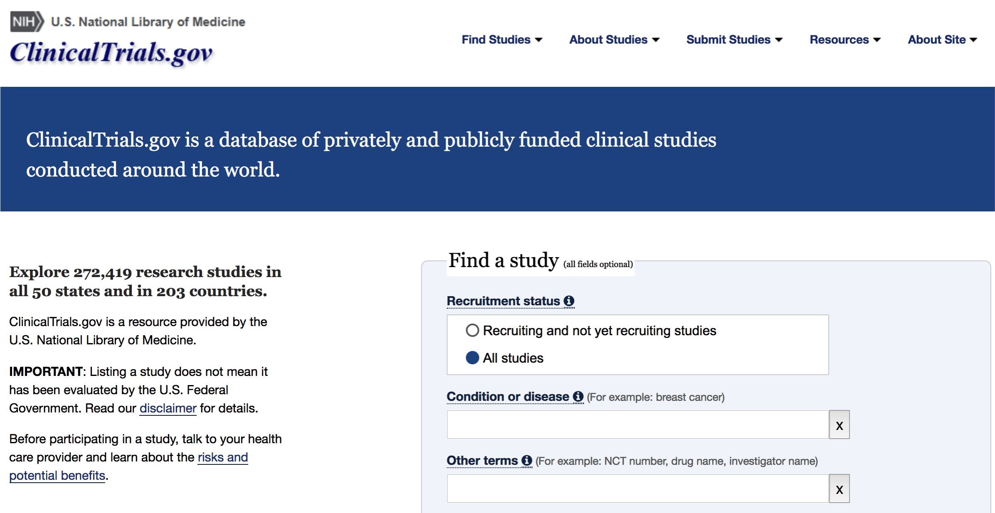
CLINICALTRIALS.GOV

Slide 4
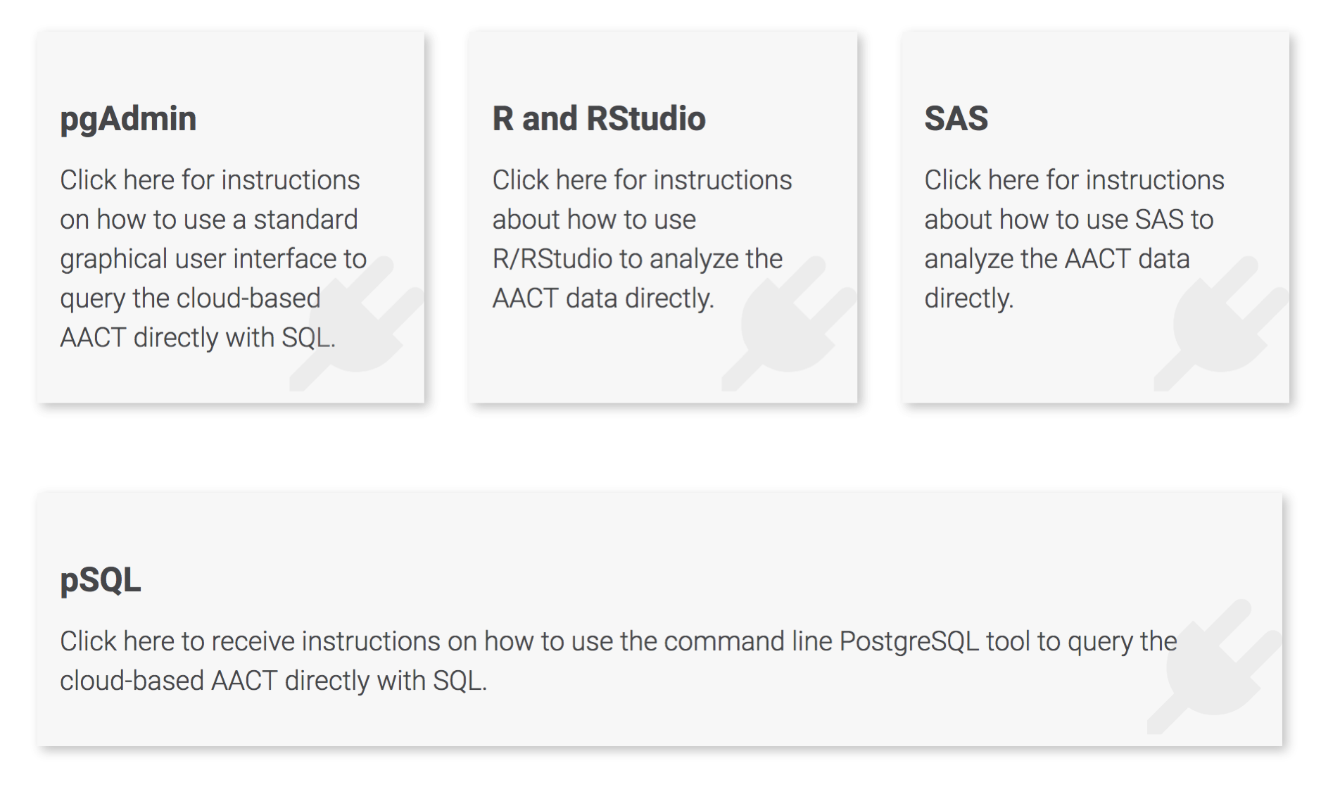
Aggregate analysis of clinicaltrials.gov
Notes:
The National Institutes of Health has recognized the importance of sharing individual participant data or IPD; and ClinicalTrials.gov includes fields for principal investigators to provide information about their plans to share data, as well as a description of how they plan to share it. The ClinicalTrials.gov team recently published a small study of clinical trial records to determine trialists' intent to share individual participant data as called for by the International Committee of Medical Journal Editors (ICMJE) and the US Institute of Medicine [1].

Slide 5
ANALYSIS OF INTENT TO SHARE DATA: YES, NO, UNDECIDED

Slide 6
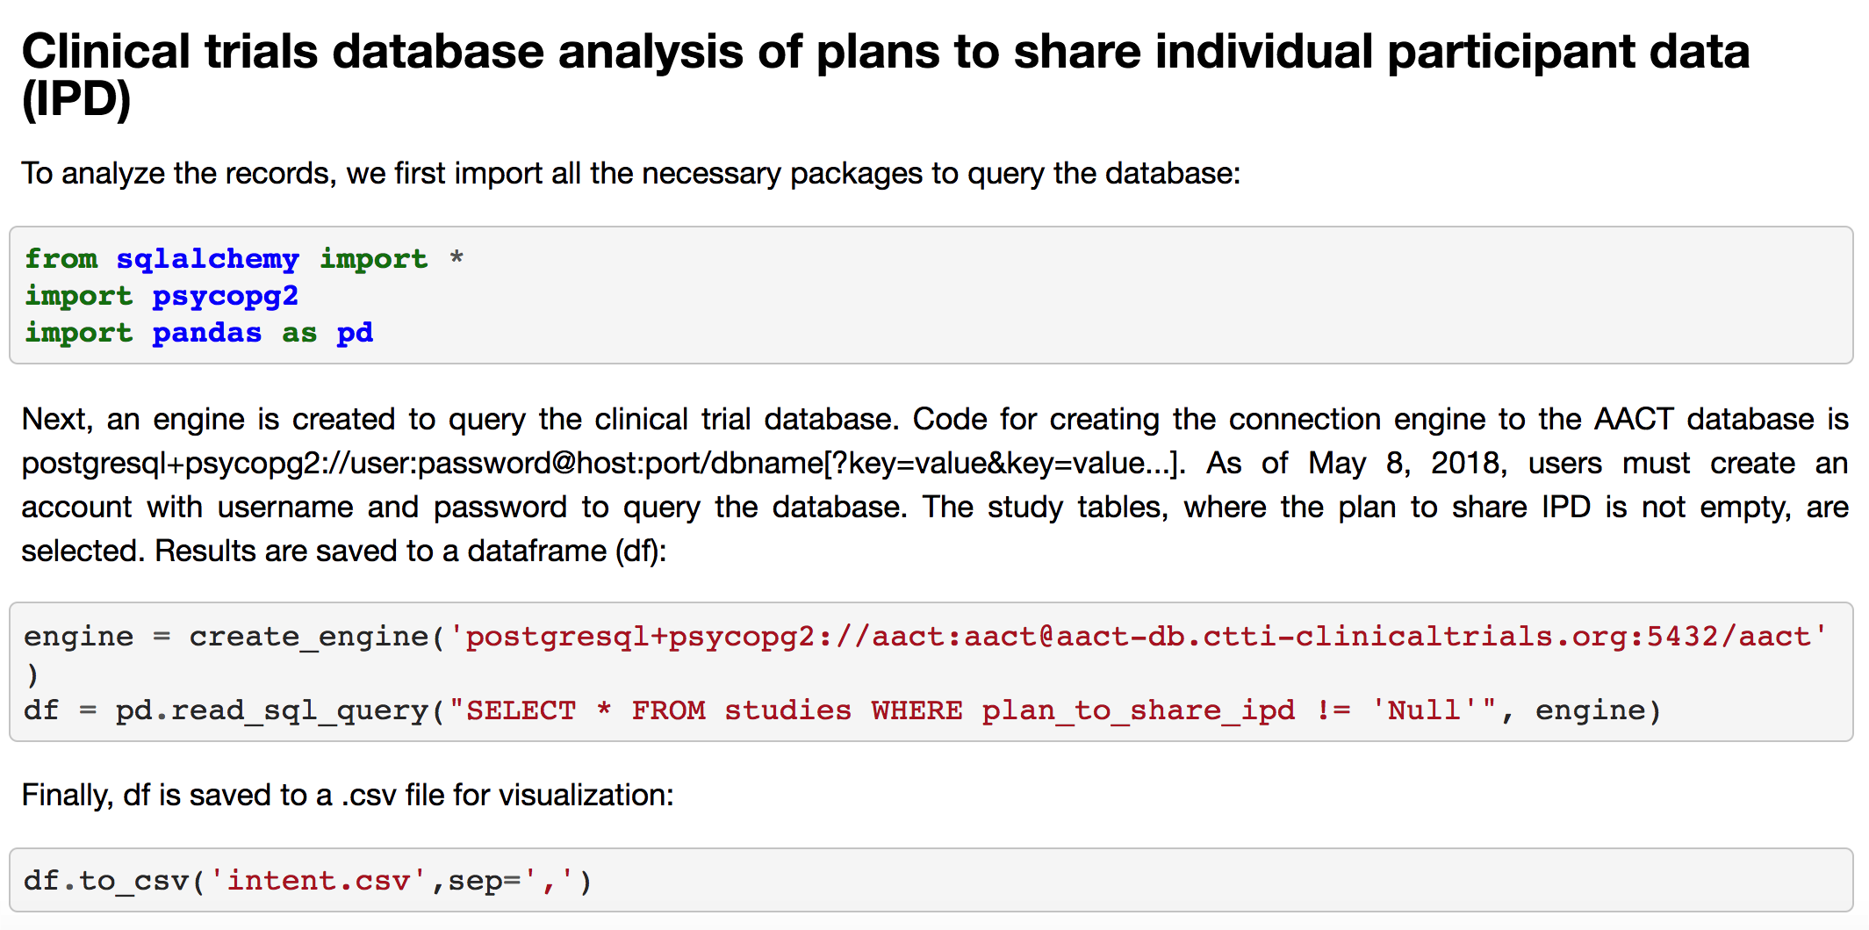
First code set to query db

Slide 7
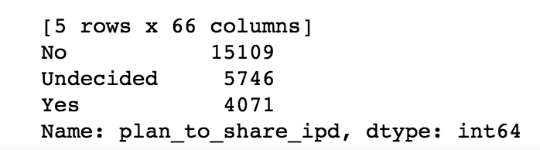
Results: yes, no, undecided

Slide 8
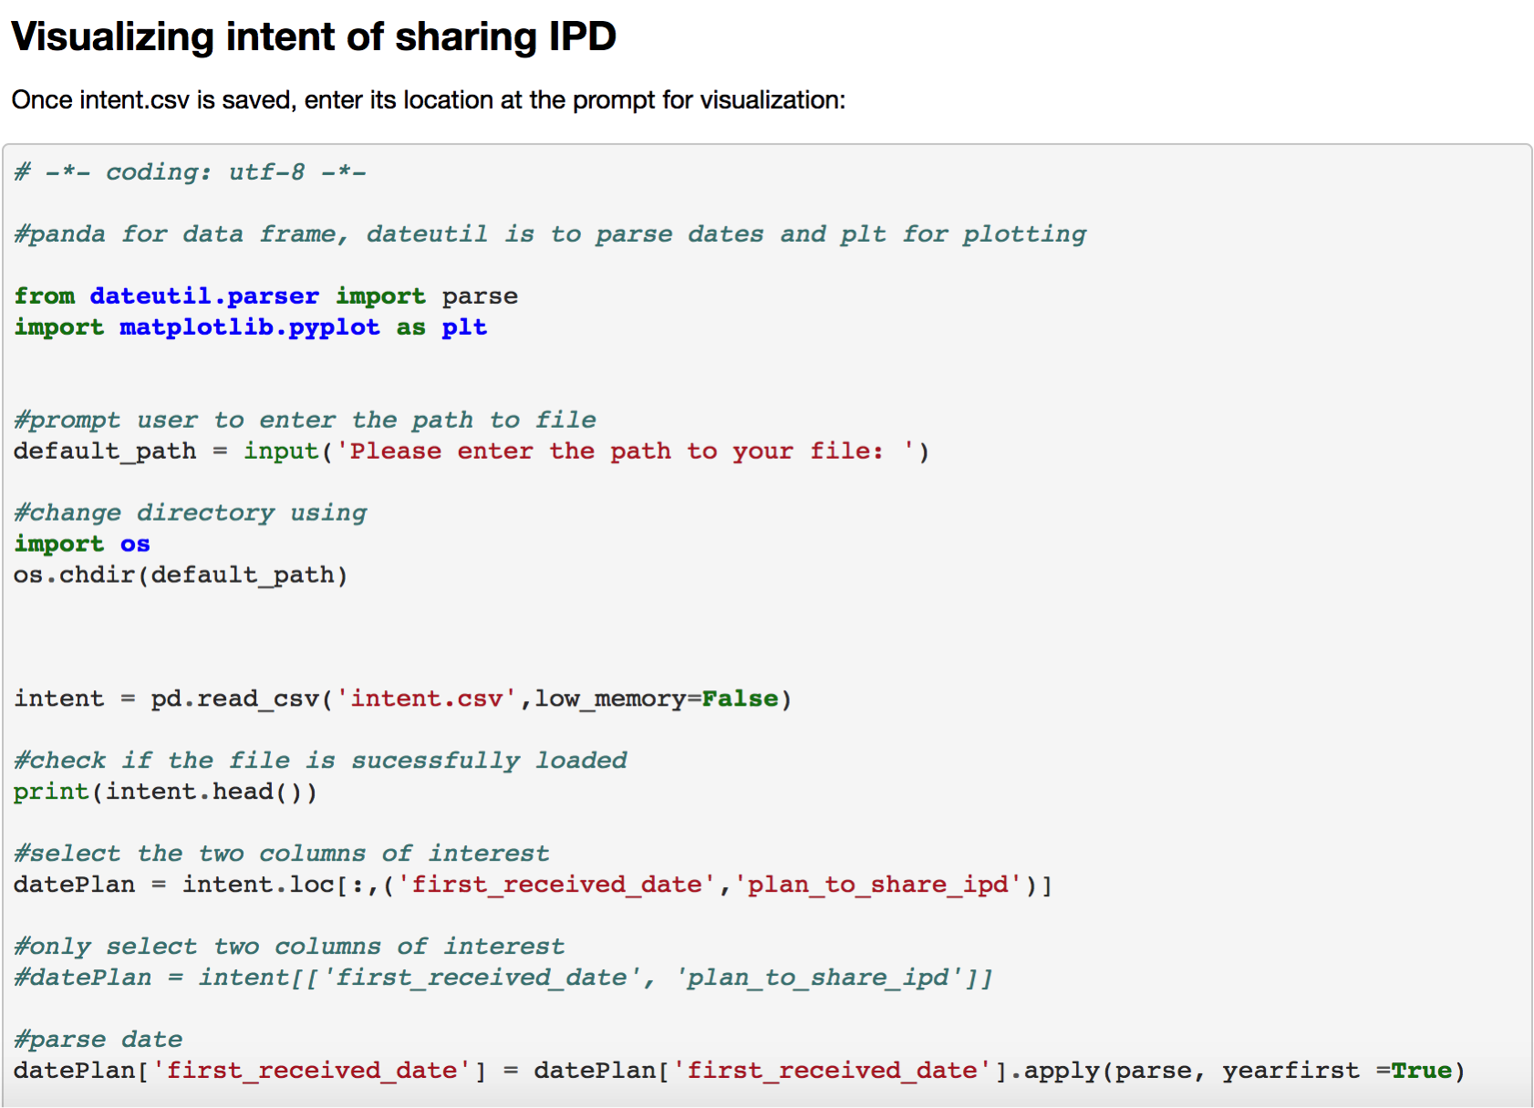
Visualization of the data

Slide 9
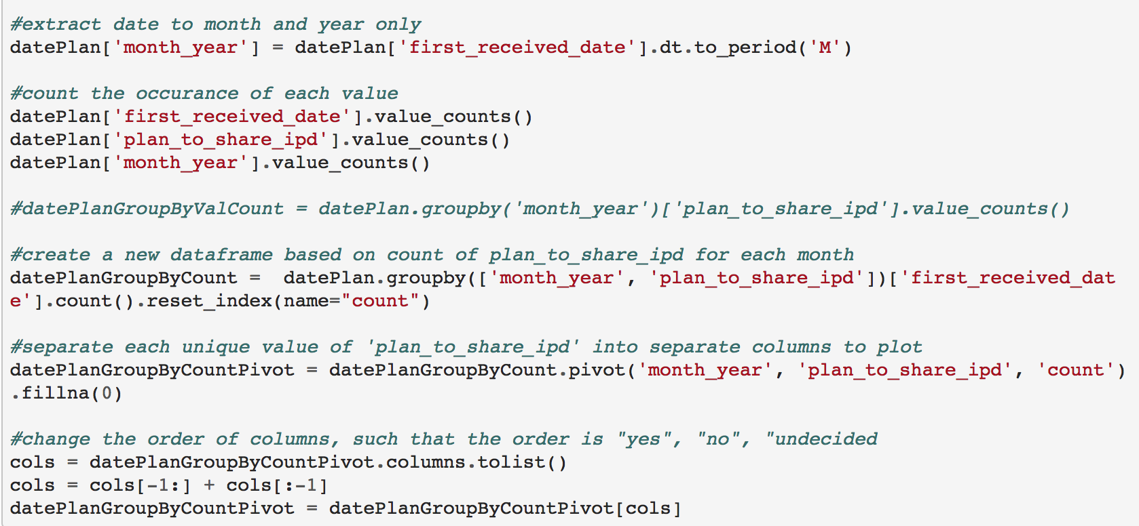
More visualization code

Slide 10
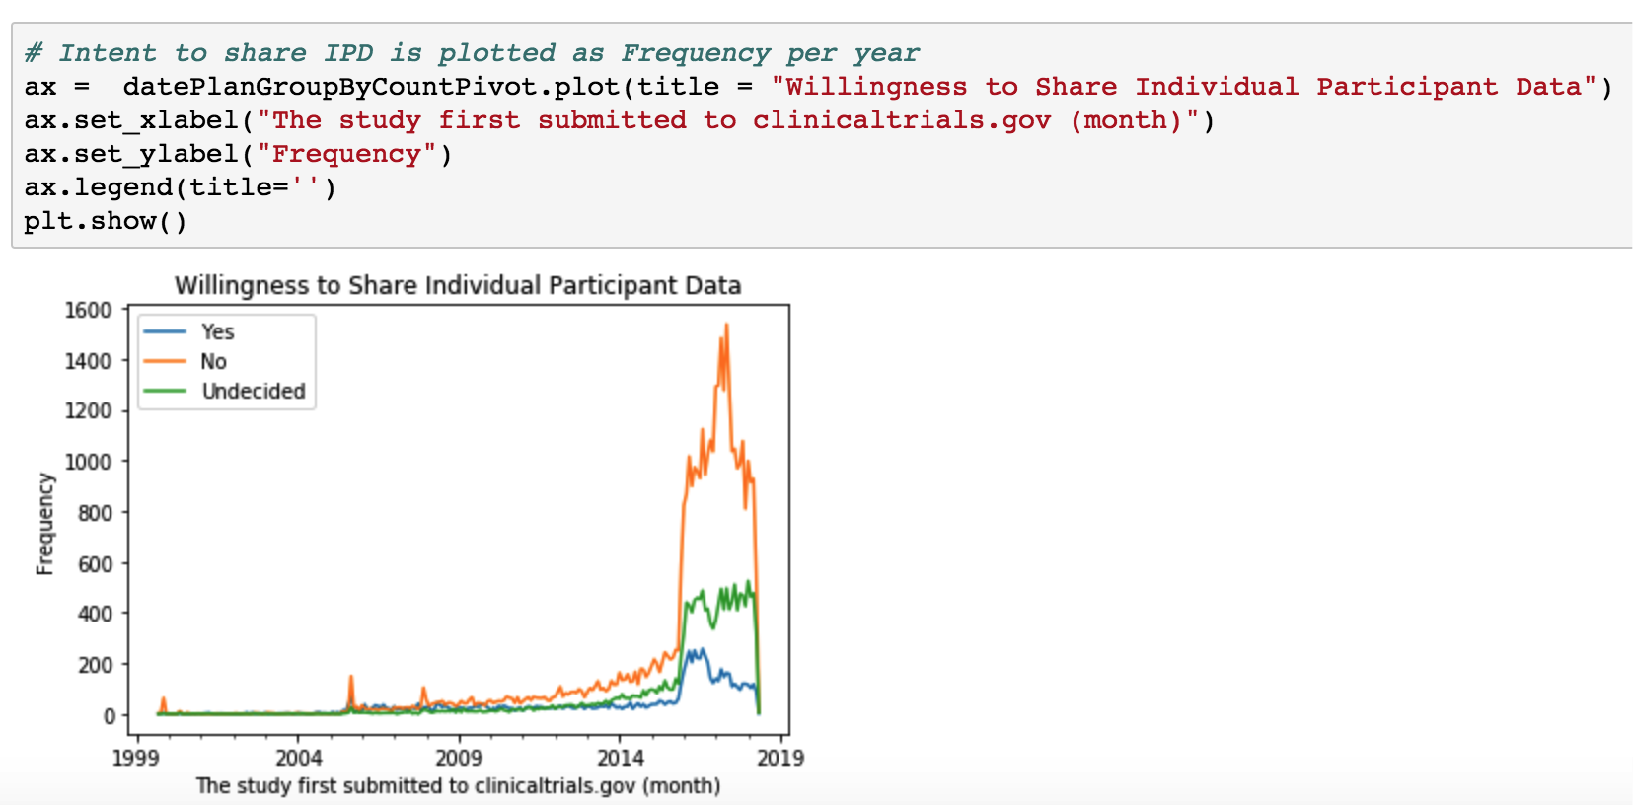
graph

Slide 11
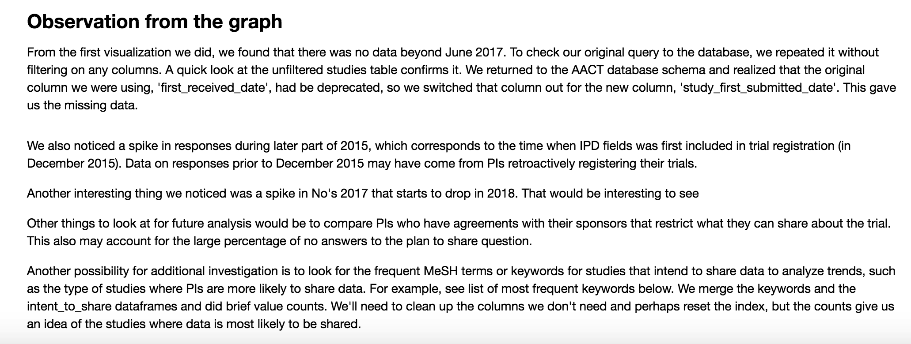
Visualization comments

Slide 12
Future project plans
Contact ClinicalTrials.gov collaborators regarding findings to ask questions about data
Analyze additional data to determine why so many PIs don’t intend to share
Analyze topics or keywords of studies where PIs do intend to share data

Slide 13
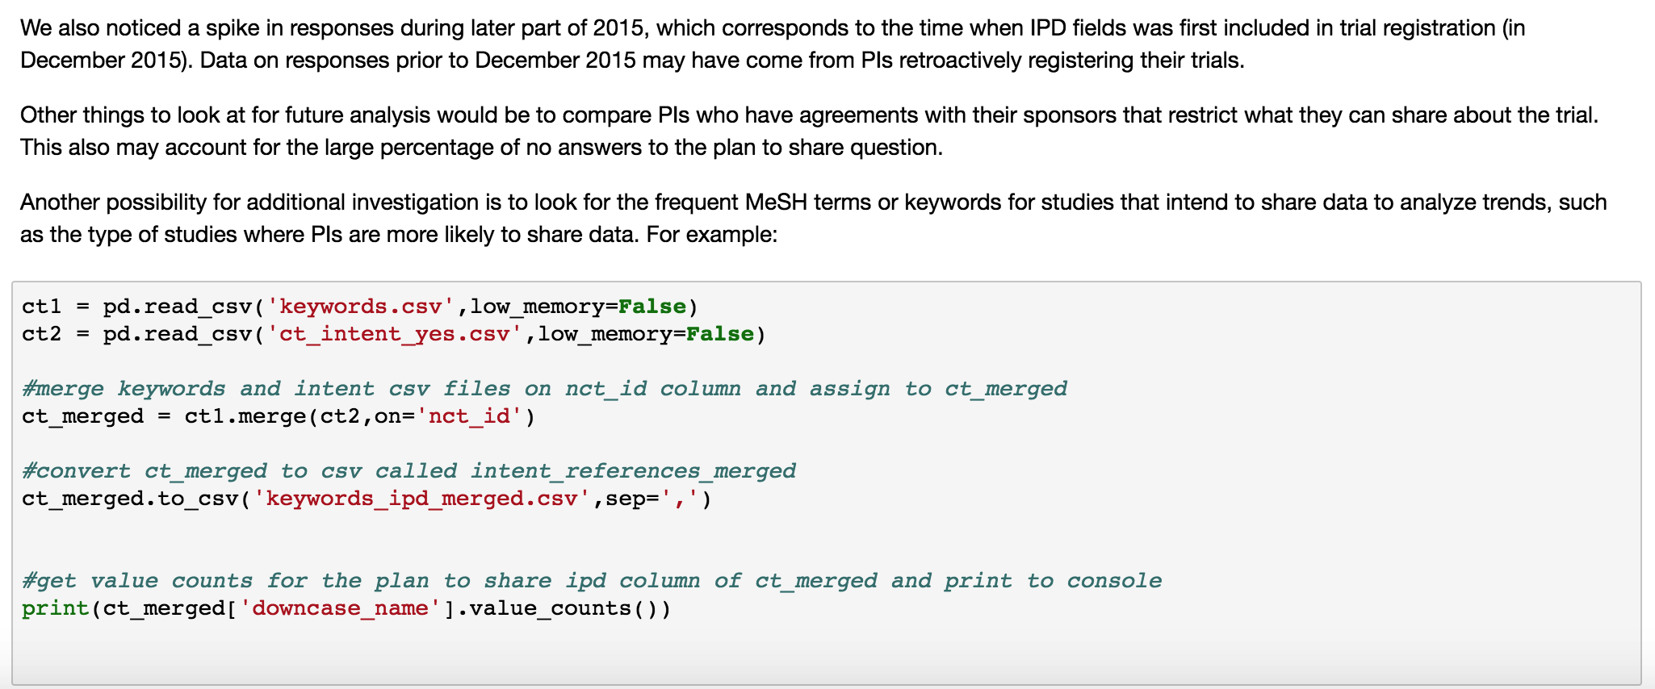
Visualization – additional comments

Slide 14
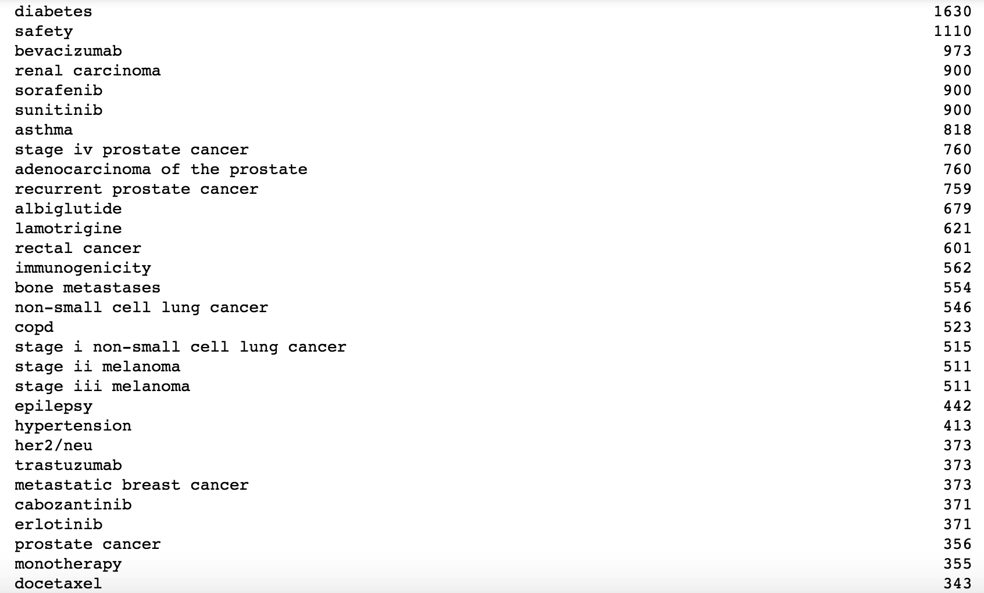
Keyword counts – top 400

Slide 15
Thank you!

