Slide 1
Content Analysis of Clinical Trials Data
Wanda
Narun
Shirley
Monika

Slide 2
Clinical Trials Data
ClinicalTrials.gov as a part of NIH ask PI to inform if they intend to share Individual Participant Data(IPD)
ClinicalTrials.gov has information how IPD information will be shared
Data has been analyzed on records registered where the plan to share column isn’t empty
Purpose of this project is to examine PI’s intent and whether intent has changed since the International Committee of Medical Journal Editors (ICMJE) published their policy of requiring a data sharing statement for clinical trial registration
Source of our data is the Aggregate Analysis of ClinicalTrials.gov (AACT) database containing all the ClinicalTrials.gov records

Slide 3
Connect and query database
Import libraries sqlalchemy , psycopg2, and panda
Create an engine to the database
engine = create_engine()
Query Engine and save the information as dataframe (df)
df = pd.read_sql_query("SELECT * FROM studies WHERE plan_to_share_ipd != 'Null'", engine)
Save information as csv file
df.to_csv('intent.csv',sep=',')

Slide 4
Open file and capture columns of interest
Import necessary libraries os from dateutil.parser import parse import matplotlib.pyplot as plt
Prompt user to provide input file path and change to that dir
default_path = input() os.chdir(default_path)
Select two columns of interest
datePlan = intent[[, ]]

Slide 5
Parse and clean data
Parse Date columns
datePlan['first_received_date'] = datePlan['first_received_date'].apply(parse, yearfirst =True)
Extract date to month and year only
datePlan['month_year'] = datePlan['first_received_date'].dt.to_period('M')
Count the occurance of each value
datePlan[‘month_year’].value_counts()
datePlan[‘plan_to_share_ipd’].value_counts()
datePlan[‘first_received_date’].value_counts()
Create a new dataframe based on count of plan_to_share_ipd for each month
datePlanGroupByCount = datePlan.groupby([‘month_year’, ‘plan_to_share_ipd’])[‘first_received_date’].count().reset_index(name=)
Seprate each unique value of into separate columns to plot
datePlanGroupByCountPivot = datePlanGroupByCount.pivot’month_year’,’plan_to_share_ipd’ ,’count’ ).fillna(0)
Change the order of columns, such that the order is , ,
cols = datePlanGroupByCountPivot.columns.tolist() cols = cols[-1:] + cols[:-1] datePlanGroupByCountPivot = datePlanGroupByCountPivot[cols]

Slide 6
Plot Frequency of three potential choices as a function of year
Plot and label the data
ax = datePlanGroupByCountPivot.plot(title = )
ax.set_xlabel()
ax.set_ylabel()
ax.legend(title=’’) plt.show()

Slide 7

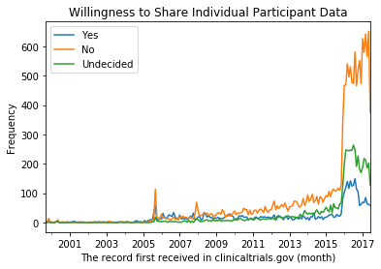
Willingness to Share Individual Participant Data Plot

Slide 8
References and Thanks
http://www.icmje.org/recommendations/browse/publishing-and-editorial-issues/clinical-trial-registration.html#two
https://jamanetwork.com/journals/jama/fullarticle/2670243 https://aact.ctti-clinicaltrials.org/
Prof. Martin Skarzynski

