Slide 1
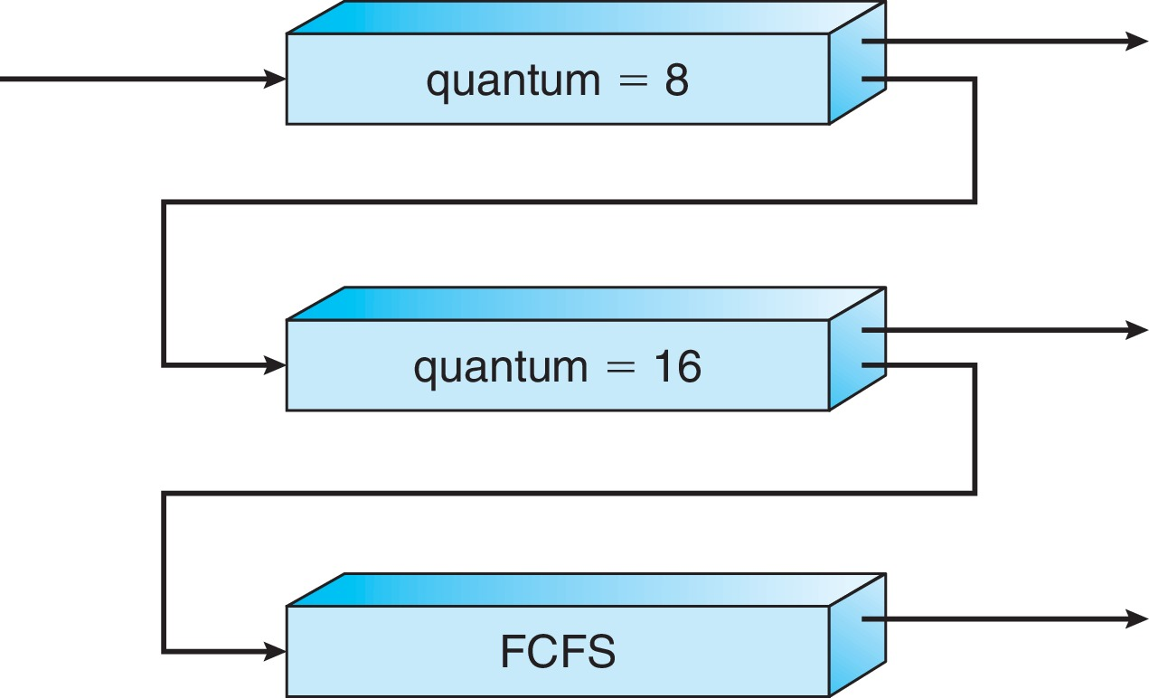
Example of Multilevel Feedback Queue
請注意此範例無Run limit !
Three queues:
Q₀ – RR with time quantum 8 milliseconds
Q₁ – RR time quantum 16 milliseconds
Q₂ – FCFS
Scheduling
A new job enters queue Q₀ which is served FCFS
When it gains CPU, job receives 8 milliseconds
If it does not finish in 8 milliseconds, job is moved to queue Q₁
At Q₁ job is again served FCFS and receives 16 additional milliseconds
If it still does not complete, it is preempted and moved to queue Q₂

Slide 2
Example of RR with Time Quantum = 4
Process Burst Time
P₁ 24
P₂ 3
P₃ 3
The Gantt chart is:
Typically, higher average turnaround than SJF, but better response
q should be large compared to context switch time
q usually 10ms to 100ms, context switch < 10 usec

Slide 3






Example of Priority RR and Run limit
假設有一Queue有5行程，行程執行時間如下，
Queue Type 為(Priority round-robin) Run limit=2 Time Quantum= 3
ProcessA arri Burst TimeT Priority
P₁ 8 2
P₂ 5 2
P₃ 5 1
$$P_{3}$$
$$P_{3}$$
$$P_{1}$$
$$P_{2}$$
$$P_{1}$$
$$P_{2}$$
0
3
5
8
11
14
16
此範例中$P_{3}$先結束，下一個是$P_{2}$結束，而$P_{1}$並未跑完需要到下一個Queue排隊

Slide 4
Example of SJF
ProcessArriva l Tim Burst Time
P₁ 0.0 6
P₂ 2.0 8
P₃ 4.0 7
P₄ 5.0 3
SJF scheduling chart
Average waiting time = (3 + 16 + 9 + 0) / 4 = 7

