Slide 1
College Event Website
Group 12

Slide 2
Group 12
Andrew Mendoza – Back end
William Wilhite – Front end
Andrew McKenzie – Database design

Slide 3
College Event Website
A website to facilitate college events hosted by Student Organizations for both public and private audiences.
Allow for the creation of new events and comment style discussion of the events.

Slide 4
Technical Details
Back End
MySQL
PHP
Front End
AngularJS
Bootstrap
Google Maps API

Slide 5
Database Layout

Slide 6
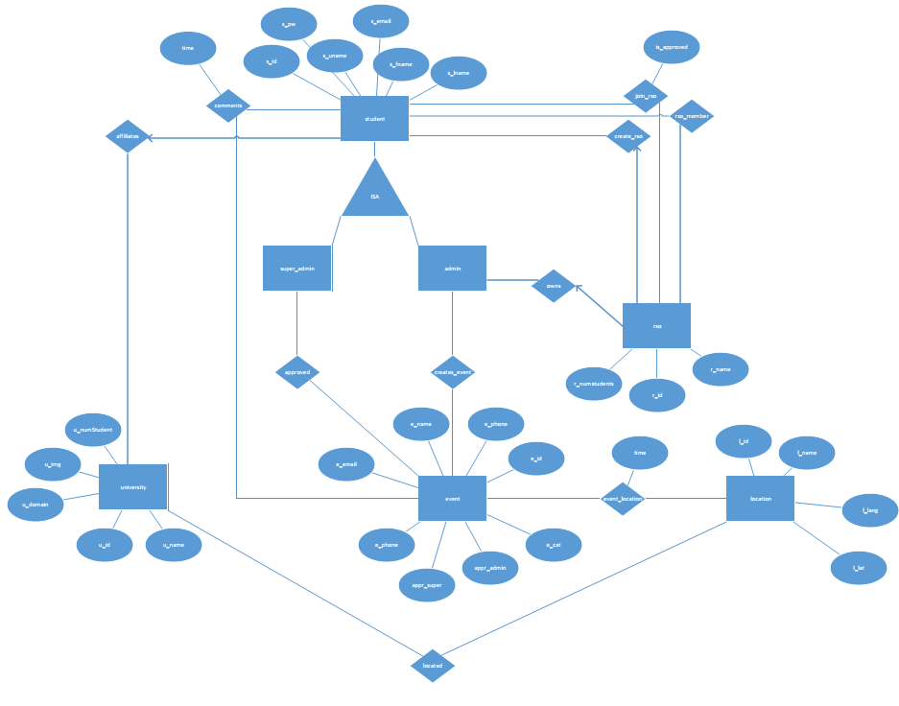

Slide 7
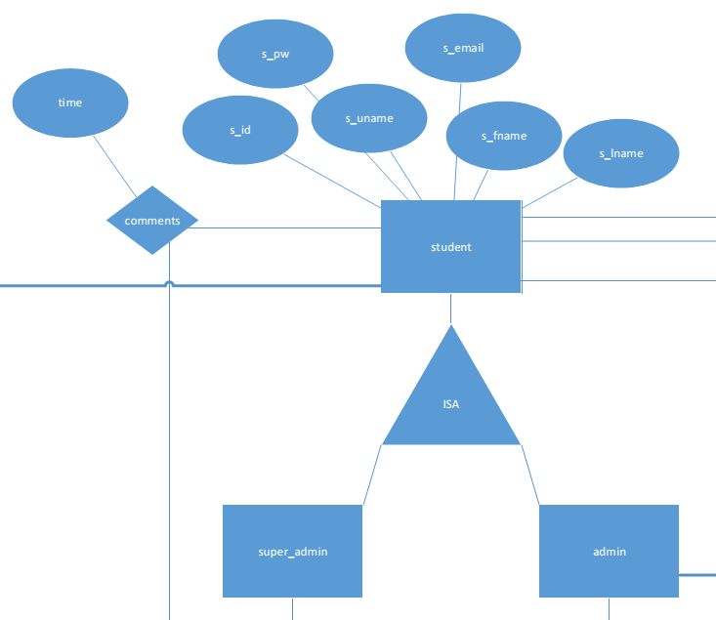

Slide 8
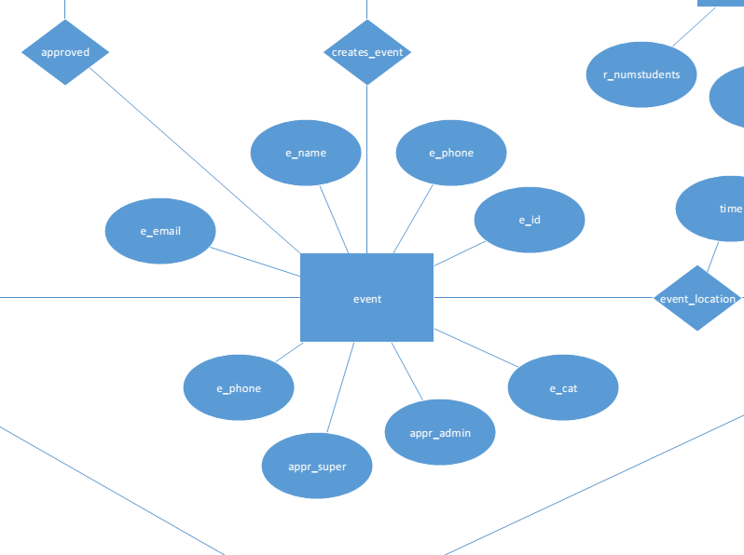

Slide 9
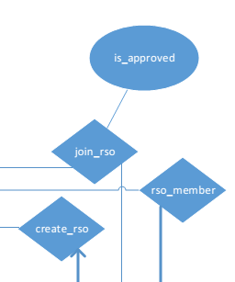
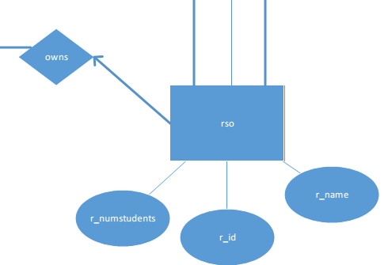

Slide 10
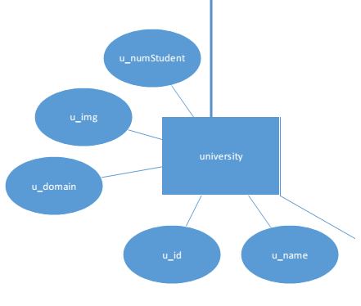

Slide 11
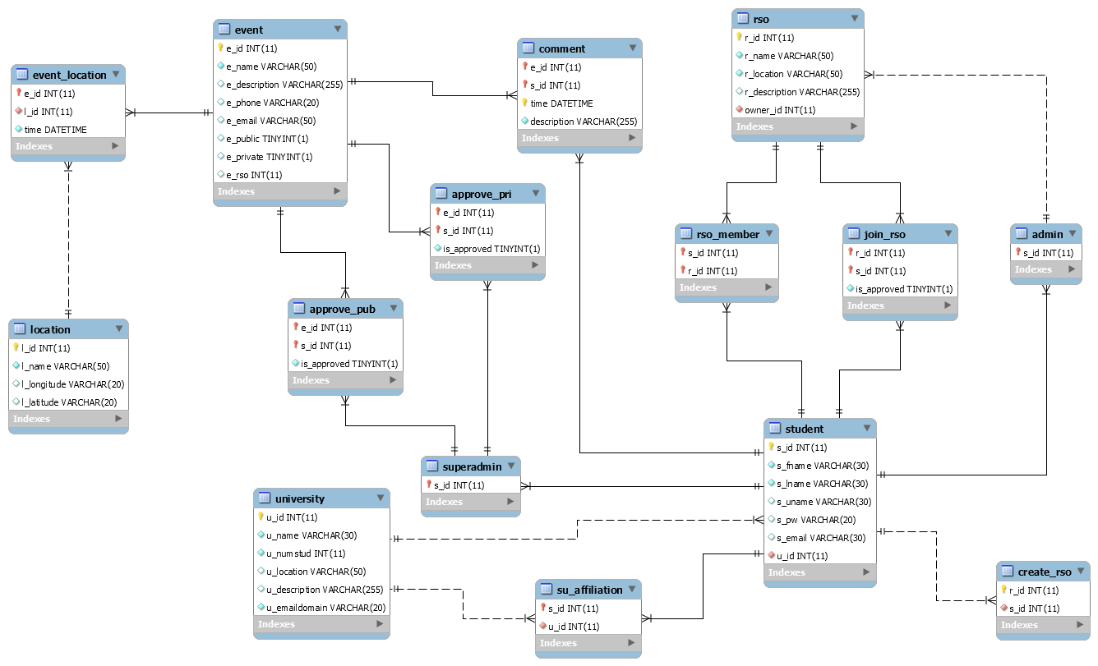

Slide 12
MySQL Creation
CREATE TABLE student(
s_id int(11) NOT NULL AUTO_INCREMENT,
s_fname varchar(30) NOT NULL,
s_lname varchar(30) NOT NULL,
s_uname varchar(30),
s_pw varchar(20),
s_email varchar(30),
u_id int(11) NOT NULL,
PRIMARY KEY (s_id),
FOREIGN KEY (u_id) REFERENCES university(u_id) ON DELETE CASCADE
);

Slide 13
MySQL Insert
INSERT INTO `eventwebsite`.`location` (`l_id`, `l_name`, `l_longitude`, `l_latitude`) VALUES ('1', 'UCF', '28.603', '-81.200');
INSERT INTO `eventwebsite`.`university` (`u_id`, `u_name`, `u_numstud`,`u_location`, `u_description`, `u_emaildomain`) VALUES ('1', 'UCF', '5', '1', 'University of Central Florida', 'knights.ucf.edu');
INSERT INTO `eventwebsite`.`student` (`s_id`, `s_fname`, `s_lname`, `s_uname`, `s_pw`, `s_email`, `u_id`) VALUES ('2', 'Andrew', 'Mendoza', 'AM2', '123', 'AM2@knights.ucf.edu', '1');

Slide 14
AngularJS and Bootstrap

Slide 15
PHP

