Slide 1
Artificial Neural Networks for Protein Structure Prediction
W. Willie Wells

Slide 2

Diseases incapacitate and sometimes kill their victims.
It would be pleasant to be able to engineer therapeutic drugs and enzymes for all known pathogens.

Slide 3

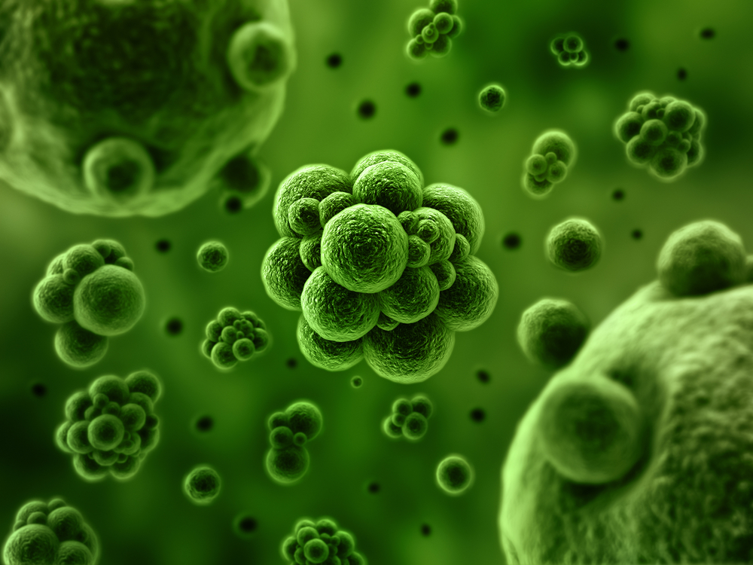
Accurate protein secondary structure prediction saves time and money in the development process of drugs to counteract pathogens.
Though accurate X-ray Diffraction is difficult, slow, and expensive. Solution: utilization of machine learning techniques.

Slide 4

Basics of protein secondary structure
Basics of Artificial Neural Networks (ANN)
How to apply ANN to protein secondary structure prediction

Slide 5
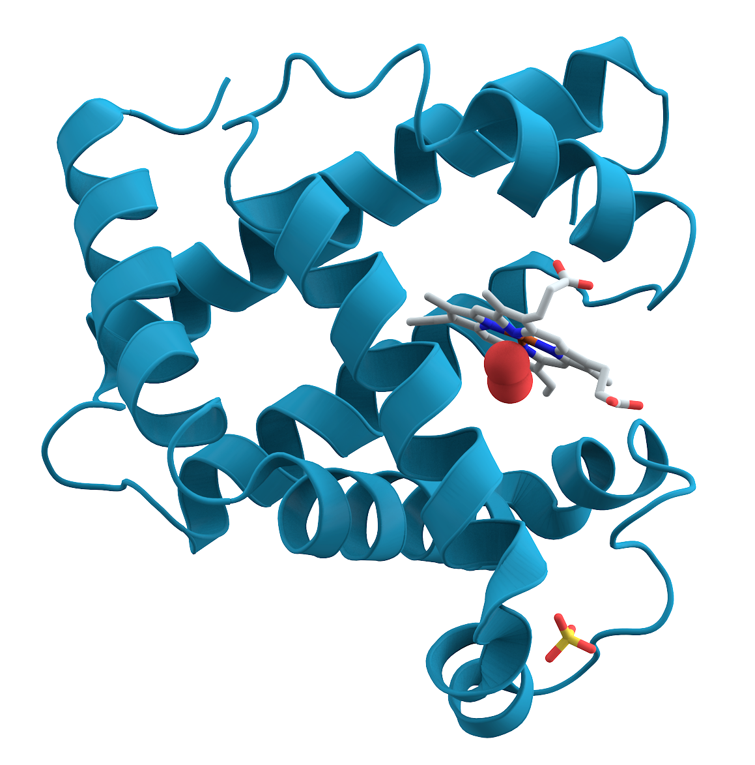
There exists multiple algorithms in use to predict protein secondary structure.
Protein secondary structure is highly non-linear and involves complex interactions.
Hydrogen bonding patterns determine protein secondary structure.

Slide 6
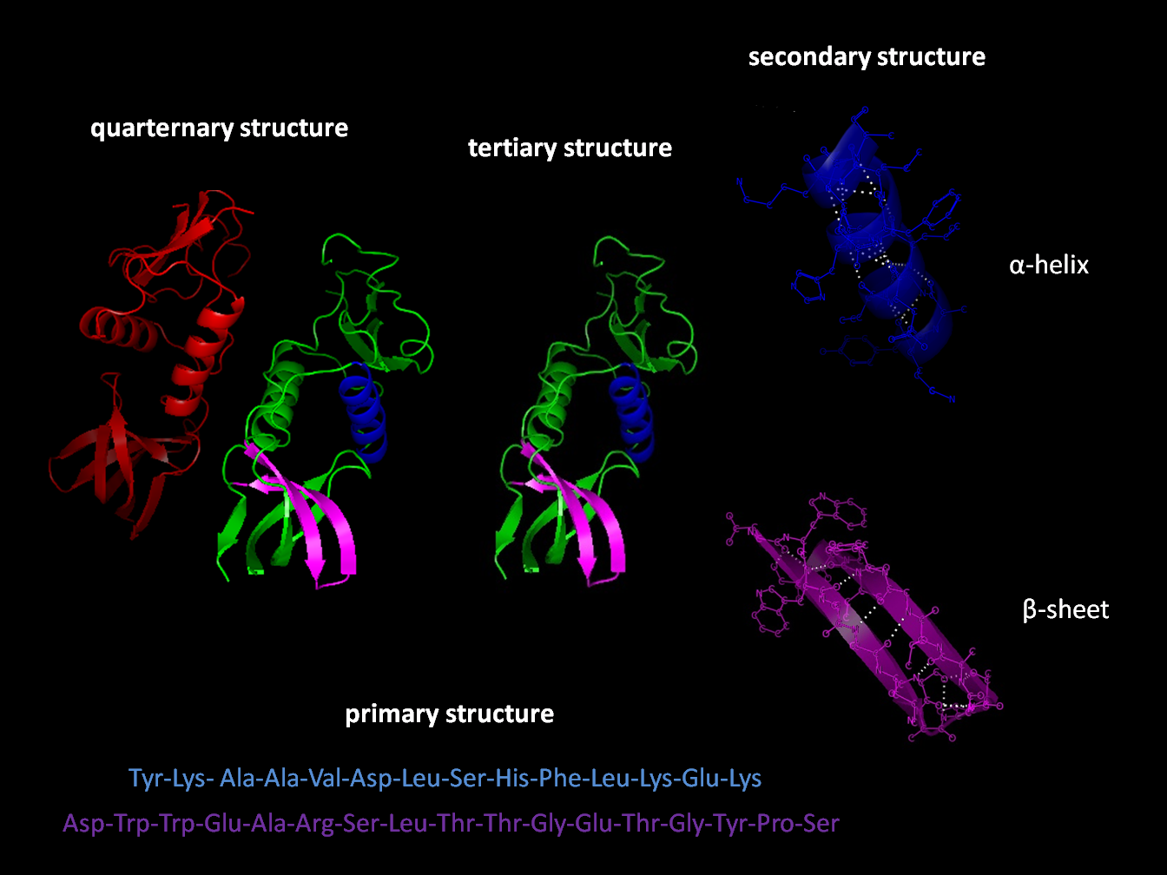
Types of Protein Secondary Structures:
α-helix (H)
β-sheet (E = extended strand)
coil or loop (C or L)
turn (T)

Slide 7
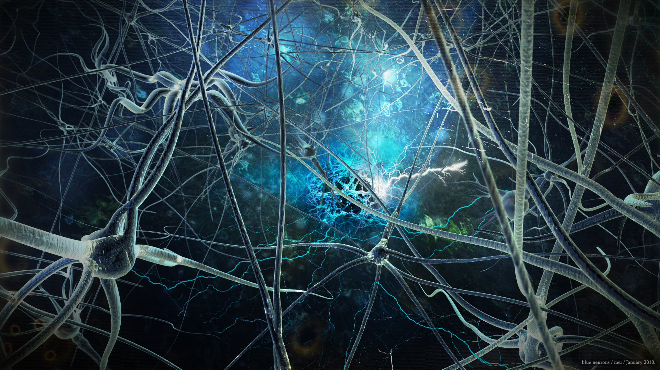
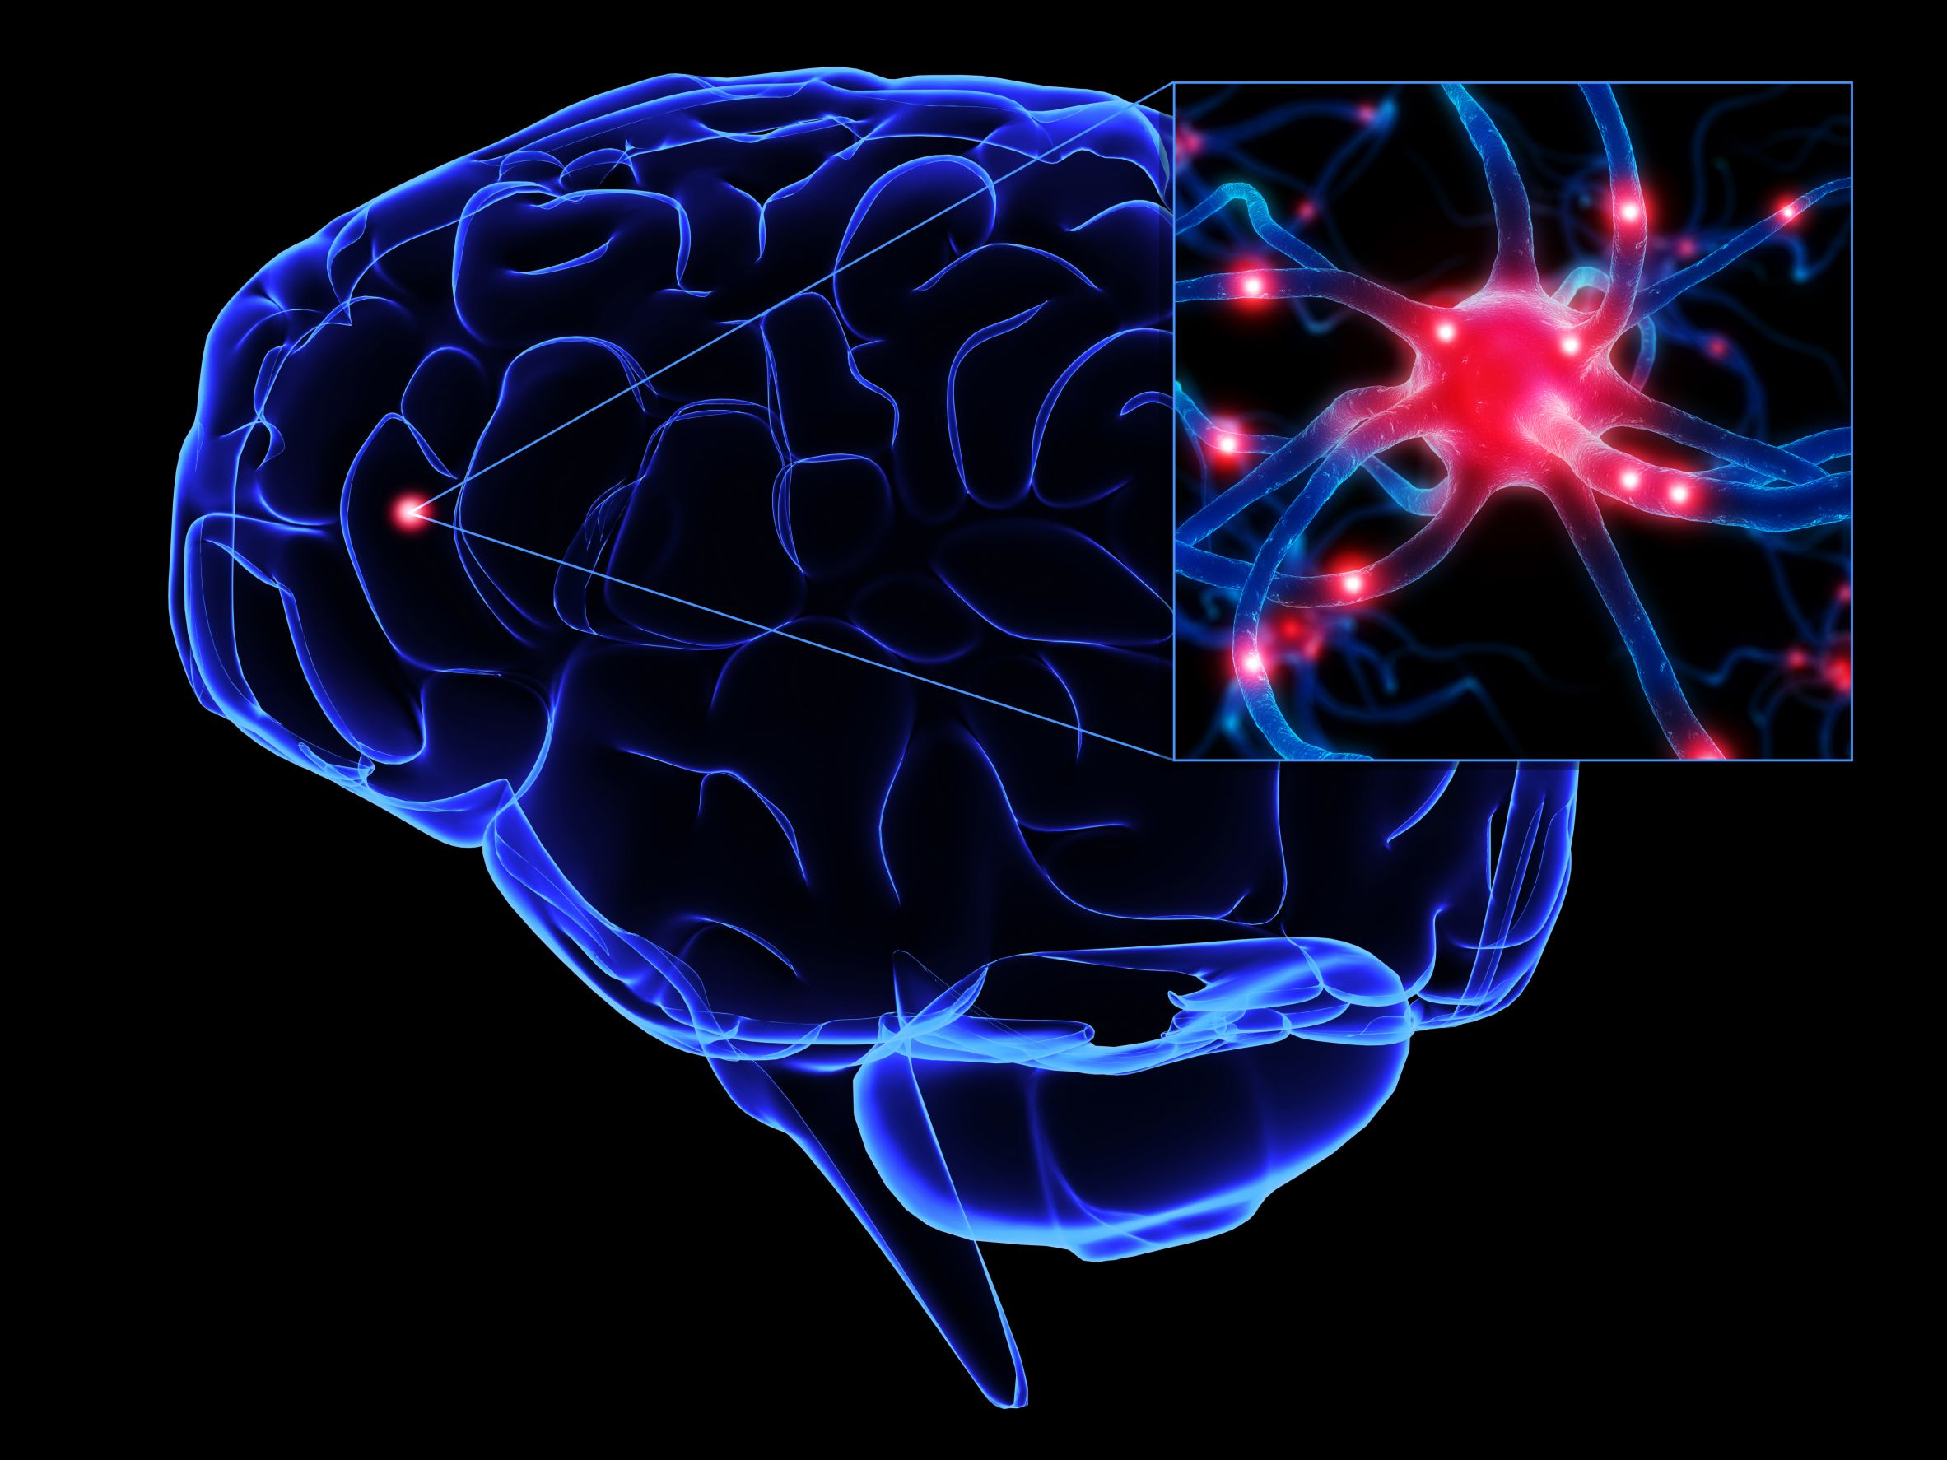
Artificial neural networks are modeled after the network of neurons in the brain.
Each artificial neuron has a weight (wij) associated with each input (xj).
All inputs to a single neuron are weighted, summed and passed to an activation function (f) to produce an output (yi).
yi = f(Σjwijxj), for all yi in ANN

Slide 8
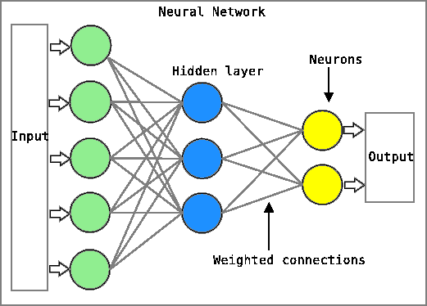
The learning process during the training phase:
Compare output with desired output
Backward propagate the error (E)
Update weights via wij + ∆wij
∆wij = -α * δE/δwij
Where α is the learning rate.

Slide 9
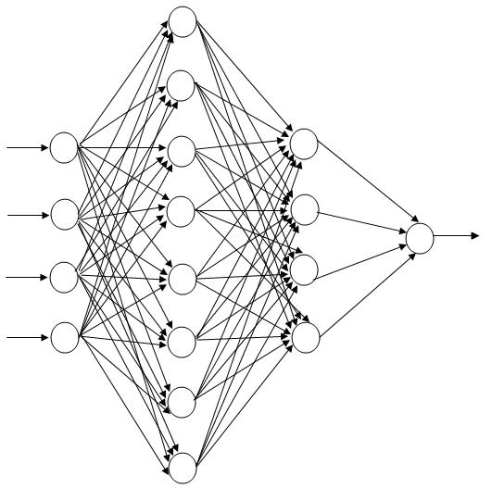
Perceptron
Feed Forward (Multi-layer Perceptron)
Radial Basis Function
Bidirectional Recursive
Kohonen Self Organizing Maps (SOM)
Competitive Layers
Learning Vector Quantification
Hopfield Network

Slide 10
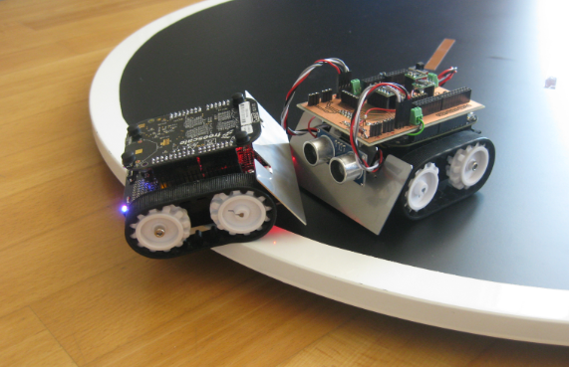
Advantages:
  Adaptive learning
  Self organization
  Real-time operation (parallel)
  Computationally powerful (complex patterns)
Disadvantages:
  ↑Number of neurons→↑computation time
  Overfitting
  Difficult to implement
  Requires data normalization

Slide 11
Applying ANN to Bioinformatics
Extract features from molecular sequences
Select usable features and encode
Initialize neural network for training
  assign number of layers, amount of neurons per layer, and random weights for each neuron input
Train network
Encode output to protein secondary structure
Using ANN results in a 70 – 90% accuracy rate

Slide 12

Diseases incapacitate and sometimes kill their victims.
Artificial Neural Networks though not perfect provide 70 - 90% accuracy in predicting protein secondary structure.
Applying these results saves time and money when engineering new therapeutic drugs to fight pathogens.

