Slide 1
A Survey of Socially Interactive Robots
Terrence Fong, Illah Nourbakhsh, Kerstin Dautenhahn

Slide 2
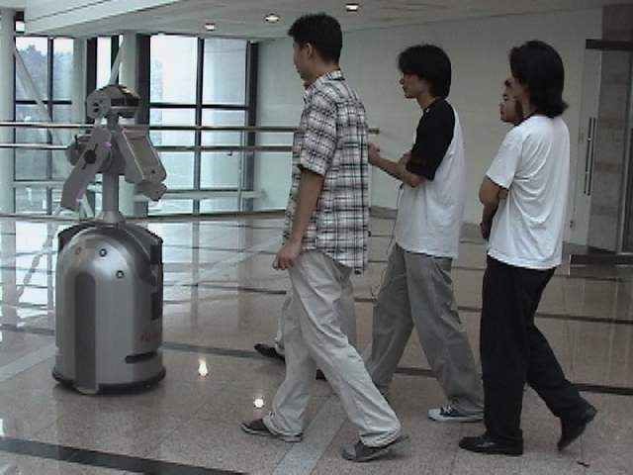
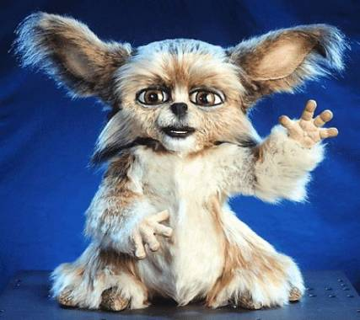
“Biologically inspired”, designers try to create robots that internally simulate, or mimic, the social intelligence found in living creatures.
Such as MIT’s Leonardo (similar look as Gizmo from the Gremlins).
“Functionally designed”, the goal is to construct a robot that appears outwardly to be socially intelligent, even if the internal design does not have a basis in science.
Such as museum tour guides.
http://entertainmentdesigner.com/news/museum-design-news/why-are-robots-getting-all-the-museum-jobs/
http://www.slashgear.com/mits-furry-robot-is-capable-of-human-learning-235400

Slide 3
The hypothesis is that in order for a robot to be understandable by humans, it must have a naturalistic embodiment, it must interact with its environment in the same way living creatures do, and it must perceive the same things that humans find to be salient and relevant.
Can a robot be understandable by humans without these traits?
Biological inspiration allows us to directly examine, test and refine those scientific theories upon which the design is based.
Which is an important and useful learning tool for researchers. Search for truth through designing a biologically inspired automata.

Slide 4
Theory of mind refers to those social skills that allow humans to correctly attribute beliefs, goals, perceptions, feelings, and desires to themselves and others.
Correct attribution of these traits to others is often biased in humans but may be accurately model at least for perception in robots.
Ethology is useful for addressing a range of behavioral issues such as concurrency, motivation, and instinct
The design of Kismet’s “synthetic nervous system”, particularly the perceptual and behavioral aspects, is heavly inspired by the social development of human infants.
Kismet Design

Slide 5

Functionally Designed: these “engineered” robots may need only to generate certain effects and experiences with the user, rather than having to withstand deep scrutiny for “life-like” capabilities.
This technique is used often in video game design as well as in design for electronic toys.
The artifacts may not have real-world counterparts.
Depictions of aliens (Blizzard’s protoss) or humanoid-animals (teenage mutant ninja turtles).
Robots are being designed using cognitive modeling, contextual inquiry, heuristic evaluation, and empirical user testing.
© 1998 Blizzard Entertainment

Slide 6
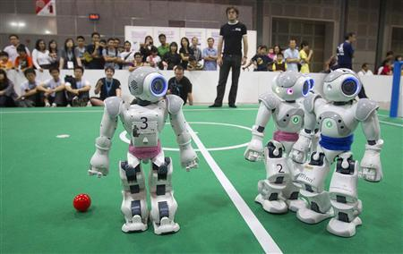
Spectators watch as robots play soccer on a miniature field during the Robocup tournament in Singapore June 22, 2010. Reuters/Vivek Prakash
Systems Engineering: Design that emphasizes functioning in a highly structured domain involves specific task behaviors.
Soccer playing robots
Iterative Design: The process of revising a design through a series of test and redesign cycles.
Is this not essential in all product design? Includes beta test for games.

Slide 7
Design Issues
Cognition (planning, decision making)
Perception (navigation, environment sensing)
Action (mobility, manipulation)
Human-robot interaction (user interface, input devices, feedback display)
Social interaction
Architecture (control, electromechanical, system)

Slide 8

Social Interaction Design Issues
Proficient perception and interpretation of human activity and behavior
Familiar believable communication
Displaying feedback responses through external architecture to interacting humans
Real-time response
Should a robot have a designed or learned responsibility?
If the former Asimov’s rules may automatically apply.
If the latter then Asimov’s rules may be broken and such a design is far more complex than the former.
https://en.wikipedia.org/wiki/I,_Robot

Slide 9
Is it more important that the robot be compatible with the human’s needs, that it matches application requirements rather than being socially competent?
To what extent does social robot design need to reflect theories of human social intelligence?

