Slide 1
Anatomy of a Large European IXP
Anja Feldmann
TU Berlin/T-Labs
Bernhard Ager ETH Zürich
Steve Uhlig
Queen Mary
University of London
Nikos Chatzis Nadi Sarrar
TU Berlin/T-Labs
Walter Willinger
AT&T Labs Research

Slide 2
IXPs – Reminder…
Accepted industry definition of an IXP (according to Euro-IX):
A physical network infrastructure operated by a single entity with the purpose to facilitate the exchange of Internet traffic between Autonomous Systems.
The number of Autonomous Systems connected should at least be three and there must be a clear and open policy for others to join.
https://www.euro-ix.net/what-is-an-ixp

Slide 3
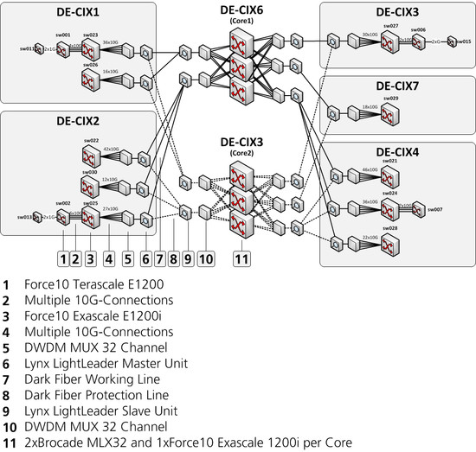
Infrastructure of an IXP (DE-CIX)
Robust infrastructure with redundency
http://www.de-cix.net/about/topology/

Slide 4
Internet eXchange Points (IXPs)
Content
Provider 1
AS2
Content
Provider 2
AS1
Layer-2 switch
AS3
IXPs
Offer connectivity to ASes
Enable peering
AS5
AS4

Slide 5
IXPs – Peering
Peering – Why? E.g.: Giganews:
“Establishing open peering arrangements at neutral Internet Exchange Points is a highly desirable practice because the Internet Exchange members are able to significantly improve latency, bandwidth, fault-tolerance, and the routing of traffic between themselves at no additional costs.”
IXPs – Four types of peering policies
Open Peering – Inclination to peer with anyone, anywhere
Most common!
Selective Peering – Inclination to peer, with some conditions
Restrictive Peering – Inclination not to peer with any more entities
No Peering – No, prefer selling transit
http://drpeering.net/white-papers/Peering-Policies/Peering-Policy.html
Notes:
240 Open Peering policy
Restrictive
126 Restrictive
49 Unknown

Slide 6
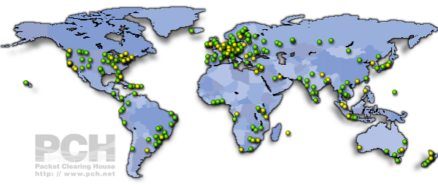
IXPs – Publicly available information
Sources: euro-ix, PCH, PeeringDB, IXP’s sites
Generally known: # IXPs ~ 350 worldwide
http://www.pch.net

Slide 7
IXPs – Publicly available information
Generally known: # IXPs ~ 350 worldwide
Somewhat known: # ASes per IXP up to 500
https://www.euro-ix.net

Slide 8
IXPs – Publicly available information
Generally known: # IXPs ~ 350 worldwide
Somewhat known: # ASes per IXP up to 500
Less known: # ASes ~ 11,000 worldwide
https://www.euro-ix.net/tools/asn_search

Slide 9
IXPs – Publicly available information
Generally known: # IXPs ~ 350 worldwide
Somewhat known: # ASes per IXP up to 500
Less known: # ASes ~ 11,000 worldwide
Even less known: IXPs =~ Tier-1 ISP traffic
AMS-IX
Total TB in

Slide 10
IXPs – Publicly available information
Generally known: # IXPs ~ 350 worldwide
Somewhat known: # ASes per IXP up to 500
Less known: # ASes ~ 11,000 worldwide
Even less known: IXPs =~ Tier-1 ISP traffic
Unknown: # of peerings at IXPs
Notes:
5 minutes

Slide 11
Peering links – current estimates?
Methodology | Number of peering links in the entire Internet
[Dhamdhere et al.] 2010 Lower bound estimate based on BGP data) | > 20,000

Slide 12
Peering links – current estimates?
Methodology | Number of peering links in the entire Internet
[Dhamdhere et al.] 2010 Lower bound estimate based on BGP data) | > 20,000
[Augustin et al., Chen et al.] 2009/2010 Targeted/opportunistic traceroute from network edge | > 40,000
Dasu 2011. Targeted data plane measurements | > 60,000

Slide 13
Outline
Introduction to IXPs
A large European IXP
IXP peering fabric
IXP member diversity
IXP traffic matrix
Discussion
Summary

Slide 14
Data – From collaboration with IXP
Major European IXP
9 month of sFlow records collected in 2011
Sampling 1 out of 16K packets
128 bytes ⇒ IP/TCP/UDP headers
Consistency checks and filters
Checked for duplicates
Filtered out IXP management traffic, broadcast and multicast (except ARP)
Eliminated IPv6 (less than 1% of traffic)
Thanks to the IXP for a great collaboration!

Slide 15
Fact 1 – IXP members/participants
Traditional classification
 | Apr 25 May 1 | Aug 22 Aug 28 | Oct 10 Oct 16 | Nov 28 Dec 4
Member ASes | 358 | 375 | 383 | 396
Tier-1 | 13 | 13 | 13 | 13
Tier-2 | 281 | 292 | 297 | 306
Leaf | 64 | 70 | 73 | 77
Countries of member ASes | 43 | 44 | 45 | 47
Continents of member ASes | 3 | 3 | 3 | 3
Daily avg. volume (PB) | 9.0 | 9.3 | 10.3 | 10.7

Slide 16
Fact 2 – IXP members/participants
By Business type
Member ASes often offer multiple services

Slide 17
Fact 3 – IXP traffic
Traffic Volume: Same as Tier-1 ISPs
IXP is interchange for Tier-2 ISPs

Slide 18
Outline
Introduction to IXPs
A large European IXP
IXP peering fabric
IXP member diversity
IXP traffic matrix
Discussion
Summary
Notes:
10 minutes

Slide 19
Fact 4 – IXP peerings
IXP peering link between pair of ASes if
IP traffic exchanged
BGP traffic only (e.g., in case of backup links)
IP otherwise
Potential links
Member ASes in Nov/Dec’11: 396
396x395 / 2 = 78,210 P-P links possible
Observed links
> 50,000 peering links
Peering rate > 60%!
June’12: 421
> 55,000 peering links!
Peering rate > 60%! > 60%!

Slide 20
Fact 4 – IXP peerings Internet-wide
Single IXP > 50,000 peering links
Derivation of new lower bound
10 large IXPs in Europe: ~160,000 peering links
Remaining 340 or so IXPs: ~ 40,000 peering links
Completely ignoring all other peerings
(Conservative) lower bound on #of peering links
> 200,000 peering links in today’s Internet (as compared to currently assumed ~ 40,000 – 60,000)
Requires a revamping of the mental picture our community has about the AS-level Internet.

Slide 21
Fact 4 – IXP peerings Internet-wide
Methodology | Number of peering links in the entire Internet
[Dhamdhere et al.] 2010 Lower bound estimate based on BGP data) | > 20,000
[Augustin et al., Chen et al.] 2009/2010 Targeted/opportunistic traceroute from network edge | > 40,000
Dasu 2011. Targeted data plane measurements | > 60,000
2012 (This talk) data from IXPs | > 200,000

Slide 22
Public view of IXP peering links
Peering links at IXP: > 50 K
How come that we did not see them?
Dataset | Unique ASes with vantage points | Peerings
Routeviews (RV) | 78
RIPE | 319
Non public BGP (NP) | 723
BGP (RV+RIPE+NP) | 997 | ~ 20-30 K
Traceroute (LG) | 148 | ~ 40-45 K
RV+RIPE+NP+LG | 1,070

Slide 23
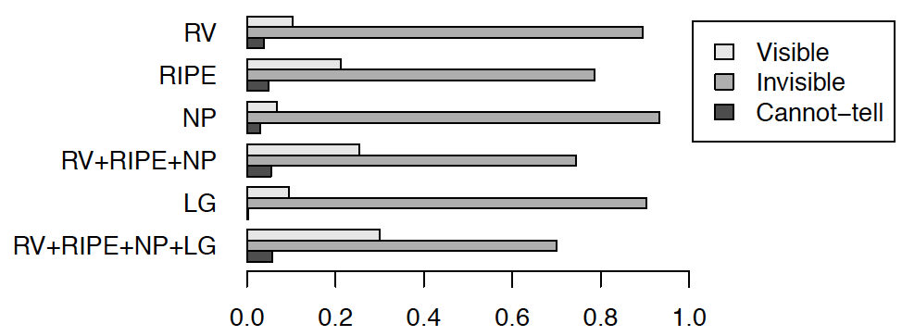
Visibility of IXP peerings
Even with all available datasets about 70% of IXP peering links remain invisible!
Even with all available datasets about 43 % of exchanged bytes remain invisible!

Slide 24
Outline
Introduction to IXPs
A large European IXP
IXP peering fabric
IXP member diversity
IXP traffic matrix
Discussion
Summary
Notes:
15 minutes

Slide 25
Member diversity – Business type
Classified ASes according to business model
For the remainder of this talk
Large ISPs (LISP)
Small ISPs (SISP)
Hosters and CDNs (HCDN)
Academic and enterprise networks (AEN)
All business models present
Recall: Most member ASes offer multiple types

Slide 26
Member diversity – # of peers
Most members have a large # of peers

Slide 27
IXP – Fraction of Web-traffic
Individual ASes differ significantly!

Slide 28
IXP – Traffic asymmetry
Individual ASes differ significantly!

Slide 29
IXP – Geographic distance
Individual ASes differ significantly!

Slide 30
Outline
Introduction to IXPs
A large European IXP
IXP peering fabric
IXP member diversity
IXP traffic matrix
Discussion
Summary

Slide 31
Daily pattern – Top-10 tier-2 members
Pronounced time of day effects
Top 10 tier-2 responsible for 33% of traffic
Some ASes fully utilize their capacity

Slide 32
Structural properties of traffic matrix
Use SVD to understand traffic matrix rank Energy in first k singular values
22 values suffice for 95% of the energy
Even smaller k for application specific matrix

Slide 33
Outline
Introduction to IXPs
A large European IXP
IXP peering fabric
IXP member diversity
IXP traffic matrix
Discussion
Summary
Notes:
20 minutes

Slide 34
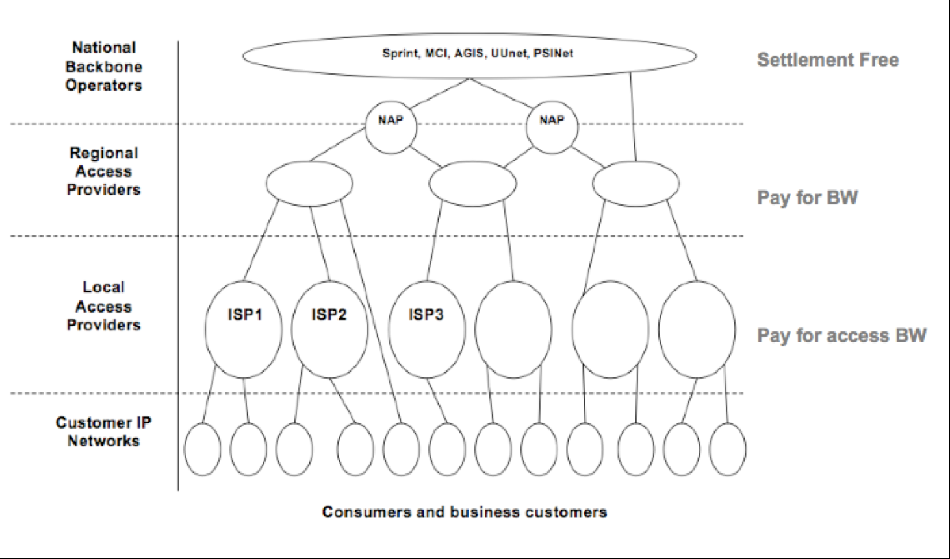
Internet: Mental model (before 2010)
http://conferences.sigcomm.org/sigcomm/2010/slides/S3Labovitz.pdf

Slide 35
Most recent mental model – a 2011
Google, Akamai, RapidShare, …
http://conferences.sigcomm.org/sigcomm/2010/slides/S3Labovitz.pdf
Flattening of the AS topology

Slide 36
Question – What about IXPs
Google, Akamai, RapidShare, …
IXP
Flattening of the AS topology
What about IXPs impact

Slide 37
Network map 2012+
Global Transit/National Backbones
„Hyper Giiants“
Large Content, Consumer, Hosting CDN
Global Internet Core
IXP
IXP
Regional / Tier2 Providers
AS 1
IXP
AS 2
Leaf IP Networks
IXPs central component
Lots of local peering – rich fabric
Even flatter AS topology than assumed

Slide 38
Some interesting observations (1)
Myth 1: Tier-1’s don’t public peer at IXPs
Fact: All Tier-1’s are members at IXP and do public peering
Tier-1’s typically use a “restrictive” peering policy
Most IXP members use an “open” peering policy
Myth 2: Establishing peerings at IXPs is cumbersome
Fact: Many IXPs make it very easy for its members to establish public peerings with other members
„Handshake agreements“
Use of IXP’s route server is offered as free value-added service
Use of multi-lateral peering agreements
Myth 3: IXP peering links are for backup
Fact: Most peering links at our IXP see traffic
Most of the public peering links see traffic
Does not include traffic on the private peering links at IXP

Slide 39
Some interesting observations (2)
Myth 4: IXPs are not interesting
Fact: As interesting as large ASes and big content
Myth 5: IXPs are very different from ASes
Fact: Large IXPs start to look more and more like ASes
Offering SLAs (DE-CIX in 2008, AMS-IX in 2011)
Support for IXP resellers (e.g., AS43531 – IX Reach)
Going oversees (AMS-IX starting a site in Hong Kong)
Extensive monitoring capabilities
IXP-specific traffic matrix vs. AS-specific traffic matrix

Slide 40
Outline
Introduction to IXPs
A large European IXP
IXP peering fabric
IXP member diversity
IXP traffic matrix
Diversity
Discussion
Summary

Slide 41
Summary
Large IXP study reveals diverse IXP eco-system wrt members, business types, connectivity, traffic, etc.
Large IXP supports rich peering fabric
Single IXP doubles the estimated number of peering links
Needs revamping of mental picture of AS-level Internet
Implications for studies of AS-level Internet
ASes – can no longer be treated as „homogeneous“
AS links – simple classification (peering, cust-prov) should fade
IXP peerings – when peering links are used as cust-prov links…
AS traffic – what traffic is carried by whom?

Slide 42
Related work
Without IXP co-operation
Connectivity related work
Xu, Duan, Zhang, Chandrashekar: On Properties of Internet Exchange Points and their impact on AS Topology and Relationship, Networking, 2004
Chang, Govindan, Jamin, Shenker, Willinger: Towards Capturing Representative AS-Level Internet Topologies. Computer Networks, 2004
Chen, Choffnes, Potharaju, Chen, Bustamante, Pei, Zhao: Where the Sidewalk Ends: Extending the Internet AS Graph Using Traceroutes From P2P Users. ACM CoNEXT, 2009
He, Siganos, Faloutsos, Krishnamurthy: A Systematic Framework for Unearthing the Missing Links: Measurements and Impact. NSDI, 2007
Oliveira, Pei, Willinger, Zhang, Zhang: The (In)completeness of the Observed Internet AS-Level Structure. IEEE/ACM Trans. Networking, 2010
Augustin, Krishnamurthy, Willinger: IXPs: Mapped? ACM IMC, 2009
Traffic related work
Restrepo, Stanojevic: A history of an Internet eXchange Point, CCR 2012
With IXP co-operation
This work

Slide 43
Summary
Large IXP study reveals diverse IXP eco-system wrt members, business types, connectivity, traffic, etc.
Large IXP supports rich peering fabric
Single IXP doubles the estimated number of peering links
Needs revamping of mental picture of AS-level Internet
Implications for studies of AS-level Internet
ASes – can no longer be treated as „homogeneous“
AS links – simple classification (peering, cust-prov) should fade
IXP peerings – when peering links are used as cust-prov links…
AS traffic – what traffic is carried by whom?

