Slide 1
Questions
What are the major drivers of chlorophyll a in FCR
Are predictable drivers (e.g., water temp, rainfall) equally as powerful as non-predictable drivers (e.g., TP load, turbidity) at predicting chl?
Are the same predictable drivers important from year to year?
Are the same drivers, regardless of predictable important from year to year?
If not, is the statistical difference in chlorophyll prediction significant?

Slide 2
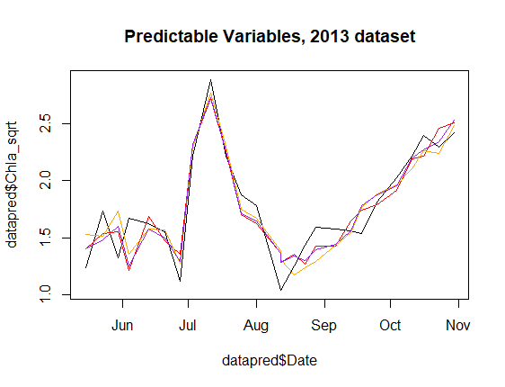
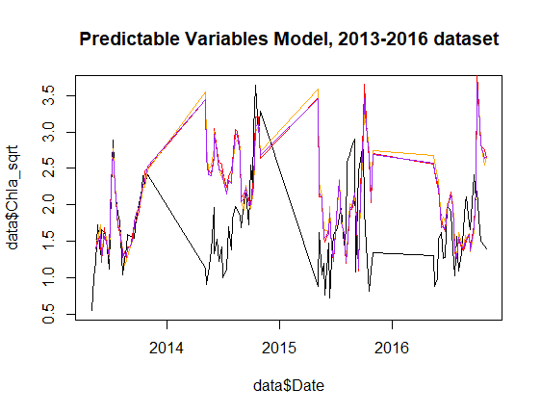
Drivers: Chla(t-1), mean flow, water temp, max windspeed, mean shortwave
R^2 = 0.8 for all three models
RMSE = 0.2 for all predictions
Notes:
-The models perform well when trained on the 2013 dataset, but when using the same model to predict the entire dataset, it does a terrible job. Perhaps this is because of the jump from October to May? What if the predictions were made for each year individually, rather than giving it the entire dataset? Or code it to ignore Chla(t-1) after the Oct-May jump
-There are several other models using different temp measurements (temp at inf, air temp) but they are statistically very similar so I didn’t present them here

Slide 3
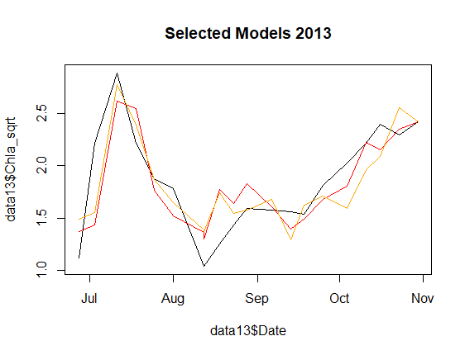
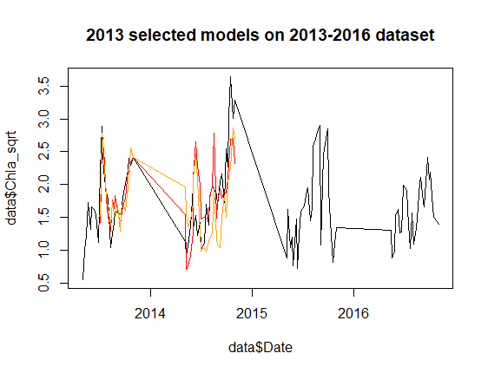
SRP + mean Shortwave and SRP + mean Inflow Temp
R^2 = 0.7
RMSE = 0.3
SRP dataset at 1.0m (i.e. 0.8m) stop after 2014
But this model does a much better job with the underlying pattern than the predictable variables

Slide 4
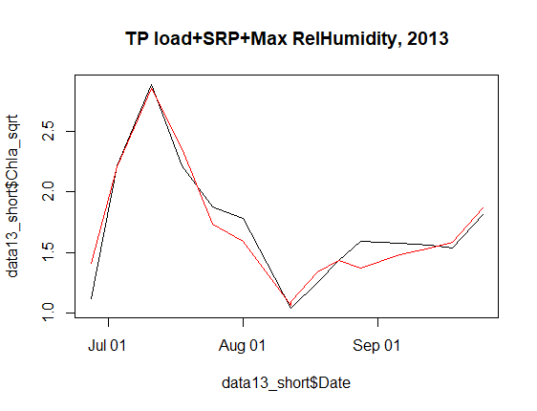
Dataset shortened to period where TP load data is available
R2 = 0.9
RMSE = 0.1
Notes:
Model doesn’t run for the longer period because TP load data is not available for 2014

Slide 5
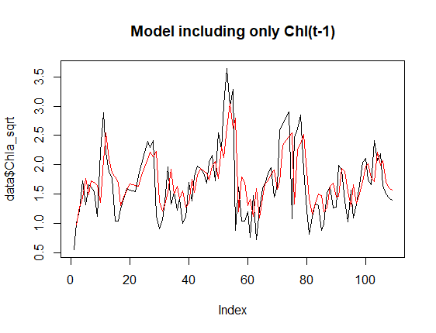
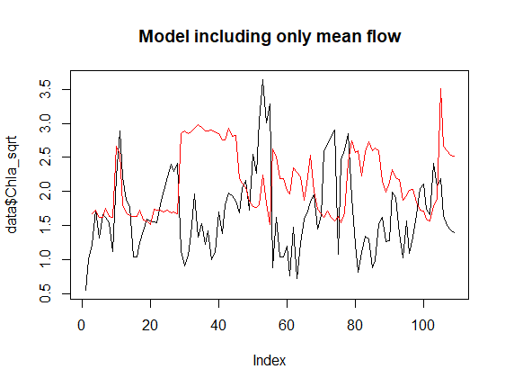
Notes:
Chl(t-1) is what is driving the strength of these models. Additional variables don’t seem to add explanatory power

Slide 6
Next steps
Inflow model from Nicole
Model selection for different years
What to do about missing chem data at 0.8m?
Is 0.1 or 1.6 justifiable to use?

