Slide 1
All models have auto regressive lag of 1 timestep

Slide 2
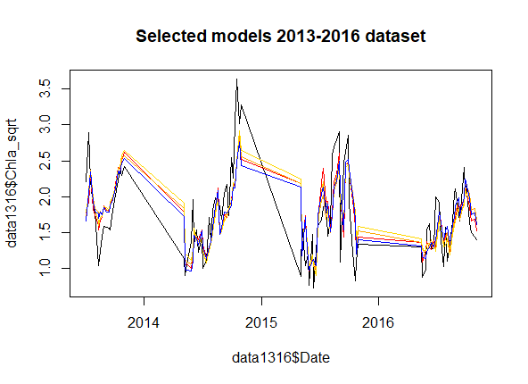
Drivers selected for entire (2013-2016) dataset
Model drivers
Mod1: SW mean + SpCond + Turbidity + DO + Temp@inf max
Mod2: SW mean + SpCond + Turbdity
Mod3: SW mean + SpCond + Turbidity + DO
Mod4: SW mean + SpCond + Turbidity + Temp@inf max
R2
0.50
0.48
0.49
0.49
RMSE
0.43
0.44
0.43
0.43
Notes:
Selected drivers for the 13-16 dataset are biased by what variables are available for the entirety of 2013-2016

Slide 3
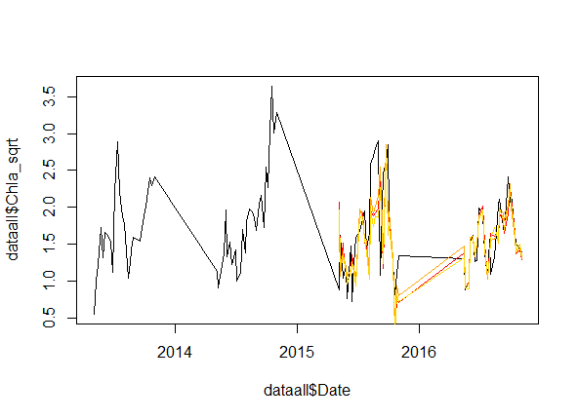
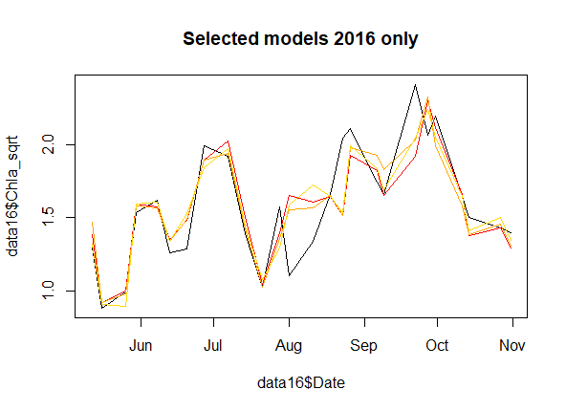
Drivers selected from 2016 only
Model Drivers
Mod1: RelHum max + SRP @ inf + TN:TP @ inf
Mod2: RelHum max + SRP @ inf + TN:TP @ inf + NH4 load
Mod3: RelHum max + SRP @ inf + TN:TP @ inf + rain sum
R2
0.71
0.74
0.73
RMSE
0.21
0.20
0.20

Slide 4
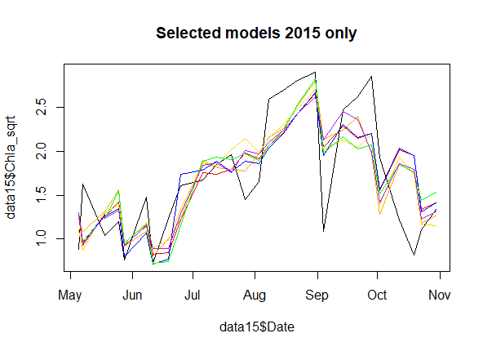
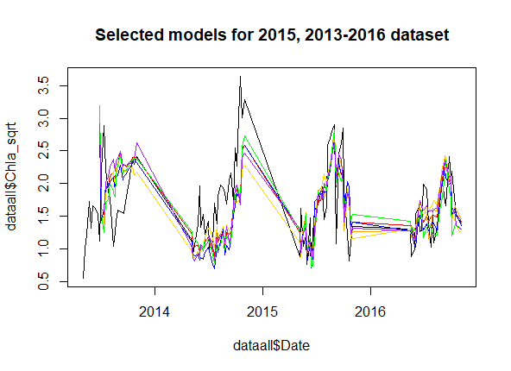
Drivers selected from 2015 only
Model drivers
Mod1: NH4 load + SpCond
Mod2: NH4 load + SpCond + TN:TP@inf
Mod3: NH4 load + SpCond + min Temp@inf
Mod4: NH4 load + SpCond + Turbidity
Mod5: NH4 load + SpCond + DO
Mod6: NH4 load + SpCond + SRP@inf
R2
0.54
0.58
0.57
0.57
0.56
0.56
RMSE
0.46
0.44
0.45
0.45
0.45
0.45

Slide 5
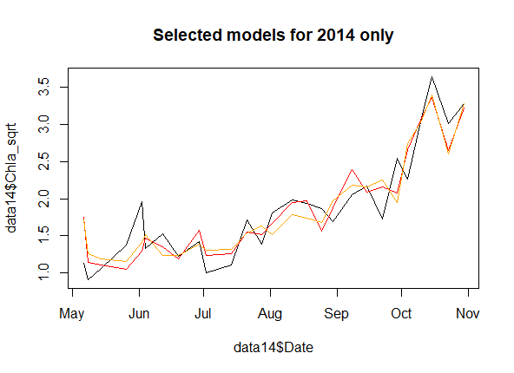
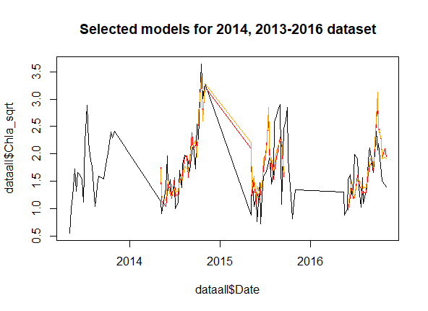
Drivers selected from 2014 only
Model drivers
Mod1: DOC@inf + SW max + flow min
Mod2: DOC@inf + SW max
R2
0.83
0.81
RMSE
0.29
0.31

Slide 6
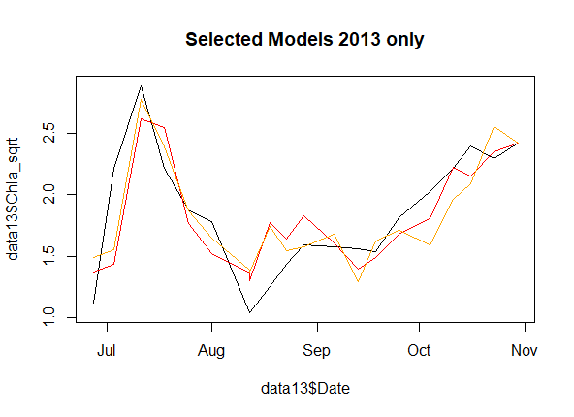
Drivers selected from 2013 only
Model drivers
Mod1: SRP + SW mean
Mod2: SRP + Temp@inf mean
R2
0.67
0.67
RMSE
0.29
0.29
Notes:
SRP is not available for some years so the model was not run for 2013-2016

Slide 7
Notes
Explanatory power (R2 and RMSE) is also quite variable from year to year
I thought this could be because some years have more variation in chl BUT this is not generally the case (e.g. 2016 has high variability and high explanatory power)

Slide 8
Next steps
Literature search (ongoing): how common is it for the factors driving chlorophyll to change from year to year?
How much are they really changing year to year in FCR? (if the selected variables from 2013 are used for 2015, how much explanatory power is lost?)
Fix the Oct-May timestep issue
Run separate analyses?
Run the selected variables for 2013-2016 timeframe on a single year
Compare selected variables to the MGMT regime from 2013-2016
Analyze BVR data in the same way to see if a MGMT effect can be parsed out

