Slide 1
FCR Historical Time Series GL(inear)M
Data from 2013-2016
Autoregressive lag of 1 (Chla_{t-1})
53 candidate variables
Selected ~<10 by looking at Spearman’s correlation matrix, visual relationship with chla, and biological importance
Global model with ‘dredge’ function to find combinations of models within 2 AICc
Developing linear models for each individual year and the overall dataset

Slide 2
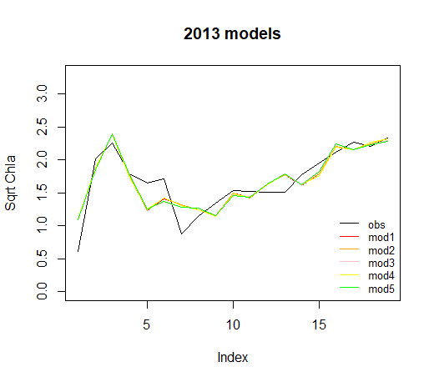
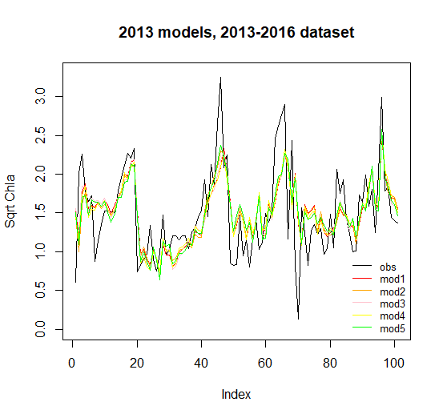
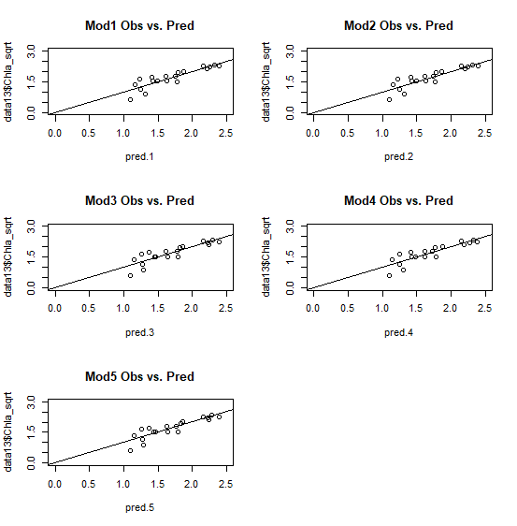
 | Model Equation | AICc | R2 Training | R2 Full | df
Mod 1 | 0.32Chla(t-1) - 3.6mean_flow - 0.002ShortWave_mean + 0.14Turbidity_log + 1.58 | 14.81 | 0.764 | 0.419 | 6
Mod 2 | 0.30Chla(t-1) - 3.9mean_flow - 0.002ShortWave_mean + 0.15Turbidity_log - 0.09NO3NO2_log + 1.7 | 14.85 | 0.764 | 0.429 | 5
Mod 3 | 0.33Chla(t-1) - 3.7mean_flow - 0.002ShortWave_mean + 0.13Turbidity_log + 0.017Rain_sum_log + 1.6 | 15.26 | 0.766 | 0.429 | 6
Mod 4 | 0.33Chla(t-1) - 3.4mean_flow - 0.003ShortWave_mean + 0.15Turbidity_log + 0.019Temp_inflow_max + 1.3 | 15.89 | 0.765 | 0.427 | 5
Mod 5 | 0.32Chla(t-1) - 4.0mean_flow - 0.002ShortWave_mean + 0.15Turbidity_log - 0.09NO3NO2_log + 0.016Rain_sum_log + 1.7 | 16.25 | 0.767 | 0.438 | 6

Slide 3
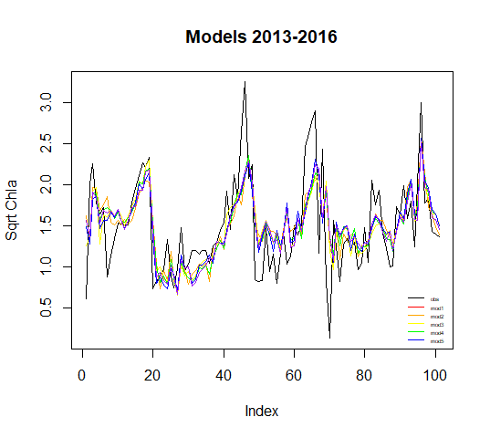
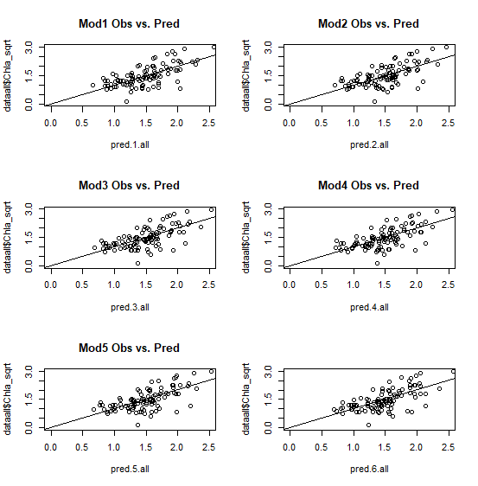
 | Model Equation | AICc | R2 | df
Mod 1 | 0.31Chla(t-1) - 5.01flow_min - 0.002ShortWave_mean + 0.15Turbidity_log + 0.14NH4_inf_log + 1.35 | 127.38 | 0.447 | 7
Mod 2 | 0.30Chla(t-1) - 4.55flow_min - 0.002ShortWave_mean + 0.13Turbidity_log + 1.60 | 127.97 | 0.431 | 6
Mod 3 | 0.32Chla(t-1) - 4.71flow_min - 0.001ShortWave_mean + 0.12Turbidity_log + 0.70RelHumimidty_max_log - 1.67 | 128.18 | 0.442 | 7
Mod 4 | 0.32Chla(t-1) - 4.33flow_min - 0.002ShortWave_mean + 0.14Turbidity_log + 0.019Temp_inflow_min + 1.3 | 128.7 | 0.439 | 7
Mod 5 | 0.32Chla(t-1) - 4.49flow_min - 0.002ShortWave_mean + 0.13Turbidity_log + 0.014Rain_sum_log + 1.62 | 129 | 0.438 | 7
Mod 6 | 0.35Chla(t-1) - 5.26flow_min + 0.12Turbidity_log + 1.09RelHumidity_max_log - 3.74 | 129.21 | 0.424 | 6

Slide 4
 | Model Equation | AICc | R2 | df
Mod 1 | 0.31Chla(t-1) - 5.01flow_min - 0.002ShortWave_mean + 0.15Turbidity_log + 0.14NH4_inf_log + 1.35 | 127.38 | 0.447 | 7
Mod 2 | 0.30Chla(t-1) - 4.55flow_min - 0.002ShortWave_mean + 0.13Turbidity_log + 1.60 | 127.97 | 0.431 | 6
Mod 3 | 0.32Chla(t-1) - 4.71flow_min - 0.001ShortWave_mean + 0.12Turbidity_log + 0.70RelHumimidty_max_log - 1.67 | 128.18 | 0.442 | 7
Mod 4 | 0.32Chla(t-1) - 4.33flow_min - 0.002ShortWave_mean + 0.14Turbidity_log + 0.019Temp_inflow_min + 1.3 | 128.7 | 0.439 | 7
Mod 5 | 0.32Chla(t-1) - 4.49flow_min - 0.002ShortWave_mean + 0.13Turbidity_log + 0.014Rain_sum_log + 1.62 | 129 | 0.438 | 7
Mod 6 | 0.35Chla(t-1) - 5.26flow_min + 0.12Turbidity_log + 1.09RelHumidity_max_log - 3.74 | 129.21 | 0.424 | 6
 | Model Equation | R2 Full | df
Mod 1 | 0.32Chla(t-1) - 3.6mean_flow - 0.002ShortWave_mean + 0.14Turbidity_log + 1.58 | 0.419 | 6
Mod 2 | 0.30Chla(t-1) - 3.9mean_flow - 0.002ShortWave_mean + 0.15Turbidity_log - 0.09NO3NO2_log + 1.7 | 0.429 | 5
Mod 3 | 0.33Chla(t-1) - 3.7mean_flow - 0.002ShortWave_mean + 0.13Turbidity_log + 0.017Rain_sum_log + 1.6 | 0.429 | 6
Mod 4 | 0.33Chla(t-1) - 3.4mean_flow - 0.003ShortWave_mean + 0.15Turbidity_log + 0.019Temp_inflow_max + 1.3 | 0.427 | 5
Mod 5 | 0.32Chla(t-1) - 4.0mean_flow - 0.002ShortWave_mean + 0.15Turbidity_log - 0.09NO3NO2_log + 0.016Rain_sum_log + 1.7 | 0.438 | 6

Slide 5
Variables between the two models
2013
Mean daily flow
Daily shortwave mean
Turbidity (log tr’ed)
Nitrate+Nitrite (log tr’ed)
Daily rain sum (log tr’ed)
Max temperature at inflow
2016
Minimum daily flow
Daily shortwave mean
Turbidity (log tr’ed)
Ammonium at inflow (log tr’ed)
Daily rain sum (log tr’ed)
Min temperature at inflow
Max relative humidity (log tr’ed)

