Slide 1
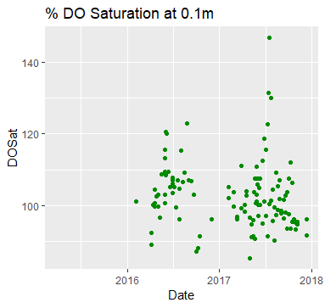
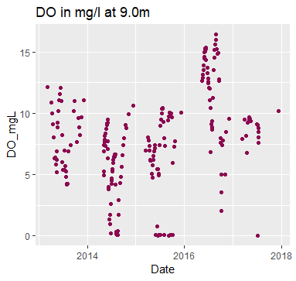
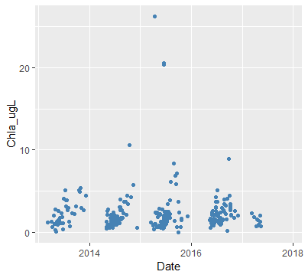
Notes:
DO at 9.0m is higher than I would have expected—SSS activation? Also lots of variation. 2013 relatively high values, drops down in 2014 and 2015, higher on average in 2016 and 2017
% DO Sat from YSI—find way to calculate % DO Sat from CTD DO mg/L data?? Salinity and pressure required?

Slide 2
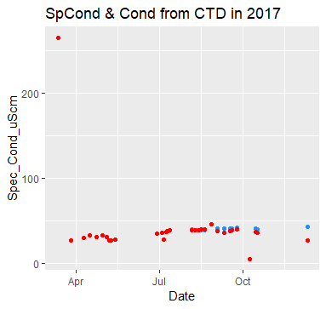
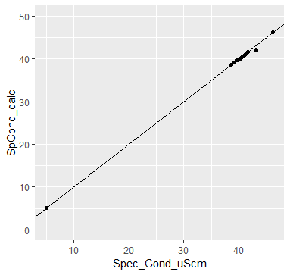
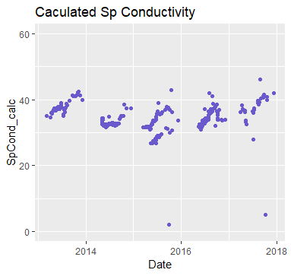
Notes:
Original specific conductivity data from CTD for 2017 only—periwinkle data was calculated based on collected conductivity data: SC = AC / (1 + r(T-25))(where r = 0.0191)

Slide 3
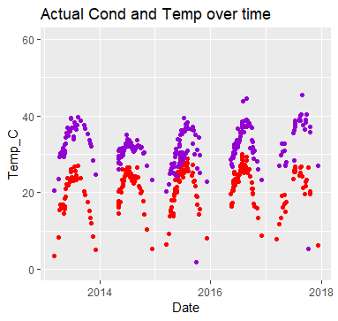
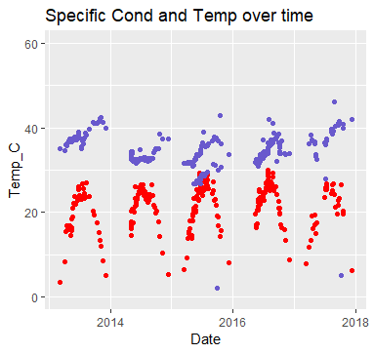
Notes:
Yay!

Slide 4
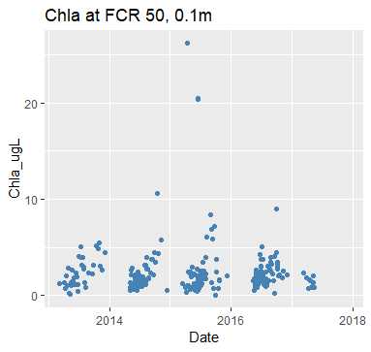
Notes:
General increase seasonally, with most years showing a decrease in winter before data collection stops

Slide 5
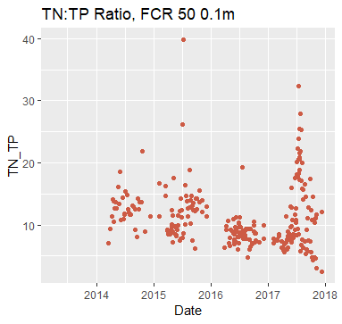
Notes:
No TN data for 2013, hence no TN:TP values
Lots of variability

Slide 6
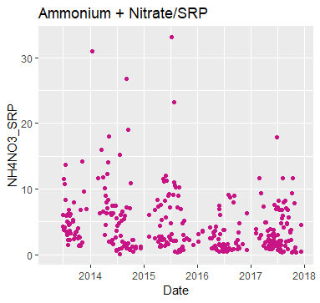
Notes:
Used “NO3NO2” from chemistry data

Slide 7
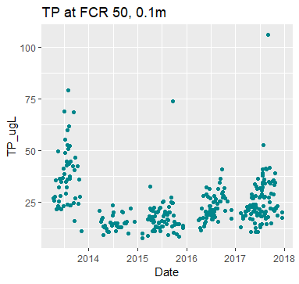
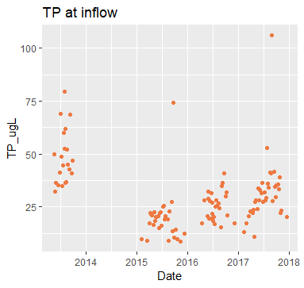
Notes:
2014?
Increase in concentration since 2015, but 2013 had higher overall average
Inflow and 0.1m @FCR50 show comparable trends

Slide 8
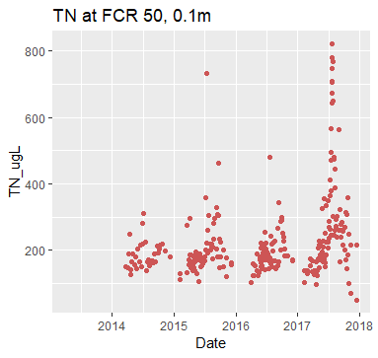
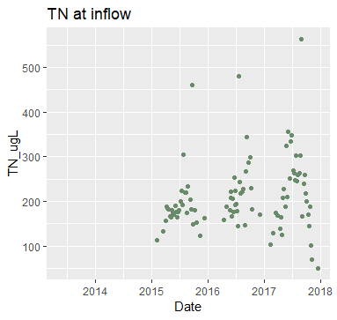
Notes:
In-lake TN (@0.1m) is higher than at inflow, especially in 2017

Slide 9
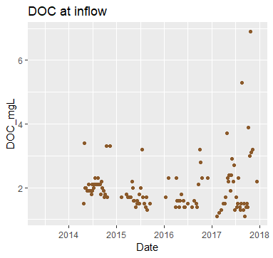
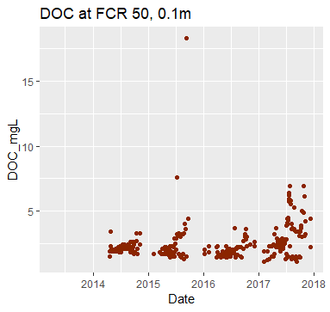
Notes:
If inflow was influencing site 50, there would be a delay in the effect…hard to see here, but maybe once data is appended and can graph on one plot it could be visible

Slide 10
Next Steps for upcoming weeks
Format met data
QAQC CTD layer data (found date duplicates)
Calculate TN:TP and NH4NO3:SRP ratios for inflow
Append data sets (CTD, YSI, Chemistry, inflow, fluora, met)
Light extinction coefficient data from Mary
Calculate % DO Saturation?
Look at 2015 and 2016 separately
Keep manipulations in mind—represent large events graphically?
Inflow data (gauge) –Mary is still working on this
Get better at ggplot (legends, multiple axis labels, facet plots, etc.)
OTHER
Cary Ecosystem Ecology short course in Jan—possible? scheduling and funding?
Leading lab meeting—GFRP or figures?

