Slide 1
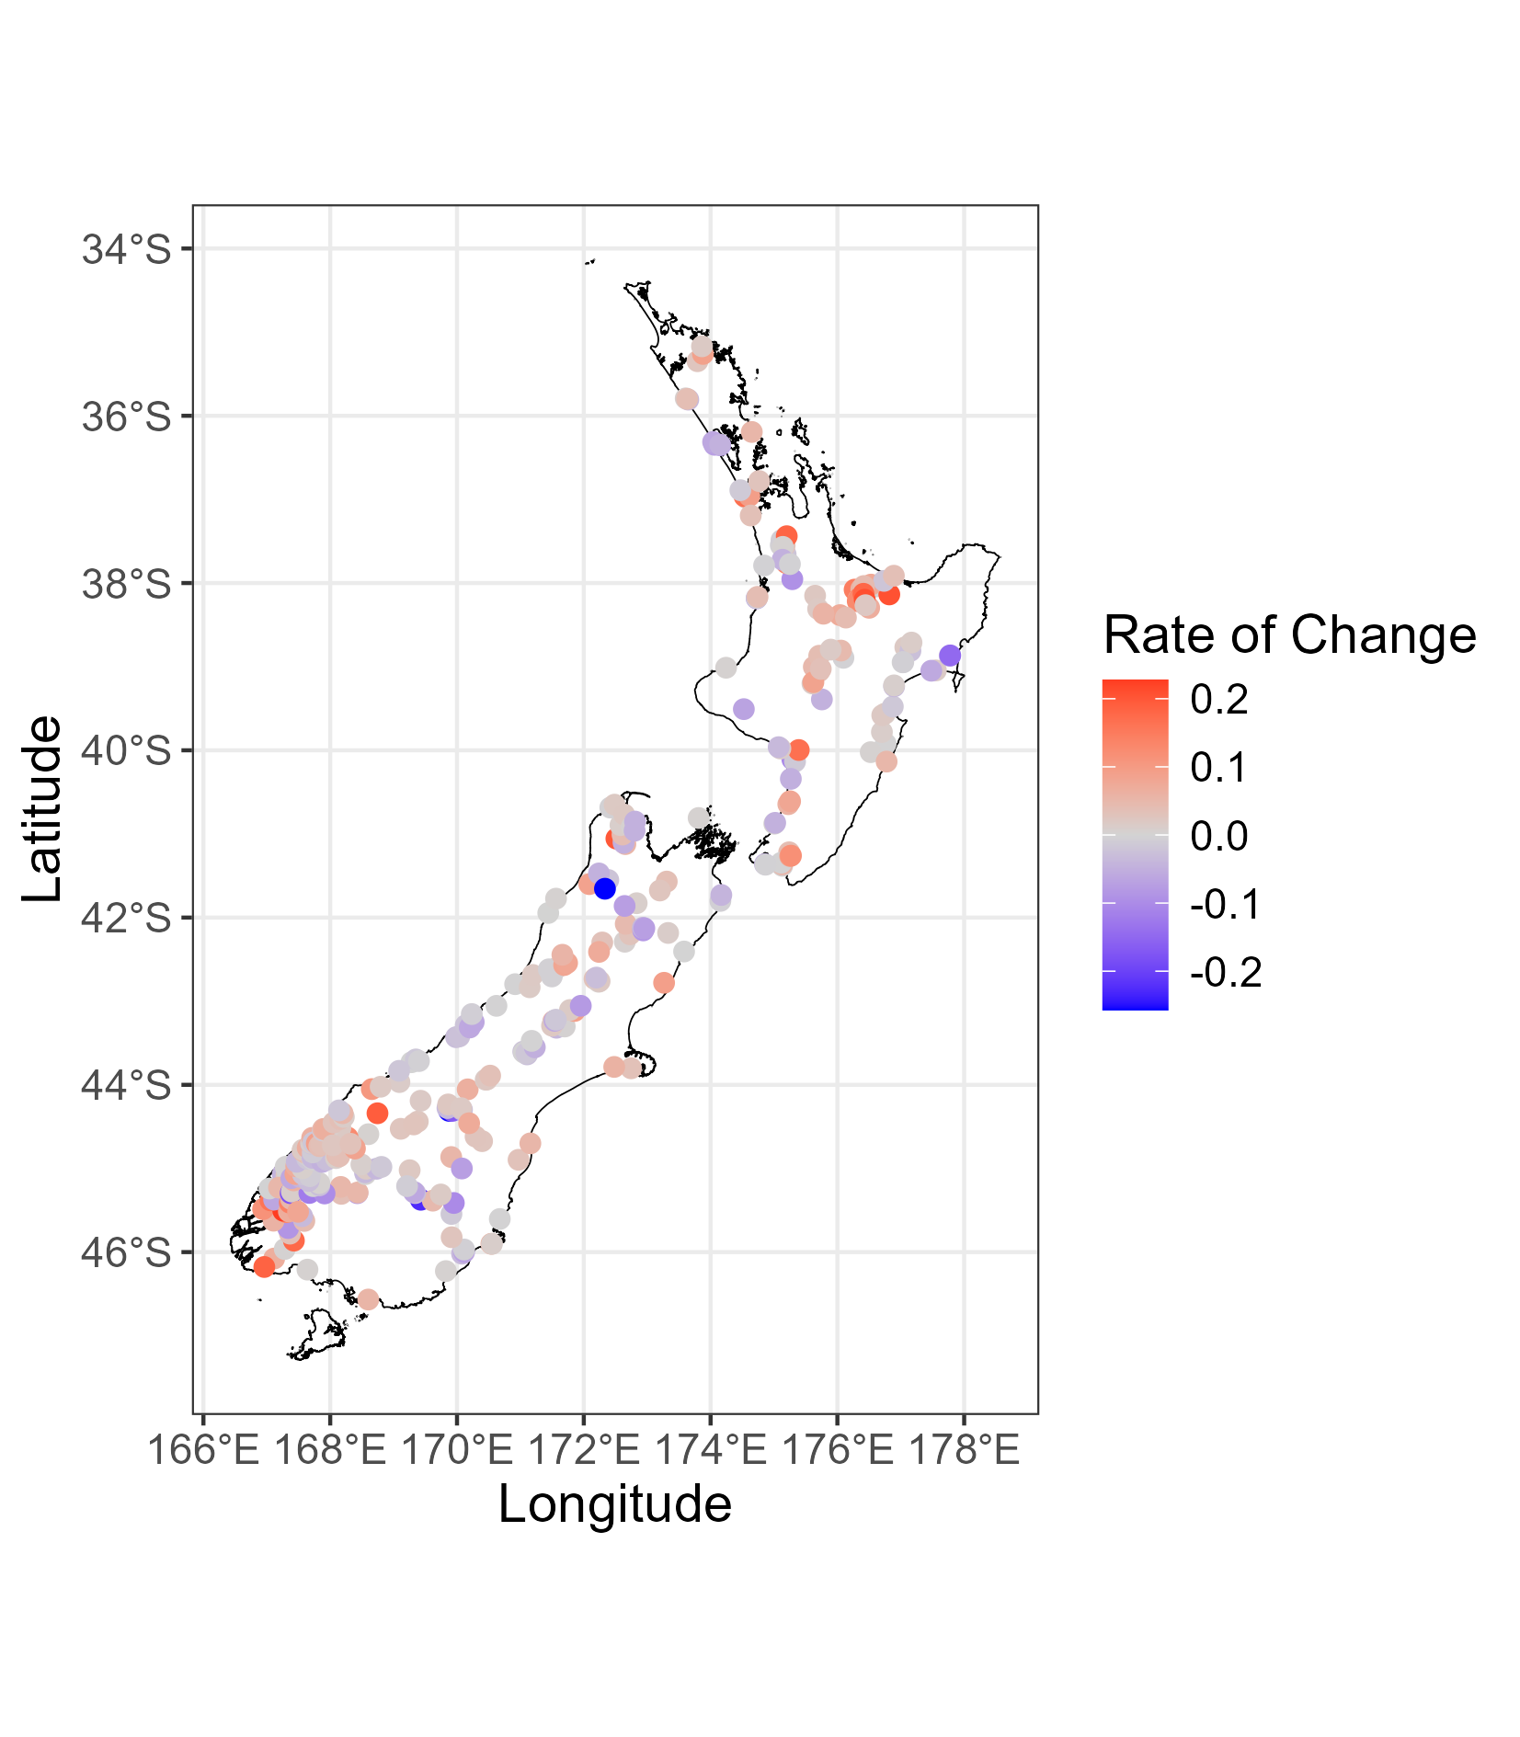
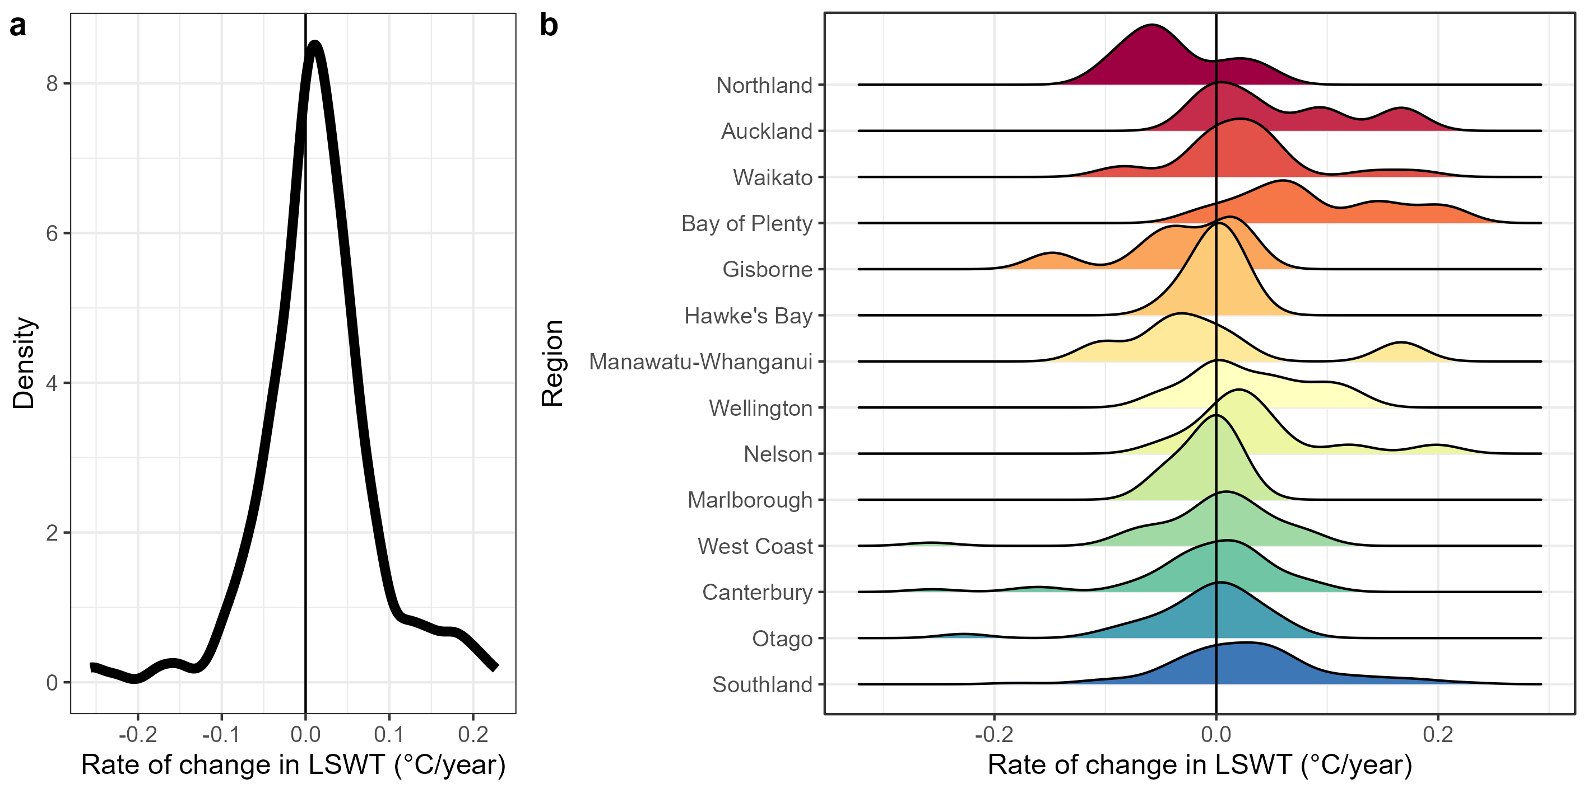
c

Slide 2
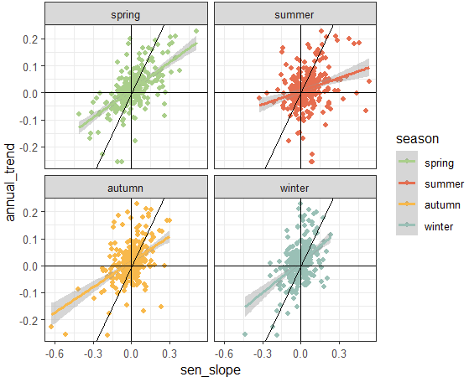

Slide 3
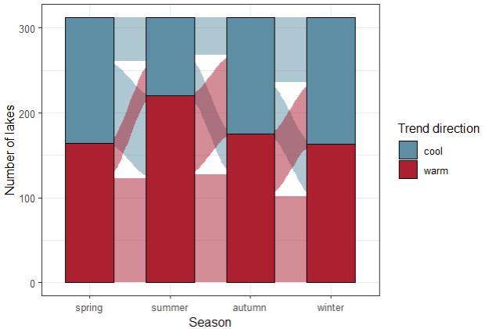
16%
14%
24%
31%
15%
20%
13%
30%
23%
39%
41%
33%

Slide 4
LSWT change is occurring broadly and is important for lake ecosystems
Variability in trends is high, and while drivers are well known, their predictive power remains low
Many studies use focus on either annual or summer trends, without a comprehensive understanding of the temporal variability of trends across seasons
Further, while many studies have published rates of change in LSWT across the globe, a robust literature review synthesizing decades of research remains needed

