Slide 1

ROS - Lesson 6
Teaching Assistant: Roi Yehoshua
roiyeho@gmail.com

Slide 2
Agenda
Navigation planners
Adaptive Monte-Carlo Localization

Slide 3
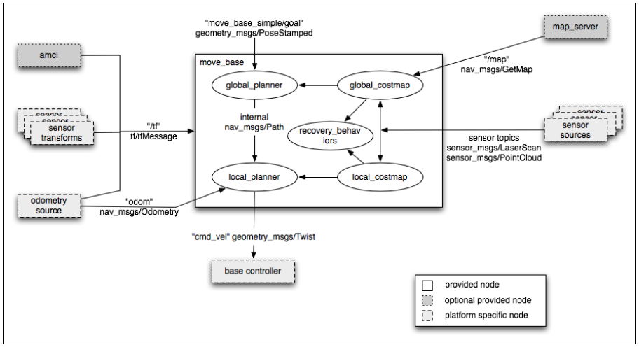
Navigation Stack

Slide 4
Global Planner
http://wiki.ros.org/navfn
A package that provides functions to create the plans
The global plan is computed before the robot starts moving toward the next destination
The planner assumes a circular robot and operates on a costmap to find a minimum cost plan from a start point to an end point in a grid.
The navigation function is computed using Dijkstra's algorithm
support for an A* heuristic may also be added in the near future

Slide 5
Navfn Published Topics
The last plan computed by navfn is published on the topic /move_base_node/NavfnROS/plan everytime the planner computes a new path
This is used primarily for visualization purposes
Message type is nav_msgs/Path

Slide 6
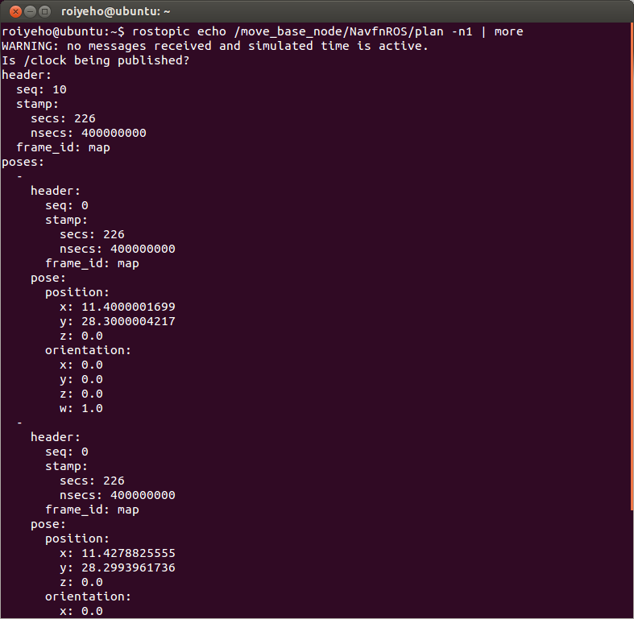
Navfn Published Topics

Slide 7
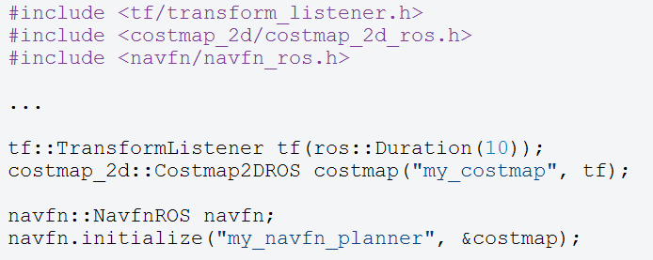
NavfnROS
The navfn::NavfnROS object is a wrapper for a navfn::NavFn object that exposes its functionality as a C++ ROS Wrapper.
It adheres to the nav_core::BaseGlobalPlanner interface found in the nav_core package.

Slide 8
Base Local Planner
http://wiki.ros.org/base_local_planner
The local planner monitors incoming sensor data and chooses appropriate linear and angular velocities for the robot to traverse the current segment of the global path.
The base_local_planner combines odometry data with both global and local cost maps to select a path for the robot to follow
The base local planner can recompute the robot's path on the fly to keep the robot from striking objects yet still allowing it to reach its destination.

Slide 9
Base Local Planner
The base local planner implements the Trajectory Rollout and Dynamic Window algorithm
References:
Brian P. Gerkey and Kurt Konolige. "Planning and Control in Unstructured Terrain". Discussion of the Trajectory Rollout algorithm in use on the LAGR robot.
D. Fox, W. Burgard, and S. Thrun. "The dynamic window approach to collision avoidance". The Dynamic Window Approach to local control.

Slide 10
Trajectory Rollout Algorithm
Discretely sample in the robot's control space (dx,dy,dθ)
For each sampled velocity, perform forward simulation from the robot's current state to predict what would happen if the sampled velocity were applied for some (short) period of time.
Evaluate each trajectory resulting from the forward simulation, using a metric that incorporates characteristics such as: proximity to obstacles, proximity to the goal, proximity to the global path, and speed.
Discard illegal trajectories (those that collide with obstacles).
Pick the highest-scoring trajectory and send the associated velocity to the mobile base.
Rinse and repeat.

Slide 11
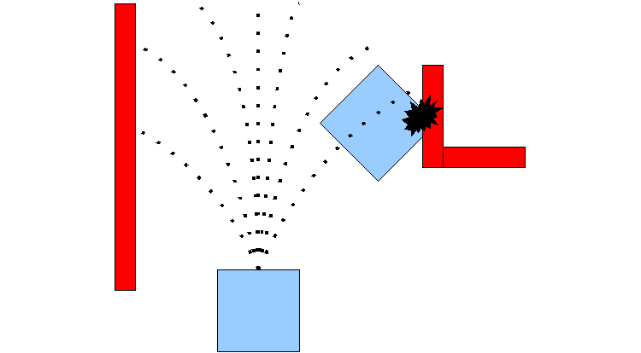
Trajectory Rollout Algorithm
Taken from ROS Wiki

Slide 12
DWA
DWA (Dynamic Window Algorithm) differs from Trajectory Rollout in how the robot's control space is sampled.
Trajectory Rollout samples from the set of achievable velocities over the entire forward simulation period given the acceleration limits of the robot, while DWA samples from the set of achievable velocities for just one simulation step given the acceleration limits of the robot.
DWA is a more efficient algorithm because it samples a smaller space, but may be outperformed by Trajectory Rollout for robots with low acceleration limits because DWA does not forward simulate constant accelerations.
In practice, DWA and Trajectory Rollout perform comparably and thus it is recommend to use of DWA for its efficiency gains.

Slide 13
Map Grid
In order to score trajectories efficiently, a Map Grid is used.
For each control cycle, a grid is created around the robot (the size of the local costmap), and the global path is mapped onto this area.
This means certain of the grid cells will be marked with distance 0 to a path point, and distance 0 to the goal.
A propagation algorithm then efficiently marks all other cells with their Manhattan distance to the closest of the points marked with zero.

Slide 14
Oscillation Suppression
Oscillation occur when in either of the x, y, or theta dimensions, positive and negative values are chosen consecutively.
To prevent oscillations, when the robot moves in any direction, for the next cycles the opposite direction is marked invalid, until the robot has moved beyond a certain distance from the position where the flag was set.

Slide 15
Base Local Planner Published Topics
global_plan
The portion of the global plan that the local planner is currently attempting to follow
Message Type: nav_msgs/Path
local_plan
The local plan or trajectory that scored the highest on the last cycle
Message Type: nav_msgs/Path
cost_cloud
The cost grid used for planning
Message Type: sensor_msgs/PointCloud2

Slide 16
Base Local Planner Parameters
There are a large number of ROS Parameters that can be set to customize the behavior of the base_local_planner::TrajectoryPlannerROS wrapper.
These parameters are grouped into several categories:
robot configuration
goal tolerance
forward simulation
trajectory scoring
oscillation prevention
global plan

Slide 17
Robot Configuration Parameters (1)
Default | Description | Parameter
2.5 | The x acceleration limit of the robot in meters/sec^2 | acc_lim_x
2.5 | The y acceleration limit of the robot in meters/sec^2 | acc_lim_y
3.2 | The rotational acceleration limit of the robot in radians/sec^2 | acc_lim_th
0.5 | The maximum forward velocity allowed for the base in meters/sec | max_vel_x
0.1 | The minimum forward velocity allowed for the base in meters/sec. It is useful to specify this to guarantee that velocity commands sent to a mobile base are high enough to allow the base to overcome friction. | min_vel_x
1.0 | The maximum rotational velocity allowed for the base in radians/sec | max_rotational_vel
0.4 | The minimum rotational velocity allowed for the base while performing in-place rotations in radians/sec | min_in_place_rotational_vel

Slide 18
Robot Configuration Parameters (2)
Default | Description | Parameter
true | Determines whether velocity commands are generated for a holonomic or non-holonomic robot. For holonomic robots, strafing velocity commands may be issued to the base. For non-holonomic robots, no strafing velocity commands will be issued. | holonomic_robot
[-0.3, -0.1, 0.1, 0.3] | The strafing velocities that a holonomic robot will consider in meters/sec | y_vels

Slide 19
Goal Tolerance Parameters
Default | Description | Parameter
0.05 | The tolerance in radians for the controller in yaw/rotation when achieving its goal | yaw_goal_tolerance
0.10 | The tolerance in meters for the controller in the x & y distance when achieving a goal | xy_goal_tolerance

Slide 20
Forward Simulation Parameters
Default | Description | Parameter
1.0 | The amount of time to forward-simulate trajectories in seconds | sim_time
0.025 | The step size, in meters, to take between points on a given trajectory | sim_granularity
3 | The number of samples to use when exploring the x velocity space | vx_samples
20 | The number of samples to use when exploring the theta velocity space | vtheta_samples
20.0 | The frequency at which this controller will be called in Hz. | controller_frequency

Slide 21
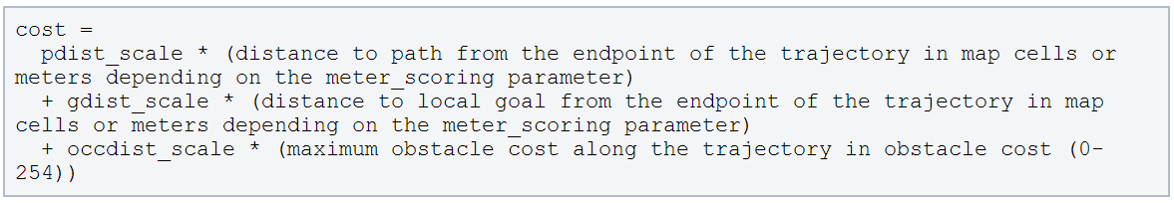
Trajectory Scoring Parameters
The cost function used to score each trajectory is in the following form:

Slide 22
Trajectory Scoring Parameters
Default | Description | Parameter
0.6 | The weighting for how much the controller should stay close to the path it was given | pdist_scale
0.8 | The weighting for how much the controller should attempt to reach its local goal, also controls speed | gdist_scale
0.01 | The weighting for how much the controller should attempt to avoid obstacles | occdist_scale
true | Whether to use the Dynamic Window Approach (DWA) or whether to use Trajectory Rollout (NOTE: In our experience DWA worked as well as Trajectory Rollout and is computationally less expensive. It is possible that robots with extremely poor acceleration limits could gain from running Trajectory Rollout, but we recommend trying DWA first.) | dwa

Slide 23
base_local_planner.yaml (1)
#For full documentation of the parameters in this file, and a list of all the
#parameters available for TrajectoryPlannerROS, please see
#http://www.ros.org/wiki/base_local_planner
TrajectoryPlannerROS:
#Set the acceleration limits of the robot
acc_lim_th: 3.2
acc_lim_x: 2.5
acc_lim_y: 2.5
#Set the velocity limits of the robot
max_vel_x: 0.65
min_vel_x: 0.1
max_rotational_vel: 1.0
min_in_place_rotational_vel: 0.4
#The velocity the robot will command when trying to escape from a stuck situation
escape_vel: -0.1
#For this example, we'll use a holonomic robot
holonomic_robot: true
#Since we're using a holonomic robot, we'll set the set of y velocities it will sample
y_vels: [-0.3, -0.1, 0.1, -0.3]

Slide 24
base_local_planner.yaml (2)
#Set the tolerance on achieving a goal
xy_goal_tolerance: 0.1
yaw_goal_tolerance: 0.05
#We'll configure how long and with what granularity we'll forward simulate trajectories
sim_time: 1.7
sim_granularity: 0.025
vx_samples: 3
vtheta_samples: 20
#Parameters for scoring trajectories
goal_distance_bias: 0.8
path_distance_bias: 0.6
occdist_scale: 0.01
heading_lookahead: 0.325
#We'll use the Dynamic Window Approach to control instead of Trajectory Rollout for this example
dwa: true
#How far the robot must travel before oscillation flags are reset
oscillation_reset_dist: 0.05
#Eat up the plan as the robot moves along it
prune_plan: true

Slide 25
TrajectoryPlannerROS
The base_local_planner::TrajectoryPlannerROS object is a wrapper for a base_local_planner::TrajectoryPlanner object that exposes its functionality as a ROS Wrapper.
It adheres to the nav_core::BaseLocalPlanner interface found in the nav_core package.

Slide 26
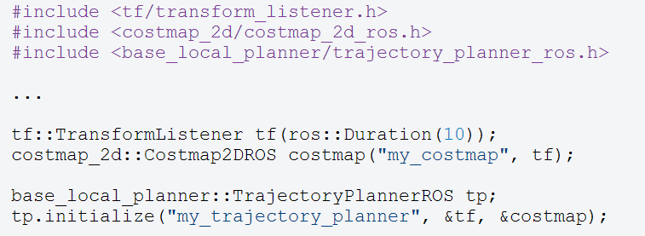
TrajectoryPlannerROS

Slide 27
Navigation Plans in rviz
NavFn Plan
Displays the full plan for the robot computed by the global planner
Topic: /move_base_node/NavfnROS/plan
Global Plan
It shows the portion of the global plan that the local planner is currently pursuing.
Topic: /move_base_node/TrajectoryPlannerROS/global_plan
Local Plan
It shows the trajectory associated with the velocity commands currently being commanded to the base by the local planner
Topic: /move_base_node/TrajectoryPlannerROS/local_plan

Slide 28
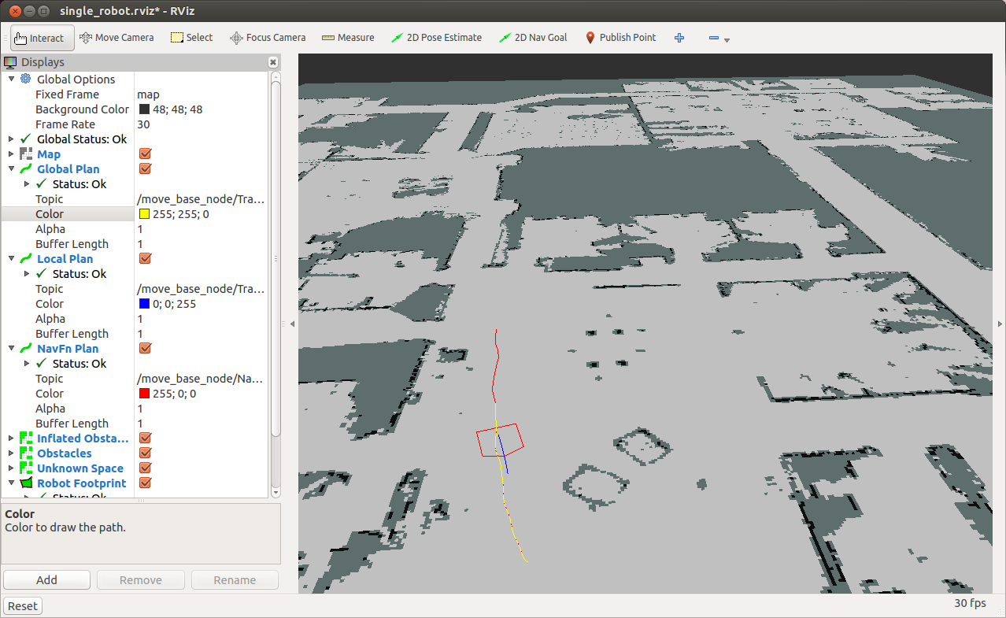
Navigation Plans in rviz
NavFn Plan
Local Plan
Global Plan

Slide 29
Changing Trajectory Scoring
Run the rqt_reconfigure tool
This tool allows changing dynamic configuration values
Open the move_base group
Select the TrajectoryPlannerROS node
Then set the pdist_scale parameter to something high like 2.5
After that, you should see that the local path (blue) now more closely follows the global path (yellow).
$ rosrun rqt_reconfigure rqt_reconfigure

Slide 30
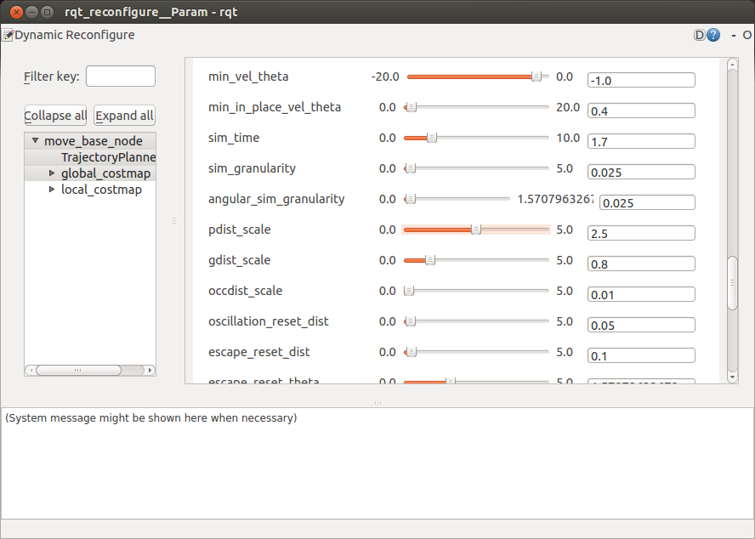
Changing Trajectory Scoring

Slide 31
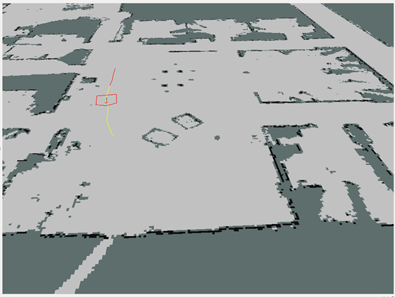
Changing Trajectory Scoring
Local plan follows global plan

Slide 32
Localization

Slide 33
Localization
Localization is the problem of estimating the pose of the robot relative to a map
Localization is not terribly sensitive to the exact placement of objects so it can handle small changes to the locations of objects
ROS uses the amcl package for localization

Slide 34
AMCL
amcl is a probabilistic localization system for a robot moving in 2D.
It implements the adaptive Monte Carlo localization approach, which uses a particle filter to track the pose of a robot against a known map.
The algorithm and its parameters are described in the book Probabilistic Robotics by Thrun, Burgard, and Fox.
http://www.probabilistic-robotics.org/
As currently implemented, this node works only with laser scans and laser maps. It could be extended to work with other sensor data.

Slide 35
AMCL
amcl takes in a laser-based map, laser scans, and transform messages, and outputs pose estimates
Subscribed topics:
scan – Laser scans
tf – Transforms
initialpose – Mean and covariance with which to (re-) initialize the particle filter
map – the map used for laser-based localization
Published topics:
amcl_pose – Robot's estimated pose in the map, with covariance.
Particlecloud – The set of pose estimates being maintained by the filter

Slide 36
AMCL Parameters
Default | Description | Parameter
100 | Minimum allowed number of particles | min_particles
5000 | Maximum allowed number of particles | max_particles
likelihood_field | Which model to use, either beam or likelihood_field | laser_model_type
2.0 | Maximum distance to do obstacle inflation on map, for use in likelihood_field model | laser_likelihood_max_dist
0.0 | Initial pose mean (x), used to initialize filter with Gaussian distribution | initial_pose_x
0.0 | Initial pose mean (y), used to initialize filter with Gaussian distribution | initial_pose_y
0.0 | Initial pose mean (yaw), used to initialize filter with Gaussian distribution | initial_pose_a

Slide 37
amcl_node.xml (1)
<launch>
<!--
Example amcl configuration. Descriptions of parameters, as well as a full list of all amcl parameters, can be found at http://www.ros.org/wiki/amcl.
-->
<node pkg="amcl" type="amcl" name="amcl" respawn="true">
<remap from="scan" to="base_scan" />
<!-- Publish scans from best pose at a max of 10 Hz -->
<param name="odom_model_type" value="omni"/>
<param name="odom_alpha5" value="0.1"/>
<param name="transform_tolerance" value="0.2" />
<param name="gui_publish_rate" value="10.0"/>
<param name="laser_max_beams" value="30"/>
<param name="min_particles" value="500"/>
<param name="max_particles" value="5000"/>
<param name="kld_err" value="0.05"/>
<param name="kld_z" value="0.99"/>
<param name="odom_alpha1" value="0.2"/>
<param name="odom_alpha2" value="0.2"/>

Slide 38
amcl_node.xml (2)
<!-- translation std dev, m -->
<param name="odom_alpha3" value="0.8"/>
<param name="odom_alpha4" value="0.2"/>
<param name="laser_z_hit" value="0.5"/>
<param name="laser_z_short" value="0.05"/>
<param name="laser_z_max" value="0.05"/>
<param name="laser_z_rand" value="0.5"/>
<param name="laser_sigma_hit" value="0.2"/>
<param name="laser_lambda_short" value="0.1"/>
<param name="laser_lambda_short" value="0.1"/>
<param name="laser_model_type" value="likelihood_field"/>
<!-- <param name="laser_model_type" value="beam"/> -->
<param name="laser_likelihood_max_dist" value="2.0"/>
<param name="update_min_d" value="0.2"/>
<param name="update_min_a" value="0.5"/>
<param name="odom_frame_id" value="odom"/>
<param name="resample_interval" value="1"/>
<param name="transform_tolerance" value="0.1"/>
<param name="recovery_alpha_slow" value="0.0"/>
<param name="recovery_alpha_fast" value="0.0"/>
</node>
</launch>

Slide 39
Particle Cloud in rviz
The Particle Cloud displays shows the particle cloud used by the robot's localization system.
The spread of the cloud represents the localization system's uncertainty about the robot's pose.
A cloud that spreads out a lot reflects high uncertainty, while a condensed cloud represents low uncertainty
As the robot moves about the environment, this cloud should shrink in size as additional scan data allows amcl to refine its estimate of the robot's position and orientation

Slide 40
Particle Cloud in rviz
To watch the particle cloud in rviz:
Click Add Display and choose Pose Array
Set topic name to /particlecloud

Slide 41
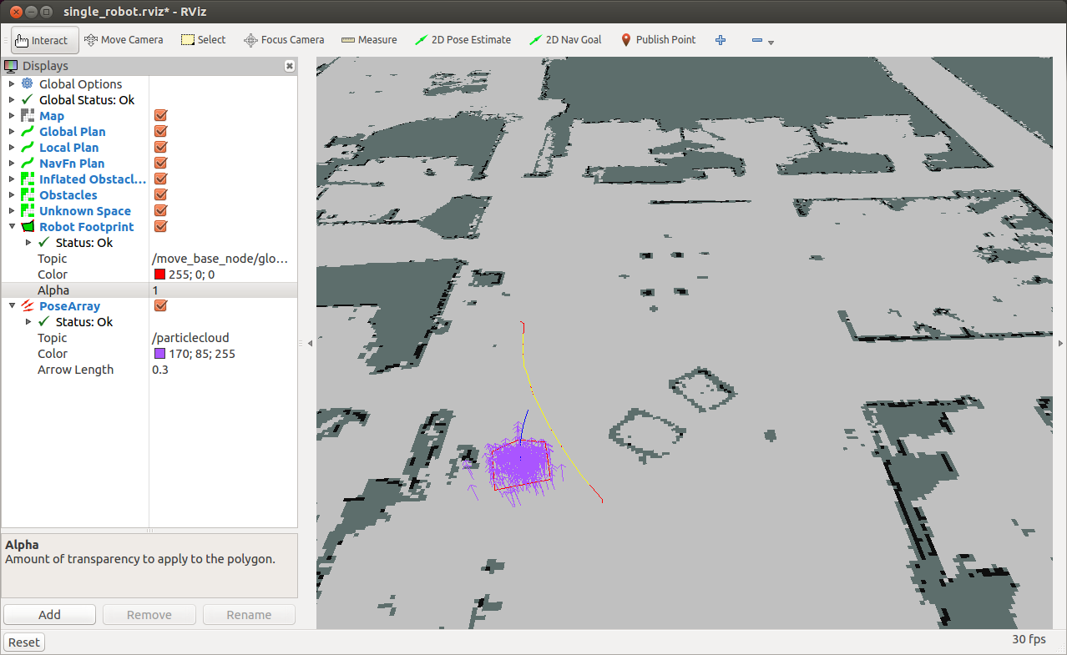
Particle Cloud in rviz

Slide 42
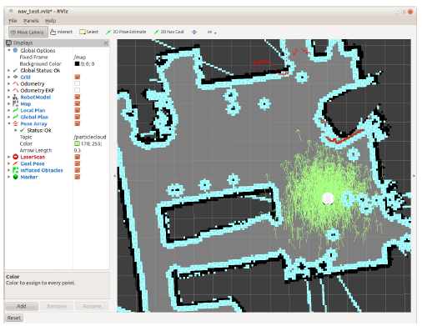
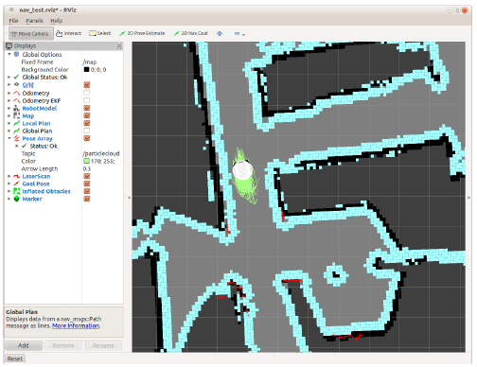
Using amcl with a Real Robot
Taken from ROS by Example / Goebel

Slide 43
Fake Localization
http://wiki.ros.org/fake_localization
A ROS node that simply forwards odometry information.
Substitutes for a localization system
Converts odometry data into pose, particle cloud, and transform data of the form published by amcl.
Mostly used during simulation as a method to provide perfect localization in a computationally inexpensive manner.

Slide 44
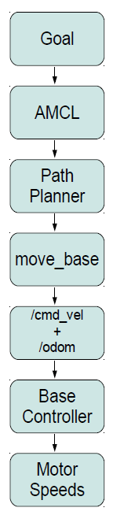
Navigation Summary

