Slide 1

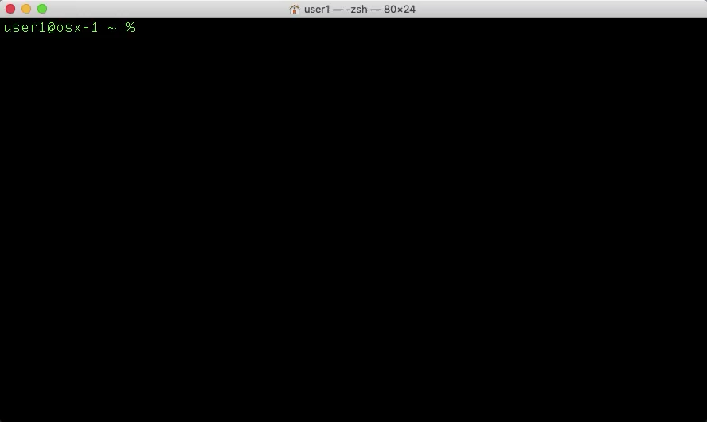
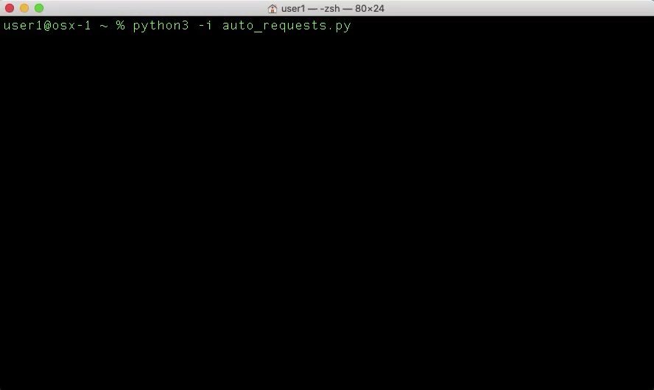
REST API Calls With HTTP
An introduction to Unix cURL & Python Requests with hands-on practice
Notes:
// TODO

Slide 2
If you want hands-on practice…
Have access to a Unix-style terminal (Linux, macOS, WSL, etc.)
https://docs.microsoft.com/en-us/windows/wsl/install-win10
Download and install Python 3
https://www.python.org/downloads/
Connect to the ATC VPN
https://atc-support.apps.wwtatc.com/vpn_access
Download this presentation from WWT’s internal GitHub
https://github.wwt.com/hullt/rest-api-http-foundations
Install a code editor
https://code.visualstudio.com/Download
Wait a few minutes while we get through an overview
Notes:
// TODO

Slide 3
Part I
REST API Background
Notes:
// TODO

Slide 4
Why Are REST APIs Important?
Programmatic interaction with…
System automation and integration with…
Something else…
Translation – APIs are the foundation of automated infrastructures (what our customers want/need)
Notes:
// TODO

Slide 5
What is cURL?
“cURL is a command-line tool for getting or sending data including files using URL syntax.”
https://en.wikipedia.org/wiki/CURL#cURL
For our purpose, cURL allows us to make REST API calls from our terminal
Notes:
// TODO

Slide 6
What is the Python “Requests” Library?
“Requests is a Python HTTP library, released under the Apache License 2.0. The goal of the project is to make HTTP requests simpler and more human-friendly.”
https://en.wikipedia.org/wiki/Requests_%28software%29
For our purpose, Requests allows us to make REST API calls with Python
Notes:
// TODO

Slide 7
Part II
cURL Syntax
Notes:
// TODO

Slide 8
Slide Template
Body template

Slide 9
Part III
Make REST API Calls With cURL
Notes:
// TODO

Slide 10
Slide Template
Body template

Slide 11
Part IV
Python Requests Syntax
Notes:
// TODO

Slide 12
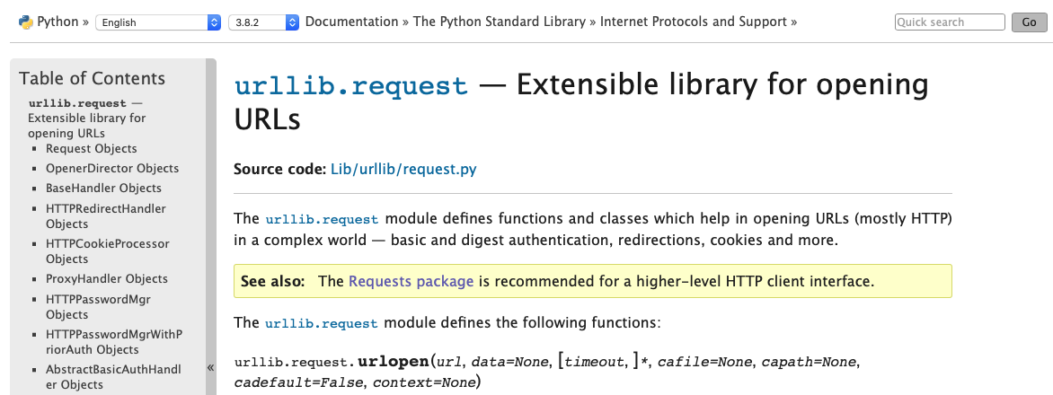
Why Python Requests?
https://docs.python.org/3.8/library/urllib.request.html

Slide 13
Part V
Make REST API Calls With Python Requests
Notes:
// TODO

Slide 14
Slide Template
Body template

Slide 16
References
https://en.wikipedia.org/wiki/CURL
https://en.wikipedia.org/wiki/Requests_%28software%29
https://curl.haxx.se
https://requests.readthedocs.io/en/master/
Cisco API documentation #1
Cisco API documentation #2
Cisco API documentation #3

Slide 17

Notes:
// TODO

