Slide 1

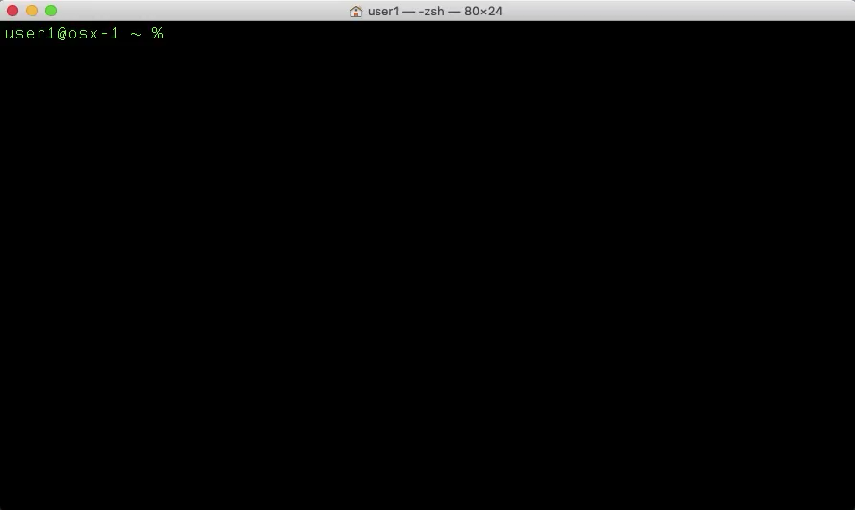
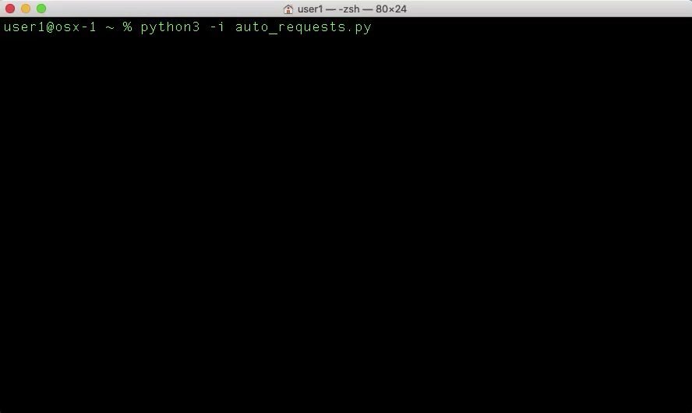
cURL & Python Requests Foundations
An introduction to Unix cURL, Python Requests, & hands-on API practice with Cisco platforms
Notes:
// TODO

Slide 2
If you want hands-on practice…
Create a Docker Hub Account
https://hub.docker.com/signup
Download and install Docker Desktop
https://www.docker.com/products/docker-desktop
Download this repo from WWT’s GitHub
https://github.com/wwt/curl-requests-foundations
Install a code editor
https://code.visualstudio.com/Download
Wait a few minutes while we get through an overview
Notes:
// TODO

Slide 3
Access the Hands-On Environment
Open your preferred terminal (bash, PowerShell, zsh, etc.)
Create and switch to a local folder
mkdir ~/code && cd ~/code
Create a Docker Container for the hands-on exercises
docker container run -itv ~/code:/code --name curl_pyreq1 wwt01/curl_pyreq
Detach from the Docker Container
control + p + q
Stop, start, and attach the Docker Container
docker container stop curl_pyreq1
docker container start curl_pyreq1
docker container attach curl_pyreq1
Notes:
// TODO
A Docker container is available which has a ready-build development environment for all of the hands-on activities
This will run on any Docker host, no dependency concerns
This isn’t a Docker class but here are some basic commands to use Docker for the hands-on activities
Create/use a local folder to organize all of your projects (/development, /code, etc.)
Download and run the Docker image from Docker Hub

Slide 4
Part I
REST API Background
Notes:
// TODO
This is not a class on REST APIs (what they are) – separate topic in a separate presentation

Slide 5

Why Are REST APIs Important?
Primary mechanism to interact with many infrastructure systems
Simple method to make CRUD requests
Portable syntax between REST clients
Translation – REST APIs are the foundation of automated infrastructures
Notes:
// TODO
Most Cisco products use REST APIs
Simpler than RPC, SOAP, etc.
https://www.linkedin.com/pulse/why-rest-api-so-popular-mangesh-bulkar/
Client/server architecture – Uses HTTP verbs (less ambiguity)
Widely documented
Portable between REST clients
cURL
Python
Postman
Etc.
Our customers want/need simple, automated infrastructures

Slide 6
Part II
REST API Calls With cURL
Notes:
// TODO

Slide 7
What is cURL?
“cURL is a command-line tool for getting or sending data including files using URL syntax.”
https://en.wikipedia.org/wiki/CURL#cURL
For our purpose, cURL allows us to make REST API calls from a terminal
Notes:
// TODO

Slide 8
Outline
Syntax format
cURL command flag definitions
Basic cURL examples and exercises

Slide 9
cURL Syntax Format
Open your preferred terminal (bash, PowerShell, zsh, etc.)
Enter the command:
curl https://www.website.com
Notes:
// TODO

Slide 10
cURL Command Flags
Several cURL command flags are common
curl [FLAGS] url
-X – HTTP method (GET, POST, PUT, DELETE) – default is GET
--url – Request URL
-H – HTTP client header to send(key/value pairs, one per -H (multiple -H allowed)
-d or --data – HTTP PUT/POST (multiple -d/--data flags allowed)
{"key1":"value1","key2":"value2"}
content-type application/x-www-form-urlencoded or use --dataraw
-i – include server response headers in STDOUT
-k – allow self-signed certificates (insecure SSL)
-L – follow redirects (location)
-v – display detailed request and response information (verbose)
-o file_name – write response output to a file instead of STDOUT
-I or --head – display ONLY response headers in STDOU
-u or --user – credentials key/value pair
--basic – Use HTTP Basic Authentication
Notes:
// TODO

Slide 11
Part III
REST API Calls With Python Requests
Notes:
// TODO

Slide 12
What is the Python “Requests” Library?
“Requests is a Python HTTP library, released under the Apache License 2.0. The goal of the project is to make HTTP requests simpler and more human-friendly.”
https://en.wikipedia.org/wiki/Requests_%28software%29
For our purpose, Requests allows us to make REST API calls with Python
Notes:
// TODO

Slide 13
Outline
Requests Library overview
Requests methods, arguments, and objects
Basic Requests examples and exercises

Slide 14
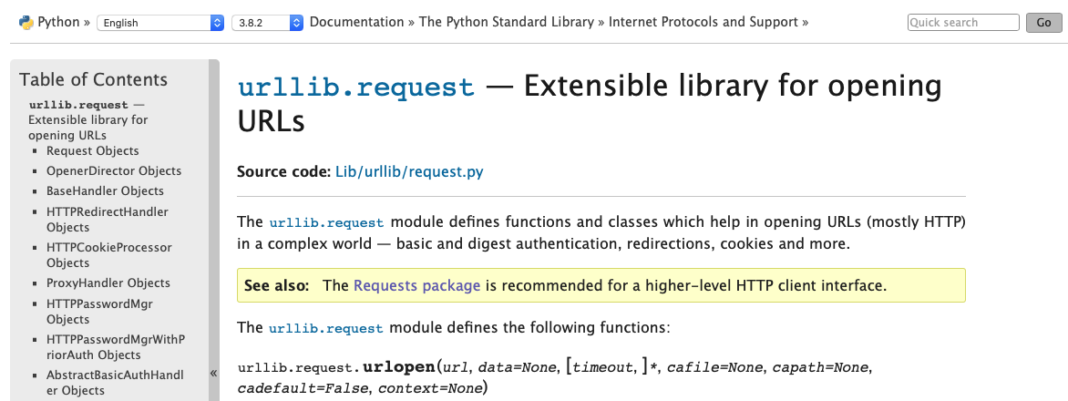
Why Python Requests?
https://docs.python.org/3.8/library/urllib.request.html

Slide 15
Part IV
Cisco Platform APIs Overview
Notes:
// TODO

Slide 16
Outline
For each of these platforms:
DNAC
Webex Teams
Meraki
ACI
Firepower
SD-WAN
Perform the following tasks:
Platform summary overview
Review API documentation
Review resources available for programmatic access/practice/testing

Slide 17
Part V
Interact With Cisco Platform APIs Using cURL
Notes:
// TODO

Slide 18
Outline
For each of these platforms:
DNAC
Webex Teams
Meraki
ACI
Perform the following tasks:
Understand authentication methodology
Build cURL request to authenticate
Build cURL request(s) to read/write data

Slide 19
Part VI
Interact With Cisco Platform APIs Using Python Requests
Notes:
// TODO

Slide 20
Outline
For each of these platforms:
DNAC
Webex Teams
Meraki
ACI
Perform the following tasks:
Review authentication methodology
Build Python scripts to authenticate
Build Python scripts to read/write data

Slide 21
Part VII
Quiz, Practice Resources, & References
Notes:
// TODO

Slide 22
Slide Template
Body template

Slide 23
References
https://www.linkedin.com/pulse/why-rest-api-so-popular-mangesh-bulkar/
https://en.wikipedia.org/wiki/CURL
https://en.wikipedia.org/wiki/Requests_%28software%29
https://curl.haxx.se
https://requests.readthedocs.io/en/master/
Cisco API documentation #1
Cisco API documentation #2
Cisco API documentation #3

