Slide 1

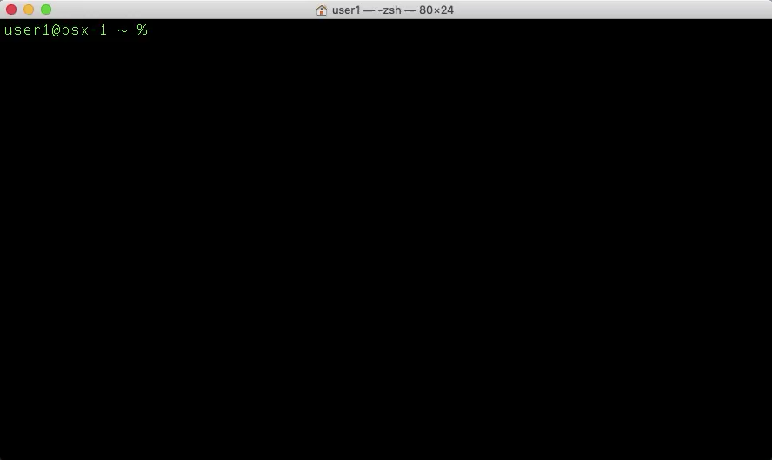
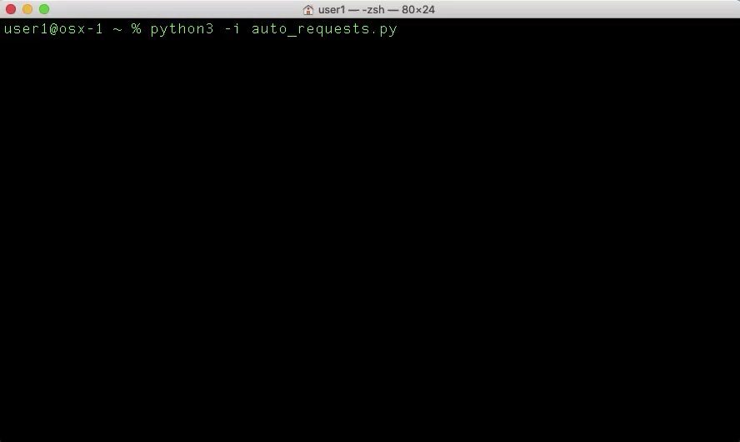
cURL & Python Requests Foundations
An introduction to Unix cURL, Python Requests, & hands-on API practice with Cisco platforms
Notes:
// TODO

Slide 2
If you want hands-on practice…
Create a Docker Hub Account
https://hub.docker.com/signup
Download and install Docker Desktop
https://www.docker.com/products/docker-desktop
Download this repo from WWT’s GitHub
https://github.com/wwt/curl-requests-foundations
Install a code editor
https://code.visualstudio.com/Download
Wait a few minutes while we get through an overview
Notes:
// TODO

Slide 3
Access the Hands-On Environment
Open your preferred terminal (bash, PowerShell, zsh, etc.)
Create and switch to a local folder
mkdir ~/code && cd ~/code
Create a Docker Container for the hands-on exercises
docker container run -itv ~/code:/code --name curl_pyreq1 wwt01/curl_pyreq
Detach from the Docker Container
control + p + q
Stop, start, and attach the Docker Container
docker container stop curl_pyreq1
docker container start curl_pyreq1
docker container attach curl_pyreq1
Notes:
// TODO
A Docker container is available which has a ready-build development environment for all of the hands-on activities
This will run on any Docker host, no dependency concerns
This isn’t a Docker class but here are some basic commands to use Docker for the hands-on activities
Create/use a local folder to organize all of your projects (/development, /code, etc.)
Download and run the Docker image from Docker Hub

Slide 5
Part I
REST API Background
Notes:
// TODO
This is not a class on REST APIs (what they are) – separate topic in a separate presentation

Slide 6

Why Are REST APIs Important?
Primary mechanism to interact with many infrastructure systems
Simple method to make CRUD requests
Portable syntax between REST clients
Translation – REST APIs are the foundation of automated infrastructures
Notes:
// TODO
Most Cisco products use REST APIs
Simpler than RPC, SOAP, etc.
https://www.linkedin.com/pulse/why-rest-api-so-popular-mangesh-bulkar/
Client/server architecture – Uses HTTP verbs (less ambiguity)
Widely documented
Portable between REST clients
cURL
Python
Postman
Etc.
Our customers want/need simple, automated infrastructures

Slide 7
Part II
REST API Calls With cURL
Notes:
// TODO

Slide 8
What is cURL?
“cURL is a command-line tool for getting or sending data including files using URL syntax.”
https://en.wikipedia.org/wiki/CURL#cURL
For our purpose, cURL allows us to make REST API calls from a terminal
Notes:
// TODO

Slide 9
Outline
Syntax format
cURL command option definitions
cURL examples and exercises
Notes:
// TODO

Slide 10
cURL Syntax Format
Format
curl [options…] <url>
Open your preferred terminal (bash, PowerShell, zsh, etc.)
Enter the commands:
curl --version or curl -V
curl https://www.whatsmyua.info
Notes:
// TODO

Slide 12
cURL Command Options
Several cURL command options are common
-X or --request – HTTP method (GET (default), POST, PUT, DELETE)
--url <url> – Request URL
-H or --header– HTTP client header(s)
-d or --data or --data-urlencode – HTTP PUT/POST data
-i or --include – include response headers in STDOUT
-I or --head – display ONLY response headers in STDOUT
-k or --insecure – allow self-signed certificates (insecure SSL)
-L or --location – follow redirects
-o <file_name> or --output <file_name> – write response to a file instead of STDOUT
-u or --user – HTTP Basic Authentication credentials in a key/value pair
-v or --verbose – display detailed info for debugging (headers, TLS handshake, etc.)
Notes:
// TODO

Slide 13
Part III
REST API Calls With Python Requests
Notes:
// TODO

Slide 14
What is the Python “Requests” Library?
“Requests is a Python HTTP library, released under the Apache License 2.0. The goal of the project is to make HTTP requests simpler and more human-friendly.”
https://en.wikipedia.org/wiki/Requests_%28software%29
For our purpose, Requests allows us to make REST API calls with Python
Notes:
// TODO

Slide 15
Outline
Requests Library overview
Requests methods, arguments, and objects
Basic Requests examples and exercises

Slide 16
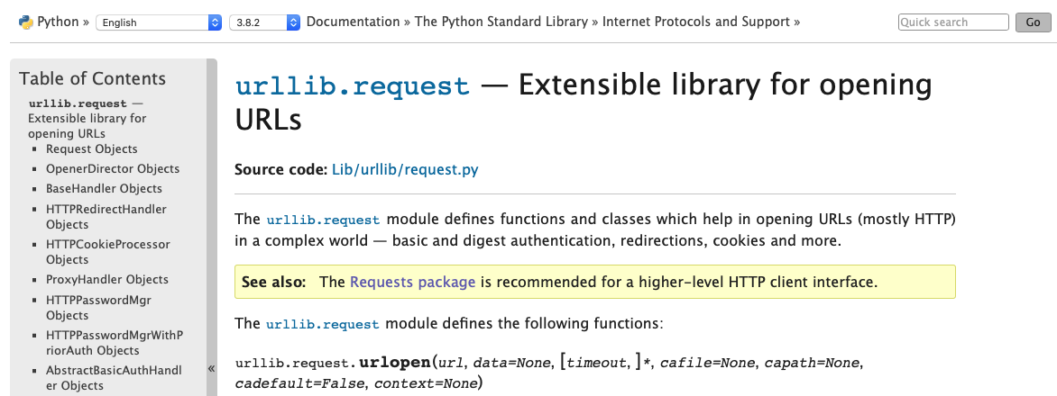
Why Python Requests?
https://docs.python.org/3.8/library/urllib.request.html

Slide 17
Part IV
Cisco Platform APIs Overview
Notes:
// TODO

Slide 18
Outline
For each of these platforms:
DNAC
Webex Teams
Meraki
ACI
Firepower
SD-WAN
Perform the following tasks:
Platform summary overview
Review API documentation
Review resources available for programmatic access/practice/testing

Slide 19
Part V
Interact With Cisco Platform APIs Using cURL
Notes:
// TODO

Slide 20
Outline
For each of these platforms:
DNAC
Webex Teams
Meraki
ACI
Perform the following tasks:
Understand authentication methodology
Build cURL request to authenticate
Build cURL request(s) to read/write data

Slide 21
Part VI
Interact With Cisco Platform APIs Using Python Requests
Notes:
// TODO

Slide 22
Outline
For each of these platforms:
DNAC
Webex Teams
Meraki
ACI
Perform the following tasks:
Review authentication methodology
Build Python scripts to authenticate
Build Python scripts to read/write data

Slide 23
Part VII
Quiz, Practice Resources, & References
Notes:
// TODO

Slide 24
Slide Template
Body template

Slide 25
References
https://www.linkedin.com/pulse/why-rest-api-so-popular-mangesh-bulkar/
https://en.wikipedia.org/wiki/CURL
https://en.wikipedia.org/wiki/Requests_%28software%29
https://curl.haxx.se
https://requests.readthedocs.io/en/master/
Cisco API documentation #1
Cisco API documentation #2
Cisco API documentation #3

