Slide 1
Environmental sound classification
蔡政憲、賴以立、黃彥魁

Slide 2
Introduction
Environmental sounds come from all the time and everywhere
it can be directly or indirectly implemented into a very wide area of topics
speech recognition
pattern identification
detect gunshot in the block
offer concrete potentialities for surveillance and security applications
Many different methods and algorithms are developed for identifying noise sources
Prediction Coding (LPC), Perceptual Linear Predictive (PLP) and Mel-Frequency Cepstral Coefficients (MFCCs)
Hidden Markov Models (HMMs), statistical pattern recognition systems, Artificial Neural Networks (ANNs), fuzzy logic systems

Slide 3
Introduction(Cont.)
Deep neural network is a way to learn abstract information from input data, which have great ability to find out non-linear relation
DCNN first used in image field, and got an excellent performance
convolutional layer to capture features of image, pooling layer to de-noising and decrease feature dimensions
Spectrogram is visual representation describing how spectrumchange along the time, and usually shown as a heat map
Mel-Frequency Cepstrum (MFC) is also a representation of signal
MFC map spectrum with mel scale and cosine transform
test the performance of DCNN by using spectrogram only, MFC only, and combine both

Slide 4
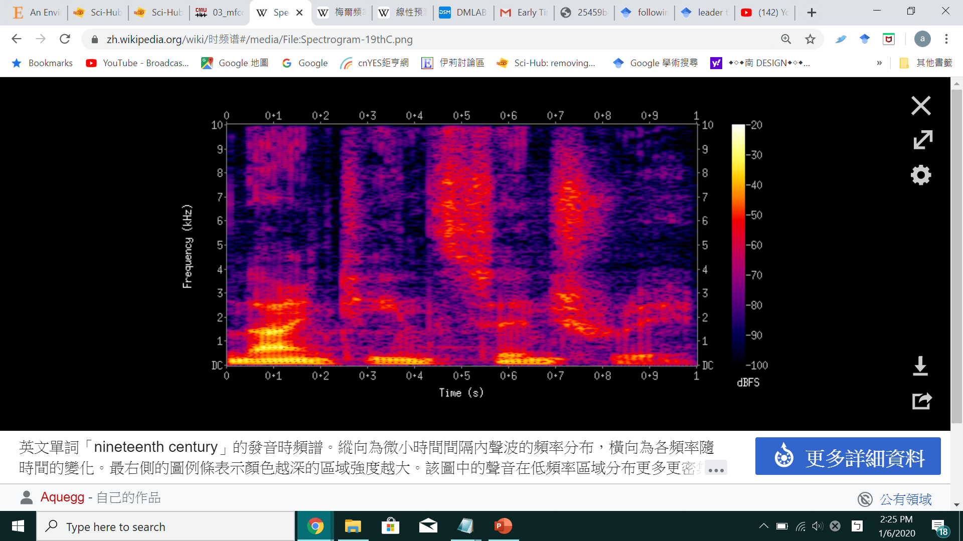

Slide 5
Related Work
F. Beritelli et al.(2008.) proposed a system based on MFCCs feature and ANNs classifier
L. Ma et al. (2003) proposed a system based on MFCCs feature and HMM classifier
L. Couvreur et al. (2004) presented a classification system based on ANNs coupled with HMMs and PLP feature
environmental sounds are more diverse and span a wide range of frequencies
Existing works for this task largely use conventional classifiers such as GMM and SVM, which do not have the feature abstraction capability found in deeper models

Slide 6
Related Work (Cont.)
IEEE challenge on Detection and Classification of Acoustic Scenes and Events (DCASE) exist a lot of deep learning method
Deep Neural Network (DNN)
Recurrent Neural Network (RNN)
Convolutional Deep Neural Network (CNN)
deep neural network models outperform traditional methods

Slide 7
Method
Data Set : ESC-50 , a labeled collection of 2000 environmental audio recordings
Load data with Librosa package
Process the data through following three methods and then calculate the individual mel-scaled spectrogram after Fourier transform
Stretch Sound
Sound Shift
White Noise
merge the above results
Define convolutional neural network
evaluate

Slide 8
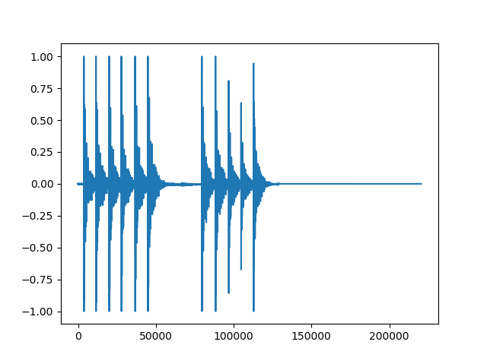
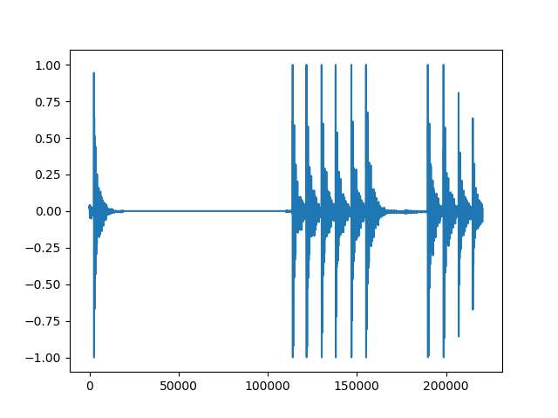
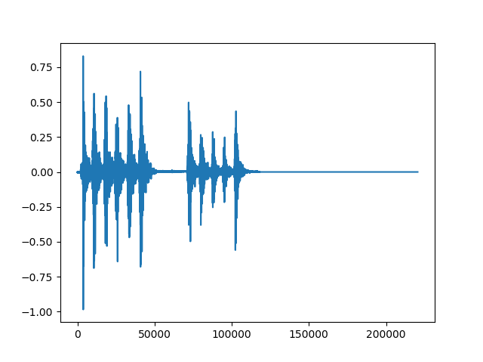
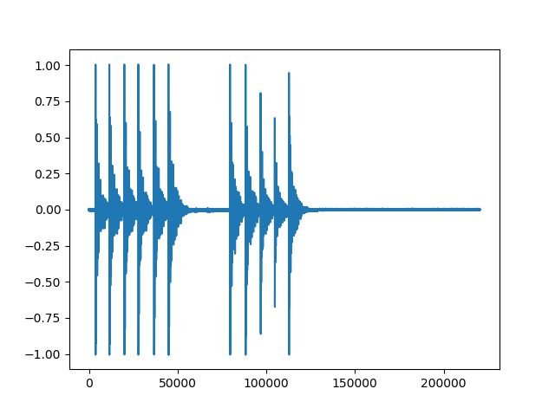
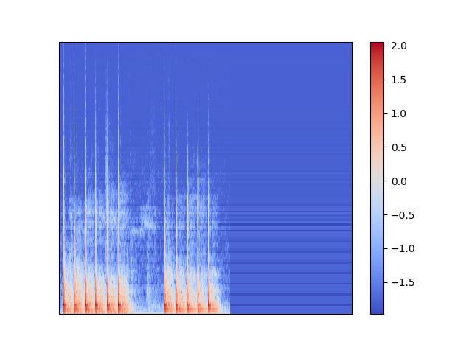
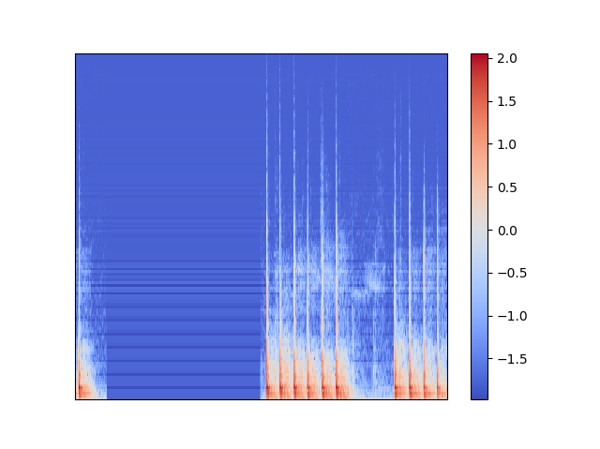
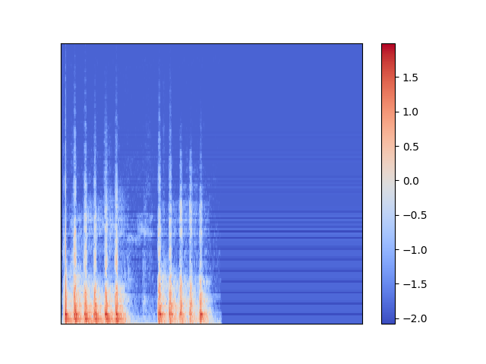
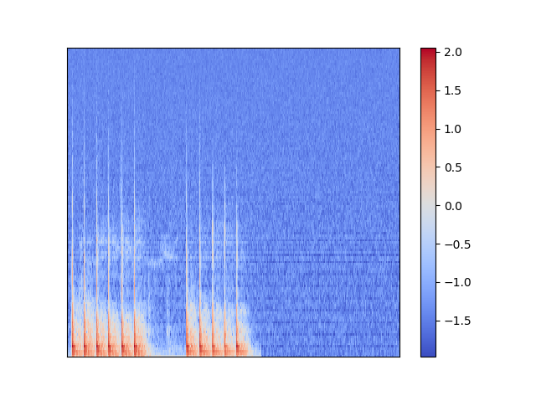
original
Sound Shift
Stretch Sound
White Noise

Slide 9
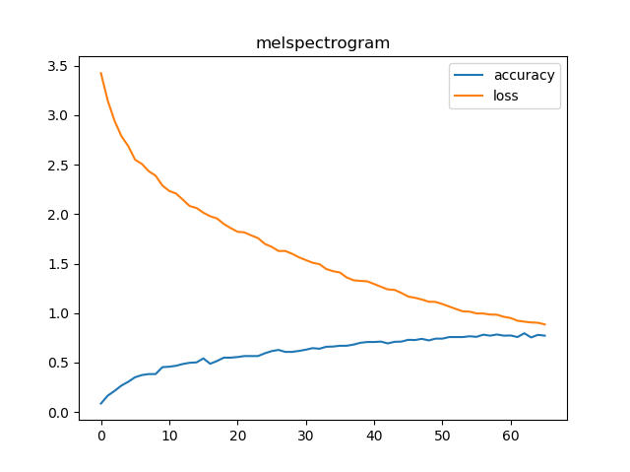
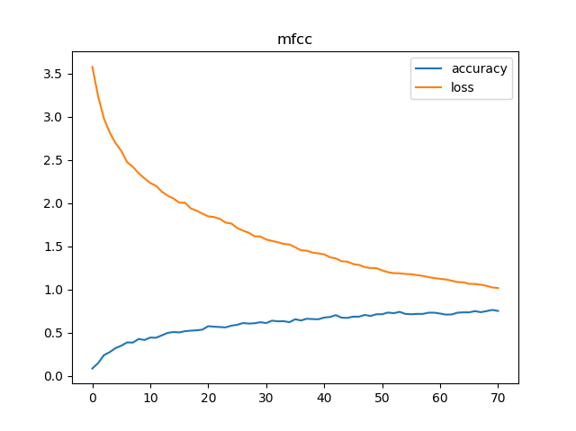
Result
Method | Our approach Mel-spectrogram | Out approach MFCC | Baseline – Random forest | Baseline – SVM
accuracy | 0.796 | 0.766 | 0.443 | 0.396

