Slide 1

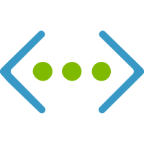



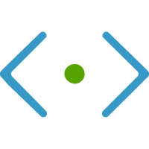





Scenario Hybrid

Slide 2
Microsoft.Network
Microsoft.Automation
Microsoft.Compute

Slide 3
Microsoft.Network
Microsoft.Automation
Microsoft.Compute
/virtualMachines

Slide 4
Microsoft.Network
/
Microsoft.Automation
.../virtualNetworks
Microsoft.Compute
/virtualMachines

Slide 5
Microsoft.Network
/
Microsoft.Automation
.../virtualNetworks
.../virtualNetworks/subnets
.../bastionHosts
.../publicIPAddresses
Microsoft.Compute
/virtualMachines

Slide 6
Microsoft.Network
/
Microsoft.Automation
/automationAccounts
.../virtualNetworks
/
.../modules
.../virtualNetworks/subnets
.../configurations
.../bastionHosts
.../networkInterfaces
.../compilationjobs
.../extensions
.../publicIPAddresses
Microsoft.Compute
/virtualMachines
/

