Slide 1
江烈 2013-07-25
Photon设计方案

Slide 2
Outline
-Why thread suck
-Actor
-AKKA
-Photon

Slide 3
Processes, kernel threads, user threads, and fibers
A process is the "heaviest" unit of kernel scheduling. Processes own resources allocated by the operating system.
A kernel thread is the "lightest" unit of kernel scheduling. At least one kernel thread exists within each process.
Light-weight process(LWP linux only) runs in user space on top of a single kernel thread and shares its address space and system resources with other LWPs within the same process. Multiple user level threads, managed by a thread library, can be placed on top of one or many LWPs - allowing multitasking to be done at the user level, which can have some performance benefits.
Threads are sometimes implemented in userspace libraries, thus called user threads. The kernel is not aware of them, so they are managed and scheduled in userspace.
Fibers are an even lighter unit of scheduling which are cooperatively scheduled: a running fiber must explicitly "yield" to allow another fiber to run, which makes their implementation much easier than kernel or user threads. A fiber can be scheduled to run in any thread in the same process.

Slide 4
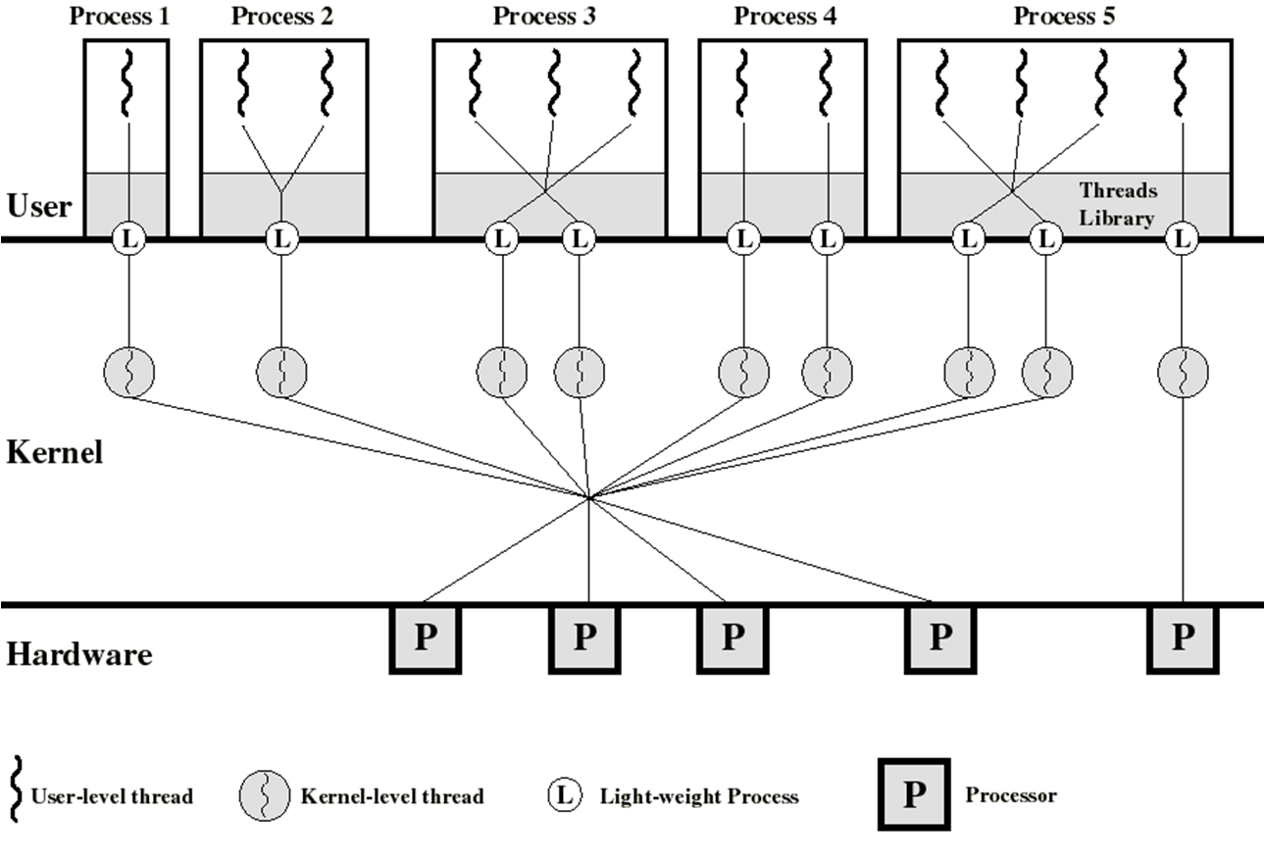
Degree of parallelism
Process 2 is equivalent to pure ULT(User-level Thread) approach
Process 4 is equivalent to pure KLT(Kernal-level Thread) approach

Slide 5
Three main thread libraries
POSIX Pthreads. Pthreads, the threads extension of the POSIX standard, may be provided as either a user- or kernel-level library.
Win32. The Win32 thread library is a kernel-level library available on Windows systems.
Java. The Java thread API allows thread creation and management directly in Java programs. However, because in most instances the JVM is running on top of a host OS, the Java thread API is typically implemented using a thread library available on the host system.
Notes:
POSIX Portable Operation System interface

Slide 6
Thread Model
1:1 (Kernel-level threading)
Threads created by the user are in 1-1 correspondence with schedulable entities in the kernel.
N:1 (User-level threading)
An N:1 model implies that all application-level threads map to a single kernel-level scheduled entity; the kernel has no knowledge of the application threads.
M:N (Hybrid threading)
M:N maps some M number of application threads onto some N number of kernel entities, or "virtual processors."

Slide 7
Thread intrinsically deficient
Threads in the same process share the same address space. When shared between threads, however, even simple data structures become prone to race hazards
To prevent this, threading APIs offer synchronization primitives such as mutexes to lock data structures against concurrent access. On uniprocessor systems, a thread running into a locked mutex must sleep and hence trigger a context switch. On multi-processor systems, the thread may instead poll the mutex in a spinlock. Both of these may sap performance and force processors in SMP systems to contend for the memory bus, especially if the granularity of the locking is fine.

Slide 8
Actor Origin
The Actor model originated in 1973. According to Carl Hewitt, unlike previous models of computation, the Actor model was inspired by physics including general relativity and quantum mechanics. It was also influenced by the programming languages Lisp, Simula and early versions of Smalltalk, as well as capability-based systems and packet switching. Its development was "motivated by the prospect of highly parallel computing machines consisting of dozens, hundreds or even thousands of independent microprocessors, each with its own local memory and communications processor, communicating via a high-performance communications network."^{[3]} Since that time, the advent of massive concurrency through multi-core computer architectures has revived interest in the Actor model.

Slide 9
Actor model
The Actor model adopts the philosophy that everything is an actor. This is similar to the everything is an object philosophy used by some object-oriented programming languages, but differs in that object-oriented software is typically executed sequentially, while the Actor model is inherently concurrent.
Decoupling the sender from communications sent was a fundamental advance of the Actor model enabling asynchronous communication and control structures as patterns of passing messages.^{[8]}
Recipients of messages are identified by address, sometimes called "mailing address". Thus an actor can only communicate with actors whose addresses it has. It can obtain those from a message it receives, or if the address is for an actor it has itself created.

Slide 10
AKKA
Akka is a toolkit and runtime for building highly concurrent, distributed, and fault tolerant event-driven applications on the JVM.
High Performance
50 million msg/sec on a single machine. Small memory footprint; ~2.5 million actors per GB of heap.
Elastic & Decentralized
Adaptive load balancing, routing, partitioning and configuration-driven remoting.

Slide 11
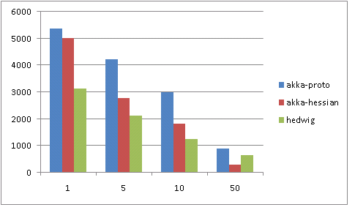
Performance Compare

Slide 12
Photon
High parallelism transport framework. Use SEDA and actor model to increase concurrent ability consequently boost the performance on multiprocessor computer.
-Reliability Level：
Fire and forget one-way
Server receive guarantee confirm + ack
Server replay guarantee sync
-Limit Resource
-Client Throttle
Global Throttle
Branch Throttle
-Server Throttle
-Client Retry
-Basic Security
-Batch Execute kit

Slide 13
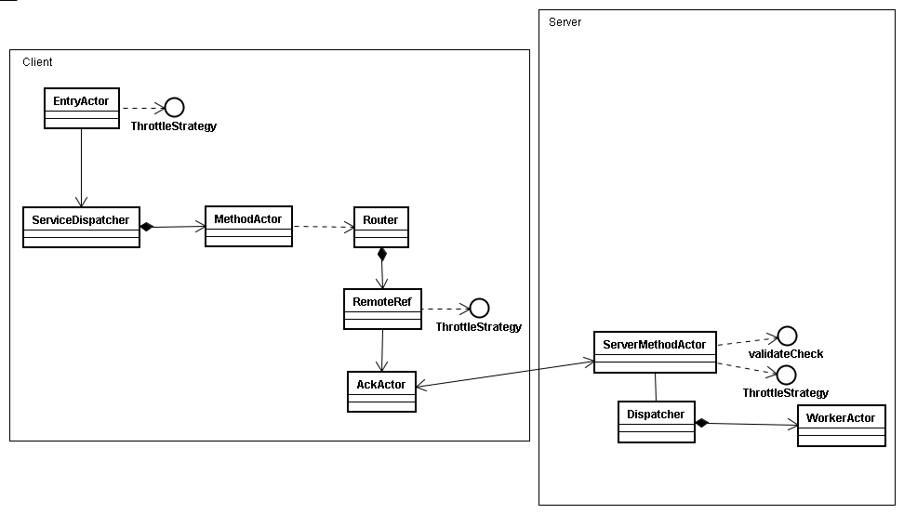
Actor view Design

Slide 14
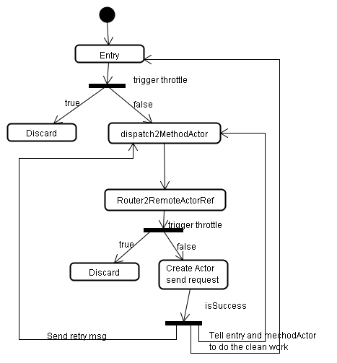
Client Process flow

Slide 15
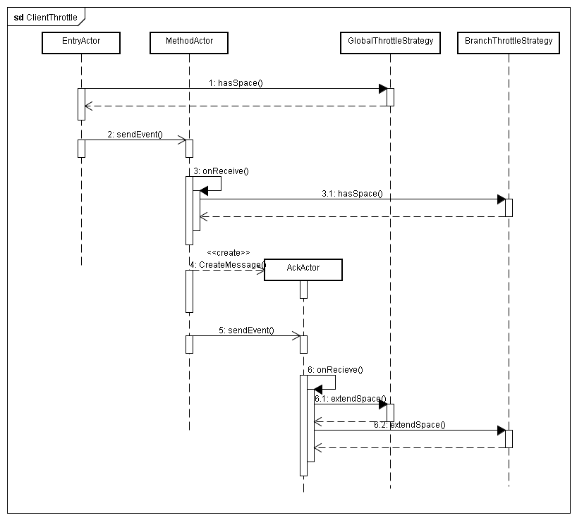
Client Throttle

Slide 16
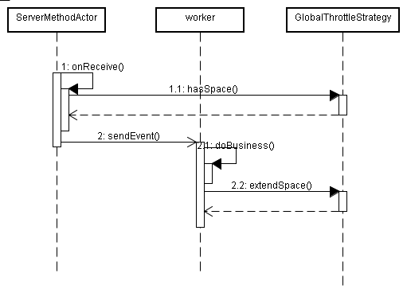
Server Throttle

Slide 17
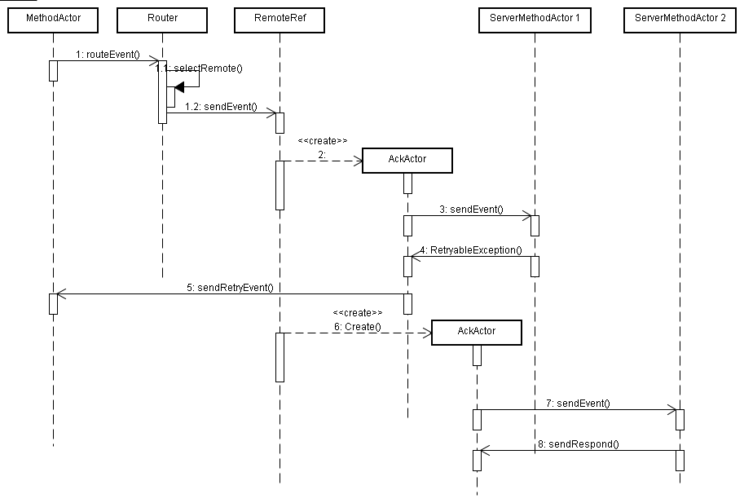
Client Retry

Slide 18
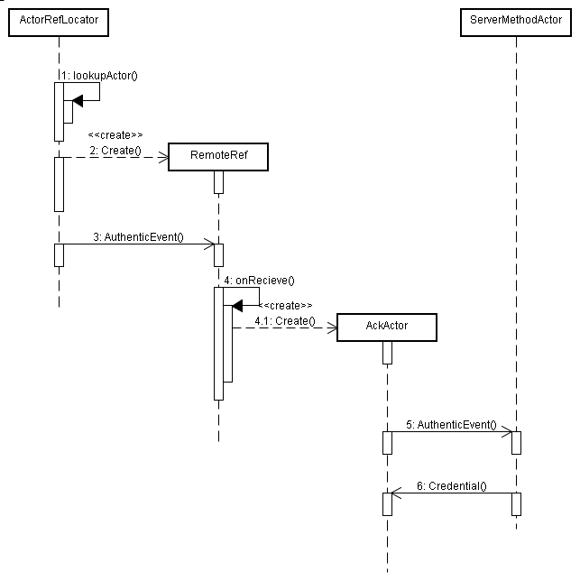
Basic Security
在创建远程Actor代理时做验证，服务端如果验证成功则返回Credential并存储在RemoteRef中，后续请求不需再做权限验证，如果验证失败则后续请求直接抛出UnauthorizedException。

Slide 19
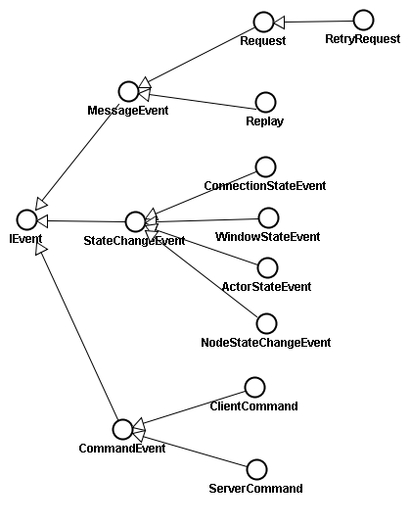
Event Hierarchy

Slide 20
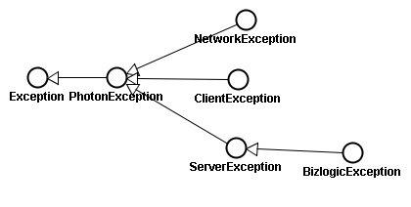
Exception Hierarchy

Slide 21
Thank you

