Slide 1
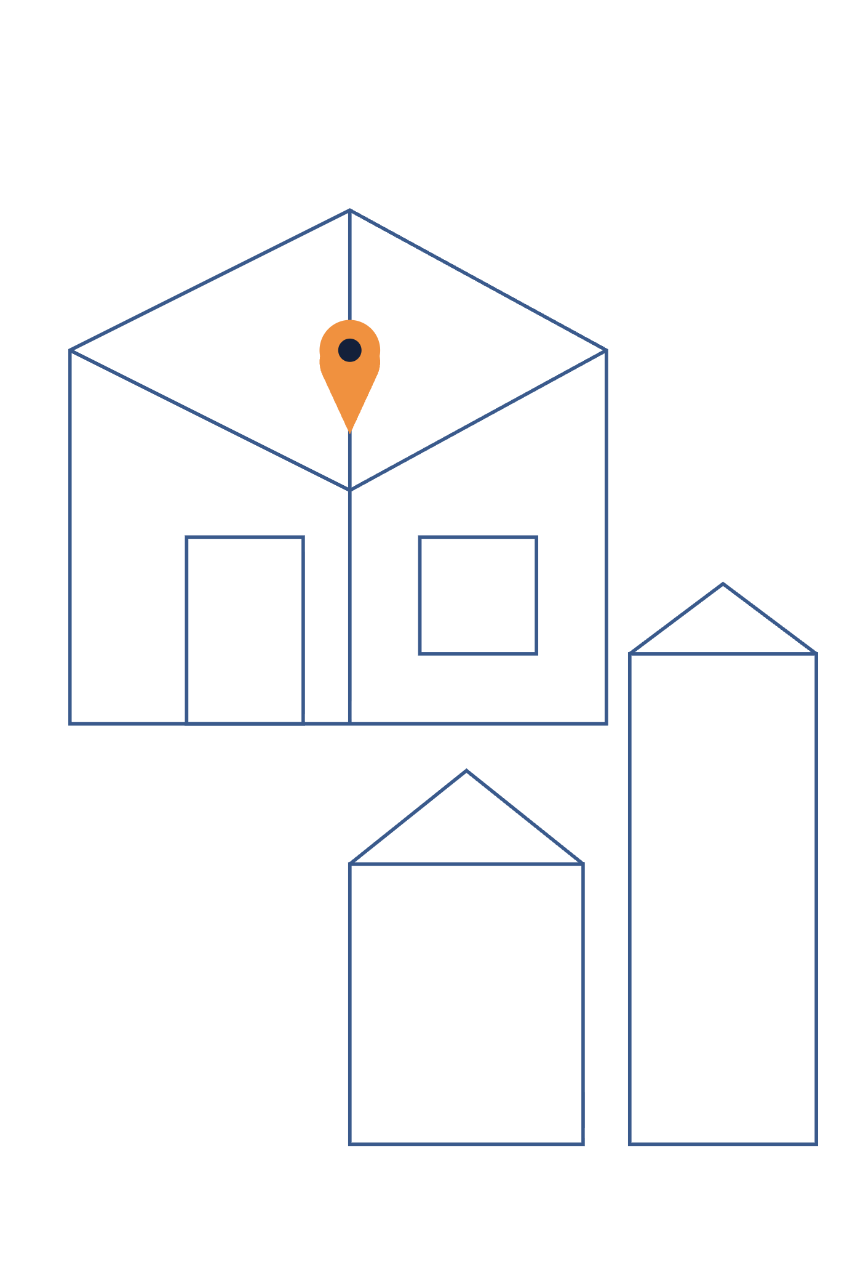
Putting a Map on the Screen
WORK SESSION 2
Mapbox GL · react-map-gl · Vercel
Tuesday, October 6, 2026 · 3:00 PM ET
Notes:
Agenda: quick Week 1 recap and where everyone is, a reminder on the PR workflow (the part that tripped people up), then the Week 2 assignment — deploy to Vercel, build a layout, and render an interactive Mapbox map with pins and popups.

Slide 2
Where everyone landed
WEEK 1 REVIEW
Student | Scaffold | PR opened | Reviewer | Your next step
Esther | Done | Done | — | Add wwwaiser as PR reviewer
Cato | Done | Done | Done | On track — be ready to explain the AI code
Venessa | Done | — | — | Open PR (setup to main) + reviewer
Mythri | — | — | — | Create repo and scaffold the app
The code work was solid across the board — the stumbles were all in the pull request workflow, not the app. That's the next slide.
Notes:
Keep this constructive — the point is "here is your one next action," not grading. Everyone scaffolded a working Next.js app. Esther just needs a reviewer; Venessa committed to a branch but never opened the PR; Mythri hasn't shared a repo yet; Cato is furthest along and all his dependencies check out — just have him be ready to explain the AI-generated parts. If showing names to the whole group feels off, I can swap to an anonymized or counts-only version.

Slide 3
Every change goes through a pull request
THE ONE HABIT TO LOCK IN
1
Branch
git checkout -b week-02-map
2
Commit
git commit -am "Add Mapbox map"
3
Push
git push -u origin week-02-map
4
Open the PR + add a reviewer
On GitHub: Compare & pull request, then add wwwaiser as reviewer. This is the step that got missed.
Never commit straight to main. A branch with no PR, or a PR with no reviewer, isn't finished work.
Notes:
This is the recurring gap from Week 1. Walk through it live once. Emphasize step 4: the PR only does its job when a reviewer is attached. From here on, every weekly assignment is delivered this way.

Slide 4
Mapbox GL
WEEK 2 ASSIGNMENT
Required tasks, due Monday, October 12 (evening)
1
2
3
4
Deploy on Vercel
Build a layout
Add a map
Pins and popups
Get a live URL
Header, sidebar, content
react-map-gl + Mapbox
Markers you can click
Notes:
The full guide is week-02.md in the course repo. Make sure Week 1 is actually finished first — a deployed, reviewed app is the foundation. The next slides walk through each of the four tasks.

Slide 5
Deploy on Vercel
TASK 1
Vercel is built for Next.js. Importing your repo gives you a live URL that redeploys on every push to main — so your project is shareable from week 2 on.
1
2
3
Import the repo
Set the root directory
Deploy and open the URL
Sign in to Vercel with GitHub and import your real-estate-map repo
If your app is in a subfolder, point Vercel at it — otherwise the build fails
Put the live link in your repo README
Notes:
Esther's app is nested in a real-estate-map/ subfolder, so she specifically needs step 2 (Vercel Settings, Root Directory). Mention the env-var gotcha is coming on the map slides — the token has to be added to Vercel too, or the deployed map is blank.

Slide 6
Build the page layout
TASK 2
Header
Sidebar
Map / content
A simple frame with Tailwind: a header on top, a sidebar for property details later, and a content area for the map. This is the shell every later week builds inside.
Keep it to boxes and spacing for now — the map and data come next.
Notes:
This is just the structural shell. Students who did the Week 1 advanced layout task already have this. Cato has a full shadcn sidebar version. The content area is where MapView goes — and it must have a height, which is the next slide's gotcha.

Slide 7
Add a map with react-map-gl
TASK 3
Install both packages
components/MapView.tsx
npm install react-map-gl mapbox-gl
'use client';
import Map from 'react-map-gl/mapbox';
import 'mapbox-gl/dist/mapbox-gl.css';
export default function MapView() {
return (
<Map
mapboxAccessToken={process.env.NEXT_PUBLIC_MAPBOX_TOKEN}
initialViewState={{ latitude: 40.7484, longitude: -73.9857, zoom: 15 }}
mapStyle="mapbox://styles/mapbox/streets-v12"
style={{ width: '100%', height: '100%' }}
/>
);
}
Add your token to .env.local
NEXT_PUBLIC_MAPBOX_TOKEN=pk...
Already in .gitignore — never commit it. A shared token is in the Week 2 guide.
Notes:
Render MapView in the content area of the layout. The initial view is over Manhattan at zoom 15 — that matters later because the Week 4 parcel tiles only show at zoom 14 to 16. Walk through the three import gotchas on the next slide before they start.

Slide 8
Five things that trip people up
READ THIS BEFORE YOU START
1
Import from react-map-gl/mapbox — the plain react-map-gl import doesn't exist in v8. Use the /mapbox subpath.
2
Import the CSS: mapbox-gl/dist/mapbox-gl.css. Skip it and markers, popups and controls land in the wrong place.
3
Start the file with 'use client' — the map is interactive, so it can't be a server component.
4
The parent needs a height. The map fills its container; with no height (e.g. h-screen or flex-1) it's 0px tall and the page looks blank.
5
Add the token to Vercel too. .env.local isn't uploaded — set NEXT_PUBLIC_MAPBOX_TOKEN in Vercel's Environment Variables and redeploy, or the live map is blank.
Notes:
Blank map is the number-one support question in Week 2, and it's almost always #4 (no parent height) locally or #5 (no token on Vercel) in production. Point these out before they start so the week goes smoothly.

Slide 9

Pins and popups
TASK 4
Render Marker and Popup components as children of <Map>. Put a few sample markers on the map; clicking one opens a popup with its info.
Marker
Popup
Place a pin at a latitude/longitude. Give it an onClick to select it.
Show a small card at that point with the marker's details when it's selected.
The popup-won't-stay-open trap: in the marker's onClick, call e.originalEvent.stopPropagation(). Otherwise the click also hits the map and immediately closes the popup you just opened.
Notes:
This stopPropagation tip saves the most common Week 2 head-scratcher after the blank map. The Marker and Popup API links are in week-02.md. This is as far as the required work goes.

Slide 10
Optional and advanced
IF YOU FINISH EARLY
OPTIONAL
ADVANCED
Experiment with layers
Richer map features
Add Source and Layer components with GeoJSON data. This is the groundwork for the parcel layer in Week 4.
Navigation controls (zoom/rotate), custom-styled or draggable markers, dynamic data.
Links for all of these are in the Advanced Tasks section of week-02.md. Do the required four first — don't skip ahead on a shaky foundation.
Notes:
Cato is already in advanced territory with his shadcn UI. For everyone else, layers are the most useful optional task because Week 4 builds directly on Source/Layer. Keep required work solid before stretching.

Slide 11
Questions?
FULL GUIDE
WEEK 2 DUE
NEXT SESSION
week-02.md
in the course repo
Monday, October 12,
in the evening
Tuesday, October 13,
3:00 PM ET
Deliver it as a pull request on a week-02-map branch, with wwwaiser as reviewer. Blank map? Check the five gotchas first, then reach out.
Notes:
Close by reinforcing the PR habit and the blank-map checklist. Offer one-on-one calls during the week for anyone stuck on deployment or the token setup.

