Slide 1
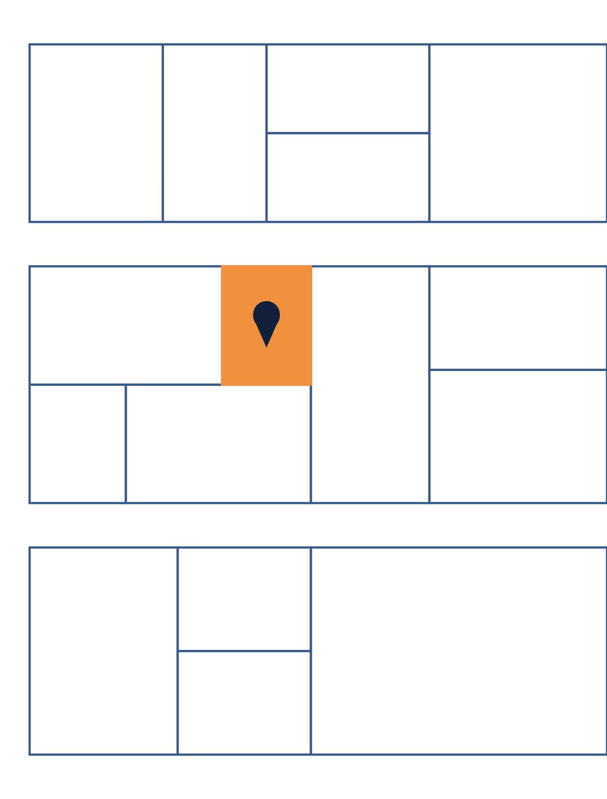
MICROINTERNSHIP · LECTURE 1
Interactive Real Estate Map
Next.js · Mapbox · GraphQL
Tuesday, September 29, 2026 · 3:00 PM ET
Notes:
Welcome everyone. Today: quick intros, how the program works, what we are building over eight weeks, and a walkthrough of the Week 1 assignment. Leave 10 minutes for questions at the end.

Slide 2
BACKGROUND
ABOUT ME
15 years in software
Serhii Vaiser
WHAT I WORK ON
GIS software for Commercial Real Estate
VP of Engineering at Meridian Capital Group
GitHub: wwwaiser
WHY I RUN THIS PROGRAM
Let students to get an experience working on real project
Notes:
Short personal intro: background, what you work on day to day, and why you run this microinternship. Mention you'll review every pull request personally.

Slide 3
YOUR TURN
Introduce yourself in about a minute
1
2
Name and school
What you've built
Where you study and what program you're in
Class projects, side projects, internships or jobs
3
4
Your goal for these 8 weeks
One thing outside of code
A skill, a portfolio piece, a job search, or all three
A hobby, a place, a fun fact
Notes:
Order: Esther, Cato, Mythri, Venessa. About a minute each. Note anyone's goals so you can tailor feedback later.

Slide 4
THE PROGRAM
How the eight weeks work
8 sessions
Tuesdays, 3 PM ET
Due Monday evening
Reviewed as PRs
One group meeting a week, through week 8
On Microsoft Teams; link in the repo README
Each week's assignment, before the next session
I review every pull request you open
You work on your own during the week. Tuesdays are for check-ins, shared problems and feedback. Stuck on something specific? Book a one-on-one call with me any day.
Notes:
Assignments live in the course repo as week-01.md through week-08.md. Emphasize the Monday-evening deadline so there is time to review before Tuesday.

Slide 5
THE PROJECT
A map that helps real estate brokers find their next deal
Click any parcel in New York City to see its building, lot and location data. Search an address, jump straight to it, and look at the street.
Notes:
This is a real product pattern: brokers prospect by browsing the map and looking up buildings. By week 8 each of you will have your own deployed version and a portfolio-ready README.

Slide 6
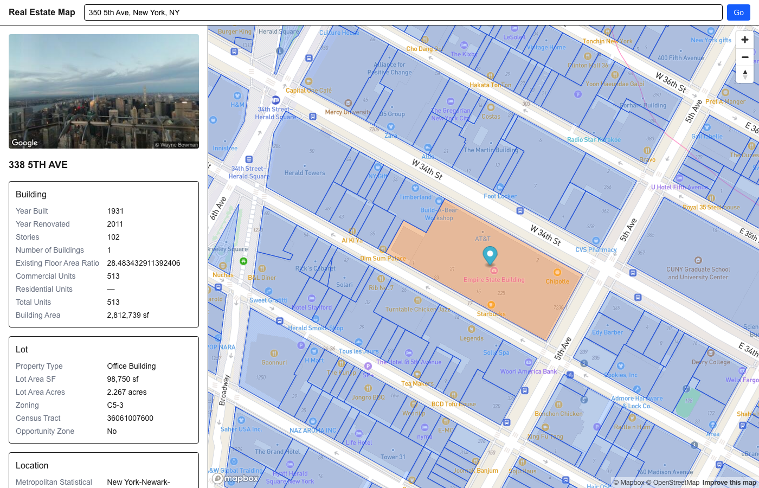
WHERE YOU'LL BE BY WEEK 7
The finished app
1 Search an address
Google finds the coordinates; our API finds the parcel
2 Parcel highlighted
Every NYC parcel, drawn from Mapbox vector tiles
3 Property details
Building, lot and location data from GraphQL
4 Street View
A street-level photo of the location
Notes:
Screenshot of the reference build: searching 350 5th Ave highlights the Empire State Building parcel and loads 1931, 102 stories, 2.8M sf. Each numbered piece maps to a week: map in 2, parcels in 4, details in 5-6, search and Street View in 7.

Slide 7
TECH STACK
What you'll work with
Layer | Tool | What it does
App | Next.js, TypeScript, Tailwind CSS | Pages, components and styling
Map | Mapbox GL via react-map-gl | Base map, pins and parcel boundaries
Data | GraphQL and Apollo Client | Property data from our API
Places | Google Maps APIs | Address search and Street View
Delivery | GitHub and Vercel | Code review and a live URL
Notes:
No prior experience with any of these is expected. The property API runs on Azure Data API builder; you only consume it. Mapbox access token is provided in the week 2 guide; Google needs your own key in week 7.

Slide 8
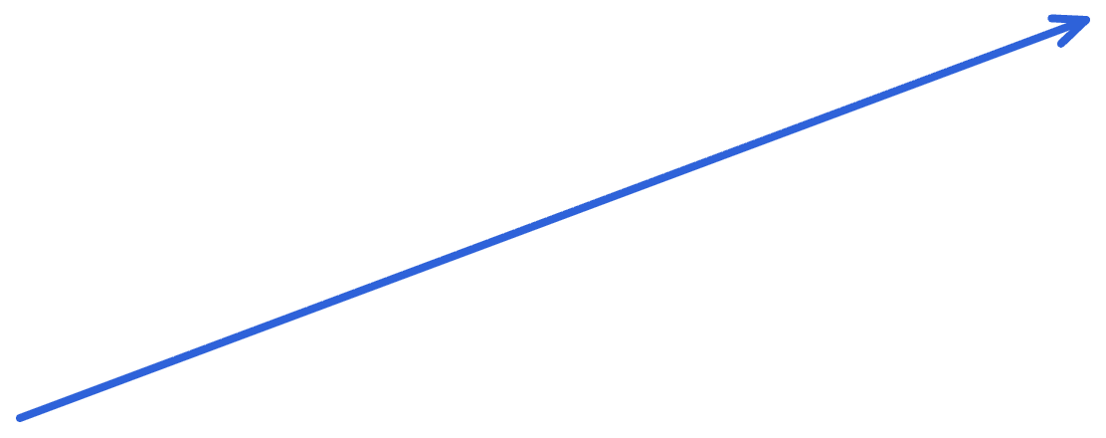
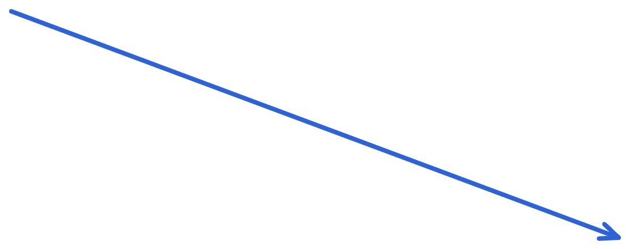
ARCHITECTURE
How the pieces fit together
Mapbox
Base map and NYC parcel vector tiles
IN THE BROWSER
Your Next.js app
GraphQL API
Property data, through your app's /api/graphql proxy
Map, sidebar and search box, hosted on Vercel
Google Maps APIs
Geocoding and Street View images
Notes:
One app talks to three services. The parcel ID is the thread that ties them together: Mapbox gives it on click, GraphQL looks up the property by it, and Google search leads back to it via coordinates.

Slide 9
ROADMAP
Eight weeks, one feature at a time
Week | Topic | You'll build
1 · this week | Getting started | Next.js app, GitHub repo, first pull request
2 | Mapbox GL | A map with pins and popups, deployed on Vercel
3 | GraphQL client | Apollo Client and your first queries
4 | Parcels layer | NYC parcel boundaries you can click
5–6 | GraphQL + map | A sidebar with the selected property's details
7 | Google APIs | Address search and Street View
8 | Presentation | A portfolio-ready README for your project
Notes:
Each week builds on the last, so falling behind compounds. If a week goes badly, reach out early rather than skipping ahead.

Slide 10
WEEK 1 ASSIGNMENT
Getting started
Due Monday, October 5, in the evening
1
2
3
4
Set up your tools
Create your GitHub repo
Scaffold the Next.js app
Open your first pull request
Notes:
Full instructions are in week-01.md in the course repo. The next three slides walk through each step.

Slide 11
STEPS 1–2
Tools and your repository
Install
Create
VS Code
A GitHub account
Or any editor. Optional extensions: ESLint, GitLens
If you don't have one yet
Node.js, latest LTS
A new repository
Includes npm, the package manager
Name it something like real-estate-map
Git
Version control for everything you build
Invite wwwaiser as a collaborator
Settings → Collaborators → Add people. I can't review your work until you do this.
Notes:
The collaborator invite is the step people forget. Ask everyone to do it today, right after class, so reviews can start this week.

Slide 12
STEP 3
Scaffold the Next.js app
When it asks | Answer
TypeScript | Yes
Linter | ESLint, not Biome
Tailwind CSS | Yes
src/ directory | Your choice
App Router | Yes
React Compiler | No
Import alias | Default (@/*)
CREATE AND RUN
npx create-next-app@latest
cd real-estate-map
npm run dev
CONNECT TO YOUR GITHUB REPO
git remote add origin https://github.com/YOU/real-estate-map.git
git push -u origin main
Notes:
create-next-app already makes a local Git repo with a first commit, so students only add the remote and push. npm may print an install-scripts warning; it's safe to ignore. Open localhost:3000 to confirm the app runs.

Slide 13
STEP 4
Every change goes through a pull request
1
Create a branch
git checkout -b week-01-setup
2
Make a change, commit
git commit -am "Change home page title"
3
Push the branch
git push -u origin week-01-setup
4
Open the PR
On GitHub: Compare & pull request, then add wwwaiser as reviewer
For Week 1, edit the home page title in app/page.tsx. Nothing blocks pushes to main, so keeping off main is up to you.
Notes:
This mirrors how professional teams work. From week 2 on, every assignment is a PR like this. Show the GitHub Compare and pull request button live if time allows.

Slide 14
AI TOOLS POLICY
Use AI as much as you like. You own every line.
ChatGPT, Copilot, Claude: all encouraged. Review everything they write. Code you can't explain during a review call counts as not done.
FINISHED WEEK 1 EARLY?
Build the page layout
Deploy on Vercel
Header, sidebar and content area with Tailwind
Get a live URL now; it's required in Week 2
Notes:
Both stretch goals become required in week 2, so doing them now buys time later.

Slide 15
Questions?
COURSE REPO
WEEK 1 DUE
NEXT SESSION
github.com/wwwaiser/
real-estate-map-project
Monday, October 5,
in the evening
Tuesday, October 6,
3:00 PM ET
Notes:
Remind everyone: invite wwwaiser as a collaborator today. The Teams link, schedule and all weekly guides are in the repo README.

