Slide 1
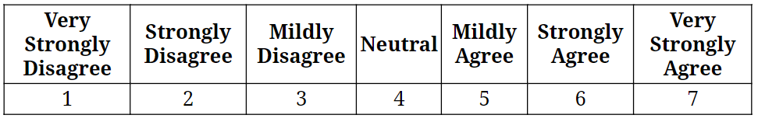

Slide 2

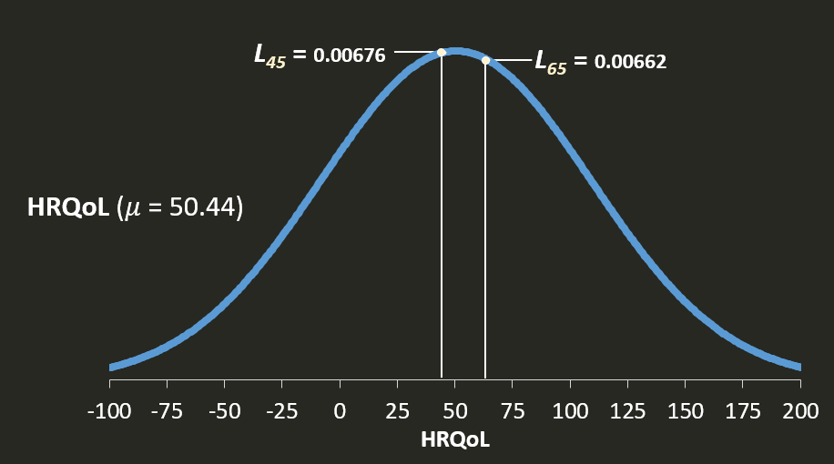
Score
QQQ
Score

Slide 3
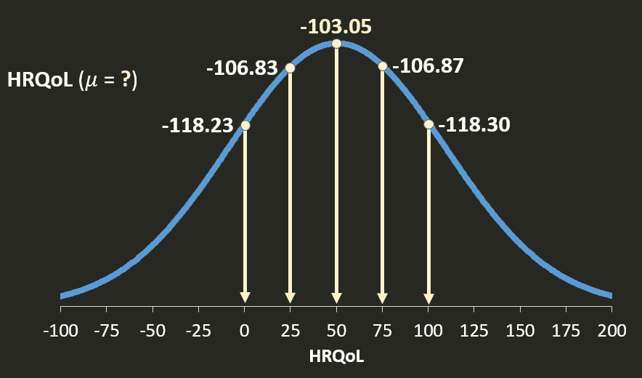
Score
Score

Slide 4
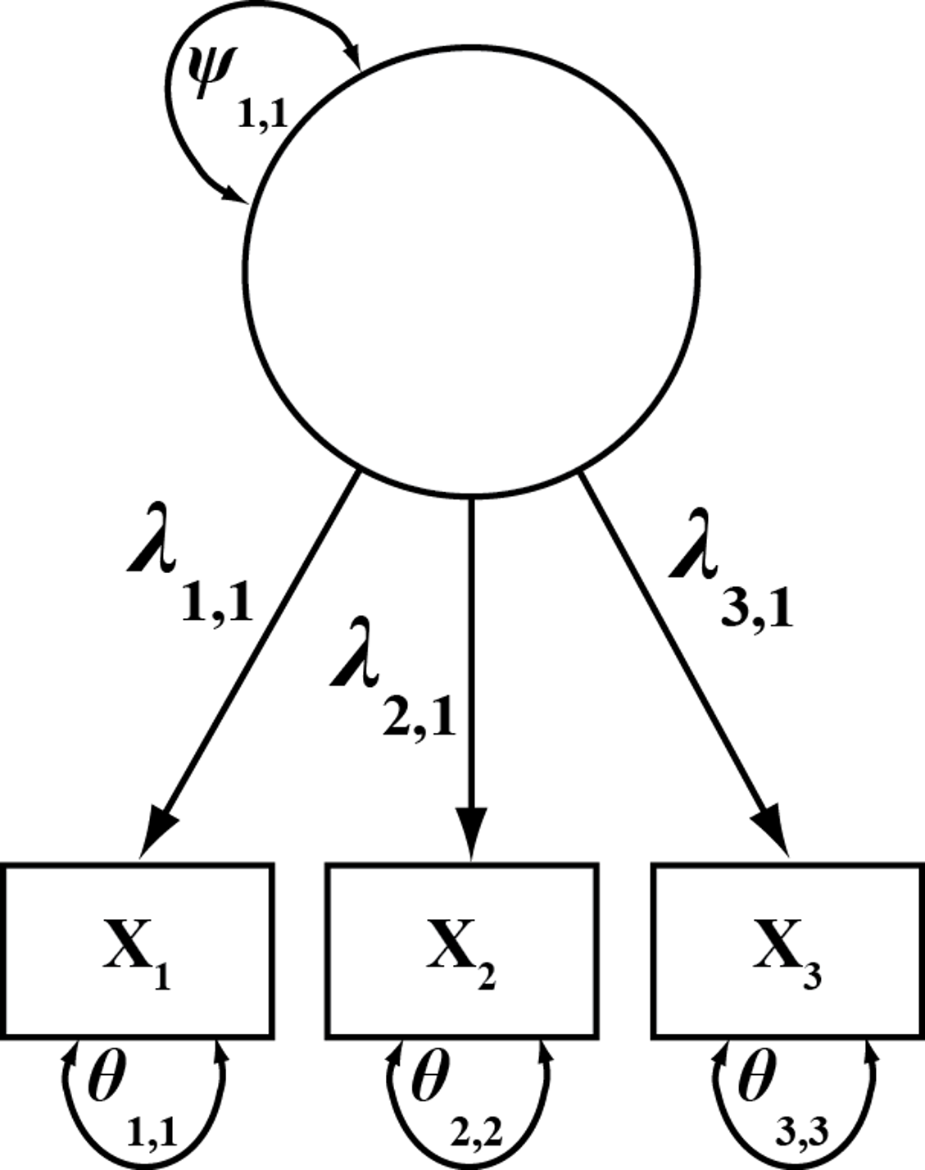
1
SUP
SUP1
SUP2
SUP3

Slide 5
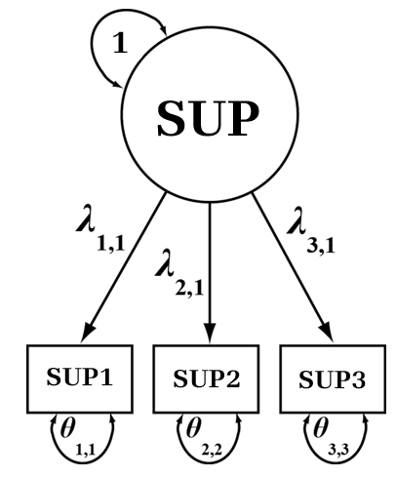

Slide 6
1
SUP
SUP1
SUP2
SUP3

Slide 7
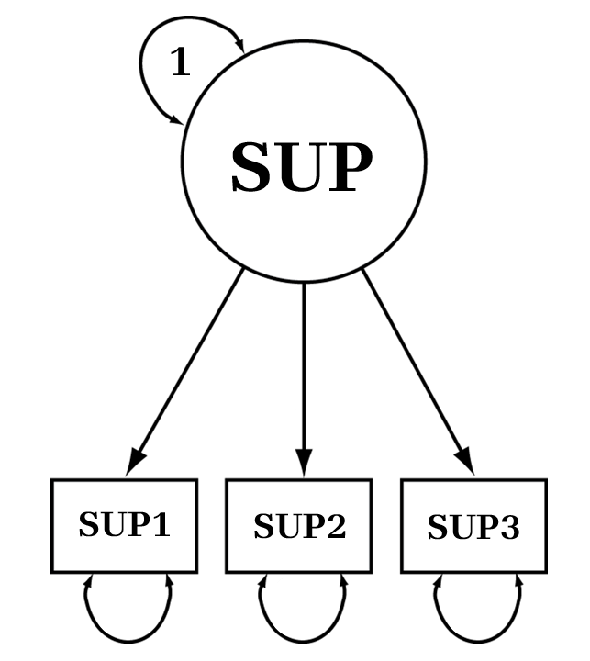
1.0
2.202
1.966
2.226
0.812
0.543
1.768

Slide 8
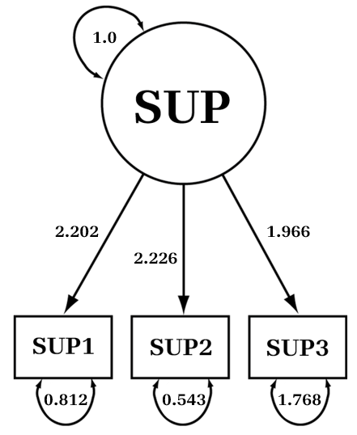

Slide 9
1.0
0.925
0.828
0.949
0.143
0.099
0.314

Slide 10
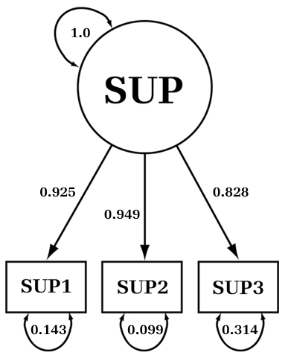

Slide 11
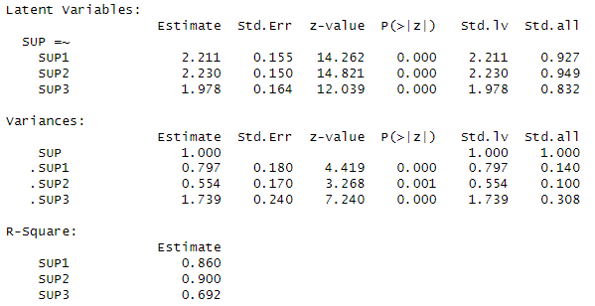

Slide 12
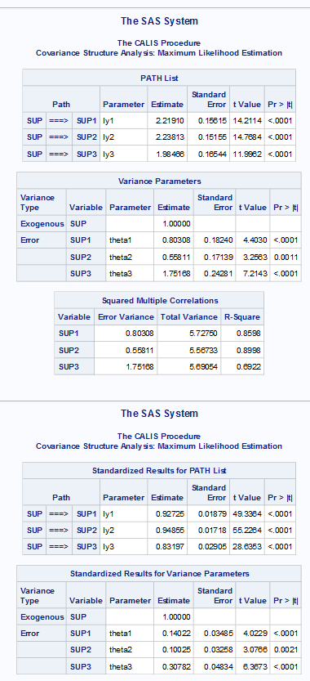

Slide 13
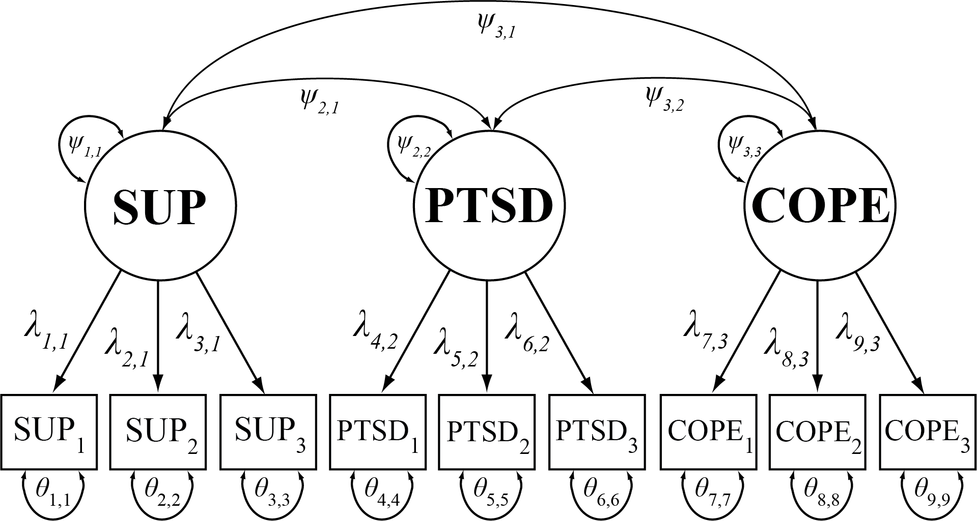

Slide 15
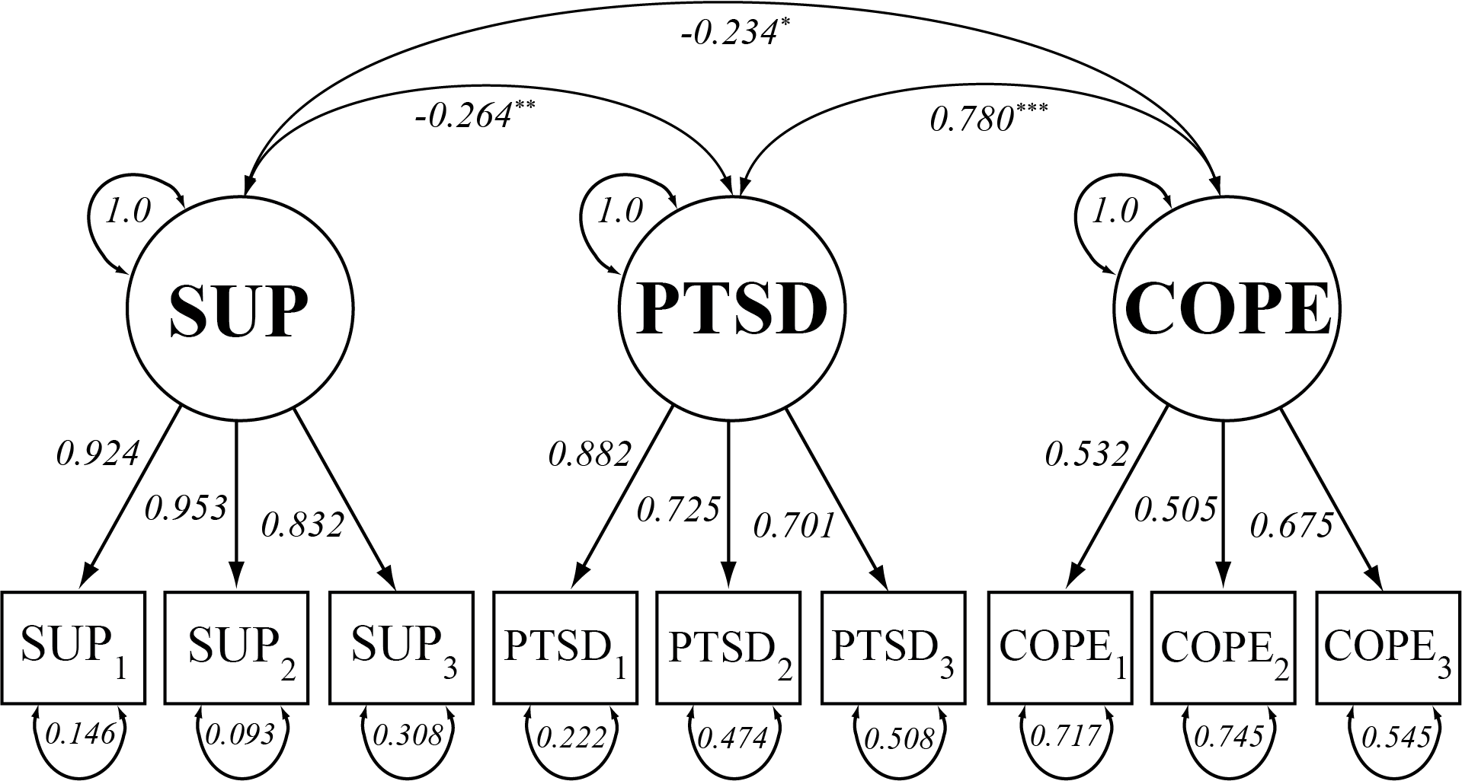

Slide 17
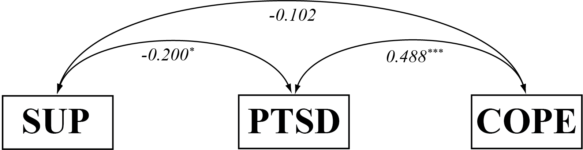

Slide 19
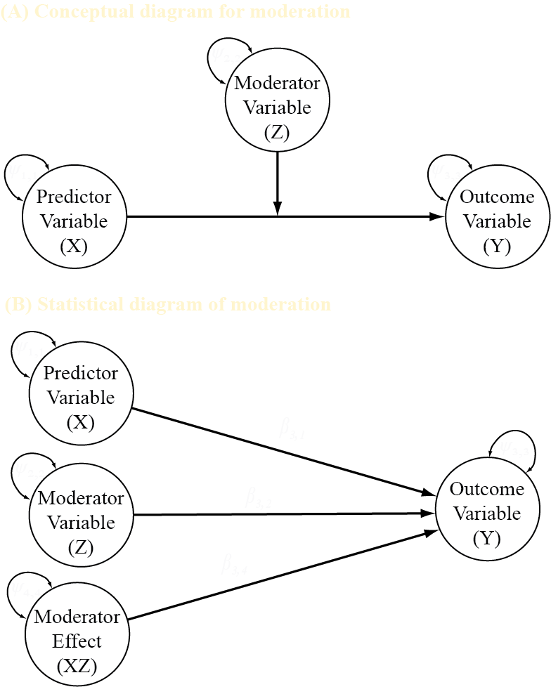
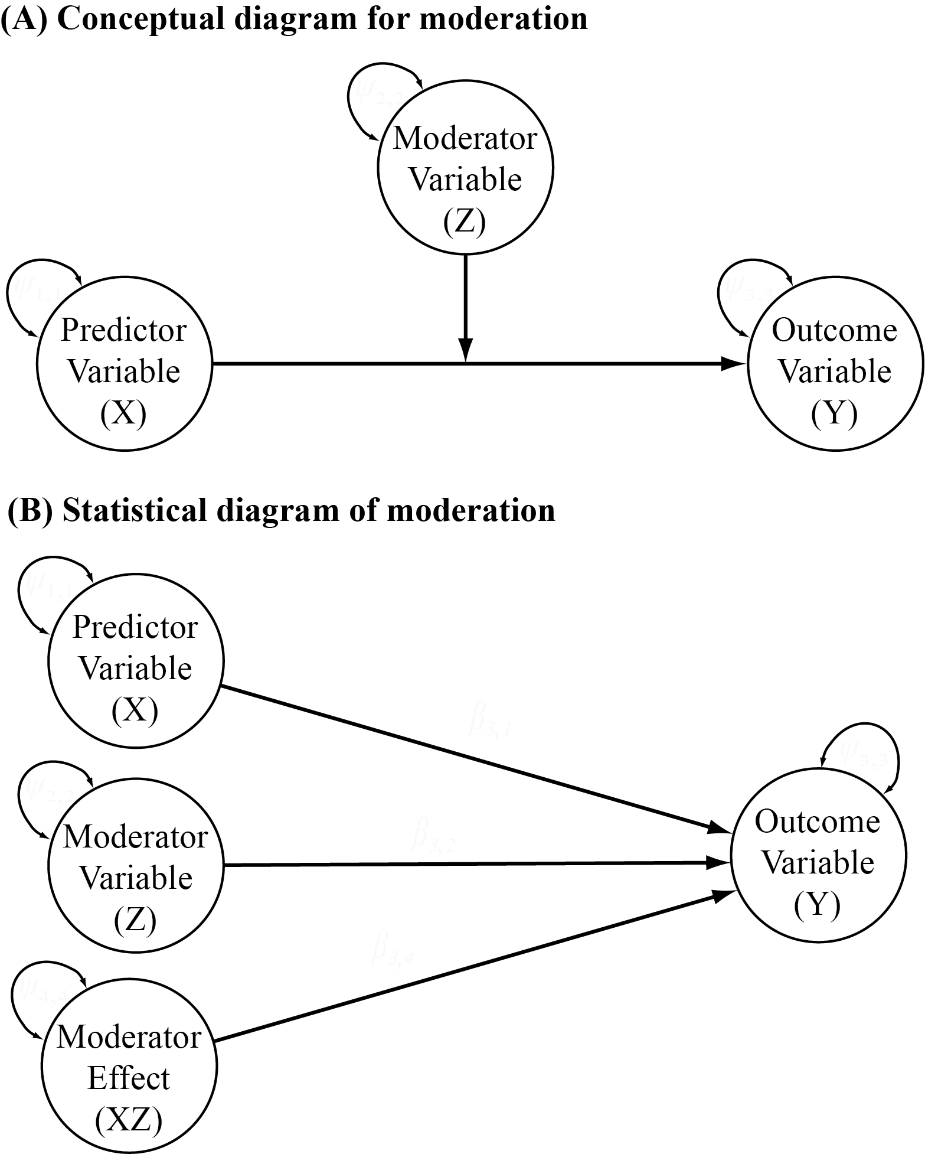

Slide 20
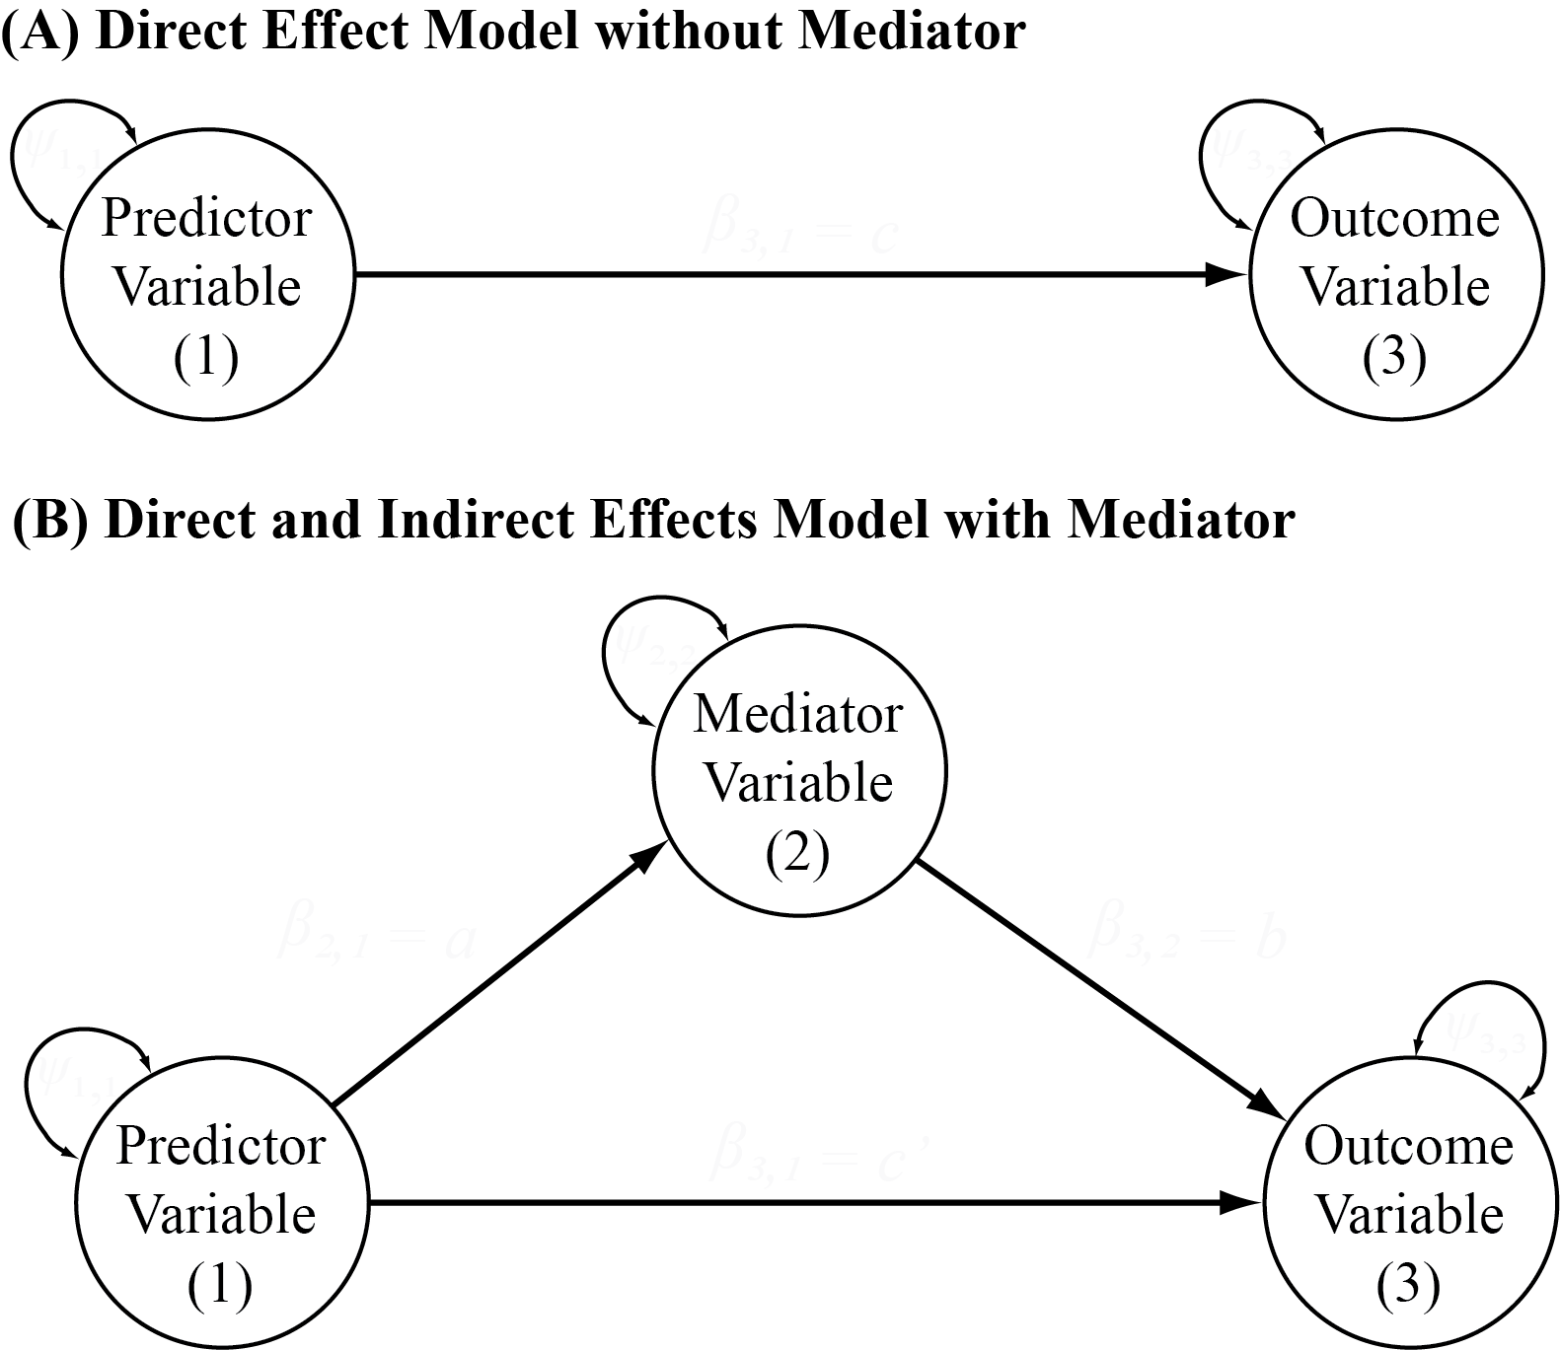

Slide 21
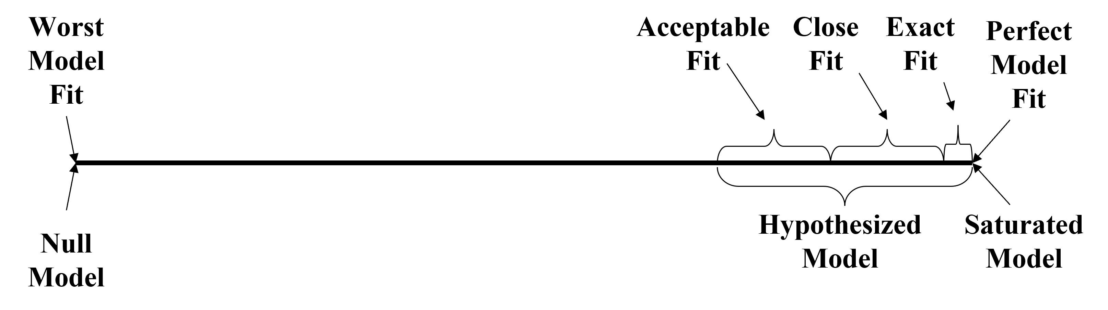
.90-.95
.95-.99
1.00
TLI (NNFI), CFI

Slide 22
RMSEA, SRMR
.08-.05
.05-.01
0.00

Slide 23
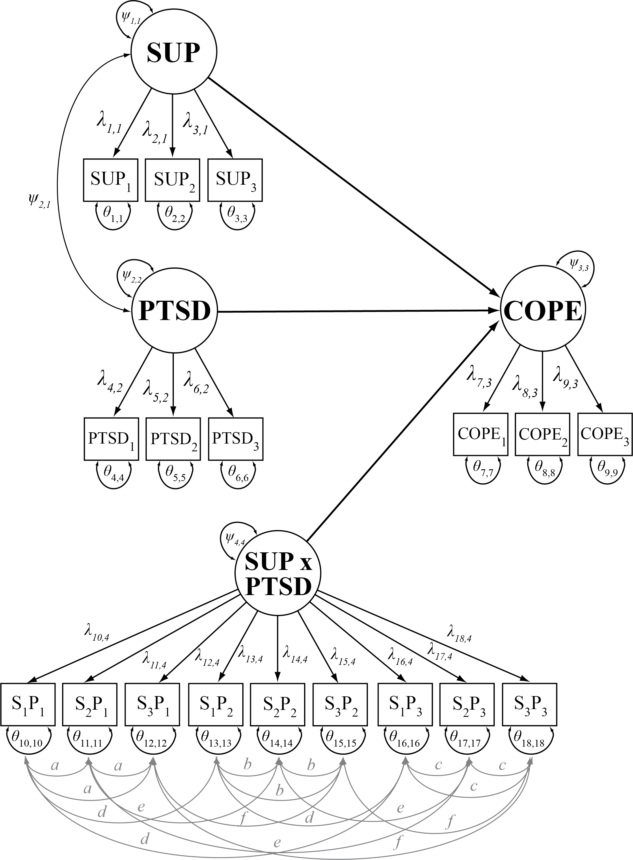

Slide 24
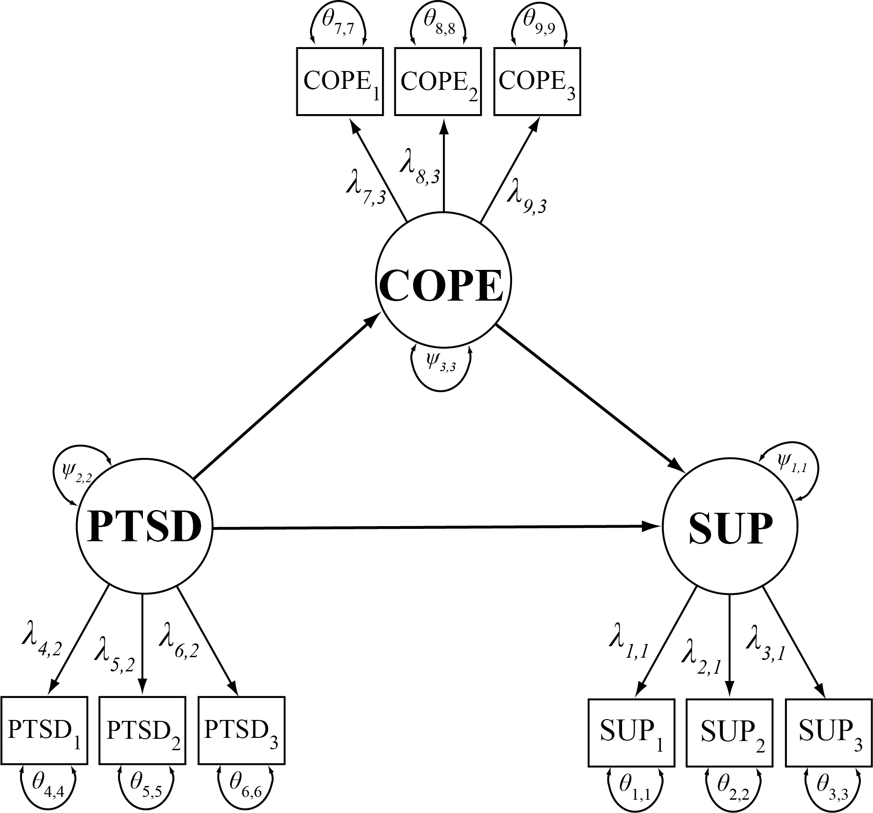

Slide 25
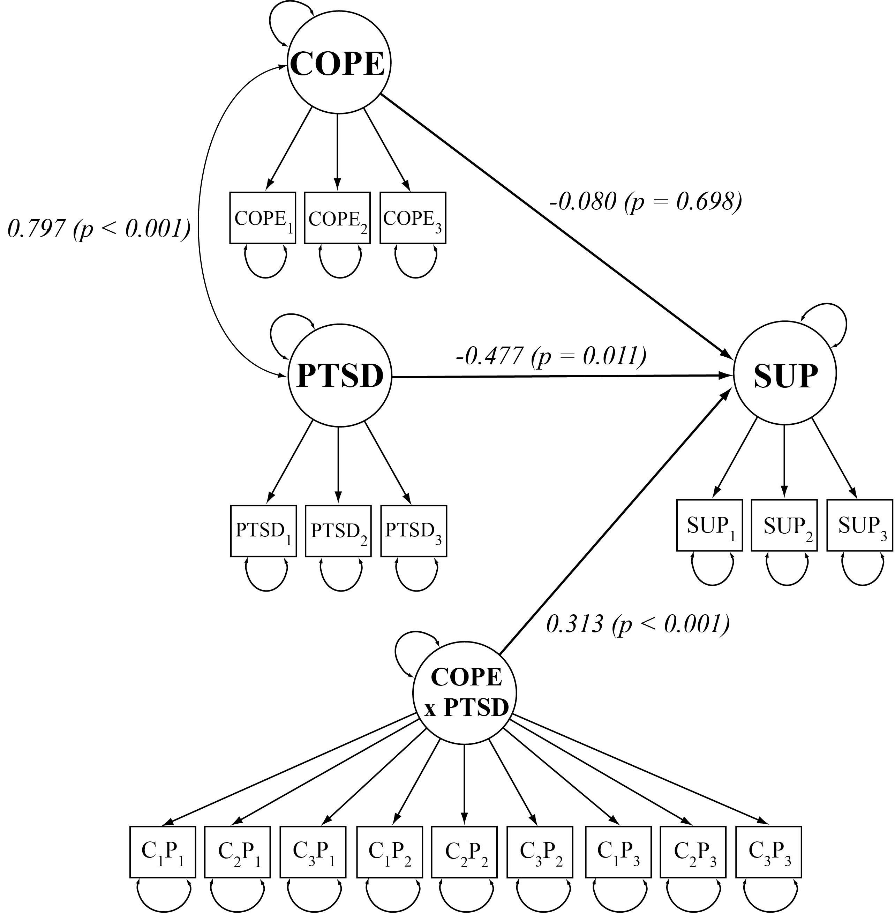

Slide 26
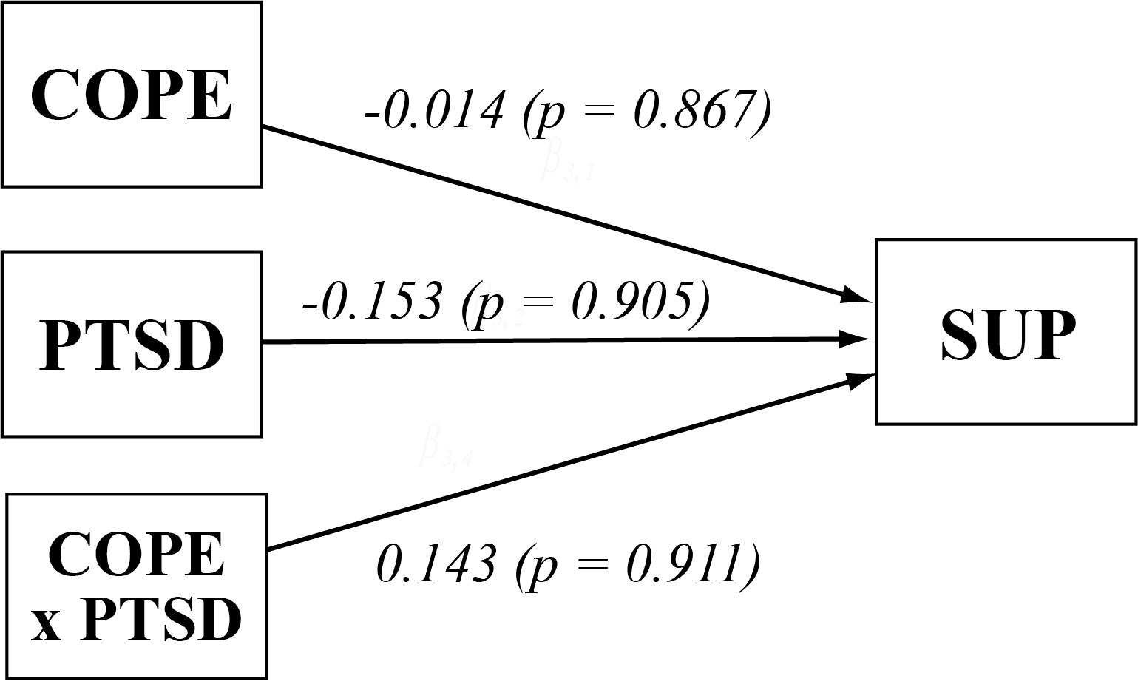

Slide 27
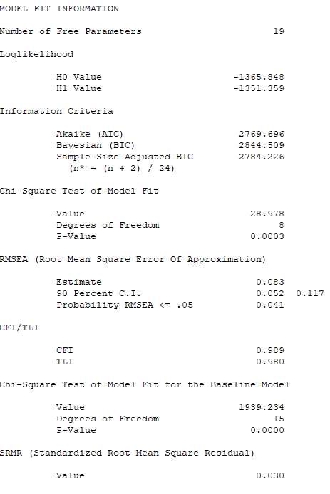
28.978
8
0.083
0.989
0.980

Slide 28
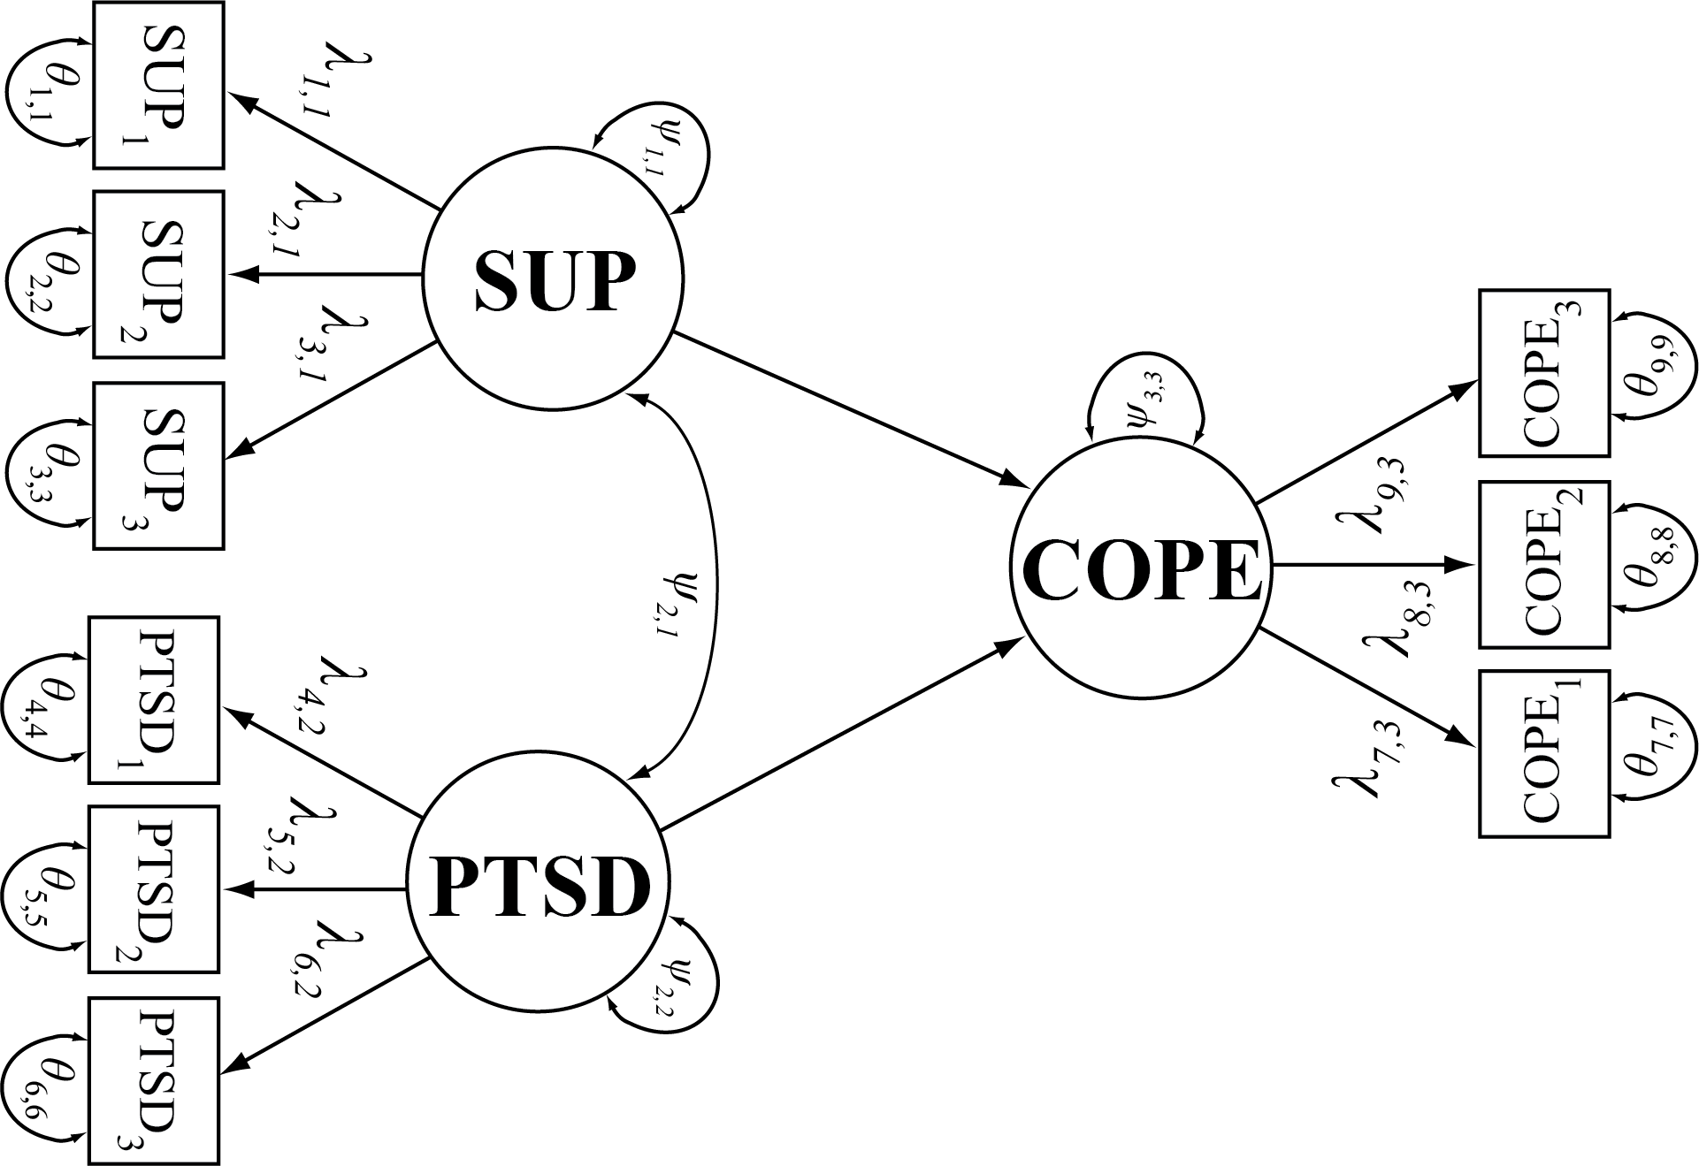

Slide 29
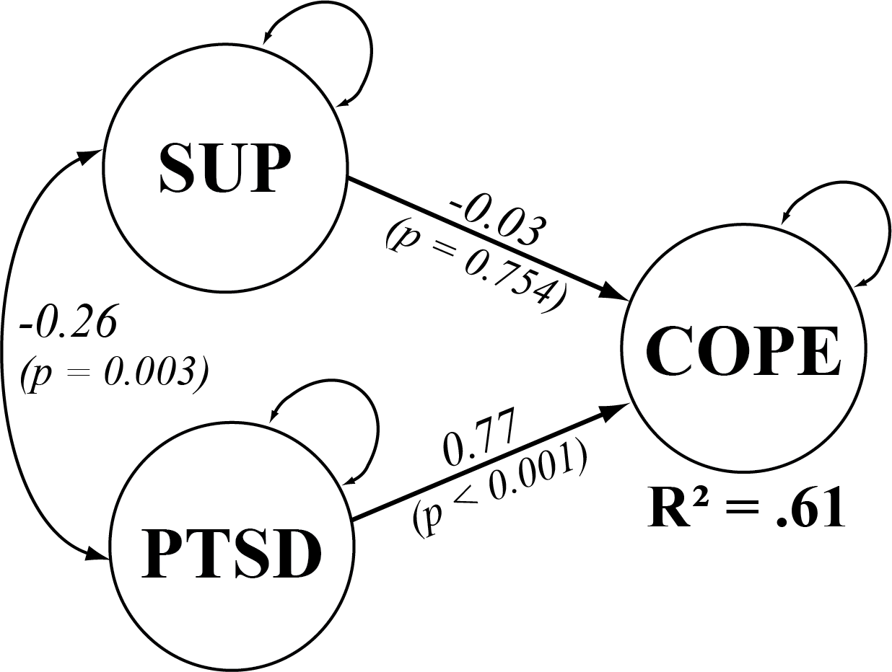
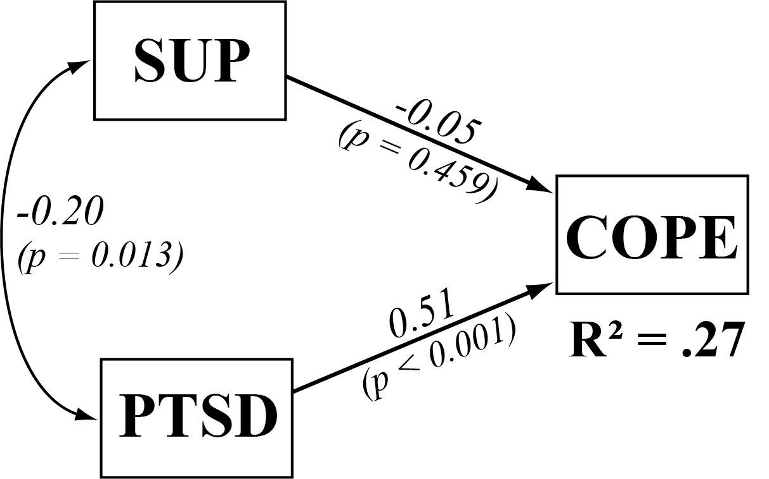

Slide 30
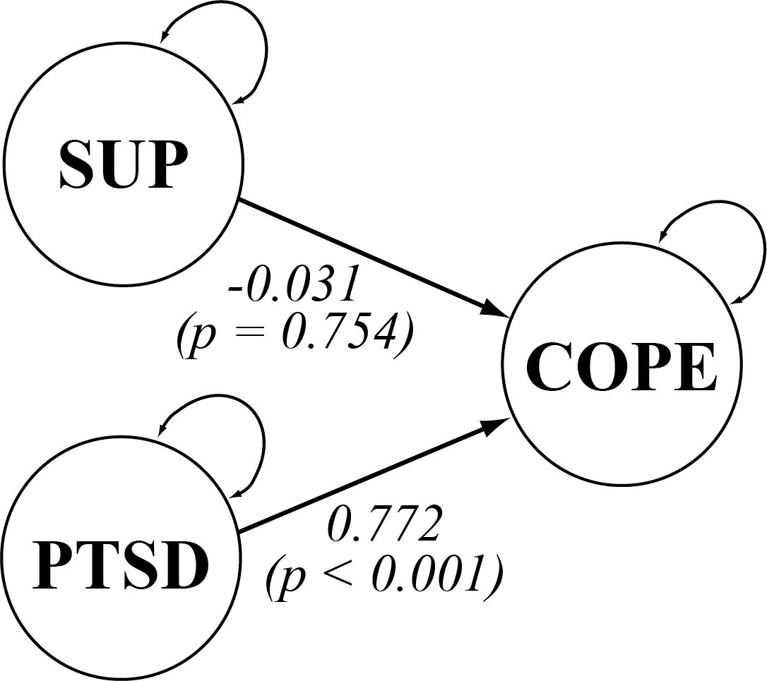

Slide 31
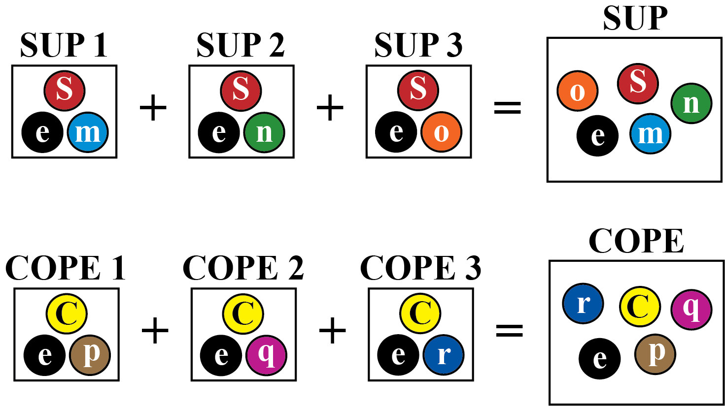
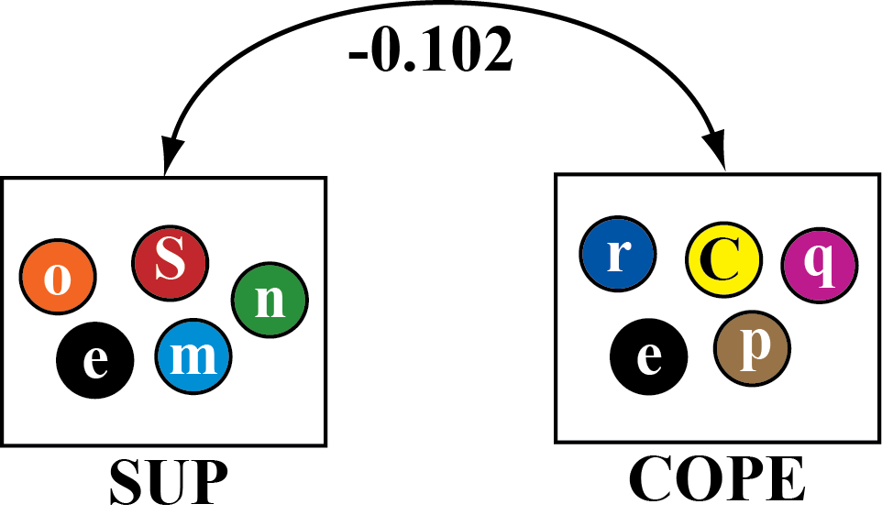

Slide 32
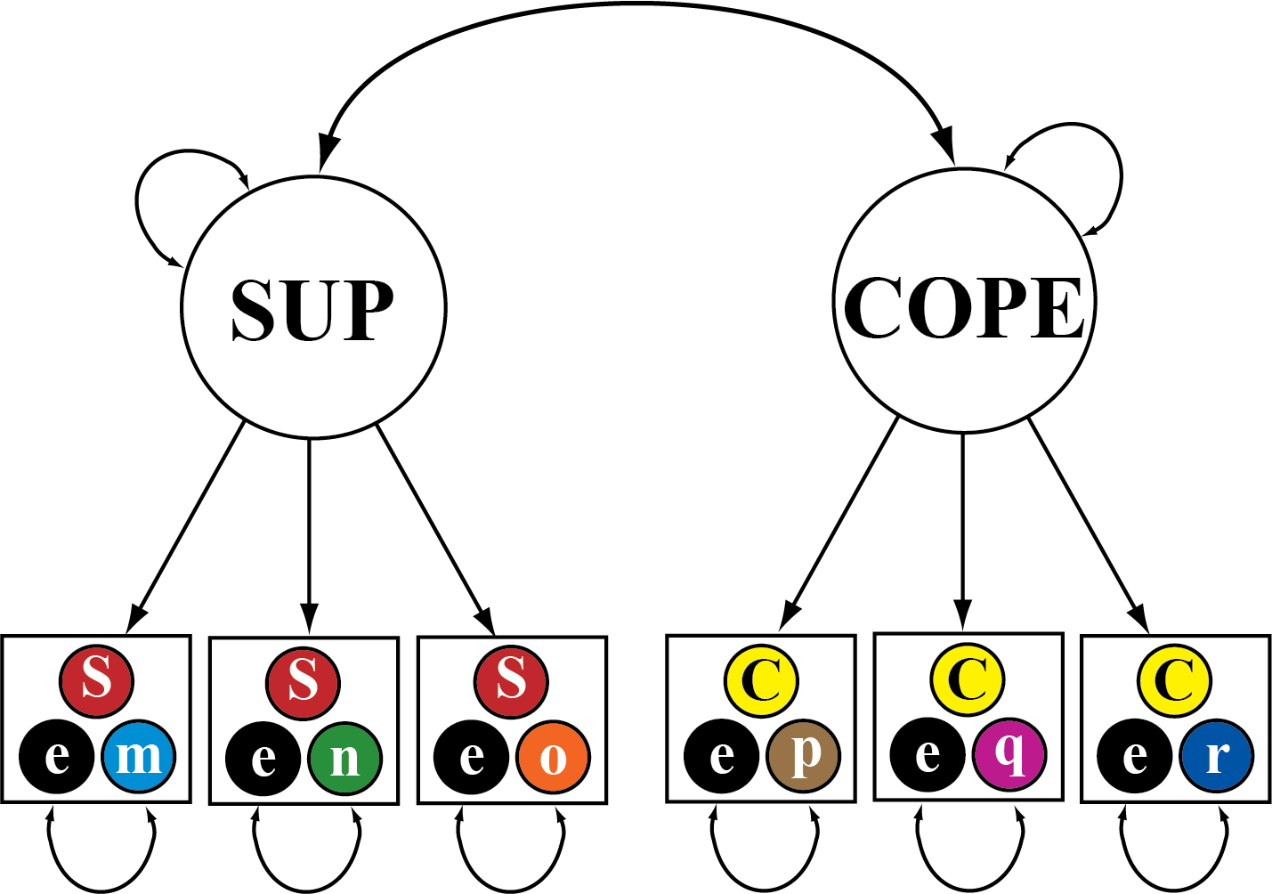
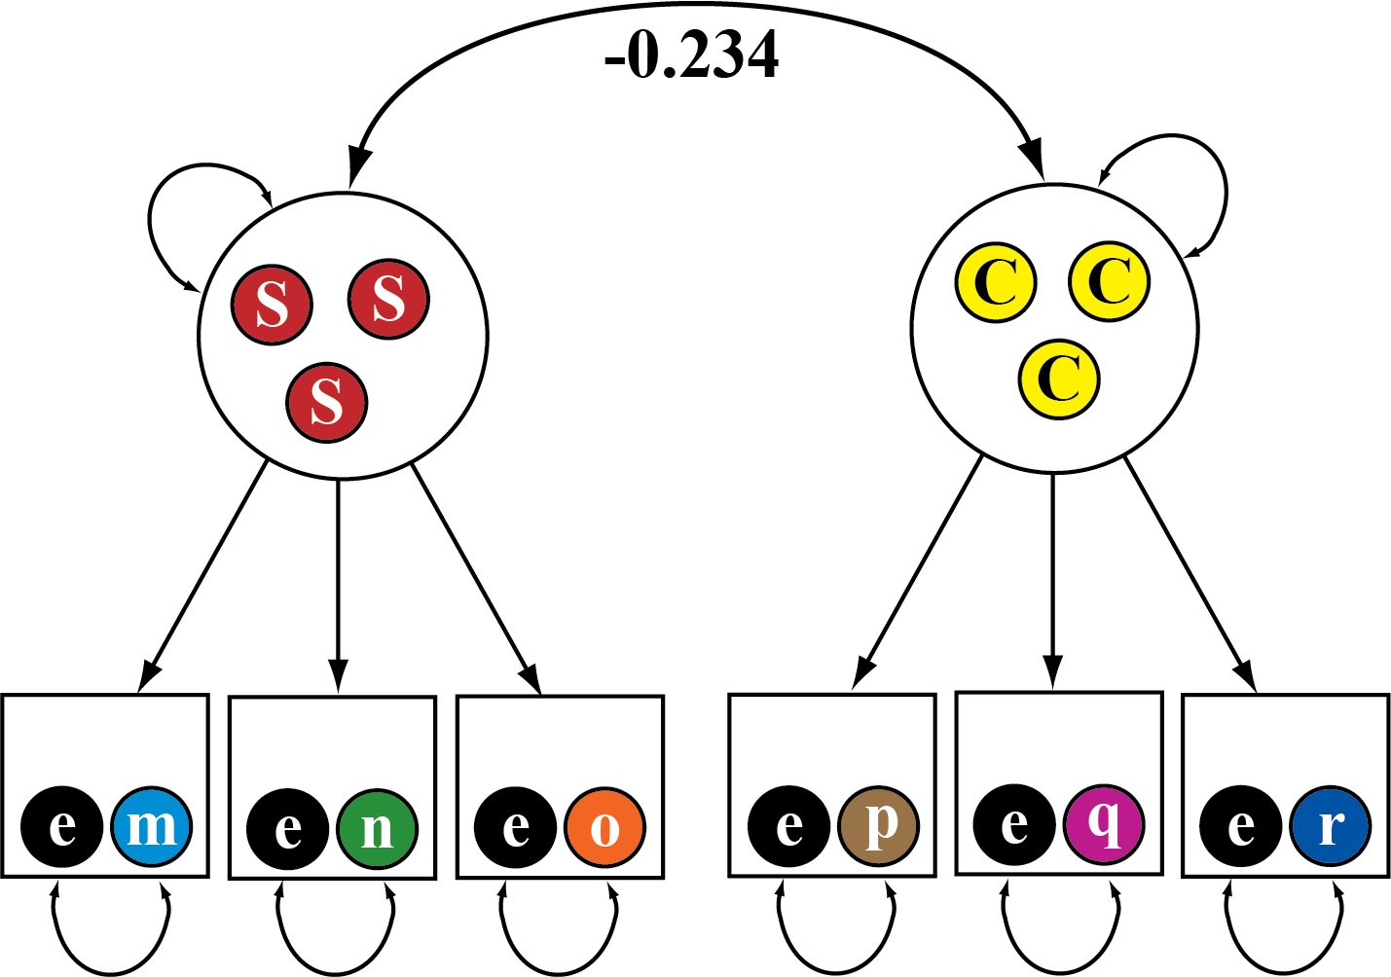

Slide 33
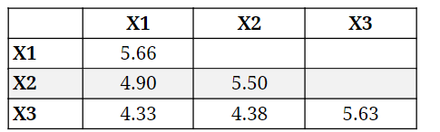
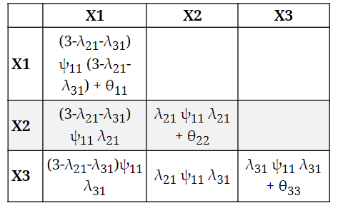
1.0
2.20
1.97
2.23
2.20 * 1.0 * 2.20 + 0.81 = 5.66
2.20 * 1.0 * 2.23 = 4.90
2.23 * 1.0 * 2.23 + 0.54 = 5.50
2.23 * 1.0 * 1.97 = 4.38
1.97 * 1.0 * 1.97 + 1.77 = 5.63
2.20 * 1.0 * 1.97 = 4.33
0.81
0.54
1.77

Slide 34
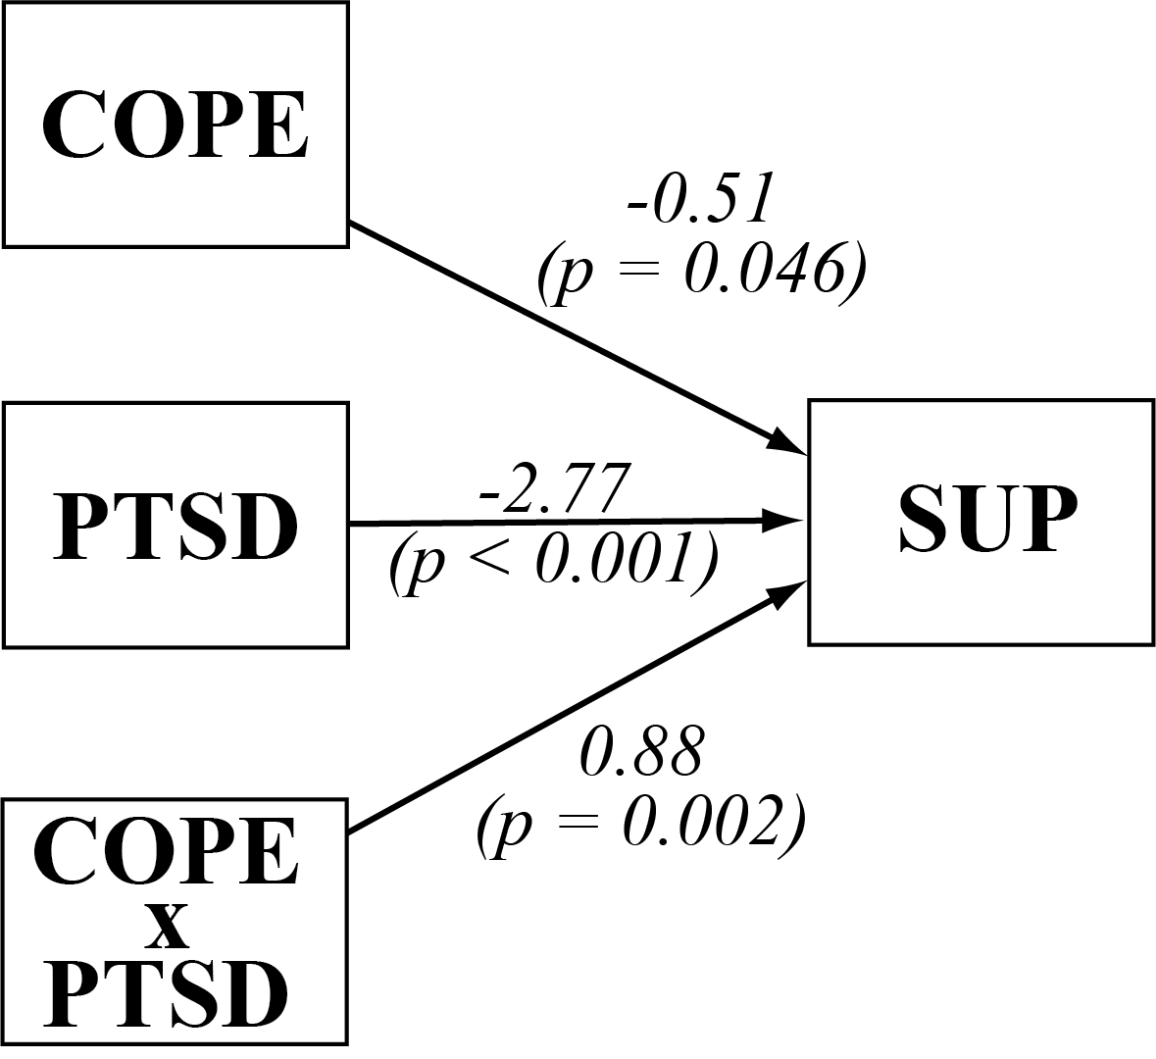

Slide 35
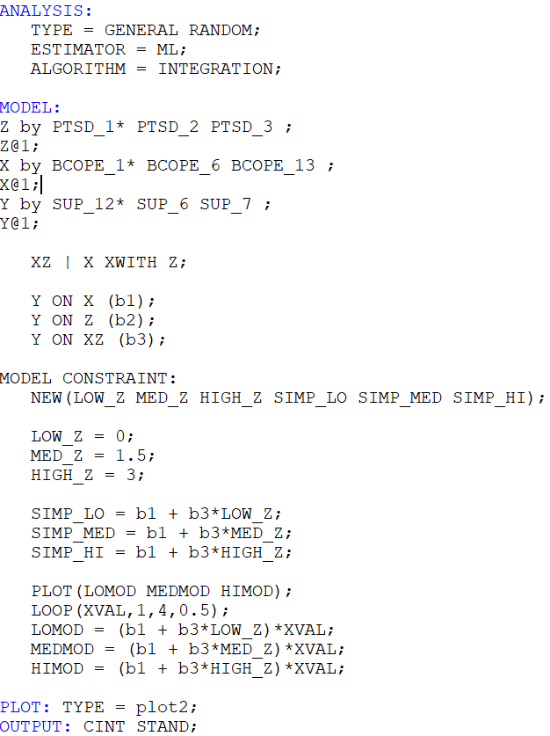

Slide 36
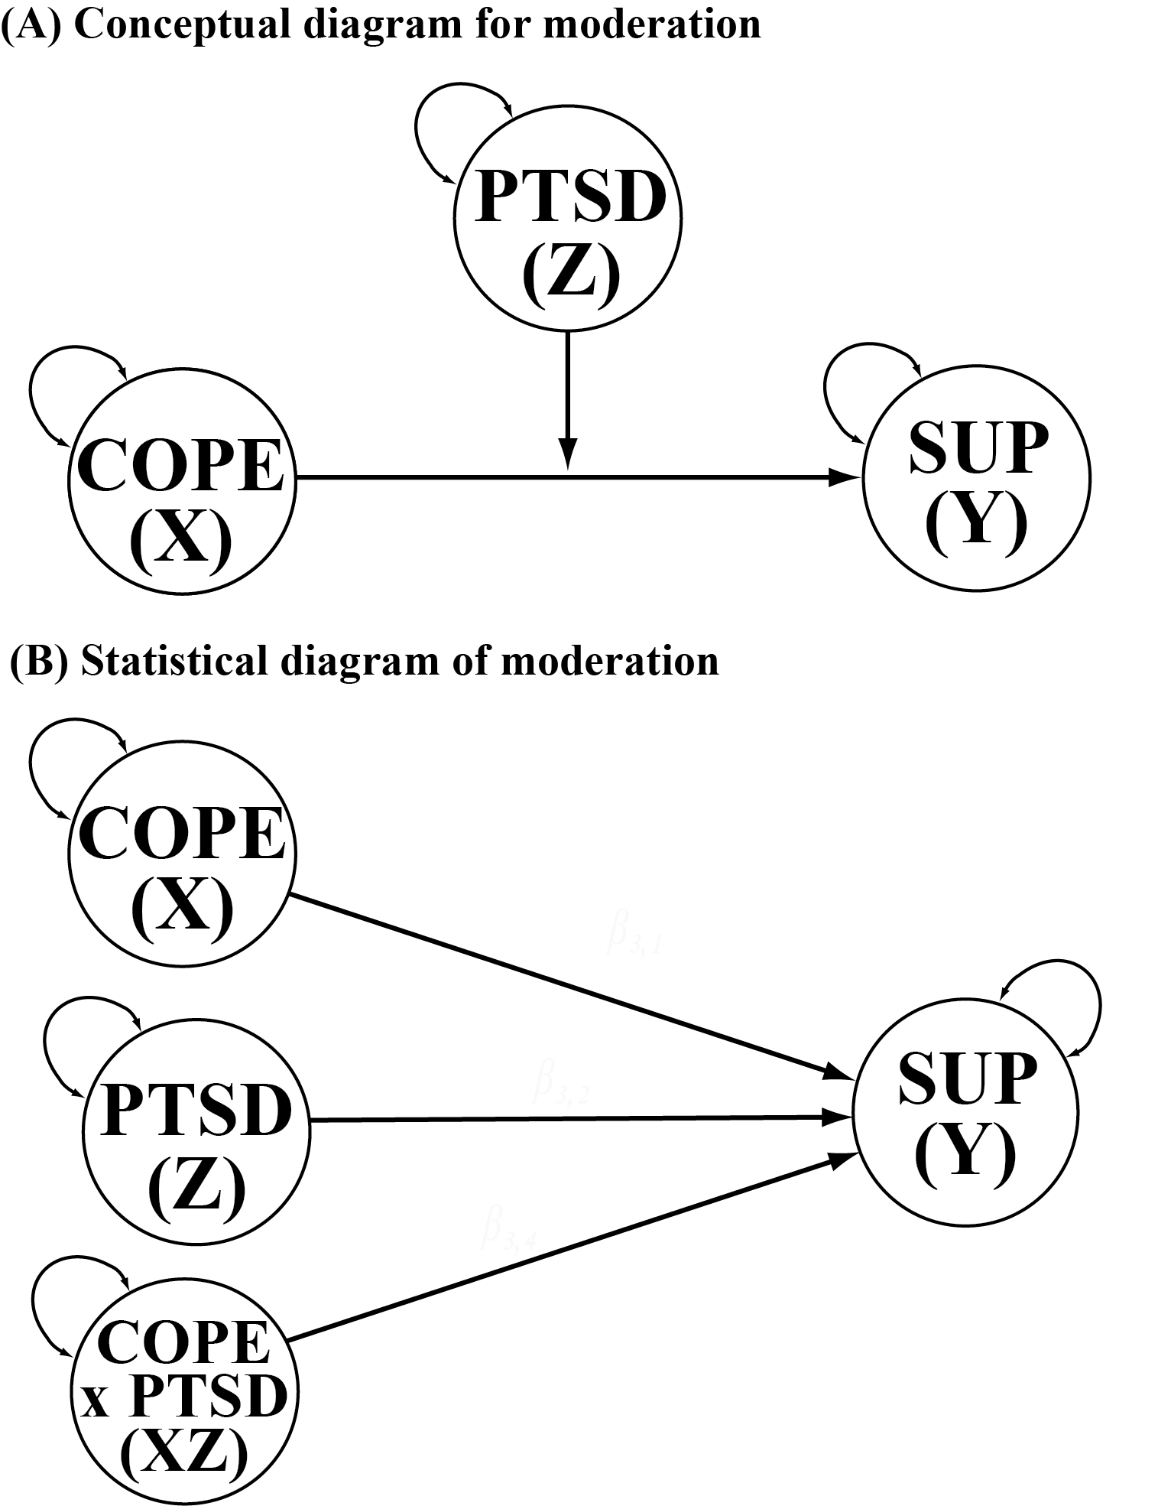

Slide 37
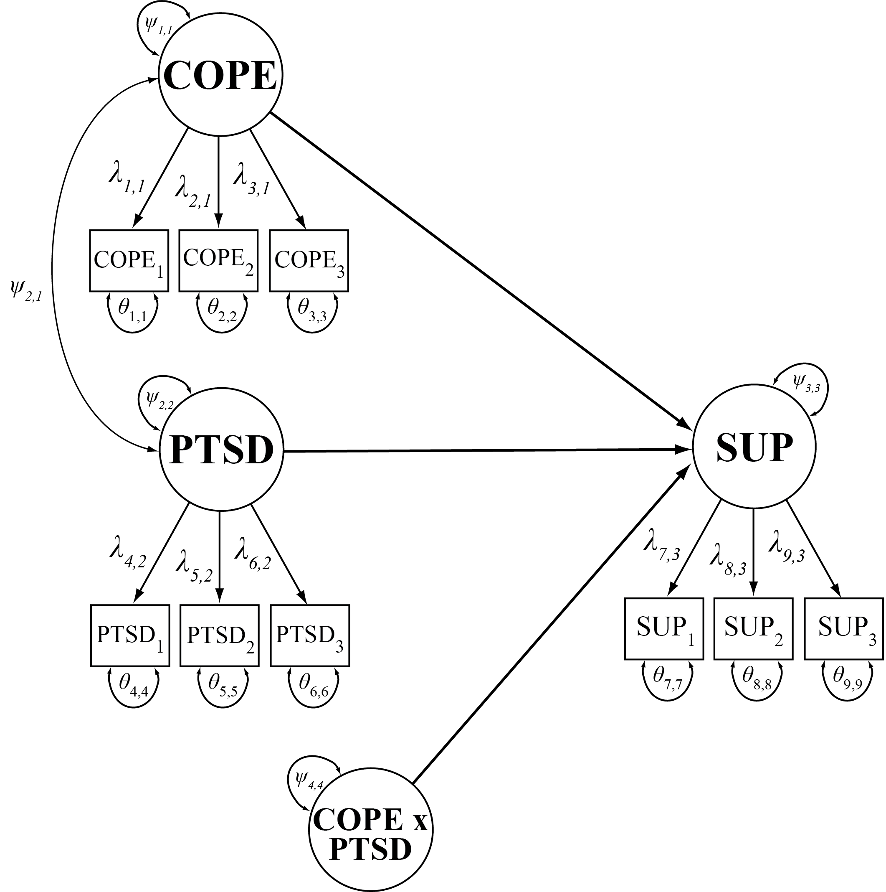

Slide 38
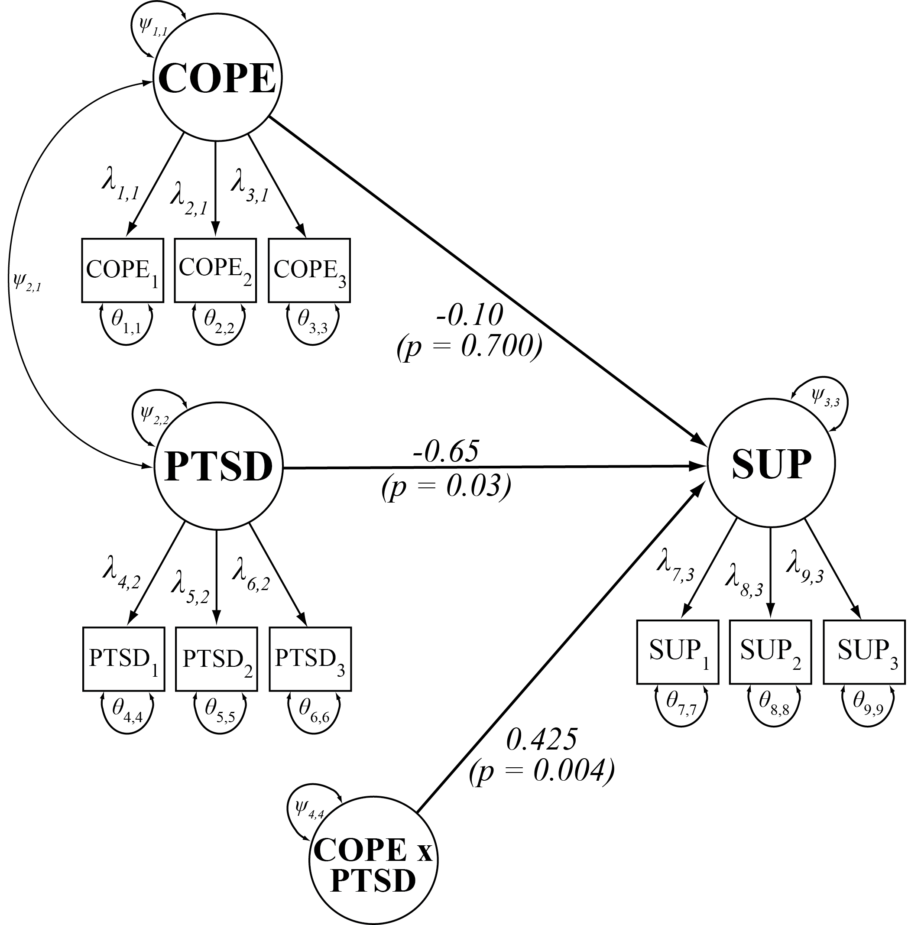

Slide 39
