Slide 1
CORA
FANG Ji

Slide 2
Problem
DSP programmers take care of everything
Algorithm
Memory
Scheduling
Code cannot be reused due to high coupling
algorithm code and control code are mixed together.

Slide 3
Goal
Design a high performance DSP programming model
Modularized design to improve code reuse
Separate data flow and control flow
Simplify developing process

Slide 4
What should a block look like?
Configuration interface
Set parameters of a block
Algorithm code
How to process data

Slide 5
Definition of Block
Variable input channels and variable output channels
Init function
Config a block
Reset function
Reset a block
Work function
Imp. an algorithm
DEFINE_BLOCK(sample_block, 1, 1)
{
BLOCK_INIT
{
auto v = $["nTaps"];
}
BLOCK_WORK
{
auto in = _$<int>(0);
auto out = $_<int>(0);
……………..// do something
consume(0, n);
produce(0, m);
return true;
}
};
M
N
Block
autoref spblk = create_block<sample_block>(2, string("nTap=10"), string("nCount=20"));

Slide 6
Memory Model
Local variable
_local_(type, name, initial);
Global variable
_global_(type, name);
a
a
_local_(int, a, 0);
_global_(int, g);
Block A
_local_(int, a, 0);
_global_(int, g);
Block B
g

Slide 7
Execution model
Blocks communicate via unbounded FIFO channels.
Blocks read and write data elements from and to channels.
Writing to a channel is non-blocking, i.e. it always succeeds and does not stall the process
Reading from a channel is blocking, i.e. a process that reads from an empty channel will stall and can only continue when the channel contains sufficient data items.
Depth first, sink first
Notes:
Kahn Process Networks

Slide 8
Control flow
Determines the scheduling sequences of connected blocks
Primitives
START, STOP, ONCE, ONCEIF, IF, IFNOT, ELSE_IF, ELSE
START(A, B, C,…,X);
STOP(finalization_code)
ONCE(A, B, C,…,X);
ONCEIF(A, B, C,…,X);
IF(condition) ⬄ if ( condition )
IFNOT(condition) ⬄ if ( ! condition )
ELSE_IF(condition) ⬄ else if ( condition )
ELSE ⬄ else
A, B, C… and condition can be any functor or function or lambda function which take no parameter and return bool value;
i.e., bool X(){ return true;}
Implemented as templates to enable compile time code optimization

Slide 9
Control flow (cont.)
Sequential flow
A
B
C
D
while ( A() ) while ( B() ) while ( C() ) while ( D() );
START(A, B, C, D); ⬄

Slide 10
Control flow (cont.)
Branch flow
START(A, B, IF(C), F, G, ELSE_IF(D), H, I, ELSE, J );
IF(C)
A
B
F
G
ELSE_IF(D)
H
I
ELSE
J

Slide 11
Control flow (cont.)
Multiple output flow
START(A, B, [&]{ START(C, D);
START(E, F); }
);
C
D
A
B
E
F

Slide 12
Control flow (cont.)
Loop flow
START(A, B, C, D);
START( A, [&]{START(B); START(C, D);} );
A
B
C
D
B
A
C
D

Slide 13
Control flow (cont.)
Compile time dynamic code generation
START(A, B,…X) as a template function
Each parameter is marked by an OP function
while, if, else_if, else
__if_exist(A::while){ while(A()) }
__if_exist(A::if){ if(A()) }
__if_exist(A::else_if){ else if(A()) }
__if_exist(A::else){ else }

Slide 14
Primitive: STOP
Stop a control flow and execute the finalization code
START(A, B, IF(C), STOP( [&]{ // finalization code here }) );

Slide 15
Primitive: STOP
int status = 0;
7 v_cs
1 v_cs
4 int64
4 int64
src
acorr
stf
status:0
foe
status:1
What’s your scheduling code ?
START(src, IF([&]{return status==0;}), [&]{ START(acorr, IF(stf), STOP([&]{status=1;})); }, ELSE_IF([&]{return status==1;}), [&]{ START(foe);} );

Slide 16
Primitive: ONCE & ONCEIF
ONCE(A, B, C,…,X);
Execute each block once one by one no matter the return value.
i.e.
A(); B(); C(); … X();
ONCEIF(A, B, C,…,X);
Execute each block once if previous block returns true.
i.e.
if ( A() ) if ( B() ) if ( C() ) … if ( X() ) ;

Slide 17
Primitive: ONCE
+
A
B
C
A
B
C
C
C
…
Example:
Assembly line
ONCE(A, B, [&]{START(C);});
802.11g TX flow
ONCE(add_stf, add_ltf, [&]{START(conv_12, intl, map_bpsk, fft, GI, …);} ,//add_sig [&]{START(conv_23, intl, map_qpsk, fft, GI, …);}//add_data );

Slide 18
Primitive: ONCE
RmGI
Pilot
FFT
ChComp
Demap
Part of 802.11g RX baseband
Multiple blocks work on the same data
ONCE(RmGI, FFT, ChComp, Pilot, Demap, …);

Slide 19
Channel
Blocks communicate via channels.
Modeled as Single Writer Multiple Reader buffer
A channel may have 1+ writers/readers
Only 1 writer is permitted to write data at a time
Only 1 shared reader is permitted to read data at a time
1+ independent readers can read data simultaneously
Channel::Create(sizeof(v_cs)) .from(A, 0).from(B, 0) .to(C, 0).to(D, 0).to(E, 0)
.to(F, 0, false).to(G, 0, false);
C
D
B
E
A
F
G

Slide 20
Creating Data Flow Graph
Create blocks
autoref src = create_block<b_file_source>();
autoref awgn = create_block<b_awgn>();
autoref sink = create_block<b_file_sink>();
Create channels & connect to blocks
Channel::Create(sizeof(v_cs)) .from(src, 0) .to(awgn, 0);
Channel::Create(sizeof(v_cs)) .from(awgn, 0) .to(sink, 0);
src
awgn
sink

Slide 21
802.11n TX
L_STF
DMA
Join
L_LTF
L_SIG
conv12
interlv
BPSK_i
Pilot
IFFT
CP
HT_SIG
BPSK_q
CSD
CP
HT_STF
HT_LTF
HT_DATA
interlv
map
Pilot
IFFT
CP
scramble
conv
SP
interlv
map
Pilot
IFFT
CSD
CP

Slide 22
802.11n RX
src
Auto corr
LSTF
L_STF
CFE
FFT
SISO
CHE
L_LTF
RM GI
FFT
SISO
CHC
MRC
demap
deintlv
viterbi
Lsig
parser
L_SIG
CFO
RM GI
FFT
SISO
CHC
MRC
demap
deintlv
viterbi
htsig
parser
HT_SIG
HT STF
HT_STF
RM GI
FFT
MIMO
CHE
HT_LTF
RM GI
FFT
MIMO
CHO
Demap
Deintlv
join
Viterbi
Descramble
CRC32
HT_DATA

Slide 23
Roadmap
Design & preliminary imp. 2 w
Sequential primitives 1w
802.11n RX 1 w
Parallel & async primitives
802.11n TX 1 w

Slide 24

Perf.
TX: (Mbps)
i7-980X (6 cores, 3.33GHz), 8G 1333 RAM
8 | 9 | 10 | 11 | 12 | 13 | 14
33.653971 | 62.351629 | 89.538893 | 100.5674 | 139.97304 | 155.87907 | 170.61391
RX: (Msps)
8 | 9 | 10 | 11 | 12 | 13 | 14
44.911475 | 26.520226 | 19.195442 | 12.640718 | 10.477418 | 7.293792 | 7.161673

Slide 25
Thanks! Q&A

Slide 26
Backup

Slide 27
Unbounded FIFO
Implementation
0
N-1
N
2N-1
Virtual address
Physical address

Slide 28
scramble
conv
interlv
map
Pilot
IFFT
CP
HT_DATA
scramble
conv
interlv
map
Pilot
IFFT
CSD
CP
MCS | CONV | INTERLV | Rate Match
8(BPSK, 1/2) |  | 6.5 (Re Imp.) | 13
9(QPSK, 1/2) |  | 13 | 26
10(QPSK, 3/4) |  | 13 | 39
11(16QAM, 1/2) |  | 26
12(16QAM, 3/4) |  | 26
13(64QAM, 2/3) |  | 39
14(64QAM, 3/4) |  | 39

Slide 29
scramble
conv
interlv
map
Pilot
IFFT
CP
HT_DATA
scramble
conv
interlv
map
Pilot
IFFT
CSD
CP
1->2
2->4
26->52
6.5->1
13->2
52->4
3->4
39->52
26->1
52->2
MCS12
39
MCS8
26
2->3
26->39
39->1
39->1
1->2
13->26
13->1
26->2
MCS13
26
MCS9
13
3->4
39->52
13->1
52->4
3->4
117->156
39->1
156->4
MCS10
MCS14
117
39
1->2
13->26
26->1
26->1
MCS11
13

Slide 30
HT_DATA
src
CFO
RM GI
FFT
MIMO
CHO
Demap
Deintlv
join
Viterbi
Descramble
CRC32

Slide 31
4x4 Perf
TX: (Mbps)
i7-980X (6 cores, 3.33GHz), 8G 1333 RAM
8 | 9 | 10 | 11 | 12 | 13 | 14
24 | 62.351629 | 89.538893 | 100.5674 | 139.97304 | 155.87907 | 170.61391
RX: (Msps)
8 | 9 | 10 | 11 | 12 | 13 | 14
24 | 22 | 21 | 18 | 17 | 15 | 14

Slide 32
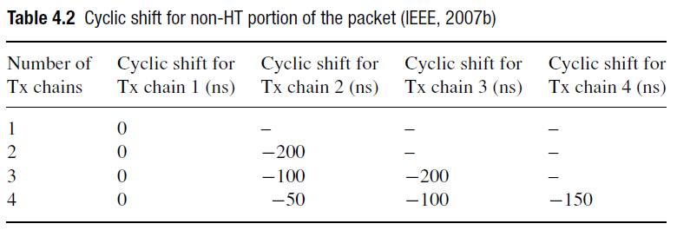
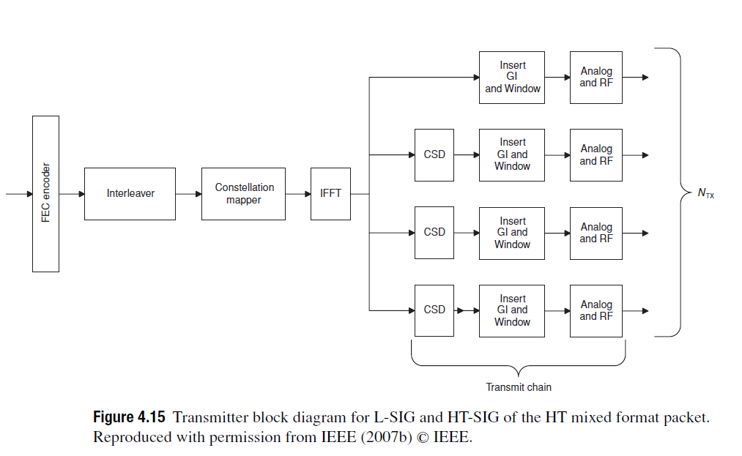
Cyclic Shift Delay
L-STF, L-LTF, L-SIG, HT-SIG

Slide 33
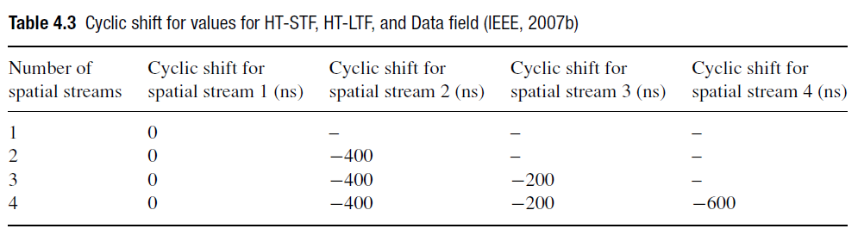
Cyclic Shift Delay
HT-STF, HT-LTF, HT-DATA

Slide 34
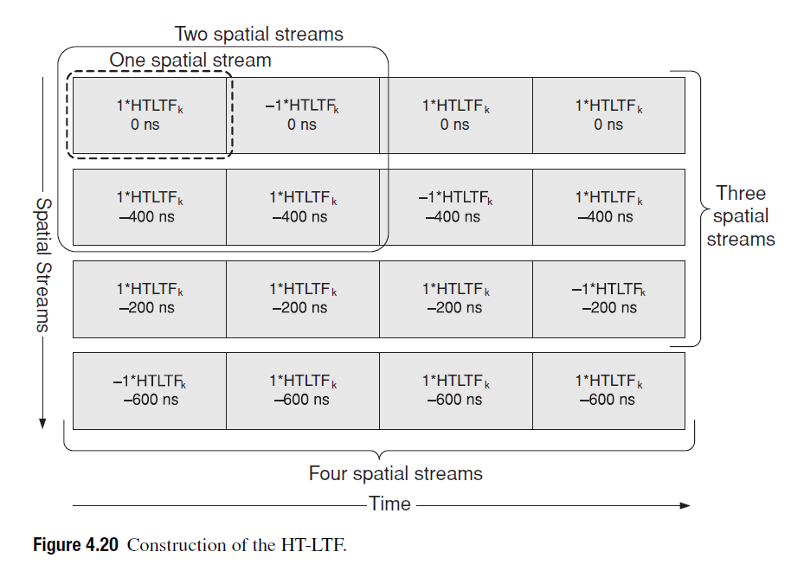

Slide 35
Viterbi34+Descramble+CRC32
1x: 64Mbps / w 58
2x seq: 31Mbps / w 30
2x parallel: 58Mbps / w 52
Pipeline 1x: 59Mbps / 62 / w 58
Pipeline 2x seq: 30Mbps / w 30
Pipeline 2x parallel: 53Mbps/58 / w 32~55

