Slide 1
Database for Data-Analysis
Developer: Ying Chen (JLab)
Computing 3(or N)-pt functions
  Many correlation functions (quantum numbers), at many momenta for a fixed configuration
  Data analysis requires a single quantum number over many configurations (called an Ensemble quantity)
  Can be 10K to over 100K quantum numbers
Inversion problem:
  Time to retrieve 1 quantum number can be long
  Analysis jobs can take hours (or days) to run. Once cached, time can be considerably reduced
Development:
  Require better storage technique and better analysis code drivers

Slide 2
Database for Data-Analysis
Developer: Ying Chen (JLab)
Computing 3(or N)-pt functions
  Many correlation functions (quantum numbers), at many momenta for a fixed configuration
  Data analysis requires a single quantum number over many configurations (called an Ensemble quantity)
  Can be 10K to over 100K quantum numbers
Inversion problem:
  Time to retrieve 1 quantum number can be long
  Analysis jobs can take hours (or days) to run. Once cached, time can be considerably reduced
Development:
  Require better storage technique and better analysis code drivers

Slide 3
Database
Requirements:
  For each config worth of data, will pay a one-time insertion cost
  Config data may insert out of order
  Need to insert or delete
Solution:
  Requirements basically imply a balanced tree
  Try DB using Berkeley Sleepy Cat:
Preliminary Tests:
  300 directories of binary files holding correlators (~7K files each dir.)
  A single “key” of quantum number + config number hashed to a string
  About 9GB DB, retrieval on local disk about 1 sec, over NFS about 4 sec.

Slide 4
Database and Interface
Database “key”:
  String = source_sink_pfx_pfy_pfz_qx_qy_qz_Gamma_linkpath
  Not intending (at the moment) any relational capabilities among sub-keys
Interface function
  Array< Array<double> > read_correlator(const string& key);
Analysis code interface (wrapper):
  struct Arg {Array<int> p_i; Array<int> p_f; int gamma;};
  Getter: Ensemble<Array<Real>> operator[](const Arg&); or
  Array<Array<double>> operator[](const Arg&);
  Here, “ensemble” objects have jackknife support, namely
  operator*(Ensemble<T>, Ensemble<T>);
  CVS package adat

Slide 5
(Clover) Temporal Preconditioning
Consider Dirac op det(D) = det(D_{t} + D_{s}/ξ)
Temporal precondition: det(D)=det(D_{t})det(1+ D_{t}⁻¹D_{s}/ξ)
Strategy:
  Temporal preconditiong
  3D even-odd preconditioning
Expectations
  Improvement can increase with increasing ξ
  According to Mike Peardon, typically factors of 3 improvement in CG iterations
  Improving condition number lowers fermionic force

Slide 6
Multi-Threading on Multi-Core Processors
Jie Chen, Ying Chen, Balint Joo and Chip Watson
Scientific Computing Group
IT Division
Jefferson Lab

Slide 7
Motivation
Next LQCD Cluster
  What type of machines is going to used for the cluster?
    Intel Dual Core or AMD Dual Core?
Software Performance Improvement
  Multi-threading

Slide 8
Test Environment
Two Dual Core Intel 5150 Xeons (Woodcrest)
  2.66 GHz
  4 GB memory (FB-DDR2 667 MHz)
Two Dual Core AMD Opteron 2220 SE (Socket F)
  2.8 GHz
  4 GB Memory (DDR2 667 MHz)
2.6.15-smp kernel (Fedora Core 5)
  i386
  x86_64
Intel c/c++ compiler (9.1), gcc 4.1

Slide 9
Multi-Core Architecture
PCI-E
Bridge
PCI-E
Expansion
HUB
Core 1
Core 2
FB DDR2
DDR2
ESB2
I/O
Memory Controller
Core 1
Core 2
PCI Express
PCI-X
Bridge
Intel Woodcrest
Intel Xeon 5100
AMD Opterons
Socket F

Slide 10
Multi-Core Architecture
L1 Cache
  32 KB Data, 32 KB Instruction
  8-Way associativity
L2 Cache
  4MB Shared among 2 cores
  16-way associativity
  256 bit width
  10.6 GB/s bandwidth to cores
FB-DDR2
  Increased Latency
  memory disambiguation allows load ahead store instructions
Executions
  Pipeline length 14; 24 bytes Fetch width; 96 reorder buffers
  Max decoding rate 4 + 1; Max 4 FP/cycle
  3 128-bit SSE Units; One SSE instruction/cycle
L1 Cache
  64 KB Data, 64 KB Instruction
  2-Way associativity
L2 Cache
  1 MB dedicated
  16-way associativity
  128 bit width
  6.4 GB/s bandwidth to cores
NUMA (DDR2)
  Increased latency to access the other memory
  Memory affinity is important
Executions
  Pipeline length 12; 16 bytes Fetch width; 72 reorder buffers
  Max decoding rate 3; Max 3 FP/cycle
  2 128-bit SSE Units; One SSE instruction = two 64-bit instructions.

Slide 11
Multi-Core Architecture
L1 Cache
  32 KB Data, 32 KB Instruction
L2 Cache
  4MB Shared among 2 cores
  256 bit width
  10.6 GB/s bandwidth to cores
FB-DDR2
  Increased Latency
  memory disambiguation allows load ahead store instructions
Executions
  Pipeline length 14; 24 bytes Fetch width; 96 reorder buffers
  3 128-bit SSE Units; One SSE instruction/cycle
L1 Cache
  64 KB Data, 64 KB Instruction
L2 Cache
  1 MB dedicated
  128 bit width
  6.4 GB/s bandwidth to cores
NUMA (DDR2)
  Increased latency to access the other memory
  Memory affinity is important
Executions
  Pipeline length 12; 16 bytes Fetch width; 72 reorder buffers
  2 128-bit SSE Units; One SSE instruction = two 64-bit instructions.
Intel Woodcrest Xeon
AMD Opteron

Slide 12
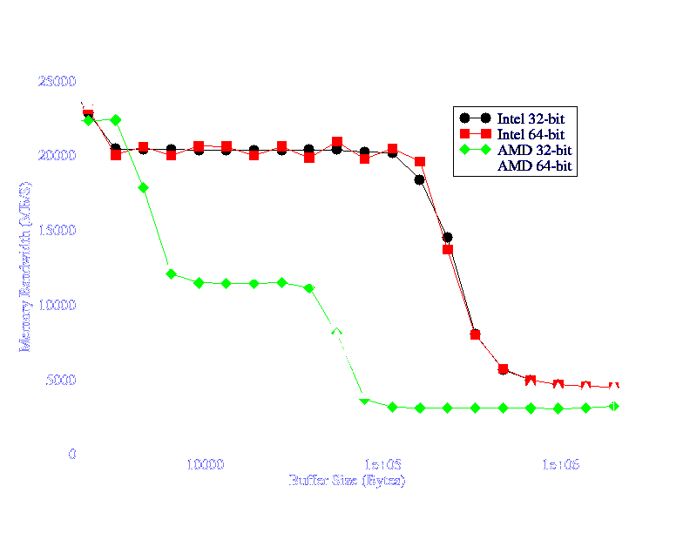
Memory System Performance

Slide 13
Memory System Performance
Memory Access Latency in nanoseconds
 | L1 | L2 | Mem | Rand Mem
Intel | 1.1290 | 5.2930 | 118.7 | 150.3
AMD | 1.0720 | 4.3050 | 71.4 | 173.8

Slide 14
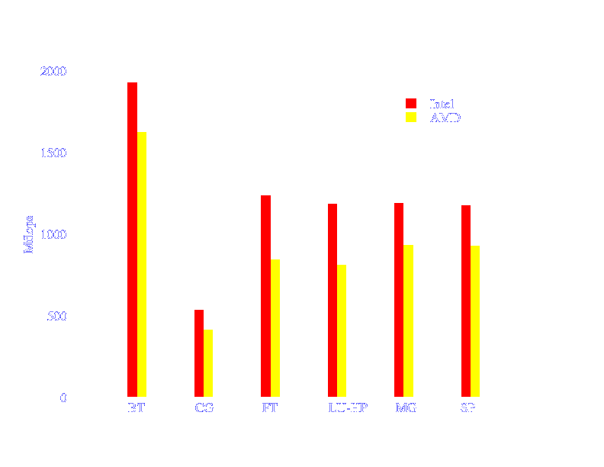
Performance of Applications
NPB-3.2 (gcc-4.1 x86-64)

Slide 15
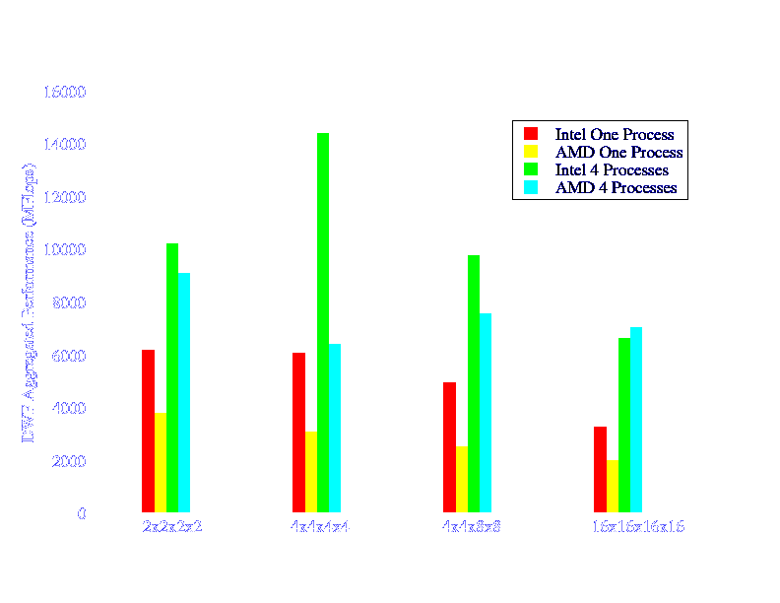
LQCD Application (DWF) Performance

Slide 16
Parallel Programming
Messages
Machine 1
Machine 2
OpenMP/Pthread
OpenMP/Pthread
Performance Improvement on Multi-Core/SMP machines
    All threads share address space
    Efficient inter-thread communication (no memory copies)

Slide 17
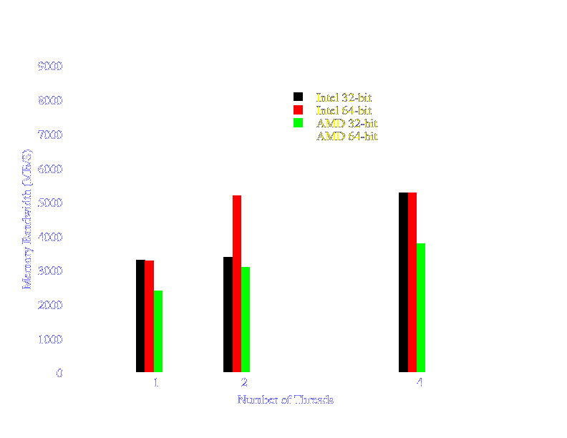
Multi-Threads Provide Higher Memory Bandwidth to a Process

Slide 18
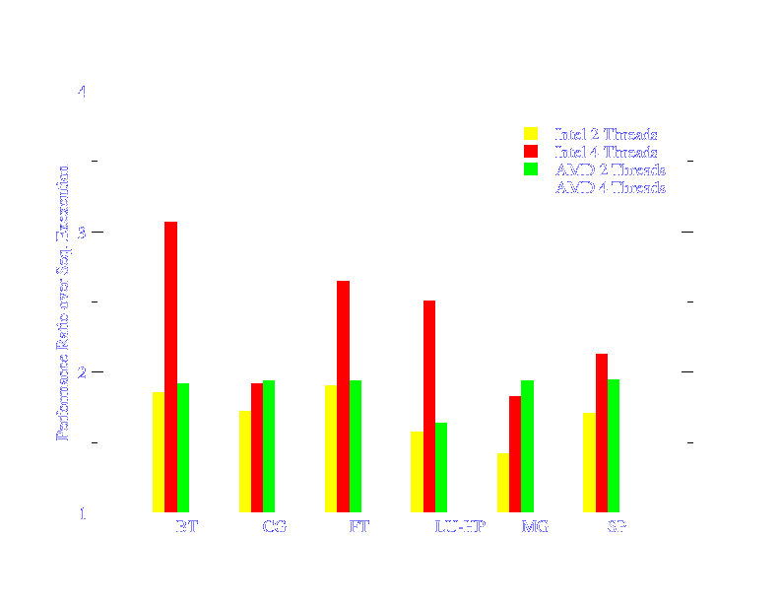
Different Machines Provide Different Scalability for Threaded Applications

Slide 19
OpenMP
Portable, Shared Memory Multi-Processing API
  Compiler Directives and Runtime Library
  C/C++, Fortran 77/90
  Unix/Linux, Windows
  Intel c/c++, gcc-4.x
  Implementation on top of native threads
Fork-join Parallel Programming Model
Master
Time
Fork
Join

Slide 20
OpenMP
Compiler Directives (C/C++)
  #pragma omp parallel
  {
  thread_exec (); /* all threads execute the code */
  } /* all threads join master thread */
  #pragma omp critical
  #pragma omp section
  #pragma omp barrier
  #pragma omp parallel reduction(+:result)
Run time library
  omp_set_num_threads, omp_get_thread_num

Slide 21
Posix Thread
IEEE POSIX 1003.1c standard (1995)
  NPTL (Native Posix Thread Library) Available on Linux since kernel 2.6.x.
Fine grain parallel algorithms
  Barrier, Pipeline, Master-slave, Reduction
Complex
  Not for general public ☺

Slide 22
QCD Multi-Threading (QMT)
Provides Simple APIs for Fork-Join Parallel paradigm
  typedef void (*qmt_user_func_t)(void * arg);
  qmt_pexec (qmt_userfunc_t func, void* arg);
    The user “func” will be executed on multiple threads.
Offers efficient mutex lock, barrier and reduction
  qmt_sync (int tid); qmt_spin_lock(&lock);
Performs better than OpenMP generated code?

Slide 23
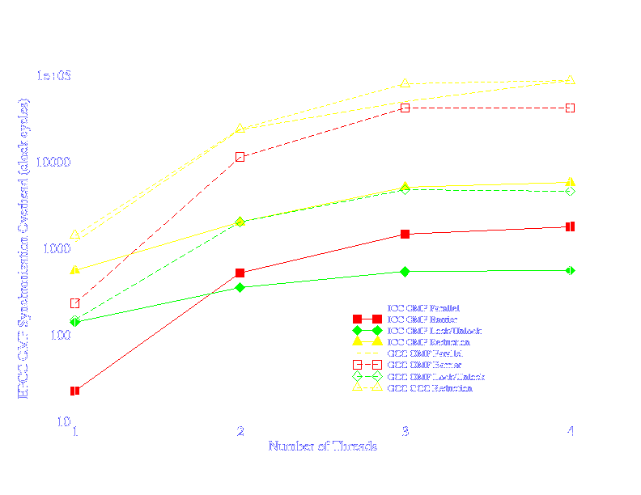
OpenMP Performance from Different Compilers (i386)

Slide 24
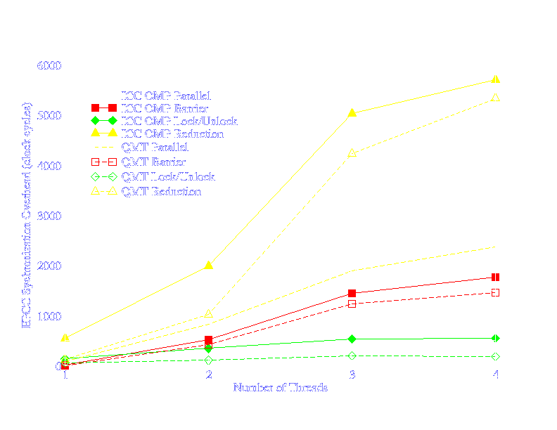
Synchronization Overhead for OMP and QMT on Intel Platform (i386)

Slide 25
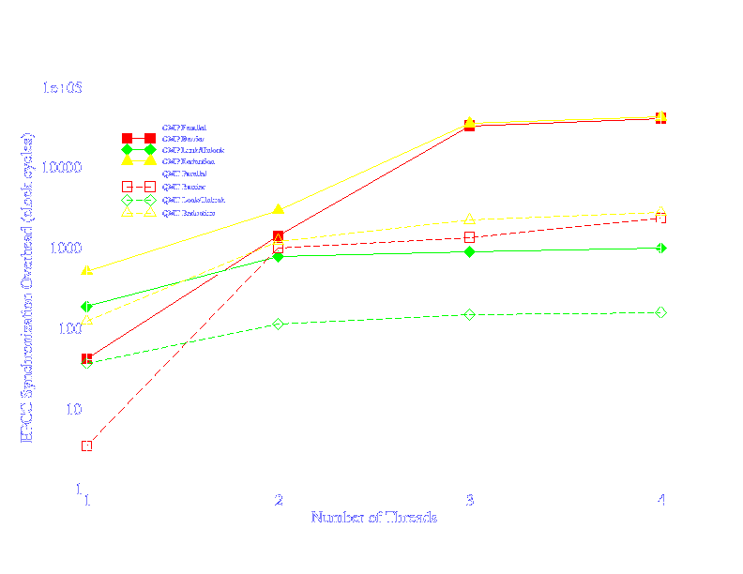
Synchronization Overhead for OMP and QMT on AMD Platform (i386)

Slide 26
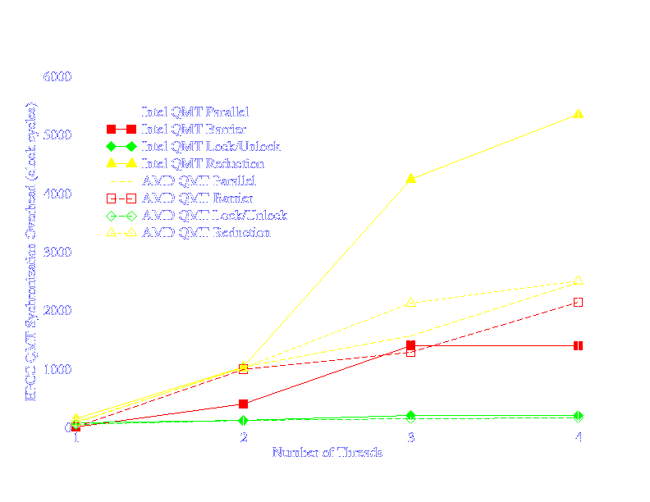
QMT Performance on Intel and AMD (x86_64 and gcc 4.1)

Slide 27
Conclusions
Intel woodcrest beats AMD Opterons at this stage of game.
  Intel has better dual-core micro-architecture
  AMD has better system architecture
Hand written QMT library can beat OMP compiler generated code.

