Slide 1
A CRM APPLICATION FOR THECHAISHOP&CO
SALESFORCE CRM PROJECT
Customer, Employer and Enterprise Management with Automated Billing, Birthday Emails, Reports and Dashboards

Slide 2
User Story
As a sales representative at TheChaiShop&Co, I want to efficiently manage customer relationships and streamline sales processes using our CRM application.
I want to easily access and update employer details and distinguish between online and offline customer records using record types.
I need automated sales calculations such as order quantity and total bill amount.
I require reports and dashboards to summarize and analyze sales data for decision-making.
I would like automated birthday email notifications with special offers to improve customer engagement and loyalty.

Slide 3
1. INTRODUCTION
1.1 Project Overview: A Salesforce-based CRM system to manage customer, employer and enterprise accounts efficiently.
The system automates sales processes, maintains customer records, generates reports and improves customer engagement through automated notifications.
1.2 Purpose: Streamline customer relationship management.
Automate billing and order calculations.
Improve data accuracy.
Enable data-driven decision-making.
Enhance customer engagement through email automation.

Slide 4
2. IDEATION PHASE – Problem Statements
Sales Representative: Manage customer orders and billing; manual calculations can cause errors and inefficiency.
Store Manager: Monitor sales and customer records; reports can be delayed when data is stored across multiple files.
Customer: Receive personalized offers and updates; lack of automated communication can delay notifications.

Slide 5
Empathy Map & Brainstorming
Target Users: Sales Representatives, Managers, System Administrators, Business Analysts.
Think & Feel: Need accurate customer data and reports.
See: Multiple registers and spreadsheets.
Pain: Errors, delays, data loss. Gain: Automation and fast reports.
Brainstormed options: Manual CRM, Excel-based management, Web-based CRM, Salesforce-based CRM, Automated email system.
Selected Idea: Salesforce-based CRM Application for TheChaiShop&Co.

Slide 6
3. REQUIREMENT ANALYSIS
Customer Journey: Login → Access CRM Application → Enter Customer Data → Generate Orders → Calculate Bills → View Reports → Decision Making.
Functional Requirements: User Login, Object Creation, Data Entry, Billing Automation, Report Generation, Email Automation.
Non-Functional Requirements: Usability, Security, Reliability, Performance, Availability, Scalability.

Slide 7
Data Flow, Technology Stack & Architecture
Data Flow: User → Salesforce UI → Custom Objects → Validation Rules → Flows → Reports → Dashboards.
Frontend: Salesforce Lightning | Database: Salesforce Cloud | Automation: Flows.
Backend: Salesforce Platform | Analytics: Reports & Dashboards.
Architecture: Presentation Layer – Lightning UI; Application Layer – Flows and Logic; Data Layer – Custom Objects; Analytics Layer – Reports and Dashboards.

Slide 8
4. PROJECT DESIGN & 5. PLANNING
Problem–Solution Fit: Replaces manual records with automated data management, cloud storage, dashboards and real-time reports.
Proposed solution includes customer, employer, enterprise and order management; automated billing; validation; record types; email automation; reports and dashboards.
Agile development approach with defined milestones and sprints.
Product backlog contains 12 user stories across developer setup, data modeling, automation, reports and dashboards.

Slide 9
6. DEVELOPMENT MILESTONES
1 Developer Account | 2 Object Creation | 3 Tabs | 4 Lightning App | 5 Global Picklist
6 Fields & Relationships | 7 Page Layouts | 8 Record Types | 9 Validation Rules
10 Email Templates | 11 Flows | 12 Reports & Dashboards | 13 Conclusion

Slide 10
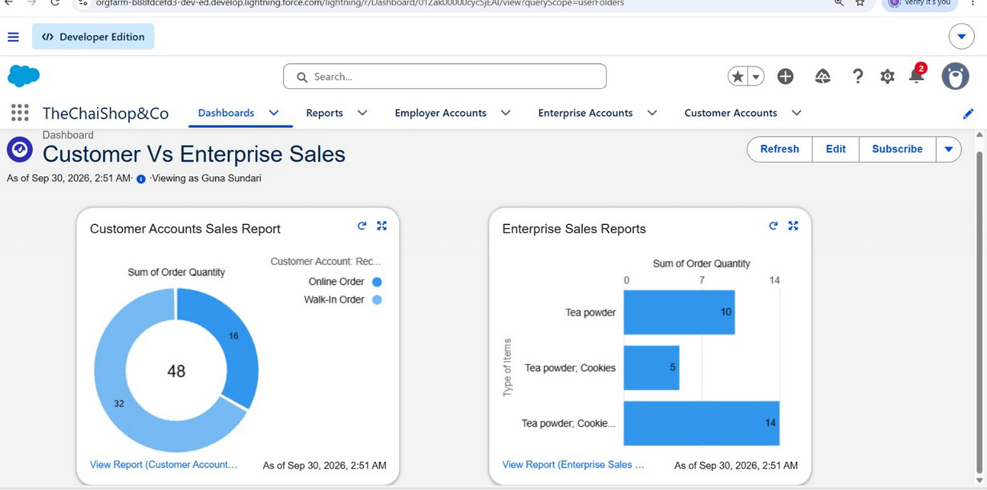
Milestone 12 – Dashboard

Slide 11
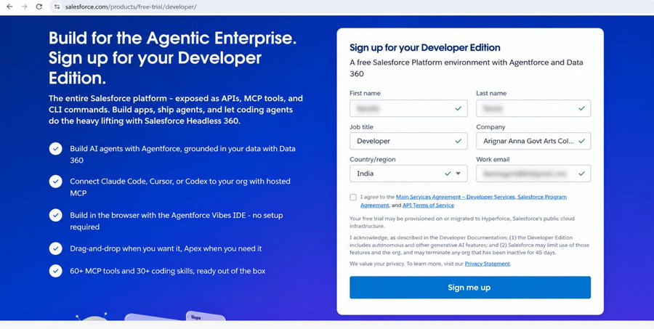
Milestone 1 – Developer Account Sign-up

Slide 12
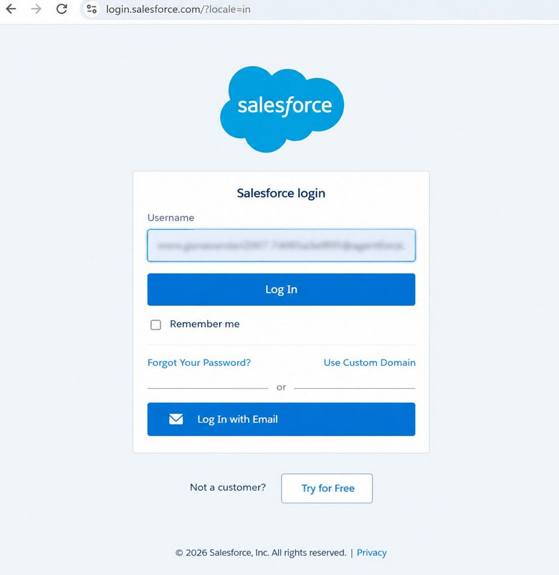
Milestone 1 – Salesforce Login

Slide 13
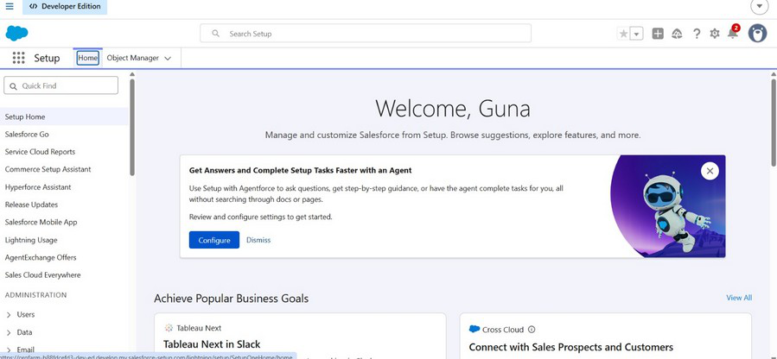
Milestone 1 – Setup Home

Slide 14
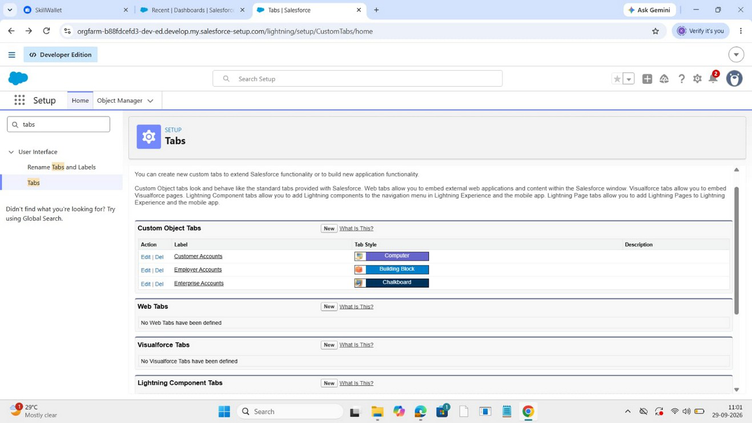
Milestones 2–4 – Objects, Tabs & App

Slide 15
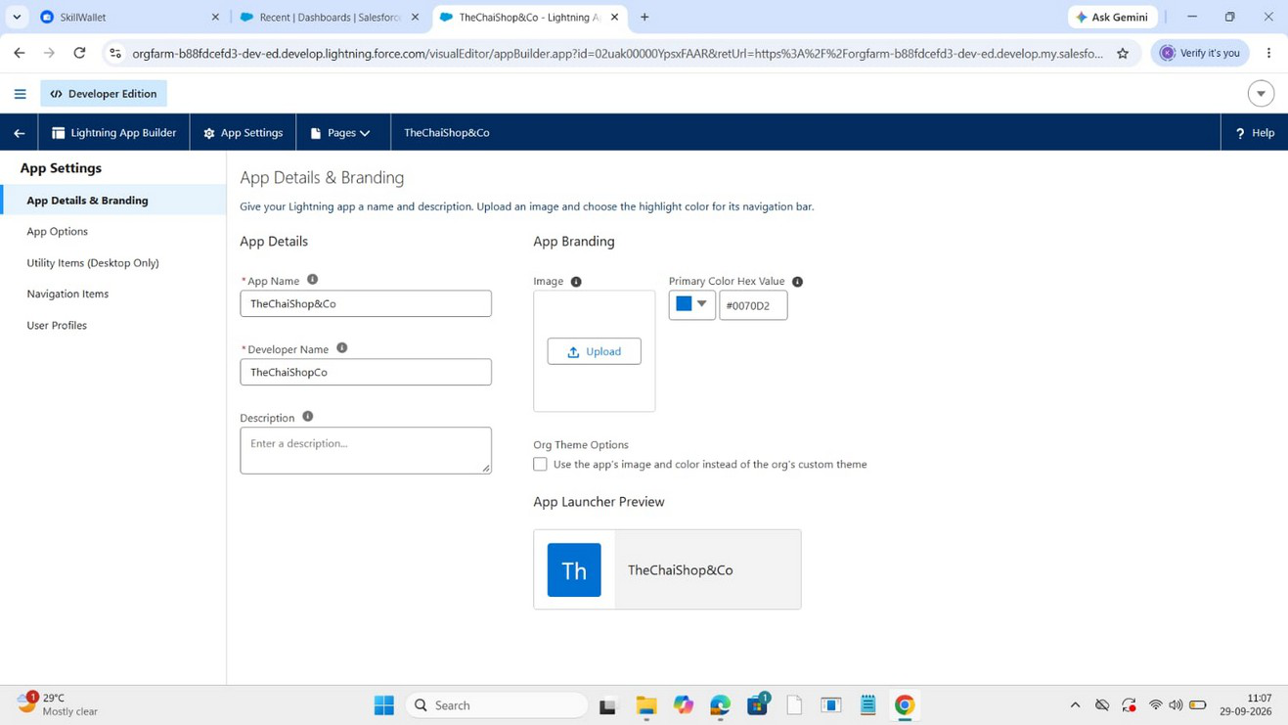
Milestone 4 – Lightning App

Slide 16
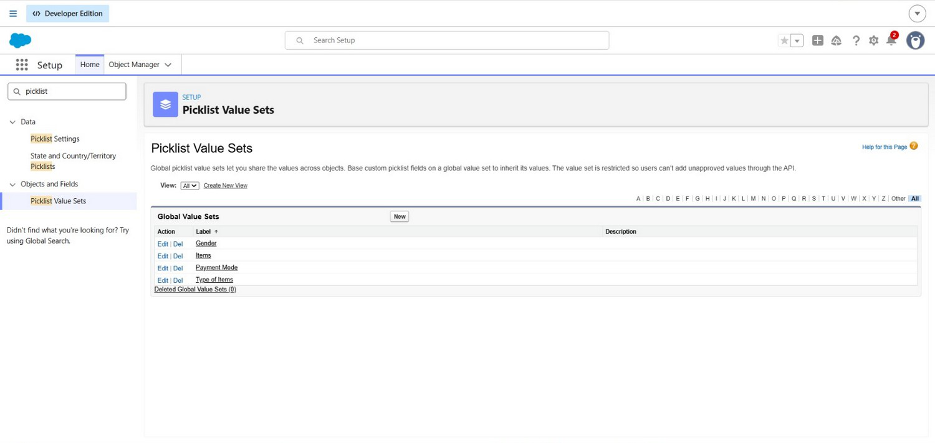
Milestone 5 – Global Picklist

Slide 17
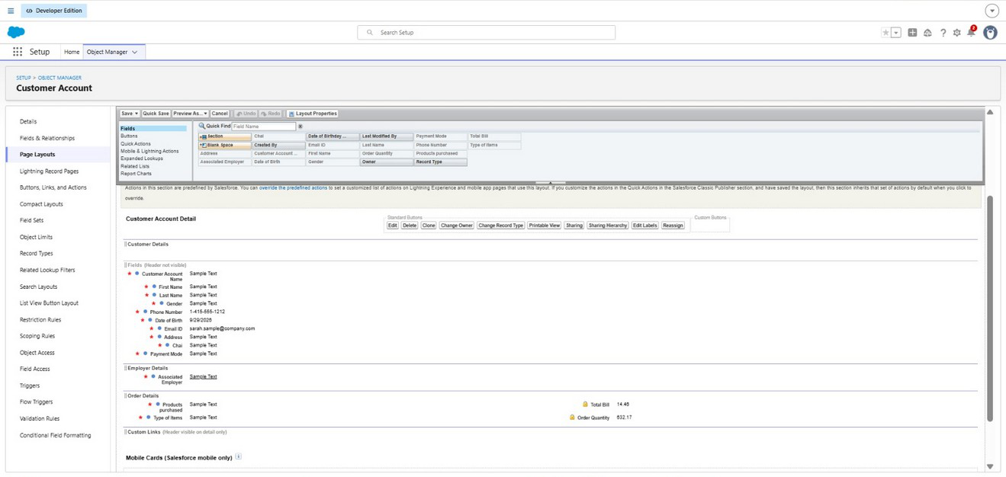
Milestone 6 – Employer Fields

Slide 18
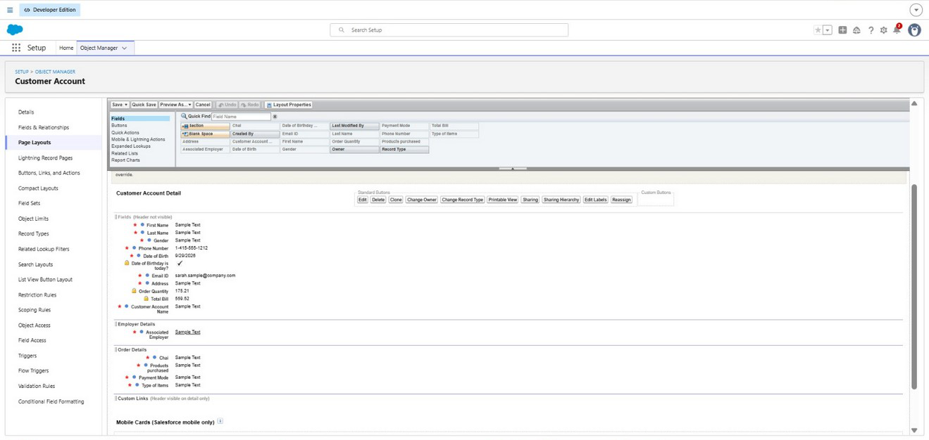
Milestone 6 – Customer Fields

Slide 19
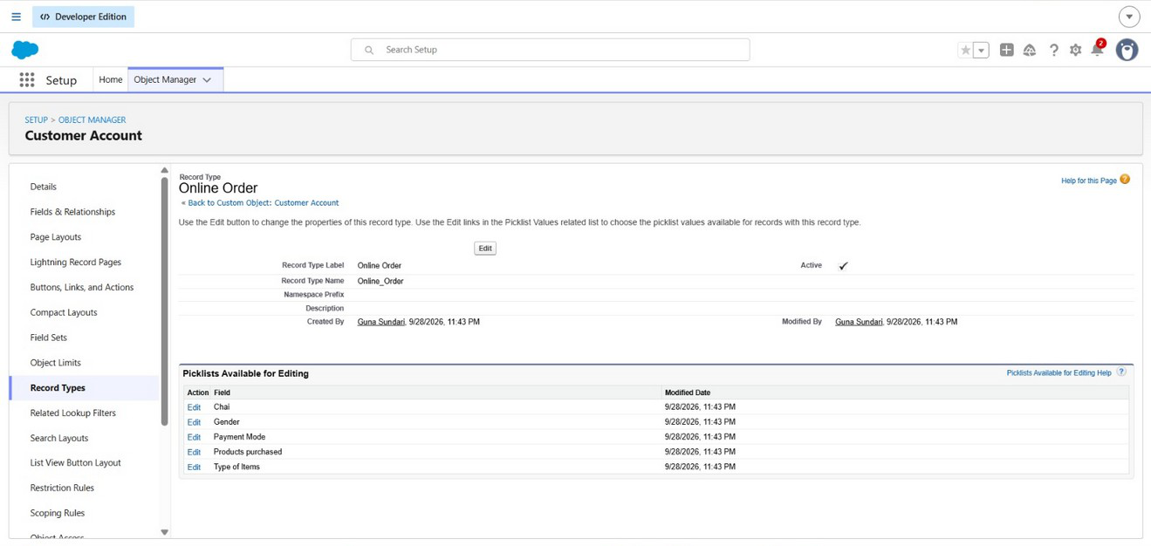
Milestone 7 – Customer Page Layout

Slide 20
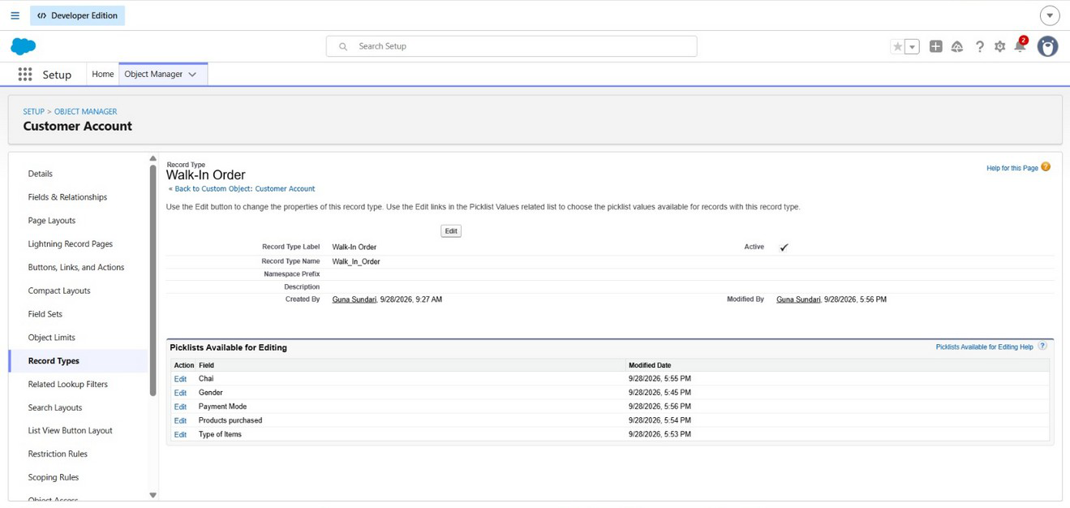
Milestone 7 – Customer Page Layout / Order Fields

Slide 21
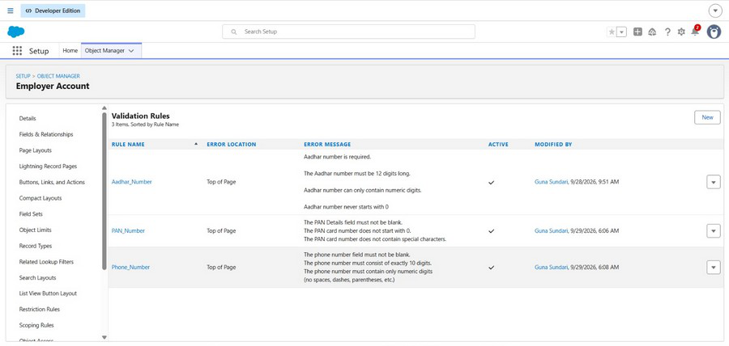
Milestone 8 – Record Types

Slide 22
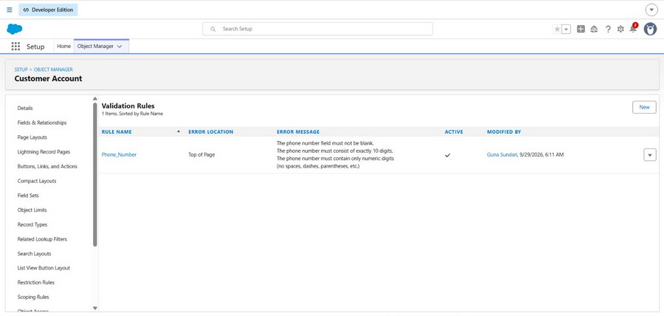
Milestone 9 – Customer Validation Rules

Slide 23
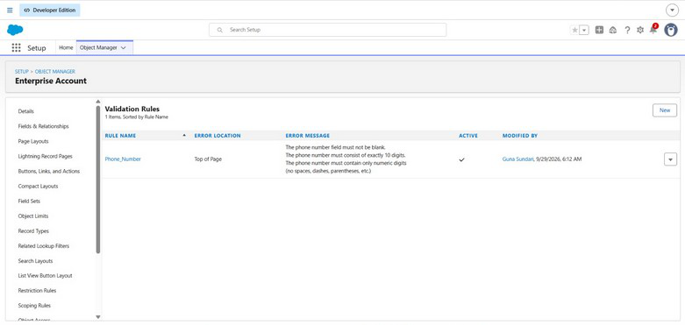
Milestone 9 – Enterprise Validation Rules

Slide 24
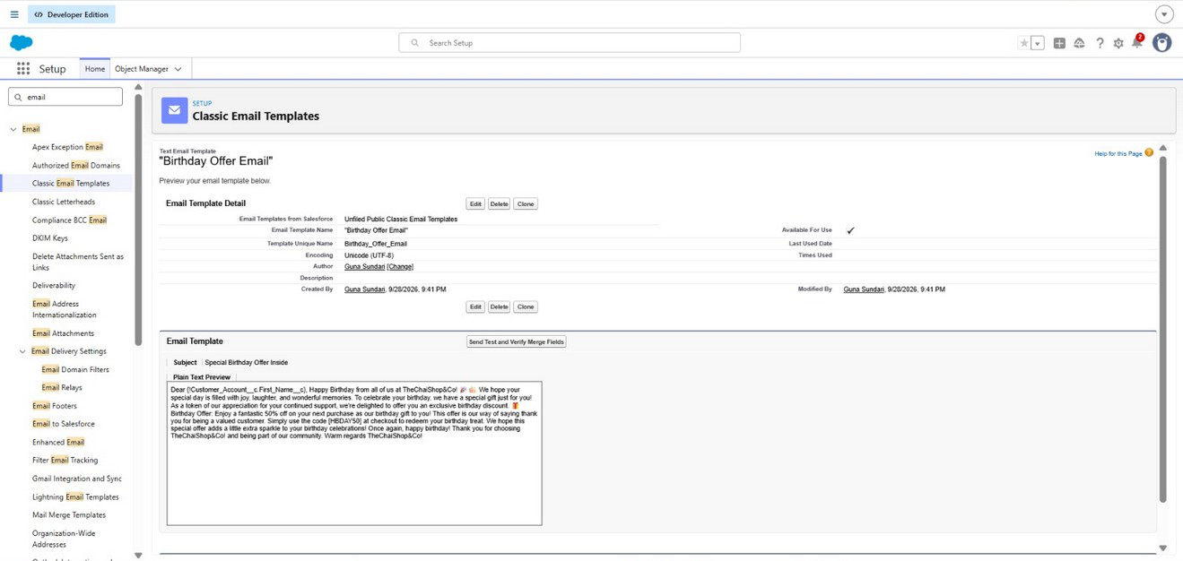
Milestone 10 – Birthday Email Template

Slide 25
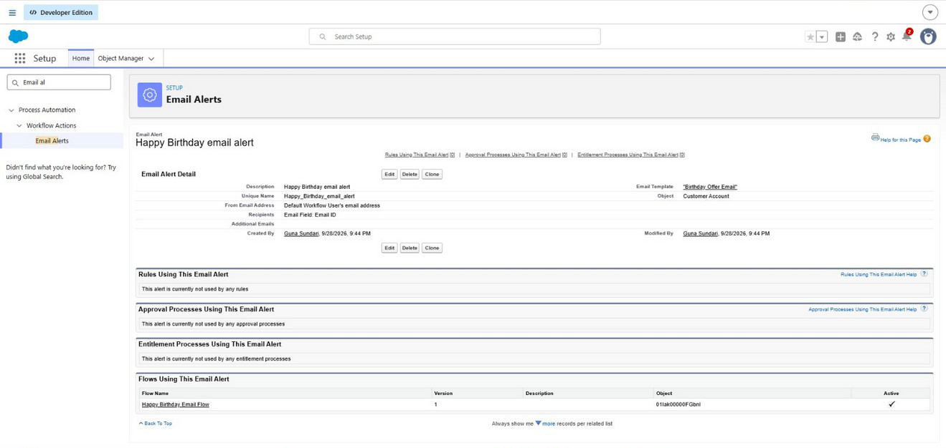
Milestone 10 – Email Alert

Slide 26
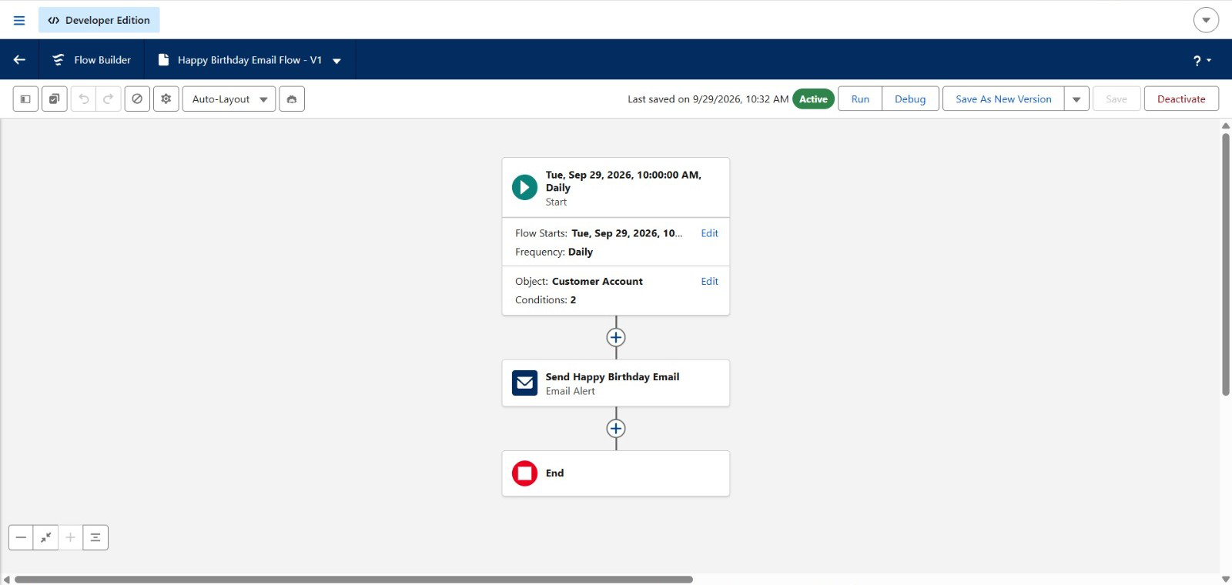
Milestone 11 – Scheduled Birthday Flow

Slide 27
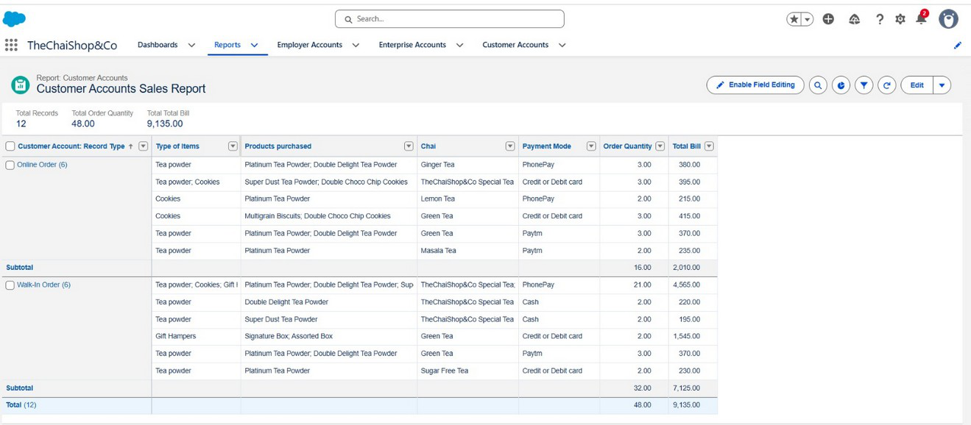
Milestone 12 – Customer Sales Report

Slide 28
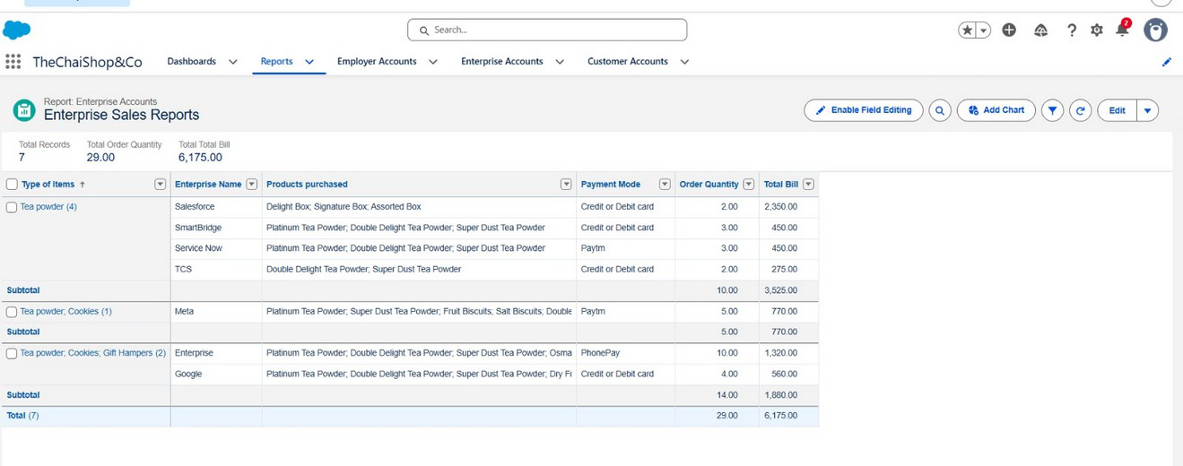
Milestone 12 – Enterprise Sales Report

Slide 29

Milestone 12 – Customer vs Enterprise Dashboard

