Slide 1

Final Project
What are the Leading Causes of Death in the United States
Wiley Winters
Regis University Anderson College of Business and Computing
MSDS 670 Data Visualization
Mr. John Koenig
March 10, 2024

Slide 2
Purpose and Research Question
The purpose of this analysis is to determine what the leading causes of death are in the United States using available data sources.
Research Question:
What are the leading causes of death in the United States from 2000 to 2017?

Slide 3
Methodology
Reviewed current literature available on the Internet
Found and downloaded relevant datasets for the analysis being conducted
Dataset were sourced from U.S. Government web sites
Cleaned data as required
Conducted analysis using Jupyter-lab and industry acceptable practices
Plotted findings and created report

Slide 4
Data
All major datasets were obtained from the U.S. National Center for Health Statistics (NCHS) and the U.S. Census Bureau.
A state spelling to abbreviation dataset was created using resources from the internet.
It was difficult to find a continuous dataset containing state populations from 2000 to 2017; therefore, two different sets were download and concatenated
The NCHS dataset consisted of seven columns and 137,700 rows
NCHS dataset contained numerous blank values, but it was determined these did not require imputing or removal from the set

Slide 5
How Death Rates are Measured
There are three methods that the CDC and NCHS uses for measuring death rates
Raw Rate – This is just the number of deaths and their causes as reported to the CDC
Age-Adjusted – Add weights to each age group in each population so that the distribution is standardized
Crude – A ratio of the population and its deaths
The Age-Adjusted and Crude Death Rates are usually calculated per 100,000 people.

Slide 6
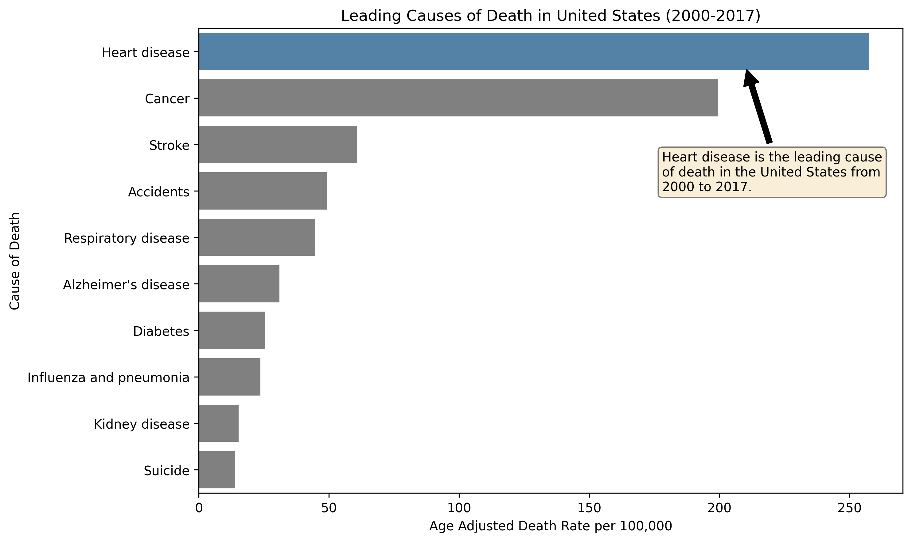
U.S. Leading Causes of Death (2000-2017)
Heart disease and cancer are the top two leading causes of death
The other causes have significantly smaller death rates than the top two.
This is plot uses average death rate between 2000 and 2017

Slide 7
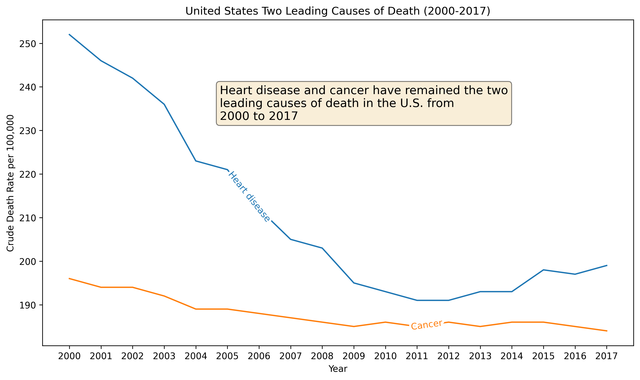
Two Leading Causes of Death
Heart Disease and Cancer have been the leading causes of death from 2000 to 2017.
The death rates for them have been trending down as time progresses
Notice the crude death rates are high for these causes

Slide 8
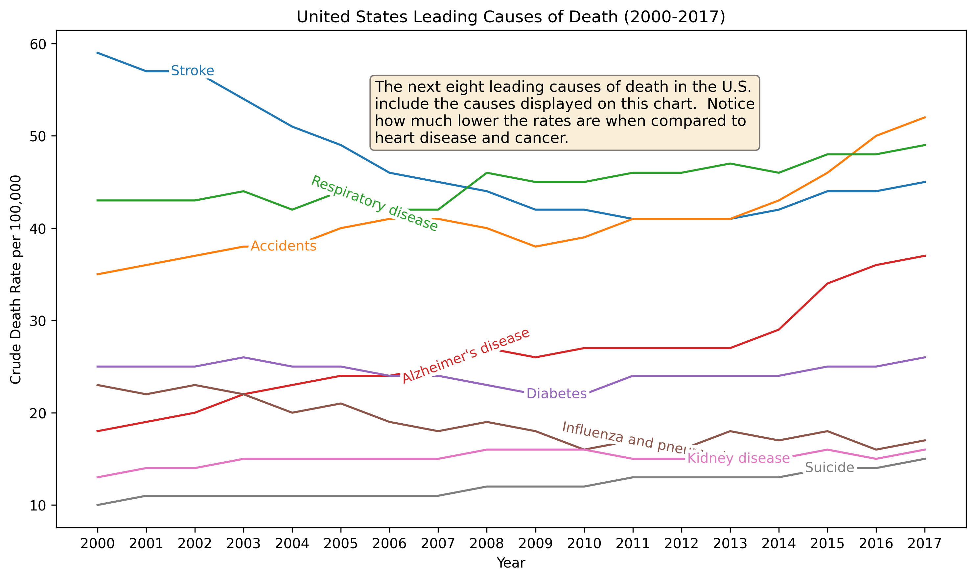
Next Eight Leading Causes of Death
The next eight leading causes of death have significantly lower rates than the top two
Heart and cancer were in the 100s per 100,000 people
The next eight are in the 10s per 100,000.

Slide 9
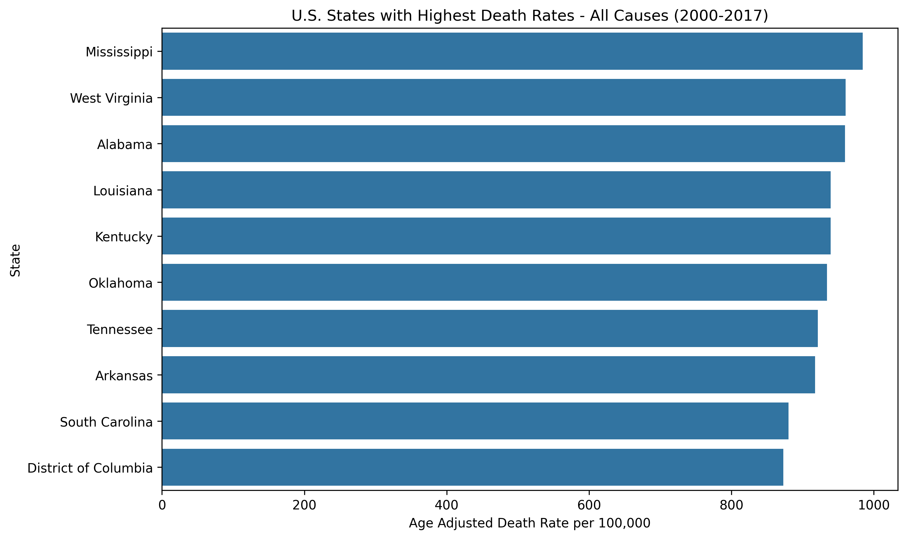
U.S. States with Highest Death Rates
All states with high death rates are in the southern U.S.
District of Columbia is counted as a state by the NCHS
The death rate on this chart is the sum of all causes.

Slide 10
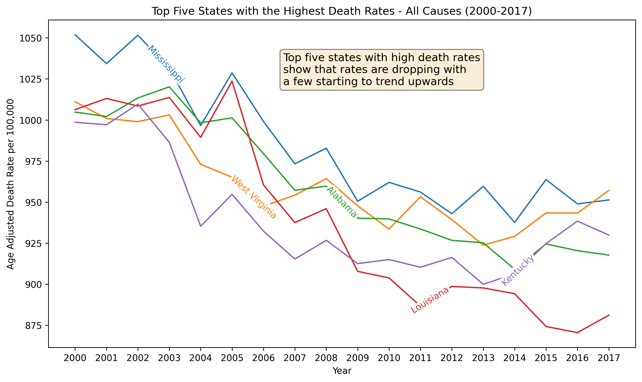
Death Rates of the top 5 States from 2000 to 2017
All the States show a downward trend of the crude death rate
Death rates are all the average of all causes
Mississippi has the highest rate of the five states displayed
West Virginia started the period lower than Mississippi, but then surpassed it in 2020

Slide 11
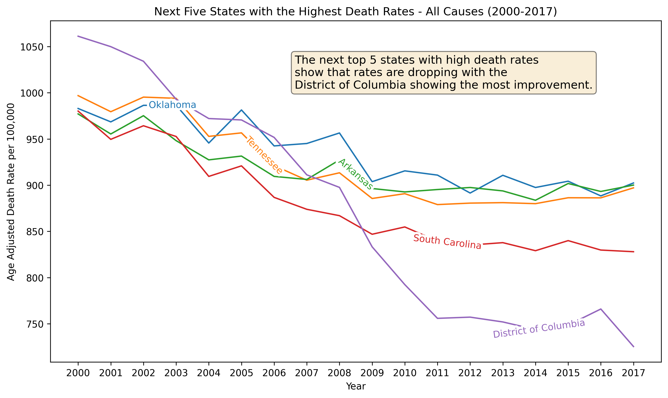
Death Rates of the Next 5 States from 2000 to 2017
The next 5 of the top 10 States also displays a downward trend in crude death rates.
South Carolina and the District of Columbia are showing the most downward trends

Slide 12
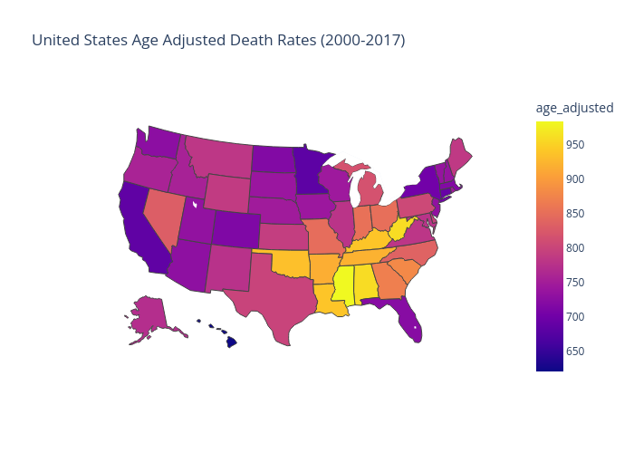
Overview United States Age-Adjusted Death Rates (2000 – 2017)
This plot is based on the average age-adjusted death rate for each state
The more yellow a state is colored the higher the age-adjusted death rate is.
As mentioned before, southern states have the highest death rates when compared to their northern and western neighbors

Slide 13
Conclusions
Heart disease and cancer are the leading causes of death in the United States
The next eight leading causes of death have significantly lower death rates than the top two
Death rates have trended down over the period this analysis covered.
The ten states with the highest death rates are in the southern United States

Slide 14
Questions?

