Slide 1

Mid-Term Project
Do Birth Rates Affect Total Population in the Top Ten Economies?
Wiley Winters
Regis University Anderson College of Business and Computing
MSDS 670 Data Visualization
Mr. John Koenig
February 11, 2024

Slide 2
Purpose and Research Question
Recently, media and other sources have reported that many developed and economically stable countries have experienced reduced birth rates with slight increases in death rates due to the COVID-19 pandemic. Much attention has been given to these countries' birth rates and how they affect overall population growth.
Research Question:
Do birth and death rates affect total population growth in the top ten economies?

Slide 3
Methodology
Conducted research to determine the top ten economies in the world
Queried the World Bank's Population Estimates and Projections database and saved data into CSV files
Used Jupyter Lab and Pandas to analyze data and produce initial visualizations
Converted Jupyter Lab to a python script for repeatability
Created sparklines using LibreOffice Calc
Compiled report

Slide 4
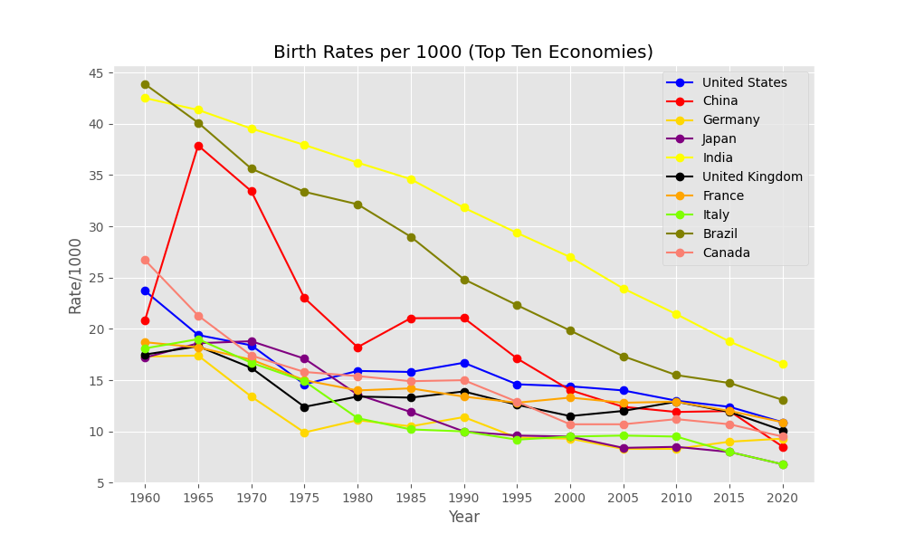
Birth Rates for Top Economies
Between 1960 and 2020 all countries being studied experience declining birth rates
China displays an interesting spike in 1965, but has trended down since then
Brazil and India still have the highest birth rates in the top economies

Slide 5
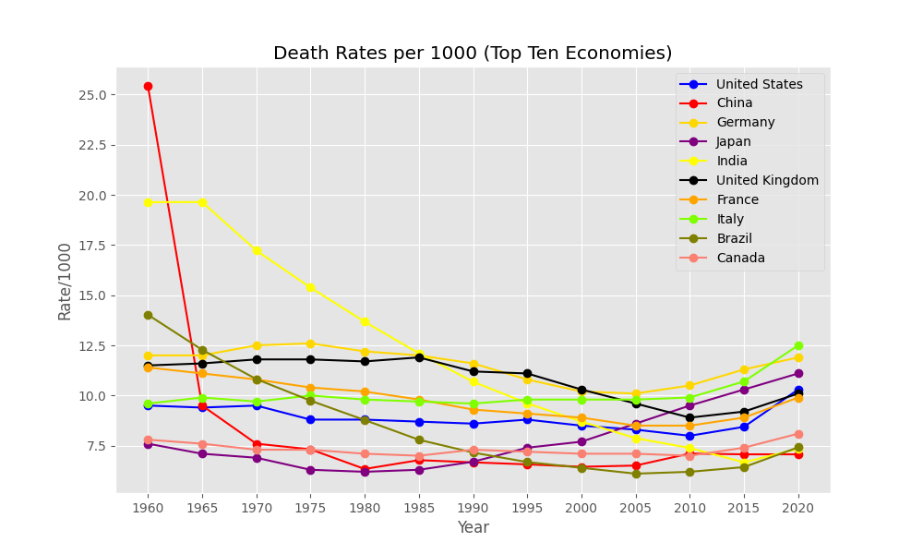
Death Rates Top Economies
1960 China had 25 deaths per 1000 people
India in 1960-1965 had around 19 deaths/1000 people
Death rates remained stable or trended down for all nations until approximately 2020 where they started to trend up

Slide 6
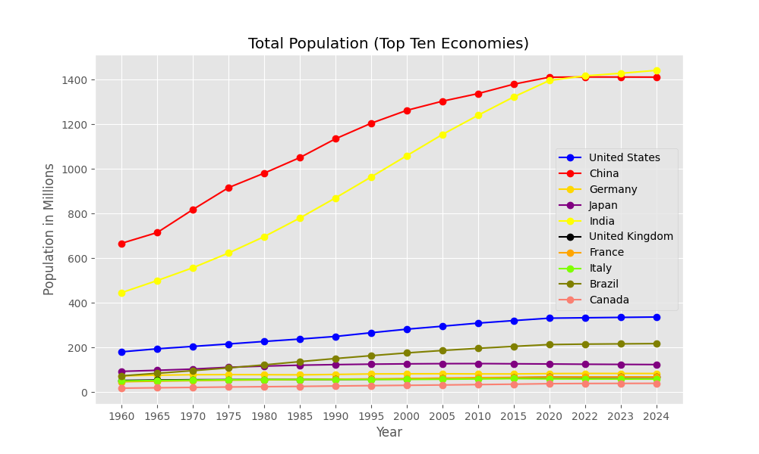
Total Populations
China and India are the most populated countries, but appears to be leveling off
Other countries have seen their populations grow more slowly when compared to China and India

Slide 7
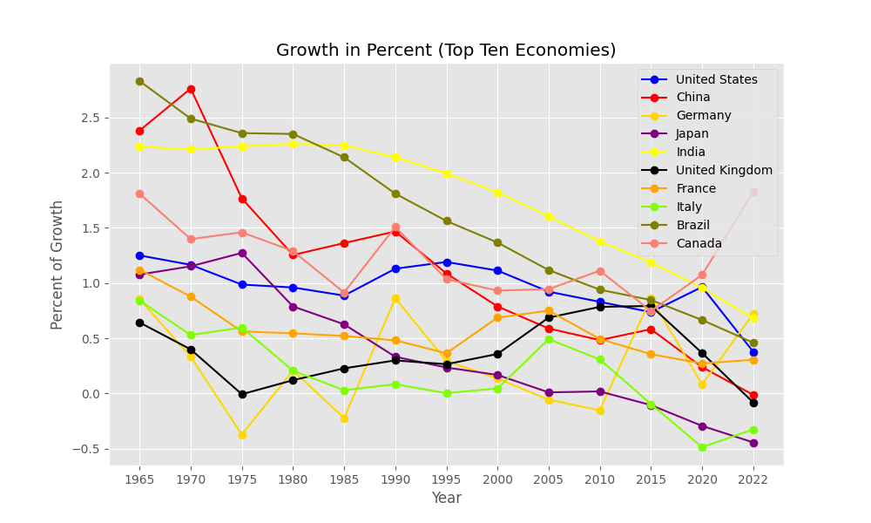
Percent of Population Change
Graph shows the percent of population change from year to year
All countries are trending down with Italy and Japan having negative growth
France trended up in 2022, but generally has been trending down.

Slide 8
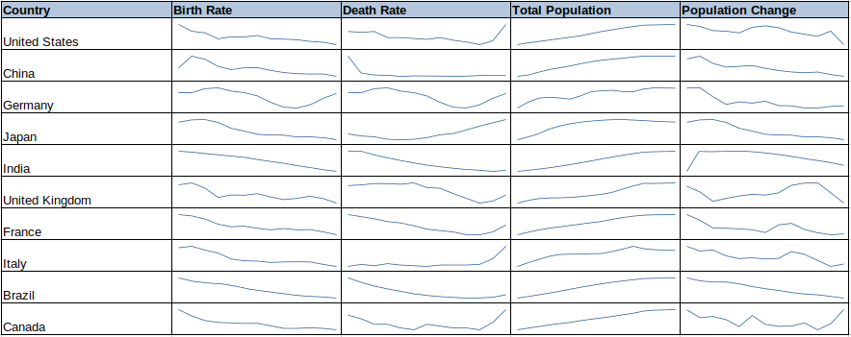
Population Trends for Each Country
Except for Germany, all the countries have declining birth rates

Slide 9
Conclusions
Birth and death rates are making an impact on the top ten economies' populations but not as fast as people think.
Countries with lower birth rates are experiencing populations that are stabilizing and will eventually start to decline if the birth rates do not increase
Japan and Italy have already started this trend with negative growth rates and declining populations

Slide 10
Questions?

