Slide 1

Assignment 6 Create Visualizations with Matplotlib
Wiley Winters
MSDS 670 Data Visualization
2024-FEB-25

Slide 2
Research Question
Does the country a person works in determine his/her annual salary and do factors such as company size and work setting also contribute to a person’s annual pay.

Slide 3
Dataset Source and Cleaning
The dataset used in this study was obtained from Jobs and Salaries in Data Science
Research indicated the dataset was obtained from ai-jobs.net and modified to include a job_category column
Dataset contained 12 columns and 9,355 rows
4014 duplicates were found and removed
Analysis was conducted on the remaining data
There are some unbalanced classes that were not handled

Slide 4
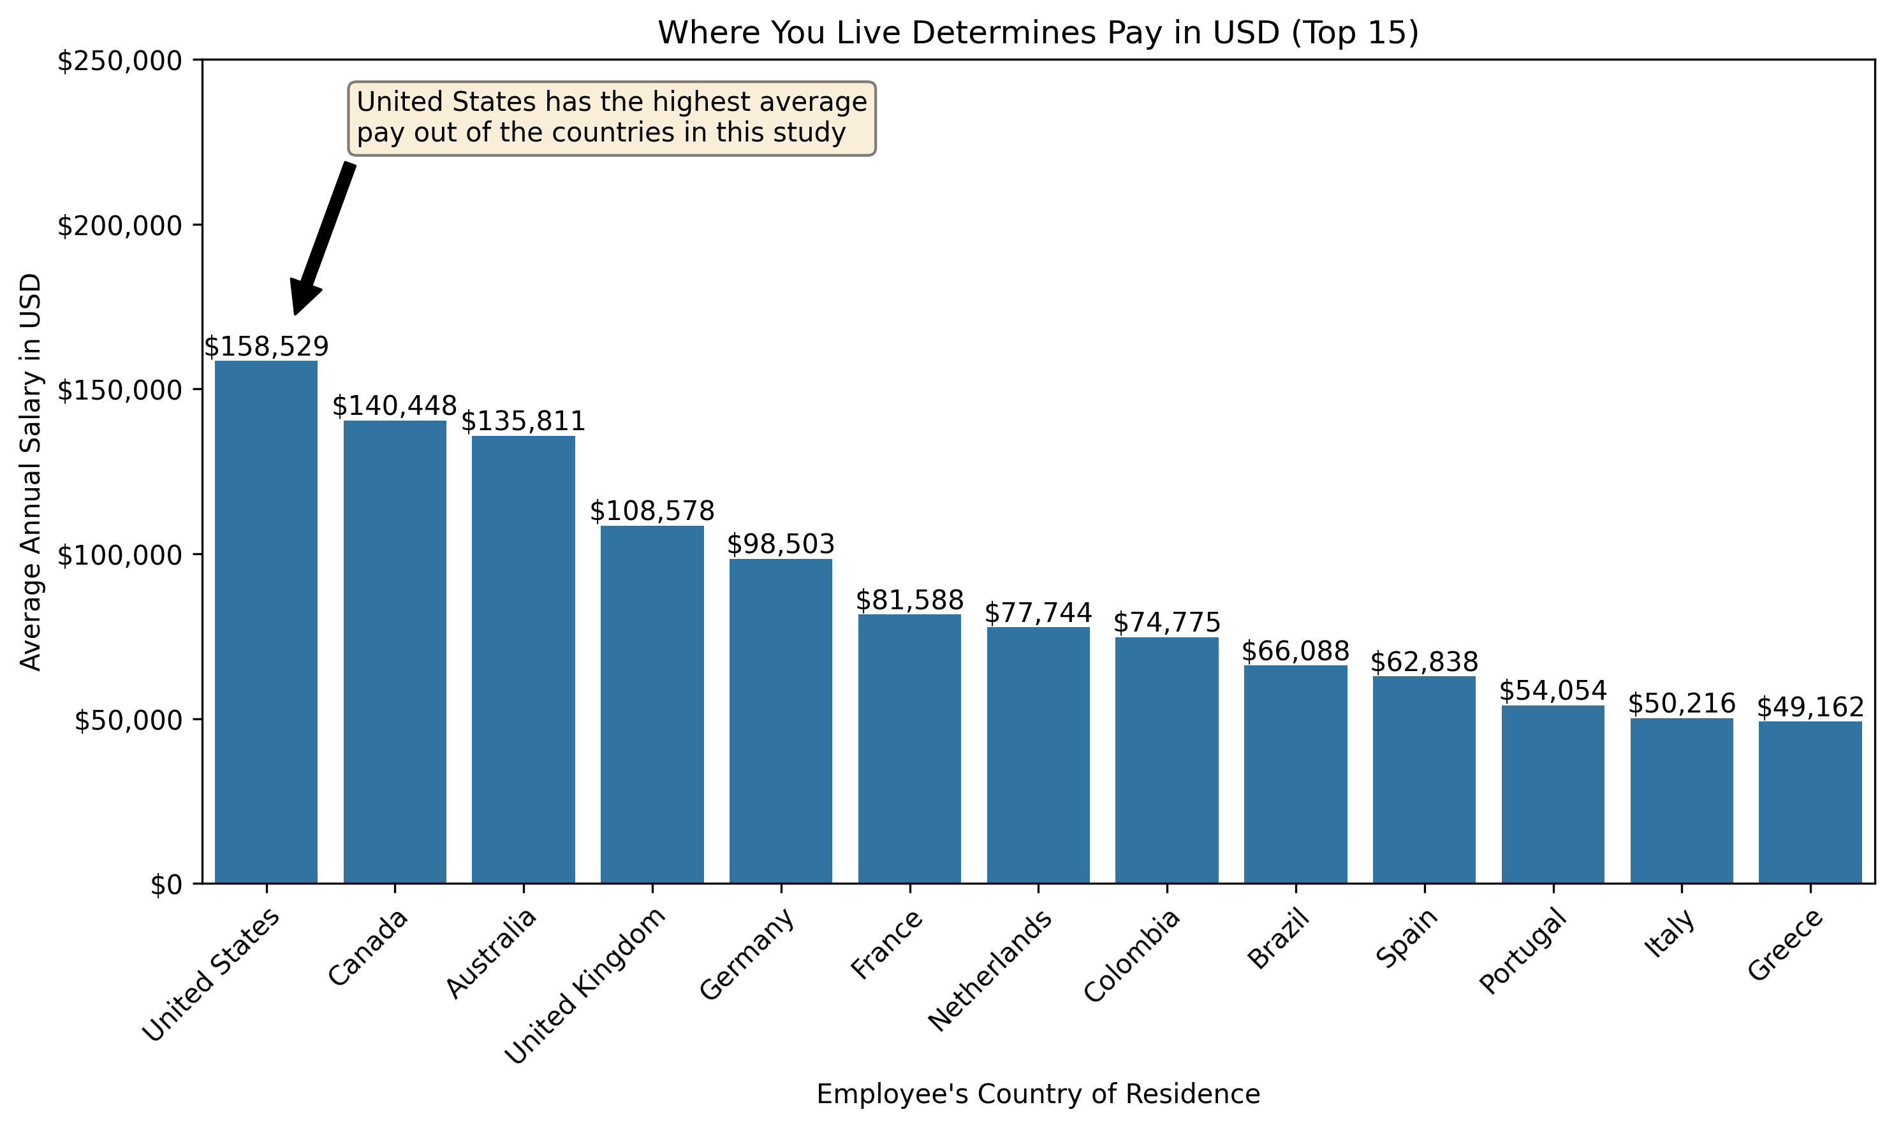
Average Salary by Country
The dataset contained many different countries, but since it was an informal survey, some countries did not have enough records to properly analyze
Duplicates were identified and removed from the dataset before analysis was conducted.
This visualization was conducted on the 15 countries that had the most records in the dataset
Although it is a simple addition and the bars are arranged from largest to smallest, The text annotation really adds to the chart

Slide 5
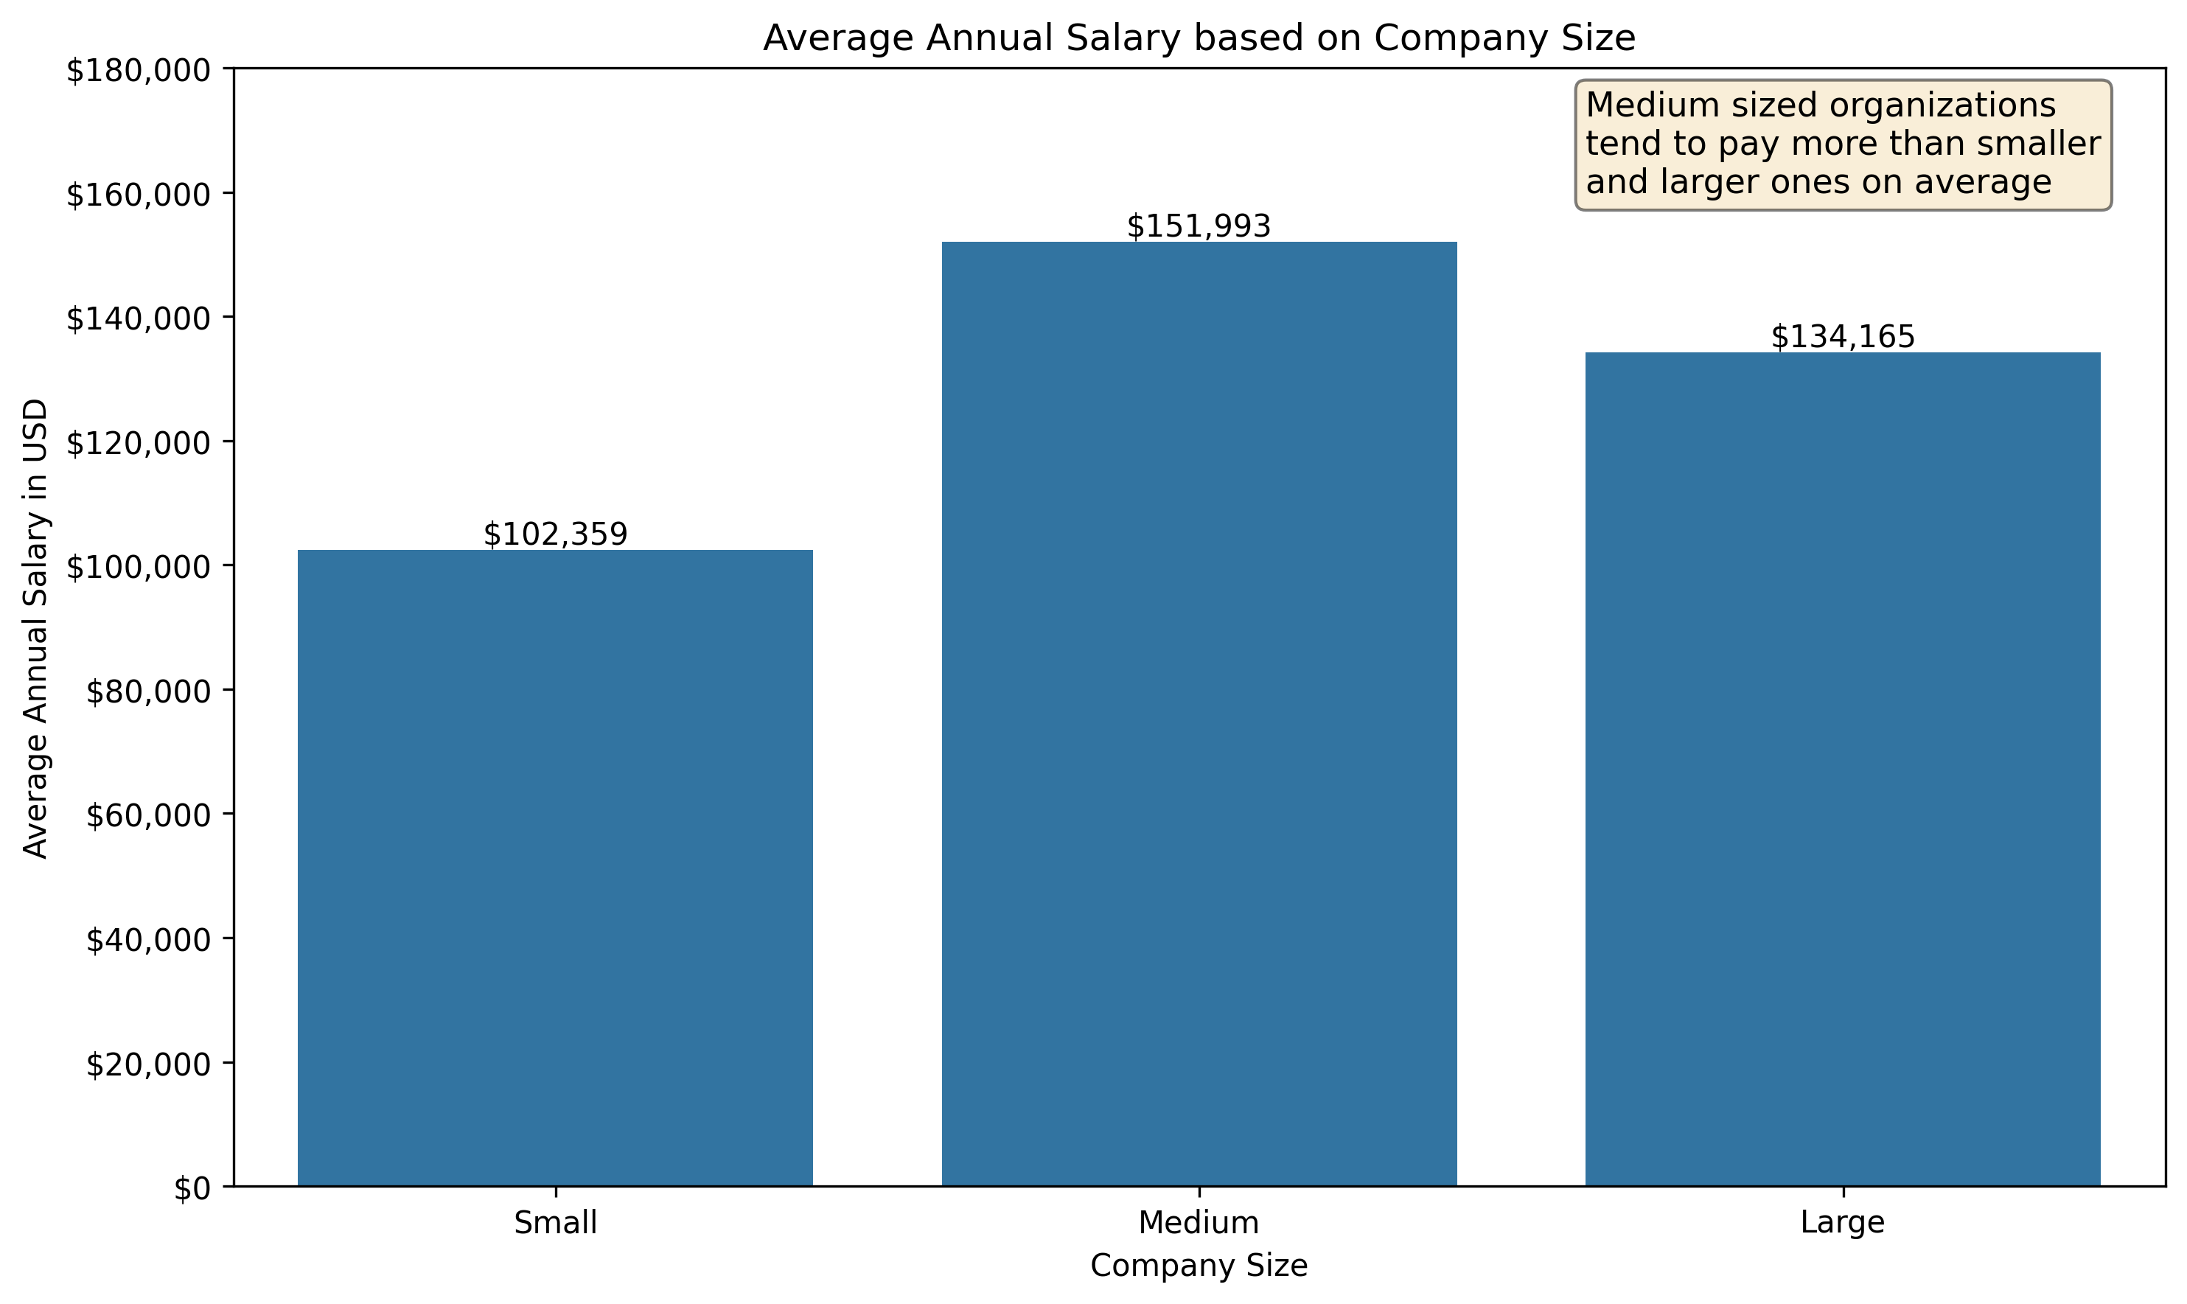
Average Salary by Company Size
Sorted the columns by company size instead of average income.
Medium sized companies have a larger annual salary in the data science and related fields
Since this data was taken from an informal survey, I am not sure of the criteria used to classified organizations by size.
I wanted to add an annotation but couldn't decide if I should include an arrow pointer or not

Slide 6
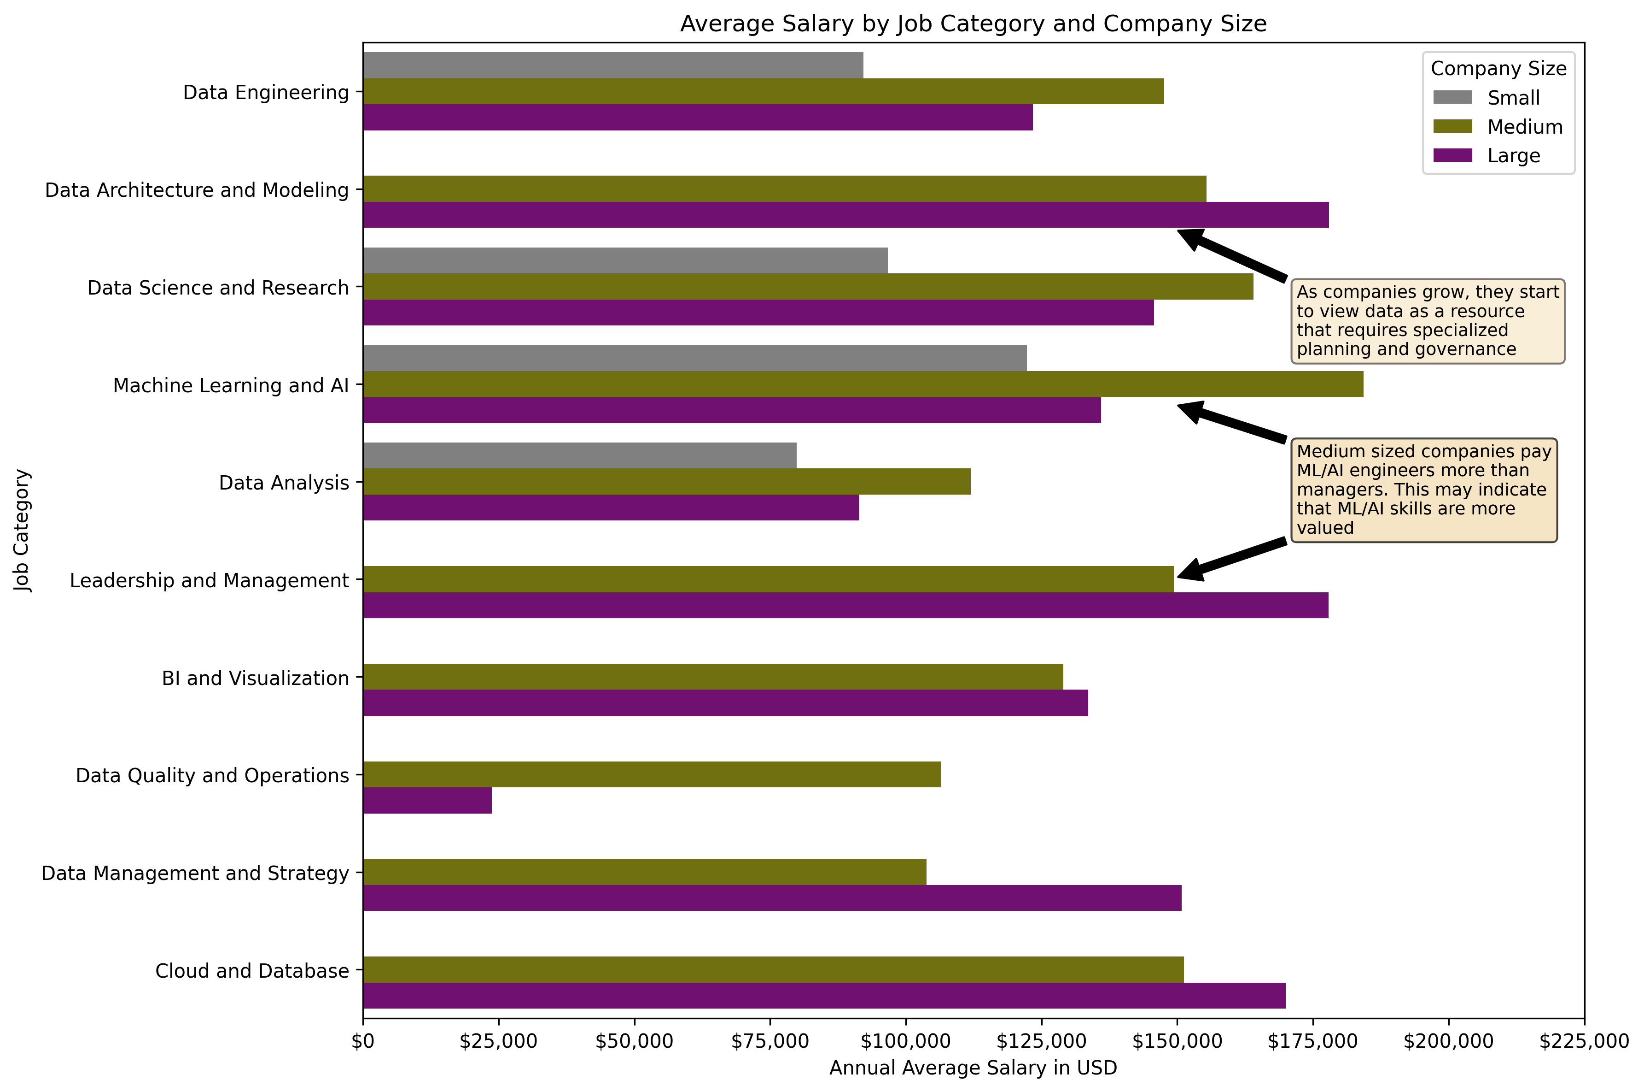
Average Salary by Job Category and Company Size
The grouped bar chart allows the audience to compare different job categories, salary, and company size
Pointed out some items on the chart that are interesting, like medium sized companies paying more for ML/AI engineers than management
Small firms often do not have the resources to hire specialized employees, and this is reflected in the chart

Slide 7
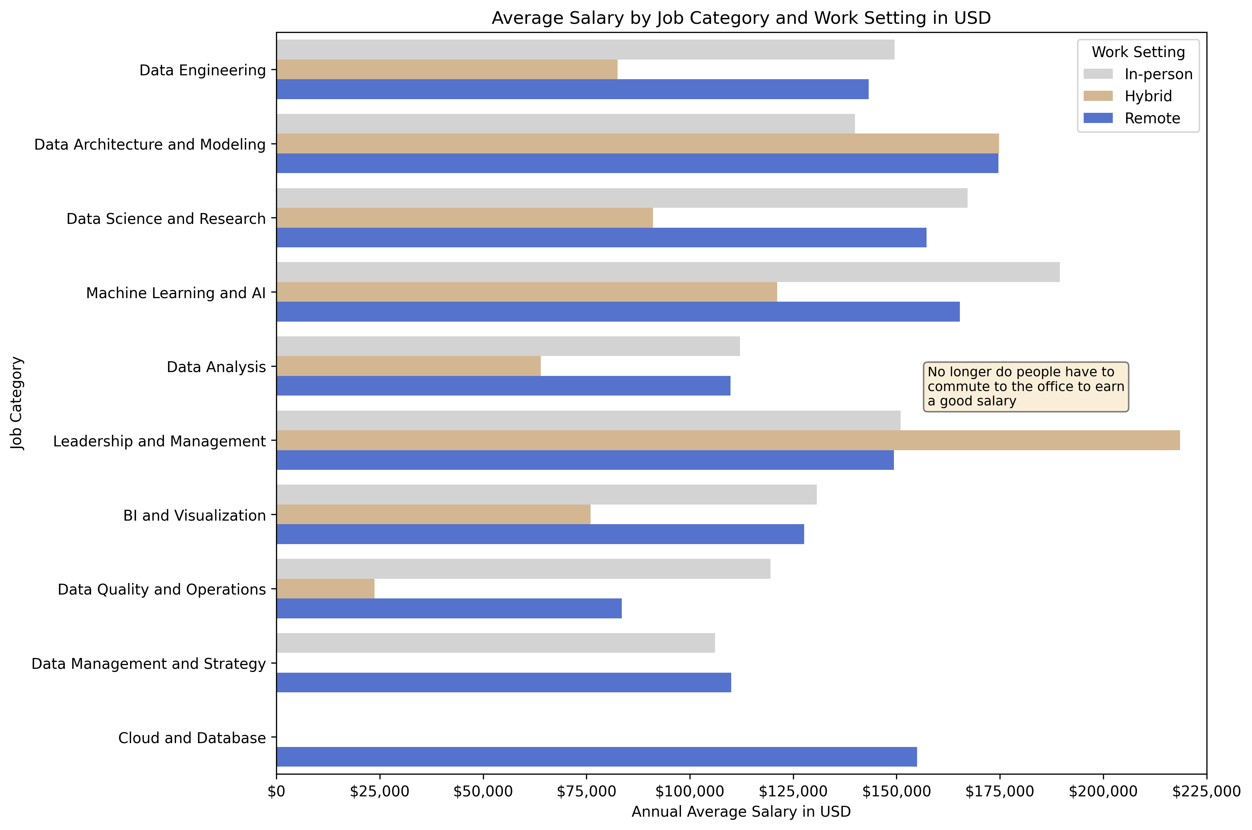
Average Salary by Job Category and Work Setting
This chart illustrates that going into the office everyday does not always pay the most.
Leadership and management having the highest average salary for hybrid work indicates that people can work effectively in a hybrid setting
Cloud and database having a high salary for remote work indicates this category of work can be done anyplace

Slide 8
Conclusions and Findings
In this dataset the United States has the highest average annual salary of the countries being compared
Company size does make a difference in annual salary with small and large companies lagging medium sized ones
Small companies do not hire as many specialized employees as medium and larger ones
People working in remote and hybrid settings can achieve salaries that rival people who go into the office everyday

Slide 9
Questions?

