Slide 1

Original Article Comprehensive, Integrative Genomic Analysis of Diffuse Lower-Grade Gliomas
The Cancer Genome Atlas Research Network
N Engl J Med
Volume 372(26):2481-2498
June 25, 2015

Slide 2
Study Overview
The Cancer Genome Atlas consortium analyzed 293 lower-grade gliomas obtained from adult patients.
The integration of genomic and clinical data shows that genetic status correlates better with biology and survival than does histologic status.

Slide 3
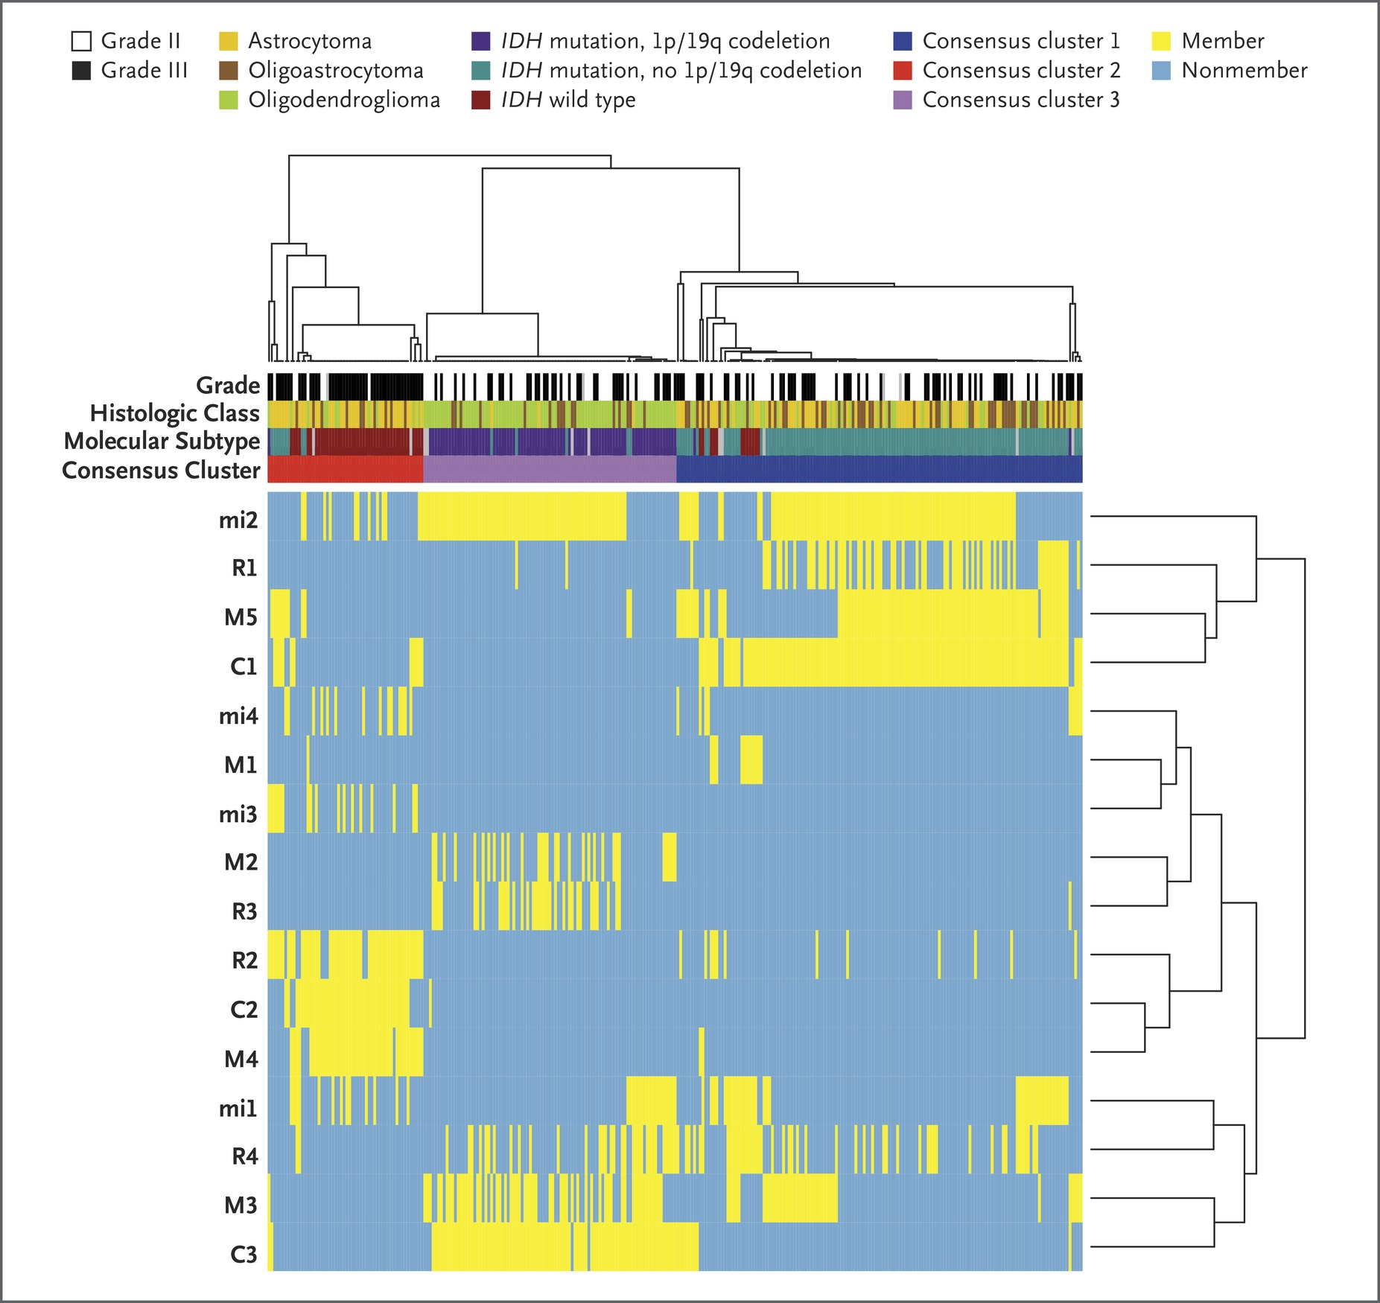
Cluster of Clusters (CoC) Analysis.
The Cancer Genome Atlas Research Network. N Engl J Med 2015;372:2481-2498
Notes:
Figure 1 Cluster of Clusters (CoC) Analysis. The results of multiplatform analyses point to biologic subtypes defined by IDH mutation and 1p/19q codeletion status. CoC analysis uses the cluster assignments derived from individual molecular platforms to stratify tumors, thereby integrating data from analysis of messenger RNA (mRNA) (designated by R on the y axis), microRNA (mi), DNA methylation (M), and copy number (C). For each sample, membership in a particular cluster is indicated by a yellow tick, and nonmembership is indicated by a blue tick. CoC analysis resulted in a strong three-class solution, and a comparison of tracks for CoC consensus cluster with tracks for histologic and molecular class shows a stronger correlation with molecular class.

Slide 4
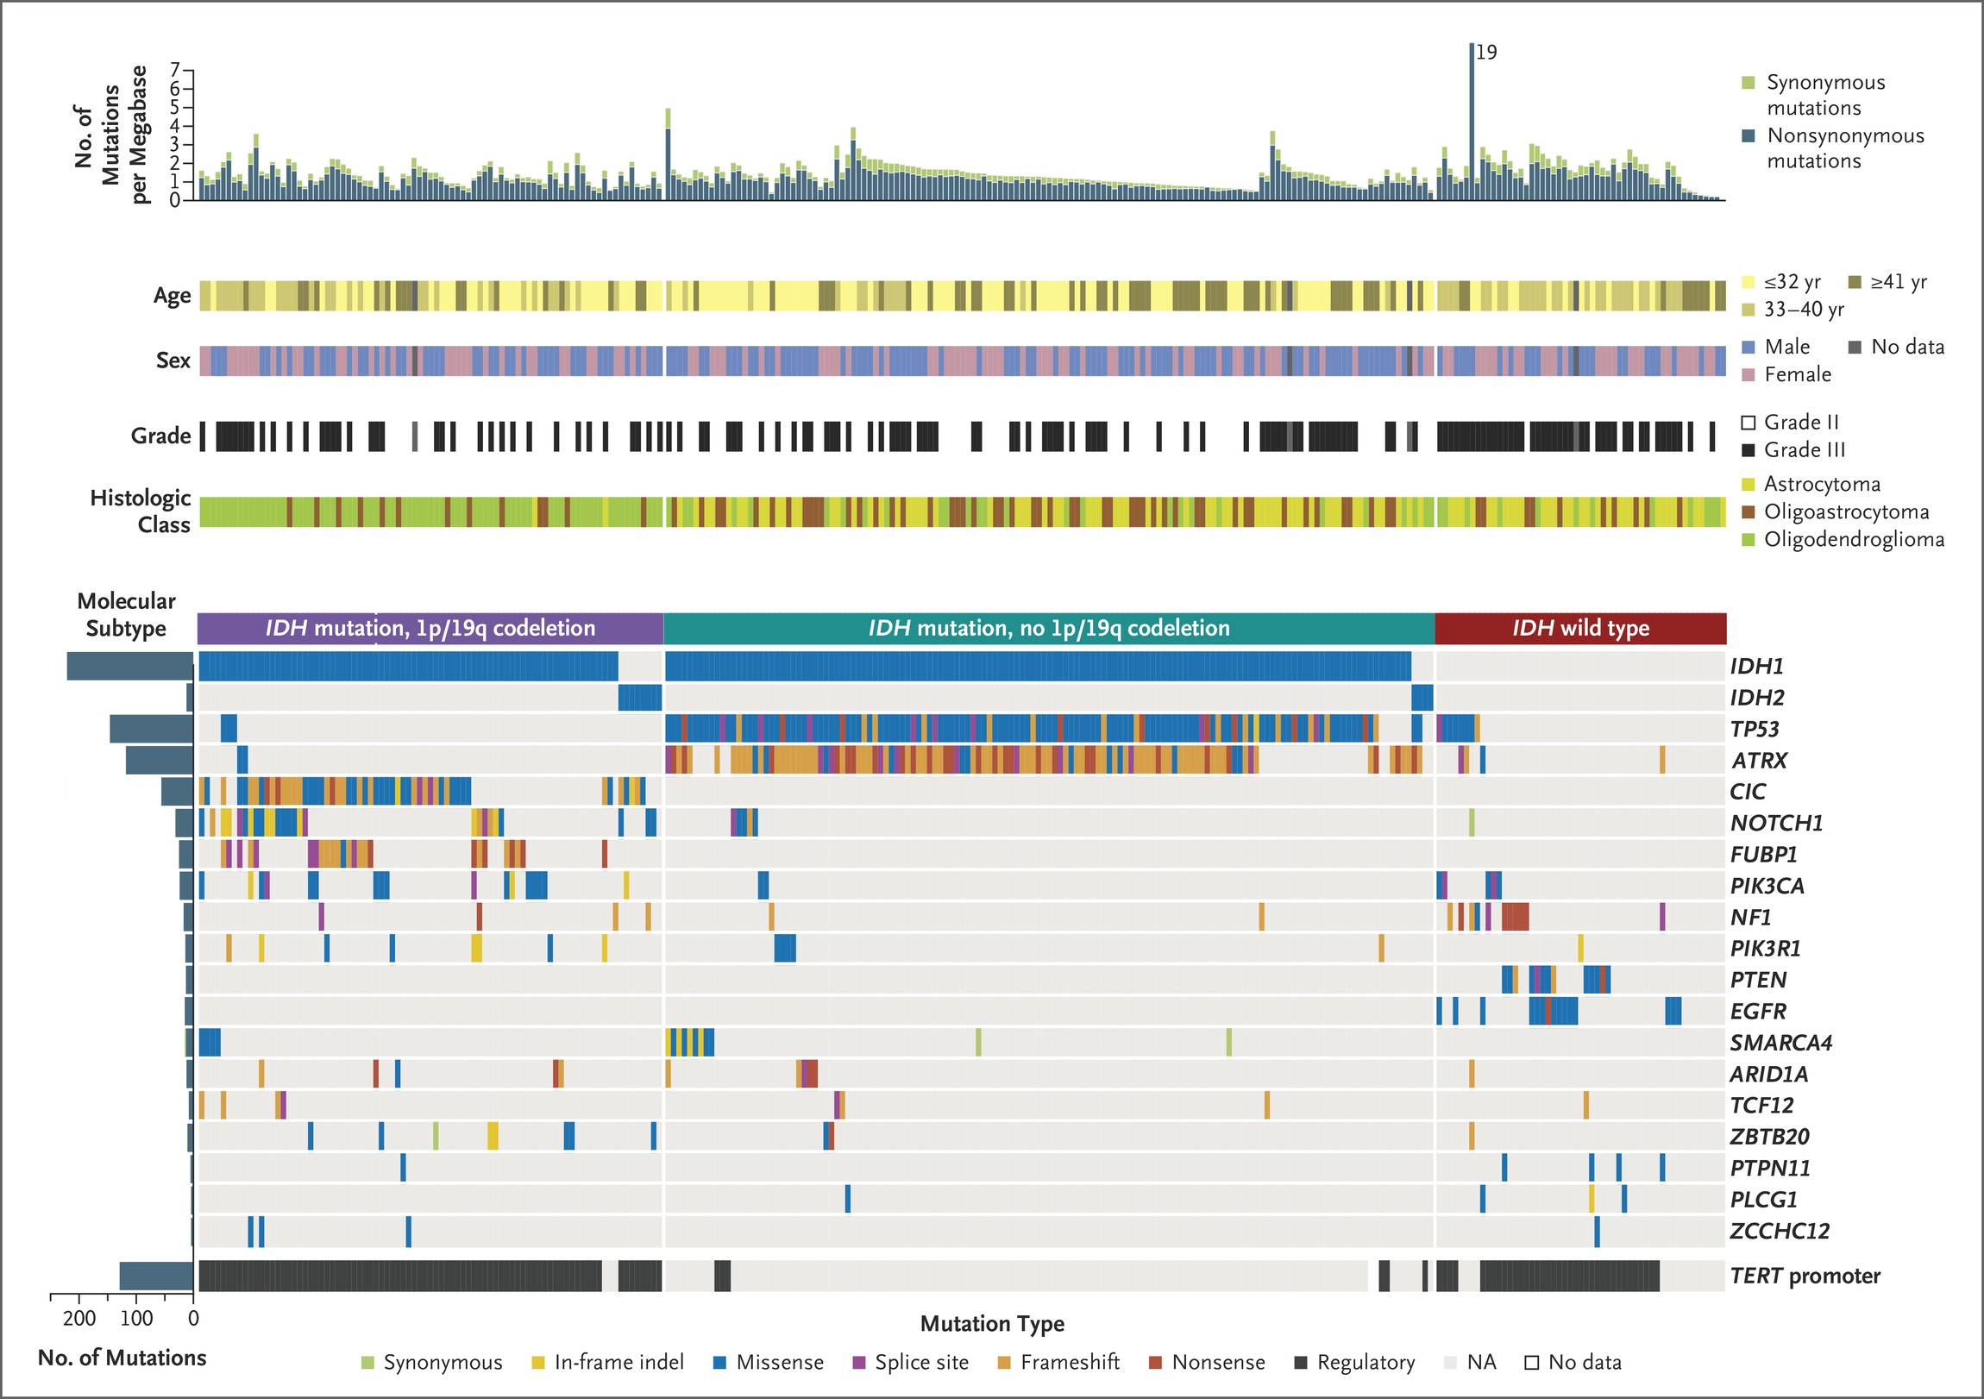
Mutational Landscape of Somatic Alterations in Lower-Grade Glioma.
The Cancer Genome Atlas Research Network. N Engl J Med 2015;372:2481-2498
Notes:
Figure 2 Mutational Landscape of Somatic Alterations in Lower-Grade Glioma. At the top of the figure, somatic mutation rates for each patient are stratified according to nonsynonymous (blue) and synonymous (green) mutations. In the middle portion of the figure, the clinical features associated with the patients are shown. At the bottom of the figure, genes that are significantly mutated (q value <0.1, determined with the use of the MutSig2CV algorithm) in lower-grade glioma are listed on the right. Samples from patients have been separated according to IDH mutation and 1p/19q codeletion status, with mutation types indicated in specific colors. NA denotes not applicable.

Slide 5
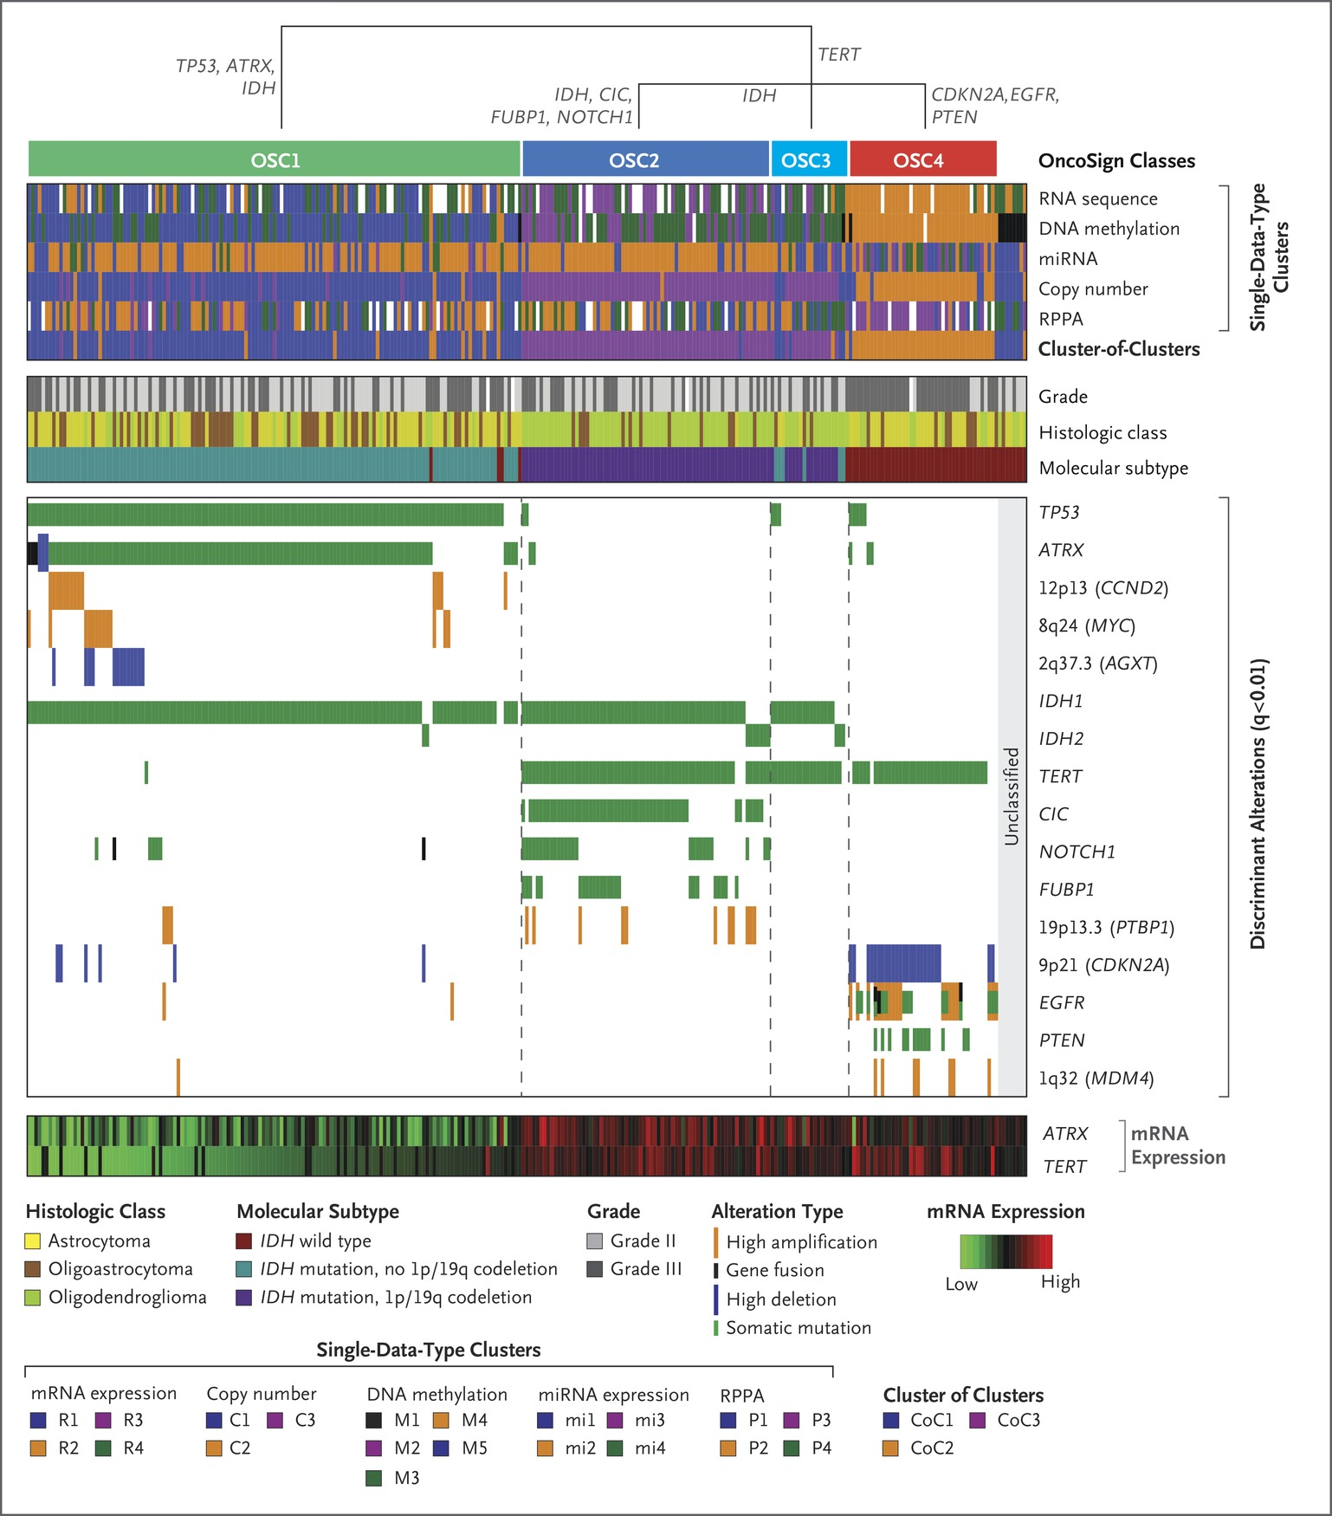
OncoSign Analysis.
The Cancer Genome Atlas Research Network. N Engl J Med 2015;372:2481-2498
Notes:
Figure 3 OncoSign Analysis. Four main classes (OncoSign classes [OSCs]) can be identified by means of unbiased clustering of tumors on the basis of recurrent copy-number alterations, mutations, and gene fusions. White indicates that no information was available. OSCs are largely consistent with the molecular subtypes identified on the basis of IDH mutation and 1p/19q codeletion status, and they also correlate with the results of single-platform analysis. Combinations of selected genomic events, termed oncogenic signatures, characterize each OSC. A small group of samples showed none of the recurrent events used in this analysis and were therefore categorized as unclassified. TERT promoter mutation and gene overexpression were found to be mutually exclusive with loss of ATRX and reduced gene expression, a finding consistent with the hypothesis that both alterations have a similar effect on telomere maintenance. The abbreviation miRNA denotes microRNA, and RPPA reverse-phase protein lysate array.

Slide 6
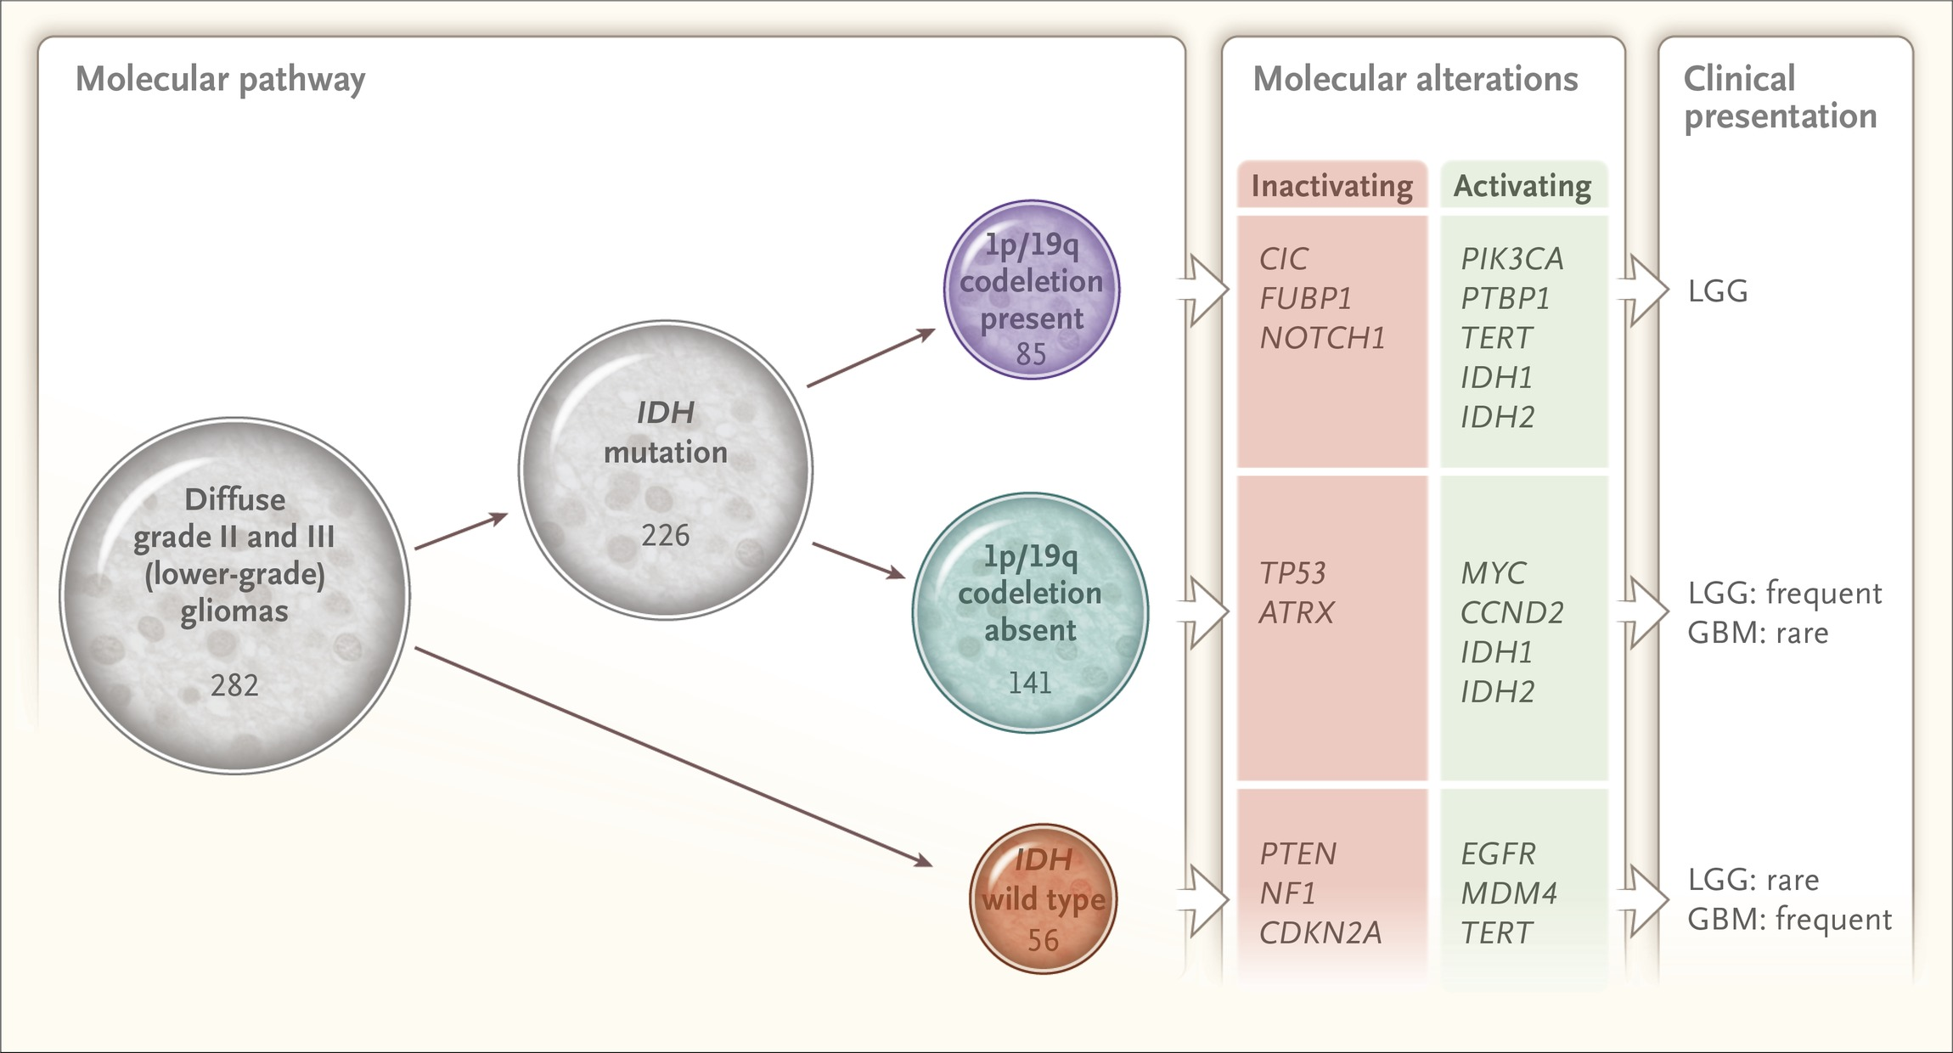
Summary of Major Findings.
The Cancer Genome Atlas Research Network. N Engl J Med 2015;372:2481-2498
Notes:
Figure 4 Summary of Major Findings. Shown is a schematic representation that summarizes the major molecular findings and conclusions of our study: consensus clustering yielded three robust groups that were strongly correlated with IDH mutation and 1p/19q codeletion status and had stereotypical and subtype-specific molecular alterations and distinct clinical presentations. GBM denotes glioblastoma, and LGG lower-grade glioma.

Slide 7
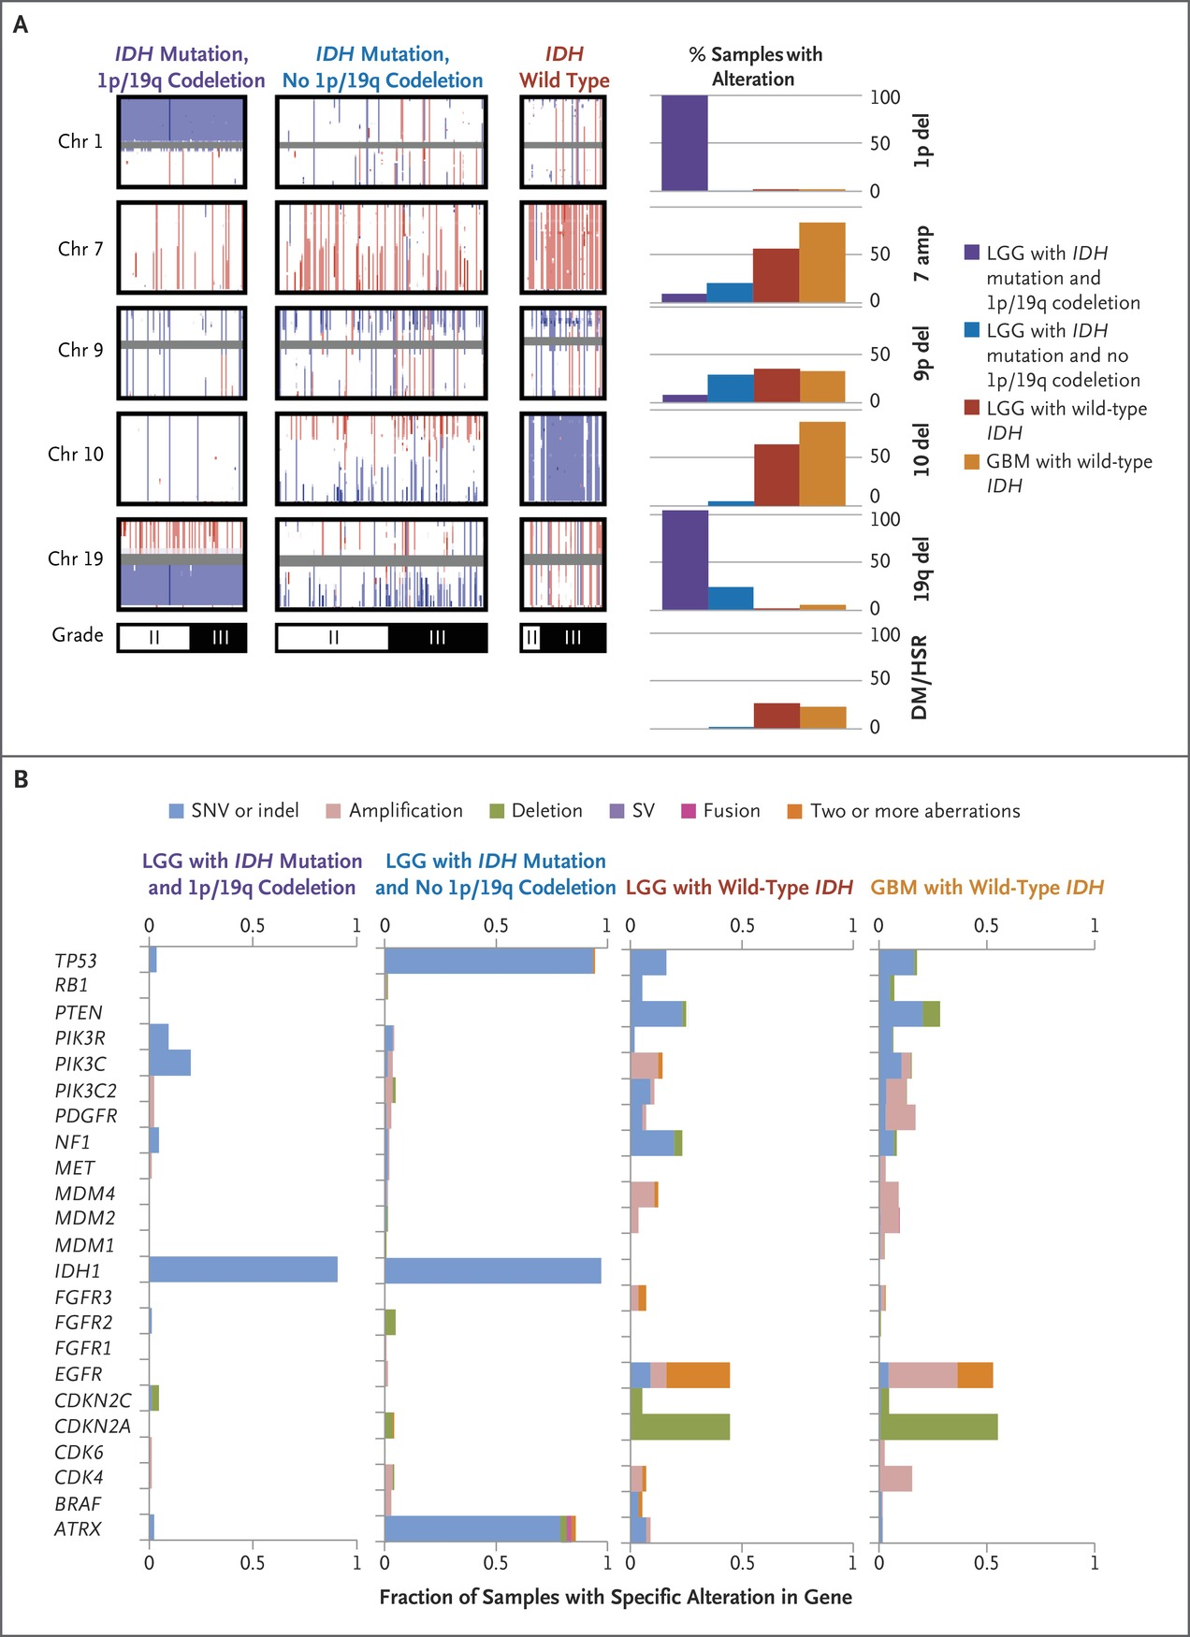
LGGs and GBMs with Wild-Type IDH.
The Cancer Genome Atlas Research Network. N Engl J Med 2015;372:2481-2498
Notes:
Figure 5 LGGs and GBMs with Wild-Type IDH. Panel A shows the frequency of large-scale copy-number alterations in specific molecular subtypes of LGG, which have been divided according to histologic grade. The University of California, Santa Cruz (UCSC), Cancer Genomics Browser33 () was used to visualize GISTIC thresholded copy-number calls across the indicated chromosomes. Each vertical line indicates the copy number for an individual sample, colored red (amplification), blue (deletion), or white (normal), at each genomic position. Percentages for the indicated copy-number alteration are shown in the bar graphs on the right. LGGs with wild-type IDH had frequencies of gains and losses similar to those of GBMs with wild-type IDH (from previously published Cancer Genome Atlas data22) and were distinct from LGGs with mutated IDH. DM/HSR denotes double-minute chromosomes or homogeneously staining regions. Panel B shows the frequencies in the indicated LGG molecular subtypes of mutational events that are commonly found in GBM with wild-type IDH, including LGGs with IDH mutation and 1p/19q codeletion (85 samples), IDH mutation and no codeletion (141), and wild-type IDH (56). SNV denotes single-nucleotide variant, and SV structural variant. Differences in mutational frequency according to tumor grade are shown in Fig. S21 in Supplementary Appendix 1.

Slide 8
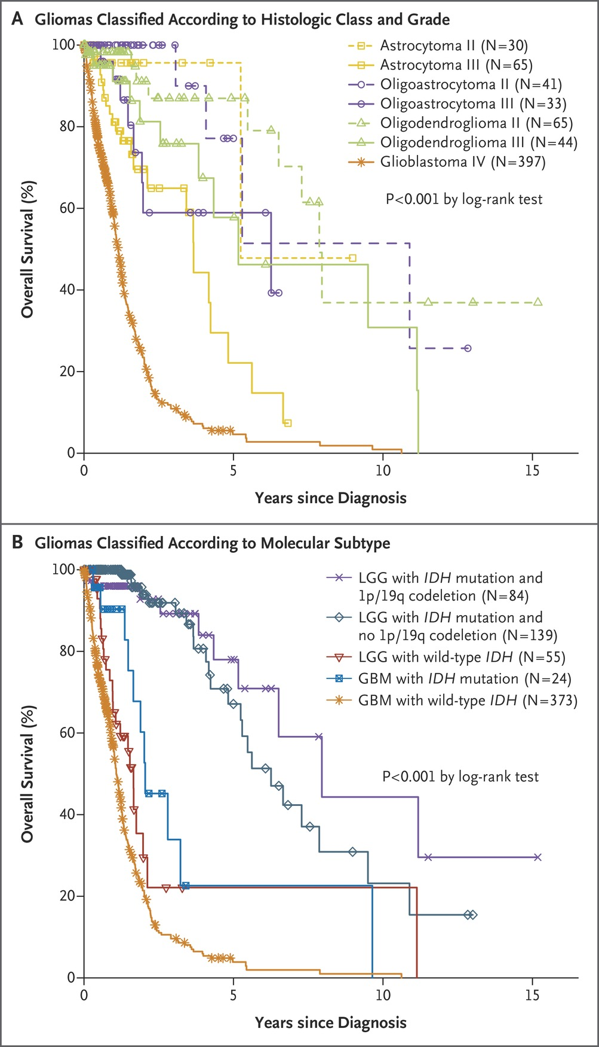
Clinical Outcomes.
The Cancer Genome Atlas Research Network. N Engl J Med 2015;372:2481-2498
Notes:
Figure 6 Clinical Outcomes. Panel A shows Kaplan–Meier estimates of overall survival among patients with LGGs that are classified according to traditional histologic type and grade. GBM samples (from previously published Cancer Genome Atlas data22) are also included for comparison. Panel B shows overall survival among patients with LGGs that are classified according to IDH mutation and 1p/19q codeletion status. GBM samples classified according to IDH mutation status are also included. The results of an age-adjusted analysis are provided in Table S2 in Supplementary Appendix 1, and further division according to histologic type, grade, and molecular subtype is shown in Fig. S22 in Supplementary Appendix 1.

Slide 9
The Cancer Genome Atlas Research Network. N Engl J Med 2015;372:2481-2498

Slide 10
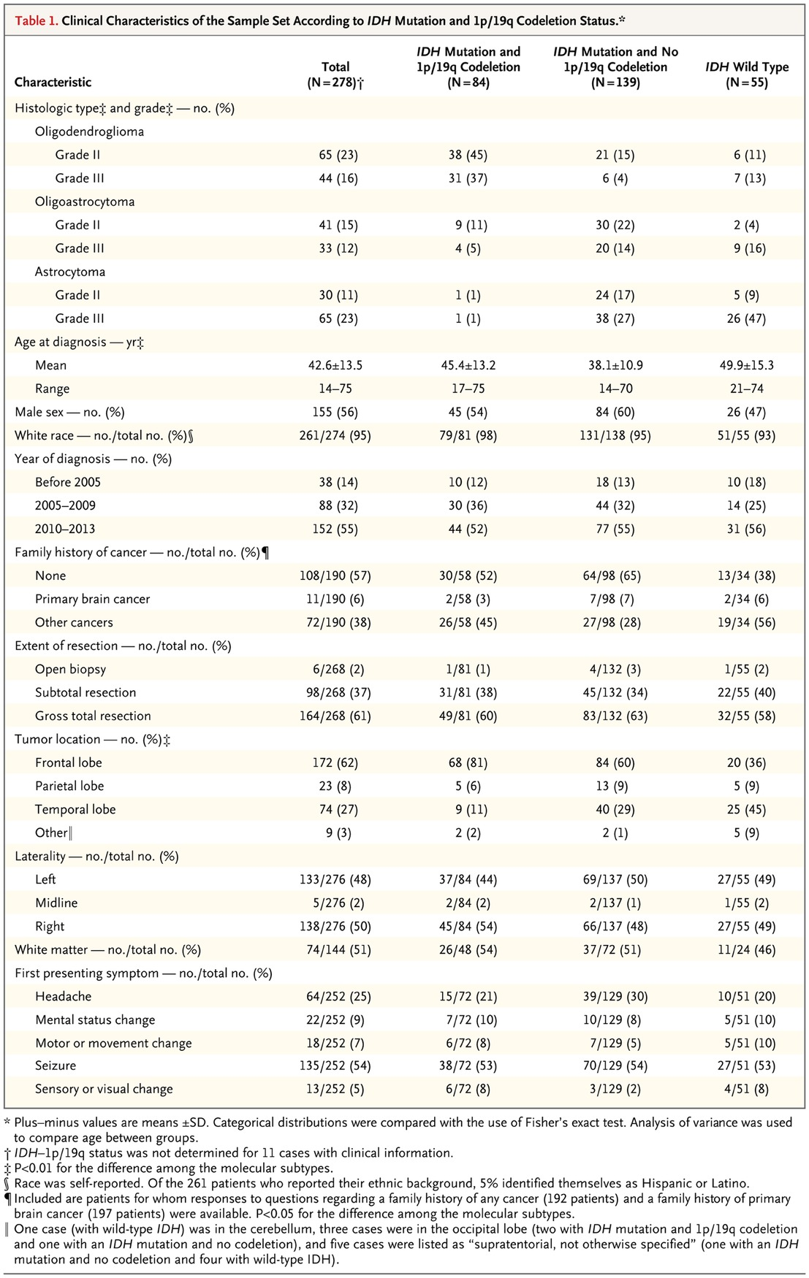
Clinical Characteristics of the Sample Set According to IDH Mutation and 1p/19q Codeletion Status.
The Cancer Genome Atlas Research Network. N Engl J Med 2015;372:2481-2498
Notes:
Table 1 Clinical Characteristics of the Sample Set According to IDH Mutation and 1p/19q Codeletion Status.

Slide 11
Conclusions
The integration of genomewide data from multiple platforms delineated three molecular classes of lower-grade gliomas that were more concordant with IDH, 1p/19q, and TP53 status than with histologic class.
Lower-grade gliomas with an IDH mutation either had 1p/19q codeletion or carried a TP53 mutation.
Most lower-grade gliomas without an IDH mutation were molecularly and clinically similar to glioblastoma.

