Slide 1

Week 6 Discussion Feature Engineering Algorithm Bias in Judicial Decision Support Systems
Wiley Winters
MSDS 640 Ethics, Privacy, and Social Justice in Data Science
2025-Aug-06

Slide 2
Introduction
Used KFold and Negative Mean Squared Error (NMSE) to select best model for predicting two-year recidivism.
Models evaluated include Logistic Regression, Kenel SVM, and Random Forest Classifier
The Random Forest Classifier (RFC) had the lowest NMSE score of approximately 0.01
Performed additional measures on the RFC model and it does very well at predicting true positives

Slide 3
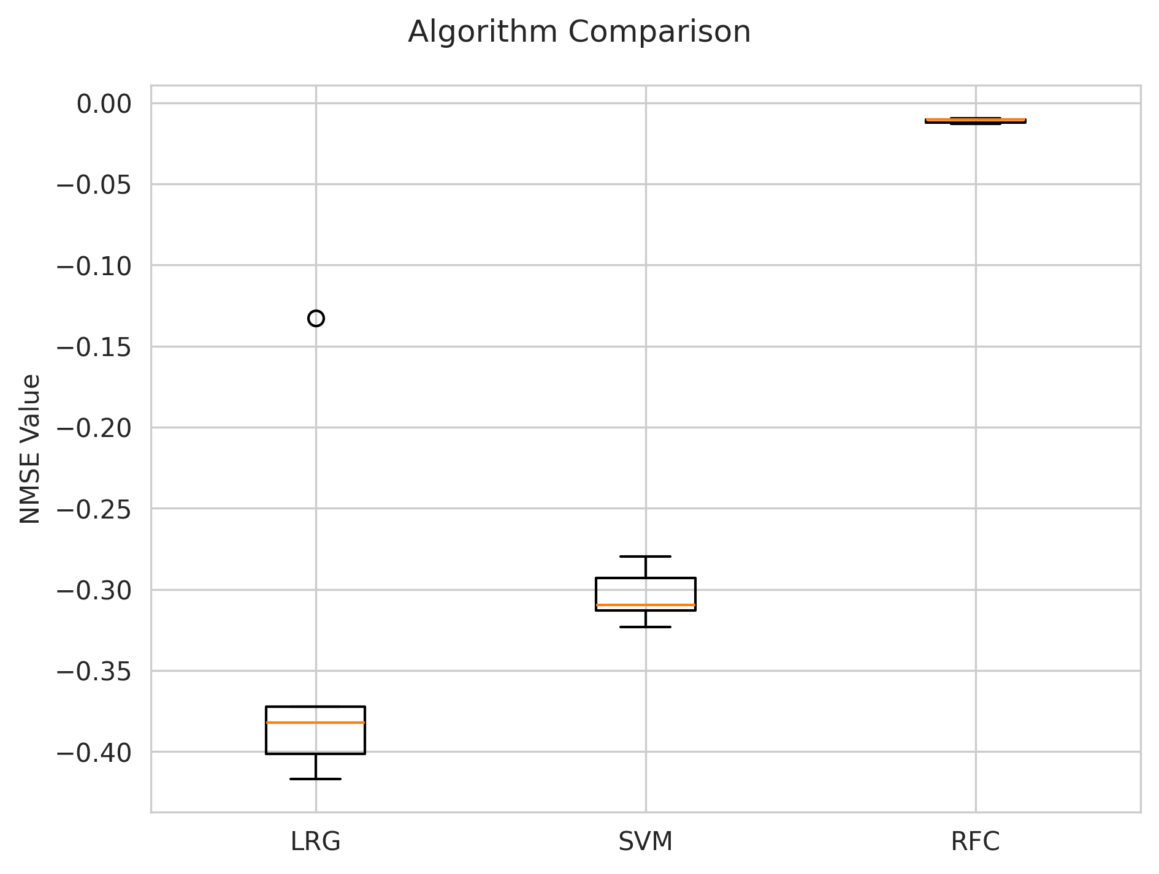
KFold Evaluation
The RFC model’s NMSE score was the closest to zero of the models evaluated
However, all three models performed very well on predicting true positives

Slide 4
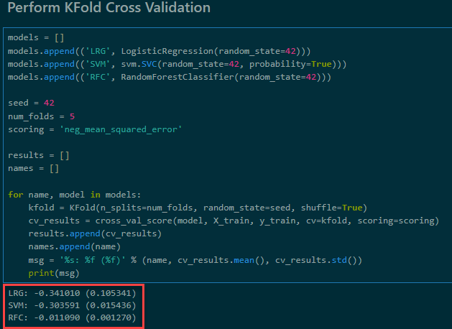
KFold Cross Validation Results
With the KFold cross validation and NMSE scoring the model with the score closest to zero is the best preforming predictor
The RFC model with its NMSE score of 0.001270 is the closest to zero

Slide 5
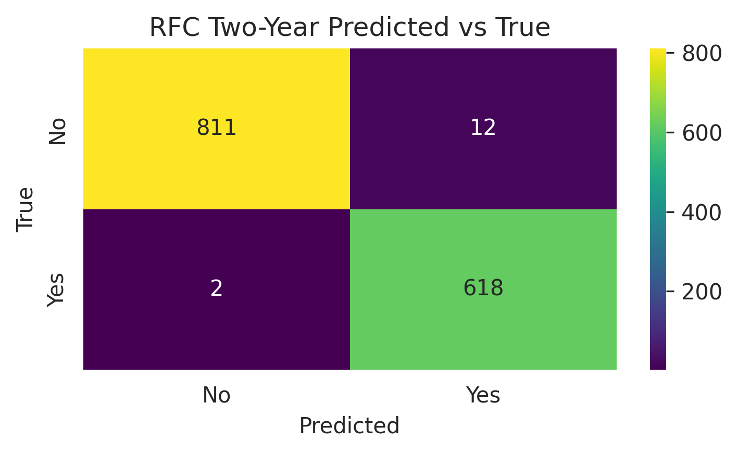
RFC Confusion Matrix
The RFC model performed well with predicting true positives
True Positive Rate (TPR) is 1.0 or 100%
False Positive Rate (FPR) is 0.01 which is low
Since the FPR is significantly lower than the TPR, I can conclude the RFC is not stuck on predicting positive values and the 100% TPR is not a concern

Slide 6
Future Work
Analysis and model training/testing is concluded
Put finishing touches on report
Create presentation
Fork repository and submit files

Slide 7
Questions

