Slide 1

Post-Treatment Brain Tumor Segmentation using MONAI SegResNet Model
Author: Wiley Winters
Date: 2026-03-08
Class: MSDS 692 – Data Science Practicum 1

Slide 2
Introduction and Problem Statement
Many studies have been conducted on diagnosing brain tumors using various methods. Not many have been conducted on post-treatment follow up images.
The likelihood of tumor regrowth increases significantly if it is not completely removed; therefore, accurately determining if a tumor has been completely removed is critical for developing the rest of the patient’s treatment plan
This study will train a MONAI SegResNet model using a BraTS-style MR Image dataset to preform brain tumor segmentation. After training, the model will be used to segment a post-treatment brain tumor dataset from the Cancer Imaging Archive

Slide 3
Background Information
In this part of the presentation I will provide background information on the following:
What is segmentation
Examples of segmentation
Example of how segmentation can identify core tumor tissue
Information about the different modalities used in MR Images

Slide 4
What is Segmentation
When segmentation is applied to a brain tumor MR Image it identifies the boundaries of the tumor regions within the brain scan
These boundaries are divided into masks and assigned a label
Label 0 – normal brain tissue (non-tumor/background)
Label 1 – necrotic/non-enhancing tumor core (NCR/NET)
Label 2 – edema (ED)
Label 3 – is not used to avoid confusion with binary encoders
Label 4 – enhancing tumor (ET)

Slide 5
What Segmentation Provides
Segmentation provides the following:
Location: Identifies exact location of the brain tumor
Size and Shape: Measures the tumor’s dimensions and form
Heterogeneity: Reveals different components within the tumor (e.g. solid tissue, necrotic areas)
Surrounding Tissue Involvement: Shows how the tumor interacts with adjacent brain structures
Cross-Modality Comparison: Provides a comprehensive view by comparing different imaging modalities

Slide 6
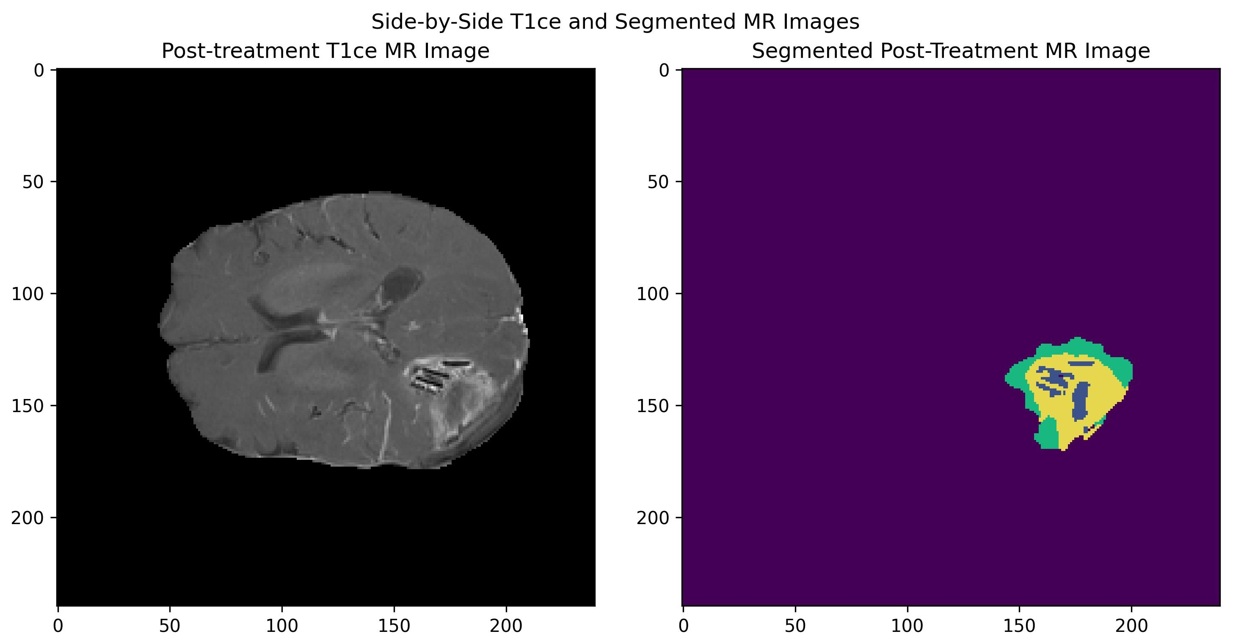
Visualization of Brain Tumor Segmentation
Left image is an MRI slice with contrast agent (T1ce)
Right image is the same slice with segmentation applied.
The large purple area is normal brain tissue
Non-enhanced tumor core (NET) is in blue
Yellow is necrotic tissue and interruptions to the brain-blood barrier
Green is edema (swelling)
Image is from post-treatment dataset
Notes:
The core tumor is actually part of the non-enhancing region of the segmentation.
Without segmentation it may have been missed or incorrectly diagnosed

Slide 7
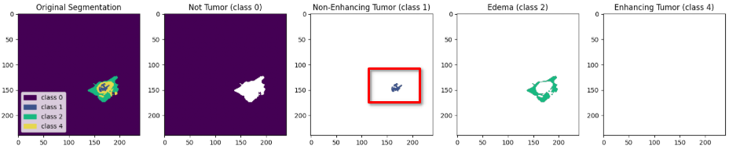
Brain Tumor Segmentation by Label
By separating the labels, it becomes easier to identify the tumor’s core and edema (swelling)
In the example below, I have separated out the Labels into their own plots. This makes it easier to identify the residual brain tumor tissue
The red box outlines the residual (non-enhancing) tumor material
Notes:
The non-enhancing tumor tissue is in blue
Yellow indicates necrotic tissue or disruptions in the brain-blood barrier (BBB)
I am not sure why Enhancing Tumor class 4 is not displaying correctly in its plot
Green is edema or swelling

Slide 8
MR Imaging Modalities Used in Segmentation
MRI segmentation is preformed by comparing the results of different MRI sequences (modalities)
SEQUENCE | KEY USE
T1w (Native) | Reveals the structure and composition of various tissue types in the brain
T1ce post-contrast | Similar to T1, but enhanced with a contrast agent which improves the visibility of abnormalities
T2w | This modality highlights the fluid content within brain tissue
FLAIR (T2f) | Suppresses the fluid signals, making it easier to identify lesions (tumors) that may not be visible on T1 or T2 images

Slide 9
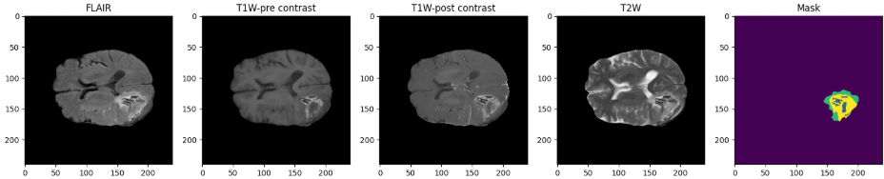
Examples of the Modalities and Mask
These images are of the same patient post-treatment for a glioma brain tumor. All of the modalities are summarized in the Mask (segmentation)

Slide 10
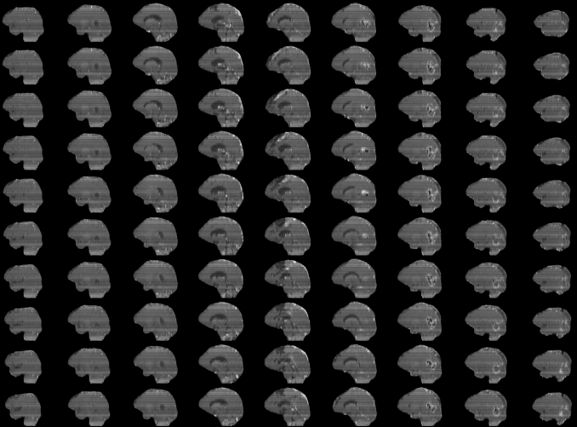
Dataset and Data Preparation
The training data was obtained from the Medical Segmentation Decathlon (MSD) and is a subset of the BraTS 2016-2017 datasets
This dataset is comprised of 4 structural modalities (T1, T1ce, T2, and T2-FLAIR)
Consists of 750 multi-parametric MR brain scans from patients with glioblatoma (GBM) or lower-grade glioma (LGG)
All samples were skull-stripped using various methods and normalized by the MSD organization
Notes:
Clinical-grate MR Image data is available in two file formats
NifTI (Neuroimaging Informatics Technology Initative) widely used for storing medical and neuroimaging data especially 3D brain images such as MRI and CT scans
DICOM (Digital Imaging and Communications in Medicine) is an international standard for storing, exchanging and transmitting medical imaging and related information

Slide 11
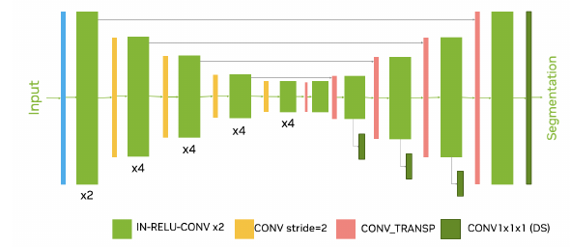
Model Selection
The Medical Open Network for Artificial Intelligence (MONAI)’s SegResNet model was chosen for the following reasons:
It is a residual encoder/decoder CNN designed specifically for 2D/3D medical segmentation
Uses less GPU resources than a transformer-style model making it a good fit for training with consumer grade GPUs
Is a top performer in challenges like BraTS
Is part of the vast MONAI ecosystem
Uses the u-net architecture as its core building block

Slide 12
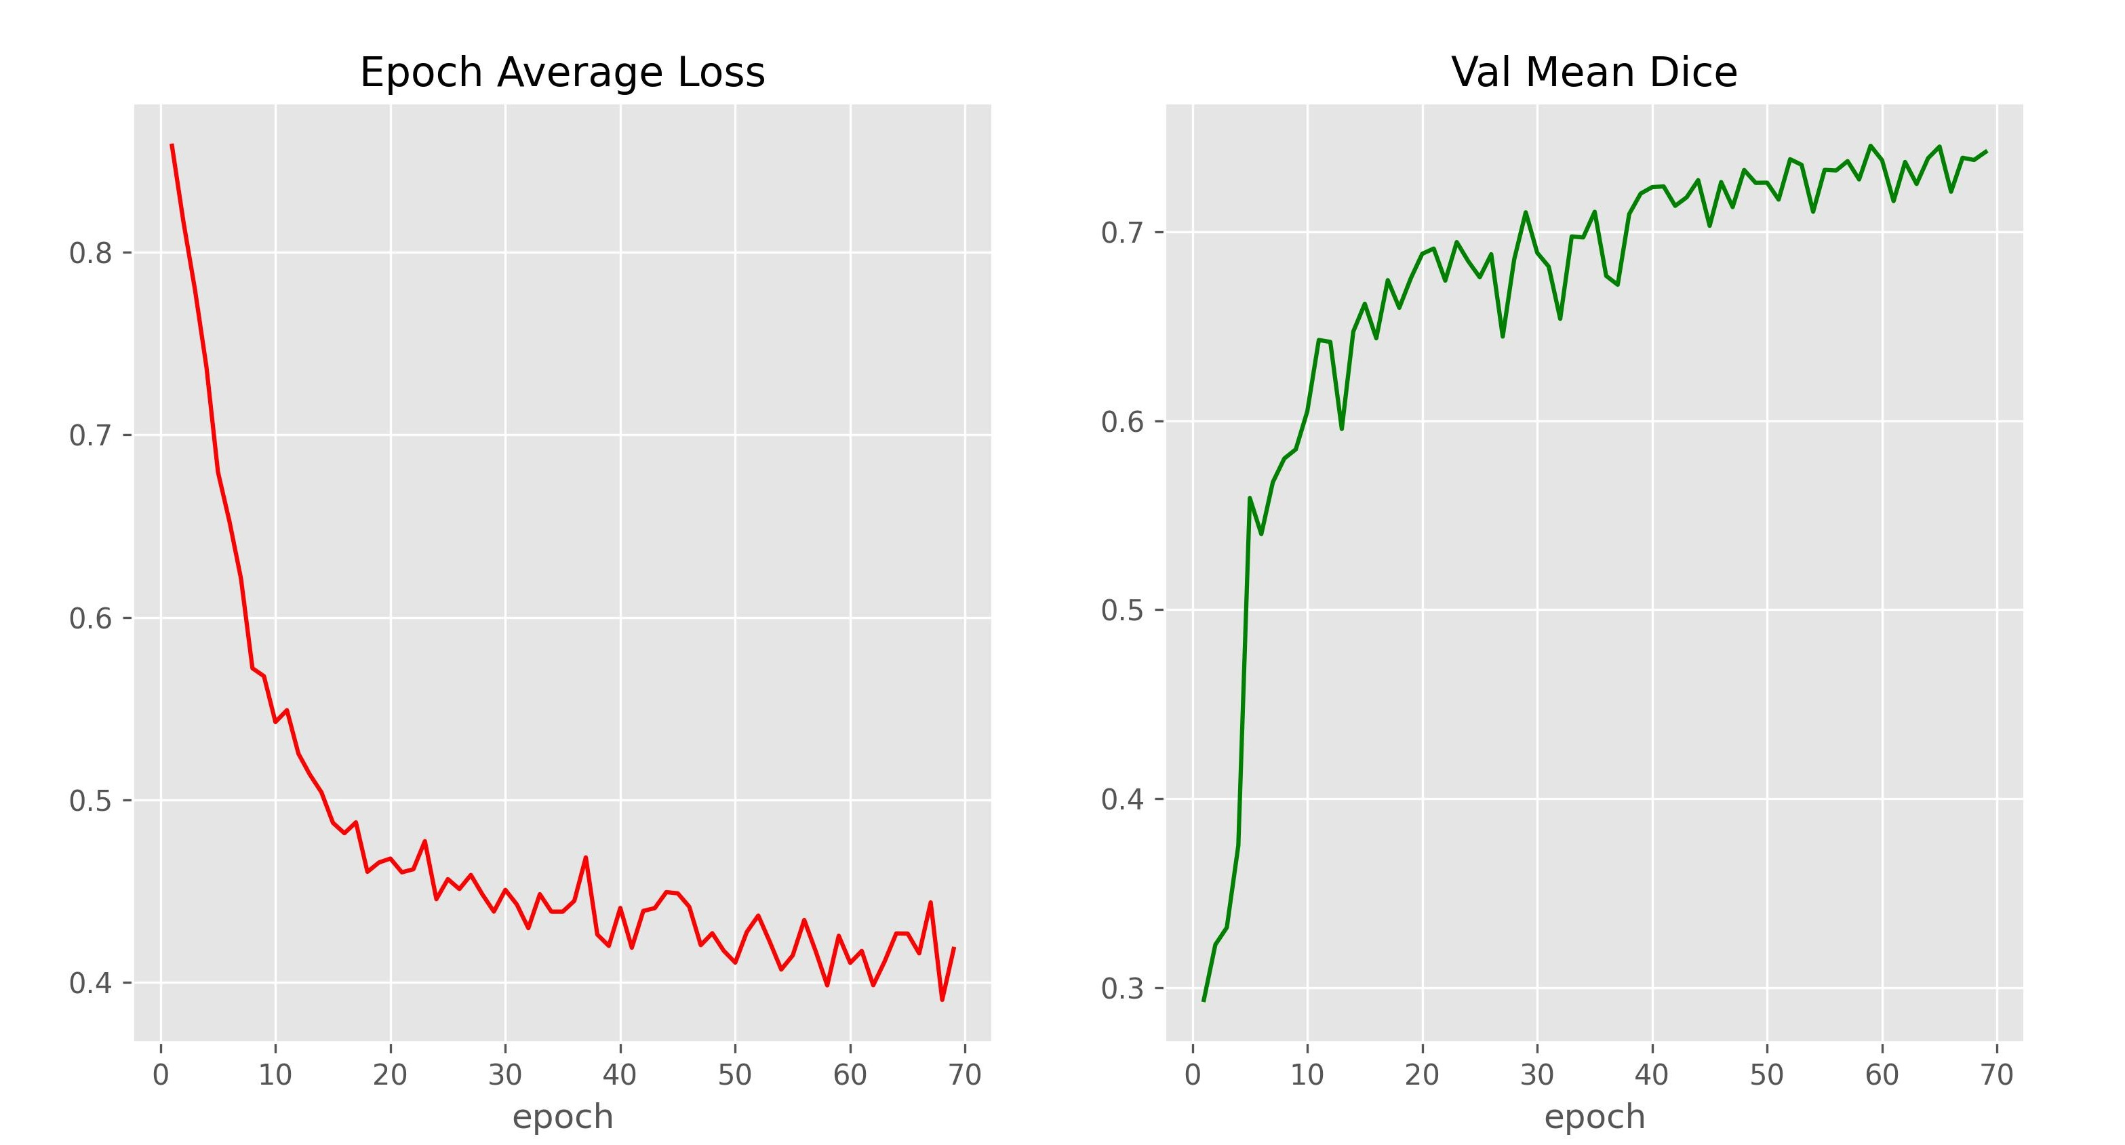
Evaluating Training/Validation Performance
Evaluating the performance of segmentation models is slightly different from binary and multi-class CNNs
Validation loss per epoch is still used, but accuracy is replaced with validation mean dice score, which quantifies the average overlap between the model’s predicted segmentation masks and the ground-truth (human-annotated) labels across all classes and validation samples (values range from 0 to 1).
For this training run the average loss was 0.42 and mean Dice score 0.74

Slide 13
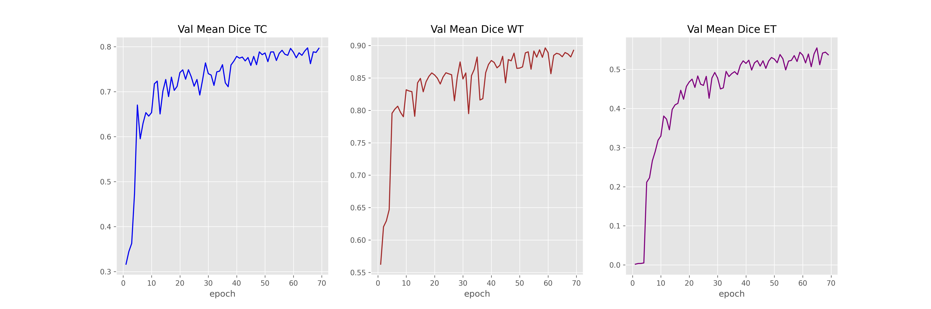
Mean Dice Score Per Region
Further evaluation can be conducted by examining the Mean Dice Score for the labels of interest. The plots below illustrate the model performs best when segmenting the whole tumor (WT) and worse on enhancing tumor (ET). The closer to 1.0 the Dice score gets to, the better the segmentation prediction is.

Slide 14
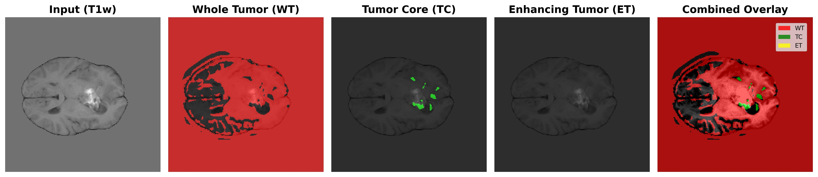
Inference Results
An image was randomly selected from a post-treatment glioma patient dataset, the best training weights were loaded and inference was preformed on four separate channels.
Results were acceptable and more tuning will have to be completed
METRIC | VALUE
Mean Dice Score | 0.49
TC mean Dice Score | 0.62
WT mean Dice Score | 0.73
ET mean Dice Score | 0.12
Notes:
Images used in inference were raw NifTI files without any pre-processing

Slide 15
Conclusions
Traditional CNN classifiers trained on pre-treatment brain tumor MR Images are not able to accurately classify post-treatment images and segmentation methods should be used
Performing segmentation on post-treatment MR Images can aid in identifying healthy brain tissue, core tumor residue, abnormalities to the blood-train barrier (BBB), and edema.
Modern segmentation models based on the U-Net architecture are the standard for segmentation of multi-modal MR data
International segmentation competitions have provided a platform for citizen data scientist, researchers, and organizations to create and learn segmentation techniques
From these competitions there has been a handful of self-supervised learning models developed and made publicly available. More research should be conducted in this domain

Slide 16
Challenges Encountered
Challenges | Solutions
Attempted to use a pre-trained binary CNN classifier to classify post-treatment brain tumor MRI images. Classifier could not determine if resection cavity was a tumor or not | Further research indicated this approach was not feasible and many researchers used a encoder/decoder method to preform brain tumor segmentation. Modified my study to follow this path
Using cutting-edge models proved to be problematic. Use of pre-trained models from MONAI often broke existing Python Packages | Worked around broken packages by paying extra attention to versions. Used different packages when possible
File path inconsistencies between datasets | Created custom data loaders for each dataset

Slide 17
Questions
?

