Slide 1

Post-Treatment Brain Tumor Segmentation using MONAI SegResNet Model
Author: Wiley Winters
Date: 2026-02-25
Class: MSDS 692 – Data Science Practicum 1

Slide 2
Introduction and Problem Statement
Many studies have been conducted on diagnosing brain tumors using various methods. Not many have been conducted on post-treatment follow up images.
The likelihood of tumor regrowth increases significantly if it is not completely removed; therefore, accurately determining if a tumor has been completely removed is critical for developing the rest of the patient’s treatment plan
This study will train a MONAI SegResNet model using datasets from the BraTS (Brain Tumor Segmentation) challenge sponsored by the Center for Biomedical Image Computing and Analytics. After training the model will be used on a post-treatment dataset to preform segmentation

Slide 3
Background Information
In this part of the presentation I will provide background information on the following:
What is segmentation
Examples of segmentation
Example of how segmentation can identify core tumor tissue
Information about the different modalities used in MR images

Slide 4
What is Segmentation
When segmentation is applied to a brain tumor MR Image it identifies the boundaries of the tumor regions within the brain scan
These boundaries are divided into masks and assigned a label
Label 0 – normal brain tissue (non-tumor/background)
Label 1 – necrotic/non-enhancing tumor core
Label 2 – edema (ED)
Label 3 – is not used to avoid confusion with binary encoders
Label 4 – enhancing tumor (ET)

Slide 5
What Segmentation Provides
Segmentation provides the following:
Location: Identifies exact location of the brain tumor
Size and Shape: Measures the tumor’s dimensions and form
Heterogeneity: Reveals different components within the tumor (e.g. solid tissue, necrotic areas)
Surrounding Tissue Involvement: Shows how the tumor interacts with adjacent brain structures
Cross-Modality Comparison: Provides a comprehensive view by comparing different imaging modalities

Slide 6
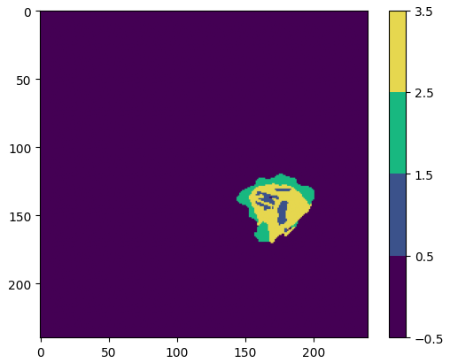
Visualization of Brain Tumor Segmentation
Raw visualization segmentation
The regions are color coded for easy of interpretation
Label 0 (normal) is the largest region
Tumor is identified in blue and yellow
Green is edema (swelling)

Slide 7
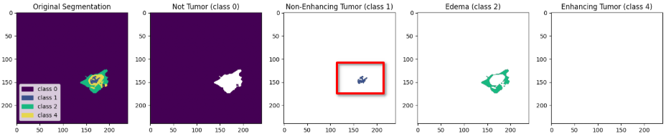
Brain Tumor Segmentation by Label
By separating the labels, it becomes easier to identify the tumor’s core and edema (swelling)
In the example below, I have separated out the Labels into their own plots. This makes it easier to identify the residual brain tumor tissue
The red box outlines the residual tumor tissue

Slide 8
MR Imaging Modalities Used in Segmentation
MRI segmentation is preformed by comparing the results of different MRI sequences (modalities)
SEQUENCE | KEY USE
T1 (Native) | Reveals the structure and composition of various tissue types in the brain
T1ce post-contrast | Similar to T1, but enhanced with a contrast agent which improves the visibility of abnormalities
T2 | This modality highlights the fluid content within brain tissue
FLAIR (T2F) | Suppresses the fluid signals, making it easier to identify lesions (tumors) that may not be visible on T1 or T2 images

Slide 9
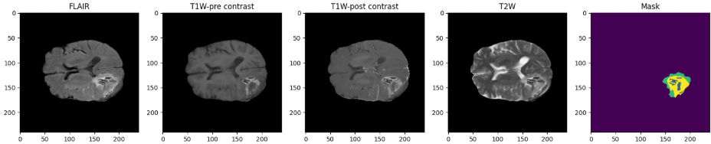
Examples of the Modalities and Mask
These images are of the same patient post-treatment for a glioma brain tumor. All of the modalities are summarized in the Mask (segmentation)

Slide 10
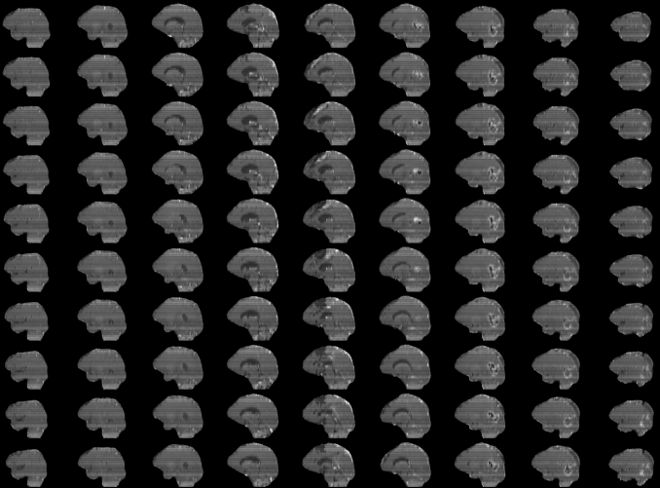
Dataset and Data Preparation
MRI NifTI volumes used for training are from the BraTS2021 dataset
This dataset is comprised of 4 structural modalities (T1, T1c, T2, and T2-FLAIR)
BraTS dataset is a collection of MRI scans of 1,480 patients acquired from multiple institutions under standard clinical conditions
Dataset are already prepared for training or inference. Images are loaded from the NifTI files and divided into four channels (i.e. T1, T1c, T2, T2F)

Slide 11
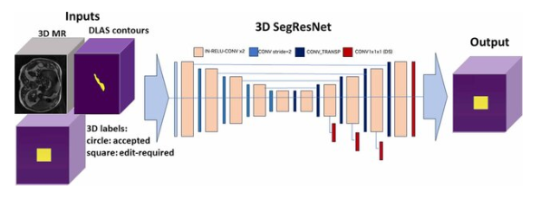
Model Selection
The Medical Open Network for Artificial Intelligence (MONAI)’s SegResNet model was chosen for the following reasons:
It is a residual encoder/decoder CNN designed specifically for 2D/3D medical segmentation
Uses less GPU resources than a transformer-style model making it a good fit for training with consumer grade GPUs
Is a top performer in challenges like BraTS
Is part of the vast MONAI ecosystem

Slide 12
Challenges Encountered
Challenges | Solutions
Attempted to use a pre-trained binary CNN classifier to classify post-treatment brain tumor MRI images. Classifier could not determine if resection cavity was a tumor or not | Further research indicated this approach was not feasible and many researchers used a encoder/decoder method to preform brain tumor segmentation. Modified my study to follow this path
Using cutting-edge models proved to be problematic. Use of pre-trained models from MONAI often broke existing Python Packages | Worked around broken packages by paying extra attention to versions. Used different packages when possible
File path inconsistencies between datasets | Created custom data loaders for each dataset

Slide 13
Future Steps
Continue work on training a MONAI SegResNet model on BraTS dataset
After successfully training the model, perform inference on post-treatment Glioma brain tumor dataset
Document findings and complete research paper

