Slide 2
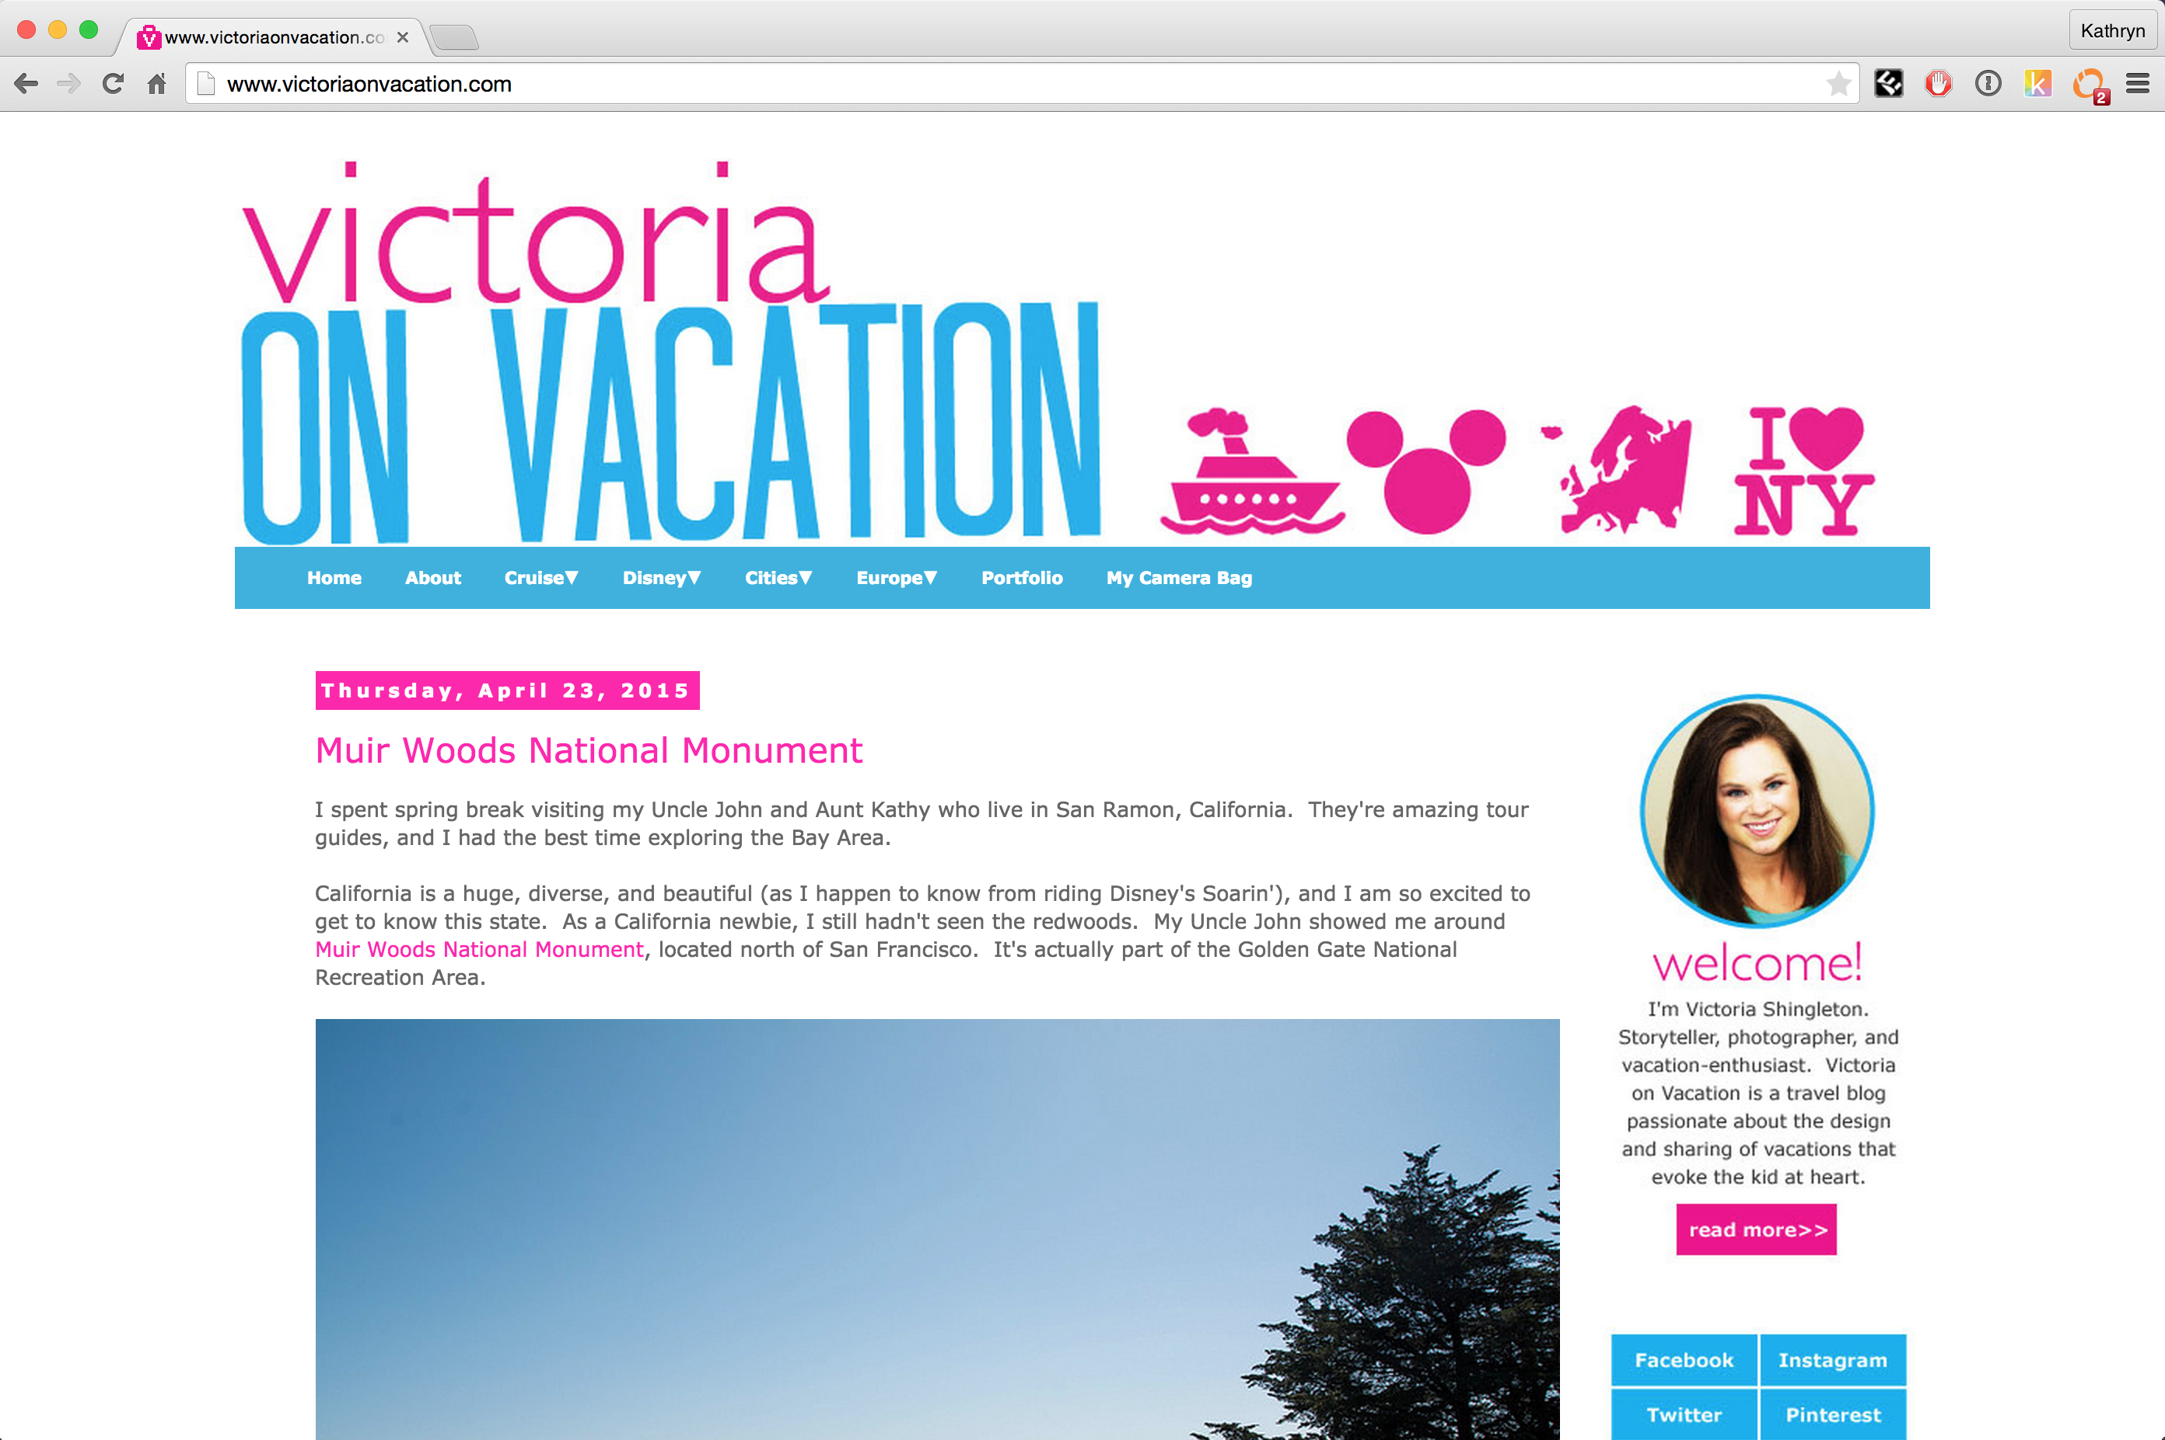
< 1000 visitors per month

Slide 3

170 million visitors per month

Slide 4
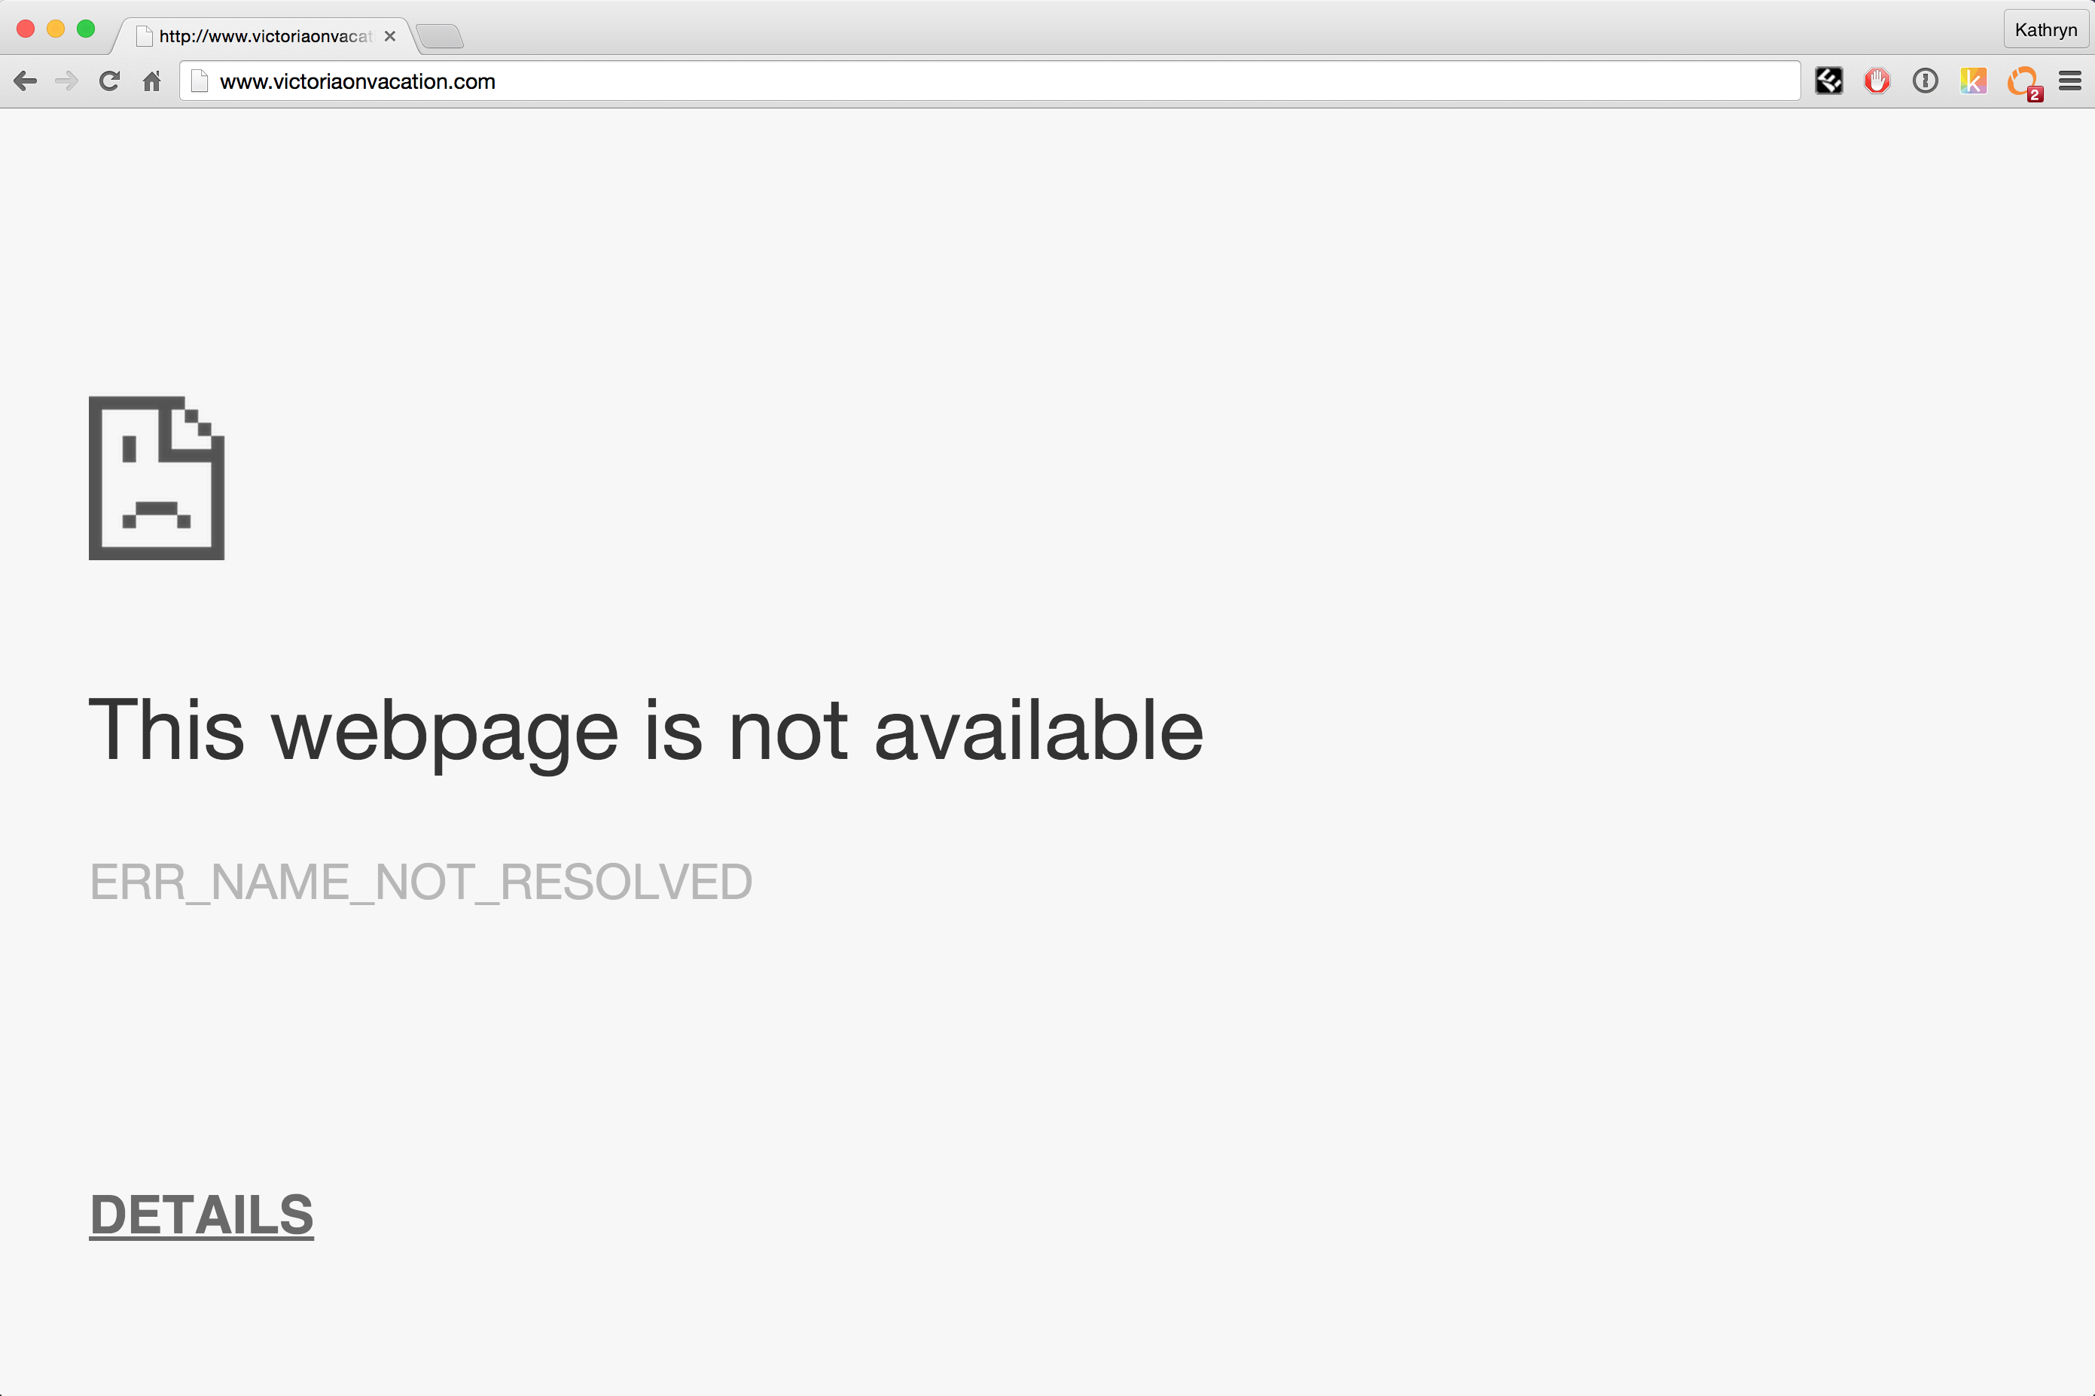
reddit hug of death
Millions of hits
Notes:
Server cannot respond to so many requests.

Slide 5
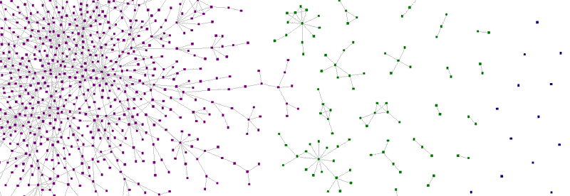
Zauberflöte: A Peer-to-Peer CDN
Katie Siegel
Teammates: Anish Athalye & Ankush Gupta

Slide 6
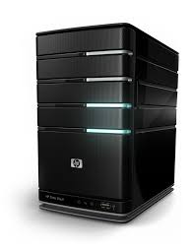

CDN: Content Distribution Network

Slide 7
Four Steps
Determine who has the resource
Open connection with peers
Request resource from peers
Advertise resource

Slide 8
1. Determine who has the resource
{Hash}
Socket.IO
Tracker
{Hash, Peers}

Slide 9

2. Open connection with peers

Slide 10
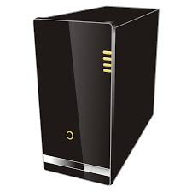
2. Open connection with peers
get
STUN
server
ice candidate,
offer
ice candidate,
offer
answer
answer
ice candidate

Slide 11
3. Request resource from peers
Data
{hash, chunk, payload}
Request
{hash, chunk}
Data
{hash, chunk, payload}
Request {hash, chunk}

Slide 12
4. Advertise Resource
Advertise
{hash}

Slide 13
Four Steps
Determine who has the resource
Open connection with peers
Request resource from peers
Advertise resource

Slide 14
Implementation
Download Manager
Tracker & Signaling Channel
DOM injection
code
Connection Manager

Slide 15



Alternatives
Notes:
Not open source, paid, not transparent

Slide 16
Demo Time

Slide 17
Benefits
Lighten server load
Increase bandwidth
Free
Lightweight
Transparent & Open Source

Slide 18
Questions?

