Slide 2
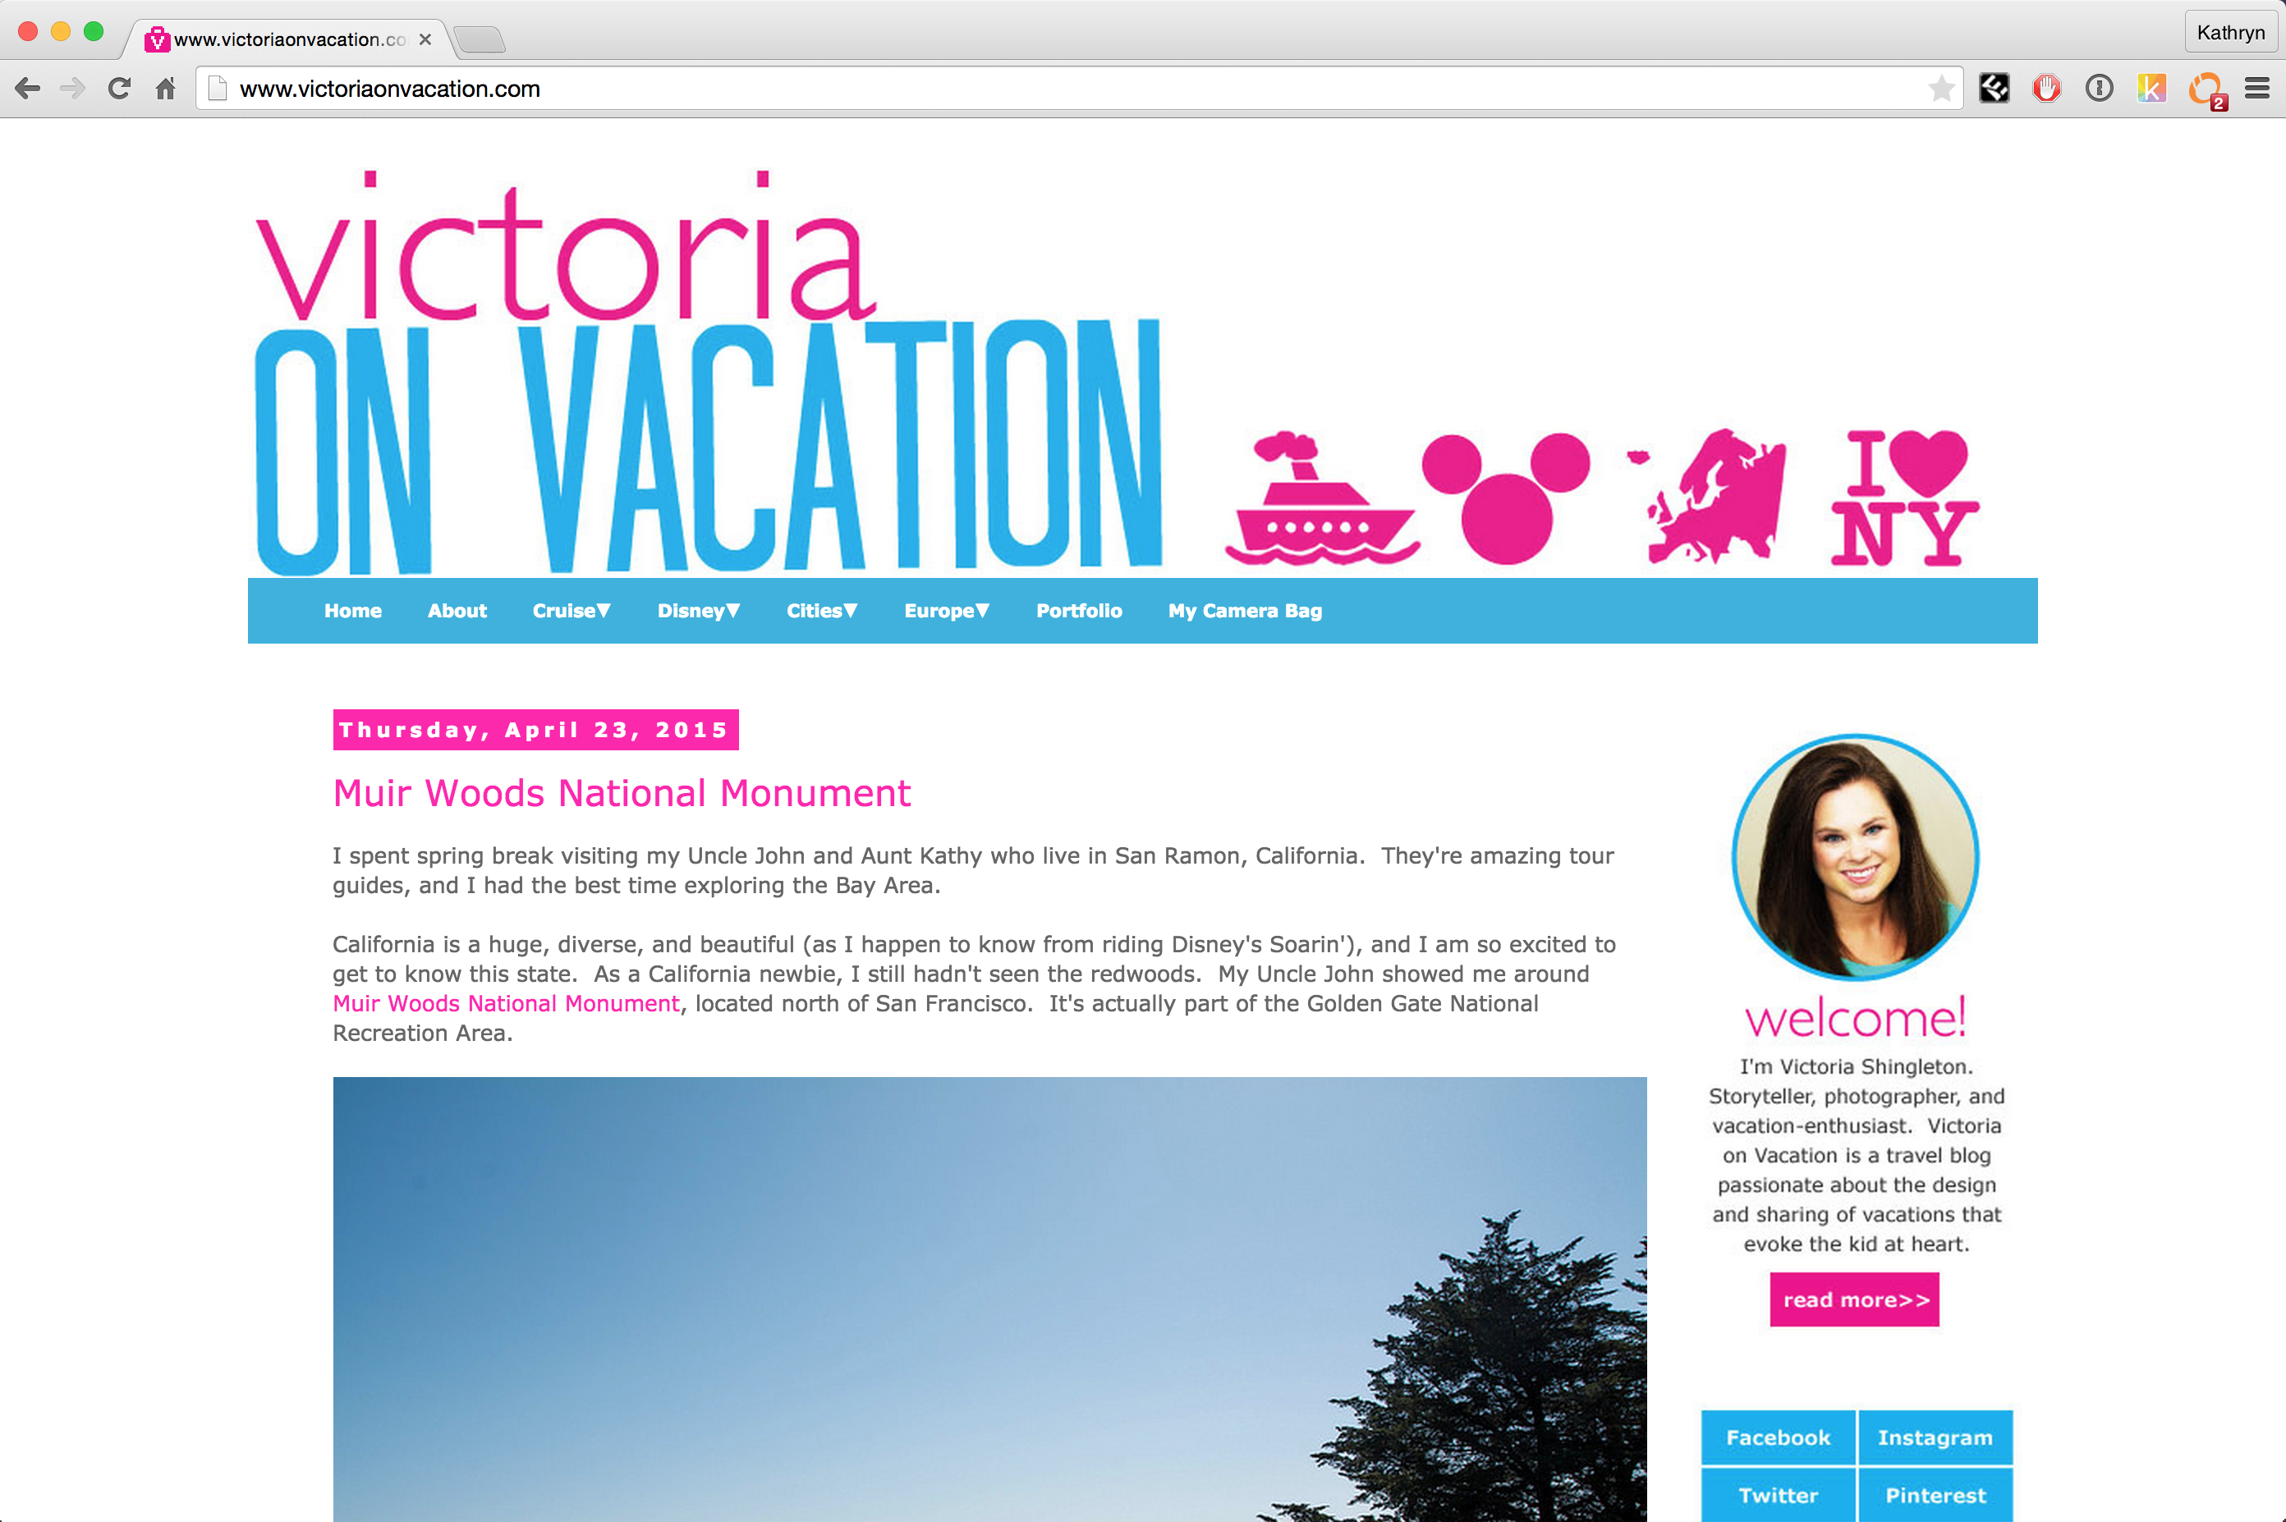
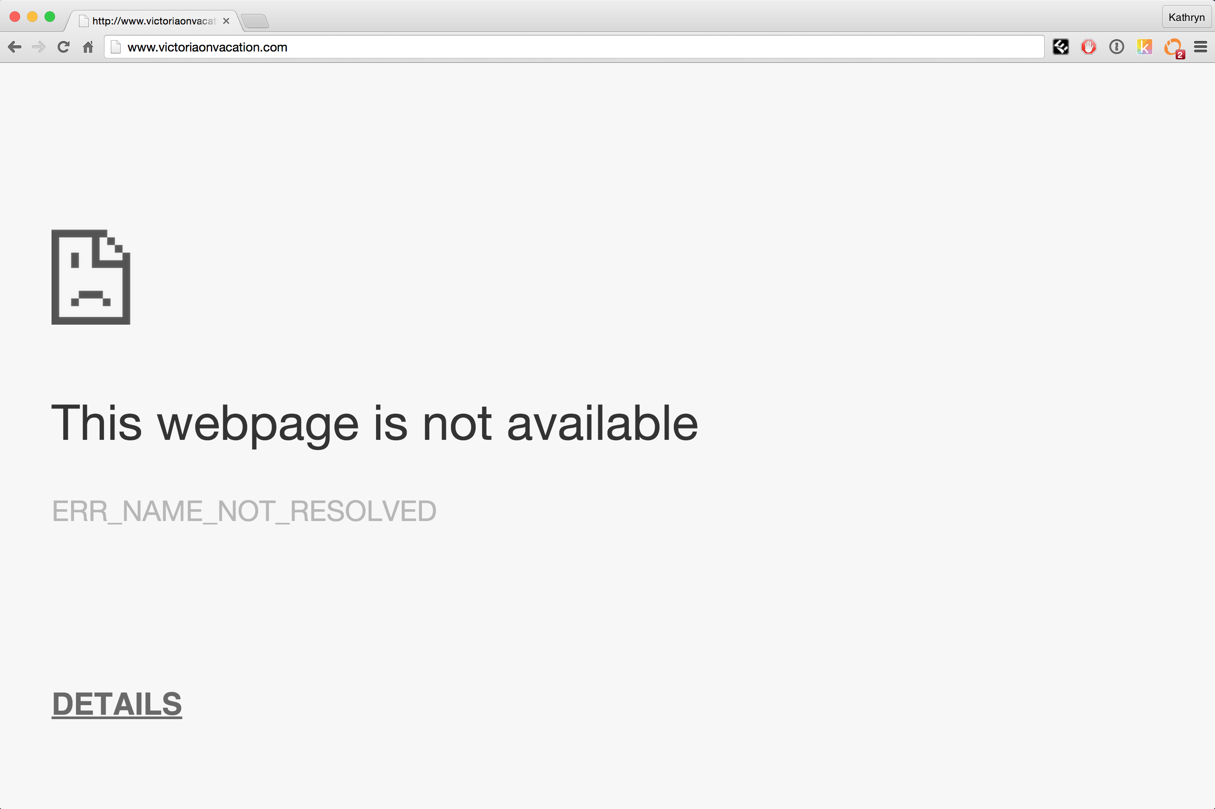

reddit hug of death
Millions of hits
Notes:
Server cannot respond to so many requests.

Slide 3
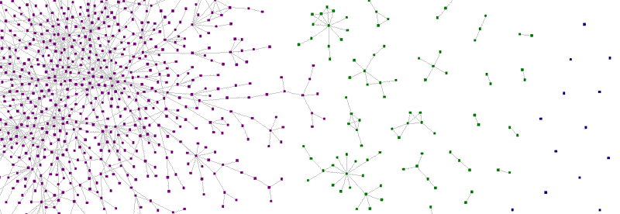
Zauberflöte: A Peer-to-Peer CDN
Katie Siegel
Teammates: Anish Athalye & Ankush Gupta

Slide 4
Methods
Determine who has the resource
Open connection with peers
Request resource from peers
Advertise resource

Slide 5
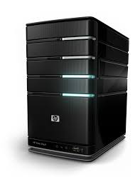

1. Determine who has the resource
{Hash}
Tracker
{Hash, Peers}

Slide 6

2. Open connection with peers

Slide 7
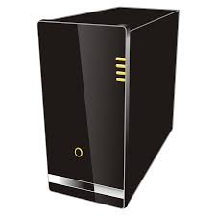
2. Open connection with peers
get
STUN
server
ice candidate,
offer
ice candidate,
offer
answer
answer
ice candidate
Notes:
Interactive connectivity establishment

Slide 8
3. Request resource from peers
Data
{hash, chunk_num, payload}
Request
{hash, chunk_num}
Data
{hash, chunk_num, payload}
Request {hash, chunk_num}

Slide 9
4. Advertise Resource
Advertise
{hash}

Slide 10
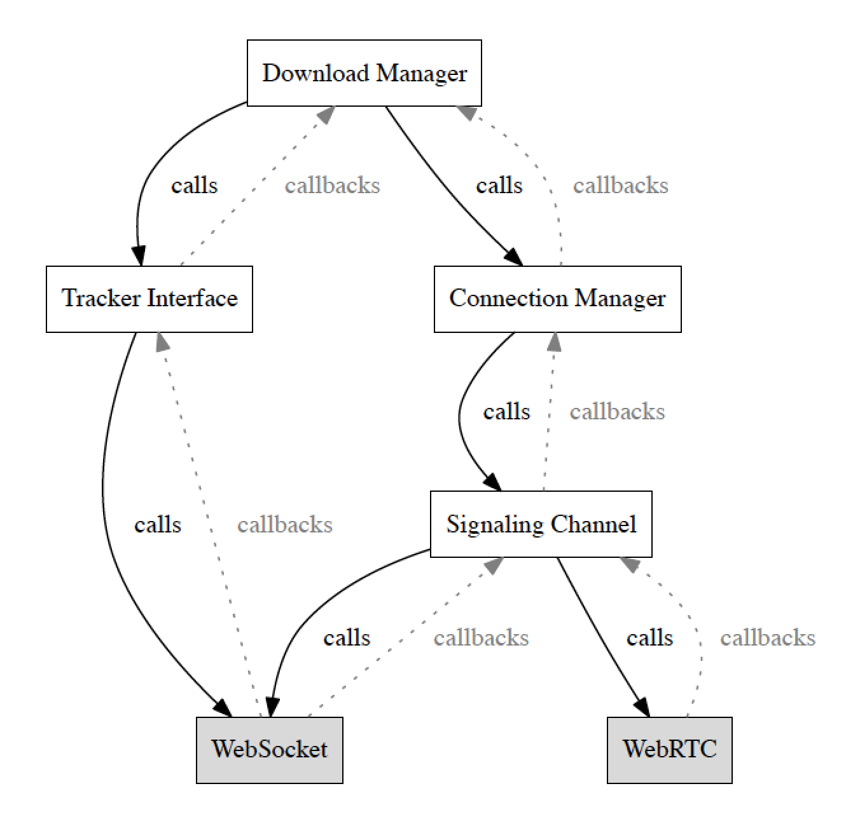
Client-side Implementation

Slide 11
Server-side Implementation
Tracker
WebRTC Signaling Channel
{“add”: {hash}}
{“peer-request”: {hash}}
{“webrtc-data”: { data: {data}
peer: {id}
}}

Slide 12
Results

Slide 13
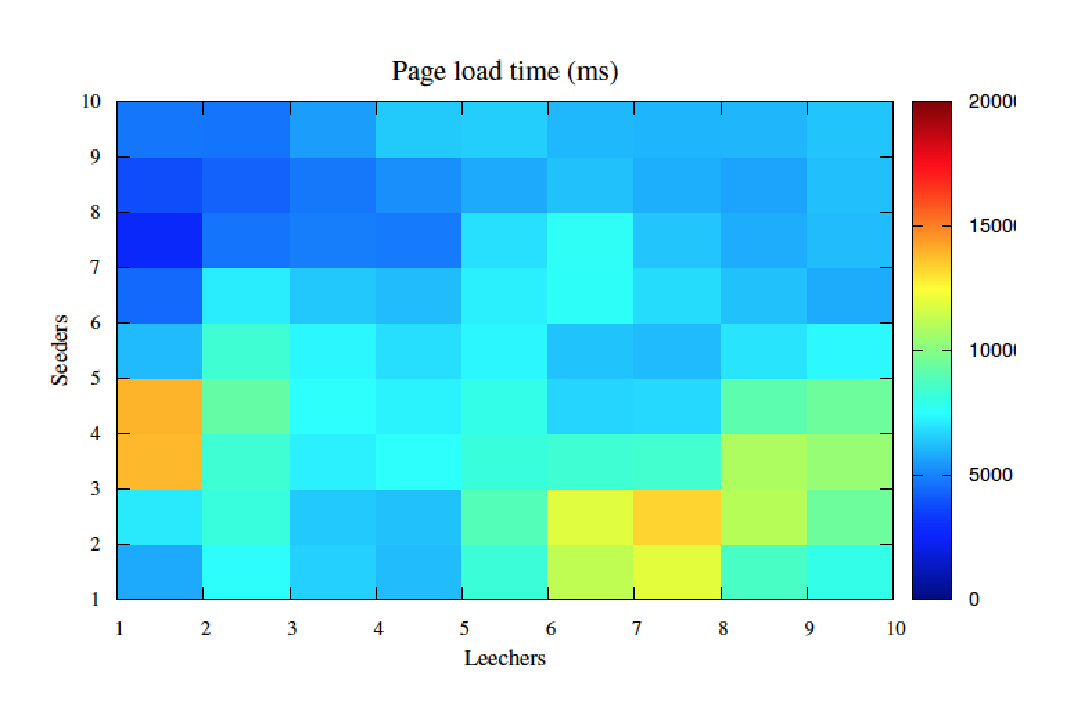
Page load times over P2P
20000
15000
10000
5000

Slide 14
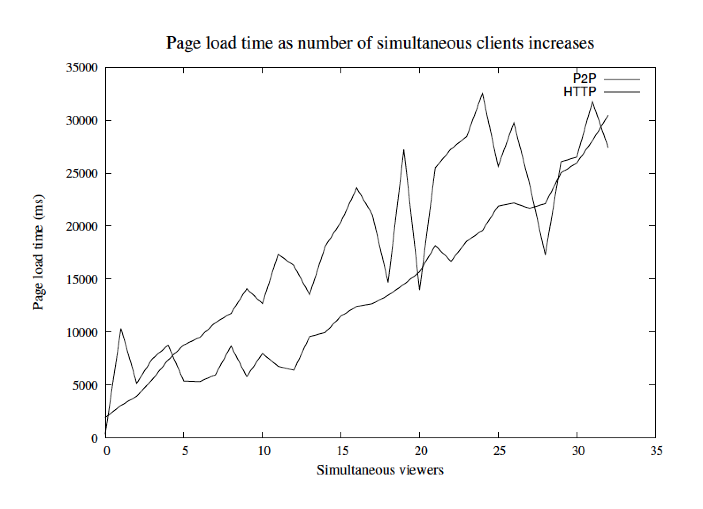

Slide 15
Demo

Slide 16



Alternatives
Notes:
Not open source, paid, not transparent

Slide 17
Benefits
Lighten server load
Increase bandwidth
Free
Lightweight
Transparent & Open Source

Slide 18
Questions?

