Slide 2

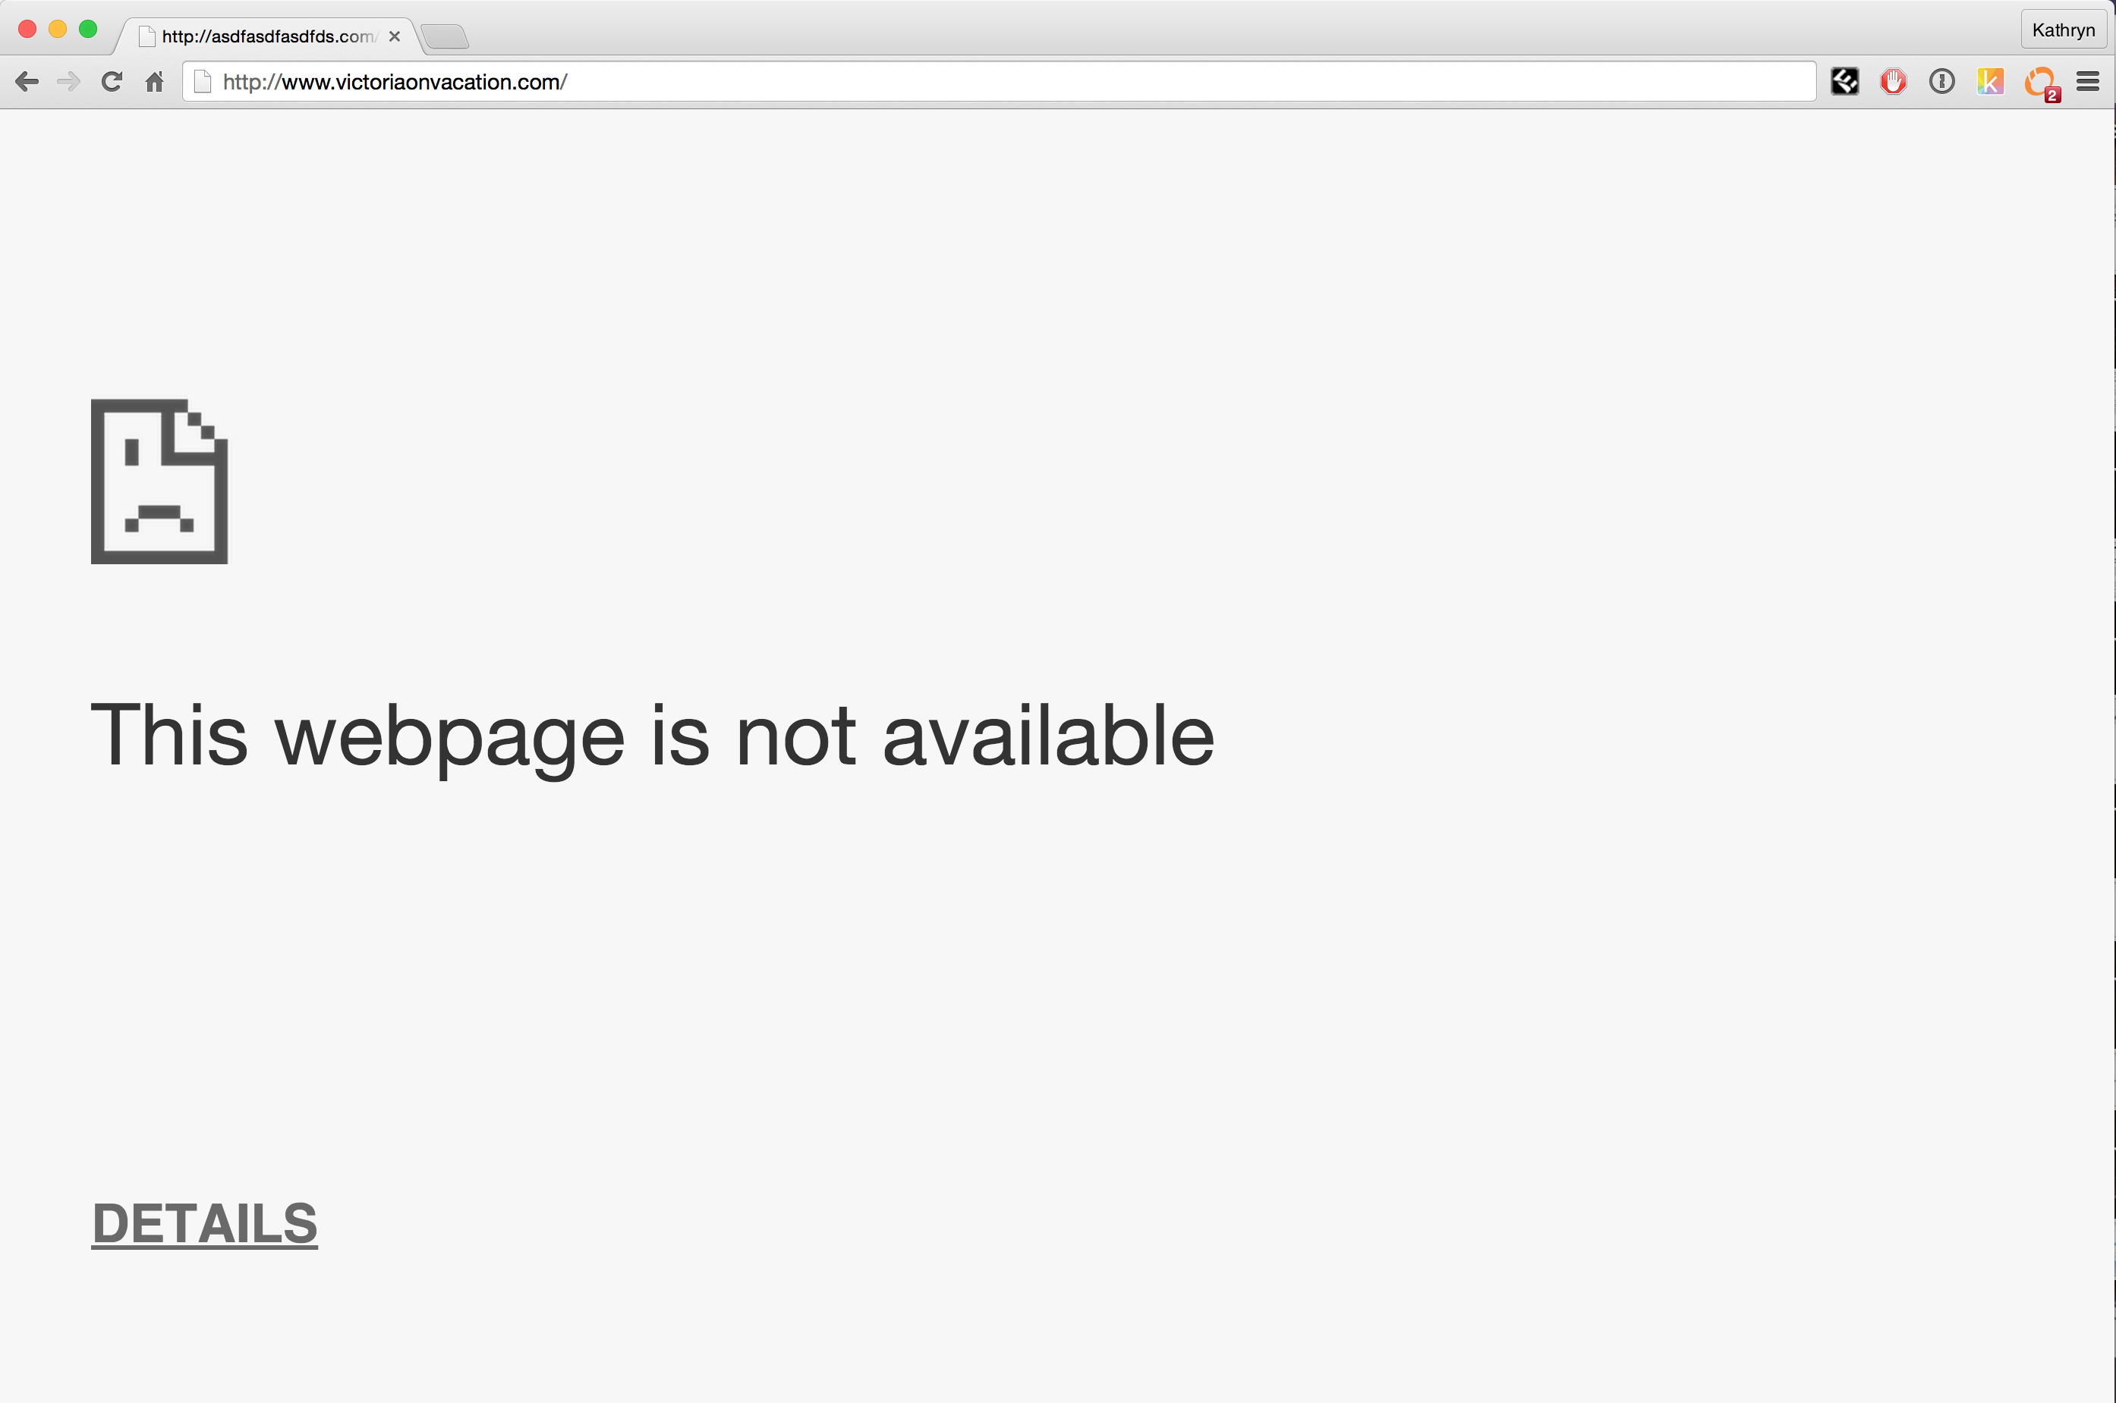
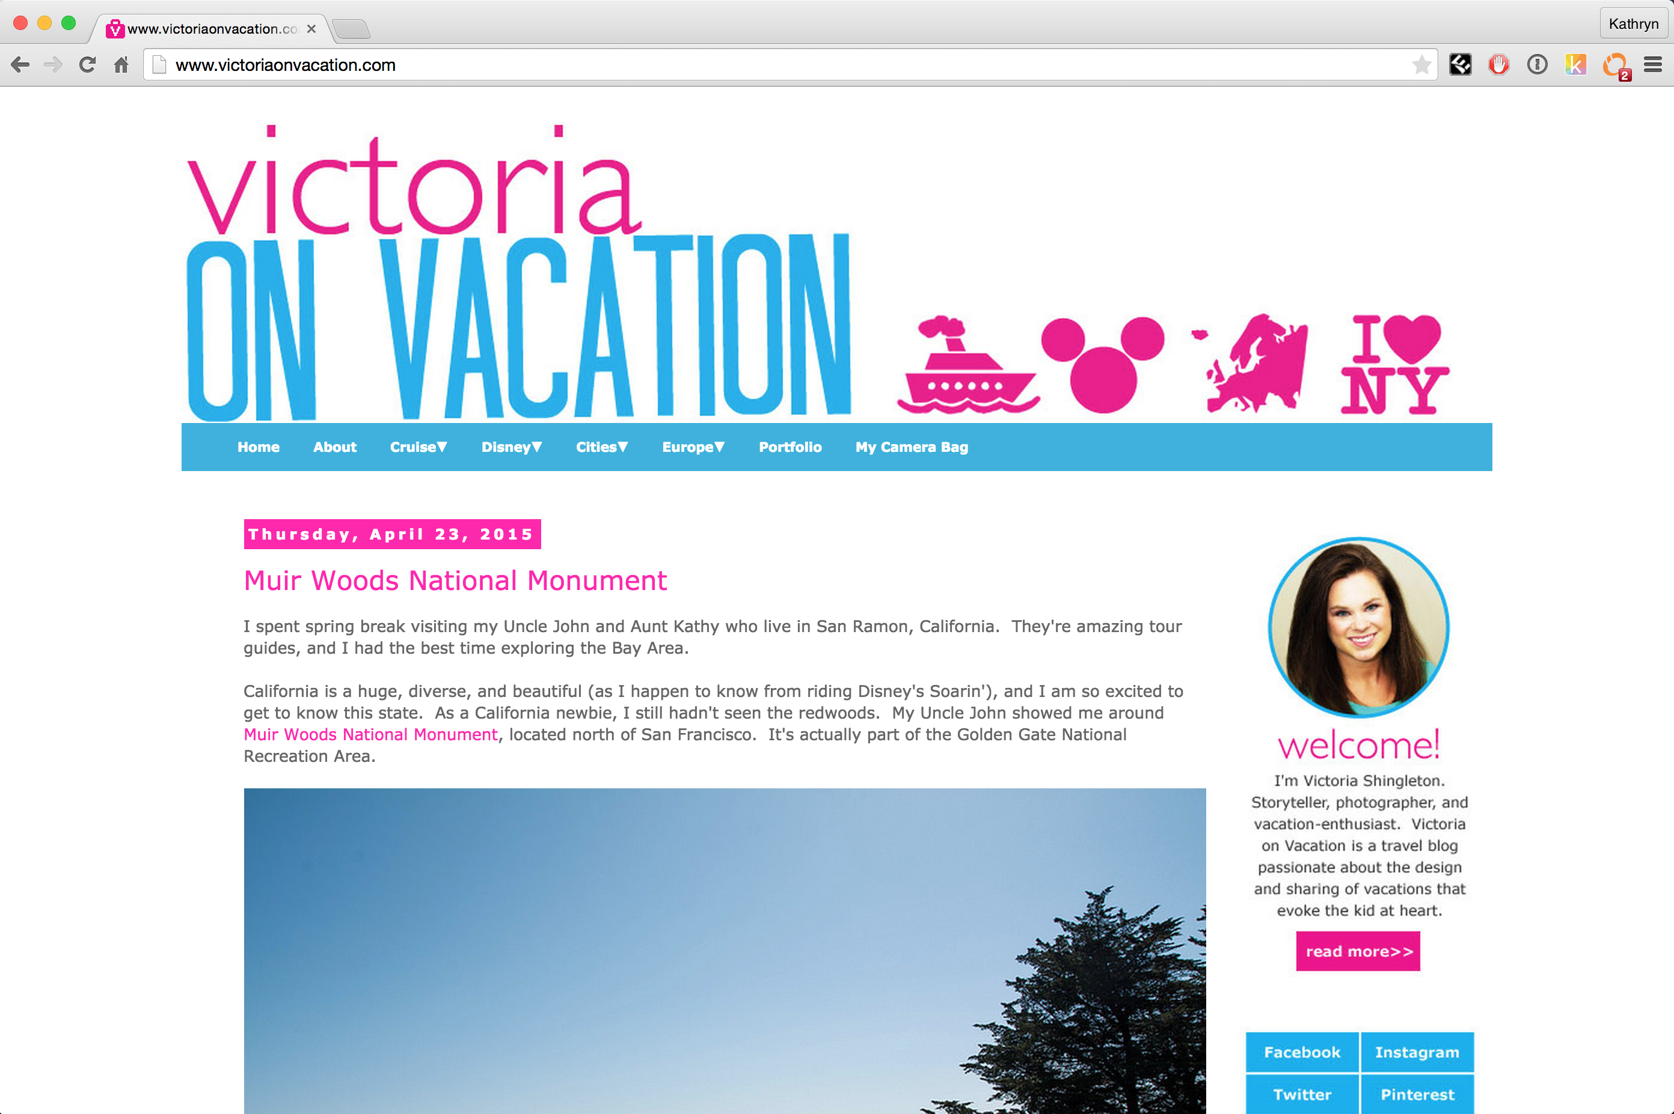
reddit hug of death
Millions of hits
Notes:
Server cannot respond to so many requests.

Slide 3
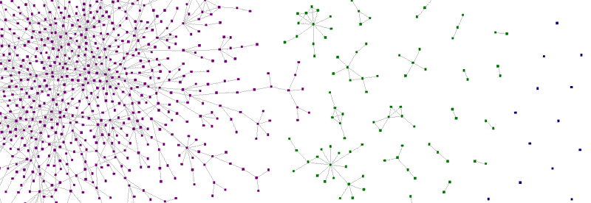
Zauberflöte: A Peer-to-Peer CDN
Anish Athalye, Ankush Gupta, Katie Siegel

Slide 4
Integration
HTTP
Zauberflöte
<img src="trees.jpg"/>
<script src="zauberflote.js"
/>
<img
data-zf- fallback="tree.jpg"
data-zf-hash="70d...79a"
/>

Slide 5
Overview
Determine who has the resource
Open connection with peers
Request resource from peers
Advertise resource

Slide 6
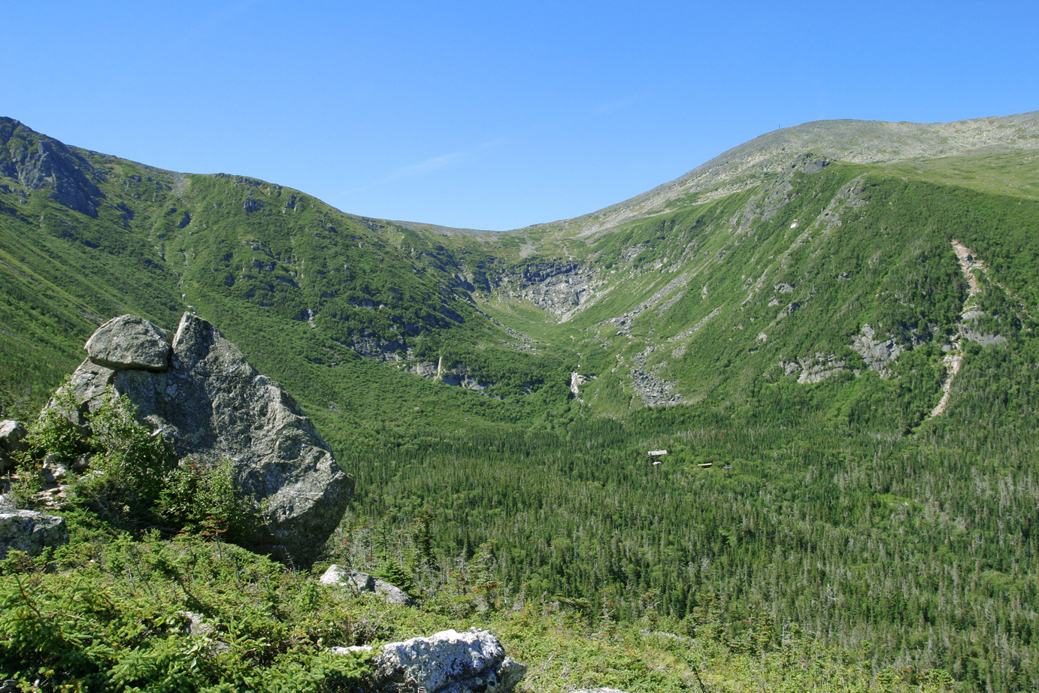
1. Determine who has the resource
SHA1 hash

Slide 7
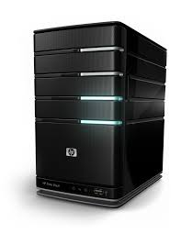

1. Determine who has the resource
{Hash}
Tracker
{Hash, Peers}

Slide 8

2. Open connection with peers

Slide 9
3. Request resource from peers
Data
{hash, chunk_num, payload}
Request
{hash, chunk_num}
Data
{hash, chunk_num, payload}
Request {hash, chunk_num}

Slide 10
4. Advertise Resource
Advertise
{hash}

Slide 11
Demo

Slide 12
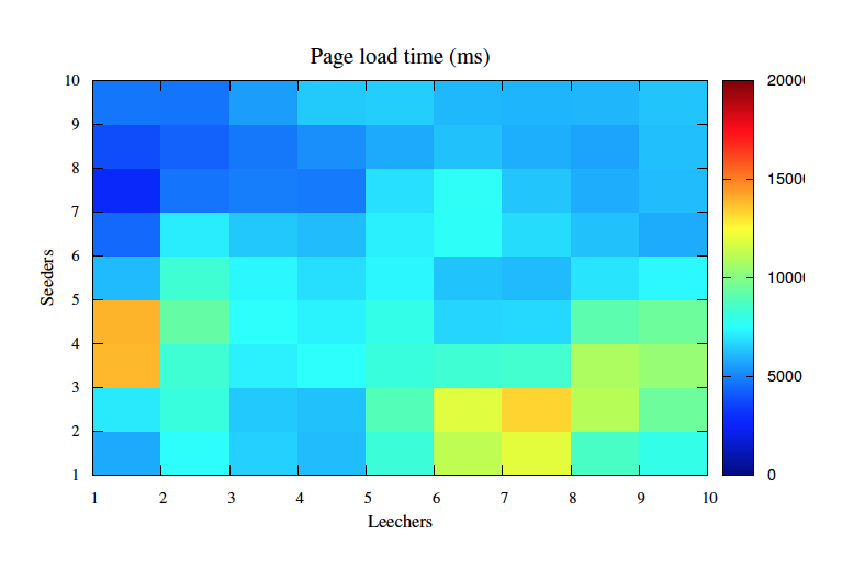
Page load times over P2P
20000
15000
10000
5000

Slide 13
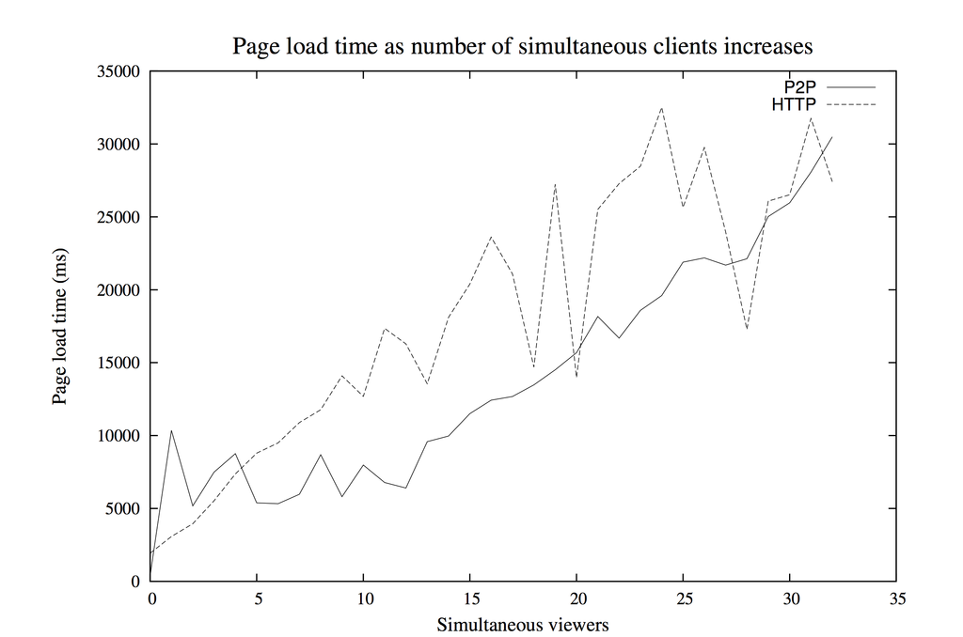

Slide 14
Future Work
Per-chunk hash validation
Hybrid downloads over HTTP & P2P
Variable request sizes
Bandwidth detection & prioritization
Support for HTML5 media

