Slide 1
Predicting Daily Restaurant Foot Traffic
CS506 Midterm Presentation
Team: Jiale Quan, Jiahao Wang, Jiaqing Xu

Slide 2
Project Overview
- Predict daily restaurant customer volume
- Use external data: weather & online reviews
- Help optimize staffing & inventory
- Focus: Victoria Seafood (Allston, Boston)

Slide 3
Data Sources
- OpenWeatherMap API: Historical weather
- Yelp API: Reviews and star ratings
- Google Popular Times: Simulated traffic

Slide 4
Data & Simulation
- Synthetic data generated for Feb–Mar 2025
- Fields: date, temperature, humidity, precipitation, foot traffic
- Used weather + day-of-week patterns

Slide 5
Scripts and Processing
- simulate_foot_traffic.py
- get_weather_data.py
- get_yelp_reviews.py
- Clean merge and EDA in progress

Slide 6
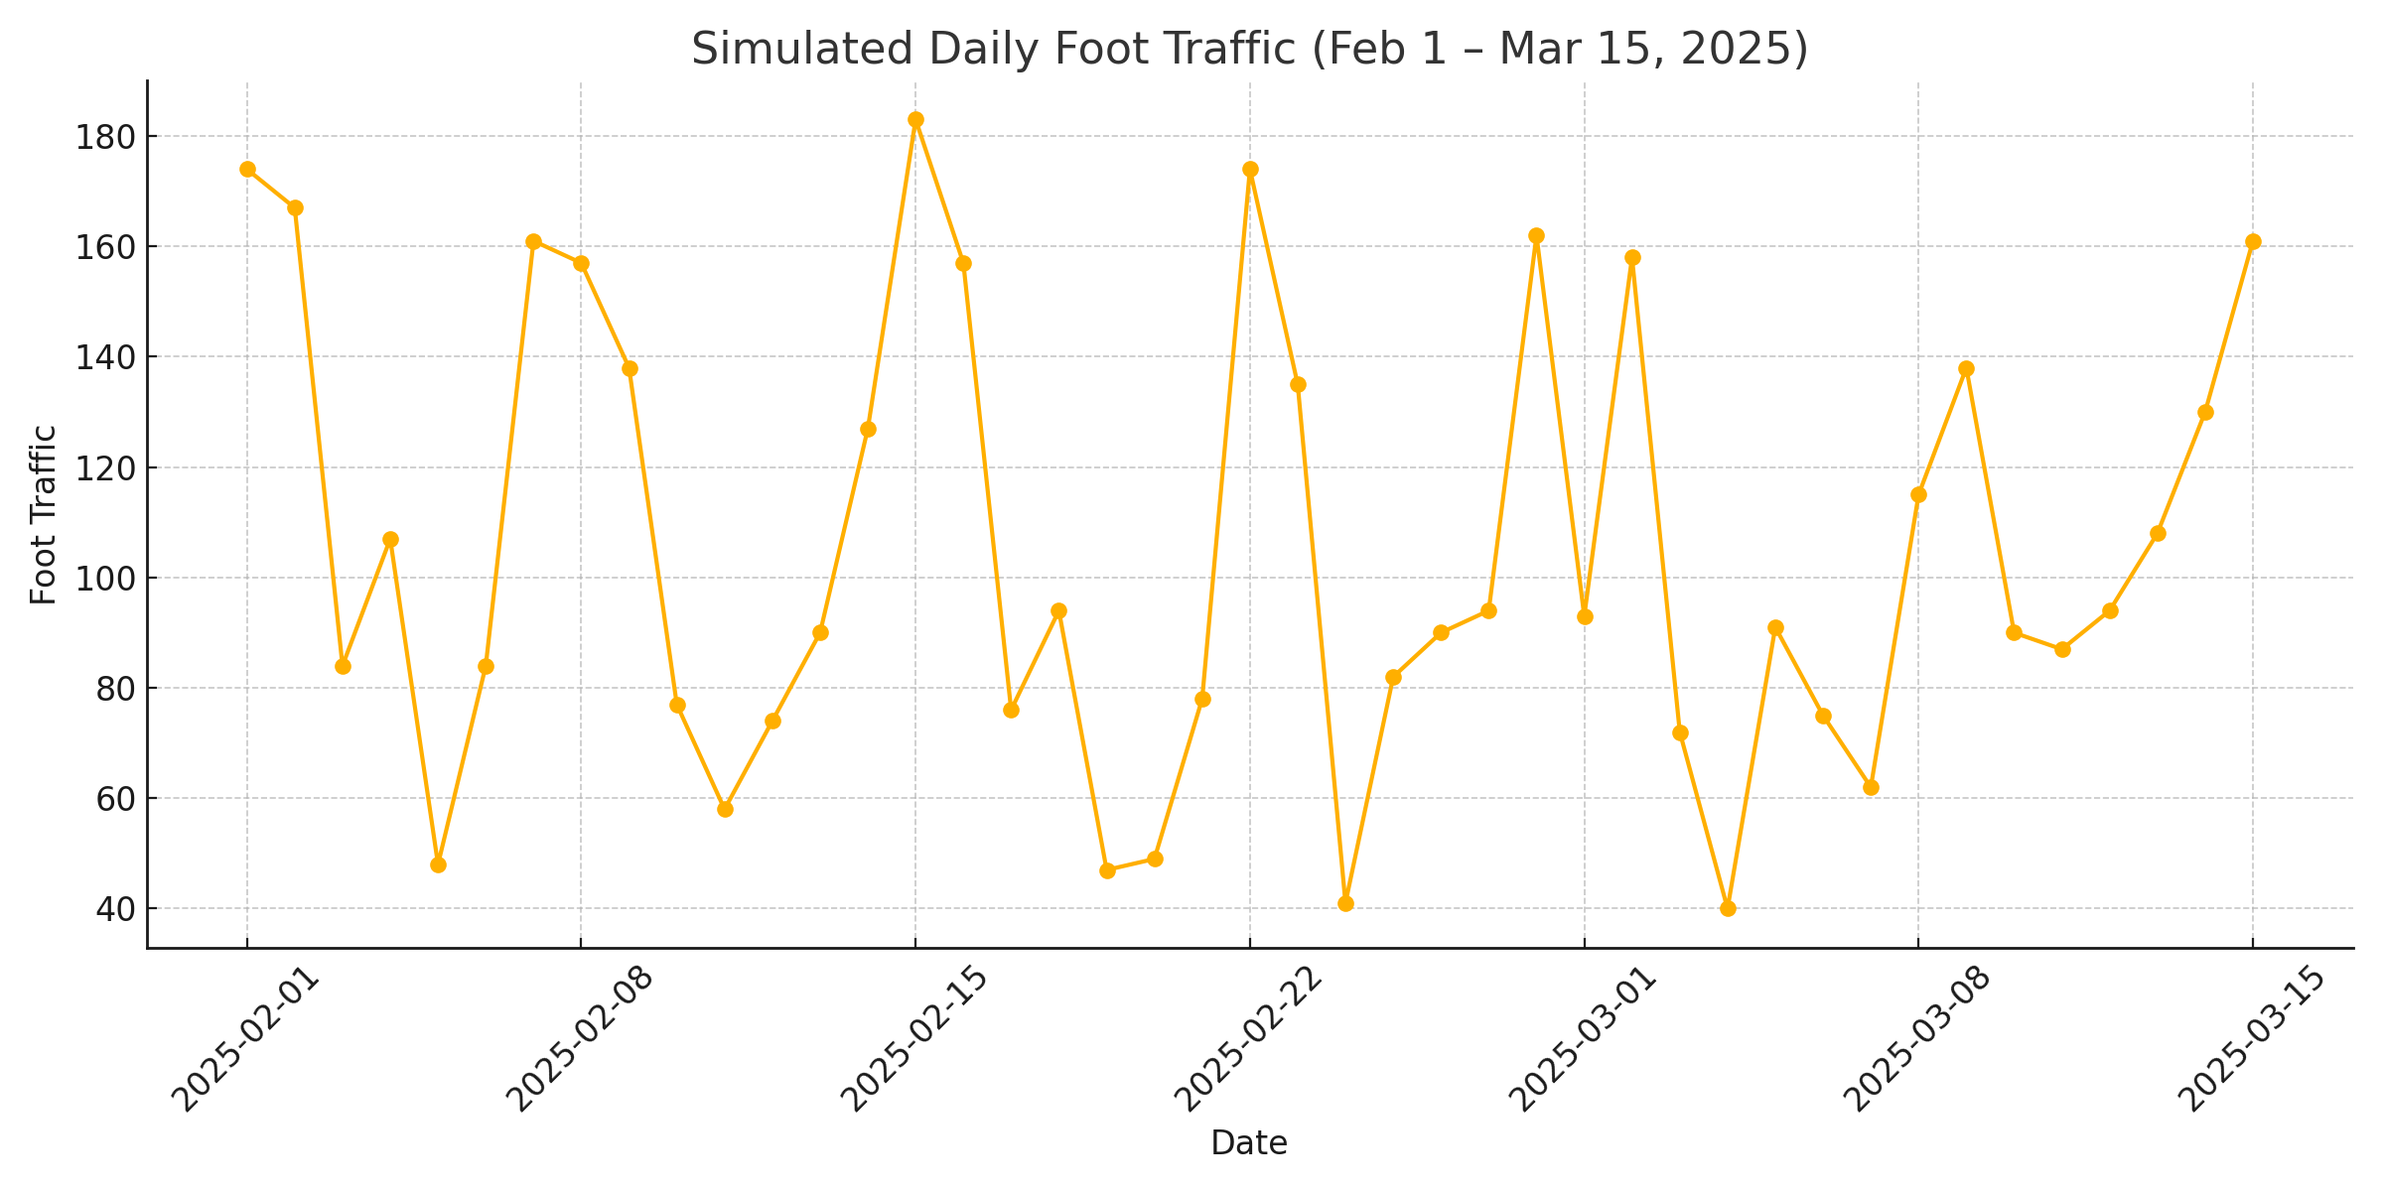
Preliminary Visualization

Slide 7
Modeling Plan
- Linear Regression (baseline)
- XGBoost (non-linear patterns)
- Prophet (seasonal time series)
- Linear model trained with basic features

Slide 8
Next Steps
- Finish feature engineering
- Train advanced models
- Add sentiment analysis
- Optional: build interactive dashboard

Slide 9
Thank You
Questions or feedback welcome!

