Slide 1
Personality Elicitation

Slide 2
Background & Motivation
Background
Large Language Models (LLMs) have been extensively applied.
Research indicates that it is feasible to infer user personality traits through User-LLM interactions.
This capability serves as a prerequisite for personalized services while simultaneously presenting a critical challenge for privacy preservation.
Motivation：Trait Activation Theory (TAT): behavior = f (trait * situation)
Existing personality analysis methods typically rely on rich user-generated content, such as essays and social media posts.
In contrast, interactions with LLMs are often characterized by short, task-oriented exchanges, where user responses contain sparse personality-related cues.
两个方向：数据和识别
数据：现有的方向用的数据其实没有包含很多性格信息，如果没有相对应的situation，对应的trait根本就不会激发），这个数据里面也就没有对应trait的信息
识别：现有的识别方法都是liwc或者分析词等等，没有理解situation（一次性输出ocean，大概率是依靠ocean之间的相关性才有一定的准确度），我们的方法是先分析situation，然后再推断到底激发了什么trait，才能知道应该推断哪个trait

Slide 3
Problem
Can we actively elicit latent personality traits within sparse, task-oriented Human-LLM interactions to achieve accurate profiling without compromising user experience?
Input
Method
Output
Human-LLM Interaction
Adaptive, closed-loop framework.
Big 5

Slide 4

Related work
1. Text-based Personality Recognition
Approaches:
Statistical: LIWC
Deep Learning: BERT/RoBERTa
LLM
Gaps:
Passive Assumption: Assumes user text (essays and social media posts) naturally contains sufficient traits information. However, Human-LLM interactions are predominantly task-oriented; consequently, they lack sufficient personality-relevant information.
Data Scarcity: There is a notable scarcity of human-machine dialogue datasets annotated with personality labels.
2. Psychological Foundations
Trait Activation Theory (TAT):
Formula:
Concept: Traits are latent potentials activated only by specific Situational Cues.
Nudging Theory:
Concept: Subtle "choice architecture" changes to guide behavior without restriction (Thaler & Sunstein).

Slide 5
Intuition
Drawing on Trait Activation Theory, personality traits are most readily manifested in response to specific situational stimuli.
Given the established validity of psychometric inventories like the IPIP-NEO, we hypothesize that adapting these static items into dynamic conversational strategies can effectively elicit user personality traits.

Slide 6
Challenge & Solution
Challenge 1: How can specific dialogue content be mapped to abstract personality traits within constrained task-oriented scenarios?
Challenge 2: How can personality cues be elicited while minimizing disruption to user experience and natural conversational flow?
Solution 1: Leveraging Trait Activation Theory to align dialogue contexts with target traits.
Solution 2: Applying Nudging Theory to seamlessly embed IPIP scenarios into conversational strategies.

Slide 7
Evaluation
Study 1: LLM-Based Simulation (Controlled & Scalable)
Multi-Agent Architecture:
User Agent: Simulates diverse users covering all Big Five trait combinations.
Target Agent (Assistant): Multiple LLMs (e.g., Llama 3, GPT-...) to verify robustness.
Analyst Agent: SOTA LLM (GPT5.2)
Protocol:
10-Turn Constraint: Measuring elicitation efficiency within short interactions.
Ground Truth: Pre-configured personality profiles of the User Agent.
Study 2: Human-Subject Study (Ecological Validity)
Participants:
Pilot study with N >= 20 participants to validate real-world performance.
Procedure (Three-Step Pipeline):
Pre-Assessment: Participants complete the IPIP-NEO Questionnaire to establish Ground Truth (P_{true}).
Interaction: Participants engage in dialogues.
Comparison: Calculating the correlation between prediction (P_{pred}) and Ground Truth (P_{true}).

Slide 8
Methodology
Situation DIAMONDS
Duty, Intellect, Adversity, Mating, Positivity, Negativity, Deception, Sociality
Input
User Prompt at the current turn t.
Interaction History
IPIP
Trait-Relevant Scenarios/Items
Big 5
Context-activatable traits
Designed LLM Response
User Reaction
Nuding Strategies
Facilitate
Confront
Social Influence
Deceive
User profile
Motivation (H/L)
Capability (H/L)
Analyzed User Personality

Slide 9
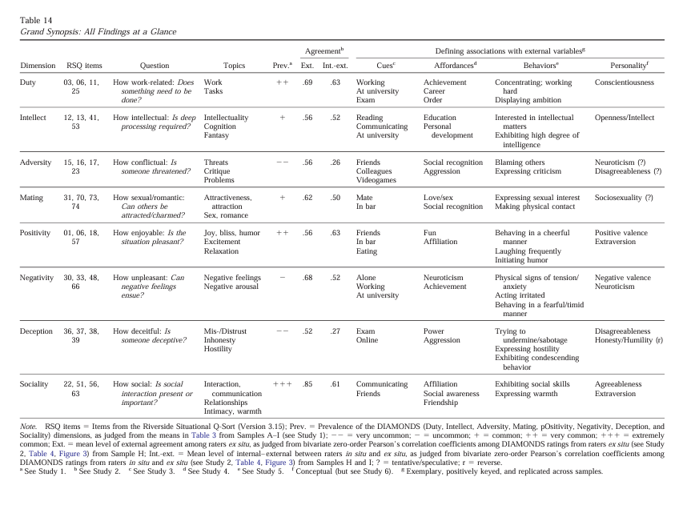
Methodology

Slide 10
Personality Elicitation via LLM Communication Strategies
Personality Trait | Baseline Acc. | Attack Acc. | Baseline F1 | Attack F1
Openness | 0.81 | 0.62 | 0.81 | 0.56
Conscientiousness | 0.59 | 0.75 | 0.56 | 0.75
Extraversion | 0.62 | 0.88 | 0.56 | 0.87
Agreeableness | 0.53 | 0.66 | 0.40 | 0.61
Neuroticism | 0.78 | 0.81 | 0.78 | 0.81
AVERAGE | 0.67 | 0.74 | 0.62 | 0.72
Findings
Overall Improvement: Active elicitation strategies yielded superior overall performance compared to the baseline.
Specific Regression: However, a notable decline was observed specifically in the Openness dimension.
Conclusion
Efficacy: Adjusting communication strategies is proven effective in enhancing personality inference performance.
Next Step
Investigation: Analyze the causes of the Openness decline.
Adaptive Optimization: Implement real-time user profiling (Motivation/Capability) to enable targeted trait selection rather than random elicitation.

Slide 11
THANKS

