Slide 1
Graphics Pipeline Study With MESA On Ubuntu
Ryan Polley, Pranjal Abhyankar, Vivek Mishra, Wanxin Wang

Slide 2
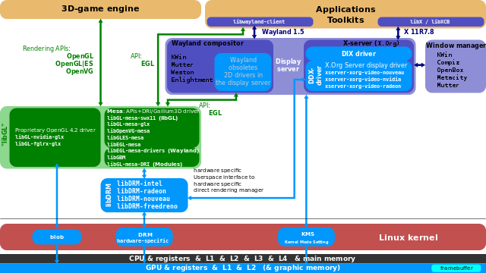
An overview of graphics pipeline in perception of a software developer

Slide 3
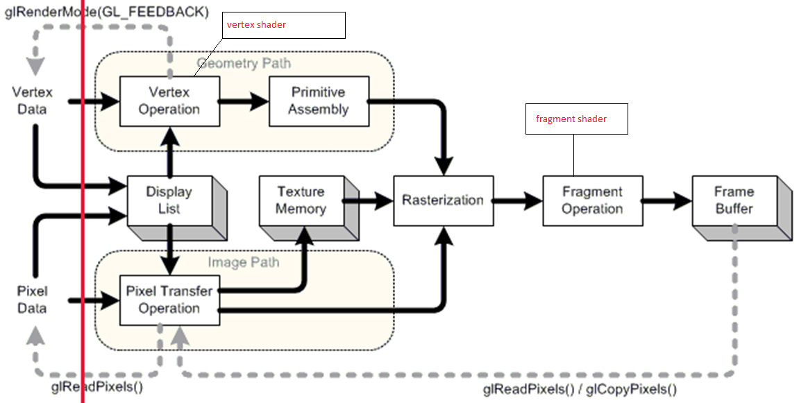
OpenGL pipeline for CPU&GPU parallel

Slide 4
Categories of 3D graphical applications
1
3D modeling software (Blender, 3DMax, …)
Designed for complex functionalities, requires for modules extensibility
Most of the modules are not required for high graphical performance
2
Game engine (Unity 3D, Unreal, …)
High demand for graphical performance
Change pre-defined graphical procedure should be cautious
Graphical procedure customization is limited

Slide 5
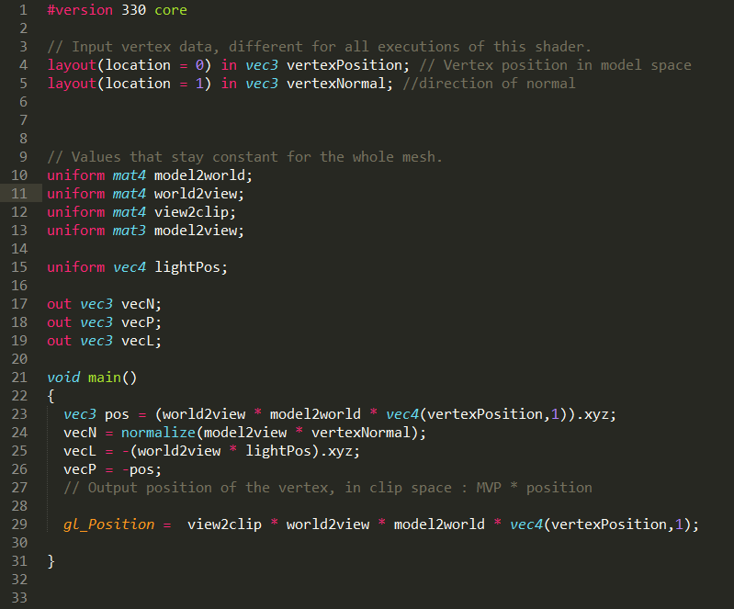
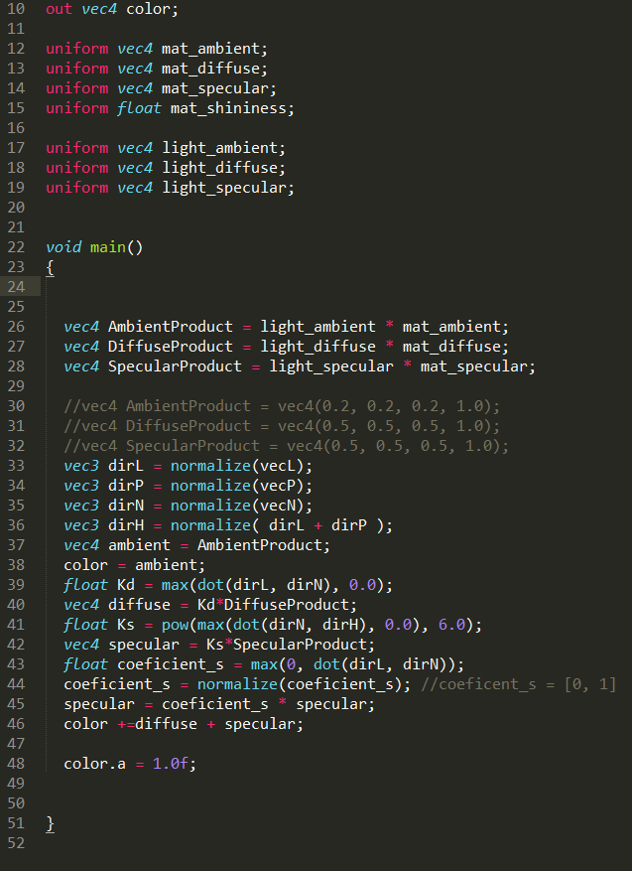
An example of a prototype for 3D Modeling (visualizing)
https://www.youtube.com/watch?v=CKIZVz-LKQI

Slide 6
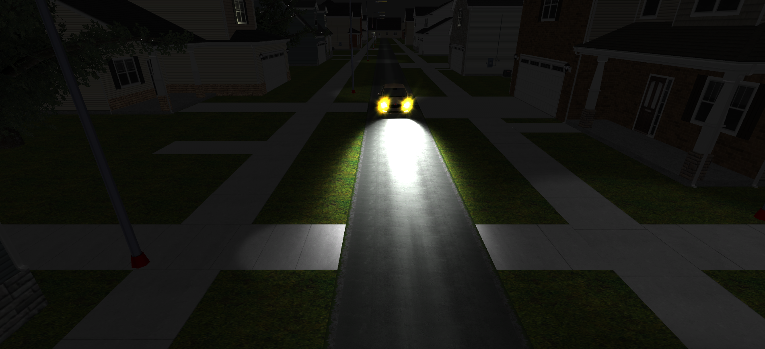
The graphical procedure for a game engine
https://www.youtube.com/watch?v=JqwzVPtCa6g

Slide 7
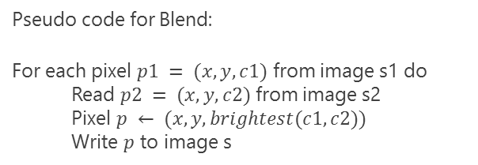

The graphical procedure for a game engine (from hypothesis)
Forward rendering mode in unity3D in pseudo-code:
Image $Img_{n}←Black$
For light source $l ∈\{\{ambient lights\}, \{directional lights\}, \{point lights\}, \{spot lights\}, \{area lights\}\}$ do
Select grouped objects s that use same shader $p$ rendered under$l$
Set vertex buffer with geometry data of s
Load shader program $p$ attached with s
For each object o$∈s$ do
$Img_{n+1}← Render(l, o, p)$
$Img_{n}←Blend({Img}_{n}, {Img}_{n+1})$
Render $Img_{n}$ to display
Pseudo code for Blend:
For each pixel $p1 = (x, y, c1)$ from image s1 do
Read $p2 = (x, y, c2)$ from image s2
Pixel $p ← (x, y, brightest(c1, c2))$
Write $p$ to image s

Slide 8
Inspecting on the graphics pipeline will confirm the hypothesis
1
Right-click in the word office in the following phrase: office furniture
2
Choose Smart Lookup, and notice that results are contextual for that phrase, not Microsoft Office apps.
3
Just for fun, try Smart Lookup again by right-clicking in the word Office in Step 2.

Slide 9

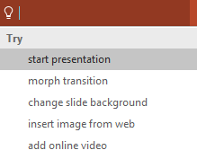

More questions about PowerPoint?
Select the Tell Me button and type what you want to know.
Visit the PowerPoint team blog
Go to free PowerPoint training
Give feedback about this tour
SELECT THE ARROW WHEN IN SLIDE SHOW MODE
Notes:
In Slide Show mode, select the arrows to visit links.

