Slide 1
Graphics Pipeline Study With MESA On Ubuntu
Ryan Polley, Pranjal Abhyankar, Vivek Mishra, Wanxin Wang

Slide 2
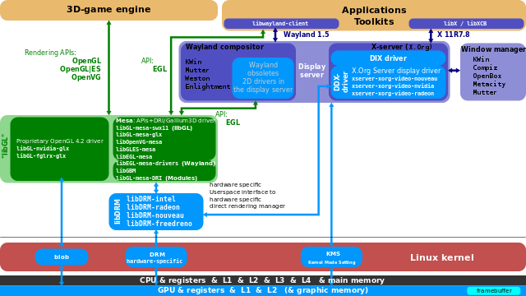
An overview of graphics pipeline in perception of a software developer

Slide 3
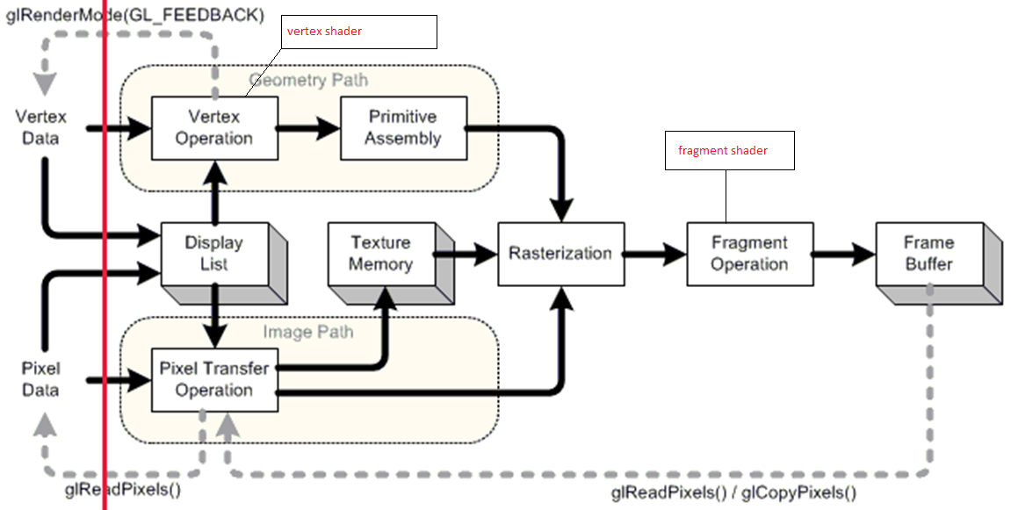
OpenGL pipeline for CPU&GPU parallel

Slide 4
CPU & GPU cooperations for graphics rendering
for each triangle t stored in VBO do in parallel
for each vertex v on t do in parallel
Run vertex shader program with input v
Interpolate fragment data f based on 3 vertices of t
Run fragment shader program with input f
Decide the visibility and color on each pixel stored in FBO(frame buffer object)

Slide 5
Categories of 3D graphical applications
1
3D modeling software (Blender, 3DMax, …)
Designed for complex functionalities, requires for modules extensibility
Most of the modules are not required for high graphical performance
2
Game engine (Unity 3D, Unreal, …)
High demand for graphical performance
Change pre-defined graphical procedure should be cautious
Graphical procedure customization is limited

Slide 6
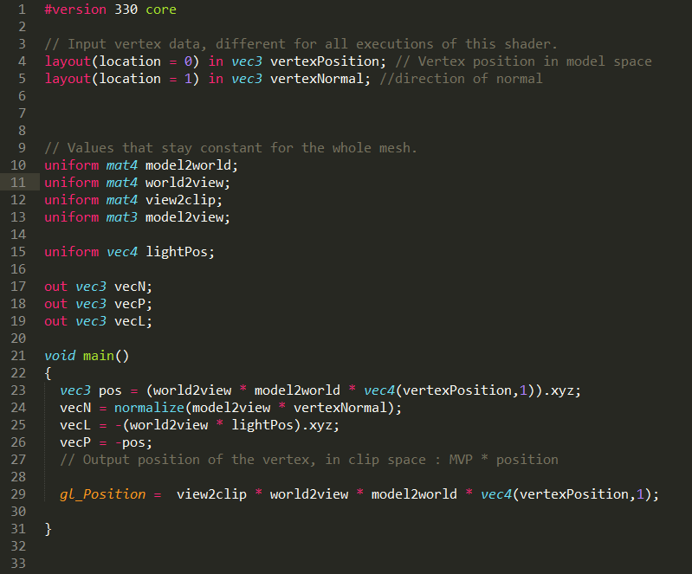
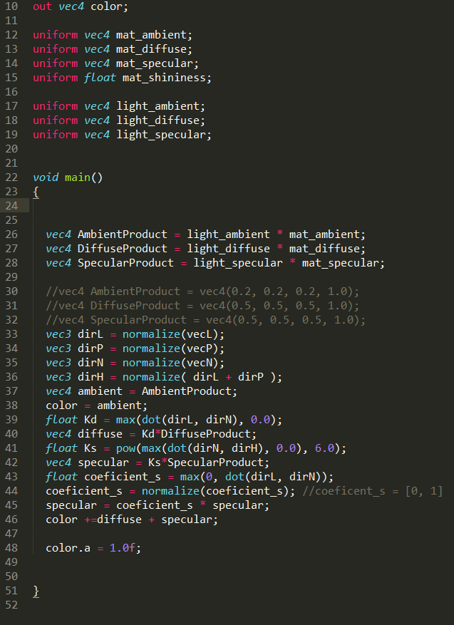
An example of a prototype for 3D Modeling (visualizing)
https://www.youtube.com/watch?v=CKIZVz-LKQI

Slide 7
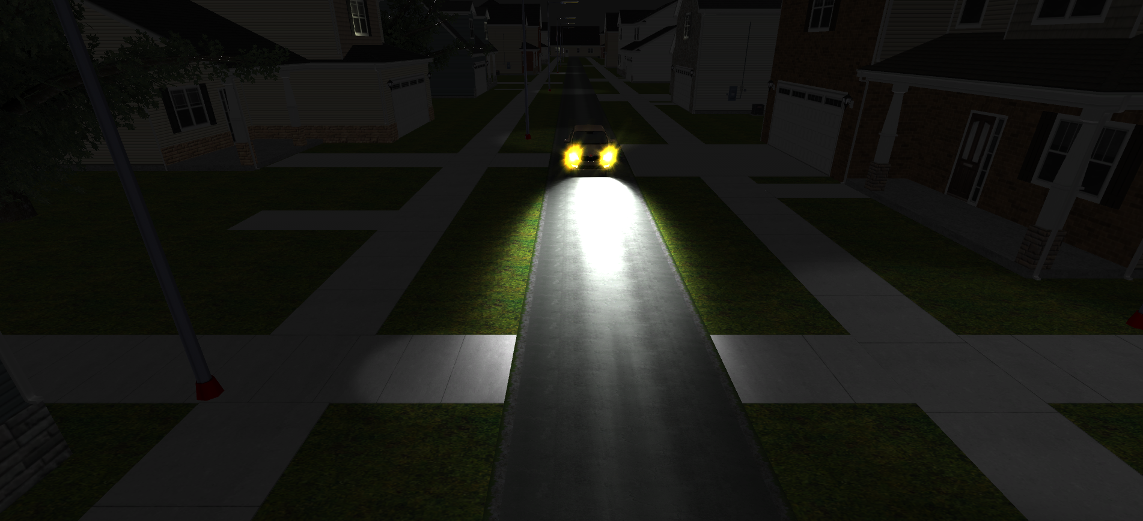
The graphical procedure for a game engine
https://www.youtube.com/watch?v=JqwzVPtCa6g

Slide 8
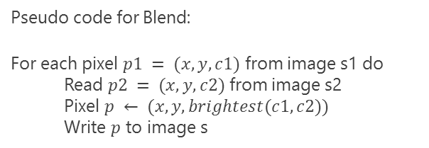

The graphical procedure for a game engine (from hypothesis)
Forward rendering mode in unity3D in pseudo-code:
Image $Img_{n}←Black$
For light source $l ∈\{\{ambient lights\}, \{directional lights\}, \{point lights\}, \{spot lights\}, \{area lights\}\}$ do
Select grouped objects s that use same shader $p$ rendered under$l$
Set vertex buffer with geometry data of s
Load shader program $p$ attached with s
For each object o$∈s$ do
$Img_{n+1}← Render(l, o, p)$
$Img_{n}←Blend({Img}_{n}, {Img}_{n+1})$
Render $Img_{n}$ to display
Pseudo code for Blend:
For each pixel $p1 = (x, y, c1)$ from image s1 do
Read $p2 = (x, y, c2)$ from image s2
Pixel $p ← (x, y, brightest(c1, c2))$
Write $p$ to image s

Slide 9
Inspecting on the graphics pipeline opens the black box
1
To generate trace log information for the usage of OpenGL and EGL from graphical application
2
To yield graphical output, for example to add a water mark on the display for every graphical application
3
To profile hardware, and graphical driver information
4
To port Unreal engine to Ubuntu, and log and profile it

Slide 10
More questions about graphics pipeline
Notes:
In Slide Show mode, select the arrows to visit links.

