Slide 1
CS 4476/6476 Spring 2020
PS1
Wenyue Wang
wenyue_wang@gatech.edu
903204153

Slide 2
Short answer problems

Slide 3
1.1 Use numpy.random.rand to return the roll of a six-sided die over N trials.
def prob_1_1(N):
"""
Args: N: the number of trials.
Returns: arr: array of rolls.
"""
### START CODE HERE ###
arr = np.ceil(np.random.rand(N) * 6)
### END CODE HERE ###
return arr
1.2 Let y be the vector: y = np.array([11, 22, 33, 44, 55, 66]). Use the reshape command to form a new matrix z that looks like this: [[11,22],[33,44],[55,66]]
def prob_1_2(y):
"""
Args: y: numpy array.
Returns: z: numpy array of shape (new_size,2).
"""
### START CODE HERE ###
z = y.reshape((round(len(y)/2),2))
### END CODE HERE ###
return z

Slide 4
1.3 Use the numpy.max and numpy.where functions to set x to the maximum value that occurs in z (above), and set r to the row number (0-indexed) it occurs in and c to the column number (0-indexed) it occurs in.
def prob_1_3(z):
"""
Args: z: numpy array of shape (3,2).
Returns: x: max value in z.
r: row index of x.
c: column index of x.
"""
### START CODE HERE ###
x = np.max(z)
r = np.where(z==x)[0][0]
c = np.where(z==x)[1][0]
### END CODE HERE ###
return (x, r, c)
1.4 Let v be the vector: v = np.array([1, 4, 7, 1, 2, 6, 8, 1, 9]). Set a new variable x to be the number of 1’s in the vector v.
def prob_1_4(v):
"""
Args: v: numpy array.
Returns: x: number of 1’s in v.
"""
### START CODE HERE ###
x = np.where(v==1, 1, 0).sum()
### END CODE HERE ###
return x

Slide 5
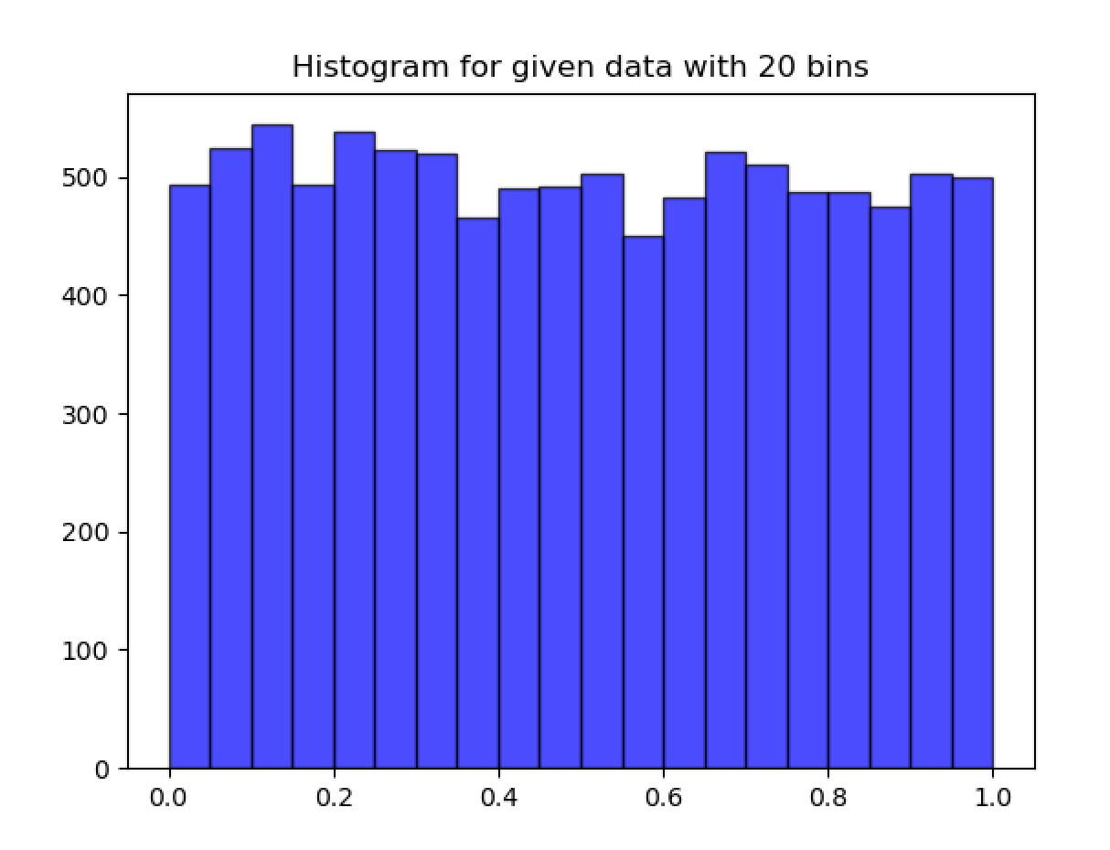
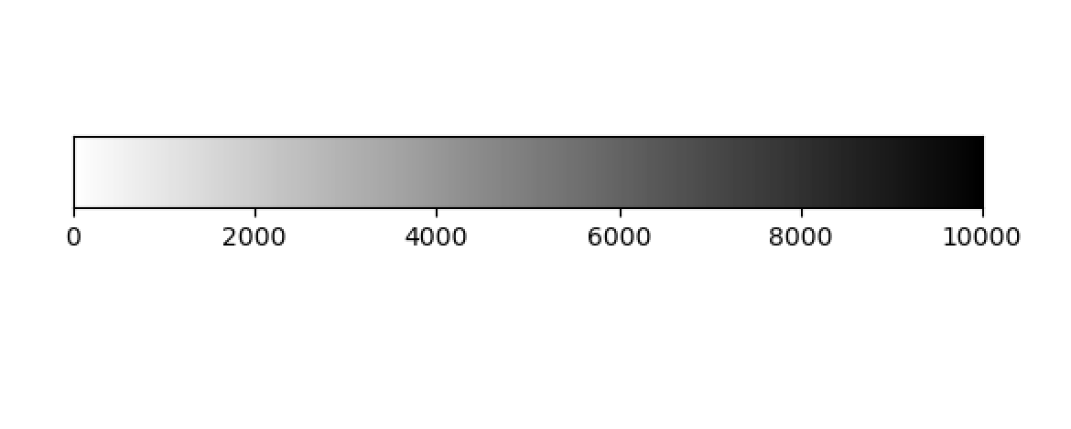
2.1 Plot all the intensities in A, sorted in decreasing value. Provide the plot in your answer sheet. (Note, in this case we don’t care about the 2D structure of A, we only want to sort the list of all intensities.)
2.2 Display a histogram of A’s intensities with 20 bins. Again, we do not care about the 2D structure. Provide the histogram in your answer sheet.

Slide 6
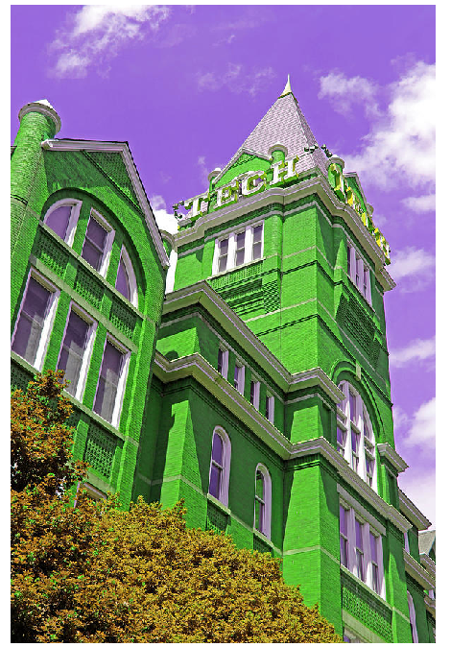
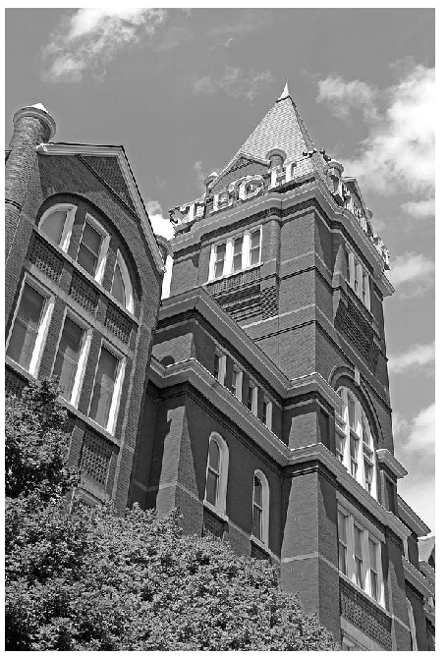
3.1 Display the color channel swapped image.
3.2. Display the grayscale image.

Slide 7
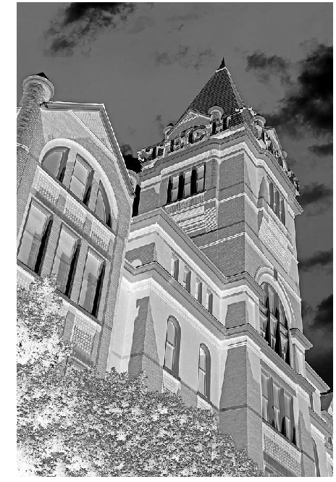
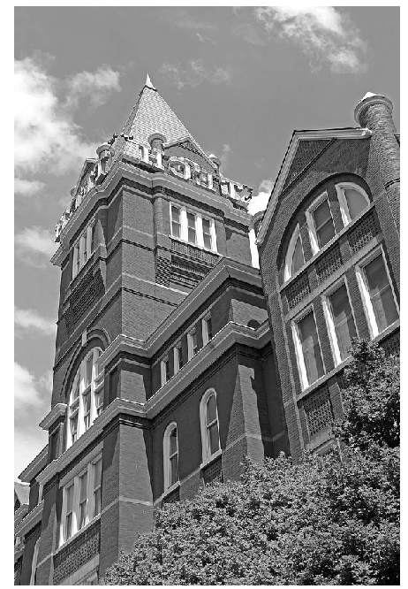
3.3 Display the negative image.
3.4 Display the mirror image.

Slide 8
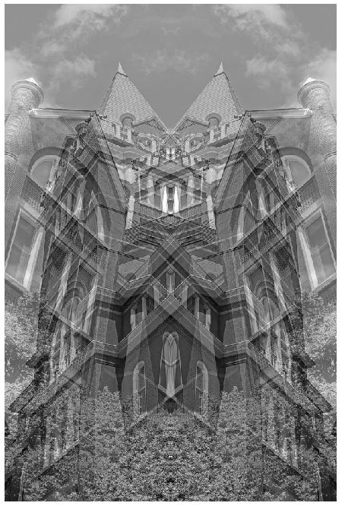
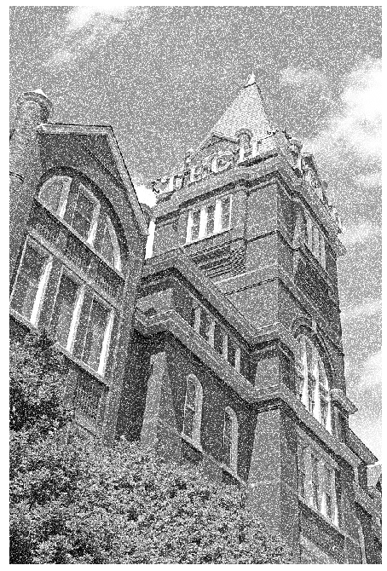
3.5 Display the averaged image.
3.6. Display the clipped image.

Slide 9
Understanding Color

Slide 10
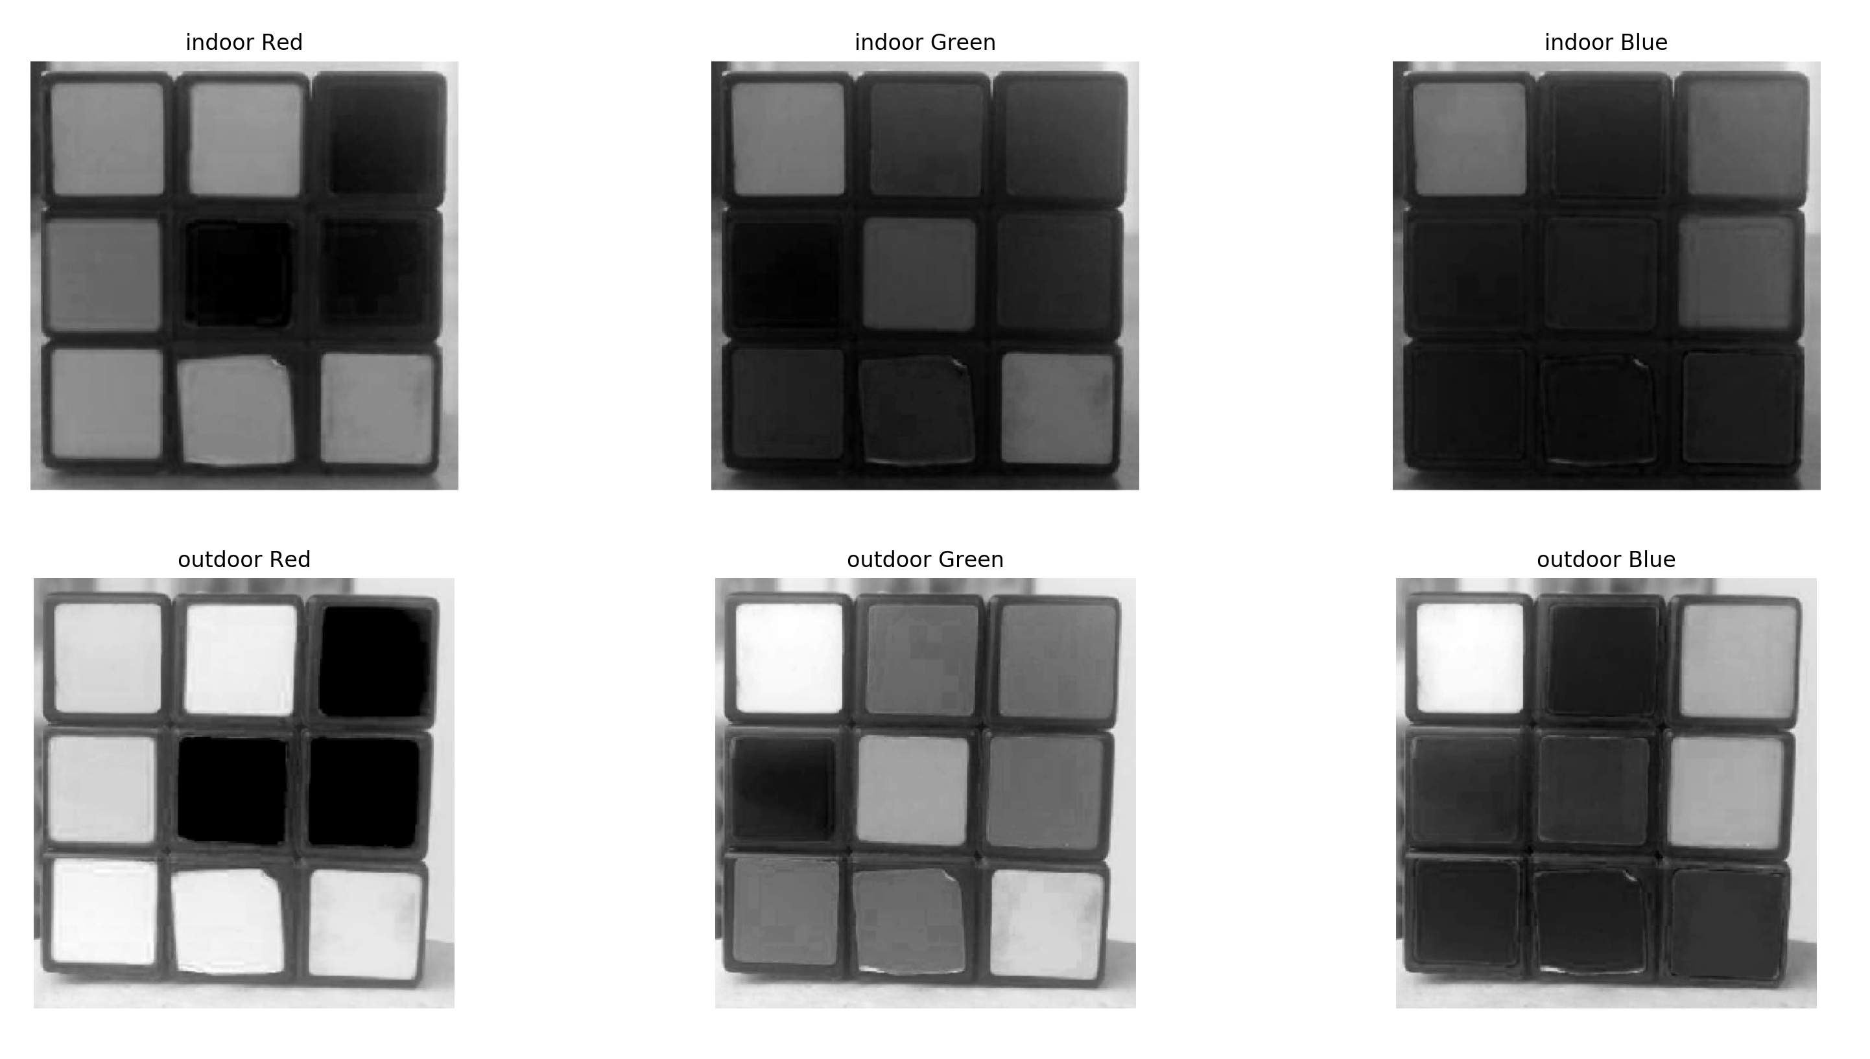
4.1. Load the images and plot their R, G, B channels separately as grayscale images using plt.imshow()(beware of normalization).

Slide 11
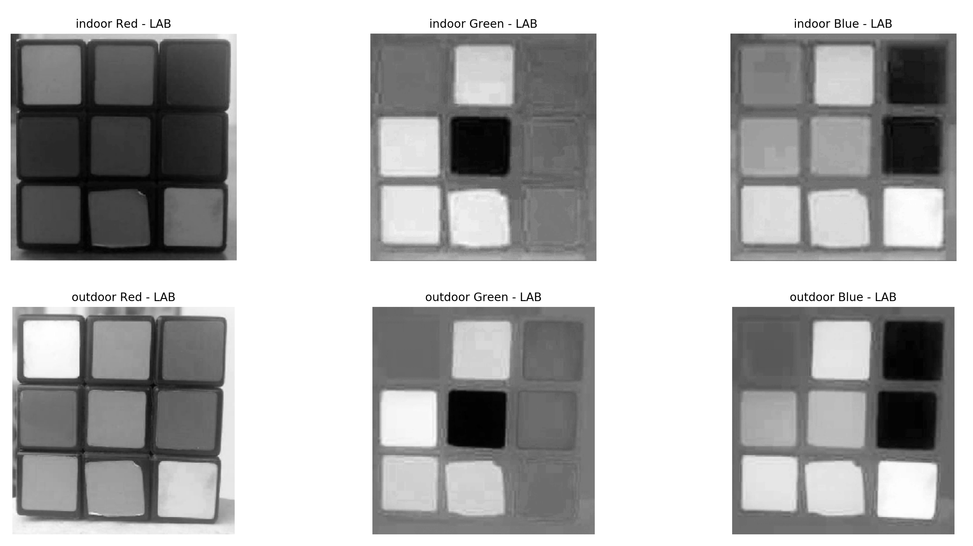
4.1.(contd) Then convert them into LAB color space using cv2.cvtColor()and plot the three channels again.

Slide 12
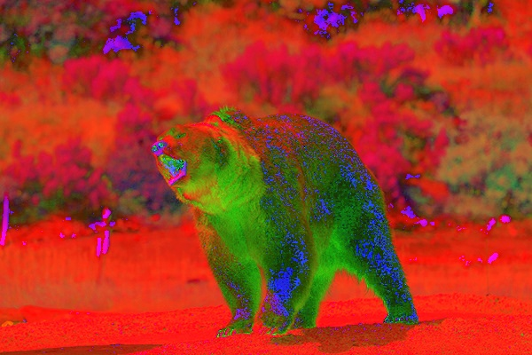
4.2. How do you know the illuminance change is better separated in LAB color space?
LAB method not only concern about color itself, but also the brightness. From the previous two figures in 4.1, we can notice that LAB adjust the brightness for indoor and outdoor to be more similar, but the boundary of each square from outdoor is clearer, which indicates the light provides more illuminance in this environment. On the other hand, the only thing to distinguish indoor and outdoor from RGB model is the brightness, which may not be correct or accurate in certain environment.
4.3. Convert the input image from RGB to HSV.

