Slide 1
CS 4476/6476 Spring 2020
PS4
Wenyue Wang
Wenyue_wang@gatech.edu
903204153

Slide 2
Color Quantization with K-Means

Slide 3
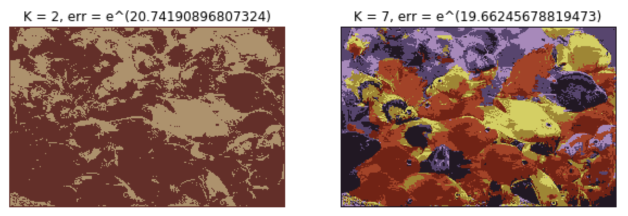
2.1 Color Quantization of RGB images
<Insert images here>

Slide 4
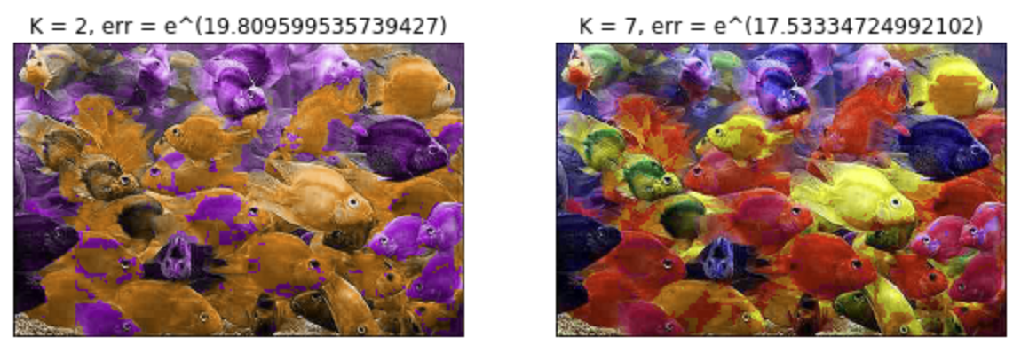
2.2 Color Quantization of HSV images
<Insert images here>

Slide 5
2.3 Quantization error (remember to use the random state initialized in the script).
Enter values as log_{e}(error)
k | RGB | HSV
3 | 15.12216290311367 | 14.600732690618507
5 | 14.704915196955724 | 13.526757245272831
10 | 14.113046320228813 | 12.235082753577267

Slide 6
1.4 Answers (1-2 sentences each)
a) Number of quantization bins decide number of colors in RGB image and number of Hue values in HSV image. Thus, as number of quantization bins increases, the quantitative image would have more color and would be more similar to the original image. In addition, the quantization error would be less.
b) In RGB space, after doing quantization we will have k colors. In HSV space, we will have more than k colors since we only quantize Hue value but not Saturation and Value.
c)1. compare with histogram between original image and quantized image
2. Randomly choose pixels or areas, and check their error

Slide 7
Hough Transform
Hough Transform on Generated Images

Slide 8
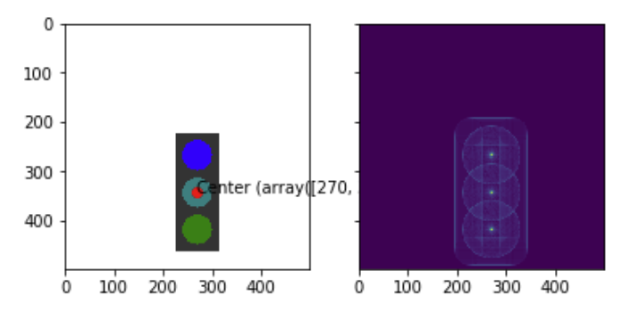
3.1.1 Traffic lights - Blank

Slide 9
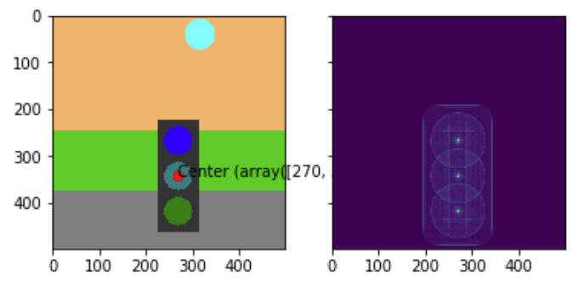
3.1.2 Traffic lights - Scene

Slide 10
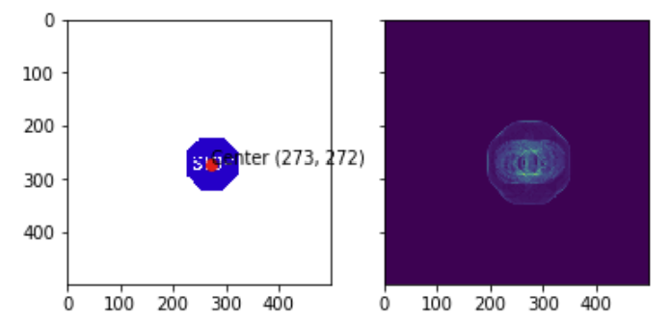
3.2.1 Stop sign detection

Slide 11
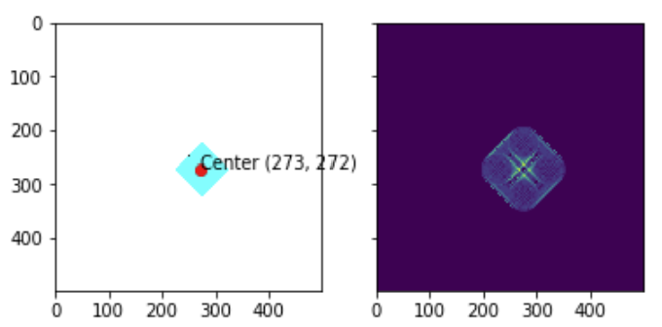
3.2.2 Warning sign detection

Slide 12
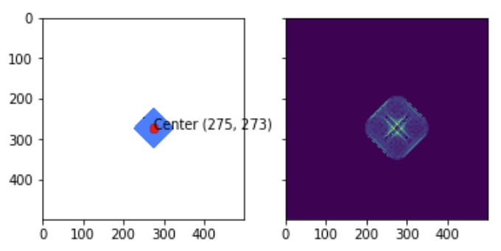
3.2.3 Construction sign detection

Slide 13
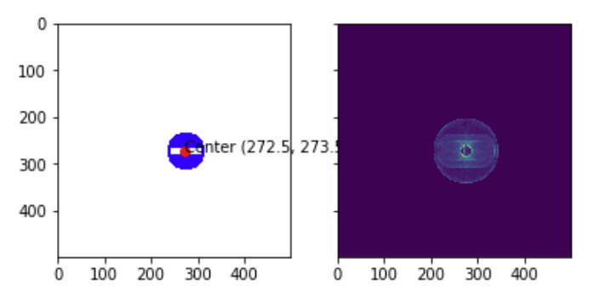
3.2.4 Do not enter sign detection

Slide 14
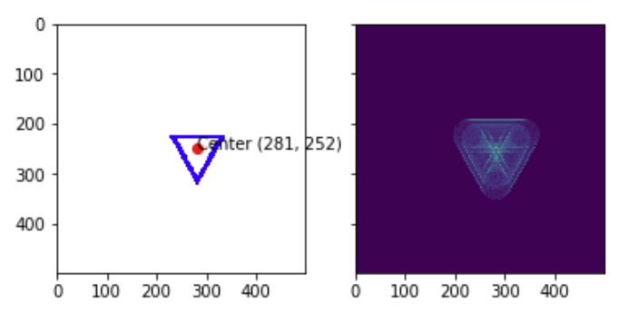
3.2.5 Yield sign detection

Slide 15
Extra Credit
Hough Transform on Real Images

Slide 16
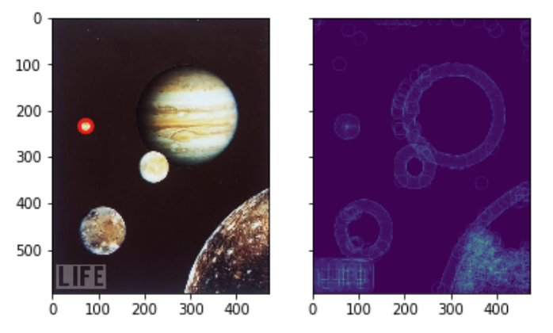
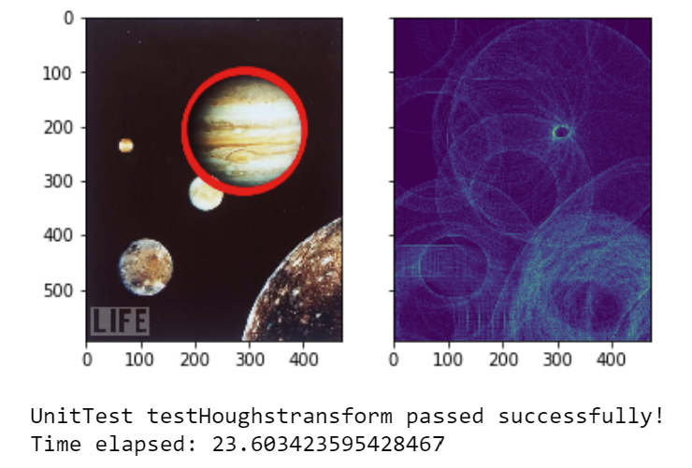
4.1 Known Radius

Slide 17
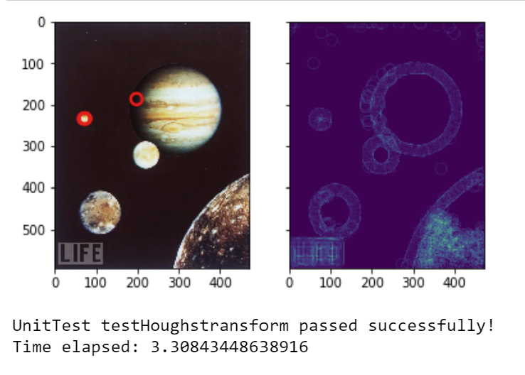
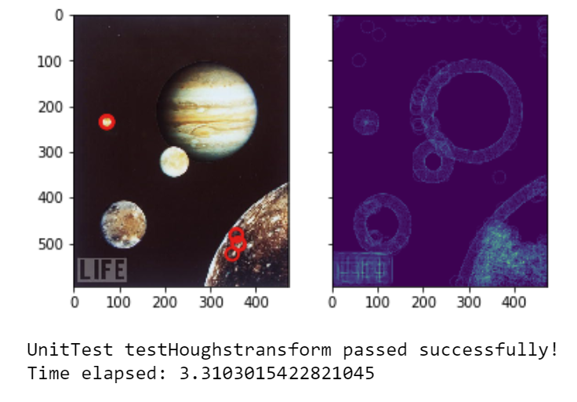
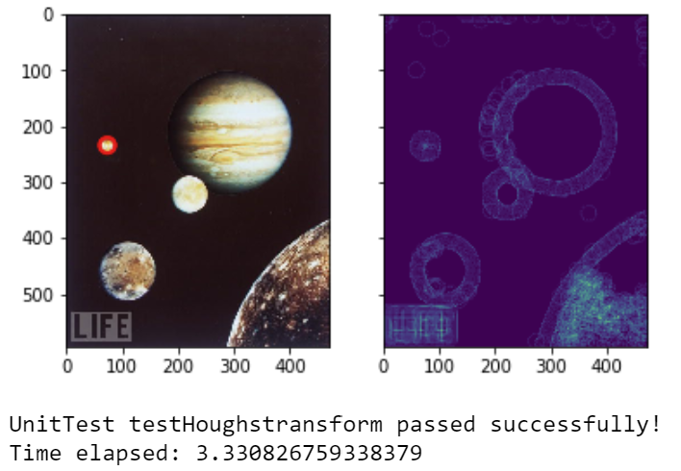
4.1 Known Radius
Threshold = 0.4
Threshold = 0.7
Threshold = 0.95
When threshold is low, the circle detection is not accurate, the error is significant as it detects some incorrect object. Then after I increase the threshold, it only detects the correct object.

Slide 18
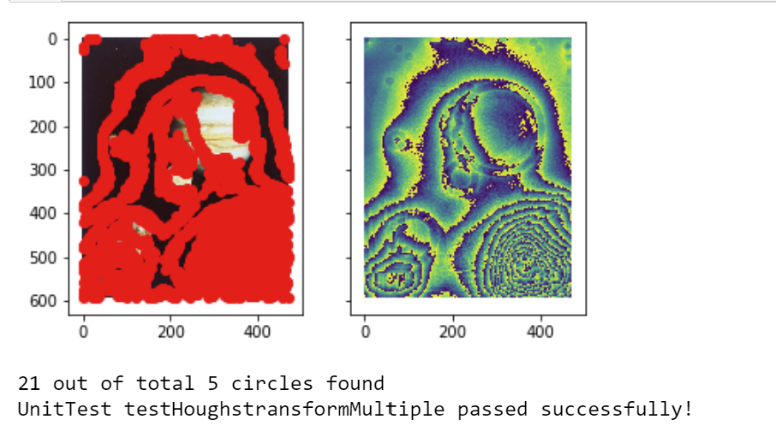
4.2 Unknown Radii

